Slide 1
What Does Post-Training Actually Buy?
Accuracy, process, and coverage: a mathematical view of RL post-training
Yihe Zang · 2026.11.19
Notes:
Today: when post-training raises a score, what did the model actually gain? We answer with a few exact calculations, and use them to settle a recent debate.

Slide 2
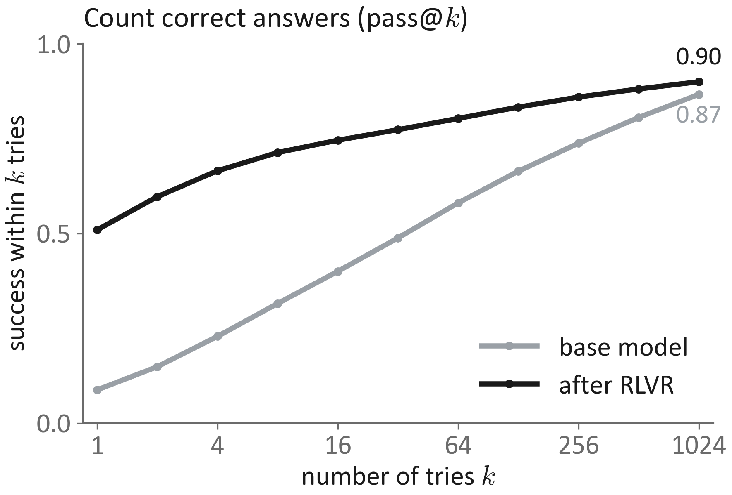
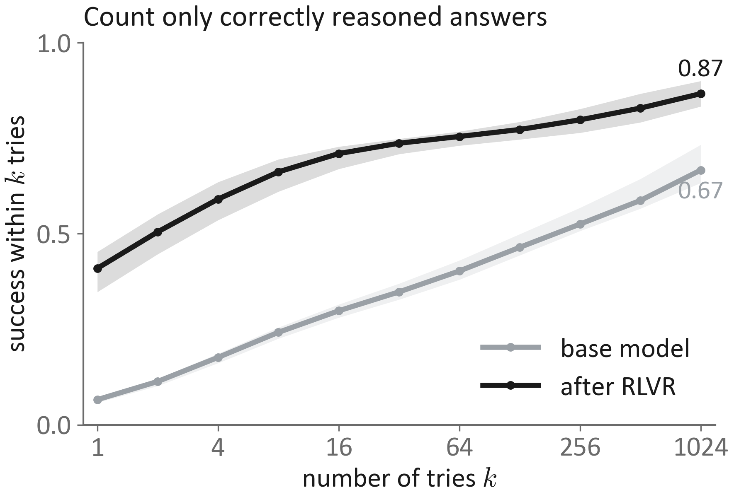
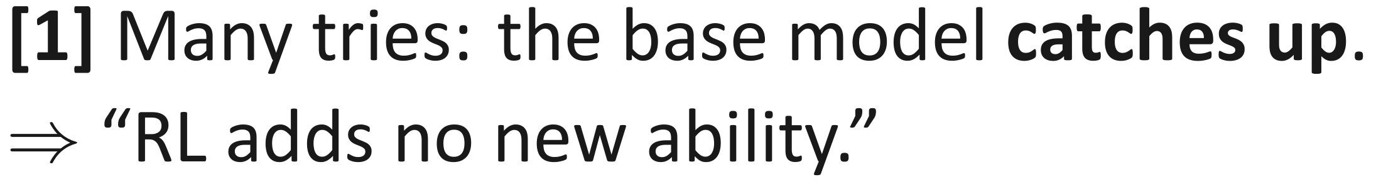
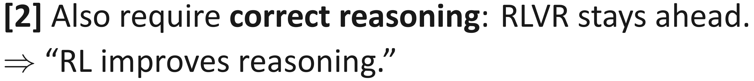
Same RL training, two opposite verdicts
Data: [2], Fig. 2. Both panels: Qwen2.5-32B vs DAPO-Qwen-32B on AIME 2024. Right: LLM judge, majority vote (band: any/all).
Notes:
Two 2025 papers look at the same kind of training: RL with verifiable rewards (RLVR), e.g. reward 1 if the math answer is correct. Paper [1] counts correct answers. With many tries, the base model catches up and even solves more problems, so RL seems to add no new ability. Paper [2] also checks the reasoning. Then RLVR stays ahead, so RL seems to improve reasoning. Same training, opposite conclusions. These are real numbers from paper [2], Figure 2: the same two models, Qwen2.5-32B and DAPO-Qwen-32B, on AIME 2024. Left, counting answers, the base model climbs from 0.09 to 0.87 and nearly meets RLVR's 0.90 at 1024 tries; [2] shows it overtakes on other benchmarks, which is [1]'s observation. Right, counting only correctly reasoned answers, a judged gap stays: 0.87 versus 0.67. The shaded bands are the judge's any-correct and all-correct variants.

Slide 3
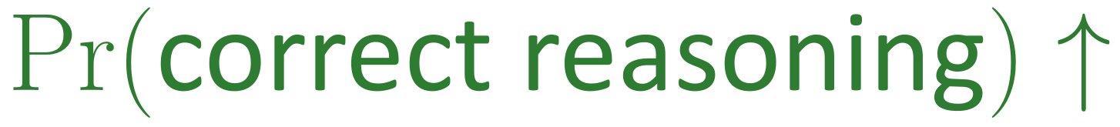
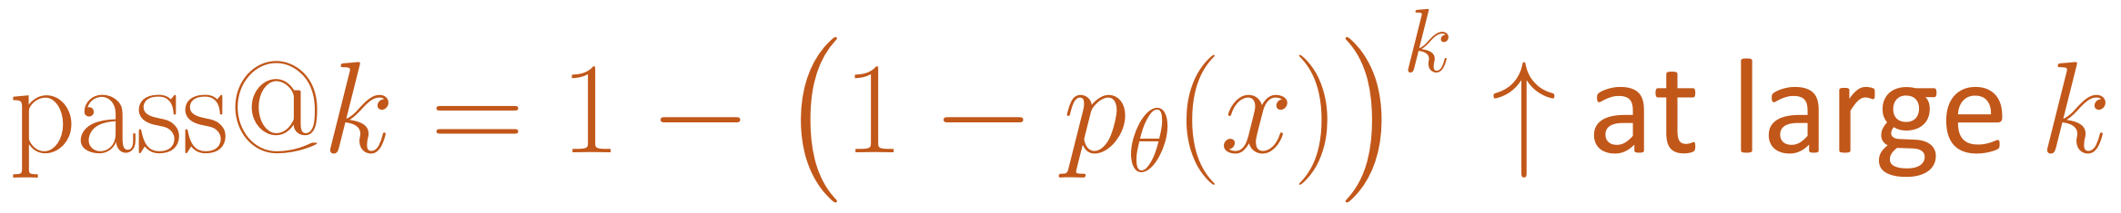
One score hides three different gains
Accuracy
Solve the same problem more reliably
Score goes up
(pass@1)
Process
Right answer for the right reason
Coverage
Solve more distinct problems
Claim: [1] and [2] measure different gains, so both can be right.
Notes:
Our claim: the word 'better' mixes three different gains. Accuracy: the same problem is solved more reliably. Process: right answers come from right reasoning, not luck. Coverage: more different problems can be solved at all, given a budget of tries. The two papers measure different gains, so they need not disagree. The rest of the talk works out where each gain comes from.

Slide 4
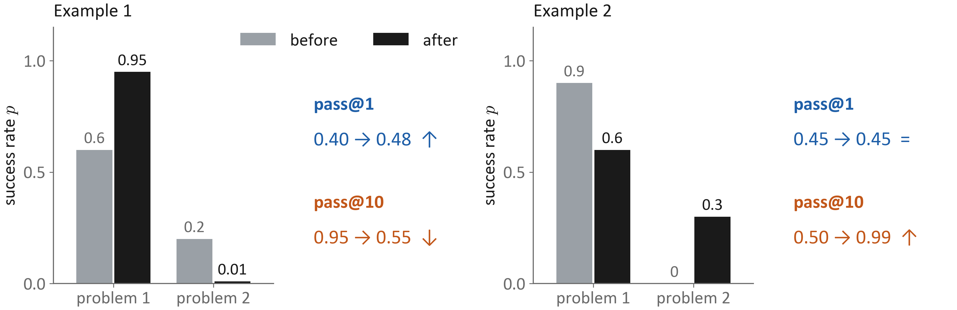
Accuracy and coverage can move in opposite directions
Notes:
Two toy examples with two problems each. Example 1: training pushes an easy problem from 0.6 to 0.95 but almost kills the hard one. pass@1 goes up, pass@10 drops from 0.95 to 0.55. Example 2: the reverse. pass@1 stays the same, pass@10 rises from 0.5 to 0.99. Nothing exotic is needed: pass@k is concave in p, so moving probability between problems changes the two statistics differently.

Slide 5
Plan: follow the training pipeline with four questions
Q1
What does the reward want?
Q2
Where can training actually get it?
Q3
When do process and transfer improve?
Q4
What does each test measure?
Each section ends with the same question: which gain, and why?
Safety training is the same math with a different reward.
Notes:
To know which gain a training run produces, we follow the pipeline. Q1: what distribution does the reward ask for? Q2: can sampling-based training actually reach it, and on which problems? Q3: under what conditions does an answer-only reward improve reasoning, or help problems that were never solved? Q4: which measurement sees which gain? Each section ends by coming back to the three gains. Safety appears near the end as the same math with a different reward.

Slide 6
What does the reward want?
Question 1
Ignore sampling. Ignore optimization. Solve for the ideal answer distribution.
Notes:
First we pretend we can set the probability of every answer directly. What distribution does the reward ask for?

Slide 7
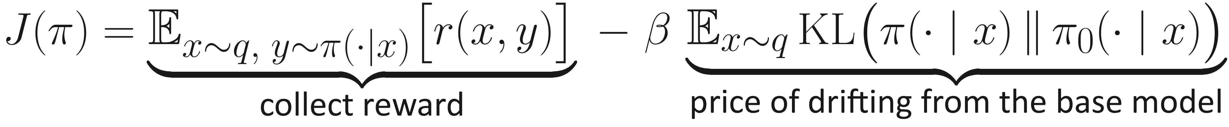
The objective: chase reward, stay close to the base model
Notes:
The standard KL-regularized objective. The first term collects reward. The second term charges for drifting away from the base model; beta sets the price. Everything in Q1 and Q2 is about the exact maximizer of this objective. This is not a toy: PPO-RLHF, DPO, GRPO, RLOO and REINFORCE++ all optimize this shape, and DPO even starts from its exact maximizer. The notably different family drops the KL term: DAPO, Dr. GRPO and SimPO. That is beta = 0. Two of our results still apply to them, and we point them out when we get there: an answer the base model never produces stays out of reach, and the sampling squeeze in Q2 does not depend on beta at all.

Slide 8
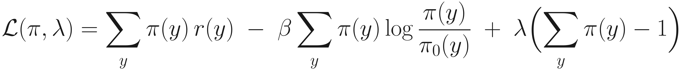
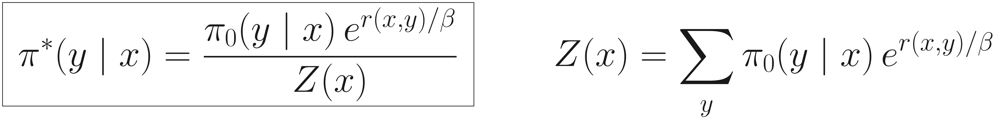
Solve it with one Lagrange multiplier per prompt
Notes:
Fix a prompt. Each answer probability is a variable; the only constraint is that they sum to one. Set the derivative of the Lagrangian to zero. The multiplier term is the same for all answers, so it is just the normalizer. Result: the base model times exp(reward / beta), normalized by Z. The objective is strictly concave, so this is the unique maximum, and its value is beta times log Z.

Slide 9
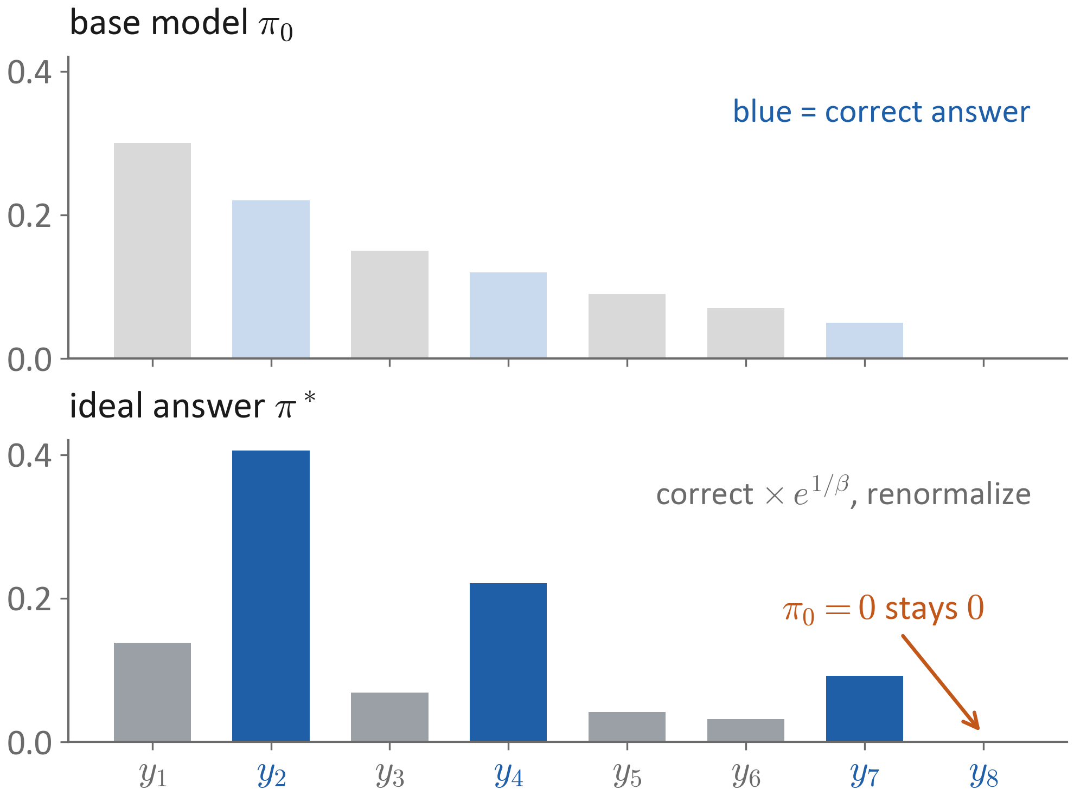
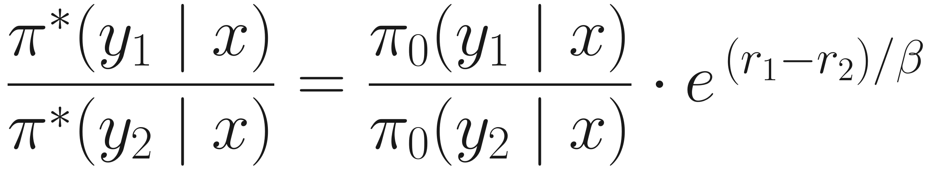
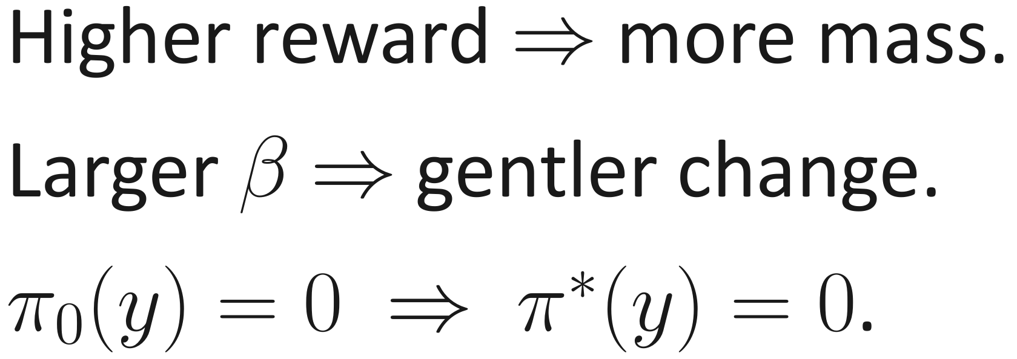
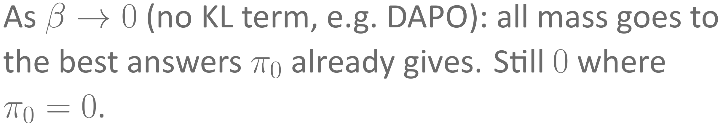
The ideal model reweights what the base model already says
Accuracy gain comes for free. Process and coverage: not explained yet.
Notes:
A picture of the solution. Top: the base model over eight answers; blue ones are correct. Bottom: the ideal model. Correct answers are multiplied by e^(1/beta) and everything is renormalized. Two things to notice. Accuracy goes up for free. And an answer the base model never produces stays at zero: reweighting cannot create anything new. It also says nothing about whether the boosted answers have correct reasoning. For methods without the KL term (beta = 0, such as DAPO): as beta goes to zero, all mass moves to the best answers the base model already gives, and it is still zero wherever the base model is zero.

Slide 10
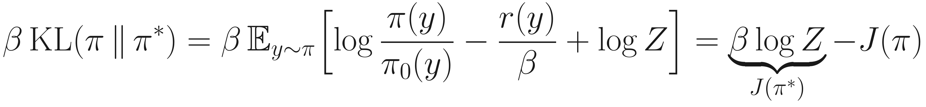
The training score measures loss with a reverse-KL ruler
When the ideal model is out of reach, training picks the closest model by reverse KL.
Notes:
Real networks cannot represent pi-star exactly. Plug the solution back in: the gap between the best score and the score of any model is exactly beta times the reverse KL from that model to pi-star. So maximizing the score is the same as projecting pi-star onto the models we can represent, using reverse KL. The score is a ruler, and the ruler is reverse KL.

Slide 11
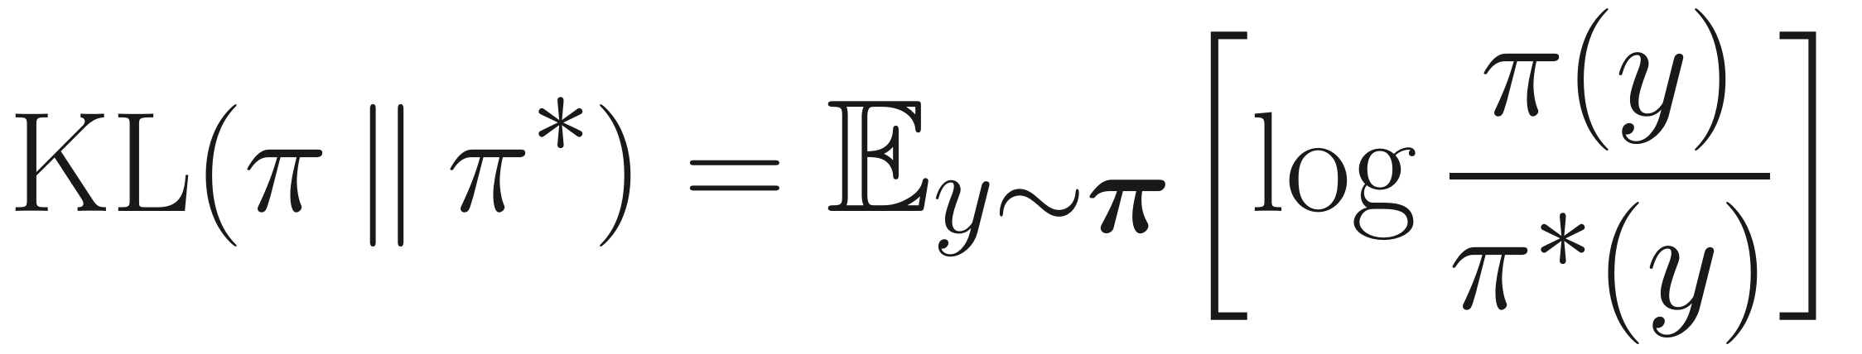
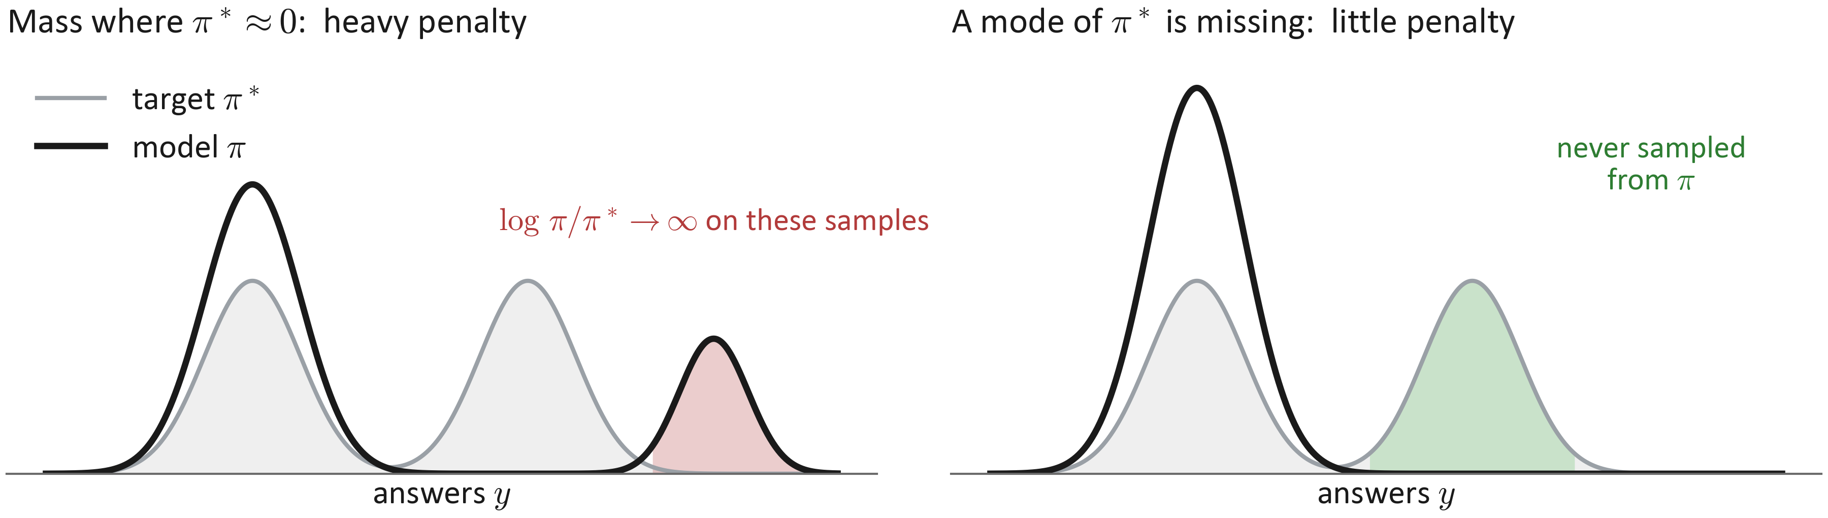
The reverse-KL ruler is imbalanced
Wrong answers: punished hard. Missing solutions: almost free.
Notes:
Reverse KL averages over the model's own samples. Left: if the model puts mass where pi-star is nearly zero, the log ratio explodes on those samples, so this is punished hard. Right: if the model misses a whole mode of pi-star, those answers are never sampled from the model, so they barely enter the average. Wrong answers are expensive; missing solutions are almost free.

Slide 12
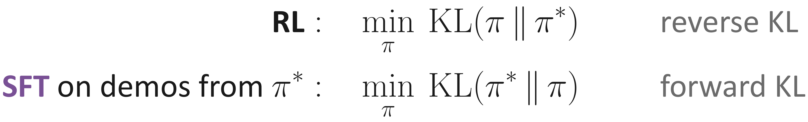
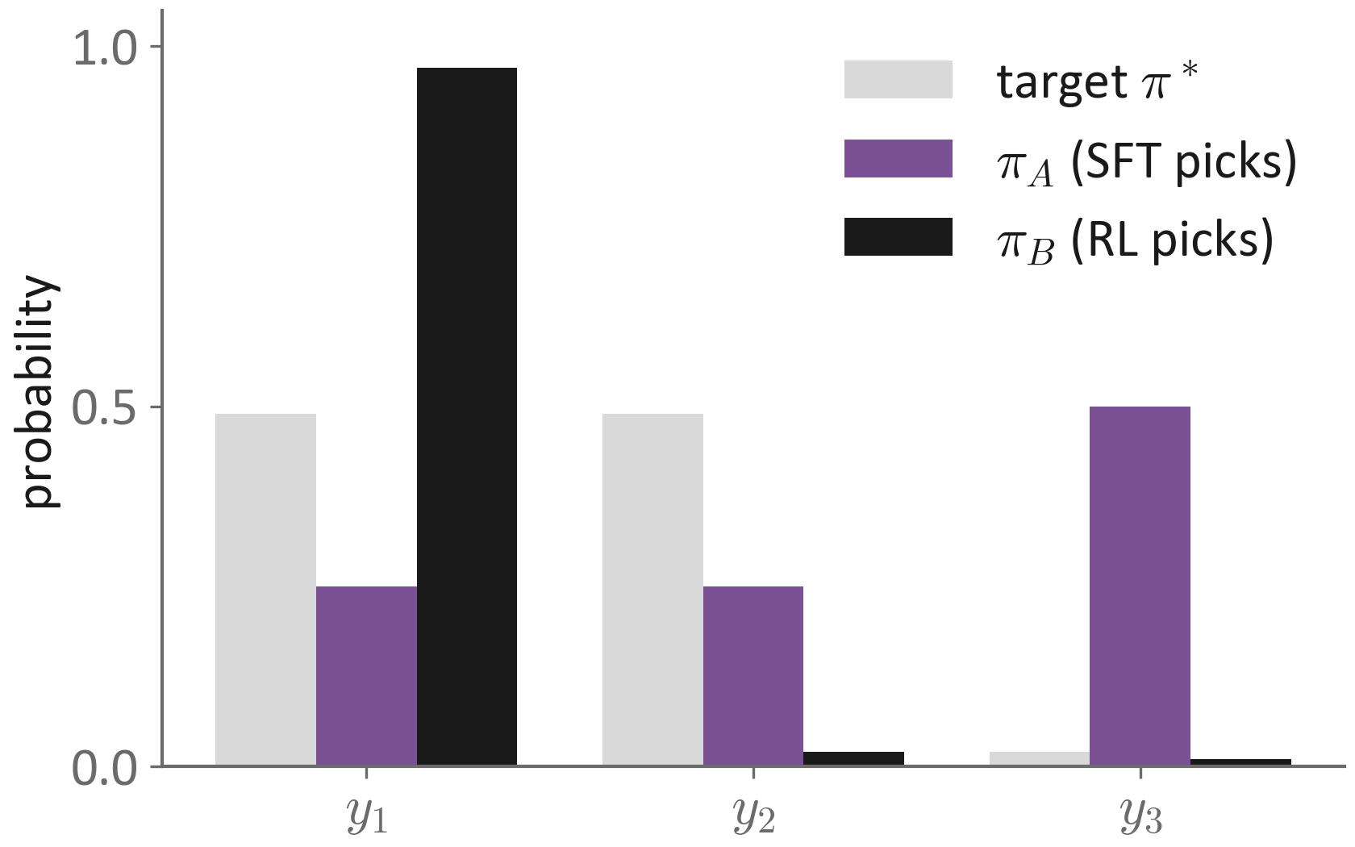
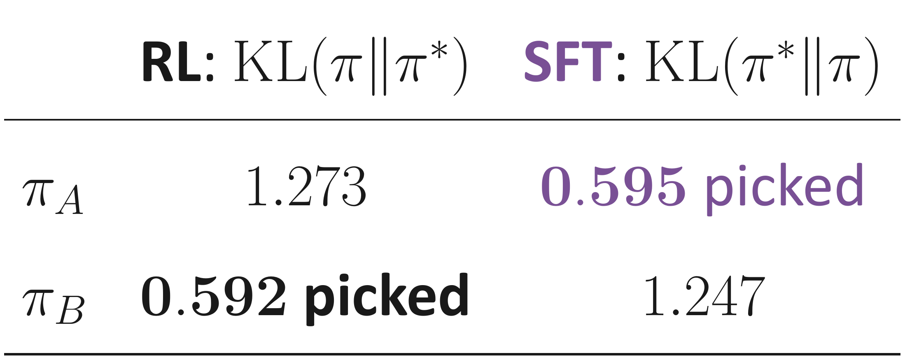
Same target, opposite picks: RL concentrates, SFT spreads
Notes:
Compare with SFT. If demonstrations come from pi-star, the SFT loss equals a constant plus the forward KL. Same target, opposite ruler. A three-answer example: the target splits mass between y1 and y2. pi_A keeps both but wastes half its mass on y3. pi_B nearly drops y2. Reverse KL (RL) picks pi_B. Forward KL (SFT) picks pi_A.

Slide 13
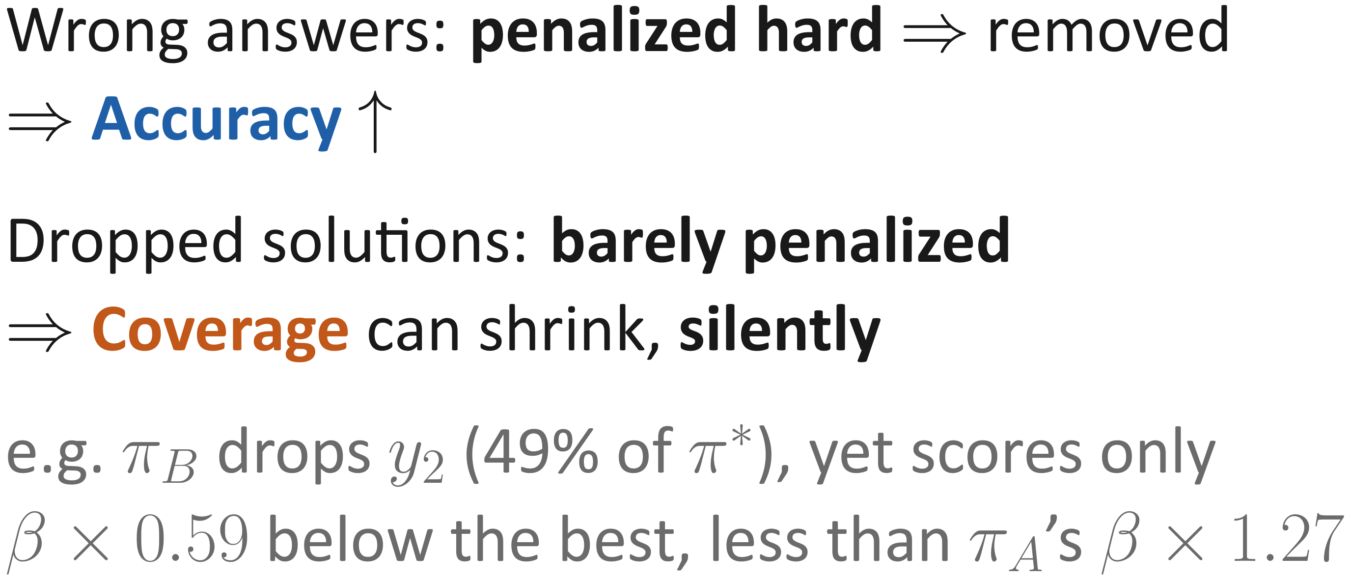
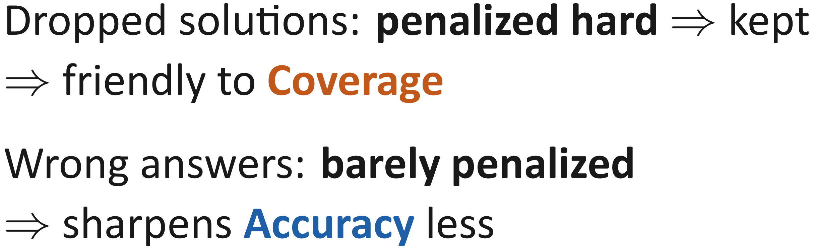
Consequence: RL's score cannot see lost coverage
RL (reverse KL)
SFT / distillation (forward KL)
Notes:
Put the two faces together. With limited capacity, the cheapest compromise for RL is to concentrate on a few solutions it can represent well. The heavy face removes wrong answers, which drives the accuracy gain. The free face lets solutions drop, and the score never complains. In the example, pi_B drops y2, which carries 49 percent of pi-star, yet its score is only beta times 0.59 below the best, less than pi_A's beta times 1.27. Where does 0.59 come from? KL(pi_B || pi-star) = 0.97 log(0.97/0.49) + 0.02 log(0.02/0.49) + 0.01 log(0.01/0.02) = 0.662 - 0.064 - 0.007, about 0.592, and the score gap is beta times this KL. The y2 term itself is even negative; the cost mostly comes from over-weighting y1. SFT is the mirror image. Prediction for [1]: RLVR wins at small k, distillation lifts the whole pass@k curve. One caveat: within a single prompt, pass@k only depends on total success; dropped modes become lost problems across prompts through shared parameters, which is Q3.

Slide 14
Q1 answer: the reward wants a reweighted base model
Q1
What does the reward want?
Q2
Where can training actually get it?
Q3
When do process and transfer improve?
Q4
What does each test measure?
Next: can training actually reach this target, and on which problems?
Notes:
Back to the main question. Accuracy: explained by reweighting. Coverage: can shrink, and the training score does not show it. Process: not explained yet. But all of this assumed we know the reward of every answer. Next: can training actually reach this target?

Slide 15
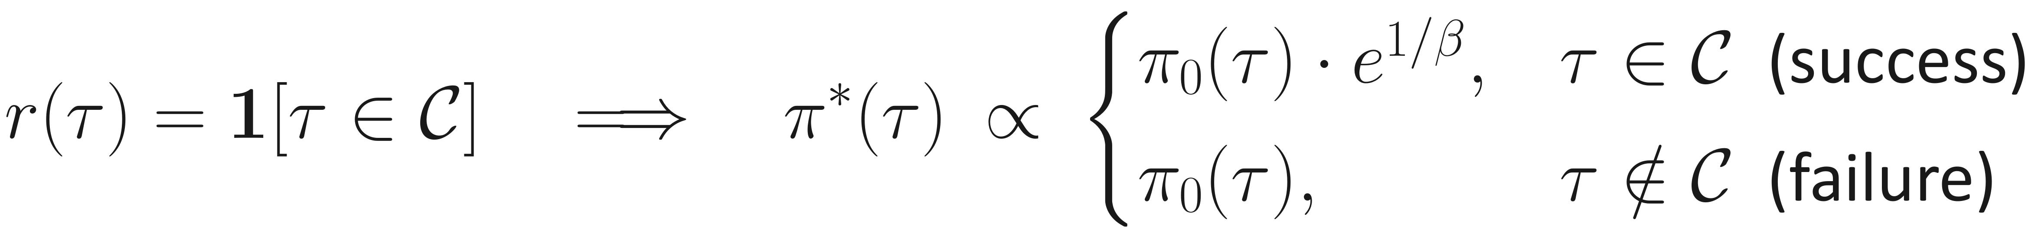
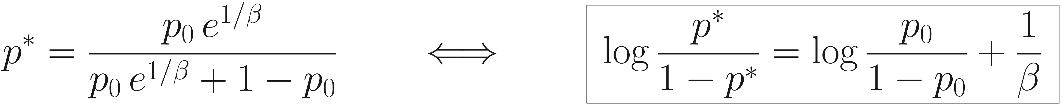
Binary reward: the ideal model only rescales success vs. failure
Notes:
With reward 1 for success and 0 for failure, every successful answer gets the same factor e^(1/beta). So the solution only changes the total mass of the two classes: the log-odds of success shift by exactly 1/beta. Inside each class, nothing moves.

Slide 16
Why only the class totals move
Notes:
A short derivation. Split the KL into a coin-flip part that moves the class totals, plus two terms that reshuffle answers inside each class. Those two terms are non-negative. So for any target success rate, the cheapest way is to leave the inside of each class untouched, and the ideal solution does exactly that.

Slide 17
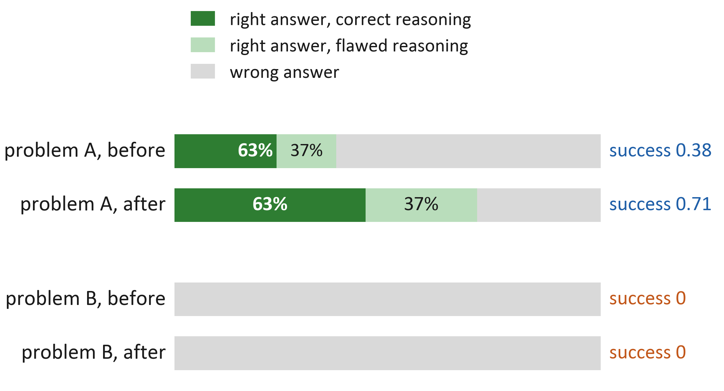
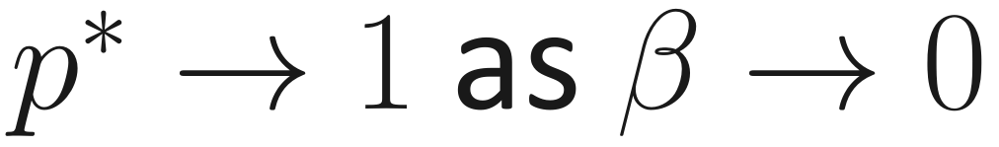
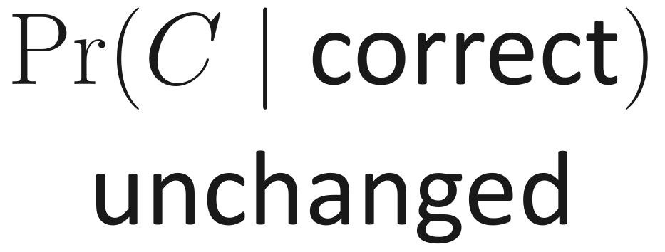
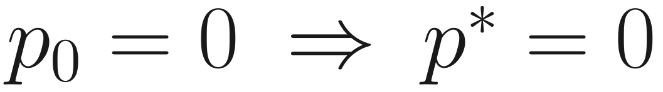
The reweight-only model: what “learning nothing new” already gives
Accuracy
can rise arbitrarily
Process
no gain
Coverage
no gain
Everything after this asks: what does real training do beyond the reweight-only model?
Notes:
This is our reweight-only model, the best a training run can do without learning anything new. Problem A: success goes from 0.38 to 0.71. That is an accuracy gain. But inside the right answers, the split between correct reasoning and lucky reasoning stays 63 to 37: no process gain. Problem B has success zero and stays at zero: no coverage gain. Everything after this asks one question: what does real training do beyond this reweight-only model?

Slide 18
Where can training actually get it?
Question 2
The ideal model needs the reward of every answer. Training only sees the answers it samples.
Notes:
Now we bring sampling back. We first make the ideal solution concrete for a binary reward, then ask how expensive it is to get there.

Slide 19
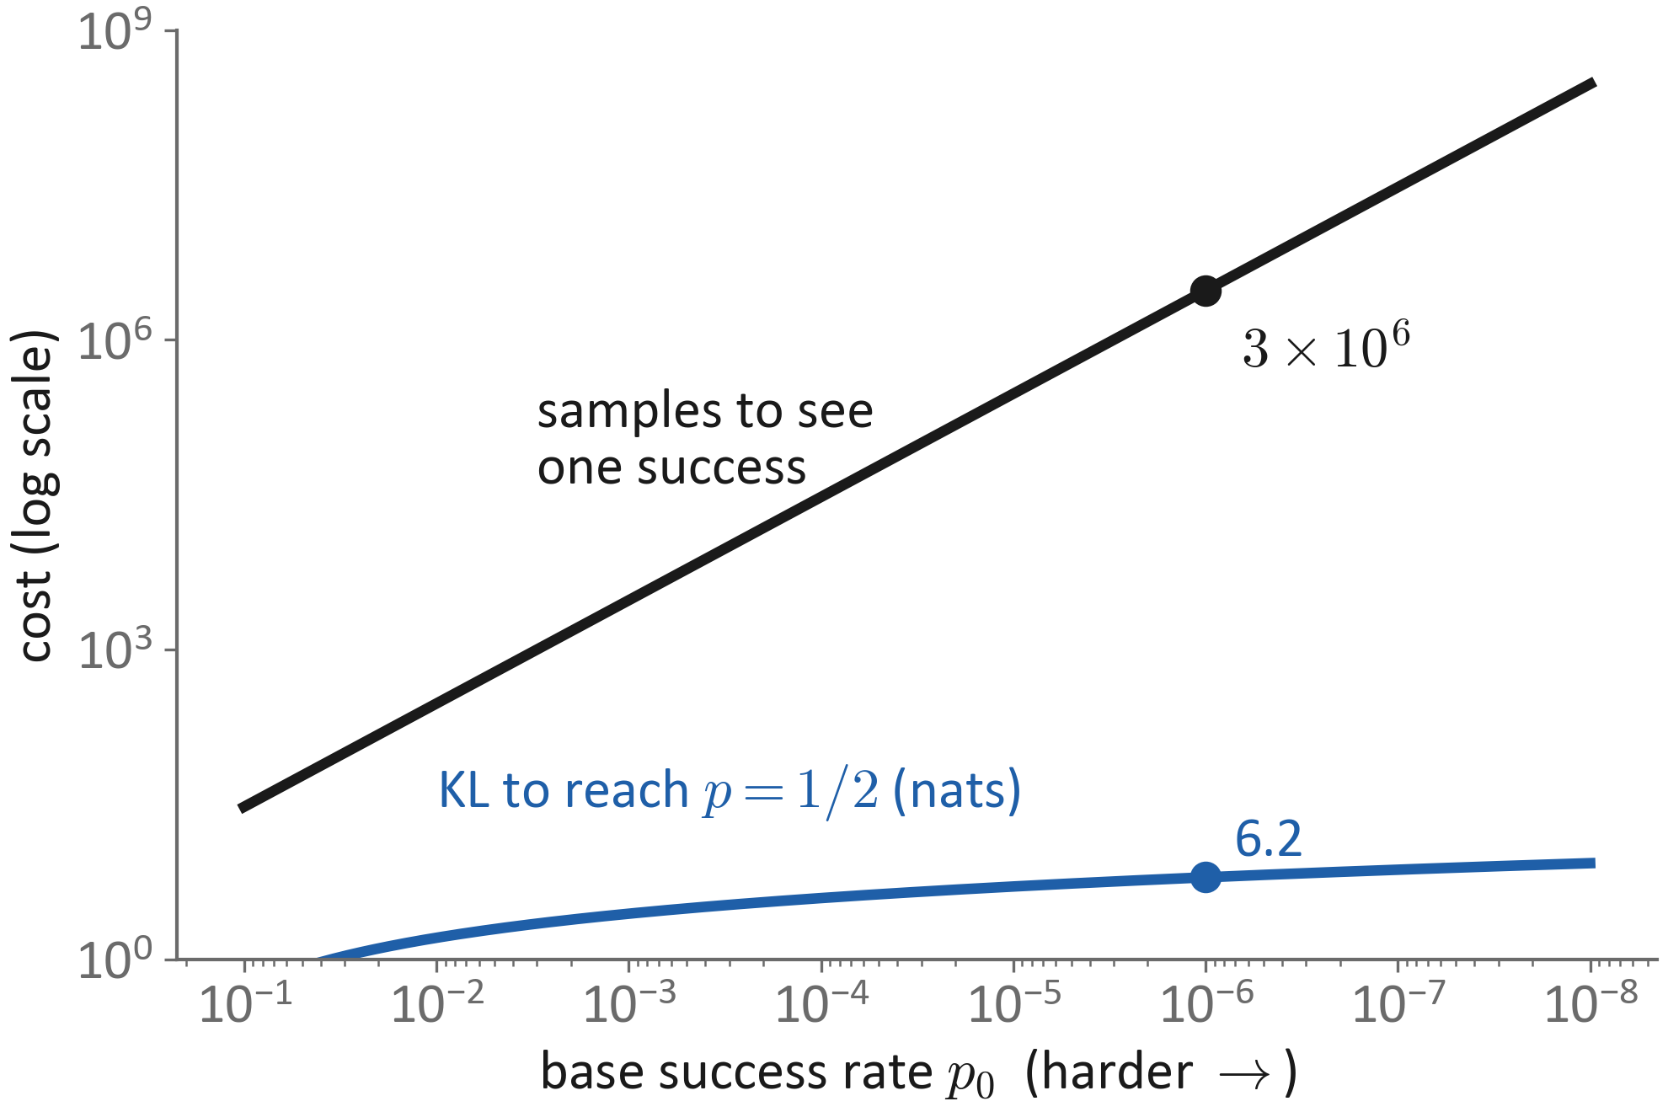
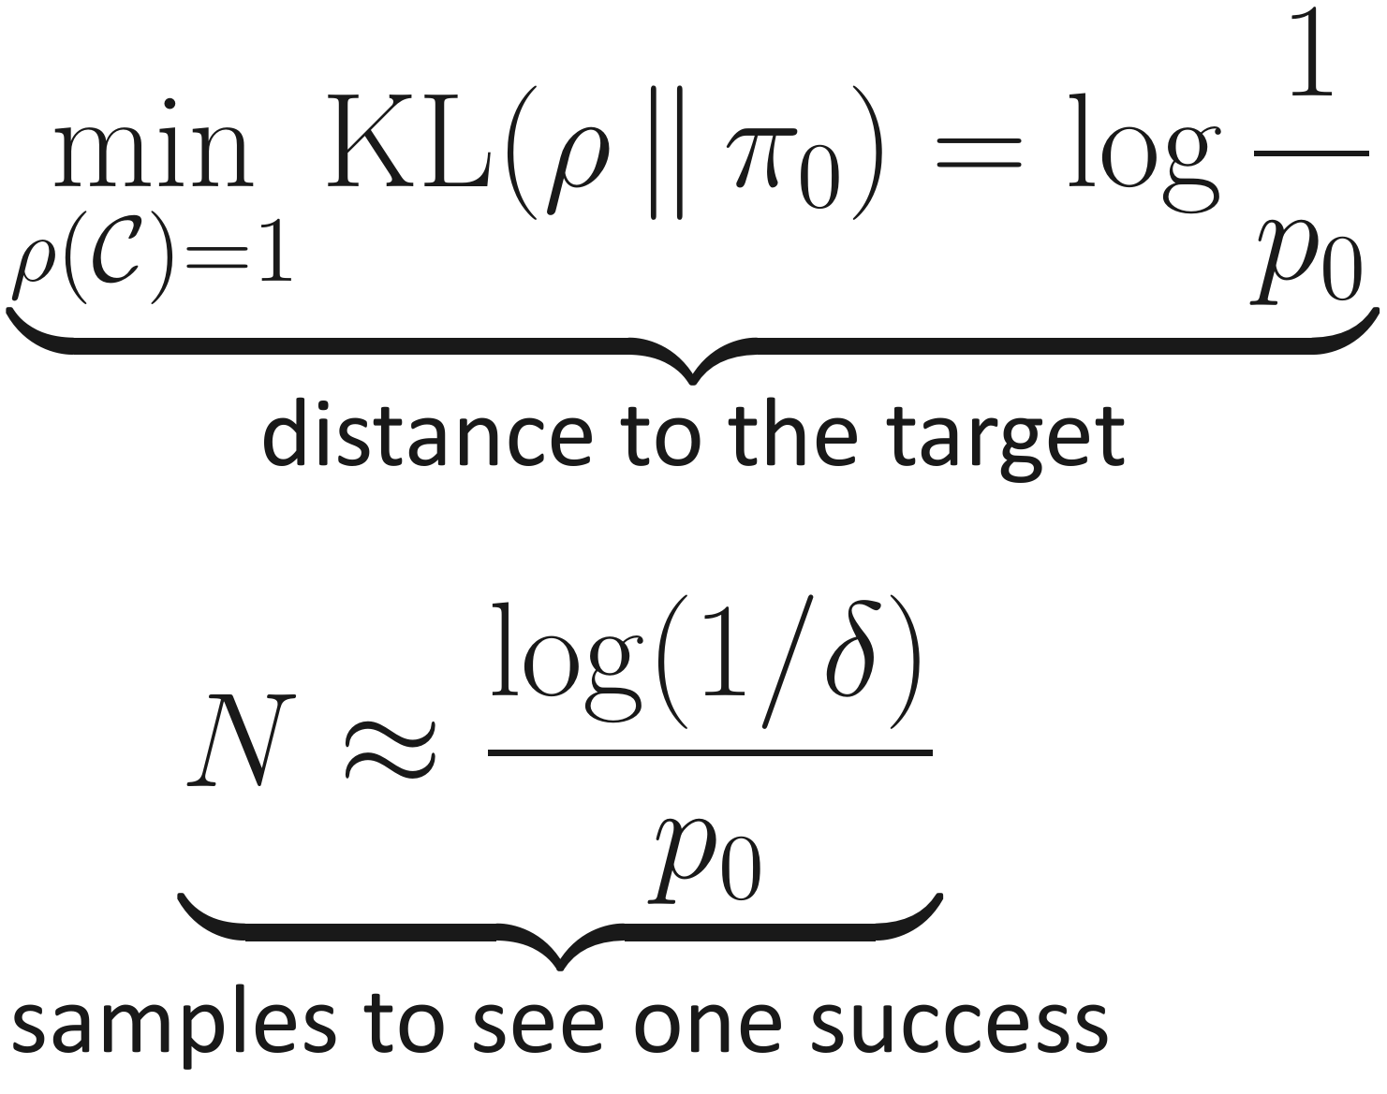
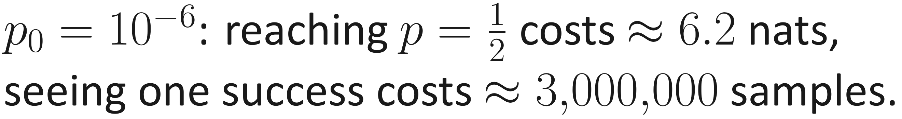
The target is close; the signal is far
A close target does not mean a reachable signal.
Notes:
How far is the target, and how hard is it to find? The distance, measured in KL, grows only like log(1/p0). The number of samples needed just to see one success grows like 1/p0. At p0 = 1e-6, reaching p = 1/2 costs about 6 nats, but seeing one success costs about three million samples. A close target does not mean a reachable signal.

Slide 20
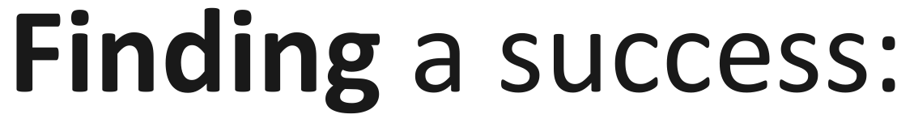
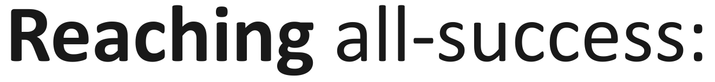
Where the two costs come from
Notes:
Both numbers in two lines. Finding: N independent tries all fail with probability (1-p0)^N. Reaching: any distribution that only produces successes pays at least log(1/p0) in KL, with equality when we condition the base model on success.

Slide 21
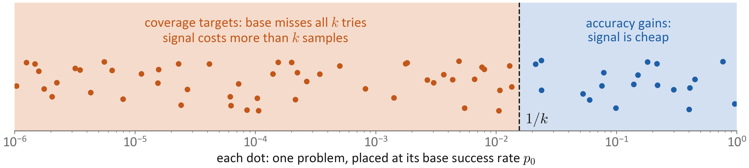
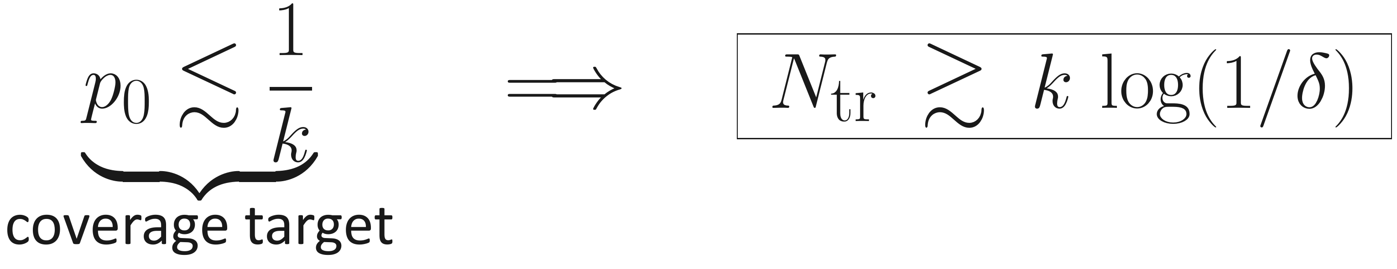
Coverage is squeezed by its own definition
The problems we most need to improve have the most expensive signal.
Notes:
Each dot is a problem placed at its base success rate. Coverage gains live, by definition, on problems with p0 below about 1/k: the base model misses all k tries at test time. Plug that into the sampling cost: training must sample such a problem more times than the test gives the base model. So the problems we most need to improve are exactly the ones with the most expensive signal, and RLVR's gains naturally flow to accuracy. Note that this argument is about sampling, not about the objective, so it holds for any beta, including beta = 0.

Slide 22
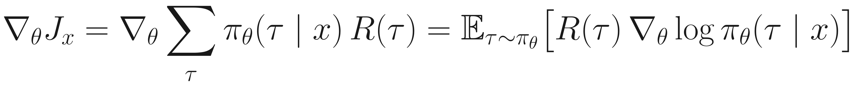
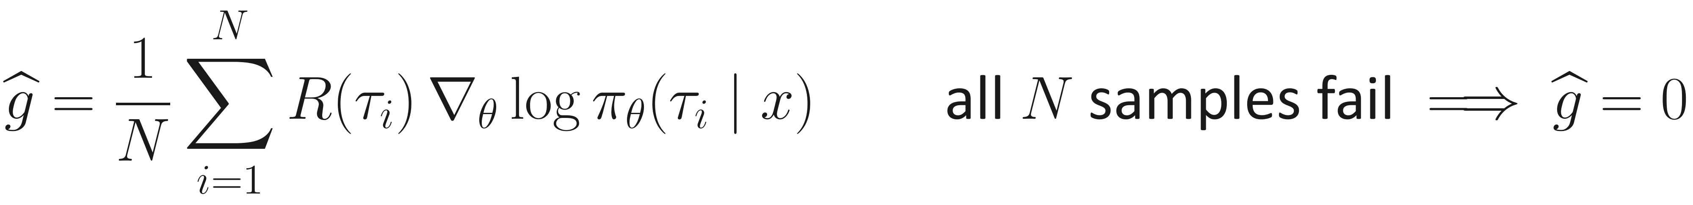
Policy gradient: only sampled answers get updated
No sampled success, no update.
Notes:
How does a sampled answer change the model? The log-derivative trick turns the gradient of expected reward into an average over sampled answers. The verifier needs no gradient. A baseline reduces variance without bias. With binary reward, only successful samples push; if all samples fail, the gradient estimate is exactly zero. This is also why methods with beta = 0 cannot create coverage directly: their objective would accept any correct answer, but the update only ever touches answers that were sampled.

Slide 23
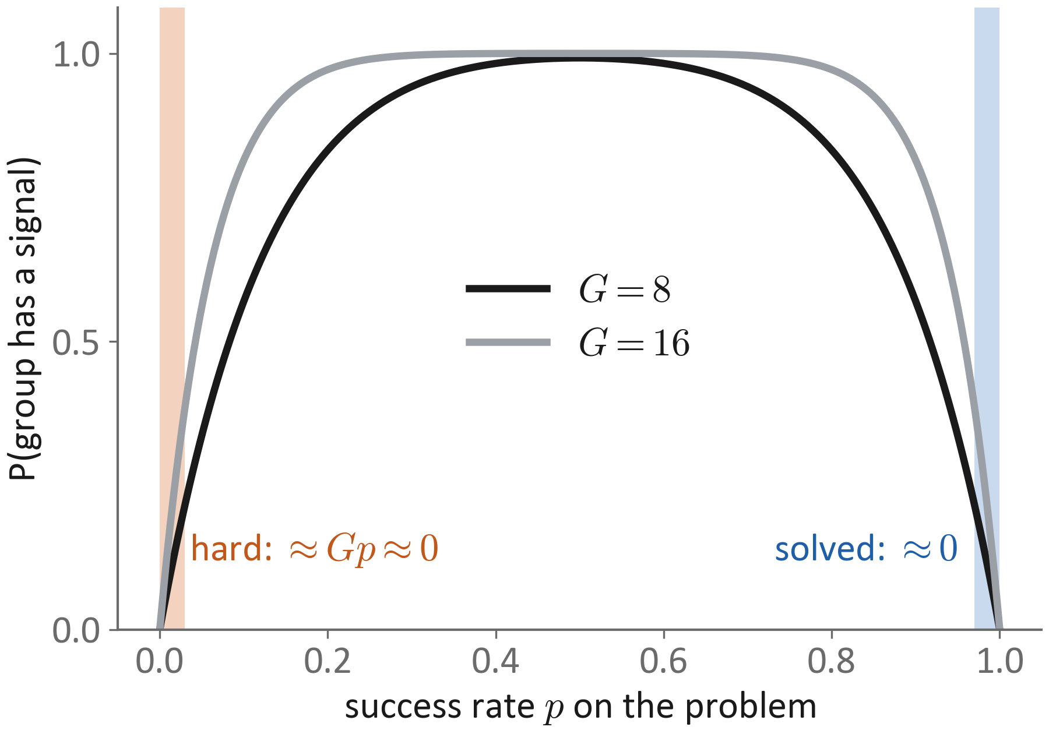
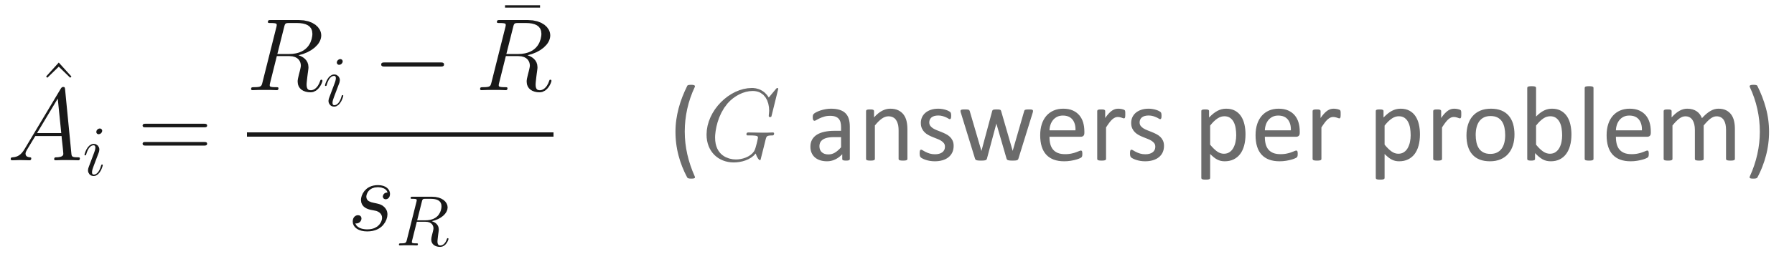
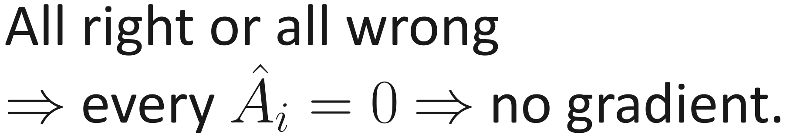
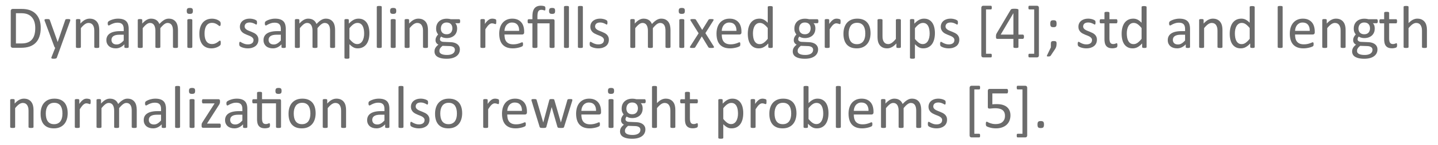
GRPO learns only from groups that mix right and wrong
Learning effort flows to medium problems. Hard ones may get nothing for a long time.
Notes:
In practice the baseline is the group mean. If all G answers in a group are right, or all are wrong, every advantage is zero and the problem contributes nothing. The chance of a mixed group is about G times p on hard problems, so they can go without any gradient for a long time. Solved problems also drop out. Learning effort flows to medium-difficulty problems.

Slide 24
Q2 answer: learning opportunity is very uneven
Q1
What does the reward want?
Q2
Where can training actually get it?
Q3
When do process and transfer improve?
Q4
What does each test measure?
Next: how could process or coverage improve at all?
Notes:
Back to the main question. The ideal solution is a reweight-only model: accuracy for free, no process gain, no coverage gain. And even reaching it depends on finding signal, which is squeezed exactly on the coverage targets. Next: how could process or coverage improve at all?

Slide 25
Beyond the reweight-only model
Question 3
When can an answer-only reward improve reasoning, or help problems it never solved?
Notes:
The reweight-only model leaves two gaps: process and coverage. This section gives the conditions under which each gap can be filled.

Slide 26
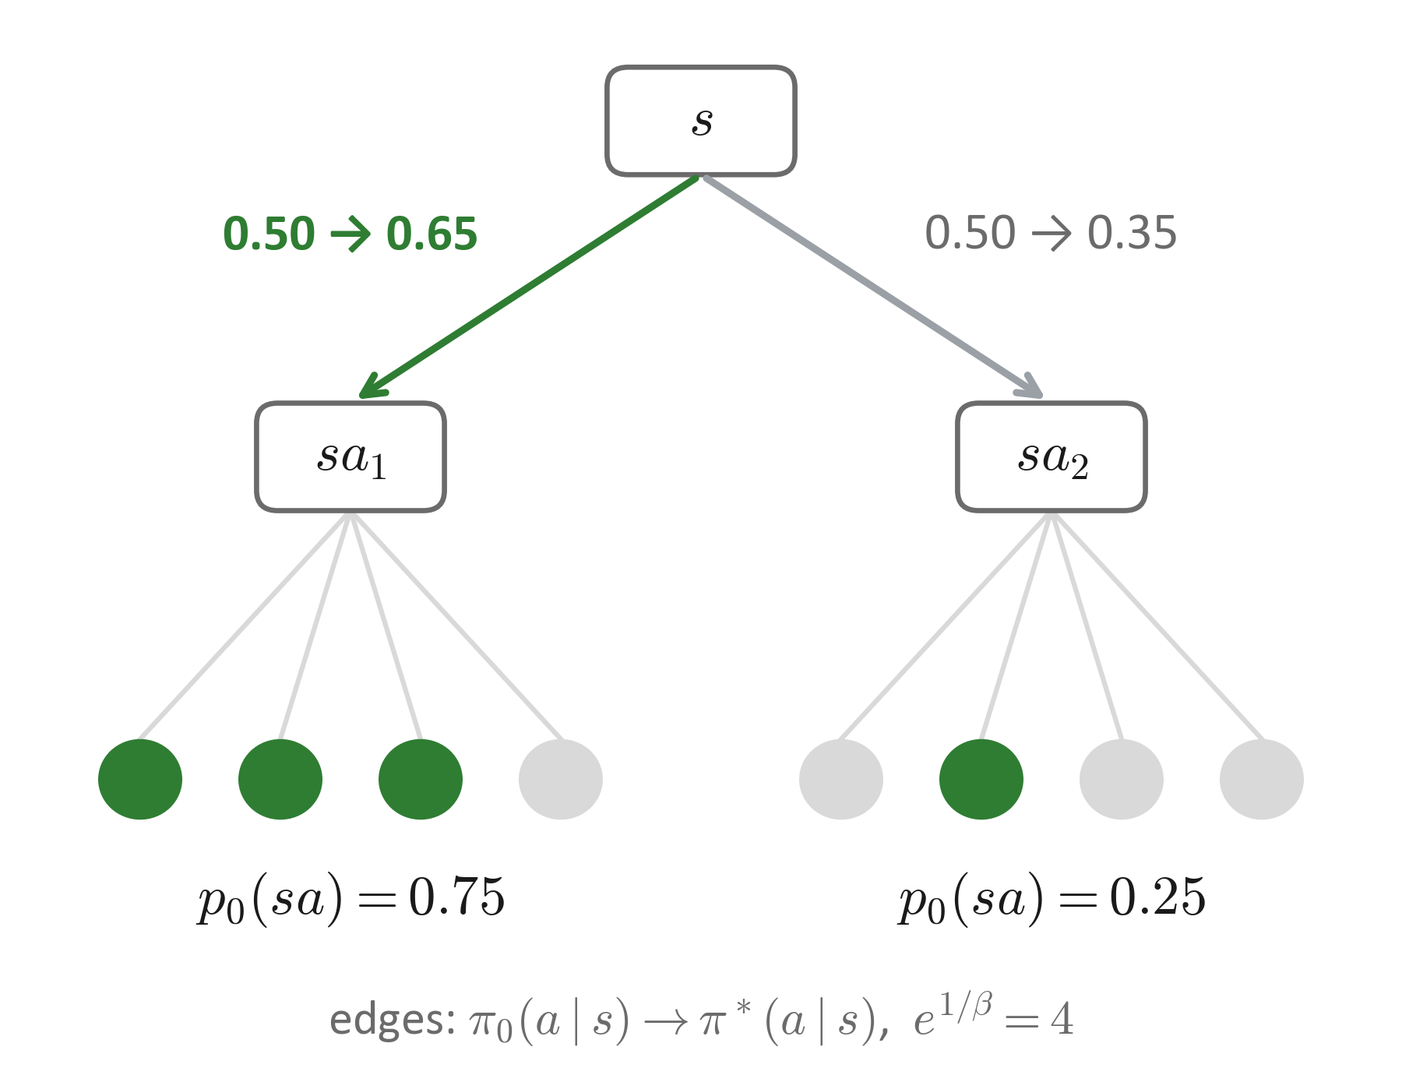
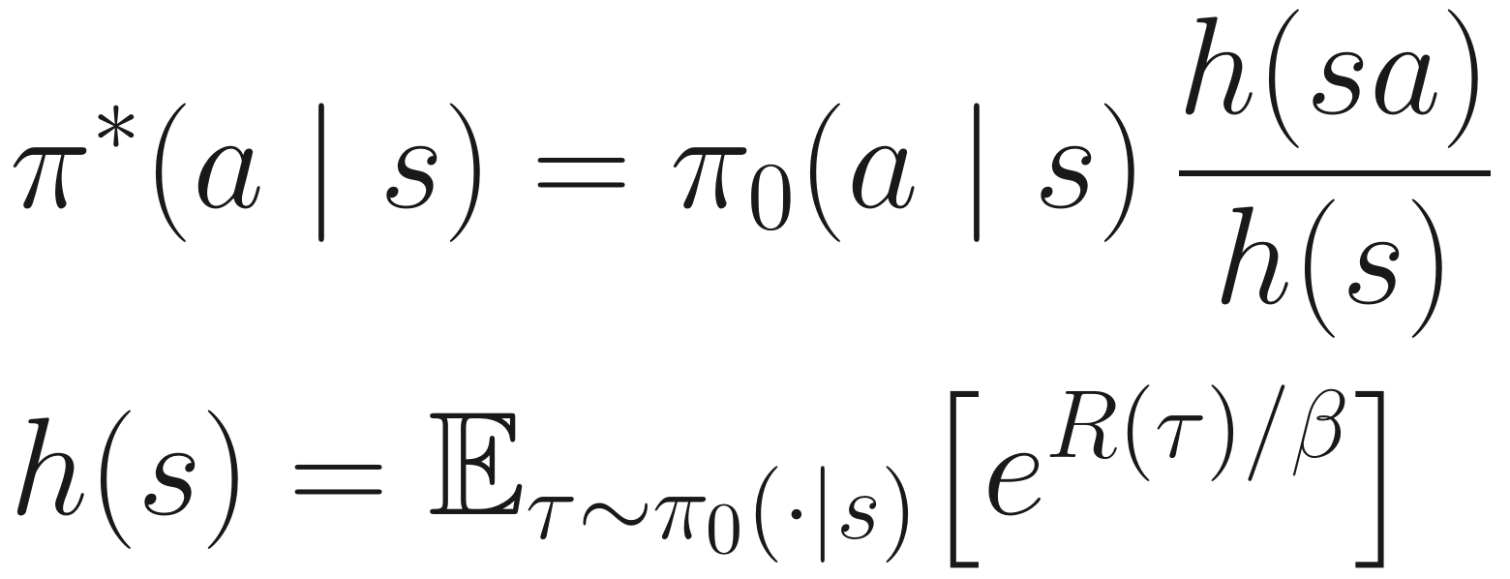
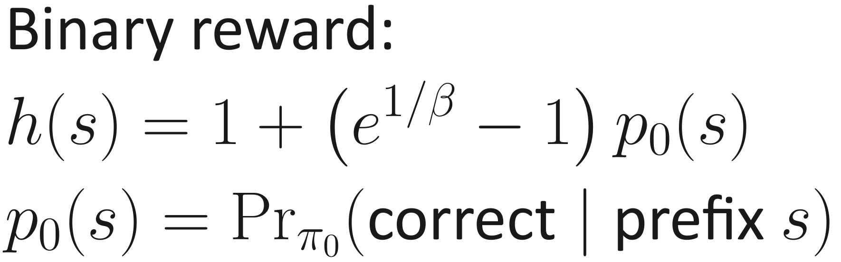
An answer-only reward still tells good steps from bad
A step is credited by how often it leads to success.
Notes:
A common worry: one score for the whole answer cannot say which step was good. In a single update that is true, but on average it is not. The ideal next-step probability multiplies the base probability by h(sa)/h(s): how promising the continuation is. With binary reward, h is a simple function of the chance that the prefix leads to a correct answer. In the tree, step a1 leads to success 75% of the time and gains probability; a2 loses it.

Slide 27
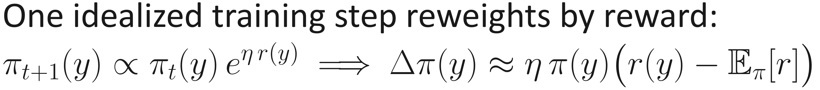
Key tool: a behavior grows if and only if it covaries with reward
Next: set f = “the reasoning is correct”.
Notes:
One identity does most of the work in this section. Take one idealized training step: reweight every answer by e to the eta times its reward. This step is the exact best answer to: raise reward, but change the model by at most a small KL. For a small step, each probability moves by eta times its probability times its advantage, reward minus average reward. Then for any behavior f, its average moves by eta times the covariance of f with the reward, and the reward itself moves by eta times its variance, which is never negative. Dividing the two removes the step size: per unit of reward gained, f changes by Cov(f, r) over Var(r). So as training raises reward, a behavior rises exactly when it covaries positively with reward. This is exact along idealized training; real networks add sampling and parameter sharing, which Q2 and Q3 treat. Next we set f to 'the reasoning is correct'.

Slide 28
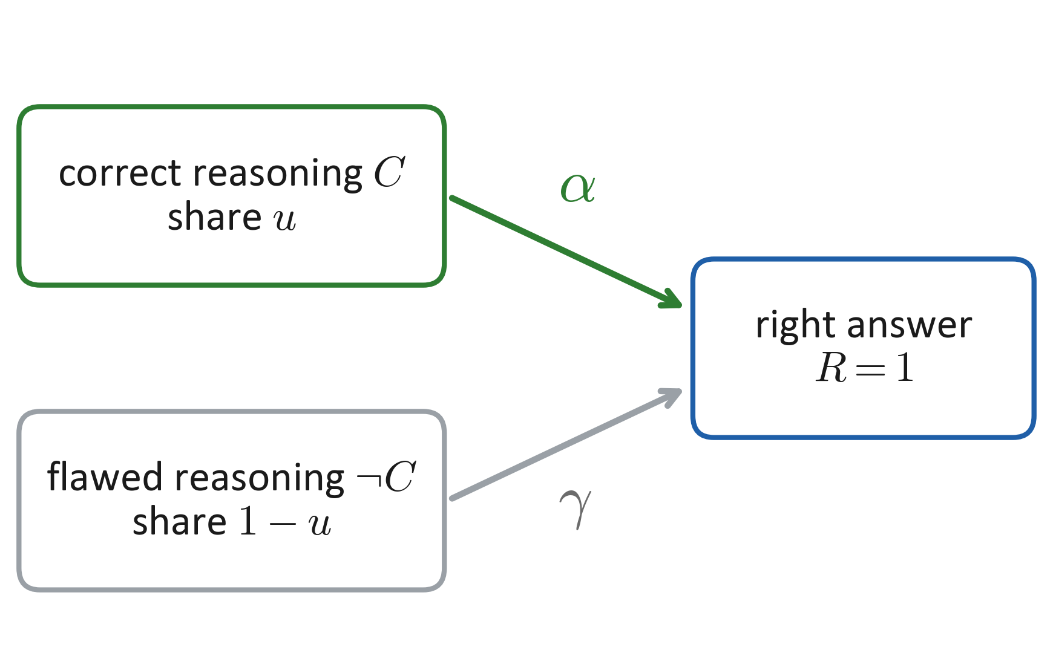
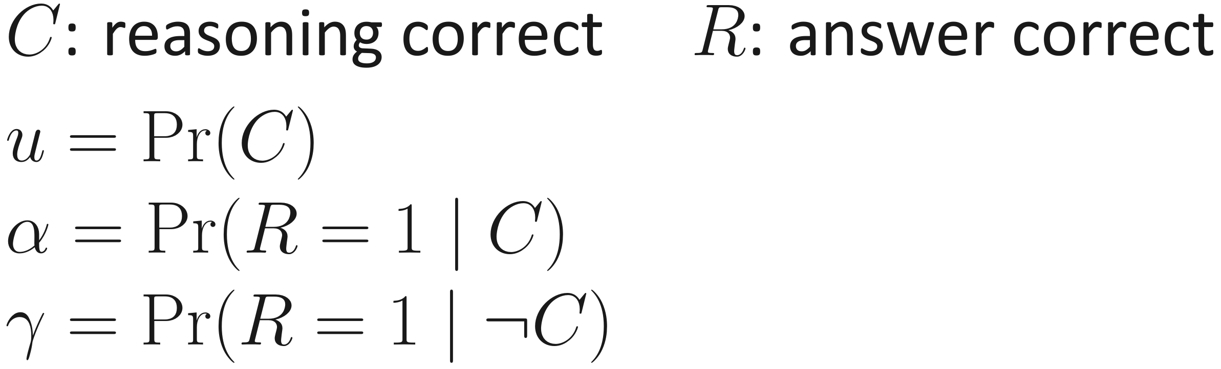
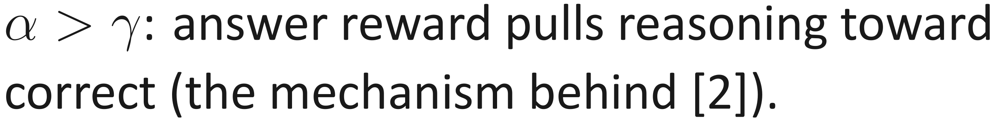
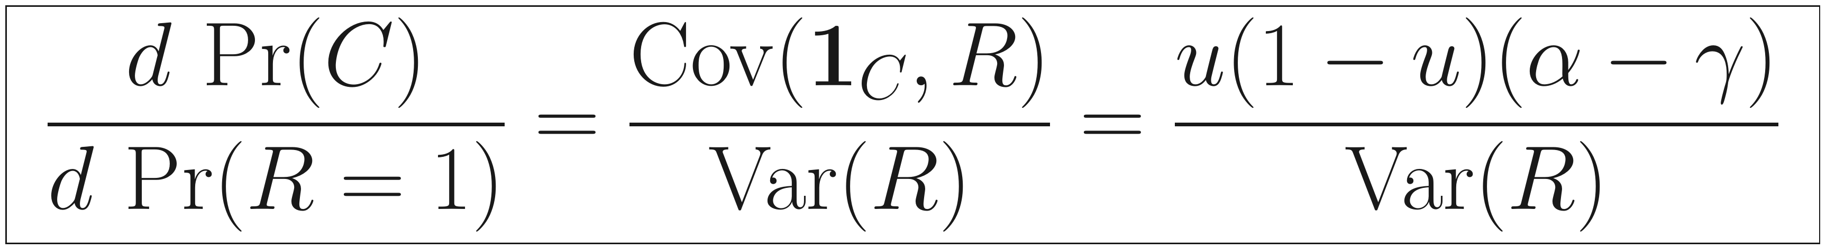
Process improves only if correct reasoning wins more often
Notes:
Let alpha be the chance that correct reasoning gives a right answer, and gamma the same for flawed reasoning. The covariance is u(1-u)(alpha - gamma). If correct reasoning really is more likely to reach the right answer, the answer reward pulls the model toward correct reasoning. This is the mechanism behind [2]. If guessing and shortcuts pay off just as well, there is no pull. In reward units: the share of correct reasoning changes, per unit of accuracy gained, by Cov(1_C, R) over Var(R). The covariance is u alpha minus u times (u alpha plus (1 minus u) gamma), which simplifies to u(1-u)(alpha minus gamma); Var(R) is positive, so the sign is the sign of alpha minus gamma.

Slide 29
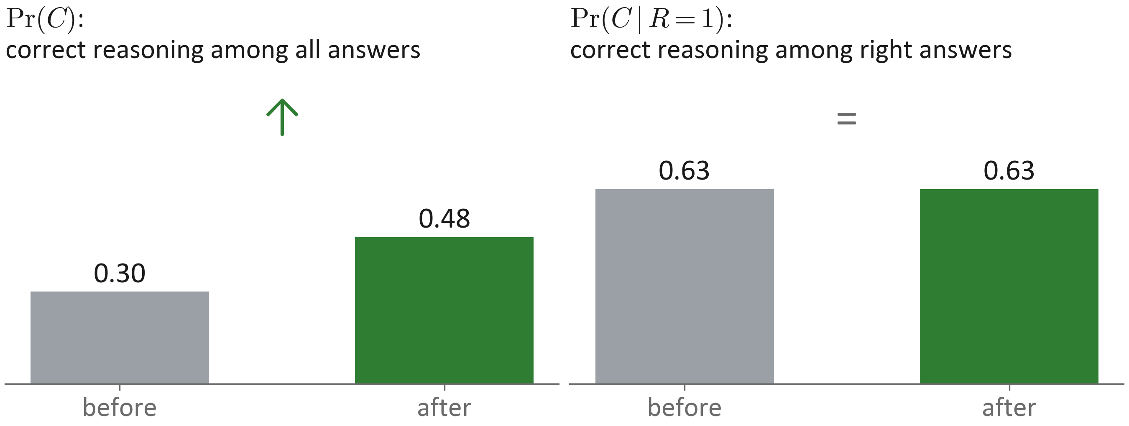
More correct reasoning, but right answers are no more reliable
More reliable right answers need a reward that checks the reasoning: process supervision.
Notes:
This does not contradict the reweight-only model. With binary reward, the share of correct reasoning rises from 0.30 to 0.48 only because right answers as a group become more common, and correct reasoning is more common among right answers (63 percent) than overall (30 percent). Among right answers, correct reasoning stays at 63 percent: a right answer is no more reliable than before. To change that, the reward must tell right answers with correct reasoning from lucky ones. That is the job of process supervision.

Slide 30




Shared parameters carry updates to answers never sampled
The only way around the sampling squeeze, but the sign is not guaranteed.
Notes:
Now coverage. All answers share one set of parameters. A gradient step on a sampled answer u changes the log-probability of any other answer u' by the inner product of their gradients. u' does not have to be sampled, or even belong to the same problem. This is the only route around the sampling squeeze: a problem can improve without ever being solved in training. But the sign is not guaranteed: opposed gradients push other answers down. [9] shows a dramatic case.

Slide 31
Q3 answer: process and transfer need conditions
Q1
What does the reward want?
Q2
Where can training actually get it?
Q3
When do process and transfer improve?
Q4
What does each test measure?
Next: which test sees which gain?
Notes:
Back to the main question. Process gain needs alpha > gamma, and with an answer-only reward it raises the share of correct reasoning, but right answers do not become more reliable. Coverage has a second route, transfer through shared parameters, which can help or hurt. A flawed reward can reverse both. Next: which test sees which gain?

Slide 32
What does each test measure?
Question 4
Read the evidence against the reweight-only model.
Notes:
Now we use the three gains and the reweight-only model to read the evidence, starting with the two papers from the opening.

Slide 33




[1] explained: concentration plus the sampling squeeze
Data: [1], Fig. 7, Minerva. Base: Qwen2.5-Math-7B; RLVR: Oat-Zero-7B; distilled: DeepSeek-R1-Distill-Qwen-7B.
[1] measures coverage. Real, but it does not show that RL learned nothing.
Notes:
Paper [1] in our terms, with its own data: Figure 7, Minerva. Base is Qwen2.5-Math-7B, RLVR is Oat-Zero-7B, distilled is DeepSeek-R1-Distill-Qwen-7B. At small k, RLVR shows an accuracy gain from reweighting: 0.16 to 0.35 at k = 1. The curves cross between k = 16 and 32. At large k, the base model wins for two reasons we derived: reverse KL concentrates on a few solutions, and hard problems give no signal unless training samples them more than k times. The distilled model sits above the base model at every k, 0.68 versus 0.64 at k = 128: forward KL keeps modes, and demonstrations bring new solutions. So [1] measures coverage. Its finding is real, but it does not show that RL learned nothing.

Slide 34




[2] explained: it tests what the reweight-only model cannot change
Data: [2], Fig. 2, k = 1024. Qwen2.5-32B vs DAPO-Qwen-32B.
[2] measures process. RLVR's right answers are better reasoned than the base model's.
Notes:
Paper [2] in our terms, with its own data at k = 1024. The reweight-only model keeps the share of correct reasoning among right answers fixed. CoT-pass@k counts only answers with correct reasoning, so it is sensitive exactly to this share. On AIME 2025, the base model hits 77 percent of problems by answer, but only 33 percent with correct reasoning: most of its large-k coverage is lucky. RLVR hits 87 percent, 77 percent with correct reasoning. AIME 2024 shows the same direction, smaller: 0.67 of 0.87 versus 0.87 of 0.90. Reweighting cannot turn lucky hits into reasoned ones, so training did more than reweighting. Caveats: the judge is an LLM with majority vote, and on MATH500, AMC23 and Minerva the two models differ little, as [2] itself reports.

Slide 35
The debate, resolved: two papers, two different gains
[1] Does RL really incentivize reasoning beyond the base model?
[2] RLVR implicitly incentivizes correct reasoning
Coverage
Process
RLVR mostly concentrates probability
RLVR's right answers are better reasoned
Both can be true at once. The dispute is about metrics, not facts.
Notes:
So the two papers do not contradict each other. [1] measures coverage and finds that RLVR mostly concentrates probability. [2] measures process and finds that RLVR's right answers are better reasoned. Both can be true at once. The dispute is about metrics, not facts.

Slide 36
Other evidence fits the same map
Paper | Finding | On the map
[3] RLVR on iterated multiplication | No bad local maxima, yet training can stall; entropy and curriculum help | Q2: signal, not the landscape, is the bottleneck
[10] Post-training is (massive) supervised learning | Reasoning SFT works even from random initialization | Coverage can be taught by demonstrations
[11] Safety mid-training | Safety gains survive later general SFT and GRPO | The retention check every gain should pass
Notes:
Three more results placed on the map. [3]: in a controlled multiplication task, the reward landscape has no bad local maxima, yet training can still stall; the bottleneck is signal, as in Q2. [10]: large-scale reasoning SFT works even from random initialization, so demonstrations can create coverage directly. [11]: safety gains that survive later general training: the retention check that every gain should pass.

Slide 37

Safety: the same math with a different reward
Notes:
Safety training is the same machinery with a different reward, so every main-line result has a safety version. Rare violations are expensive to find, just like rare successes: 0.1% per try becomes 63% over a thousand tries. Refusing at the start is not the same as recovering from a risky prefix [7]. A gameable safety score can flip the sign [8]. Unrelated training can erode safety through shared parameters [9]. And we must measure harm and helpfulness separately, and re-test after further training [11].

Slide 38
Four questions to ask any post-training paper
1
Concentration or coverage?
Accuracy vs Coverage
→ per-problem success rates; pass@k at several k
2
Lucky hit or sound reasoning?
Process
→ check the reasoning, not only the answer
3
More compute or better compute?
all gains
→ compare at the same total tokens or FLOPs
4
Memorized or reusable?
all gains
→ unseen tasks, rephrasing, further training
Notes:
A practical checklist. One: concentration or coverage? Look at per-problem success rates and pass@k at several k. Two: lucky hit or sound reasoning? Check the reasoning. Three: more compute or better compute? Compare at the same total budget. Four: memorized or reusable? Test unseen tasks, rephrasing, and further training.

Slide 39

Takeaway: measure each gain on its own
Post-training reweights what the base model already does. Accuracy comes free; process and coverage need conditions.
Notes:
The whole talk in one table. Accuracy comes from reweighting and needs no condition. Process needs alpha > gamma, and making right answers more reliable needs a process reward. Coverage needs signal, which is squeezed, or transfer, which can go either way, or demonstrations. Each one has its own measurement, and each gain should survive rephrasing, new tasks, and further training. One sentence: post-training reweights what the base model already does; accuracy comes free, process and coverage need conditions.

Slide 40
References
[1] Does Reinforcement Learning Really Incentivize Reasoning Capacity in LLMs Beyond the Base Model? (2025). arXiv:2504.13837
[2] Reinforcement Learning with Verifiable Rewards Implicitly Incentivizes Correct Reasoning in Base LLMs (2025). arXiv:2506.14245
[3] RLVR Landscapes for Iterated Multiplications Can Be Benign: Insights from Spin-Glass Theory (2026). arXiv:2609.28625
[4] DAPO: An Open-Source LLM Reinforcement Learning System at Scale (2025). arXiv:2503.14476
[5] Understanding R1-Zero-Like Training: A Critical Perspective (2025). arXiv:2503.20783
[6] Reinforcement Learning and Control as Probabilistic Inference: Tutorial and Review (2018). arXiv:1805.00909
[7] Safety Alignment Should Be Made More Than Just a Few Tokens Deep (2024). arXiv:2406.05946
[8] Reward Misspecification Degrades Chain-of-Thought Monitorability (2026). arXiv:2610.28303
[9] Emergent Misalignment: Narrow Finetuning Can Produce Broadly Misaligned LLMs (2025). arXiv:2502.17424
[10] Hassid, Adi & Schwartz. Post-training is (Massive) Supervised Learning (2026). arXiv:2606.07527
[11] Safety Mid-Training: Internalizing LLM Safety as a Foundational Capability (2026). arXiv:2610.26809

