Slide 1
Unity 3d -Chapter2-
soulseek

Slide 2
목차
Scene & Camera
GameObject & Component

Slide 3
Scene & Camera

Slide 4
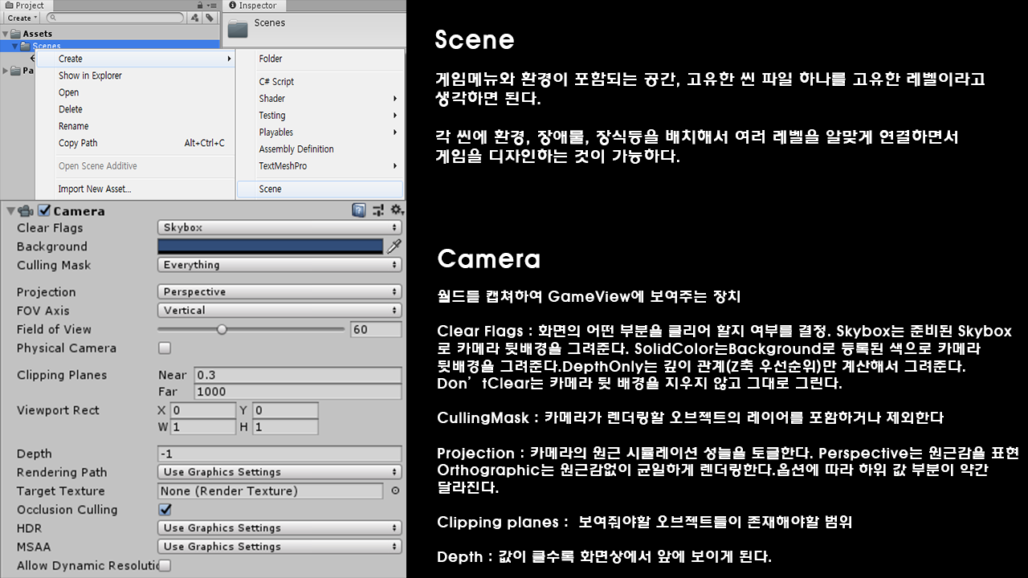
1. Scene & Camera

Slide 5
GameObject & Component

Slide 6
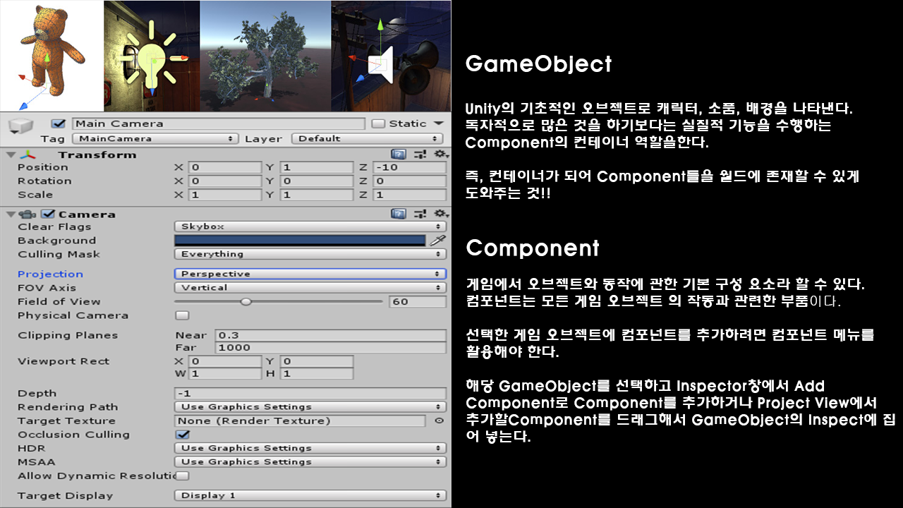
2. GameObject & Component

