Slide 1

CS512 INTRODUCTION TO PYTHON
FINAL PROJECT : WEB SCRAPING
ASSEL KASSENOVA

Slide 2
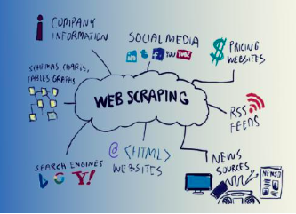


CS512 INTRODUCTION TO PYTHON
Web scraping is a technique to fetch data from websites.

Slide 3
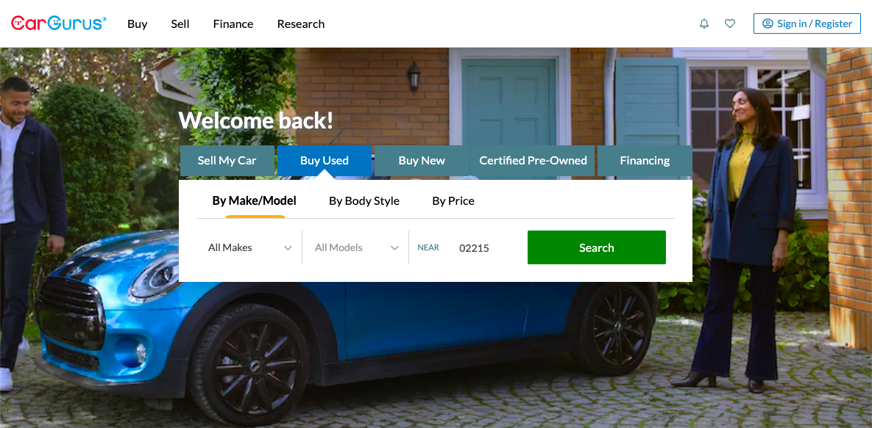
CS512 INTRODUCTION TO PYTHON

Slide 4
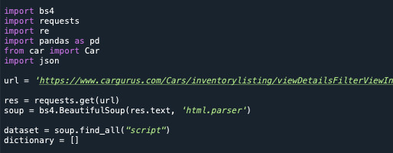
1.Assigning specific URL
2.Sends a request to URL
3. Scrapes
Text from URL
4. All script found on soup stored in dataset. & empty list dictionary created
CS512 INTRODUCTION TO PYTHON

Slide 5
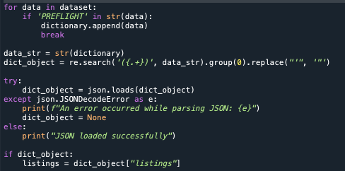
CS512 INTRODUCTION TO PYTHON
1.
2.
3.

Slide 6
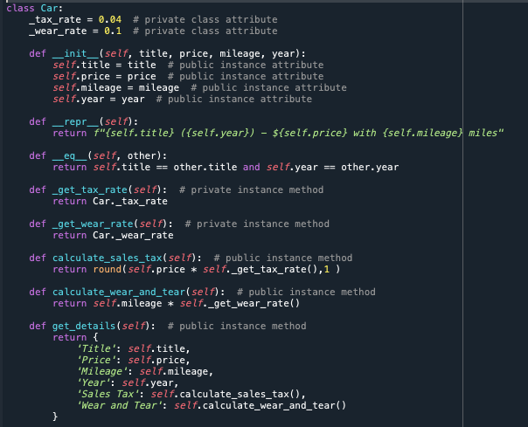

Slide 7
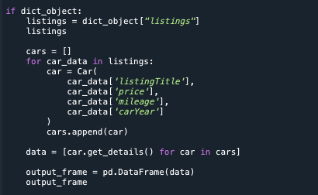
CS512 INTRODUCTION TO PYTHON
1.
2.
3.

Slide 8
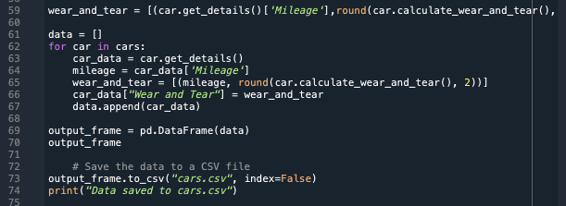
CS512 INTRODUCTION TO PYTHON

Slide 9
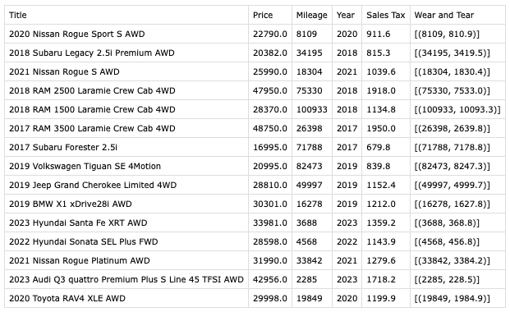
CS512 INTRODUCTION TO PYTHON
FINAL OUTPUT
DATA

Slide 10
CS512 INTRODUCTION TO PYTHON
WHY IT IS USEFUL?
E-COMMERCE PRODUCT PRICING PROCESS
FOR PRIVATE CAR DEALERS TO DEFINE ADDITIONAL COST

Slide 11
CS512 INTRODUCTION TO PYTHON
THANK YOU!!!

