Slide 1
function JsCalendar( ){
Authors: Marc, Josep, Haroon

Slide 2
a-mental-rollercoaster.js
function startLearning ( ){
Starting off with the project seemed very complicated, and it was!
We spent the whole first day investigating and brainstorming ideas about how to design the Calendar.
We coded, we designed, we got stuck but at the end we managed to finish the project just in time.
}

Slide 3
redesign-mind.css (What we Learned)
1
Work Efficiently with Grids:
2
Working With Dates:
3
Local Storage and JSON
{
Since we had to display the months using grids, Arranging and rearranging them was the first step of the way.
}
{
Working with time and dates to get the desired values we need, for example last day(31 or 30 or 28) of previous months, day of week where month starts etc. }
{
Most Importantly, we learned how to store and retrieve date from local Storage, this was on of the hardest parts of the project for us.
}

Slide 4
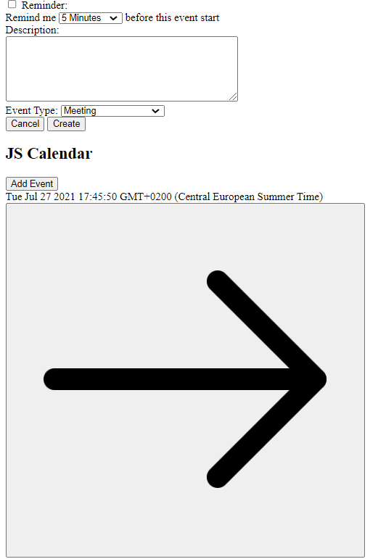
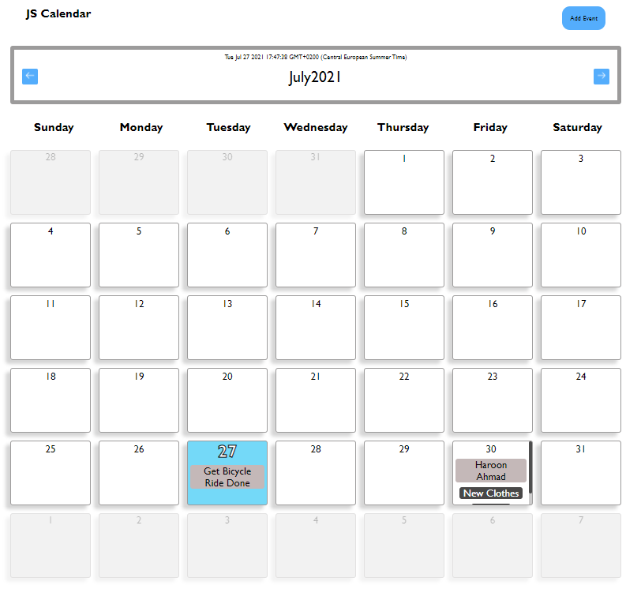
After applying redesign-mind.css
Going in the Project
Coming out of the Project: Literal Expression.

Slide 5

errors-and -problems
And the next day, most certainly,
We got stuck in how to use the
retrieved data from Local Storage.
But once done, it all seems easy!
Local Storage was one of the biggest challenges for us, because we had never worked with it before, but behold, I was stuck on this single line for one whole day :(

Slide 6
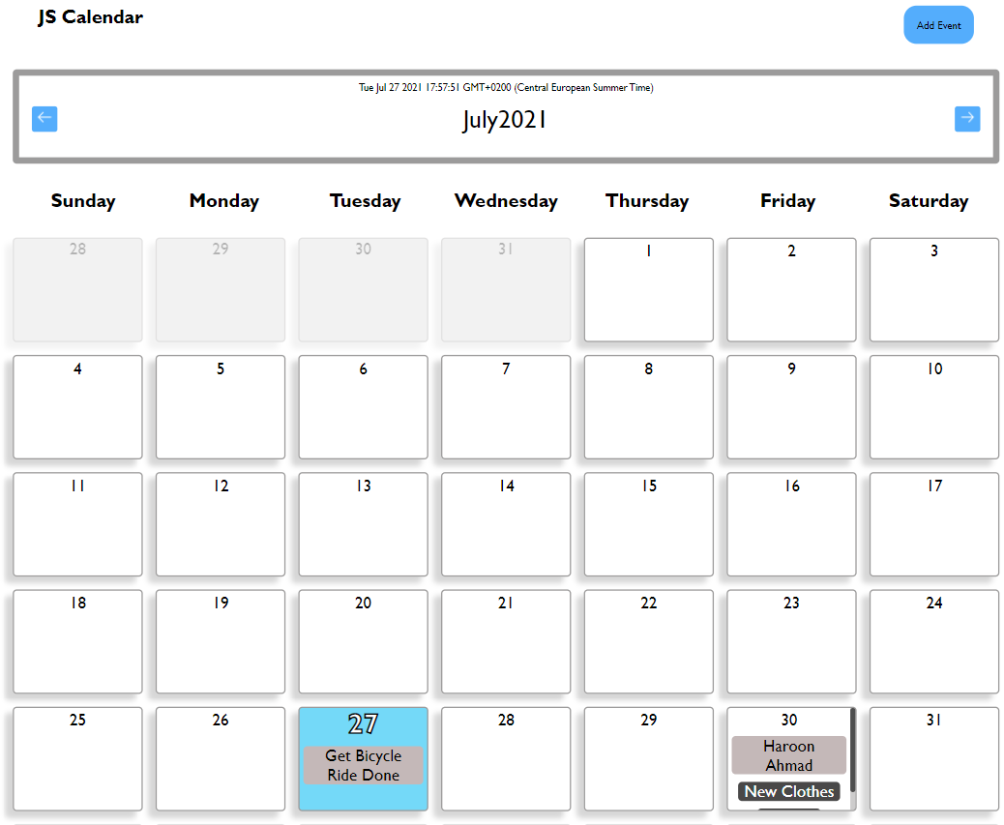
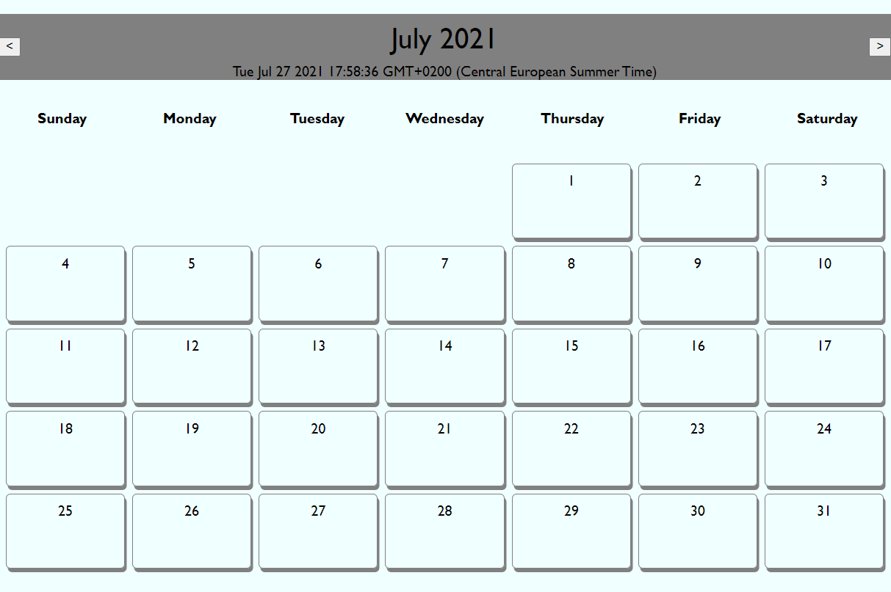
We started off with 2 Calendar Variants.
In 3 days, we had 2 fully working Calendars( Showing Dates and Months). We decided to continue with Josep’s Variant because it was Cleaner and more efficient.

Slide 7
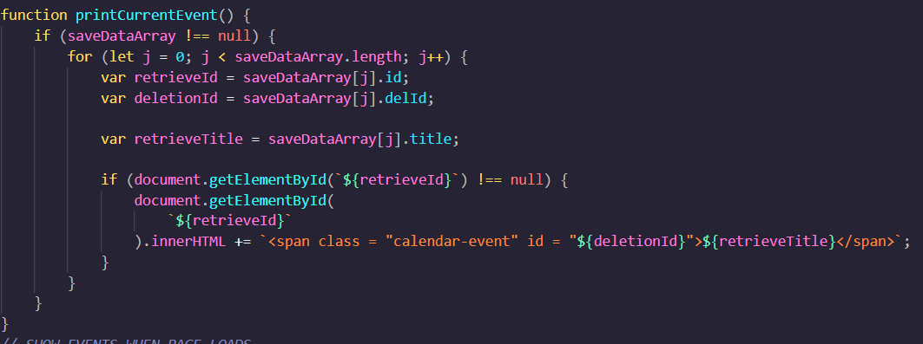
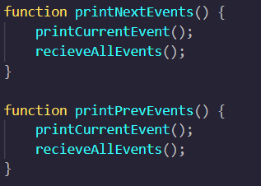
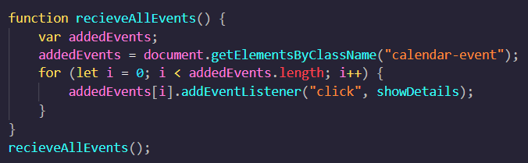
AddingTheLocalStorageFunctionalities.js
During the days we had, left. We basically added the Rest of Functionalities. >Printing events of every month.
>Add events for the future months and dates
>Limit events to only future dates.
>Different Modals and the reminder event(unfinished).

Slide 8
Final-Touches.css
.we-are-done{
Last day for us was basically try to find any bugs that existed and try to fix them.
Apply some CSS effects.
}
CSS and Final Bug fixes

Slide 9
Thank You,
Questions?
Authors: Marc, Josep, Haroon

