Slide 1
Investigation of pandemics impact on stock prices
Team members: Aitore Issadykova, Assem Kussainova

Slide 2
Aims
Study the behavior of stock prices during previous pandemics
Build the prediction models for stock prices using data of previous pandemics and identify the best

Slide 3
Data
Companies: Disney, Amazon, Southwest Airlines Company, IBM, Marriott, Samsung, Twitter
Pandemics: SARS, MERS, Ebola

Slide 4
Methods
AutoRegressive Integrated Moving Average
Linear Regression
Support Vector Machine
Long Short-Term Memory
Metrics: MSE, MAPE

Slide 5
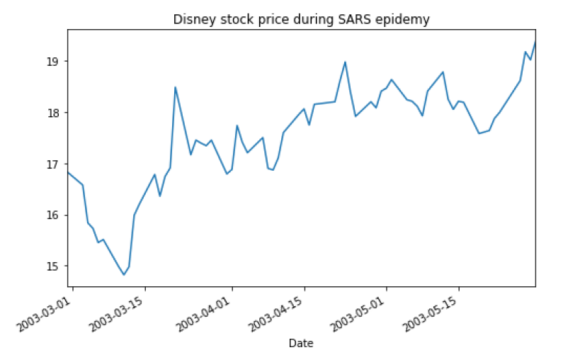
Results
Stocks tend to have similar behavior during studied pandemics

Slide 6
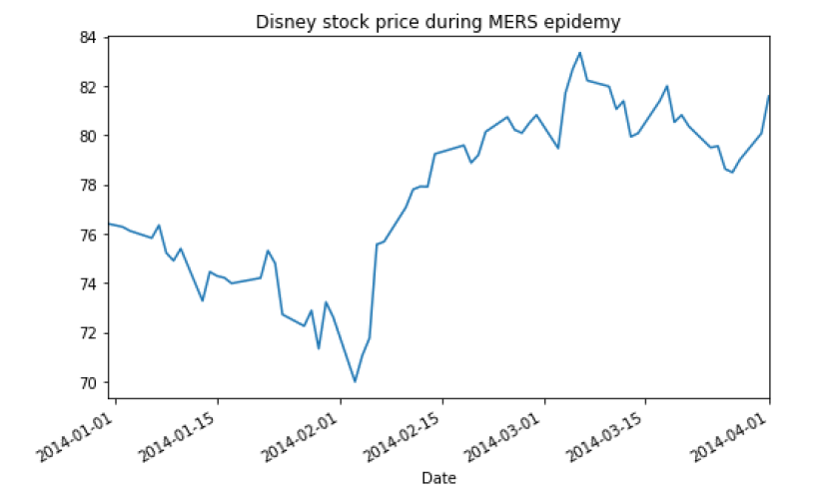

Slide 7
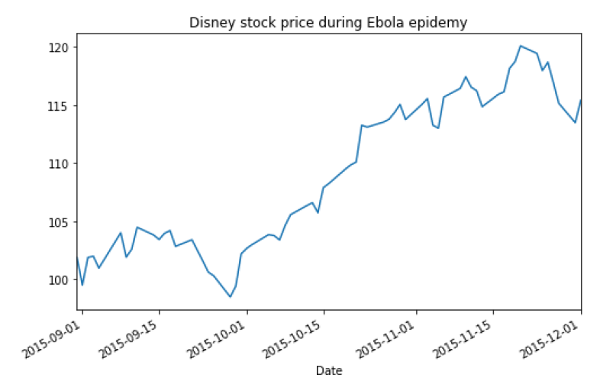

Slide 8
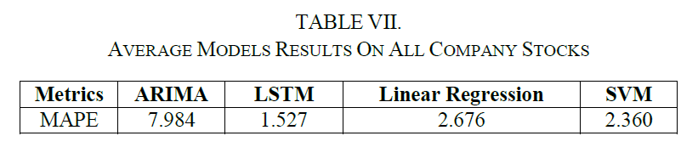
Results
Best performed model: LSTM
Average accuracy: 98.57%

Slide 9
Future improvements
Test model on most recent pandemic COVID-19 data
Study the effect of pandemics using higher amount of data
Study the effect of other related factors to increase accuracy

Slide 10
Thank you for attention!

