Slide 1
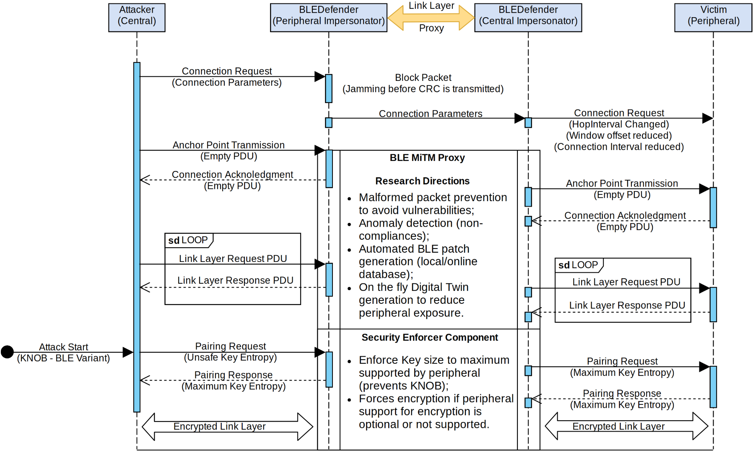

Real time MITM defense for Bluetooth Low Energy (Proposal)
Malicious Central
Vulnerable target device
1. Block initial connection from attacker and connect to the peripheral instead;
Secure bridge
Connection confirmation
Acknowledgements
2. Bridge packets from and to peripheral to the central and drop malicious packets;
A man-in-the-middle attack can be avoided
3. Force usage of secure encryption parameters (i.g., maximum key size, secure connections, passcode, etc);

Slide 2
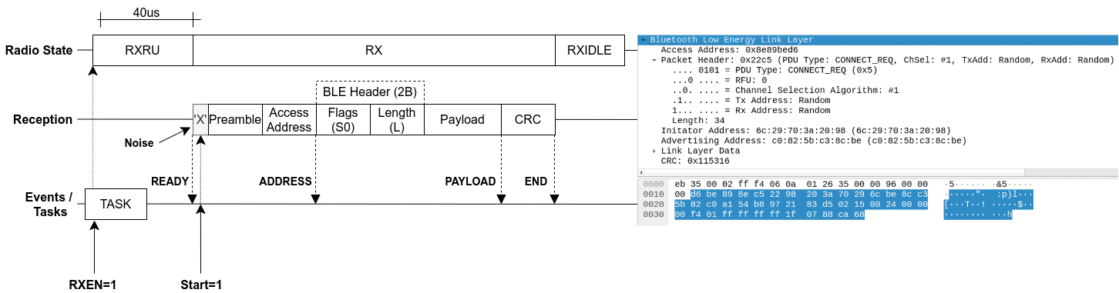
Reception Path

Slide 3
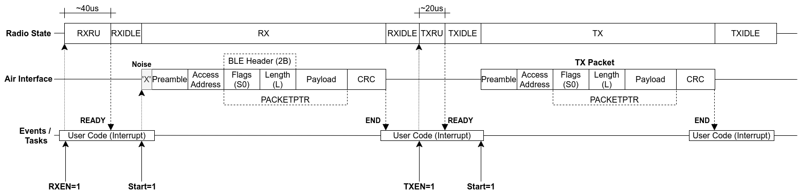
Reception to Transmission

Slide 4
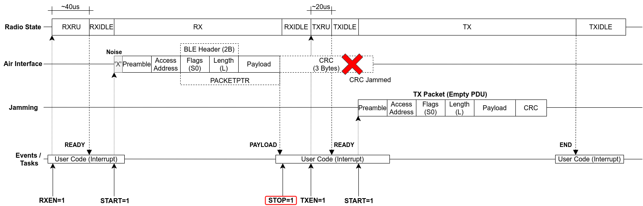
Simple CRC Jammin (Slow)

Slide 5
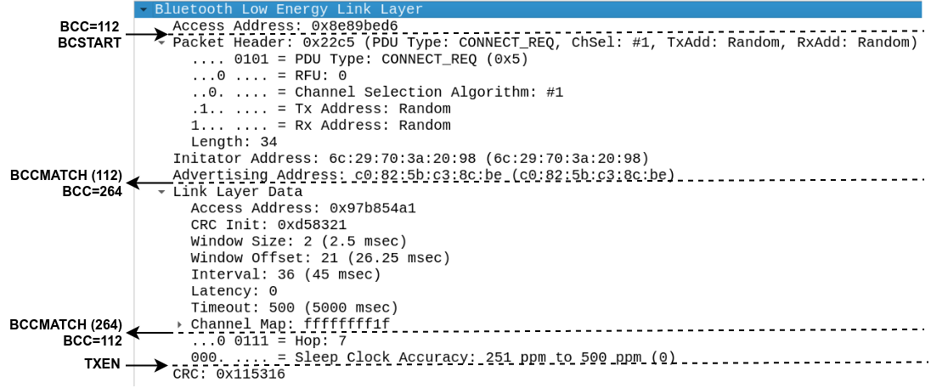
CRC Jamming via Bit Counter

Slide 6
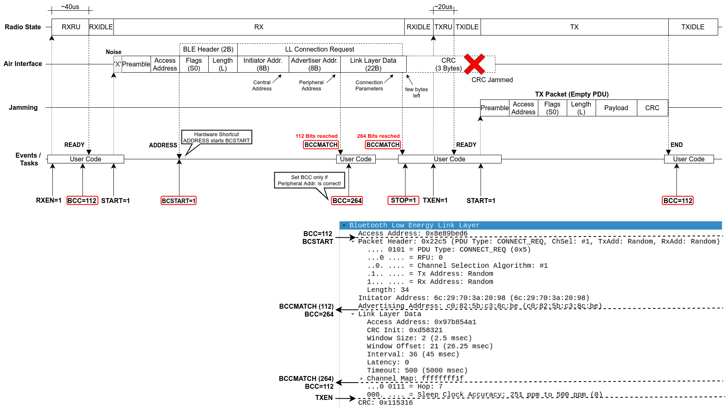
CRC Jamming via Bit Counter

