Slide 1
A History of Sudden Cardiac Death
The role of the autonomic nervous system
Anish Shah MD
February 18, 2019

Slide 2
introduction
Important concepts, Objectives, Outline

Slide 3
Why did he die on Tuesday and not on Monday?
~ Douglas P. Zipes

Slide 4
Important concepts
Role of ANS in developing arrhythmia
Measuring balance of autonomic tone

Slide 5
Objectives
Understand mechanisms behind triggers of SCD
Autonomic imbalance may be a risk factor for SCD

Slide 6
MI
Stimuli
Triggers
LV
mass
VT/VF
Substrate
Stress
Autonomic
Modulation
QTI

Slide 7
Outline
Current model of sudden cardiac death
Relevant anatomy and physiology of ANS
Ventricular substrate
Triggers that lead to sudden death

Slide 8
History
Fatal syncope to Ventricular Fibrillation

Slide 9
John Macwilliam
Trained at Ludwig Institute of Physiology, home of Fick, Pavlov, Kronecker
First proposed that VF was mechanism of SCD in 1889
Fatal syncope, delirium cordis, circus contraction, intervermiform movement
Induction of cardiac tetany through electricity
First successful VF defibrillation (1947)
de Silva 1989; Meyer 1988

Slide 10
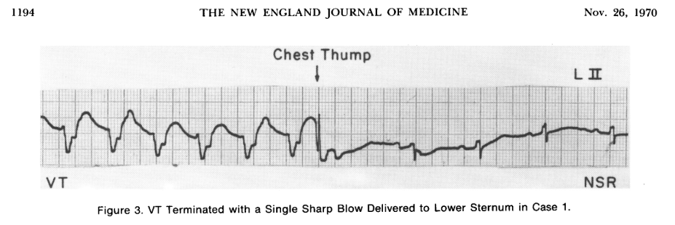
VT corrected with a precordial thump…1970
Pennington et al 1970

Slide 11
A model of sudden Death
Coronary care unit, electrical accidents, Susceptibility to Fibrillation

Slide 12
Precipitating events
Threat, grief, arousal, personal danger, reunion precede sudden death… 8 cases, 1971
Anxiety/anger precipitated SCD in depressed factory workers… 26 cases, 1972
Increased stress precedes SCD, and matches data from ICD shocks
MACE follows circadian pattern, peaking from 6 AM to 10 AM, followed by 6 PM to 8 PM
Engel 1971; Green et al 1972; Rahe et al 1973; Lampert et al 2002, Taggart et al 2011; Muller 1999
Notes:
Anecdotes of events of threat, grief, arousal, mourning, personal danger, reunion precede sudden death.(Engel, 1971)
After the Northridge earthquake in 1994, there was an increase in number of SCD, even after accounting for trauma or physical exertion.(Leor, Poole, & Kloner, 1996)
In an industrial plant in Rochester, NY, there were 26 reported cases of sudden death. Interviews with family noted that these individuals had been depressed over the past several weeks, and the events happened in the setting of acute arousal, either through increased work, anxiety, or anger.(Greene, Goldstein, & Moss, 1972)
Increasing stress has been shown to precede SCD,(Rahe, Bennett, Romo, Siltanen, & Arthur, 1973) and when measured in patients with ICD, VT and VF showed a similar pattern.(Lampert et al., 2002; Peter Taggart, Boyett, Logantha, & Lambiase, 2011)
The events also follow a circadian rhythm. Peak events of MACE occur from 6 AM to 10 AM, followed by a secondary peak of events from 6 PM to 8 PM.(Boudreau, Dumont, Kin, Walker, & Boivin, 2011; Muller, 1999; Portaluppi et al., 2012)

Slide 13
Coronary care unit
70-90% post-MI have ventricular extrasystole
Bernie Lown proposed CCU would reduce mortality after myocardial ischemia
Premises: restful rooms, cardiac monitoring, cardiac nurses, arrhythmia prophylaxis
Reduced mortality >30% to <20%
Lown & Selzer 1968

Slide 14
Premises of sudden death
Mechanism of SCD is VF
Electrical instability precedes catastrophe
Ventricular beats predispose the vulnerable heart to VT/VF
Transient nervous risk factors induce electrical instability
Lown et al. 1977

Slide 15
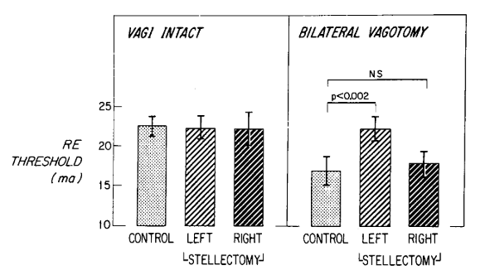
Premises of sudden death
Mechanism of SCD is VF
Electrical instability precedes catastrophe
Ventricular beats predispose the vulnerable heart to VT/VF
Transient nervous risk factors induce electrical instability
Kolman et al. 1975

Slide 16
Autonomic Nervous System
Neurocardiac axis, Sympathovagal balance

Slide 17
Neurocardiac axis
Extends from brain to heart
Intrinsic cardiac ganglia
Intrathoracic extracardiac ganglia
CNS (medulla, spinal column)
Complex, bidirectional, hierarchical
Armour 2010; Davis & Natelson 1993

Slide 18
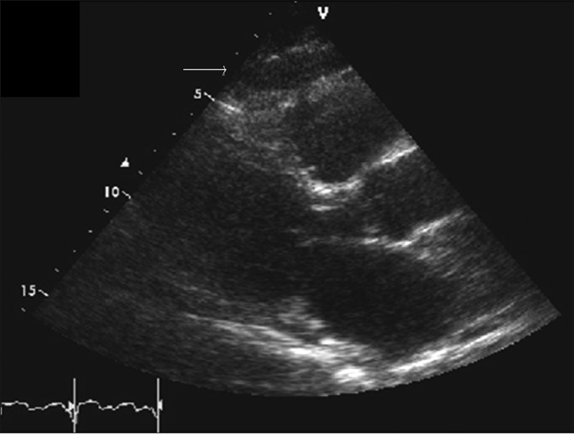
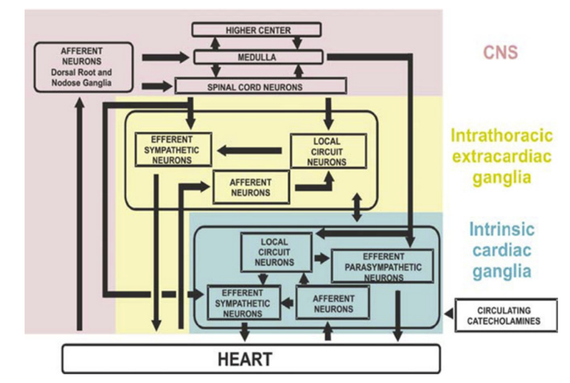
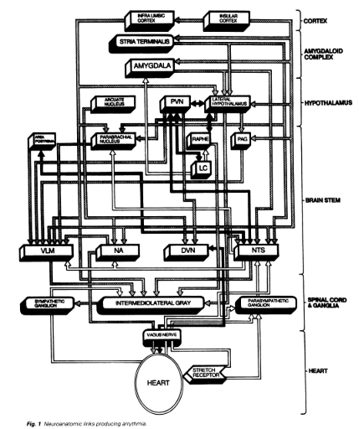

Slide 19
Sympathetic TONE LEADS TO VF
Stellate ganglion stimulation increases VF, particularly after coronary occlusion
Stellate ganglion carry sympathetic fibers, and after ganglionectomy, VF threshold increased (31% to 11%)
Complicated… unilateral stellectomy may have compensatory lateral hyperactivity
Harris, Otero, & Bocage, 1971; Kliks, Burgess, & Abildskov, 1975)

Slide 20
Vagal tone can be protective
Vagal tone only salutary with increased sympathetic tone
Vagus acts through muscarinic, nicotinic, adrenergic, nitrergic signaling paths
Methacholine raises VFT
Atropine reduces VFT
Multiple types of vagal neurons in medulla, some affected by respiration, others not (feline)
Kolman et al., 1975; Rabinowitz, Verrier, & Lown, 1976 ; Brack & Coote 2011; Daly & Kirkman 1989

Slide 21
Heart rate variability
Definition, Measurement, Application

Slide 22

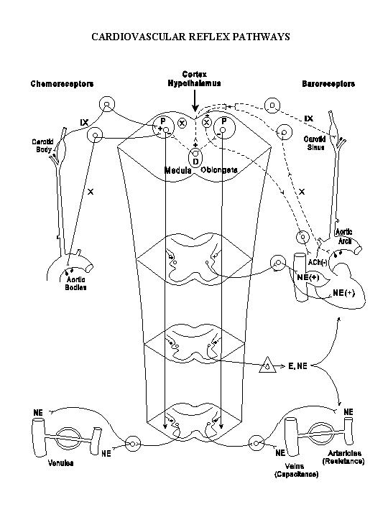
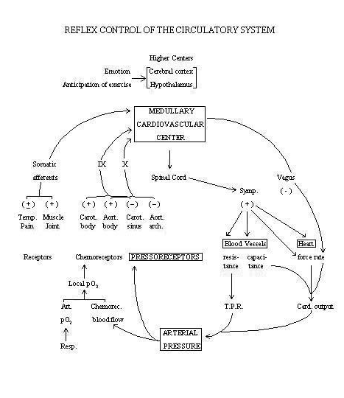

Slide 23
Purpose of HRV
Multiple factors influence CV control, including complicated reflex arches
Eventually ANS integrates on the SA node
HRV is summation of multiple levels of information (essentially a dynamic check-sum of the ANS)
Harris, Otero, & Bocage, 1971; Kliks, Burgess, & Abildskov, 1975)

Slide 24
MEASUREMENT
Geometric domain (e.g. SDNN)
Non-linear domain
Frequency domain
Kleiger, Miller, Bigger, & Moss, 1987; Lombardi et al., 1987

Slide 25
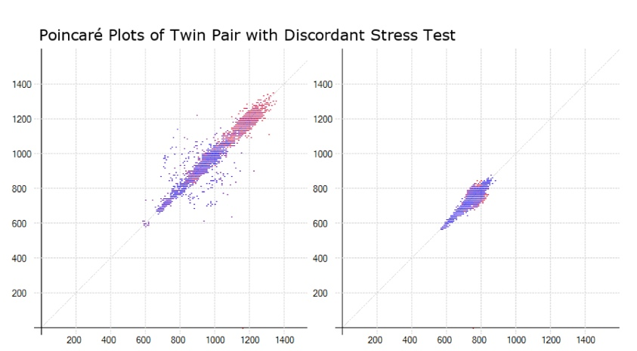
Non-linear HRV (Dyx)
Tayel & AlSaba, 2015
Notes:
Two Poincaré plots that represent one hour of ECG data at 7 AM between a twin pair discordant for myocardial stress perfusion abnormalities. Each point represents an RR interval (ms) on the x-axis plotted against the following RR interval (ms) on the y-axis over the course of the recording. The first twin (left) was negative for myocardial stress perfusion deficits (Dyx = 3.7), and the second twin (right) was positive for myocardial perfusion deficits (Dyx = 1.7).

Slide 26
Power spectral analysis
VLF is between 0.0033 and < 0.04 Hz (RAAS)
LF is between 0.04 and < 0.15 Hz (baroreceptor)
HF is between 0.15 and < 0.40 Hz (respiration)
Akselrod et al 1981
Notes:
Very low frequency (VLF) is between 0.0033 and < 0.04 Hz; low frequency (LF) is between 0.04 and < 0.15 Hz; and high frequency (HF) is between 0.15 and < 0.40 Hz. These frequency bands integrate heart rate in response to physiologic stimuli, including influences of the renin-angiotensin-aldosterone system (VLF), baroreceptor activity (LF), and respiration (HF).

Slide 27
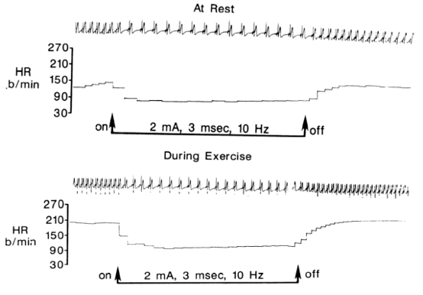
Accentuated Antagonism
Stramba-Badiale et al., 1991
Notes:
Measure the different components is quite useful, particularly in teasing apart the effects. This study uses a conscious canine model to demonstrate an important, summative concept of accentuated antagonism.(Stramba-Badiale et al., 1991) Each dog has had a vagal nerve stimulator implanted in the cervical region, and subsequently had this activated during exercise versus at rest. 1) Immediately there is a change in heart rate with stimulation, suggesting that vagal activity is very rapid in its effect, almost instantaneous. 2) The effect was over-proportional to the amount of sympathetic tone (e.g. at higher heart rates, a larger bradycardic response occurred)

Slide 28
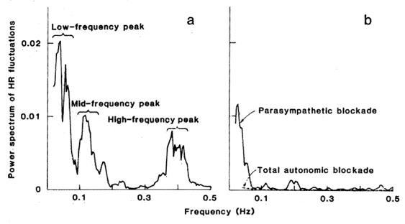
Fourier Transform
Akselrod et al 1981

Slide 29
HRV
Integration of the ANS on SA node
Vagal tone is sudden, sympathetic tone is slow
Abnormal HRV is associated with mortality
Notes:
Very low frequency (VLF) is between 0.0033 and < 0.04 Hz; low frequency (LF) is between 0.04 and < 0.15 Hz; and high frequency (HF) is between 0.15 and < 0.40 Hz. These frequency bands integrate heart rate in response to physiologic stimuli, including influences of the renin-angiotensin-aldosterone system (VLF), baroreceptor activity (LF), and respiration (HF).

Slide 30
Ventricular Substrate
Innervation of the heart, Ventricular size, Effect of Ischemia

Slide 31
Differential innervation
Inferior wall of the LV has higher proportion of vagal afferents (canine, human)… pattern seen on MIBG scans as well
Sinus bradycardia in inferior ischemia?
Hypotension in RCA infarct?
Walker, Thames, Abboud, Mark, & Kloppenstein, 1978; Morozumi et al., 1997
Notes:
Very low frequency (VLF) is between 0.0033 and < 0.04 Hz; low frequency (LF) is between 0.04 and < 0.15 Hz; and high frequency (HF) is between 0.15 and < 0.40 Hz. These frequency bands integrate heart rate in response to physiologic stimuli, including influences of the renin-angiotensin-aldosterone system (VLF), baroreceptor activity (LF), and respiration (HF).

Slide 32
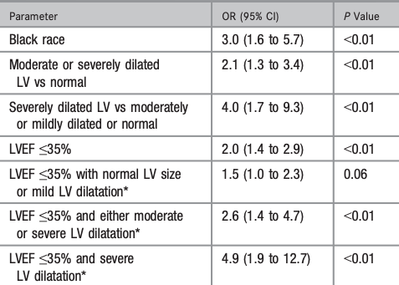
LV size
>4 cm needed to sustain VF
Higher LV volume/mass increases susceptibility to VF
Walker, Thames, Abboud, Mark, & Kloppenstein, 1978; Morozumi et al., 1997; Narayanan et al., 2014
Notes:
Very low frequency (VLF) is between 0.0033 and < 0.04 Hz; low frequency (LF) is between 0.04 and < 0.15 Hz; and high frequency (HF) is between 0.15 and < 0.40 Hz. These frequency bands integrate heart rate in response to physiologic stimuli, including influences of the renin-angiotensin-aldosterone system (VLF), baroreceptor activity (LF), and respiration (HF).

Slide 33
Ischemia
Transmural: leads to sympathetic denervation/reinnervation
Subendocardial: may only damage vagal efferent
Denervation and hyperinnervation lead to heterogenous sympathetic fibers = arrhythmogenesis
Ischemia location leads to changes in tone in nonischemic territory
Herre et al., 1988; Zipes, 1990; Huang, Boyle, & Vaseghi, 2017; Neely & Hageman, 1990
Notes:
The depth of ischemia is important. Transmural infraction leads to sympathetic denervation, unlike subendocardial ischemia, which may only damage vagal efferent nerves (as seen in figure).(Herre et al., 1988; Zipes, 1990)
Response to ischemia can be both denervation as well as hyperinnervation, which leads to tissue that has heterogenous sympathetic fibers, leading to arrhythmogenesis.(Huang, Boyle, & Vaseghi, 2017) The location of ischemia is also important, as measuring postganglionic activity shows differences in activity depending on whether it serves ischemic versus nonischemic territory.(Neely & Hageman, 1990)

Slide 34
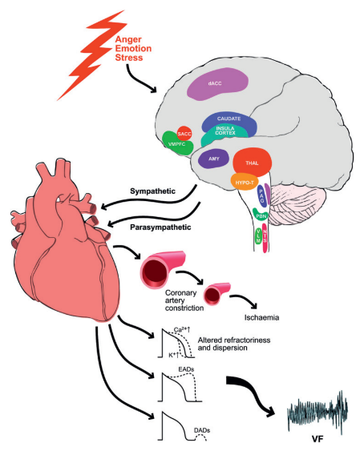
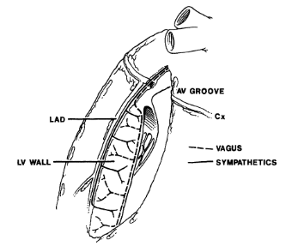

Slide 35
Triggering sudden death
Precipitating events, Autonomic Risk

Slide 36
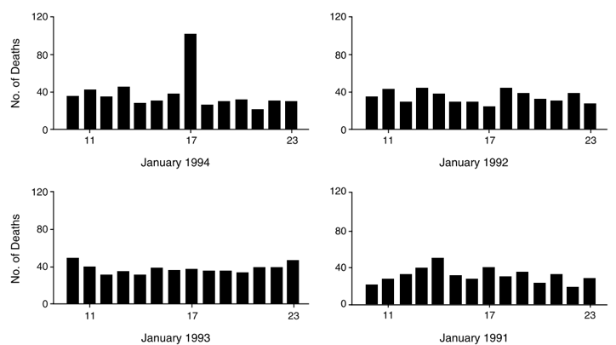
Leor et al 1996
Notes:
Anecdotes of events of threat, grief, arousal, mourning, personal danger, reunion precede sudden death.(Engel, 1971)
After the Northridge earthquake in 1994, there was an increase in number of SCD, even after accounting for trauma or physical exertion.(Leor, Poole, & Kloner, 1996)
In an industrial plant in Rochester, NY, there were 26 reported cases of sudden death. Interviews with family noted that these individuals had been depressed over the past several weeks, and the events happened in the setting of acute arousal, either through increased work, anxiety, or anger.(Greene, Goldstein, & Moss, 1972)
Increasing stress has been shown to precede SCD,(Rahe, Bennett, Romo, Siltanen, & Arthur, 1973) and when measured in patients with ICD, VT and VF showed a similar pattern.(Lampert et al., 2002; Peter Taggart, Boyett, Logantha, & Lambiase, 2011)
The events also follow a circadian rhythm. Peak events of MACE occur from 6 AM to 10 AM, followed by a secondary peak of events from 6 PM to 8 PM.(Boudreau, Dumont, Kin, Walker, & Boivin, 2011; Muller, 1999; Portaluppi et al., 2012)

Slide 37
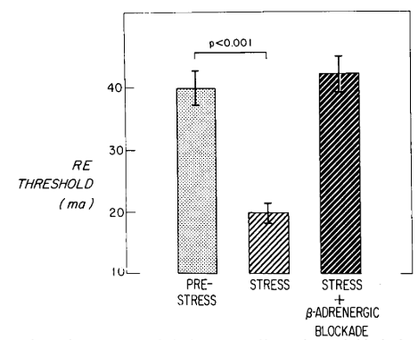
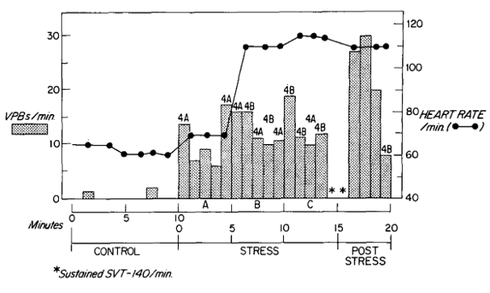
Lown, Verrier, & Corbalan, 1973; Lown et al., 1977; Verrier, Calvert, & Lown, 1975

Slide 38
Autonomic risk
Are there patients at additional risk for SCD independent of traditional risk factors?
La Rovere et al 1998; Bauer 2017; De Ferrari et al 2007

Slide 39
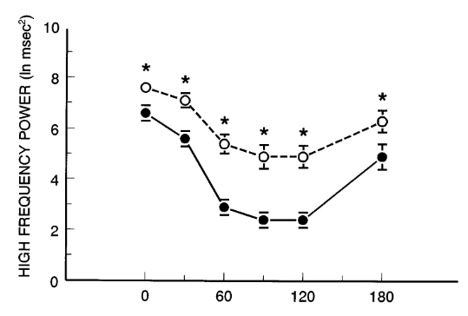
Houle & Billman 1999

Slide 40
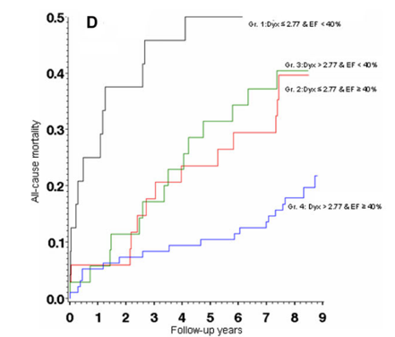
Jørgensen et al 2016

Slide 41
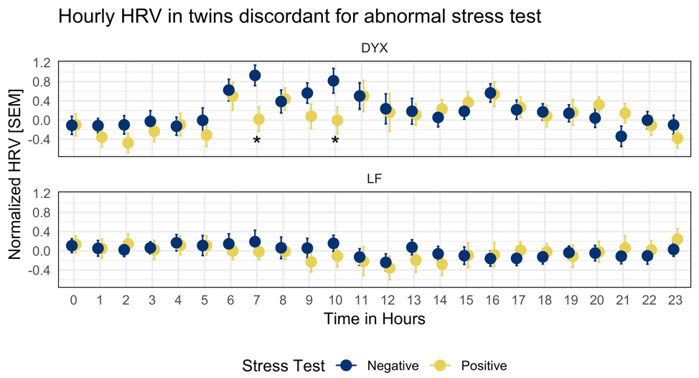
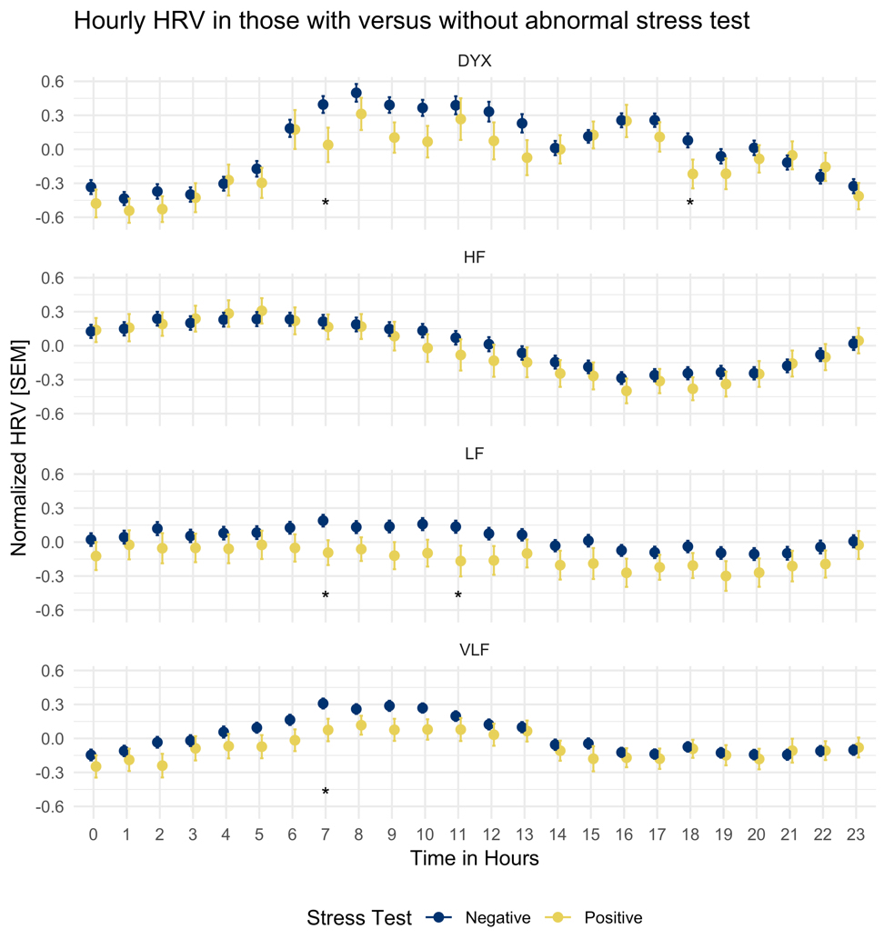
Jørgensen et al 2016

Slide 42
References
Heroes and legends

Slide 43
Akselrod, S., Gordon, D., Ubel, F. A., Shannon, D. C., Barger, A. C., & Cohen, R. J. (1981). Power spectrum analysis of heart rate fluctuation: A quantitative probe of beat-to-beat cardiovascular control. Science, 213(4504), 220–222. https://doi.org/10.1126/science.6166045
Aras, K. K., Faye, N. R., Cathey, B., & Efimov, I. R. (2018). Critical Volume of Human Myocardium Necessary to Maintain Ventricular Fibrillation. Circulation. Arrhythmia and Electrophysiology, 11(11), e006692. https://doi.org/10.1161/CIRCEP.118.006692
Armour, J. A. (2010). Functional anatomy of intrathoracic neurons innervating the atria and ventricles. Heart Rhythm, 7(7), 994–996. https://doi.org/10.1016/j.hrthm.2010.02.014
Bauer, A. (2017). Identifying high-risk post-infarction patients by autonomic testing — Below the tip of the iceberg. International Journal of Cardiology, 237, 19–21. https://doi.org/10.1016/j.ijcard.2017.03.087
Boudreau, P., Dumont, G., Kin, N. M. K. N. Y., Walker, C.-D. D., & Boivin, D. B. (2011). Correlation of heart rate variability and circadian markers in humans. In 2011 Annual International Conference of the IEEE Engineering in Medicine and Biology Society (pp. 681–682). IEEE. https://doi.org/10.1109/IEMBS.2011.6090153
Brack, K. E., Coote, J. H., & Ng, G. A. (2011). Vagus nerve stimulation protects against ventricular fibrillation independent of muscarinic receptor activation. Cardiovascular Research, 91(3), 437–446. https://doi.org/10.1093/cvr/cvr105
Brack, K. E., Patel, V. H., Coote, J. H., & Ng, G. A. (2007). Nitric oxide mediates the vagal protective effect on ventricular fibrillation via effects on action potential duration restitution in the rabbit heart. Journal of Physiology, 583(2), 695–704. https://doi.org/10.1113/jphysiol.2007.138461
Daly, M. B., & Kirkman, E. (1989). Differential modulation by pulmonary stretch afferents of some reflex cardioinhibitory responses in the cat. The Journal of Physiology, 417, 323–341.
Davis, A. M., & Natelson, B. H. (1993). Brain-heart interactions. The neurocardiology of arrhythmia and sudden cardiac death. Texas Heart Institute Journal, 20(3), 158–169.
De Ferrari, G. M., Sanzo, A., Bertoletti, A., Specchia, G., Vanoli, E., & Schwartz, P. J. (2007). Baroreflex Sensitivity Predicts Long-Term Cardiovascular Mortality After Myocardial Infarction Even in Patients With Preserved Left Ventricular Function. Journal of the American College of Cardiology, 50(24), 2285–2290. https://doi.org/10.1016/j.jacc.2007.08.043
de Silva, R. A. (1989). John MacWilliam, evolutionary biology and sudden cardiac death. Journal of the American College of Cardiology, 14(7), 1843–1849. https://doi.org/10.1016/0735-1097(89)90041-7
Engel, G. L. (1971). Sudden and rapid death during psychological stress. Folklore or folk wisdom? Annals of Internal Medicine, 74(5), 771–782. https://doi.org/10.7326/0003-4819-74-5-771

Slide 44
Greene, W. A., Goldstein, S., & Moss, A. J. (1972). Psychosocial Aspects of Sudden Death: A Preliminary Report. Archives of Internal Medicine, 129(5), 725–731. https://doi.org/10.1001/archinte.1972.00320050049005
Harris, A. S., Otero, H., & Bocage, A. J. (1971). The induction of arrhythmias by sympathetic activity before and after occlusion of a coronary artery in the canine heart. Journal of Electrocardiology, 4(1), 34–43. https://doi.org/10.1016/S0022-0736(71)80048-1
Herre, J. M., Wetstein, L., Lin, Y. L., Mills, A. S., Dae, M., & Thames, M. D. (1988). Effect of transmural versus nontransmural myocardial infarction on inducibility of ventricular arrhythmias during sympathetic stimulation in dogs. Journal of the American College of Cardiology, 11(2), 414–421. https://doi.org/10.1016/0735-1097(88)90110-6
Houle, M. S., & Billman, G. E. (1999). Low-frequency component of the heart rate variability spectrum: a poor marker of sympathetic activity. American Journal of Physiology-Heart and Circulatory Physiology, 276(1), H215–H223. https://doi.org/10.1152/ajpheart.1999.276.1.H215
Huang, W. A., Boyle, N. G., & Vaseghi, M. (2017). Cardiac Innervation and the Autonomic Nervous System in Sudden Cardiac Death. Cardiac Electrophysiology Clinics. https://doi.org/10.1016/j.ccep.2017.08.002
Jørgensen, R. M., Abildstrøm, S. Z., Levitan, J., Kobo, R., Puzanov, N., Lewkowicz, M., … Group, N. I. C. D. pilot study. (2016). Heart Rate Variability Density Analysis (Dyx) and Prediction of Long-Term Mortality after Acute Myocardial Infarction. Annals of Noninvasive Electrocardiology : The Official Journal of the International Society for Holter and Noninvasive Electrocardiology, Inc, 21(1), 60–68. https://doi.org/10.1111/anec.12297
Kleiger, R. E., Miller, J. P., Bigger, J. T., & Moss, A. J. (1987). Decreased heart rate variability and its association with increased mortality after acute myocardial infarction. The American Journal of Cardiology, 59(4), 256–262. https://doi.org/10.1016/0002-9149(87)90795-8
Kliks, B. R., Burgess, M. J., & Abildskov, J. A. (1975). Influence of sympathetic tone on ventricular fibrillation threshold during experimental coronary occlusion. The American Journal of Cardiology, 36(1), 45–49. https://doi.org/10.1016/0002-9149(75)90866-8
Koene, R. J., Adkisson, W. O., & Benditt, D. G. (2017, December). Syncope and the risk of sudden cardiac death: Evaluation, management, and prevention. Journal of Arrhythmia. https://doi.org/10.1016/j.joa.2017.07.005
Kolman, B. S., Verrier, R. L., & Lown, B. (1975). The effect of vagus nerve stimulation upon vulnerability of the canine ventricle. Circulation, 52(4), 578–585. https://doi.org/10.1161/01.CIR.52.4.578
La Rovere, M. T., Bigger, J. T., Marcus, F. I., Mortara, A., & Schwartz, P. J. (1998). Baroreflex sensitivity and heart-rate variability in prediction of total cardiac mortality after myocardial infarction. Lancet, 351(9101), 478–484. https://doi.org/10.1016/S0140-6736(97)11144-8
Lampert, R., Joska, T., Burg, M. M., Batsford, W. P., McPherson, C. A., & Jain, D. (2002). Emotional and physical precipitants of ventricular arrhythmia. Circulation, 106(14), 1800–1805. https://doi.org/10.1161/01.CIR.0000031733.51374.C1

Slide 45
Leor, J., Poole, W. K., & Kloner, R. A. (1996). Sudden Cardiac Death Triggered by an Earthquake. New England Journal of Medicine, 334(7), 413–419. https://doi.org/10.1056/NEJM199602153340701
Lombardi, F., Sandrone, G., Pernpruner, S., Sala, R., Garimoldi, M., Cerutti, S., … Malliani, A. (1987). Heart rate variability as an index of sympathovagal interaction after acute myocardial infarction. The American Journal of Cardiology, 60(16), 1239–1245. https://doi.org/10.1016/0002-9149(87)90601-1
Lown, B., & Selzer, A. (1968). The coronary care unit. The American Journal of Cardiology, 22(4), 597–602. https://doi.org/10.1016/0002-9149(68)90167-7
Lown, B., Verrier, R., & Corbalan, R. (1973). Psychologic stress and threshold for repetitive ventricular response. Science, 182(4114), 834–836. https://doi.org/10.1126/science.182.4114.834
Lown, B., Verrier, R. L., & Rabinowitz, S. H. (1977). Neural and psychologic mechanisms and the problem of sudden cardiac death. The American Journal of Cardiology, 39(6), 890–902. https://doi.org/10.1016/S0002-9149(77)80044-1
Meyer, J. A. (1988). Claude Beck and Cardiac Resuscitation. Annals of Thoracic Surgery, 45(1), 103–105. https://doi.org/10.1016/S0003-4975(10)62412-5
Morozumi, T., Kusuoka, H., Fukuchi, K., Tani, A., Uehara, T., Matsuda, S., … Nishimura, T. (1997). Myocardial iodine-123-metaiodobenzylguanidine images and autonomic nerve activity in normal subjects. Journal of Nuclear Medicine : Official Publication, Society of Nuclear Medicine, 38(1), 49–52.
Muller, J. E. (1999). Circadian variation in cardiovascular events. American Journal of Hypertension, 12(2 Pt 2), 35S–42S. https://doi.org/10.1016/S0895-7061(98)00278-7
Neely, B. H., & Hageman, G. R. (1990). Differential cardiac sympathetic activity during acute myocardial ischemia. The American Journal of Physiology, 258(5 Pt 2), H1534-41. https://doi.org/10.1152/ajpheart.1990.258.5.H1534
Ng, G. A., Brack, K. E., & Coote, J. H. (2001). Effects of direct sympathetic and vagus nerve stimulation on the physiology of the whole heart - A novel model of isolated Langendorff perfused rabbit heart with intact dual autonomic innervation. Experimental Physiology, 86(3), 319–329. https://doi.org/10.1113/eph8602146
Pennington, J. E., Taylor, J., & Lown, B. (1970). Chest Thump for Reverting Ventricular Tachycardia. New England Journal of Medicine, 283(22), 1192–1195. https://doi.org/10.1056/NEJM197011262832204
Portaluppi, F., Tiseo, R., Smolensky, M. H., Hermida, R. C., Ayala, D. E., & Fabbian, F. (2012). Circadian rhythms and cardiovascular health. Sleep Medicine Reviews. https://doi.org/10.1016/j.smrv.2011.04.003

Slide 46
Rabinowitz, S. H., Verrier, R. L., & Lown, B. Muscarinic effects of vagosympathetic trunk stimulation on the repetitive extrasystole (RE) threshold., 53 Circulation § (1976).
Rahe, R. H., Bennett, L., Romo, M., Siltanen, P., & Arthur, R. J. (1973). Subjects’ recent life changes and coronary heart disease in Finland. American Journal of Psychiatry, 130(11), 1222–1226. https://doi.org/10.1176/ajp.130.11.1222
Schwartz, P. J., Verrier, R. L., & Lown, B. (1977). Effect of stellectomy and vagotomy on ventricular refractoriness in dogs. Circulation Research, 40(6), 536–540. https://doi.org/10.1161/01.RES.40.6.536
Shenasa, M., & Shenasa, H. (2017). Hypertension, left ventricular hypertrophy, and sudden cardiac death. International Journal of Cardiology, 237, 60–63. https://doi.org/10.1016/j.ijcard.2017.03.002
Stramba-Badiale, M., Vanoli, E., De Ferrari, G. M., Cerati, D., Foreman, R. D., & Schwartz, P. J. (1991). Sympathetic-parasympathetic interaction and accentuated antagonism in conscious dogs. American Journal of Physiology-Heart and Circulatory Physiology, 260(2), H335–H340. https://doi.org/10.1152/ajpheart.1991.260.2.H335
Taggart, P., Boyett, M. R., Logantha, S. J. R. J., & Lambiase, P. D. (2011). Anger, emotion, and arrhythmias: From brain to heart. Frontiers in Physiology, 2 OCT. https://doi.org/10.3389/fphys.2011.00067
Taggart, P., Critchley, H., & Lambiase, P. D. (2011). Heart-brain interactions in cardiac arrhythmia. Heart, 97(9), 698–708. https://doi.org/10.1136/hrt.2010.209304
Tayel, M., & AlSaba, E. (2015). Poincaré Plot for Heart Rate Variability. International Journal of Medical, Health, Biomedical, Bioengineering and Pharmaceutical Engineering, 9(9), 708–711.
Verrier, R. L., Calvert, A., & Lown, B. (1975). Effect of posterior hypothalamic stimulation on ventricular fibrillation threshold. American Journal of Physiology, 228(3), 923–927.
Walker, J. L., Thames, M. D., Abboud, F. M., Mark, A. L., & Kloppenstein, H. S. (1978). Preferential distribution of inhibitory cardiac receptors in the left ventricle of the dog. American Journal of Physiology, 235(2), H188–H192. https://doi.org/10.1152/ajpheart.1978.235.2.H188
Zipes, D. P. (1990). Influence of myocardial ischemia and infarction on autonomic innervation of heart. Circulation, 82(4), 1095–1105. https://doi.org/10.1161/01.CIR.82.4.1095

Slide 47
Thank you
Special thanks to:
Marc D. Thames MD and Amit shah MD, MSCR for mentorship
Chiefs and Program Administration
My colleagues

