Slide 1

Mitro Bank Challenge
Provide Insights to the Product Strategy Team in the Banking Domain presented by Codebasics

Slide 2
Problem Statement
Mitron Bank is a legacy financial institution headquartered in Hyderabad. They want to introduce a new line of credit cards, aiming to broaden its product offerings and reach in the financial market.
After Analyzing this provided dataset and generating some key finding and giving key finding to Strategy team of Mitro Bank this report will help them to understand their customer needs and Market trend they will take necessary action to improve their Credit Card services

Slide 3
Goal 1
Goal 3
Present your insights to Mr.Bashnir Rover & team. Be creative and concise with your presentation. Use your dashboard in the presentation along with the deck.
Use “Insight Ideas from Tony.pdf”. Create metrics and visuals accordingly.
Goal 2
Goal 4
Design a dashboard with your metrics and analysis. The end users of this dashboard are top-level management and the product strategy team hence the dashboard should be self-explanatory and easy to understand.
Use additional data based on your own research to support your
recommendations.

Slide 4
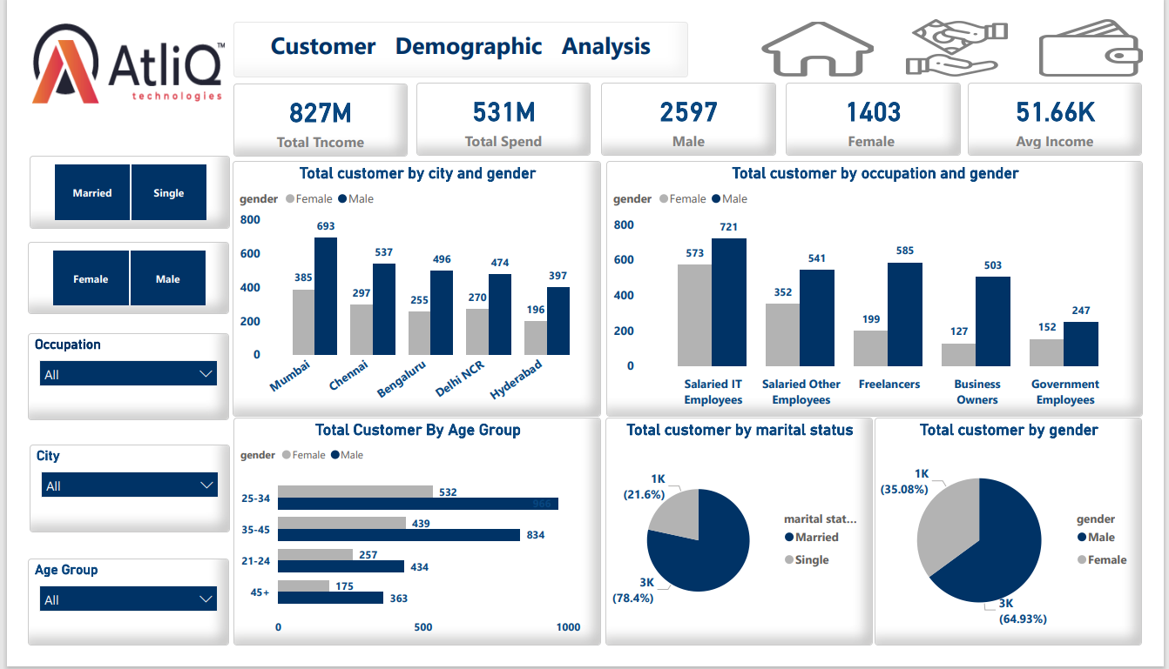

Slide 5
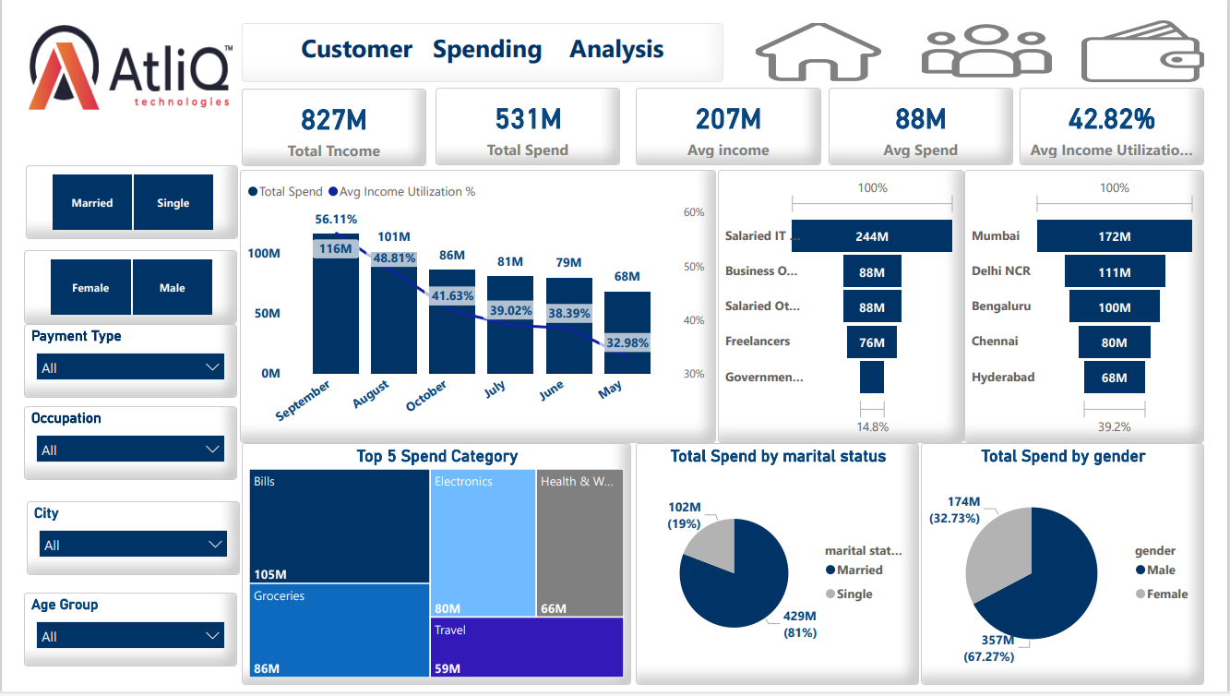

Slide 6
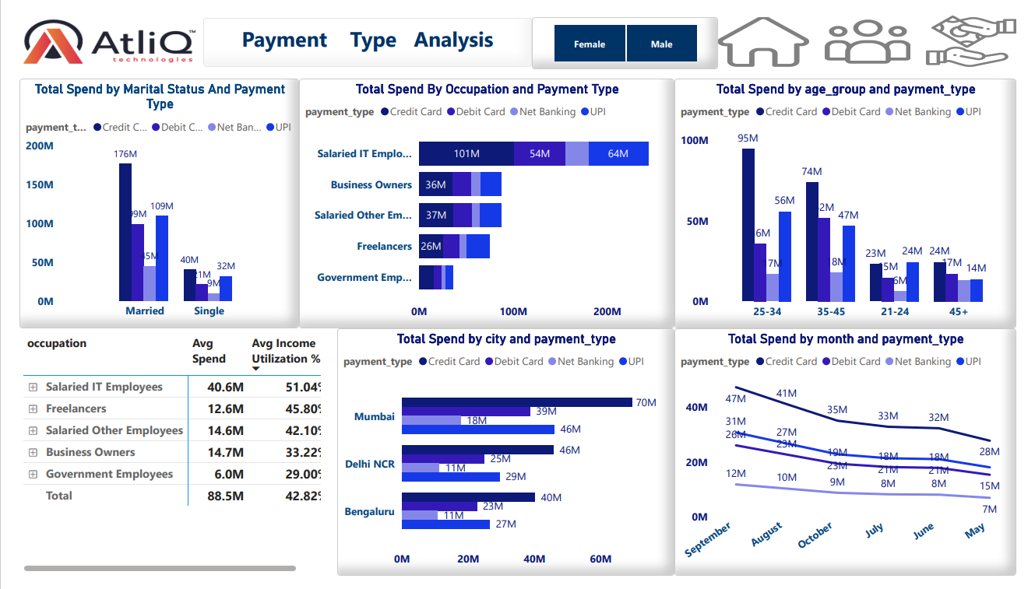

Slide 7
Insights
Demographic Analysis:
Total Customers: 4000 | Total Male: 2597 | Total Female: 1403
Most Customers are based in Mumbai (1078)
Most Customers are Salaried IT Employees (1294)
Married: 3136 (78%) | Single: 864 (22%)
Most Customers are in the Age group of 25-34: 1498 | 35-45: 1273
Income Utilization % : 42.82%
Customer Spending Analysis:
Married: 429M | Single: 102M
Most spending done in Mumbai (172M)
Most spending done in the month of September (116M)
Most spending is done for Bills Payment (105M)
Most spending is done by Salaried IT employees (244M)
Customer Spending Analysis
Married: 429M | Single: 102M
Most spending done in Mumbai (172M)
Most spending done in the month of September (116M)
Most spending is done for Bills Payment (105M)
Most income utilization % done by
Salaried IT employees 51% followed by freelancers 46%

Slide 8
Recommendation for Next Credit Card
Tailored Rewards Program:
Create a rewards program that aligns with the spending patterns of salaried IT employees, self-employed individuals, and freelancers. This could include cash back on common categories of spending such as groceries, dining, and business-related expenses.
Age Group related Program ;
offer exclusive benefits for married customers, single customers, or those in the 25-34 age group
Flexible Payment Options:
Offer flexible payment plans to accommodate different income structures. This could include customizable monthly payment options, allowing users to adjust their payment schedule based on their cash flow.
Low Annual Fees and Interest Rates:
Keep annual fees competitive and offer reasonable interest rates to attract and retain customers. Consider providing introductory offers, lower rates for loyal customers, or special promotions for specific spending categories
Collaborations with Top Spenders:
Partner with top spenders in various categories (bill payments, groceries, electronics) to provide exclusive discounts or early access to new products and services.

Slide 9
City-Specific Offers:
Introduce city-specific promotions and discounts based on the highest spending cities like Mumbai, Delhi NCR, and Bengaluru.
Collaborate with local businesses to provide unique perks for cardholders in these cities.
Occupation-Centric Features:
Design credit card features that align with the needs of the majority occupation group, such as special benefits for Salaried IT employees.
Offer targeted promotions and discounts on relevant services and products for each occupation category.
Monthly Spending Challenges:
Encourage cardholders to maximize their credit card usage by creating monthly spending challenges.
Offer bonus rewards or cashback for achieving specific spending milestones, especially during peak spending months like September.

Slide 10
Seasonal Spending Campaigns:
Launch seasonal campaigns that align with the highest spending months (e.g., September and August).
Offer additional rewards or cashback for specific categories during these periods.
Contactless and Mobile Payments:
Ensure the credit card supports contactless payments and integrates with popular mobile payment platforms. This adds convenience for users who prefer digital and contactless transactions.

