Slide 1
SOFTWARE PROJECT LAB-1
Submitted By: Asshifa Sultana
Roll: BSSE 1632
1 / 10

Slide 2
STEGOFUSION
AN INTEGRATED MULTI-ALGORITHM BASED IMAGE STEGANOGRAPHY SYSTEM
Supervised By: Dr. Emon Kumar Dey
Associate Professor · IIT, University of Dhaka
2 / 10

Slide 3
Objectives
01
02
Securely hides text data inside BMP images using multiple algorithms.
Integrates compression, error detection and LSB embedding
03
04
Uses randomized pixel selection to avoid detectable patterns.
Preserves image quality with minimum visual distortion.
05
06
To transmit the stego image securely to a receiver over a network using simple TCP socket communication.
Displays details after embedding, including modified pixel count, exports the data to CSV file.
3/ 10

Slide 4
Algorithms at a Glance
1. Huffman Compression Compresses text data before embedding to reduce size.
2. Hamming Error Correction Detects and corrects bit errors using parity bits and bitwise operations.
3. Logistic Chaotic Map Randomizes data embedding positions using iterative non linear equation.
4. LSB Embedding Hides data bits in image pixels by altering least significant bits of pixel values.
5. TCP Socket Transmission Allows to transmit the stego image directly to a receiver over a network using a simple TCP socket connection.
4 / 10

Slide 5
Workflow
EMBEDDING
Text
Huffman
Compress
Hamming
Encode
Chaotic
Map
LSB
Embed
Stego
BMP
▶
▶
▶
▶
▶
EXTRACTING
Stego
BMP
Chaotic
Map
LSB
Extract
Hamming
Decode
Huffman
Decompress
Text
▶
▶
▶
▶
▶
TRANSMISSION
Stego
BMP
TCP Socket
Send
Network
Transmit
Receiver
Accepts
Stego
Received
▶
▶
▶
▶
5 / 10

Slide 6
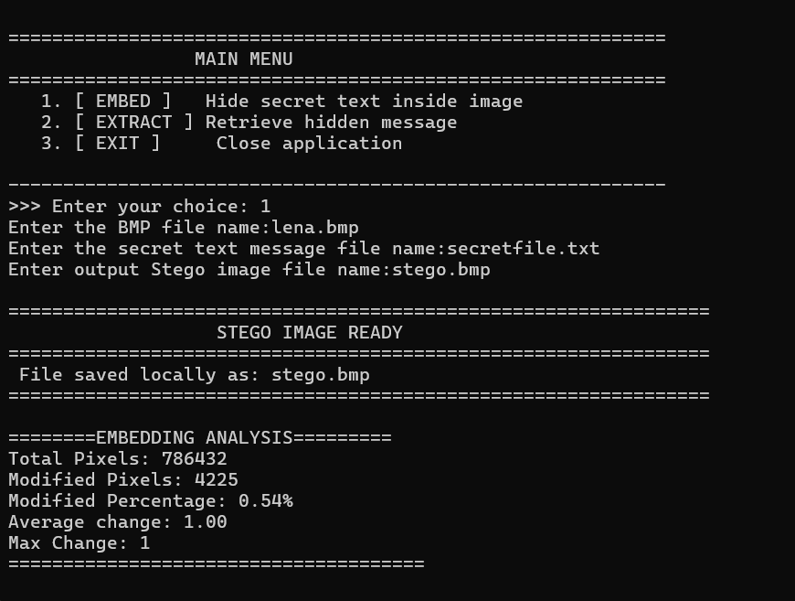
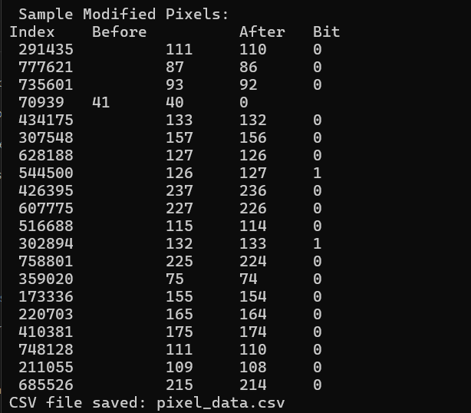
Program Output
6 / 10

Slide 7
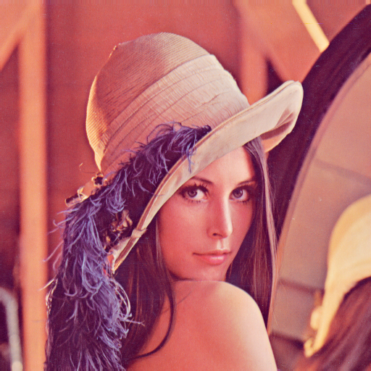

Program Output
Before
After
lena.bmp
stego.bmp
7 / 10

Slide 8
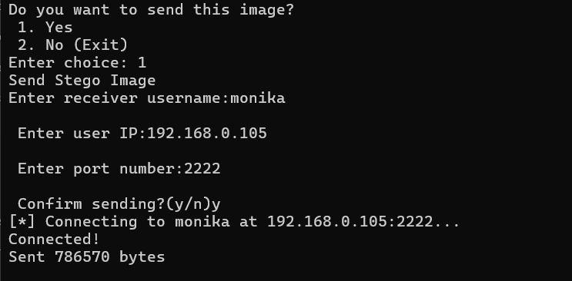
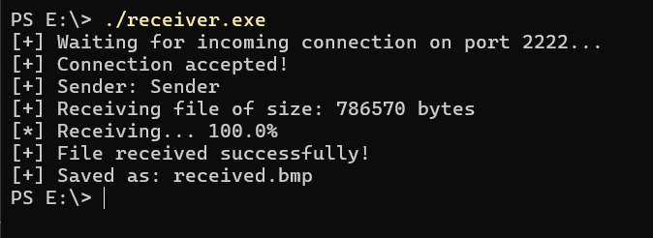
Program Output
Sender side:
Receiver side:
8 / 10

Slide 9
Limitations
1. Supports only 24-bit BMP images, excluding common formats like JPEG and PNG.
2. Hamming(7,4) can only correct single-bit errors; multiple errors in one block cause incorrect decoding.
3. Hamming overhead increases embedded bit count by 75%, reducing the effective capacity of the cover image.
4. Message size is strictly limited by image dimensions, restricting the amount of data that can be hidden.
9/ 10

Slide 10
Thank You!
Email: bsse1632@iit.du.ac.bd
GitHub: https://github.com/asshifasultana/SPL-1.git
10/ 10

