Slide 1





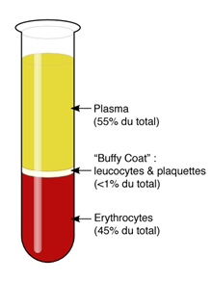
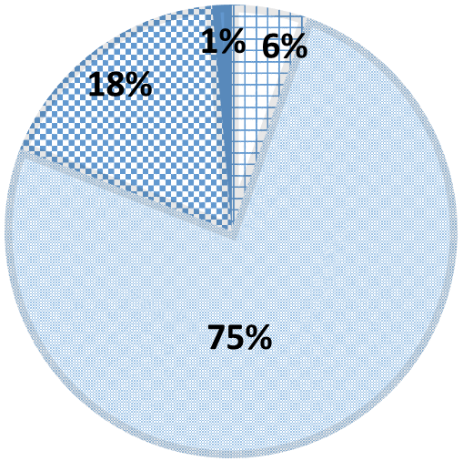
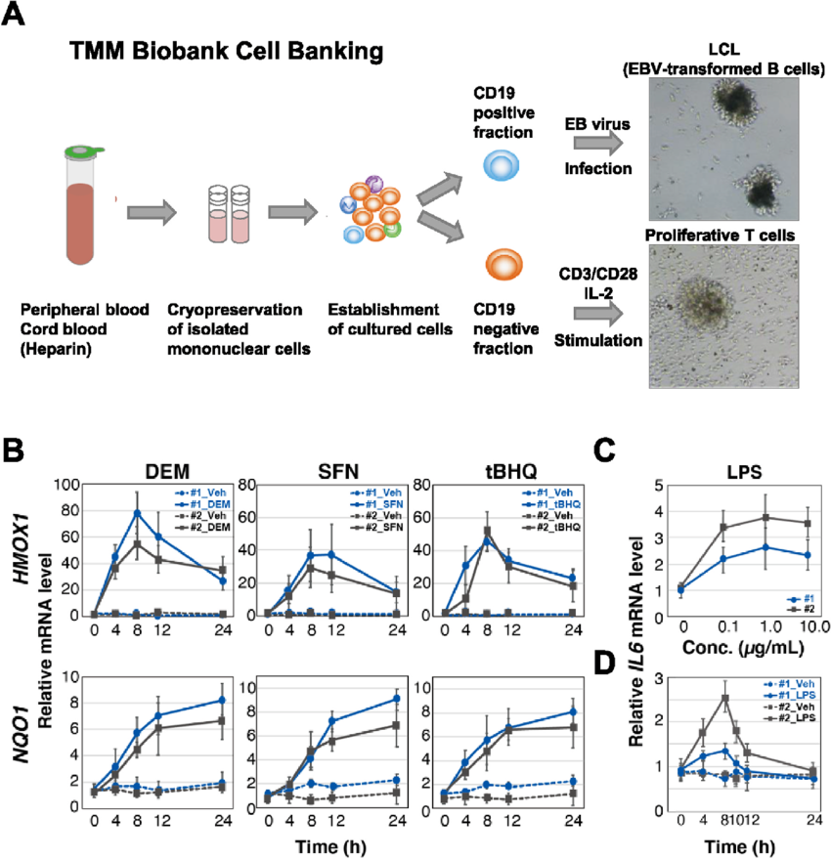
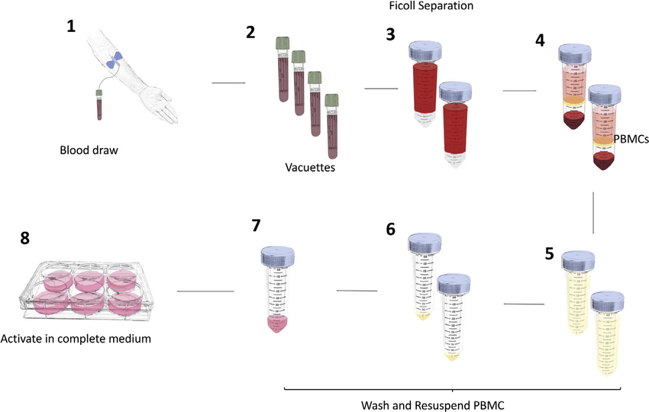
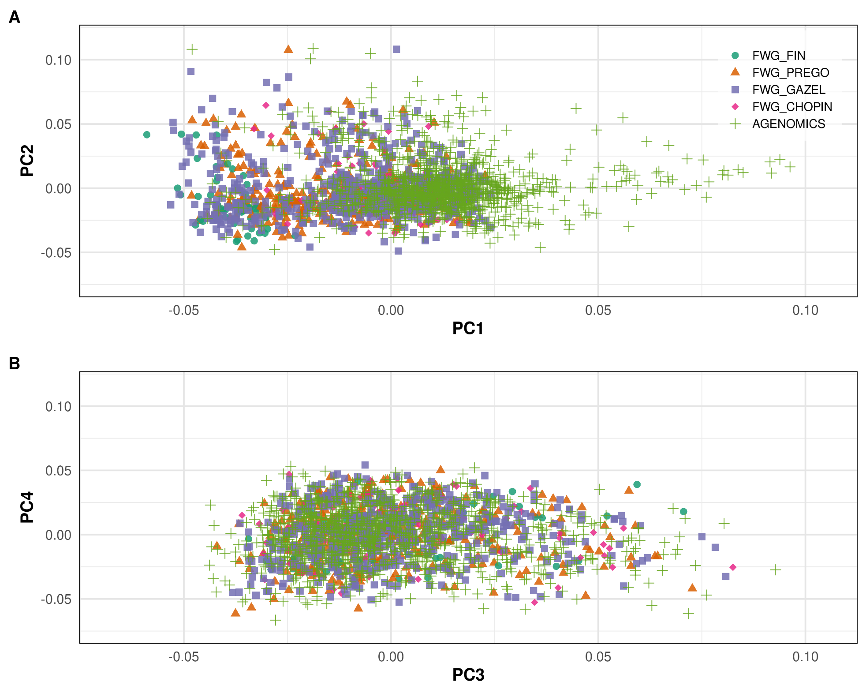
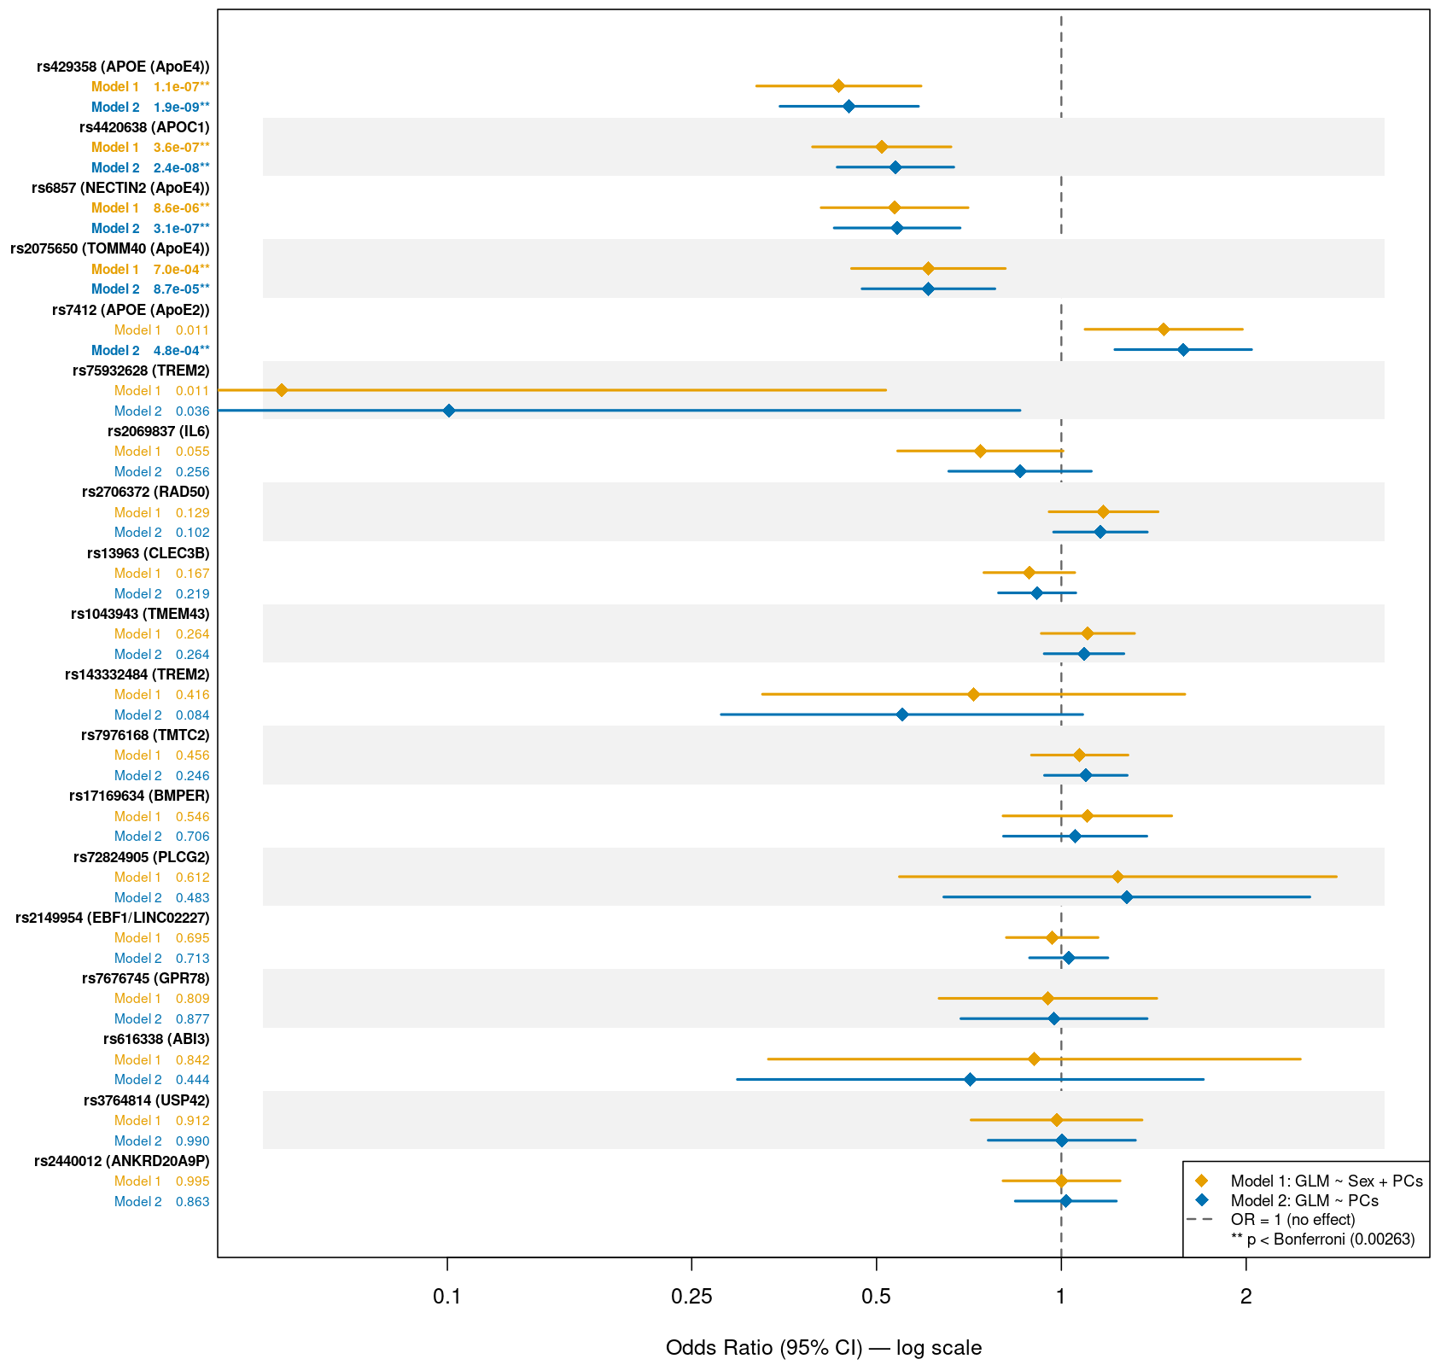


Replication of Published Longevity-Associated Variants in the French Centenarians Cohort
Assia BENMEHDIA¹, Mourad SAHBATOU², Florian SANDRON¹, Delphine BACQ-DAIAN¹, Hélène BLANCHÉ², Edith LE FLOCH¹, Alexandre HOW-KIT², Jean-François ZAGURY³, French Whole Genome Consortium, Jean-François DELEUZE^{1,2,4@} and Claire DANDINE-ROULLAND^{1@}
¹ Centre National de Recherche en Génomique Humaine (CNRGH), Institut de Biologie François Jacob, Direction de la Recherche Fondamentale, CEA, Evry, France
² Centre d’Etude du Polymorphisme Humain, Fondation Jean Dausset (CEPH), Paris, France
³ Laboratoire de Génomique, bio-informatique et chimie moléculaire, Conservatoire national des arts et métiers (CNAM), Paris, France
⁴ Centre de Référence, d’Innovation, d’expertise et de transfert (CREFIX), Evry, France
deleuze@cnrgh.fr; claire.dandine@cnrgh.fr;
Introduction
Aging is a universal and complex process driven by both genetic and environmental factors, many of which contribute to age-related diseases, making centenarians a valuable model of healthy aging and disease resistance [1]. Numerous genetic variants have been associated with exceptional longevity across various studies, cohorts, and platforms, yet their replication in independent populations remains limited. The AGENOMICS project aims to uncover the genetic determinants of exceptional longevity through whole-genome sequencing of over 1 100 French centenarians from the CEPH Chronos cohort [2]. In this context, we performed a targeted lookup of literature-reported variants associated with longevity [3] or Alzheimer's disease (AD) [4], and compared their allele frequencies with those from a FranceGenRef (FWG) control cohort [5], to assess the replicability of these associations in a French population.
Materials & Methods
Sample type
Sex
1 068 Samples
French Whole Genome cohort (FWG)
(FIN, PREGO, GAZEL, CHOPIN) [20-70] years
Buffy Coat
DNA Extraction &
Library Preparation
Variant Calling
(GATK 4.6.2.0)
AGENOMICS data from CEPH Chronos cohort
100%
Females 33% (n=351)
Whole Genome Sequencing
NovaSeq X+ (AGENOMMICS) / HiseqX (FWG)
Post-Variant Calling Quality Filtering
SSC
Nonagenarians (N) [90–99]
Centenarians (C) [100–104]
Semi-supercentenarians (SSC) [105–109]
Supercentenarians (SC) (≥110)
LCL
Males 67% (n=717)
Raw Data Quality Control
(FASTQ files)
Variant Annotation (SNPEff & gnomAD v4.1) & Descriptive statistical (Bcftools & PLINK2)
1 106 Samples
N
65%
SC
C
PBMC
Females 84% (n=928)
Alignment to Reference Genome
(GRCh38)
Lookup analysis (PLINK2)
35%
Males 16% (n=178)
AGENOMICS samples, stratified into four age groups, include 35% peripheral blood mononuclear cells (PBMCs) and 65% lymphoblastoid cell lines (LCLs), with 84% female participants. DNA was sequenced on the NovaSeq X+ platform and processed through alignment, variant calling, and quality control filtering (VQSR, gnomAD filters, complex genomic regions), retaining approximately 30 million variants that passed QC filters. Variants were annotated using SNPEff and gnomAD v4.1, and statistical analyses were performed with Bcftools 1.18 and PLINK2 [6]. These 19 literature-reported variants associated with longevity or neurodegenerative diseases was conducted by querying their allele frequencies in the dataset and comparing them against 1 068 samples from the FWG cohort (FIN, PREGO, GAZEL, CHOPIN), using a generalized logistic model (GLM) with two covariate models: PCs combined with sex (Model 1), principal components (PCs) only (Model 2).
Results
Table legend: Variant ID: SNP identifier; Chr: chromosome; AF (ALT): alternative allele frequency
Variant ID | Chr | Implicated gene | Ancestry (Study) | Genotyping method | P-value (Study) | AF (ALT) AGENOMICS | AF (ALT) FWG | AF (ALT) gnomAD
rs13963 | 3 | CLEC3B | East Asian (Japanese) | Genotyping | 1.87 × 10⁻⁸ | 0.39295 | 0.41776 | 0.43411
rs1043943 | 3 | TMEM43 | East Asian (Han Chinese) | Genotyping | 3.59 × 10⁻⁸ | 0.58762 | 0.61075 | 0.65151
rs7676745 | 4 | GPR78 | European | Imputation | 4.30 × 10⁻⁸ | 0.04652 | 0.04486 | 0.05166
rs2149954 | 5 | EBF1/LINC02227 | European | Imputation | 1.74 × 10⁻⁸ | 0.39792 | 0.40327 | 0.36291
rs2706372 | 5 | RAD50 | European | Genotyping | 5.42 × 10⁻⁸ | 0.22042 | 0.19112 | 0.32581
rs143332484 | 6 | TREM2 | Multiple cohorts | Mixed | 1.55 × 10⁻¹⁴ | 0.00903 | 0.01355 | 0.00708
rs75932628 | 6 | TREM2 | Multiple cohorts | Mixed | 5.38 × 10⁻²⁴ | 0.00090 | 0.00608 | 0.00199
rs17169634 | 7 | BMPER | East Asian (Han Chinese) | Mixed | 1.45 × 10⁻¹⁰ | 0.08943 | 0.07243 | 0.17058
rs2069837 | 7 | IL6 | East Asian (Han Chinese) | Genotyping | 4.05 × 10⁻⁸ | 0.08266 | 0.07944 | 0.09631
rs3764814 | 7 | USP42 | European | Imputation | 5 × 10⁻¹⁵ | 0.07633 | 0.08131 | 0.19174
rs7976168 | 12 | TMTC2 | European | Imputation | 4 × 10⁻⁹ | 0.33379 | 0.32290 | 0.31255
rs2440012 | 13 | ANKRD20A9P | East Asian (Han Chinese) | Genotyping | 4.89 × 10⁻⁸ | 0.18202 | 0.18879 | 0.00143
rs72824905 | 16 | PLCG2 | Multiple cohorts | Mixed | 5.38 × 10⁻¹⁰ | 0.01265 | 0.00794 | 0.00494
rs616338 | 17 | ABI3 | Multiple cohorts | Mixed | 4.56 × 10⁻¹⁰ | 0.99503 | 0.99019 | 0.99423
rs4420638 | 19 | APOC1 | European | Genotyping | 2.2 × 10⁻¹⁶ | 0.09214 | 0.15841 | 0.18007
rs7412 | 19 | APOE (APOE2) | European | Mixed | 1.7 × 10⁻¹² | 0.10614 | 0.07850 | 0.07784
rs429358 | 19 | APOE (APOE4) | European | Mixed | 1.3 × 10⁻³⁶ | 0.05601 | 0.12336 | 0.15736
rs6857 | 19 | NECTIN2 (APOE4) | European | Imputation | 2 × 10⁻²⁷ | 0.07453 | 0.13645 | 0.12608
rs2075650 | 19 | TOMM40 (APOE4) | European/ East Asian (Han Chinese) | Genotyping | 3.39 × 10⁻¹⁷ | 0.06594 | 0.11589 | 0.13214
AGENOMICS and FWG cohorts partially overlap on PC1–PC2, reflecting minor population structure and sequencing platform differences, while full overlap on PC3–PC4 confirms overall genetic similarity. European ancestry was confirmed by projection onto 1000 Genomes populations.
The table below presents 19 variants associated with longevity or AD in the literature, identified by genotyping or imputation in European and East Asian cohorts (p-values: 2×10⁻²⁷ to 5×10⁻⁸). Variants with a positive effect on lifespan are shown in green, variants with a negative effect in red; highlighted rows failed quality control and should be interpreted with caution.
The forest plot shows odds ratios (95% CI) under two models: Model 1 (GLM ~ Sex + PCs) and Model 2 (GLM ~ PCs only). Five variants reached Bonferroni significance (p < 0.00263): rs429358 (APOE4), rs4420638 (APOC1), rs6857 (NECTIN2) and rs2075650 (TOMM40) showed OR < 1 (negative effect), while rs7412 (APOE2) showed OR > 1 (positive effect).
The four variants with a negative effect replicated under both models; APOE2 replicated under Model 2 only, likely due to sex imbalance between the AGENOMICS cohort and controls. Of these five, only rs4420638, rs7412 and rs2075650 passed QC filters; rs6857 failed due to low mappability in a segmental duplication region, and rs429358 failed the Quality by depth (QD) filter.
The remaining 14 variants did not replicate, potentially due to platform differences, insufficient power, or population specificity. Notably, ANKRD20A9P, BMPER, IL6, CLEC3B and TMEM43 were originally identified in East Asian cohorts and may harbor population-specific effects.
TREM2, PLCG2 and ABI3 were not replicated for longevity per se, but their OR in our cohort are consistent with their reported AD risk effect in the literature.
Negative effect
Positive effect
Conclusion and Future Perspectives
This study demonstrates the potential of the AGENOMICS cohort for longevity research. The successful replication of three variants, rs4420638 (APOC1), rs7412 (APOE2) and rs2075650 (TOMM40/APOE4), confirms their robust association with longevity across independent cohorts. The limited replication of the remaining variants may reflect differences in genotyping platforms versus WGS, statistical approaches, and population ancestry, as several variants were originally identified in East Asian cohorts and may not generalize to the French population studied here. Future analyses should prioritize a genome-wide association study (GWAS) across all variants available in the AGENOMICS cohort, which could reveal novel longevity-associated loci and contribute to a broader understanding of the genetics of human longevity. Additionally, sex-stratified replication analyses could help clarify the observed sex-dependent effects on variant associations.
[1] Fortney K, et al. Genome-Wide Scan Informed by Age-Related Disease Identifies Loci for Exceptional Human Longevity. PLOS Genet. 2015;11:e1005728.
[2] How-Kit A, et al. The CEPH aging cohort and biobank: a valuable collection of biological samples from exceptionally long-lived French individuals and their offspring for longevity studies. GeroScience 2023;46:2681‑95
[3] Smulders L, Deelen J. Genetics of human longevity: From variants to genes to pathways. J Intern Med. 2024. doi: 10.1111/joim.13740
[4] Sims R, et al. Rare coding variants in PLCG2, ABI3 and TREM2 implicate microglial-mediated innate immunity in Alzheimer's disease. Nat Genet. 2017;49(9):1373–1384. doi: 10.1038/ng.3916
[5] Alves I, Giemza J, Blum MGB, et al. Human genetic structure in Northwest France provides new insights into West European historical demography. Nat Commun. 2024;15:6782. doi: 10.1038/s41467-024-51087-1
[6] Chang CC, Chow CC, Tellier LC, Vattikuti S, Purcell SM, Lee JJ. Second-generation PLINK: rising to the challenge of larger and richer datasets. GigaScience. 2015;4:7. doi: 10.1186/s13742-015-0047-8

