Slide 1
Privacy-Preserving Machine Learning Lab
Lecturer: Dr. Adi Akavia
Assia Khateeb 206217028
Reem Younis 208593970
Atheer Abo Foul 314642273
Aya Miari 313426322
Our github repository:
https://github.com/assiakhateeb/PPML_lab

Slide 2
Abstract
In this project we present a solution to the problem of data leakage in cloud computing: the fully homomorphic encryption scheme.
Such a scheme need never decrypt its inputs, hence it can be run by an untrusted party without revealing its internal state, which, in turn, enables secure outsourced computation.

Slide 3
Index
Part A : Computing on cleartext data
Part B: Implementation of Algorithm 1
Part C : Computing on encrypted data
Part D: Neural Networks

Slide 4
Part A : Computing on cleartext data

Slide 5
Abstract :
In part A we Implements cleartext decision tree prediction.
In machine learning, the decision tree is an algorithm for supervised learning for classification. The algorithm allows for learning, in that it processes elements in the training set one at a time.
We implement decision tree algorithm on clear-text dataset. Then, we test accuracy of our decision tree algorithm classification results.

Slide 6

Decision Tree:
Represents a procedure for classification of data based on attributes.
Structure:
An internal node represents a ‘test’ on an attribute.
A branch represents the outcome of the test.
A leaf represents a class label.
The path from root to leaf represents classification rules of the current label at leaf.
The general motive of using Decision tree is to practice it.

Slide 7
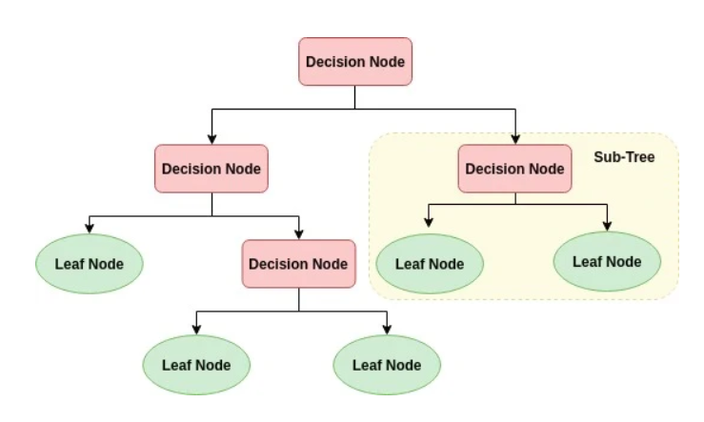
Illustrating a decision tree :

Slide 8
Assumptions on the Decision Tree:
At the beginning, we consider the whole training set as the root.
Attributes are assumed to be categorical for information gain and for gini index, attributes are assumed to be continuous.
On the basis of attribute values records are distributed recursively.
We use statistical methods for ordering attributes as root or internal node.

Slide 9
Attribute Selection Measure (ASM)
ASM is a heuristic for selecting the splitting criterion that partitions data in the best possible manner. It provides a rank to each attribute. Best score attribute will be selected as a splitting attribute.
Most popular selection measures are Information Gain, Gain Ratio, and Gini Index.

Slide 10
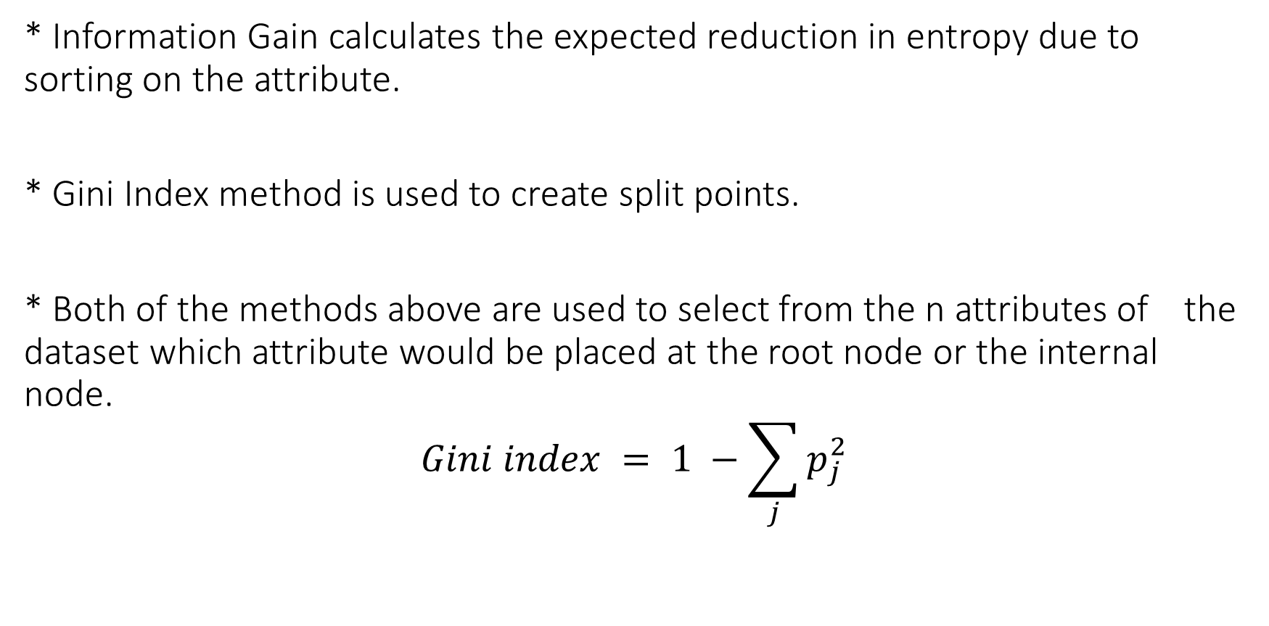
* Information Gain calculates the expected reduction in entropy due to sorting on the attribute.
* Gini Index method is used to create split points.
* Both of the methods above are used to select from the n attributes of the dataset which attribute would be placed at the root node or the internal node.
$$Gini index = 1 −\sum_{j}{p_{j}^{2}}$$

Slide 11

Entropy
Entropy is the measure of uncertainty of a random variable, The higher the entropy the more the information content.
The entropy can explicitly be written as:
$$H(X) = \sum_{n=1}^{N}{p\left(x_{i}\right)\log_{2}p(x_{i})}$$

Slide 12
Algorithm
1. Select the best attribute using Attribute Selection Measures(ASM) to split the records.
2. Make that attribute a decision node and split the dataset into smaller subsets.
3. Start building the tree by repeating this process recursively for each child until one of the condition will match:
* All the tuples belong to the same attribute value.
There are no more remaining attributes.

Slide 13
Pruning Strategy
Prune each node one by one (except the root and the leaf nodes).
Check wither pruning helps in increasing the accuracy or not:
If the accuracy increases, prune the node which gives the maximum accuracy at the end to construct the final tree.
If the accuracy is 100%, stop the algorithm right there and do not check for further new nodes.

Slide 14
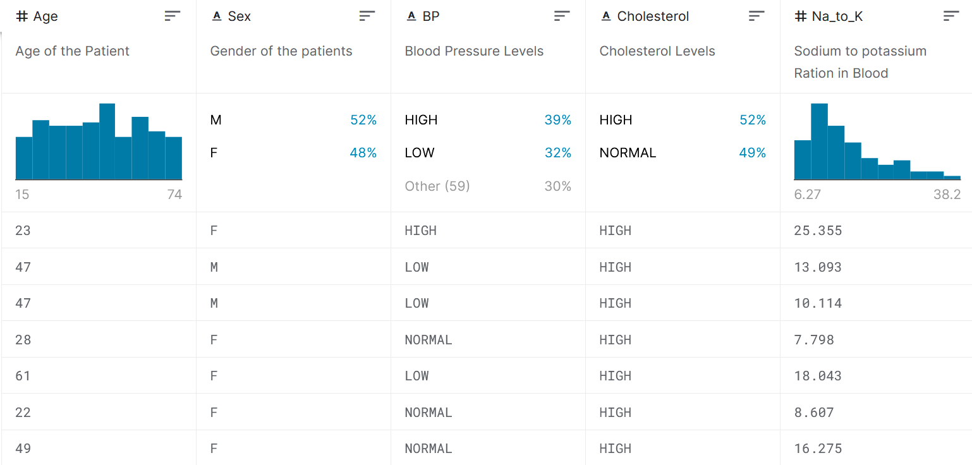
Dataset
Drug :
The dataset contains various information that effect the predictions like Age, Sex, BP, Cholesterol levels, Na to Potassium Ratio and finally the drug type.

Slide 15

Results:
Accuracy before pruning: 97.0%
Accuracy after pruning: 97.0%

Slide 16
Part B: Decision tree prediction via FHE-friendly Algorithms

Slide 17
Abstract
In part B we implement cleartext soft decision tree prediction algorithm specified in Akavia et al ECML’2020.

Slide 18
Pre-Processing
Scale the data.
prepare the polynom required for Algorithm 1.
build a tree with 1-hot encoding labels.
We predict on set of samples using Algorithm 1.
Then, we present the main results of Algorithm 1 and compare it to scikit learn results.

Slide 19

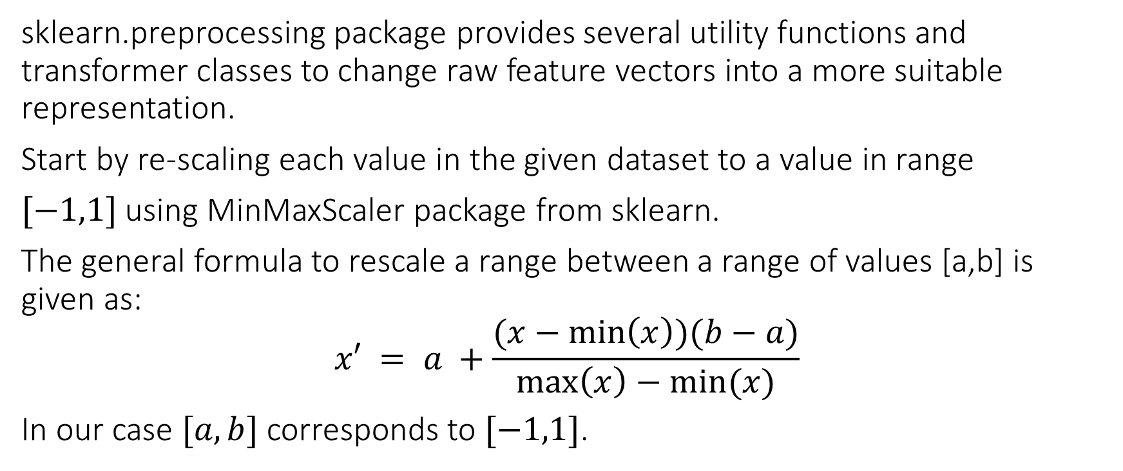
Scaling
sklearn.preprocessing package provides several utility functions and transformer classes to change raw feature vectors into a more suitable representation.
Start by re-scaling each value in the given dataset to a value in range
$[−1,1]$using MinMaxScaler package from sklearn.
The general formula to rescale a range between a range of values [a,b] is given as:
$$x′ = a +\frac{(x−\min\left(x\right))(b−a)}{\max\left(x\right)−min⁡(x)}$$
In our case $[a,b]$corresponds to $[−1,1]$.
Notes:
// insert the formula

Slide 20
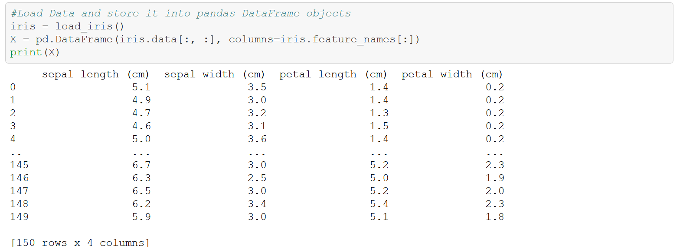
Data before scaling

Slide 21
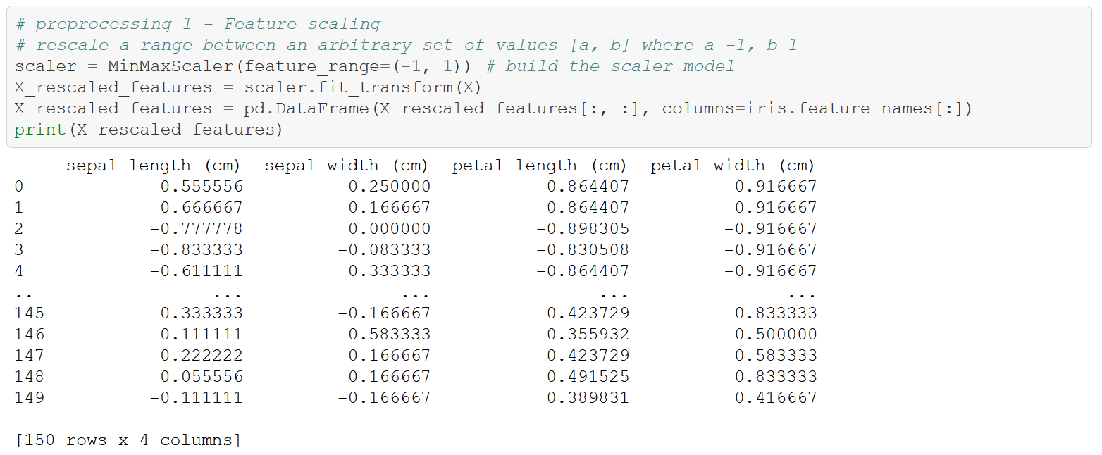
Data after scaling

Slide 22
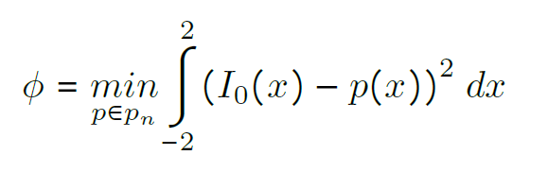
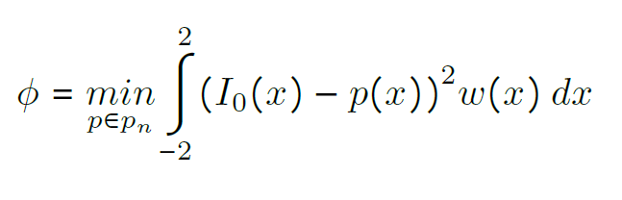
Polynom
Construct a low-degree polynomial approximation in order to approximate the step function, aiming to replace it with a soft step function.
This is done by using mean square integral.
Then, add an importance to weight of the approximation interval in order to maintain the sensitivity to error in the approximation.

Slide 23

Algorithm 1
def Tree_Predict(T, x, phi):
if T is None:
return
feature, threshold, leaf, left, right = T.getNode()
if isinstance(leaf, np.ndarray):
return leaf
else:
return (phi(x[feature] - threshold)) * Tree_Predict(right, x, phi) +
+ (phi(threshold - x[feature])) * Tree_Predict(left, x, phi)

Slide 24

Explaining the algorithm 1
Akavia's algorithm traverses all paths in the tree and computes a weighted combination of all the leaves values, where each leaf value is the 1-hot encoding of the label associated with the leaf.
The output is a length L vector assigning a likelihood score to each label, which is in turn interpreted as outputting the label with the highest score.

Slide 25
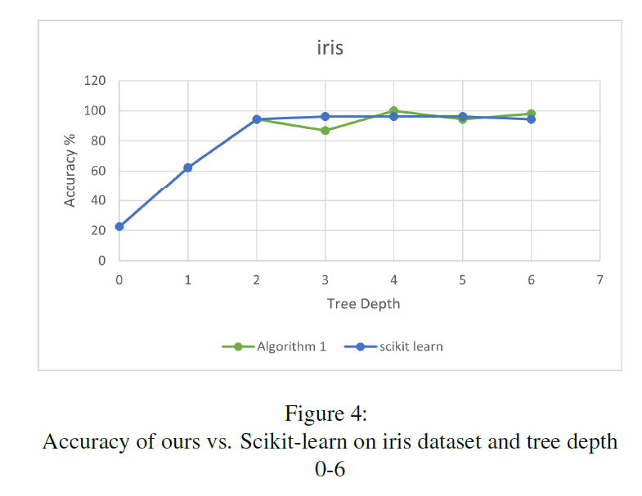
Accuracy
The accuracy is calculated as the percentage of correct classification on test samples.
$$algorithm1_score = (counter / len(res_vec))∗100$$

Slide 26
Explaining how we calculate the accuracy
Counter is equal to the sum of correct classifications and res_vec is equal to the sum of all classifications.
To know if current classification is correct or not we compare it to Y target value of the relevant sample if they are eqaul then the prediction of algorithm 1 is correct.
test samples are sent to algorithm 1 as 35% of the samples in the dataset and they are chosen randomly from the data-set.
test samples are assigned to variable X_test.
So algorithm 1 predicts over all test samples, after that we calculate accuracy according to the percentage of correct predictions on test samples that algorithm 1 predict.

Slide 27
Datasets
We trained trees up to depth 6 and compare algorithm 1 prediction's accuracy vs. scikit learn prediction's accuracy for three data sets: iris, wine and cancer.

Slide 28
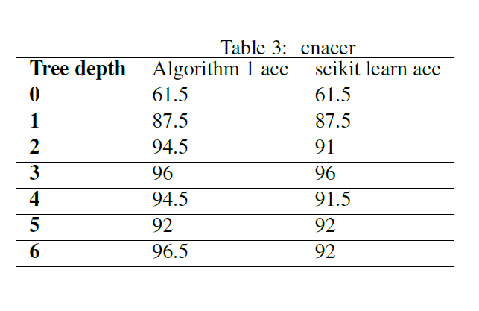
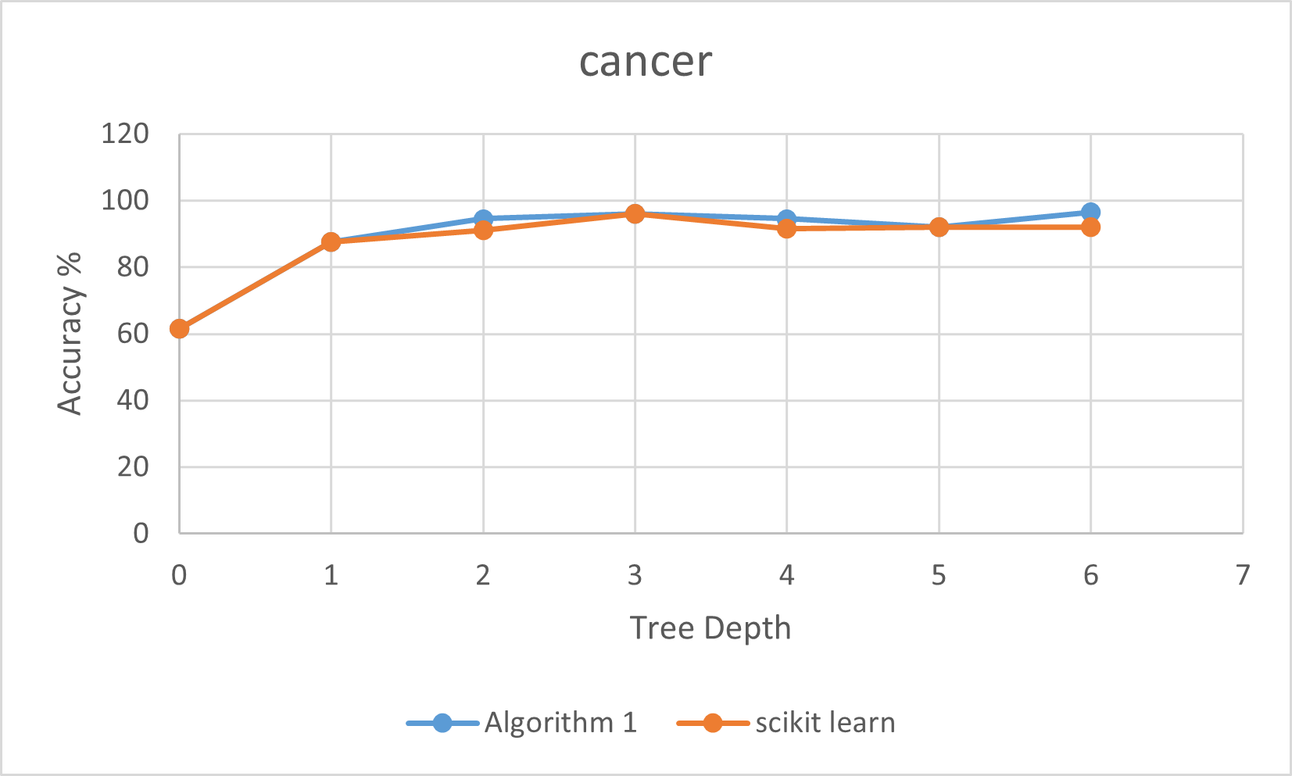
Results on Cancer dataset

Slide 29
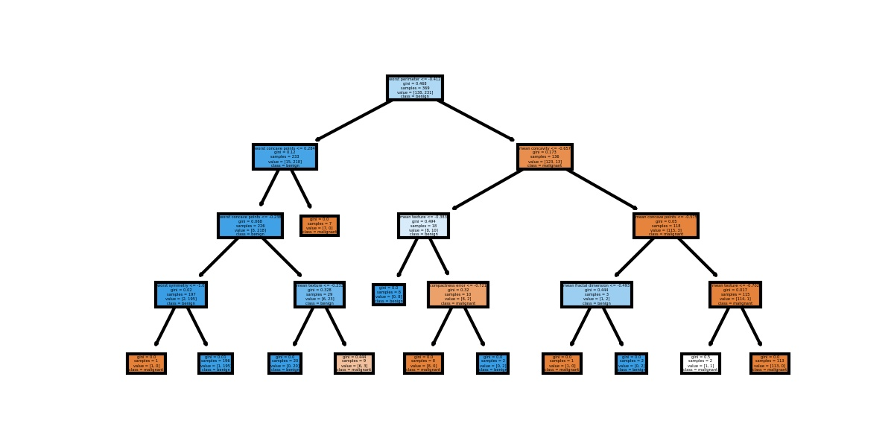
Cancer Tree :

Slide 30
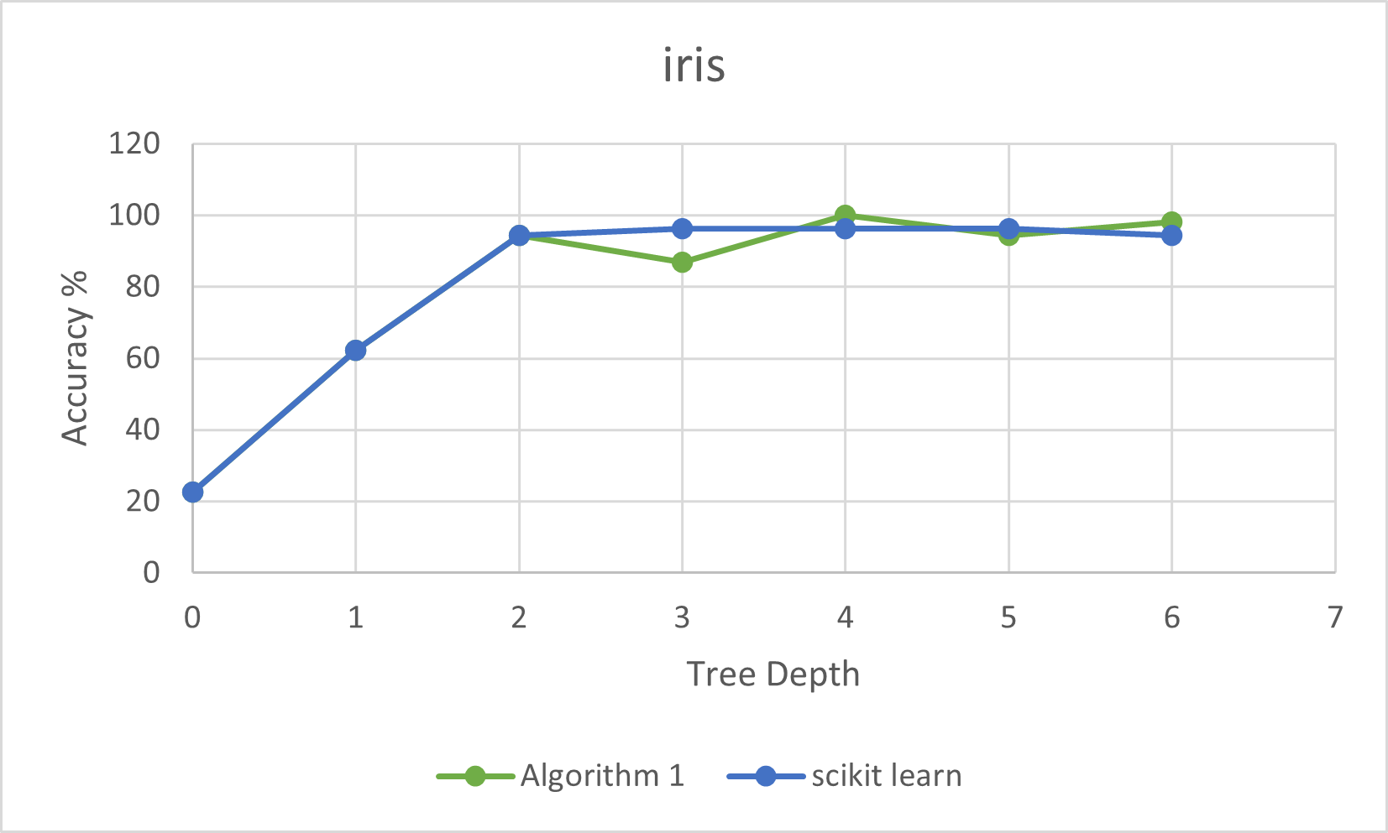
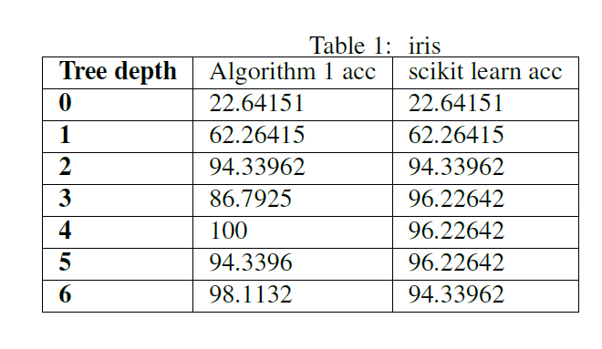
Results on Iris dataset

Slide 31
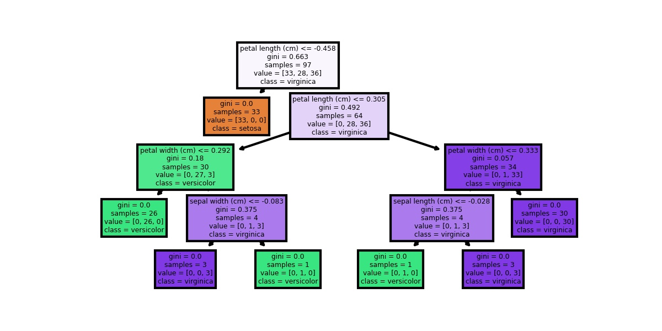
Iris Tree :

Slide 32
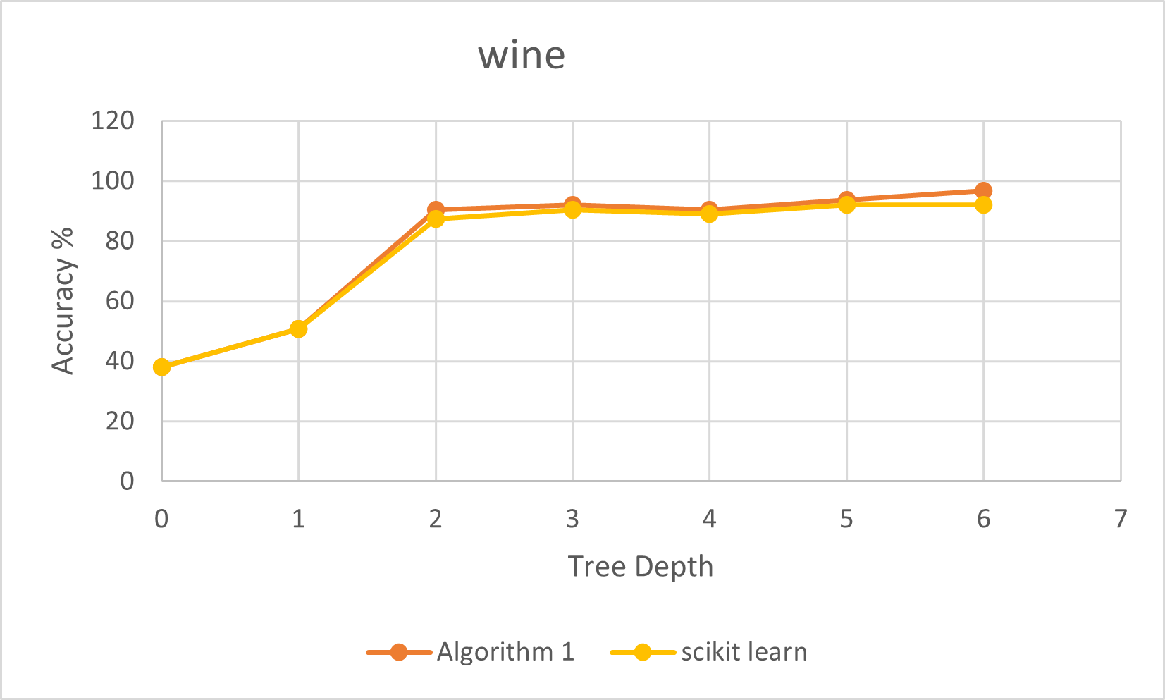
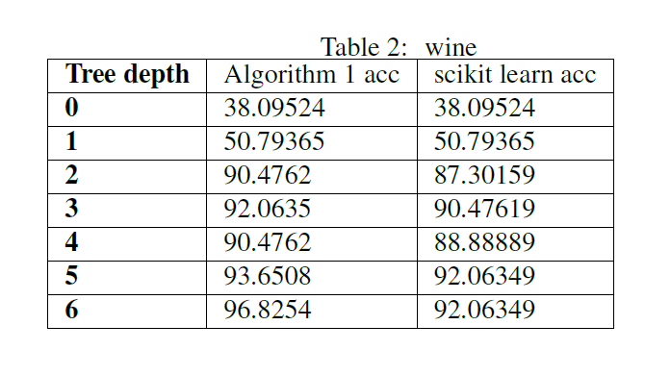
Results on Wine dataset

Slide 33
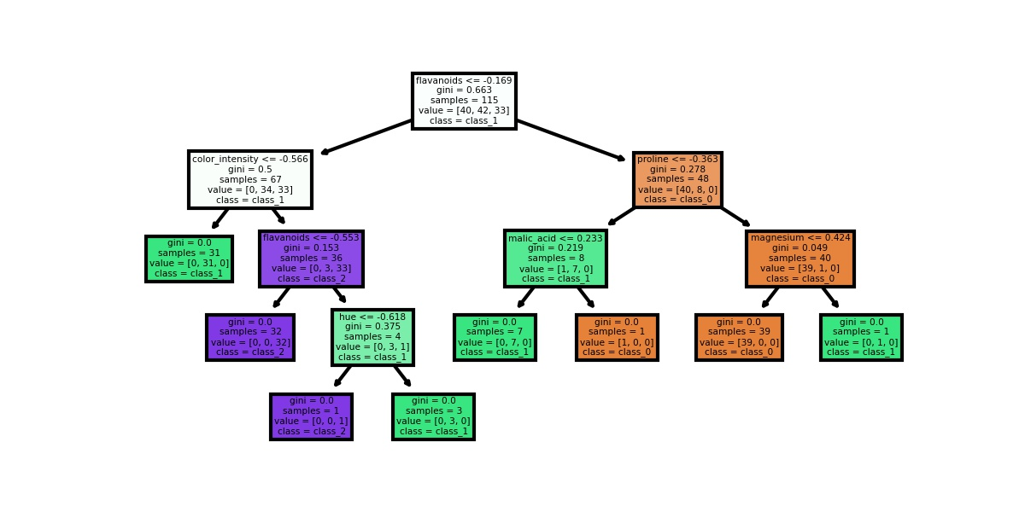
Wine Tree :

Slide 34

Conclusions
The greater the tree’s depth, the more branches it has, the higher the score.
For all the windows we got the same accuracy results. The difference was in the running time: the greater the window, the higher the runtime.
The higher the polynom’s degree, the higher the score for Algorithm 1.
The average polynomial degree that gave us the best score is 15.
We can observe that our score results are similar to scikit-learn results

Slide 35
Part C
Computing on encrypted data via FHE-friendly algorithm
!

Slide 36
Abstract:
In part C of the project we used secure protocols for prediction and training of tree based models where the data for prediction is encrypted with FHE.
Part C is an extension to prediction on encrypted data. We implement the prediction by using an adjustment of Algorithm 1.
The protocols that we used are an adaptation of the algorithms in part B but with interactive settings where data is encrypted throughout the computation.

Slide 37

FHE - Fully Homomorphic Encryption
Homomorphic Encryption provides the ability to compute on encrypted data.
These resulting computations are left in an encrypted form which, when decrypted, result in an identical output to that produced had the operations been performed on the 'original' data.

Slide 38

CKKS Scheme
CKKS scheme supports efficient rounding operations in encrypted state. The rounding operation controls noise increase in encrypted multiplication, which reduces the number of bootstrapping in a circuit.
An important characteristic of CKKS scheme that encrypts approximate values rather than exact values. When computers store real-valued data, they remember approximate values with long significant bits, not real values exactly.

Slide 39
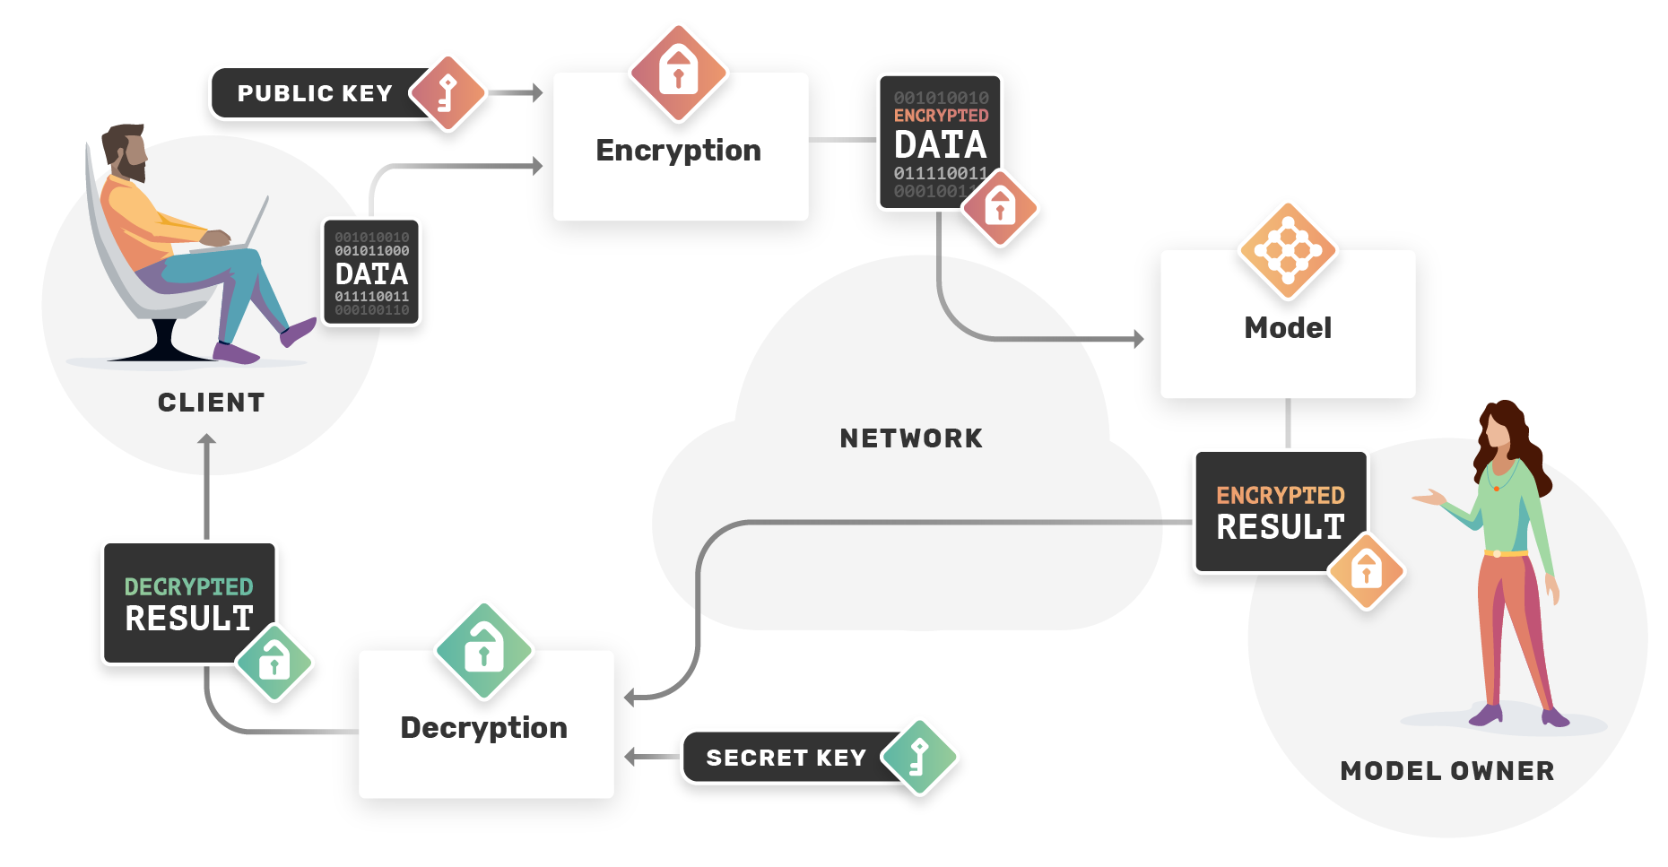
CKKS scheme is constructed to deal efficiently with the errors arising from the approximations.
The scheme is familiar to machine learning which has inherent noises in its structure.

Slide 40
TenSeal
TenSEAL is a library for homomorphic encrypting operations on tensors, built on top of Microsoft SEAL. It provides ease of use through a Python API, while preserving efficiency by implementing most of its operations using C++.
public_keys
is actually a TenSEAL Context object, a special object in TenSEAL that can hold multiple keys other than the public-key, namely the relinearization and galois keys which are public as well and serve other purposes than encrypting tensors, only the secret-key can be used to decrypt tensors.

Slide 41
Algorithm to predict over encrypted data
Akavia's algorithm traverses all paths in the tree and computes a weighted combination of all the leaves values, where each leaf value is the 1-hot encoding of the label associated with the leaf.
The output is a length L vector assigning a likelihood score to each label, which is in turn interpreted as outputting the label with the highest score.
we used polyval which is a polynomial evaluation with an encrypted tensor as variable.

Slide 42
Accuracy
The accuracy is calculated as the percentage of correct classification on test samples
We got Prediction accuracy = 93.33 %
Dataset is Iris,
Max depth : 4,
Polynom degree: 8 ,
Test size : 30 samples which is 0.2 of the data

Slide 43
We got Prediction accuracy = 88.88 %
Dataset is Cancer,
Max depth : 4,
Polynom degree: 8 ,
Test size : 36 samples which is 0.2 of the data

Slide 44
Conclusions
We got high accuracy for prediction with datasets that is encrypted with fully homomorphic encryption, in comparison to standard algorithms on cleartext data.
Prediction is slower (minutes to hours). But,the protocols we used support real-life enterprise use-cases.

Slide 45
Part D: Prediction with NN

Slide 46
Abstract:
In part D we implement the prediction of iris species using perceptron neural networks trained on the Iris data set.
ARCHITECTURE:
The main architecture of the neural networks are based on a single-layer perceptron and a multi-layer perceptron.
Each network was trained using the categorical cross entropy loss function.

Slide 47
Perceptron
In machine learning, the perceptron is an algorithm for supervised learning of binary classifiers. A binary classifier is a function which can decide whether or not an input, represented by a vector of numbers, belongs to some specific class.
It is a type of linear classifier, i.e. a classification algorithm that makes its predictions based on a linear predictor function combining a set of weights with the feature vector.

Slide 48
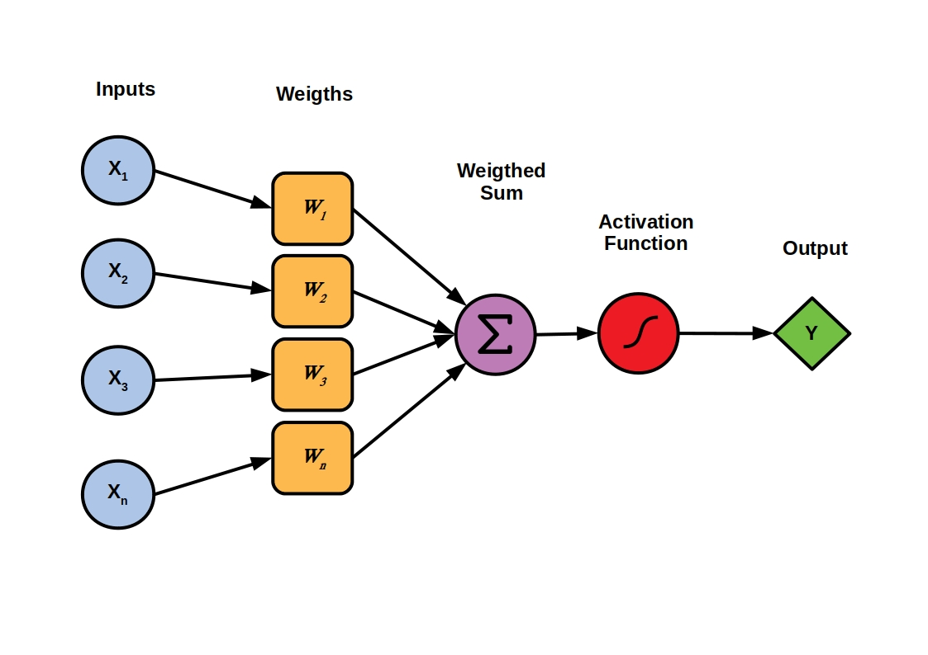
The following figure shows this learning process schematically

Slide 49
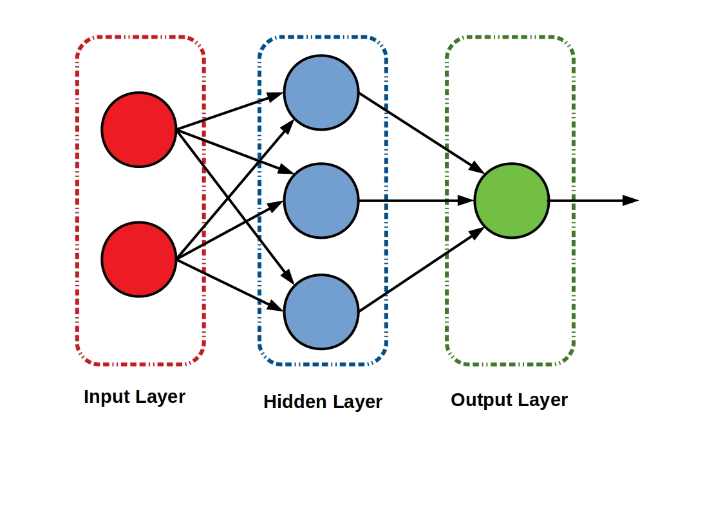
Multilayer Perceptrons (MLP)
A multilayer perceptron corresponds to what is known as a neural network. Perceptrons thus form the neuronal base, which are interconnected in different layers.
The figure shows a simple three-layer MLP.
Each line here represents a different output.

Slide 50
Results on Iris dataset:
Naive Accuracy: 66.666%
Better Accuracy: 93.333%
the multi-layer perceptron performed much better than the single-layer perceptron.
The accuracy for the single-layer perceptron and multi-layer perceptron was 66.666% and 93.333%, respectively.

Slide 51
It can easily be stated that the hidden layers and preprocessing of data allowed the multi-layer perceptron to much better learn the data.
The 2 hidden layers allowed the multi-layer perceptron to learn higher abstract features about the Iris data set and thus produced a higher accuracy. Furthermore, the data scaling and batch normalization increased the network’s learning rate.

Slide 52

Platforms
Jupyter lab
Pycharm, Python 3.9
overleaf.com
excel

Slide 53
Thank you !

