Slide 1
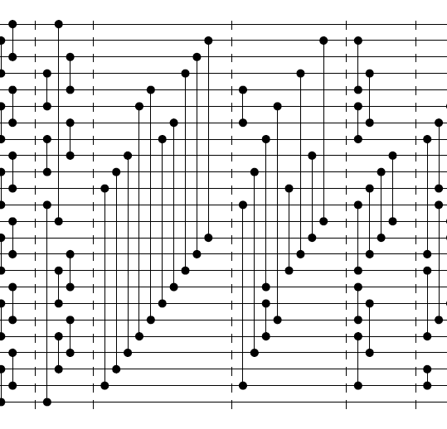
Merging almost sorted sequences yields a 24 sorter

Slide 2

Thorsten Ehlers
University of Kiel, Germany

Slide 3
TABLE OF CONTENT
1
Oblivious and non- oblivious algorithms
4
MISSION
Refers to a good or service being offered by a company ideally a product
Refers to a good or service being offered by a company ideally a product
2
WELCOME MESSAGE
5
VISION
Refers to a good or service being offered by a company ideally a product
Refers to a good or service being offered by a company ideally a product
3
MEET THE CEO
6
SERVICES
Refers to a good or service being offered by a company ideally a product
Refers to a good or service being offered by a company ideally a product

Slide 4
What are sorting networks?
Algorithms for sorting numbers (or anything else that can be ordered)
Any given sorting network only works on a fixed size input.

Slide 5
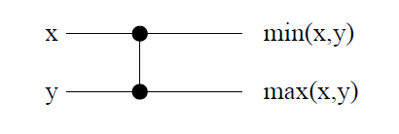
Comparator:

Slide 6
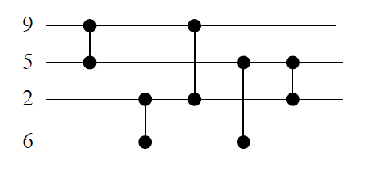
Example:
2
2
5
9
6
5
5
5
6
6
2
9
9
6

Slide 7
Sorting network is an oblivious sorting Algorithm:
Definition: an oblivious sort algorithm always makes the same comparisons, regardless of the input.

Slide 8
Oblivious sort algorithm is useful for external sorts, since there is a fixed I/O schedule, or parallel algorithms. Example for oblivious algorithm is Bitonic sort.

Slide 9
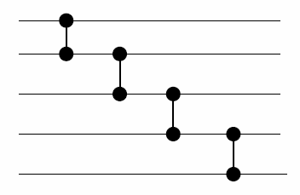
Time complexity of sorting network = depth which equals the time to produce all output values = number of layers

Slide 10
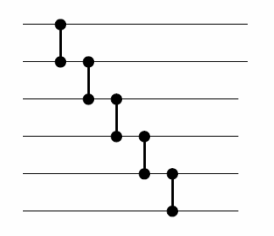
Size of network = number of comparators (5 in our example).
Space complexity = size of network

Slide 11
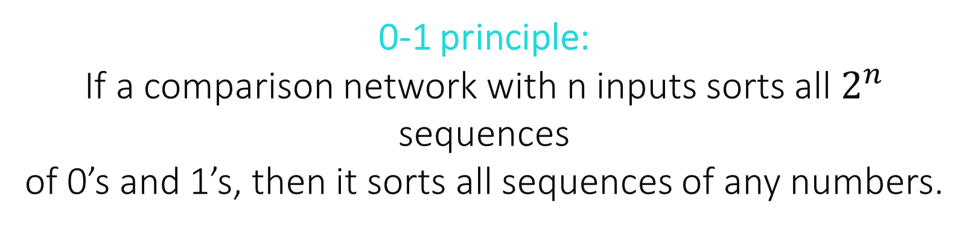
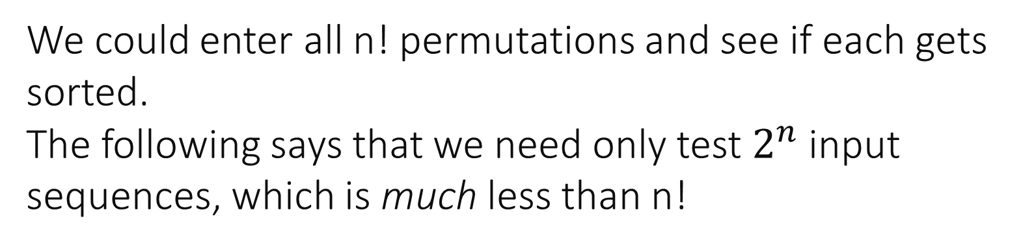
How to test a network for correctness?
We could enter all n! permutations and see if each gets sorted.
The following says that we need only test $2^{n}$ input sequences, which is much less than n!
0-1 principle:
If a comparison network with n inputs sorts all $2^{n}$ sequences
of 0’s and 1’s, then it sorts all sequences of any numbers.

Slide 12
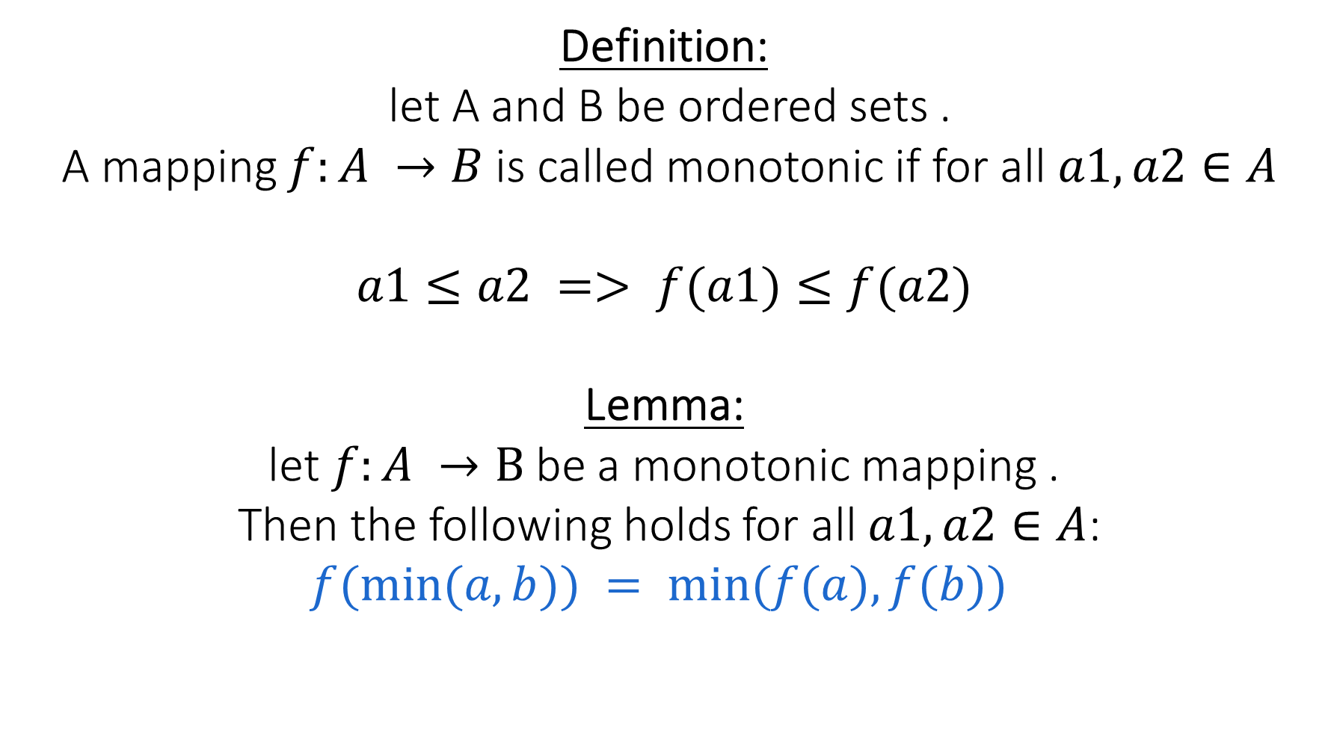
Proof:
Definition:
let A and B be ordered sets .
A mapping $f:A →B$is called monotonic if for all $a1,a2∈A$
$$a1≤a2 => f(a1)≤f(a2)$$
Lemma:
let $f:A →B$be a monotonic mapping .
Then the following holds for all $a1,a2∈A$:
$$f(min⁡(a,b)) = min⁡(f(a),f(b))$$

Slide 13
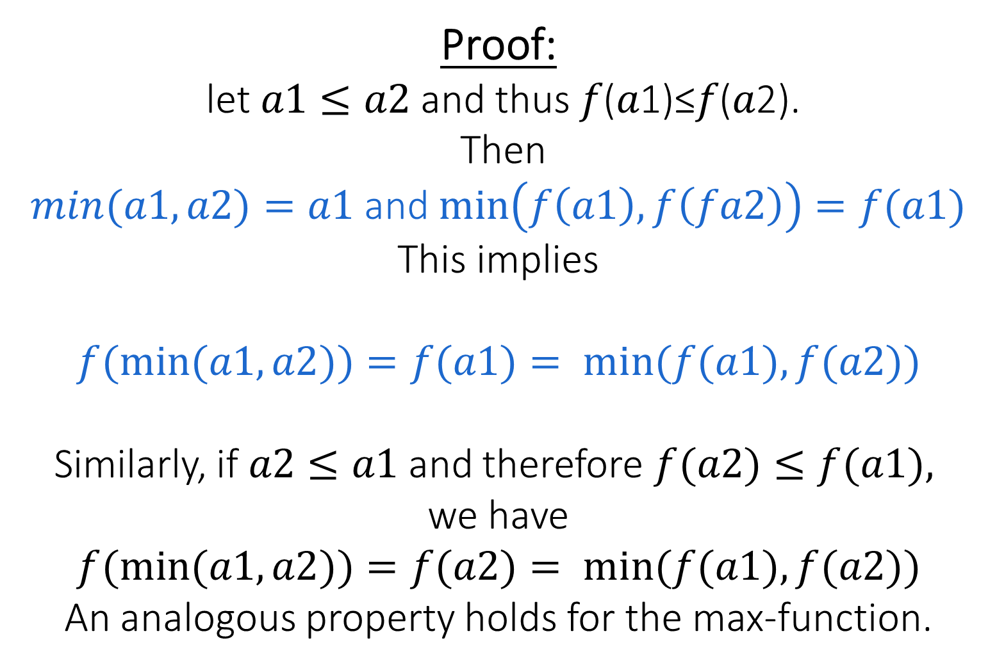
Proof:
let $a1≤a2$and thus 𝑓(𝑎1)≤𝑓(𝑎2).
Then
$min(a1,a2)=a1$and $\min\left(f\left(a1\right),f\left(fa2\right)\right)=f(a1)$
This implies
$$f(min⁡(a1,a2))=f(a1)= min⁡(f(a1),f(a2))$$
Similarly, if $a2≤a1$and therefore $f(a2)≤f(a1),$ we have
$$f(min⁡(a1,a2))=f(a2)= min⁡(f(a1),f(a2))$$
An analogous property holds for the max-function.

Slide 14
Lemma:
If the network maps input <a1, a2, . . . , an> into output
<b1, b2, . . . , bn>, then it maps <f(a1), f(a2), . . . f(an)> into
<f(b1), f(b2), . . . f(bn)>
Proof:
By induction on the number of comparisons using:
f(min(a,b)) = min(f(a),f(b))
f(max(a,b)) = max(f(a),f(b))

Slide 15
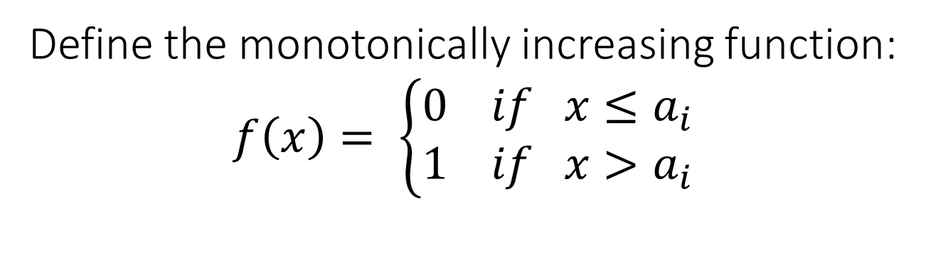
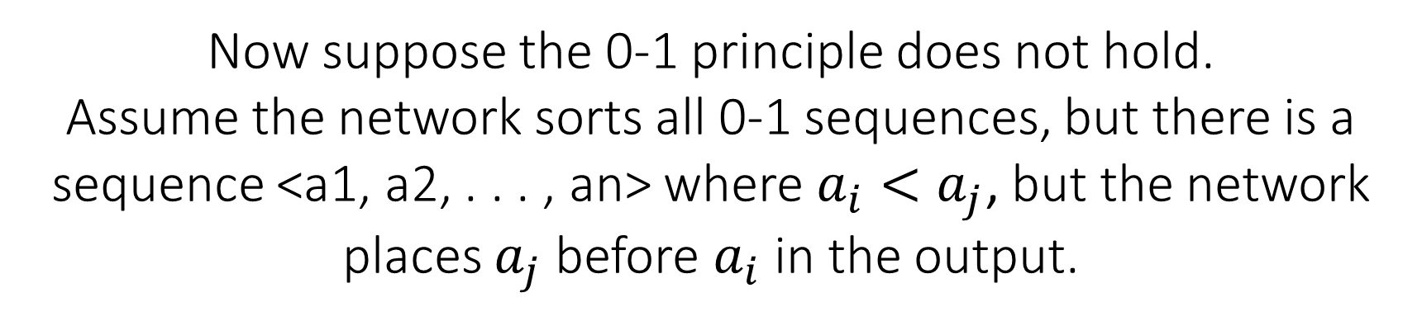
Now suppose the 0-1 principle does not hold.
Assume the network sorts all 0-1 sequences, but there is a sequence <a1, a2, . . . , an> where $a_{i}<a_{j}$, but the network places $a_{j}$ before $a_{i}$ in the output.
Define the monotonically increasing function:
$$f\left(x\right)= \left\{\begin{aligned}0 if x≤a_{i} \\ 1 if x>a_{i}\end{aligned}\right.$$

Slide 16
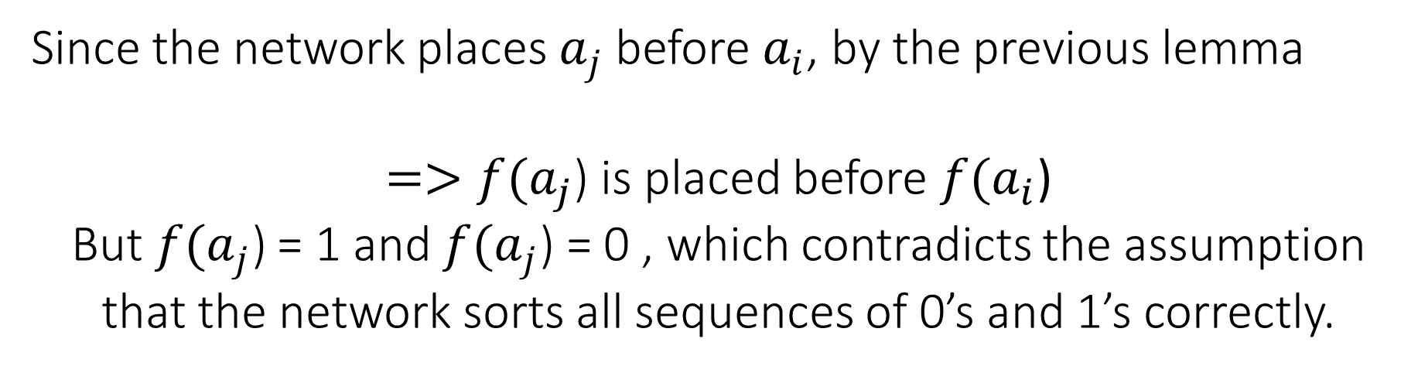
Since the network places $a_{j}$ before $a_{i}$, by the previous lemma
$=>f(a_{j}$) is placed before $f(a_{i}$)
But$f(a_{j}\text{)}$ = 1 and $f(a_{j}\text{)}$ = 0 , which contradicts the assumption that the network sorts all sequences of 0’s and 1’s correctly.

Slide 17
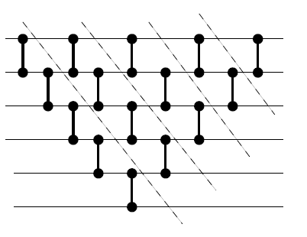
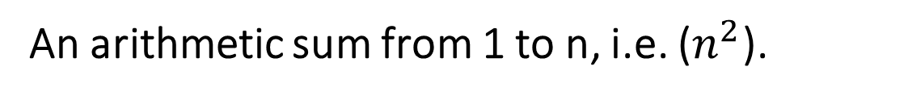
Selection Sort
This Block produces max of n inputs
Sort by recursively finding max, the max of the rest, and so on. Add one building block at a time:
What is the depth of the network?
An arithmetic sum from 1 to n, i.e. ($n^{2}$).

Slide 18
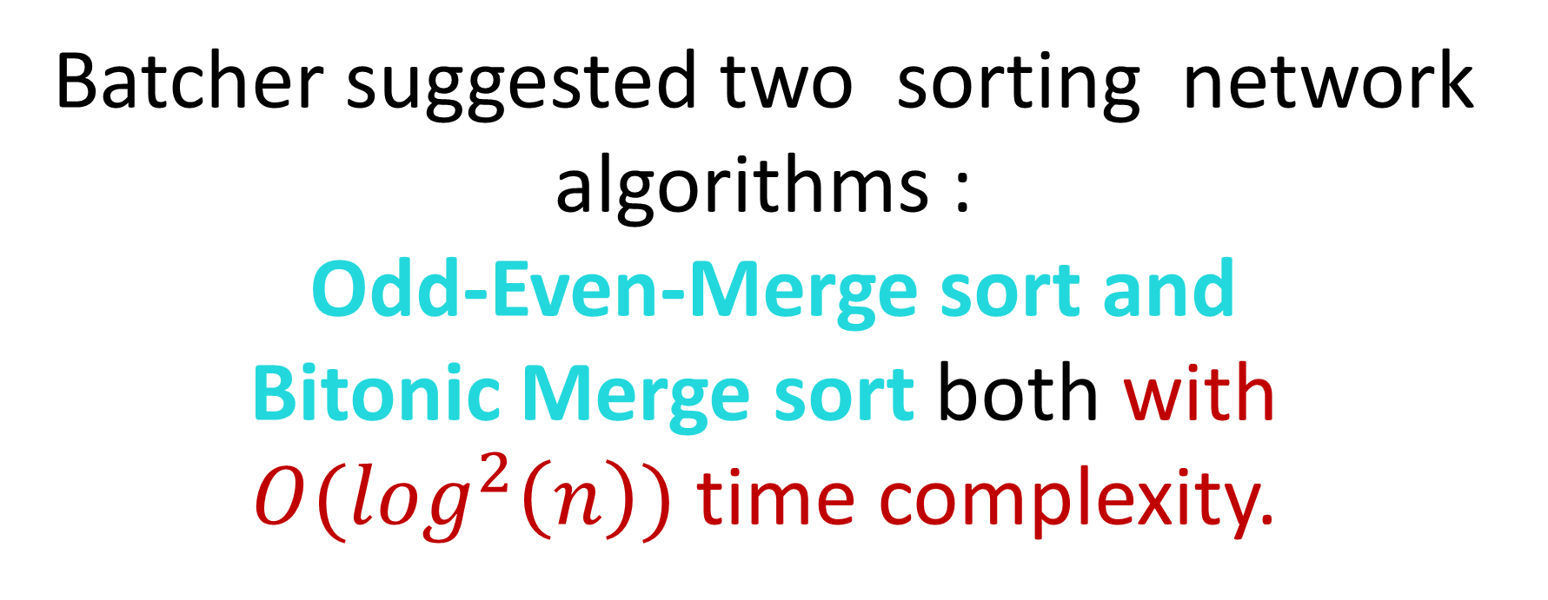
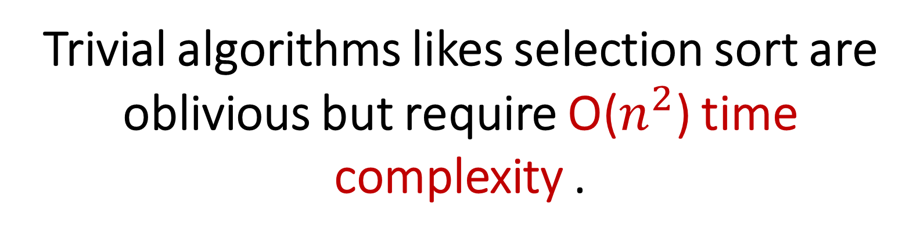
Trivial algorithms likes selection sort are oblivious but require O($n^{2}$) time complexity .
Batcher suggested two sorting network algorithms :
Odd-Even-Merge sort and
Bitonic Merge sort both with $O(\log^{2}\left(n\right))$ time complexity.

Slide 19
Bitonic sequence is a sequence that either monotonically increases and the then monotonically decreases,
or monotonically decreases and then monotonically increases.
For example:
<1,4,6,8,3,2>
<9,8,3,2,4,6>
are both bitonic

Slide 20
A Bitonic sorter
A bitonic sorter is a network that sorts every bitonic sequence.
Algorithm:
1- A bitonic sequence is divided between its two halves.
2- The i^{th} element in each part is compared with each other. If they are out of order, they are swapped.
3- Applying this procedure repeatedly onto the smaller lists, the result is a sorted sequence in ascending order.

Slide 21
However, this is only true because the algorithm makes a major assumption: it assumes the input sequence has a length that is a power of 2.

Slide 22


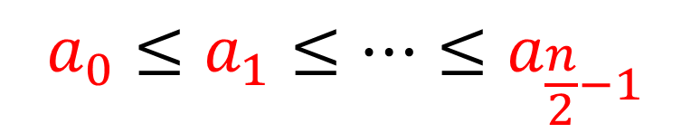
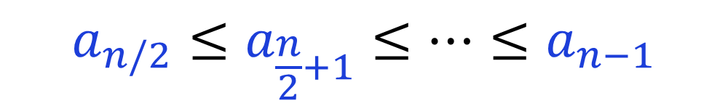
Let s = $<a_{0},a_{1},…,a_{n−1}>$ a bitonic sequence such that:
$$a_{0}≤a_{1}≤…≤a_{\frac{n}{2}−1}$$
and
$$a_{n/2}≤a_{\frac{n}{2}+1}≤…≤a_{n−1}$$

Slide 23
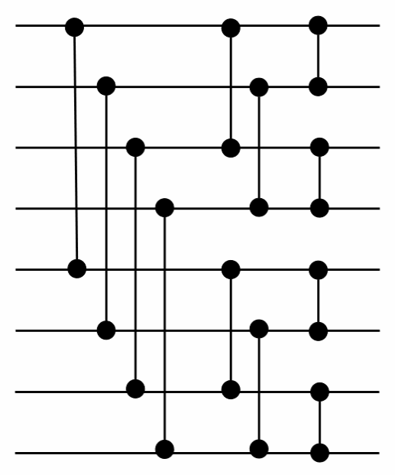
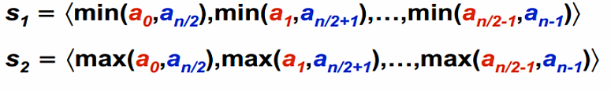

Slide 24
What if we have a random sequence of numbers?
Convert the list of numbers into a bitonic sequence which is monotonically increases then decreases.
Example:
35 16 31 4 4 31 17 16
16 35 31 4 4 31 17 16
16 4 31 35 17 31 4 16
4 16 31 35 31 17 16 4

Slide 25
Algorithm to form a Bitonic Sequence from a random input:
1- We start by forming 4-element bitonic sequences from consecutive 2-element sequence.
2- Consider 4-element in sequence x0, x1, x2, x3.
We sort x0 and x1 in ascending order and x2 and x3 in descending order.
4- We then concatenate the two pairs to form a 4 element bitonic sequence.

Slide 26
5- Next, we take two 4 element bitonic sequences,
sorting one in ascending order, the other in descending order (using the Bitonic Sort which we will discuss below), and so on, until we obtain the bitonic sequence.

Slide 27
Complexity of Bitonic sort | Best Case | Average Case | Worst Case
Time Complexity | O(log ² n) | O(log ² n) | O(log ² n)
Space Complexity |  |  | O(n log ² n)

Slide 28
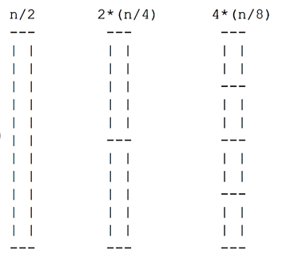
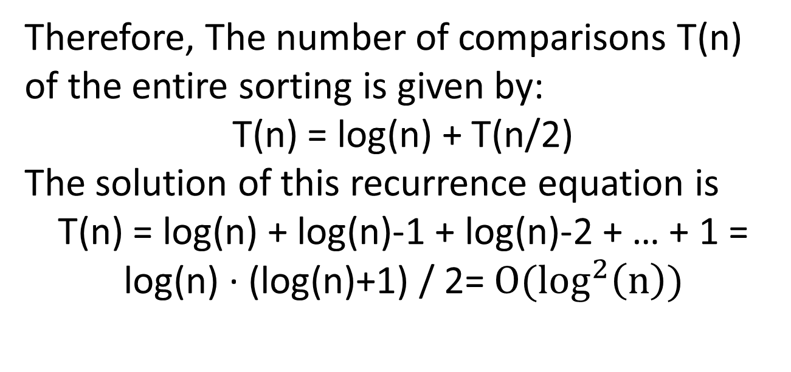
Analyze Time Complexity :
To form a sorted sequence of length n from two sorted sequences of length n/2,
log(n) comparisons are required
(for example: log(8) = 3) .
Therefore, The number of comparisons T(n) of the entire sorting is given by:
T(n) = log(n) + T(n/2)
The solution of this recurrence equation is
T(n) = log(n) + log(n)-1 + log(n)-2 + … + 1 = log(n) · (log(n)+1) / 2= $O(\log^{2}\left(n\right))$
…

Slide 29
Analyze Space Complexity :
Each stage of the sorting network consists of n/2 comparators. Therefore total (n log²n) comparators.

Slide 30
The AKS sorting networks
Ajtai-Komlós-Szemerédi(1983)
There are sorting networks of 𝑂(log𝑛) depth, and hence 𝑂(𝑛log𝑛) size.
The construction is fairly complicated.
The constant factors are very large.

Slide 31
The latest discussion of the hidden constants behind this construction that I could find were in the Zig-Zag sorting paper, the author states that 13,613,047 is the currently best known constant.
Which makes Batchers sorting networks superior for every practical number of inputs.

Slide 32
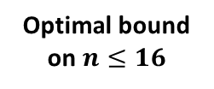
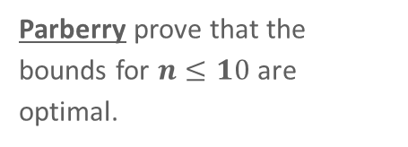


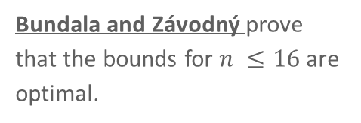
A LITTLE HISTORY
Upper bound on $n≤16$
Optimal bound on $n≤16$
17, 19 and 20 channels
Knuth summarized upper bounds on the depth of sorting networks on 𝒏≤𝟏𝟔 channels.
Ehlers and Müller found faster sorting networks for 17, 19 and 20 channels.
Bundala and Závodný prove that the bounds for $n ≤16$are optimal.
1973
1989
2014
2014
2014
Optimal bound on $n≤10$
18 and 22 channels
Parberry prove that the bounds for $n≤10$are optimal.
Al-Baddar and Batcher improved sorting networks for 18 and 22 channels.

Slide 33
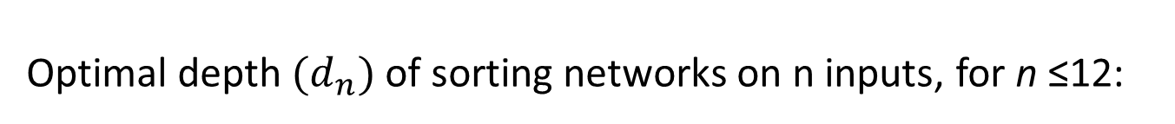
TABLE 1
Optimal depth $(d_{n})$of sorting networks on n inputs, for n ≤12:
n | 1 | 2 | 3 | 4 | 5 | 6 | 7 | 8 | 9 | 10 | 11 | 12
𝑑_𝑛 | 0 | 1 | 3 | 3 | 5 | 5 | 6 | 6 | 7 | 7 | 8 | 8

Slide 34
TABLE 2
Best known values and bounds on optimal depth (dn) of sorting networks on n inputs, for 13 ≤n ≤24.
The new result for n =24 also implies one for n =23: Removing one channel.
n | 13 | 14 | 15 | 16 | 17 | 18 | 19 | 20 | 21 | 22 | 23 | 24
𝑑_𝑛 | 9 | 9 | 9 | 9 | 10 | 11 10 | 11 10 | 11 10 | 12 10 | 12 10 | 12 10 | 12 10

Slide 35
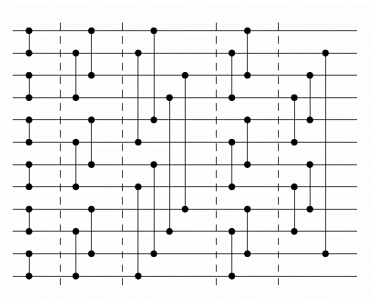
prefixes of sorting networks
One prefix p1 is considered superior to an-other prefix p2 if every sorting network beginning with p2 can be transformed into one beginning with p1.
Prefix of a sorting network on 12 channels, and 5 layers.

Slide 36
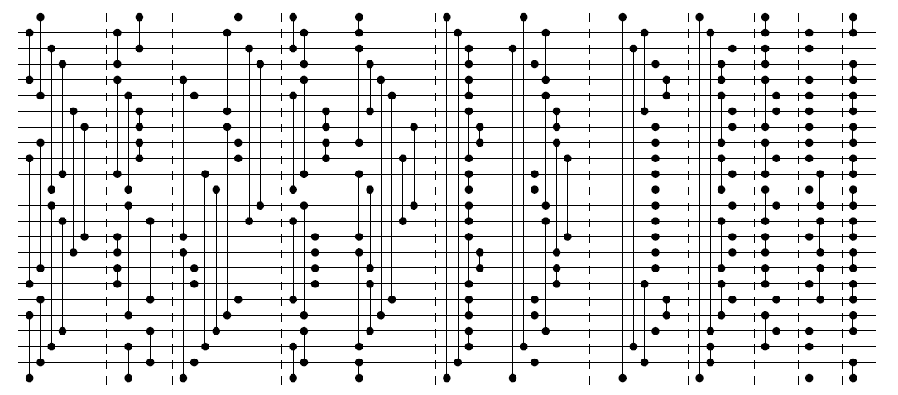
New sorting network on 24 channels, which uses only 12 layers, improving the previously best known bound by one layer.
This also implies improved sorting networks for 23 channels.
This result was obtained by combining techniques for generating prefixes of sorting networks with propositional encodings.

Slide 37
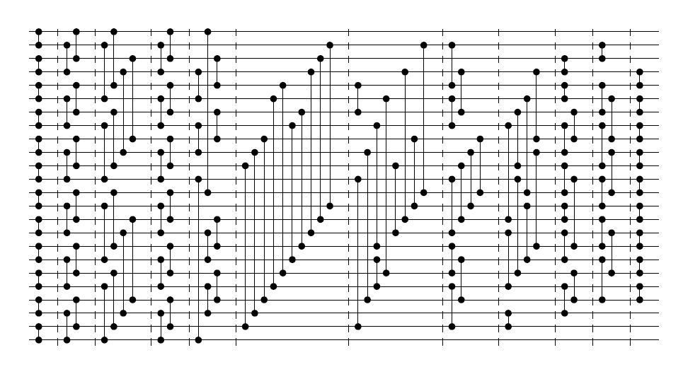
The same sorting network with prefixes of sorting networks and removing redundant comparators.

Slide 38
The sorting network in the Figure in the previous slide has 125 comparators.
Al-though improving the upper bound on the depth, it does not improve the upper bounds on the size of sorting net-works, as networks with 123 and 118 comparators for 24 and 23 inputs, respectively, are known.

Slide 39
Main open question of this paper:
The best-known sorting network on 25 channels requires 14 layers.
Ehlers guess that it should be possible to give a network on at most 13 layers, and leave it as the main open question of this paper.

