Slide 1

Institute of Engineering & Management,
University of Engineering & Management
Kolkata
Department of Computer Science & Engineering
Laboratory: - Cloud Computing & IOT Laboratory
Name: - Gourab Mondal
Section: - B
Roll Number: - 26
Enrollment Number: - 12022002001116
Year: - 3rd

Slide 2
INDEX PAGE
SL NO. | ASSIGNMENT | PAGE NUMBER
1 | WEEK 1 : STEP WISE INSTALLATION OF VMWARE FOR CONFIGURING VIRTUALIZATION | 03 - 22
2 | WEEK 2: STEP WISE INSTALLATION OF GOOGLE APP ENGINE INTO LOCAL SYSTEM | 22 - 28
3
4
5
6
7
8

Slide 3
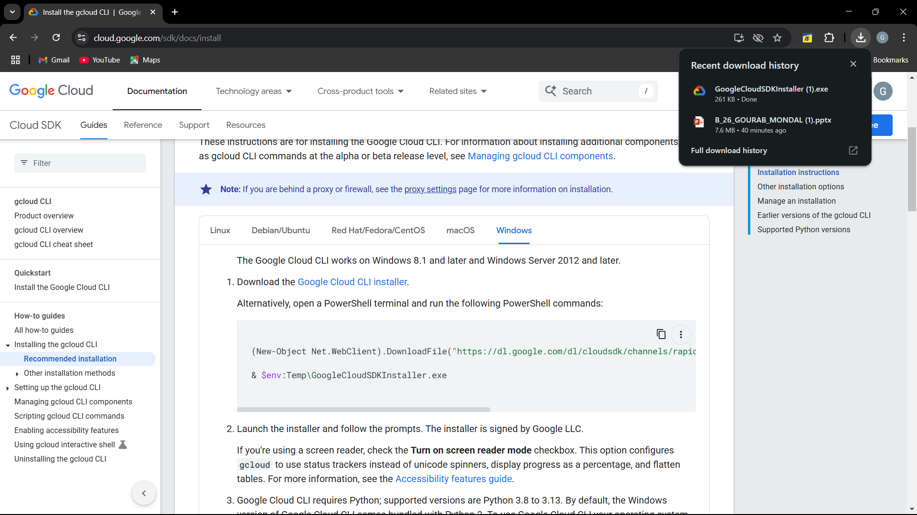
Week 2: STEP WISE INSTALLATION OF GOOGLE APP ENGINE INTO LOCAL SYSTEM
Step 1 -> Visit URL : cloud.google.com/sdk/docs/install and click the download link for GCP SDK

Slide 4
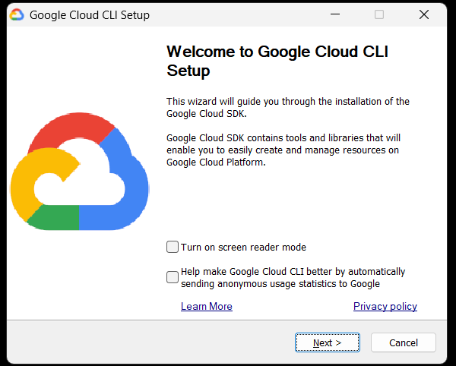
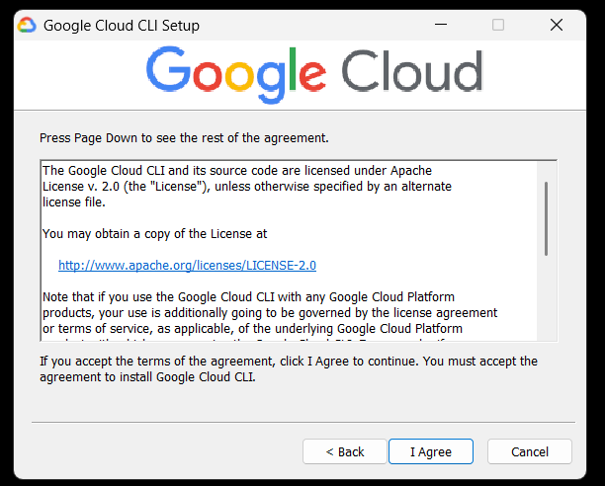
Step 2 ->Run the installer and perform following steps

Slide 5
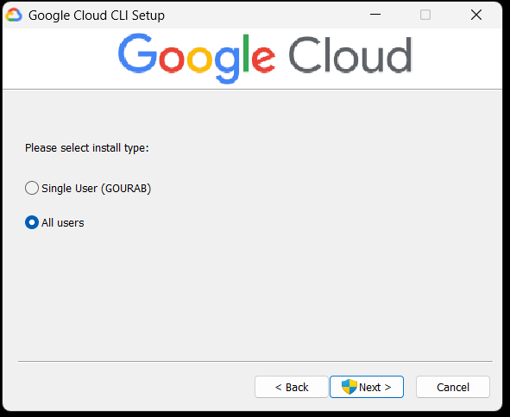
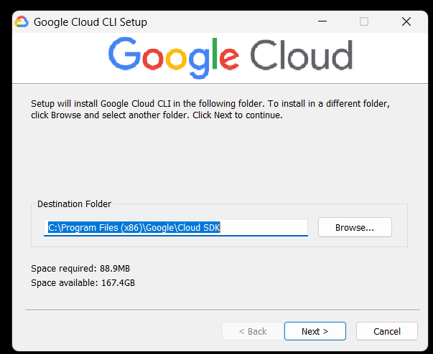

Slide 6
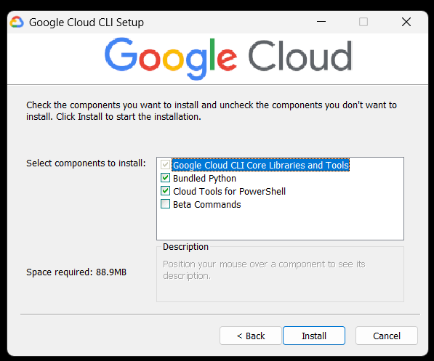
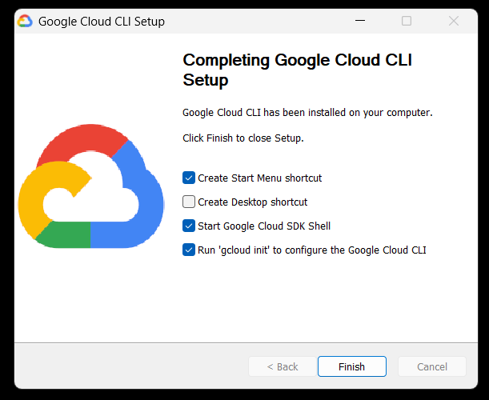

Slide 7
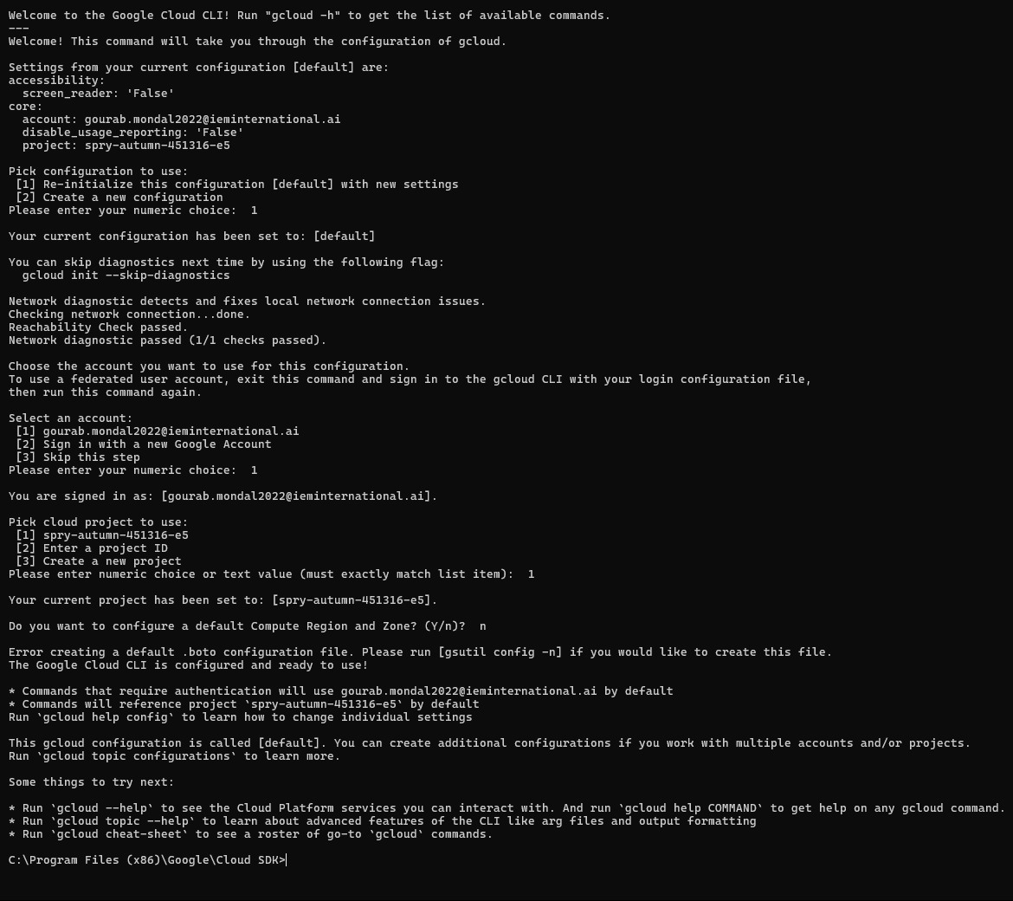
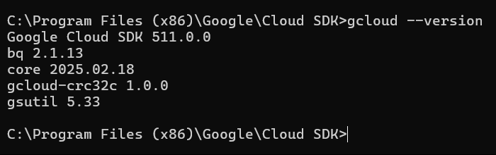
Step 3 -> Authenticate the cloud CLI with proper credentials and verify installation

Slide 8
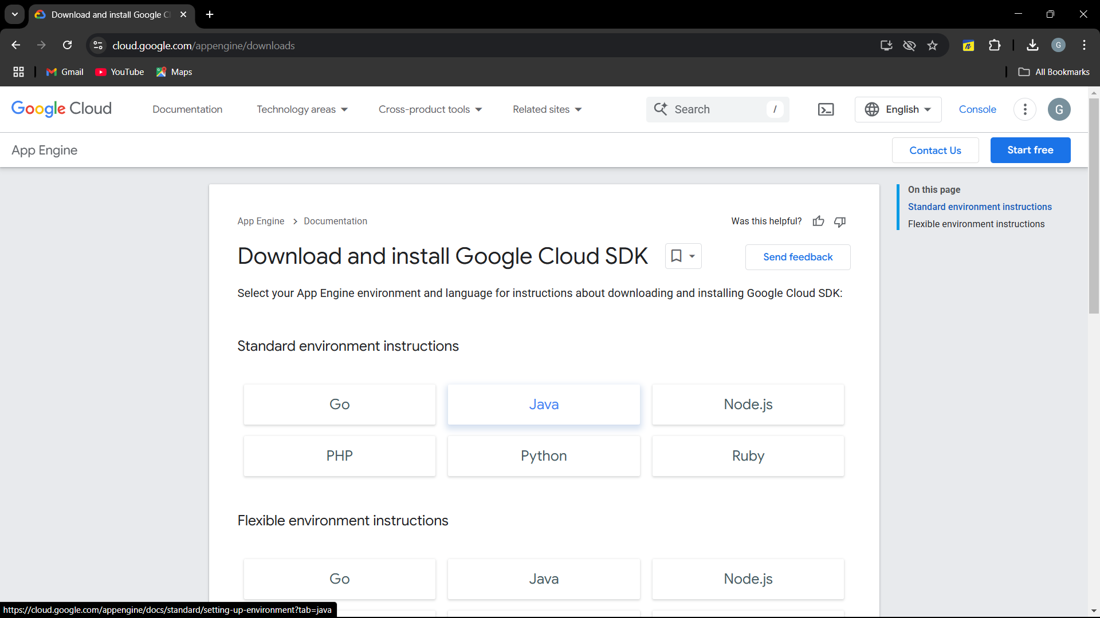
Step 4 -> Visit URL : https://cloud.google.com/appengine/downloads and Install Google App Engine java component

Slide 9
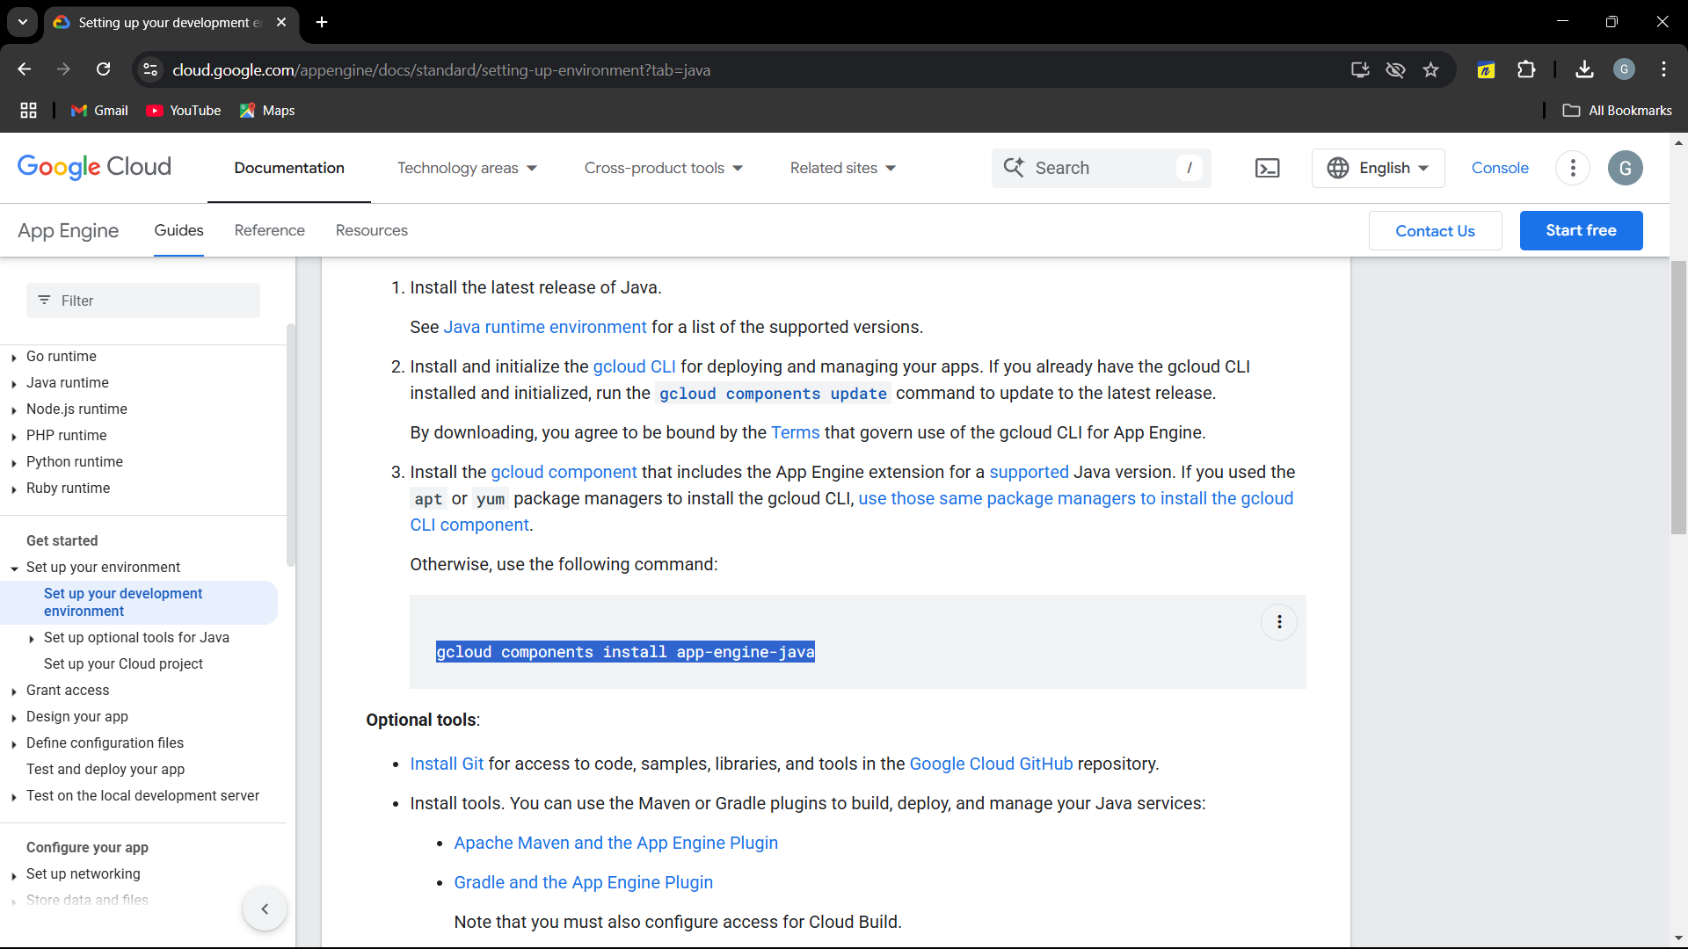
Step 5 -> Copy this CLI command and run in terminal with elevated access

Slide 10
