Slide 1
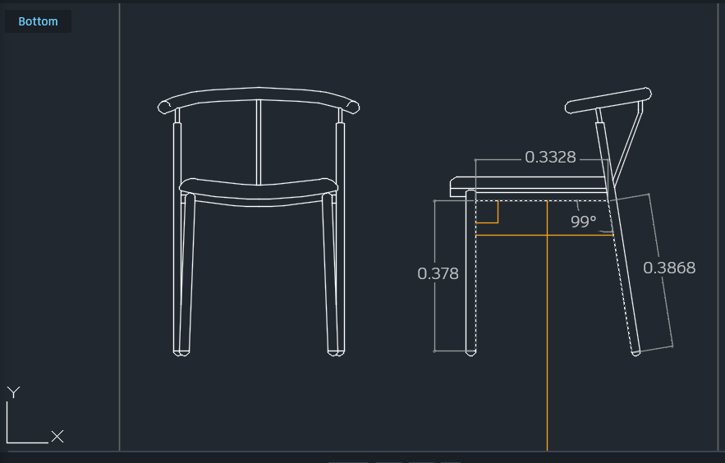
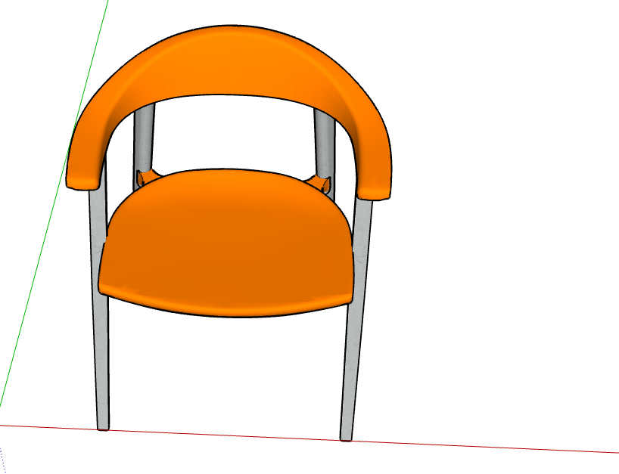
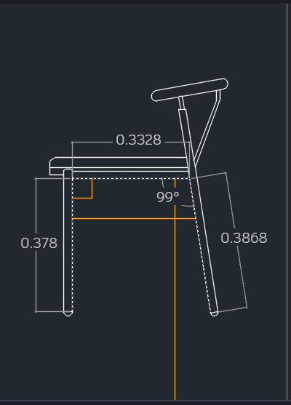
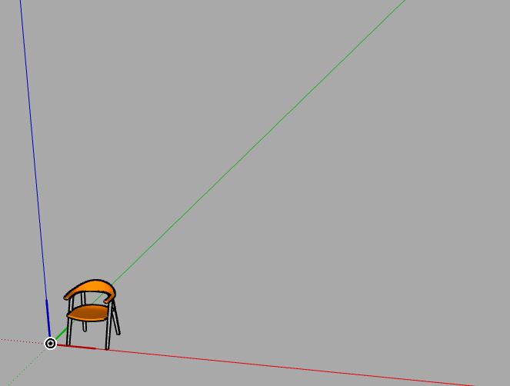
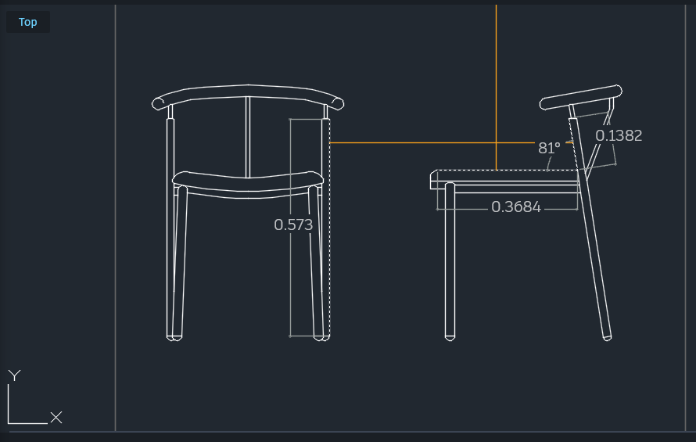
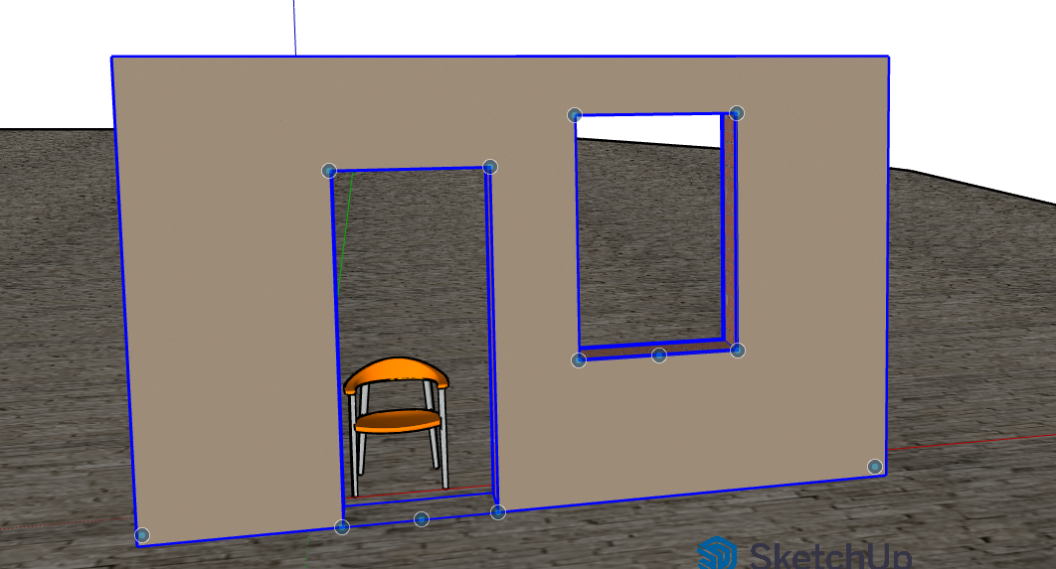
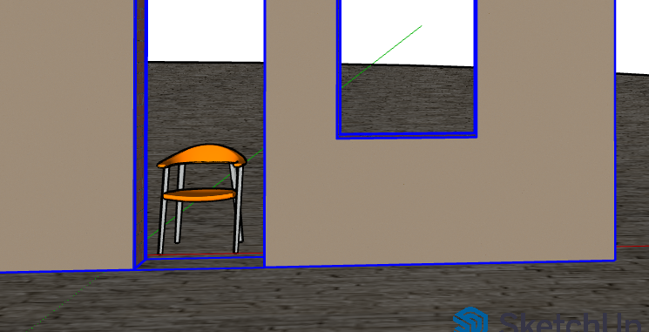
Aspect | Details
Historical Context | Emerged during post-war optimism and the Space Race. Reflected fascination with science and technology.
Design Philosophy | “The future as imagined in the past” — blending mid-century aesthetics with sci-fi inspiration.
Common Elements | Curved lines, bold geometry, chrome and metallic finishes, neon lighting, atomic motifs.
Influences | Space exploration, mid-century modern design, industrial technology, 1960s sci-fi films.
Design Features:
Curved backrest shell in fiberglass with chrome finish.
Upholstered metallic vinyl seat with geometric stitching.
Integrated LED strip under armrests for accent lighting.
Floating circular base resembling a levitating platform.
Room Application:
Living room corner, creative lounge, or studio space.
Dimensions scaled for ergonomic comfort and balanced visual proportion (approx. 900mm height, 750mm width, 850mm depth).
Name: Mohit Bhanot
Id:
Date:

