Slide 1
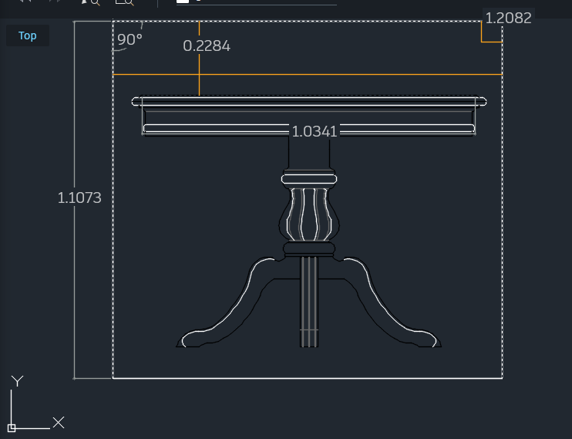
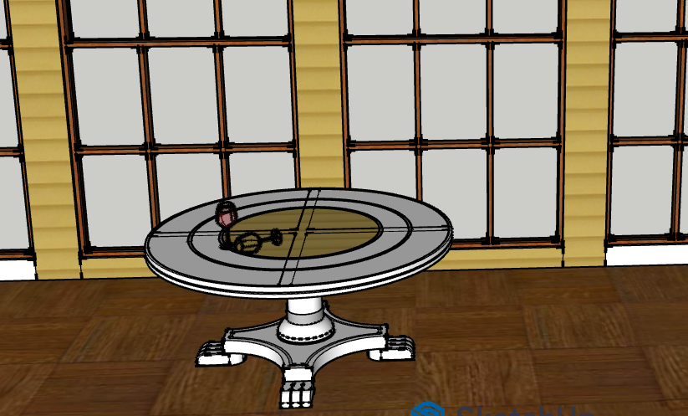
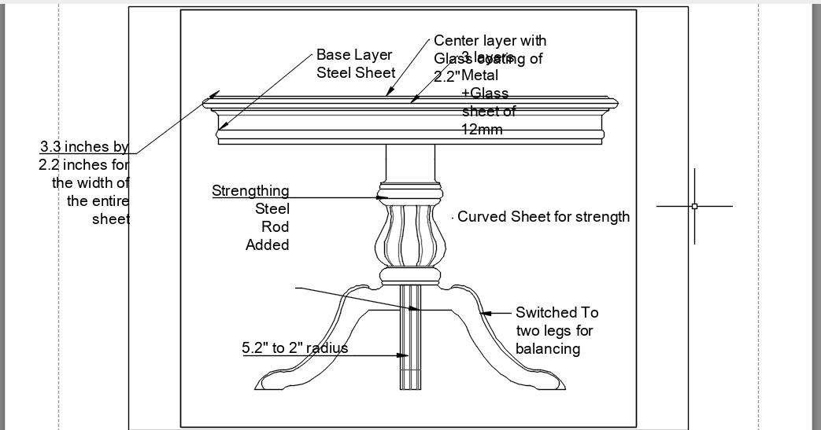
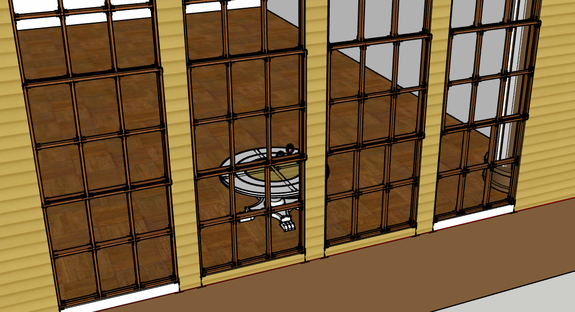
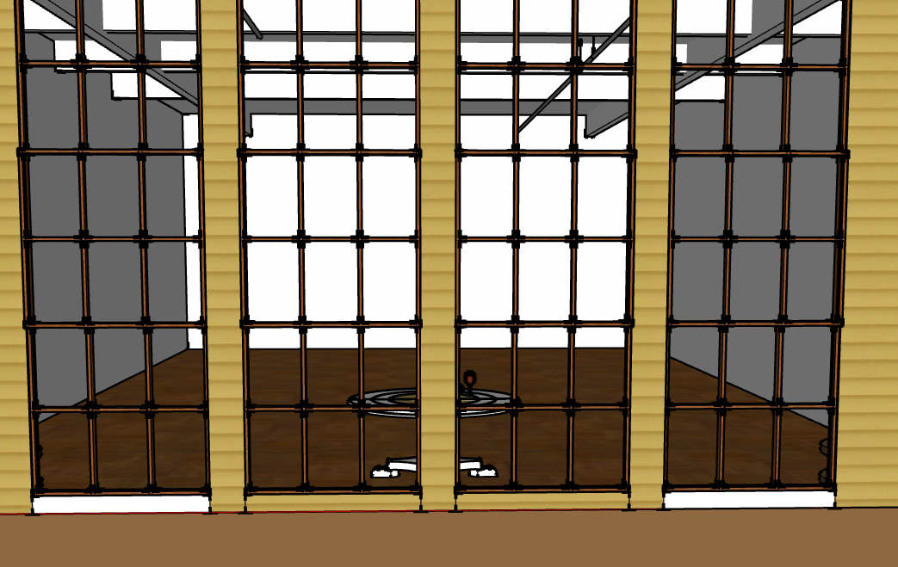
Design Brief
The Orbitron Table 2095 celebrates retro futurism by combining classic space-age curves with modern minimal transparency.
The floating glass surface mirrors the visual language of orbital structures, while the chrome base reflects 1950s optimism for the future.
Integrated lighting reinforces the illusion of weightlessness and technological advancement.
Research – Retro Futurism
Blends nostalgia + optimistic visions of the future
Influences: Space Age, Atomic Age, Mid-century modern
Signature traits:
  Metallic finishes (chrome, brushed steel)
  Streamlined, aerodynamic curves
  Bold geometric symmetry (orbits, ellipses)
  High-gloss surfaces + glowing accents
Name: Mantaj singh
ID:
Date:

