Slide 1

Network Traffic Feature Selection
for Intrusion Detection Systems
Using CICFlowMeter · CICIDS2017 · Machine Learning
Fadia Minkara, Assil Bzal

Slide 2
Presentation Overview
01
Motivation & Problem Statement
05
ML Algorithm Evaluation
02
Dataset — CICIDS2017
06
Results & Key Findings
03
Feature Extraction with CICFlowMeter
07
Conclusion
04
Feature Selection per Attack Type

Slide 3
Motivation & Problem Statement
The Challenge
Our Goal
Modern networks generate millions of packets per second — making real-time attack detection computationally expensive.
Using all 80 raw features is:
• Slow to train
• Memory intensive
• Prone to overfitting
Identify a minimal, high-impact feature subset for each attack type that:
✔ Maintains detection accuracy
✔ Reduces training time
✔ Works across 7 ML algorithms

Slide 4
Dataset — CICIDS2017
~2.8M
80
15
Network flows
Features per flow
Traffic categories
Attack types included:
BENIGN · DoS Hulk · DoS GoldenEye · DoS Slowloris · DoS Slowhttptest · FTP-Patator · SSH-Patator · Web Attack – Brute Force · Web Attack – XSS · Web Attack – SQL Injection · Infiltration · Bot · PortScan · DDoS · Heartbleed
Dataset integrity verified via MD5 checksums after download.

Slide 5
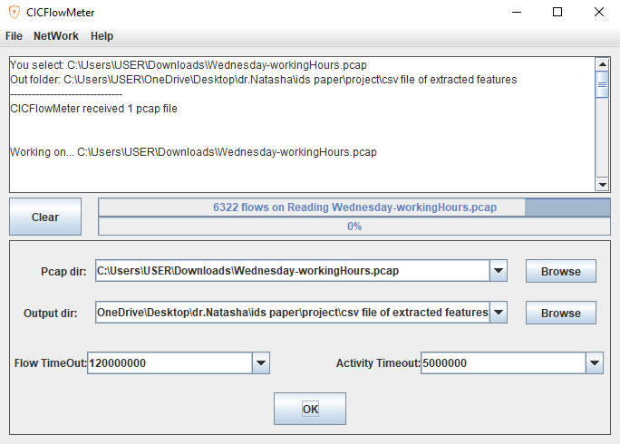
Feature Extraction — CICFlowMeter
1
6
Run GUI on .pcap files
Install Java JDK 8 + Git
Outputs 80-feature CSV per captured session
2
Clone CICFlowMeter repository
from github.com/ahlashkari/CICFlowMeter
3
Install jnetpcap locally
Native packet-capture library via Maven
4
Install Npcap driver
5
Build with Gradle
gradlew.bat distZip → CICFlowMeter.zip

Slide 6
Feature Selection — Per Attack Type
Method
Example: DoS Hulk → Top Features
Random Forest Feature Importance
For each attack, we train a binary classifier:
Attack vs. All Others
Feature importance scores rank all 80 features. The top 10 most discriminative features are selected per attack.
This produces a compact, attack-specific feature profile.
Feature
Importance
Idle Mean
0.276
Idle Min
0.184
Destination Port
0.119
Flow IAT Mean
0.092
Bwd Packet Length Std
0.081

Slide 7
ML Algorithm Evaluation Setup
7 Algorithms Compared — on the Reduced Feature Set
KNN
K-Nearest Neighbors
MLP
Multilayer Perceptron
Instance-based, proximity voting
Multi-layer perceptron
RF
Random Forest
NB
Naïve Bayes
Ensemble of decision trees
Probabilistic, Gaussian
ID3
ID3
QDA
Quadratic Discriminant Analysis
Information gain splitting
Quadratic decision boundaries
AdaBoost
Adaptive Boosting
Weak learner ensemble
Metrics: Precision · Recall · F1-Score · Execution Time

Slide 8
Evaluation Pipeline
Load CSV
Clean Data
Select Features
Split Dataset
Train & Predict
Export Results
Merged CICIDS2017 files
latin1 encoding
Remove ∞, NaN
Strip column whitespace
Load all_attacks_top_features.csv
Extract unique feature names
60% train / 20% validation / 20% test
All 7 models
Performance_Examination.csv
Pr · Rc · F1 · Time
for name, model in models.items(): start_time = time.time()
# Training
model.fit(X_train, y_train)
# Validation
y_val_pred = model.predict(X_val) val_precision = precision_score(y_val, y_val_pred, average='weighted’, zero_division=0) val_recall = recall_score(y_val, y_val_pred, average='weighted’, zero_division=0) val_f1 = f1_score(y_val, y_val_pred,average='weighted’, zero_division=0)

Slide 9
Results & Key Findings
Algorithm
Precision
Recall
F1-Score
Exec. Time
KNN
0.974
0.975
0.975
~22 s
RF
0.997
0.997
0.997
~6.63 s
ID3
0.997
0.997
0.997
~4.2 s
AdaBoost
0.850
0.902
0.874
~21 s
MLP
0.972
0.971
0.971
~51 s
Naïve Bayes
0.885
0.174
0.221
~1.06 s
QDA
0.982
0.963
0.971
~1.77 s

Slide 10
Conclusion
Extracted 80 features using CICFlowMeter on real PCAP captures from CICIDS2017.
Selected top-10 features per attack via Random Forest importance scores.
Reduced feature set maintains high accuracy.
RF and ID3 tied at F1= 0.997, with ID3 being the faster choice at 4.2s vs 6.63s.
Naïve Bayes is unsuitable despite its speed, a recall of 0.174 means it misses most attacks.

