Slide 1

Csci205 final project
Kyle Morris

Slide 2

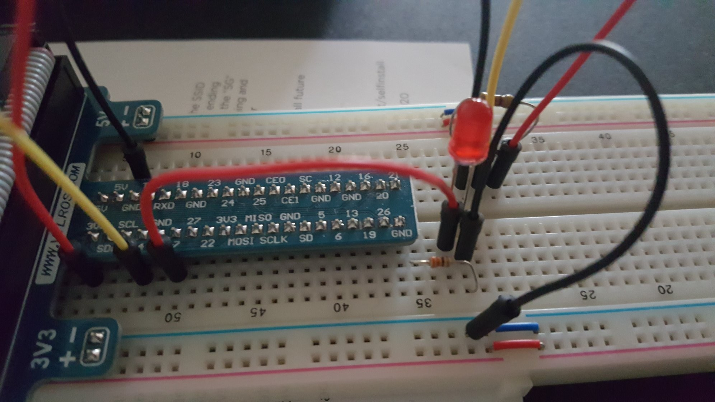
LED
LED requires two jumper wires and a 330 Ω resistor
Red = 17(3.3v), Black = GND

Slide 3
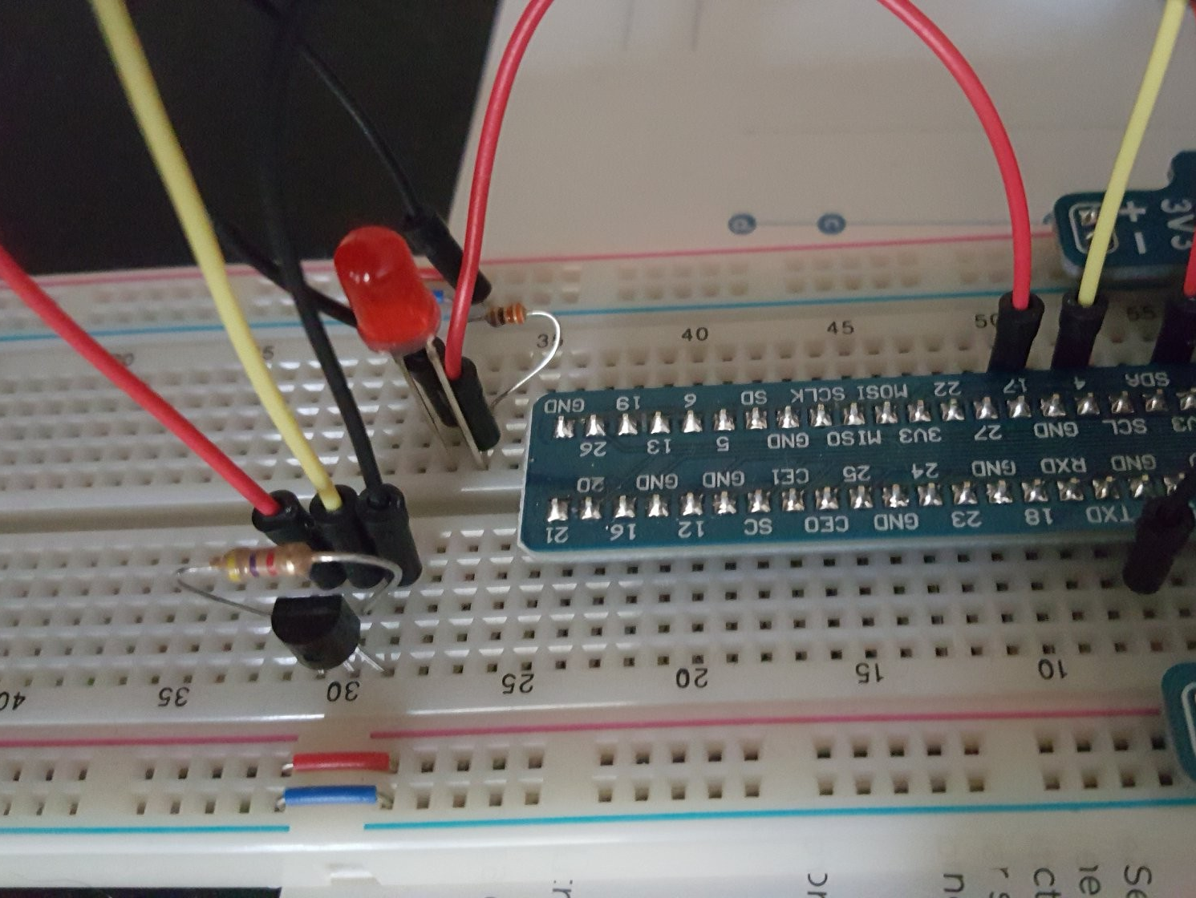

Ds18b20 Temp Sensor
The ds18b20 temperature sensor requires three jumper wires and a 4.7k Ω resistor.
Red = 3(3.3v), Black = 1(GND), Yellow = 2(DQ/data pin)

Slide 4
Prerequisites
Install git on your local machine: https://git-scm.com/book/en/v2/Getting-Started-Installing-Git
Install G++
Verify that wiringPi is installed: gpio -v
Create a folder to work from/in: sudo mkdir dirName
Change directory: cd dirName
Clone my repo using this command: sudo git clone https://github.com/assimil8/csci205-final.git

Slide 5
INstallation
Get situated: cd csci205-final
Compile executable: sudo g++ -Wall –o main main.cpp –lwiringPi
Copy .exe into necessary dir: sudo cp main /var/www/html/main
Set Chmod Perms: sudo chmod 4755 /var/www/html/main

Slide 6
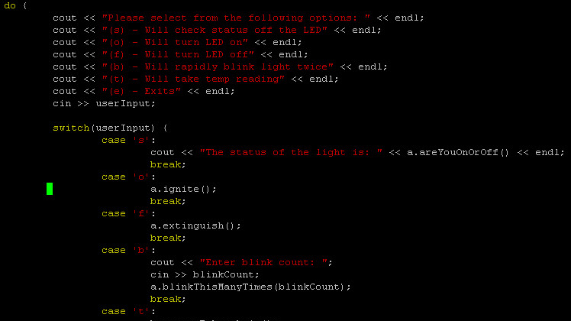
Demonstration
Running .main without any flags brings up a do-while menu with switch statement(s)
You can use the following flags: s,o,f,b,t s = returns status of LED ( LED.areYouOnOrOff() ) o = turns LED on ( LED.ignite() ) f = turns LED off ( LED.extinguish() ) b = accepts int from user and blinks that many times ( LED.blinkThisManyTimes(blinkCount) ) t = returns temp in Fahrenheit (TEMP_SENSOR.returnFahrenheit() )
You may also utilize the web interface by visiting the Pi’s IP http://x.x.x.x

Slide 7
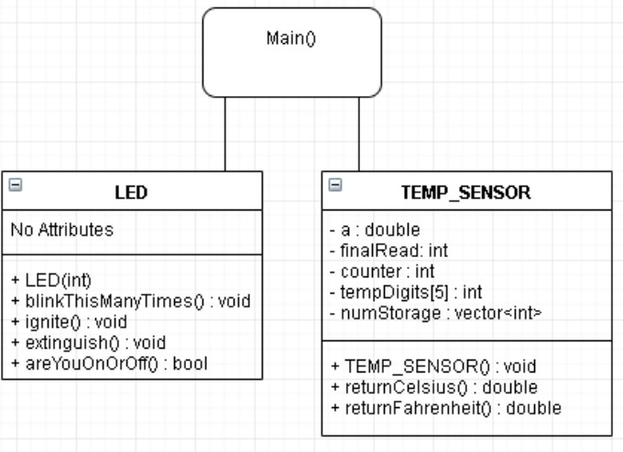
UML DIAGRAM

