Slide 1

Predictive Modeling of Cardiovascular Disease Risk Factors Using an Interpretable Machine Learning Approach
TEAM NAME: DATA DETECTIVES
Presented by:
Garima Sharma
BCA (AI & DS)
2401201212
Khushi Chauhan
BCA (AI & DS)
2401201167

Slide 2

Abstract
The Challenge
Our Approach
CVD prediction matters for early intervention, but black-box ML models lack clinical trust and transparency.
Random Forest combined with SHAP analysis on 68K+ patient records for interpretable predictions.
Key Findings
Systolic blood pressure, age, and cholesterol emerged as top predictive factors.

Slide 3

The Global CVD Crisis
17.9M
80%
Annual Deaths
Preventable Cases
CVD causes 32% of global mortality
Early detection could save millions
Cardiovascular disease progresses asymptomatically, leading to late detection. Current ML models achieve high accuracy but lack the transparency needed for clinical adoption.

Slide 4
Research Objectives
01
02
Build Predictive Model
Enable Interpretability
Develop Random Forest classifier for CVD risk assessment
Apply SHAP analysis for transparent feature attribution
03
04
Quantify Feature Impact
Clinical Validation
Rank 12 clinical features by predictive importance
Ensure findings align with medical knowledge

Slide 5
Challenges in CVD Prediction
Previous Approaches
Our Innovation
Logistic Regression: interpretable but limited accuracy
SHAP bridges the gap using cooperative game theory to provide both accuracy and transparency for healthcare ML.
SVM & Neural Networks: high accuracy, poor explainability
Clinical scoring systems: outdated risk factors

Slide 6



Methodology
Data Preparation
Model Training
SHAP Analysis
68,591 records, 13 features including age, blood pressure, cholesterol, lifestyle factors
80/20 train-test split using Random Forest classifier with optimized hyperparameters
TreeExplainer for feature importance ranking and individual prediction explanations
Tools: Python, scikit-learn, pandas, SHAP library

Slide 7
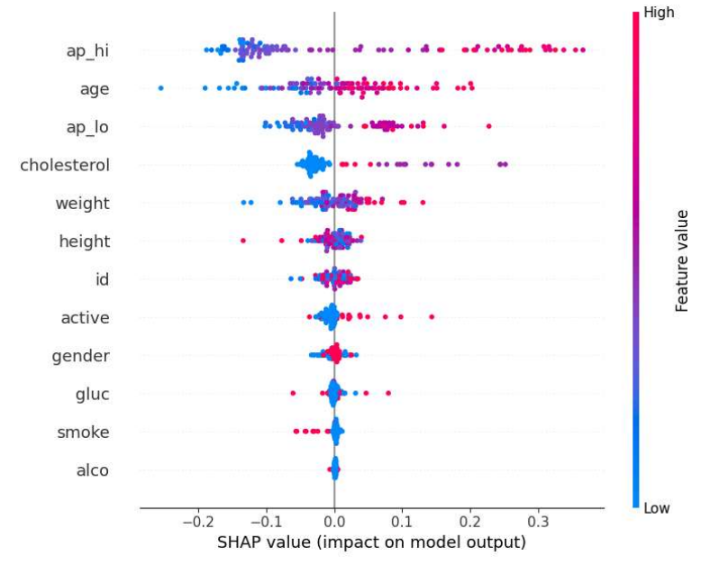
Feature Importance Results
Systolic Blood Pressure (ap_hi) is the strongest predictor of CVD risk.
Age and Cholesterol follow as major contributors.
Weight and Diastolic BP (ap_lo) also influence predictions, but less strongly.
Lifestyle factors (smoking, alcohol, activity) have minor but noticeable impacts.
High values of ap_hi, age, and cholesterol consistently increase predicted risk.
Systolic blood pressure emerged as the strongest predictor, nearly twice as impactful as weight.

Slide 8
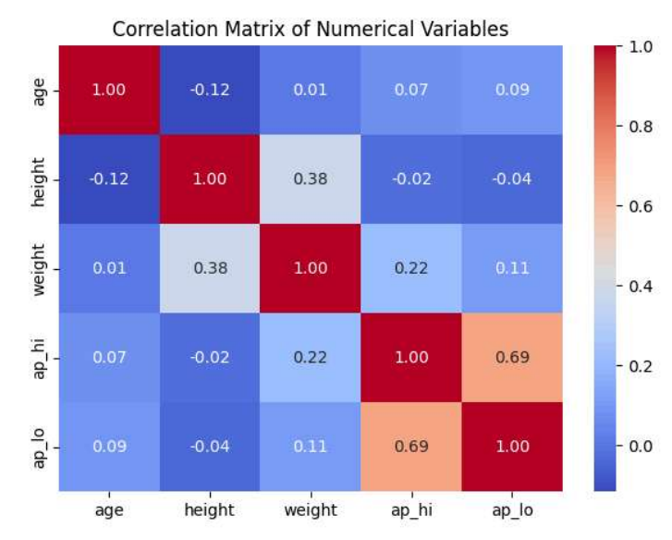
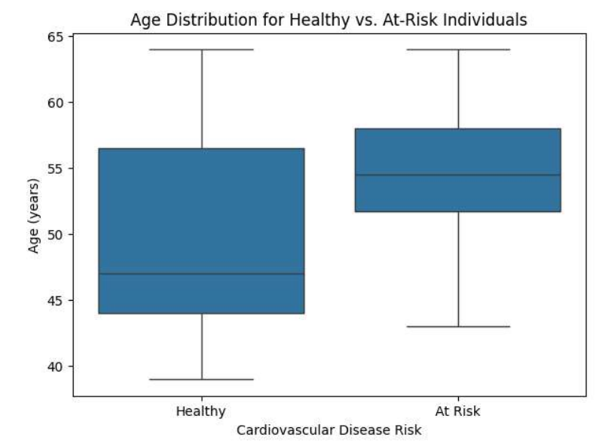
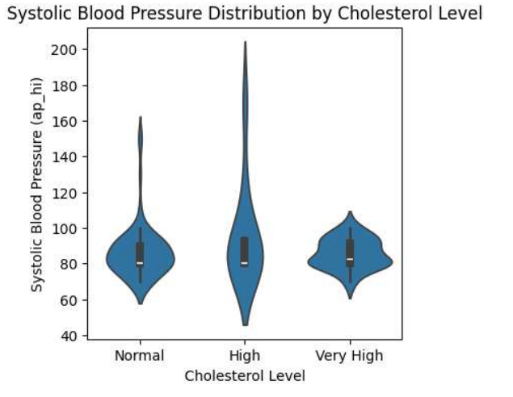
Data Insights and Results
Correlation Heatmap
Age Distribution (Box Plot: Healthy vs At-Risk)
Systolic BP vs. Cholesterol Violin Plot
Systolic (ap_hi) and Diastolic (ap_lo) BP show a strong correlation (0.69), while other variables have weaker links.
At-risk individuals are generally older, confirming age as a major cardiovascular risk factor.
Higher cholesterol levels are associated with greater and more variable systolic BP values, strengthening their role as predictors.

Slide 9




Conclusion & Future Directions
Achievement
Clinical Pilot
Enhanced Features
Successfully combined Random Forest accuracy with SHAP interpretability for CVD prediction.
Next phase: real-world validation in healthcare settings with physician feedback integration.
Future models will incorporate genetic markers and detailed lifestyle behavioral data.

Slide 10
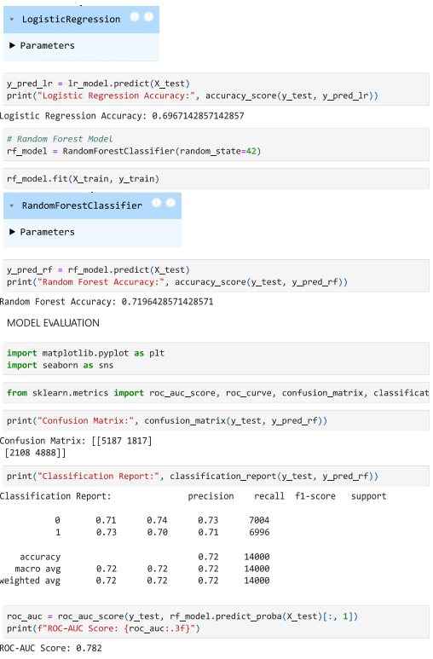
References
Key References
WHO Global Health Observatory (2021)
Lundberg & Lee: SHAP Values (2017)
Cardiovascular ML Review Studies
Random Forest in Healthcare Applications

