Slide 1

Calculator
Creating a GUI Calculator with Tkinter in Python

Slide 2

Introduction to Tkinter
Tkinter is a Python library used for creating graphical user interfaces It's one of the most commonly used GUI libraries because it's simple to use and comes pre-installed with Python.
We have to first import tkinter library by code below:

Slide 3
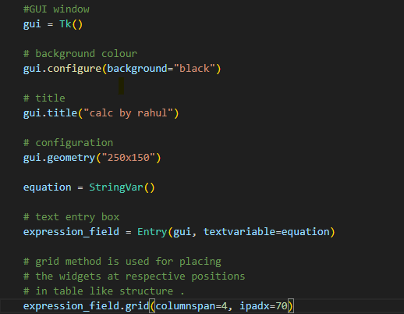
Creating the Main Window
I create the main window by this code

Slide 4
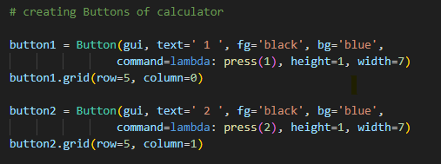

Adding Widgets - Buttons and Entry
Buttons in calculator are used to trigger actions
when clicked. I create with python script in visual
studio code with help of tkinter library as show.

Slide 5
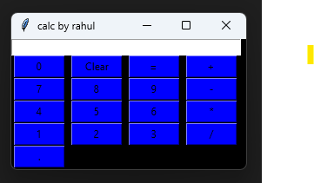
Launch of GUI Calculator
Start the GUI with code as shown:
After run all codes and function I got my GUI calculator
ready for use:
Calculator:

Slide 6
Conclusion
-Covered tkinter library
-Covered python script
-Covered visual studio code software
-Covered GitHub and Gitbase
-Covered graphic user interface
-Thank you

