Slide 1
Mini Lexical Analyzer

Slide 2
Project OVERVIEW
Web-based tool for lexical analysis of code.
Analyzes C++ code or general code input.
Input via browser: type code or upload .cpp file.
Theory: Lexical analysis scans code to break it into tokens (keywords, identifiers, operators).
Outputs: Compile lexical (C++ tokens) or full lexical analysis (all tokens, symbol table).
Results displayed in browser or saved to .txt file.

Slide 3
Objectives
Develop lexical analysis for C++ code to identify tokens.
Enable general code analysis for broader token processing.
Support code input via web UI: dynamic typing or .cpp file.
Provide two outputs: compile lexical or full lexical analysis.
Allow results to be displayed or saved as .txt file.
Demonstrate lexical analysis concepts for learning.

Slide 4
Technology stack
Frontend:
HTML: Web UI structure (index.html).
CSS: Styling for user-friendly interface.
JavaScript: Dynamic input handling and WebAssembly integration.
Backend:
C++: Core lexical analyzer logic (lexer.cpp).
WebAssembly: Compiled lexer.wasm for browser execution.
Tools:
Emscripten: Compiles C++ to WebAssembly.
GCC: C++ compilation for development.
Git: Version control for collaborative development.

Slide 5
WORKFLOW
Web UI: Input Code
Analysis Mode?
(General Mode)
(Compiler Mode)
Backend: C++ Analysis
Output: Tokens Table

Slide 6
Token stream
Lists tokens from code: keywords, identifiers, operators, comments.
Example: int x = 5; // Set x.
C++ mode tokens: int, x, =, 5, ; (comments ignored).
General mode tokens: int, x, =, 5, ;, //, Set, x.
Output Table:
Token | Type
int | Keyword
x | Identifier
= | Operator
5 | Number

Slide 7
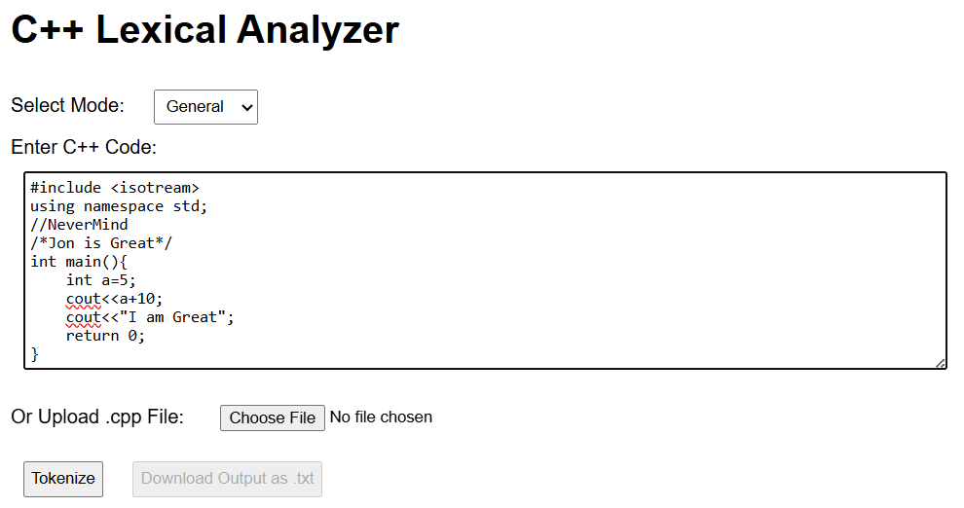
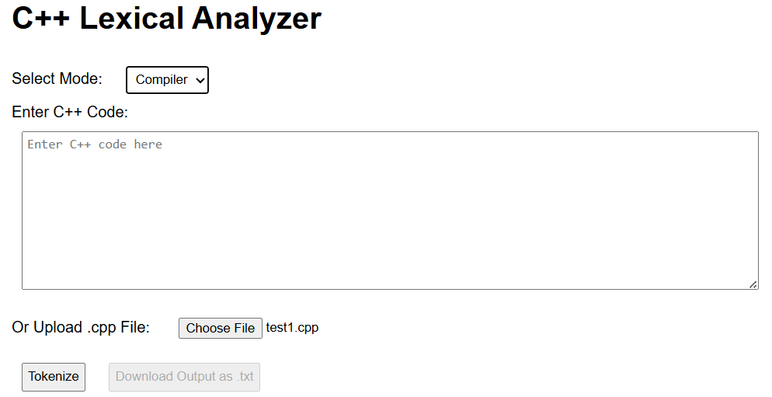
Final implementation
Demonstrating dynamic input, .cpp file upload, token table output, and .txt file export.

Slide 8
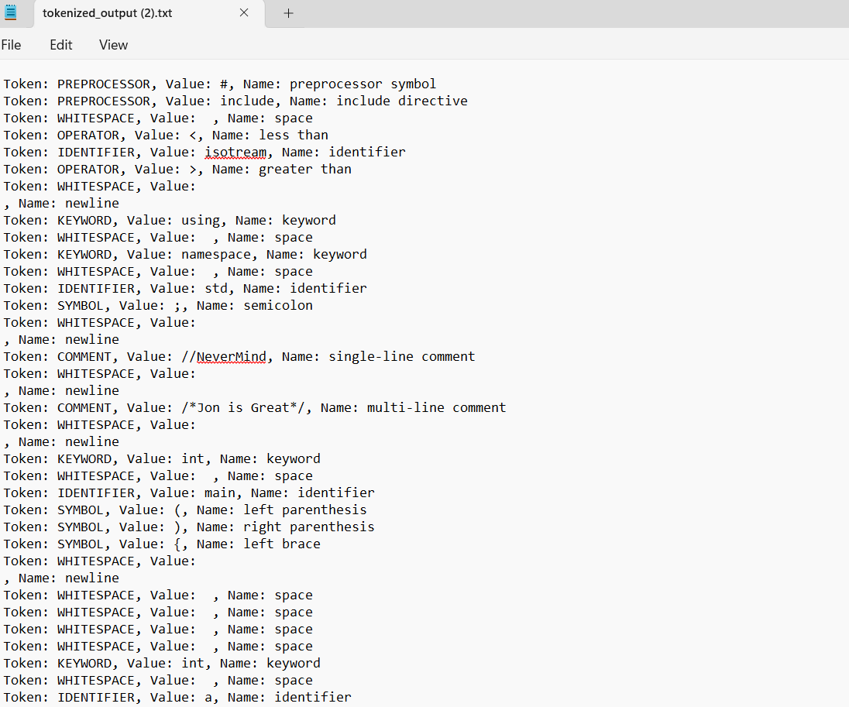
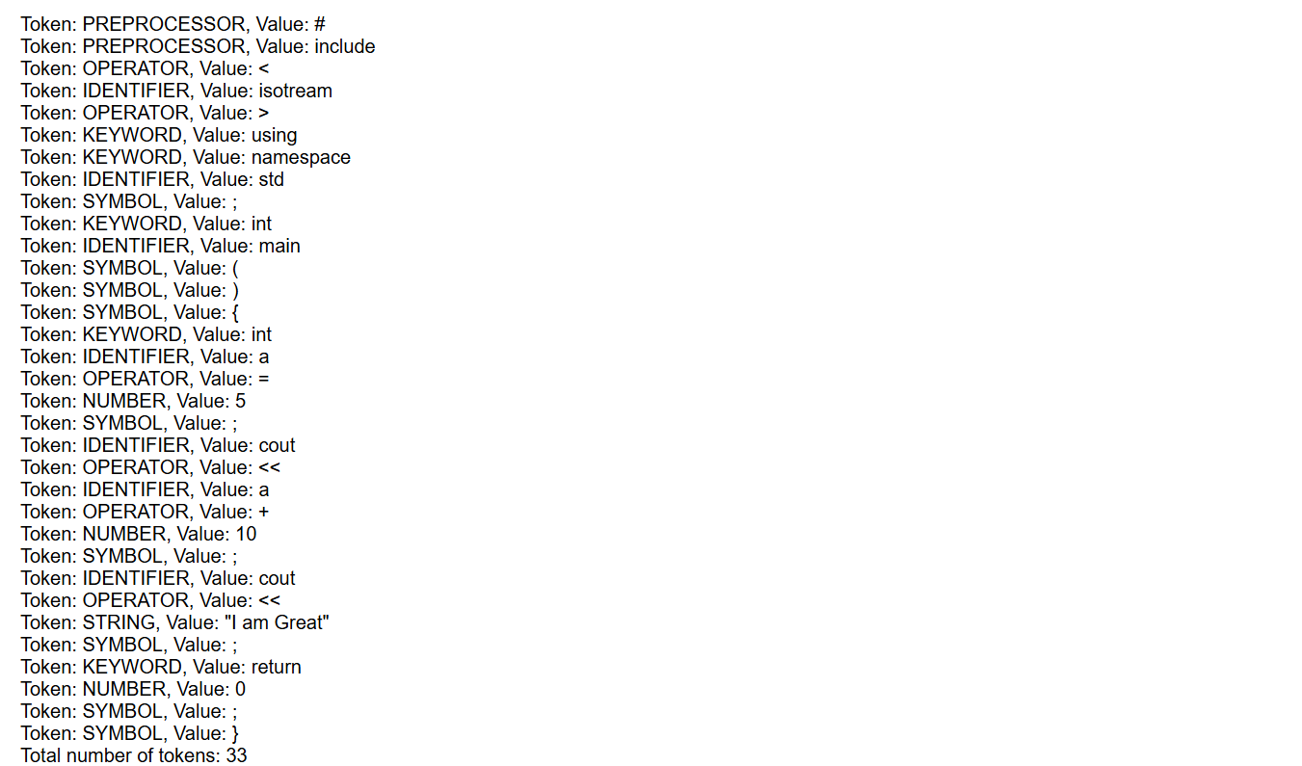
Tokens on Web Browser
Tokens in Downloaded File

Slide 9
Challenges Faced & Resolutions
Challenge 1: Integrating C++ lexer with web frontend.
Resolution: Used Emscripten to compile lexer.cpp to lexer.wasm, added extern "C" API.
Challenge 2: Handling complex C++ tokens (e.g., <<=, comments).
Resolution: Implemented robust tokenization in lexer.cpp.
Challenge 3: Accurate token naming in General mode.
Resolution: Developed getTokenName function for descriptive names.

Slide 10
Roles and responsibilities
Ashutosh Munindra Jha (Project lead and Lexical Analyzer Developer)
Akula Sai Santhosh Kumar (Lexical Analyzer Developer and Designer)
Rahul Negi (C++ integration & API)
Parkhi Rastogi (Frontend Developer)

Slide 11
TESTING
Tested C++ and general code inputs.
Verified token and symbol table outputs.
Validated web UI for typed input and .cpp uploads.
Ensured browser display and .txt download.

Slide 12
Conclusion and future scope
Built web-based lexical analyzer for C++ and general code.
Supports typed input and .cpp file uploads.
Outputs tokens, symbol table to browser or .txt file.
Future Scope:
Add lexical analysis for Python, Java.
Implement syntax highlighting in UI.
Integrate with full compiler pipeline.

