Slide 1

Notes:
[Sources]
Week8_Day2.ipynb, cells 0–6. Saved notebook outputs; no model was rerun.
Original PCA figure: cell 47. Decorative illustrations generated with OpenAI image generation; not data visualizations.
[/Sources]

Slide 2
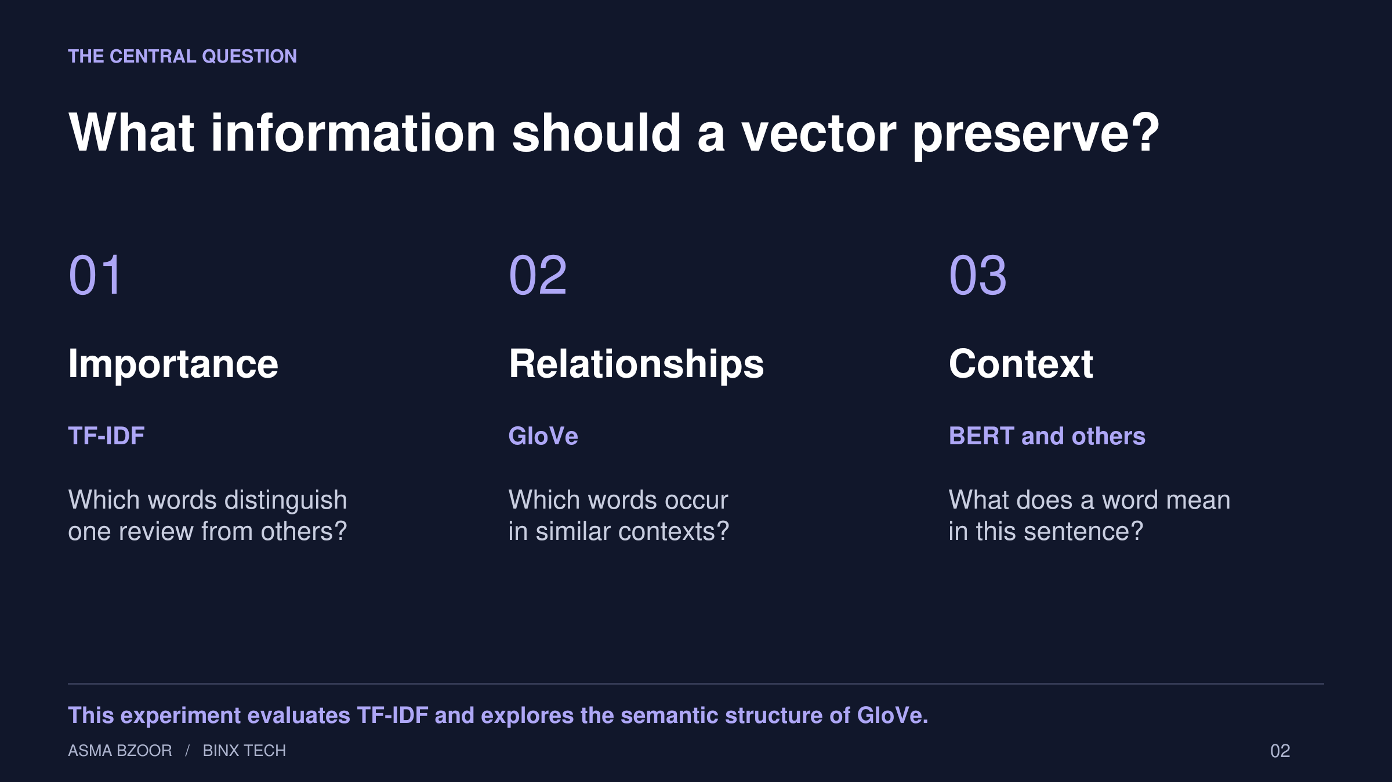
Notes:
[Sources]
Week8_Day2.ipynb, cells 2–6. Saved notebook outputs; no model was rerun.
Original PCA figure: cell 47. Decorative illustrations generated with OpenAI image generation; not data visualizations.
[/Sources]

Slide 3
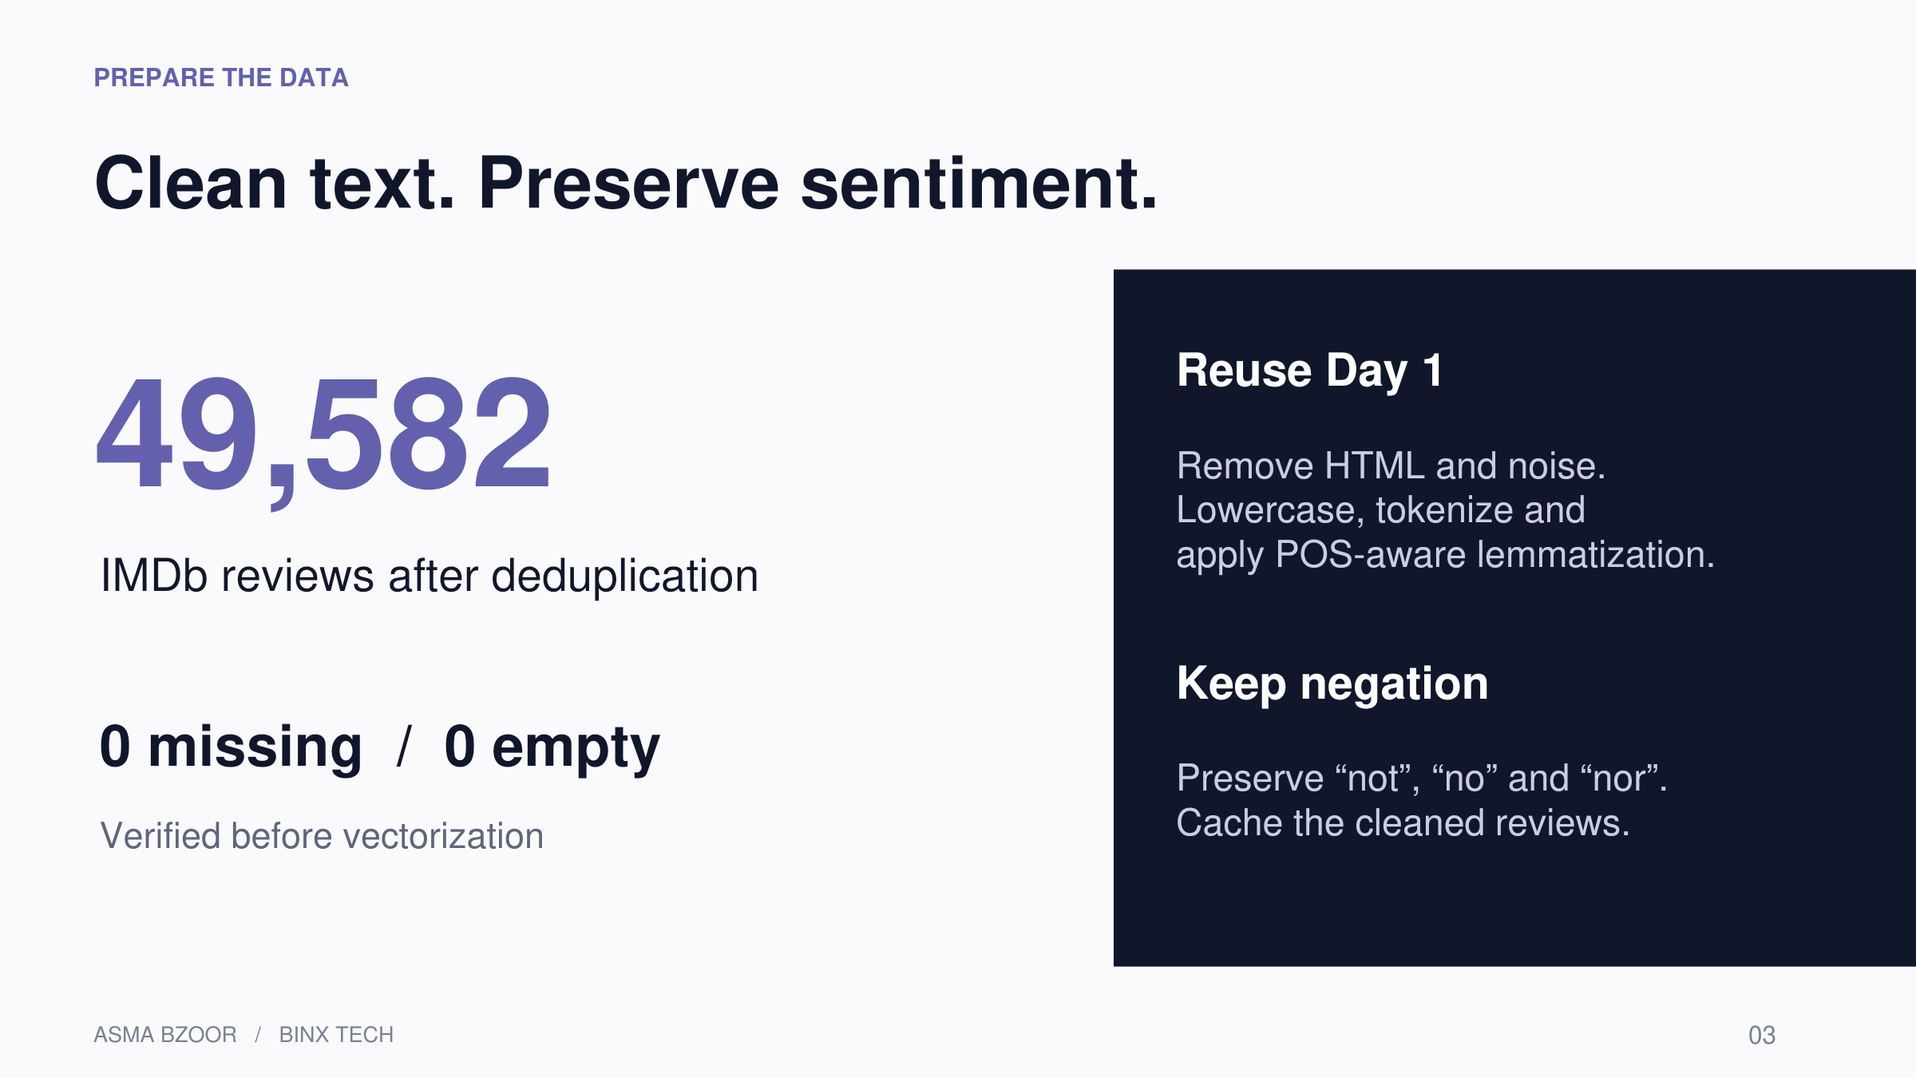
Notes:
[Sources]
Week8_Day2.ipynb, cells 10–17. Saved notebook outputs; no model was rerun.
Original PCA figure: cell 47. Decorative illustrations generated with OpenAI image generation; not data visualizations.
[/Sources]

Slide 4
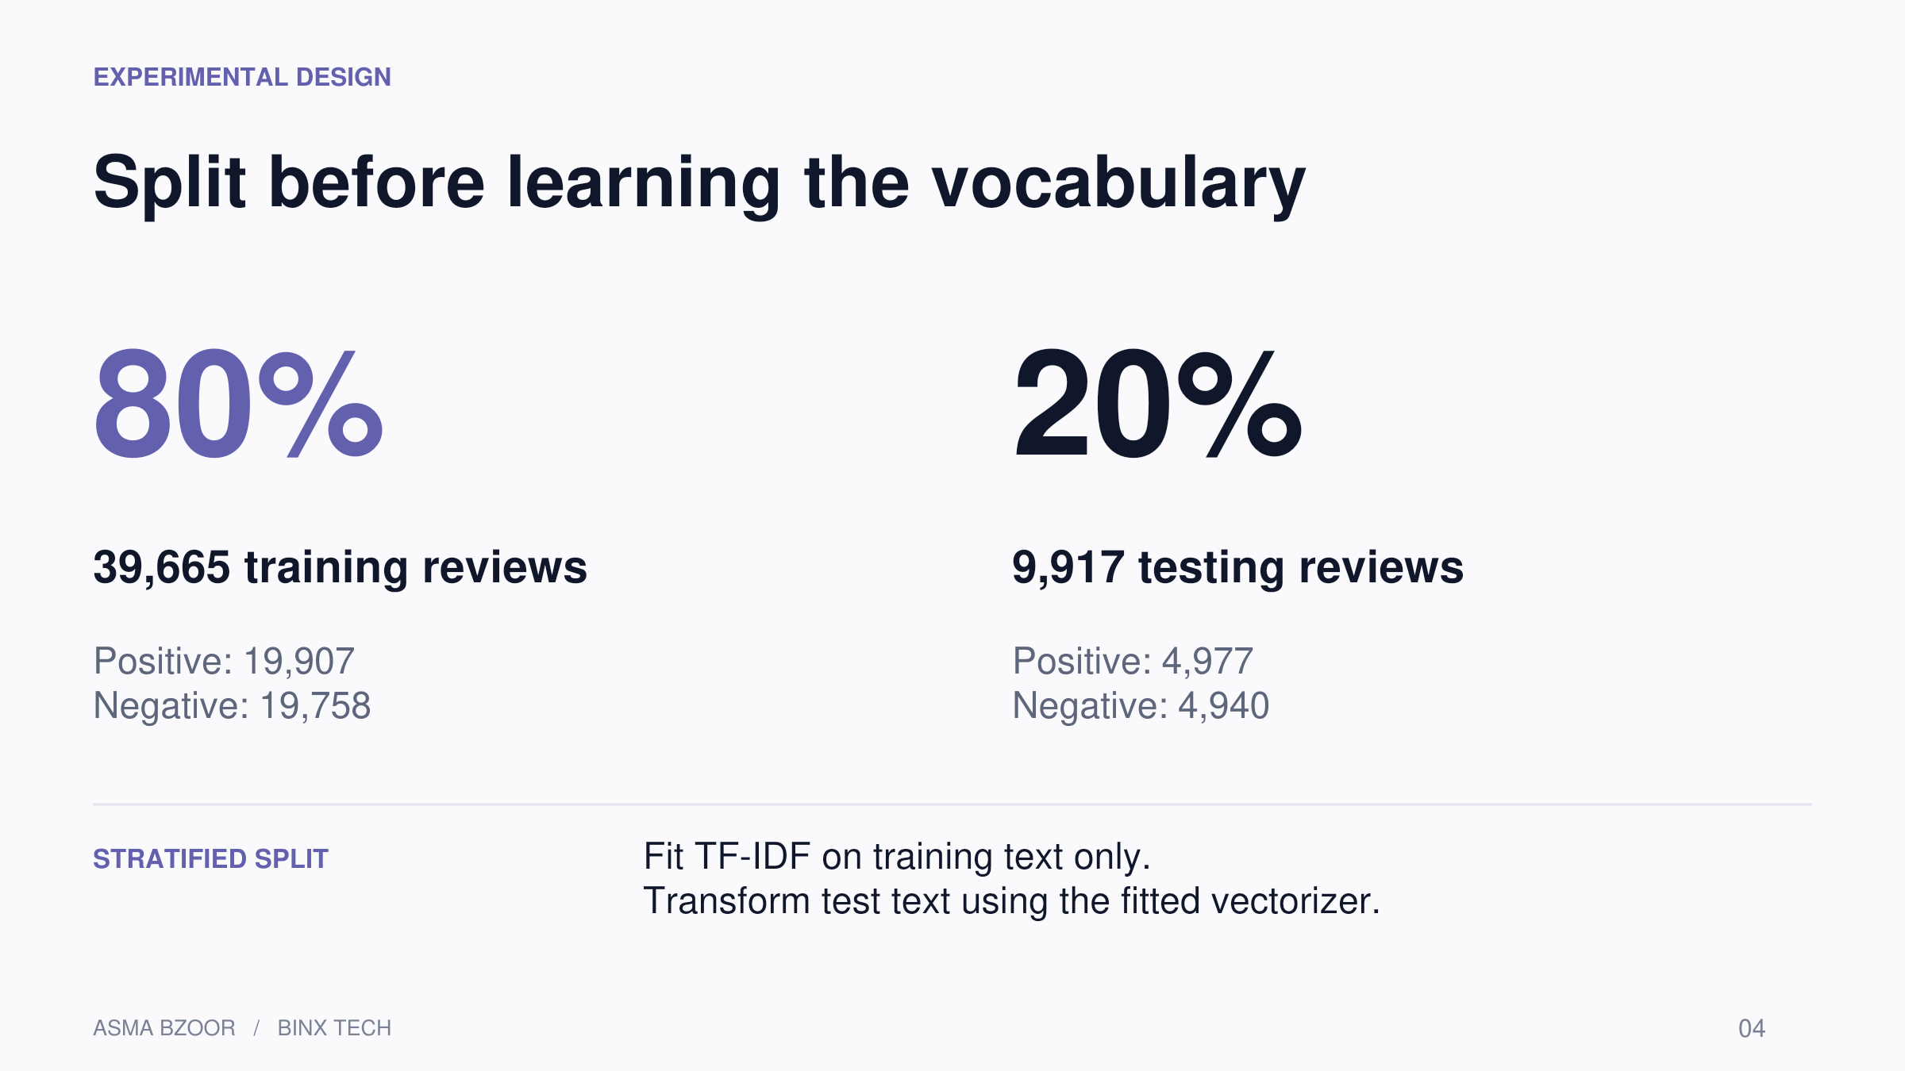
Notes:
[Sources]
Week8_Day2.ipynb, cells 19–23. Saved notebook outputs; no model was rerun.
Original PCA figure: cell 47. Decorative illustrations generated with OpenAI image generation; not data visualizations.
[/Sources]
80/20 split; random_state=42; stratify=y. Vocabulary and document frequencies are learned only from training data.

Slide 5
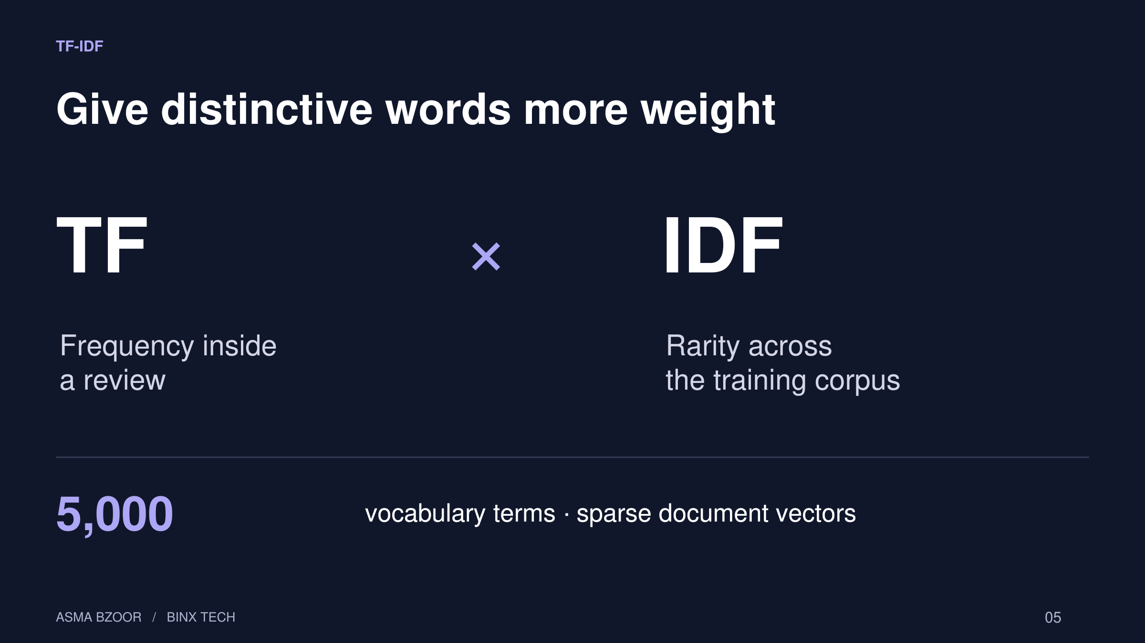
Notes:
[Sources]
Week8_Day2.ipynb, cells 3, 23–24. Saved notebook outputs; no model was rerun.
Original PCA figure: cell 47. Decorative illustrations generated with OpenAI image generation; not data visualizations.
[/Sources]
TF×IDF is the conceptual weighting. sklearn also applies its default smoothing and L2 normalization. Sparse matrix shapes: training 39,665 × 5,000; testing 9,917 × 5,000.

Slide 6
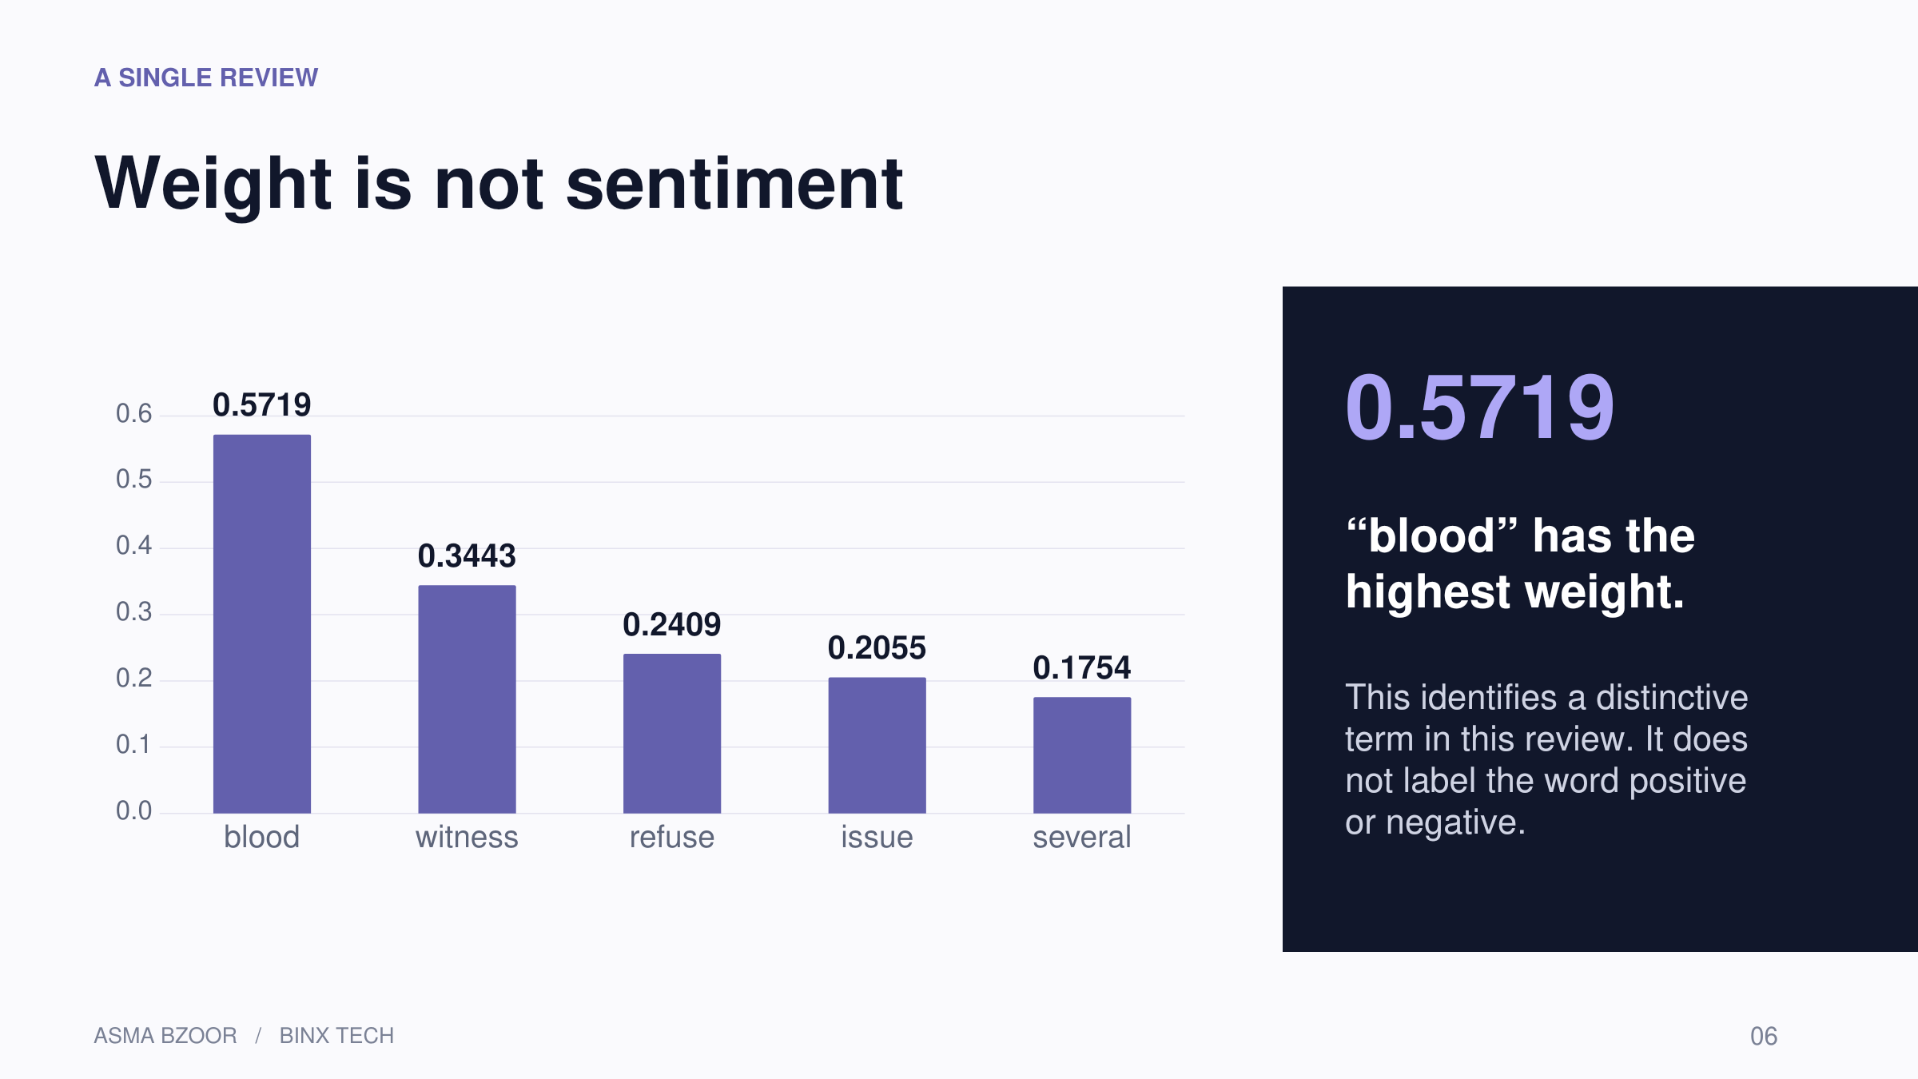
Notes:
[Sources]
Week8_Day2.ipynb, cells 26–27. Saved notebook outputs; no model was rerun.
Original PCA figure: cell 47. Decorative illustrations generated with OpenAI image generation; not data visualizations.
[/Sources]
The five largest TF-IDF weights from the first training review, rounded to four decimal places. These weights are not logistic-regression coefficients.

Slide 7
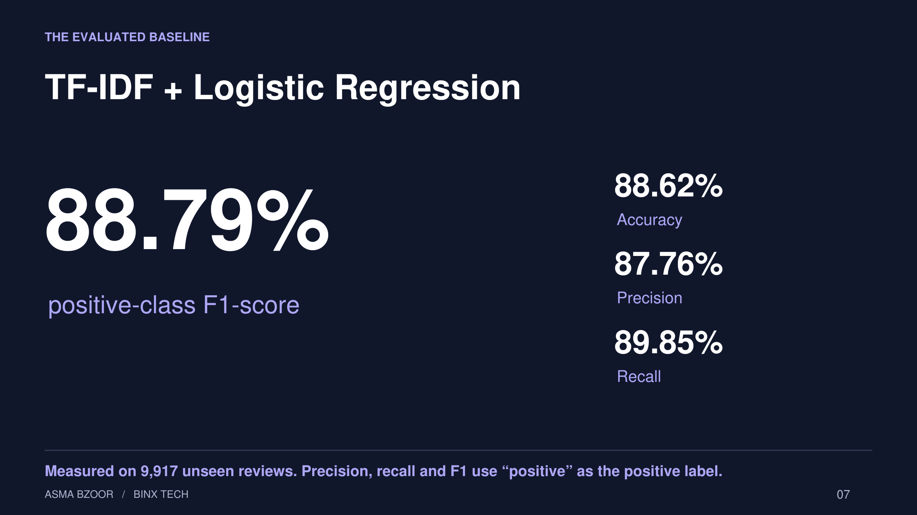
Notes:
[Sources]
Week8_Day2.ipynb, cells 30–33. Saved notebook outputs; no model was rerun.
Original PCA figure: cell 47. Decorative illustrations generated with OpenAI image generation; not data visualizations.
[/Sources]
LogisticRegression(max_iter=1000, random_state=42). Results come from one held-out test split; no CV estimate was reported.

Slide 8
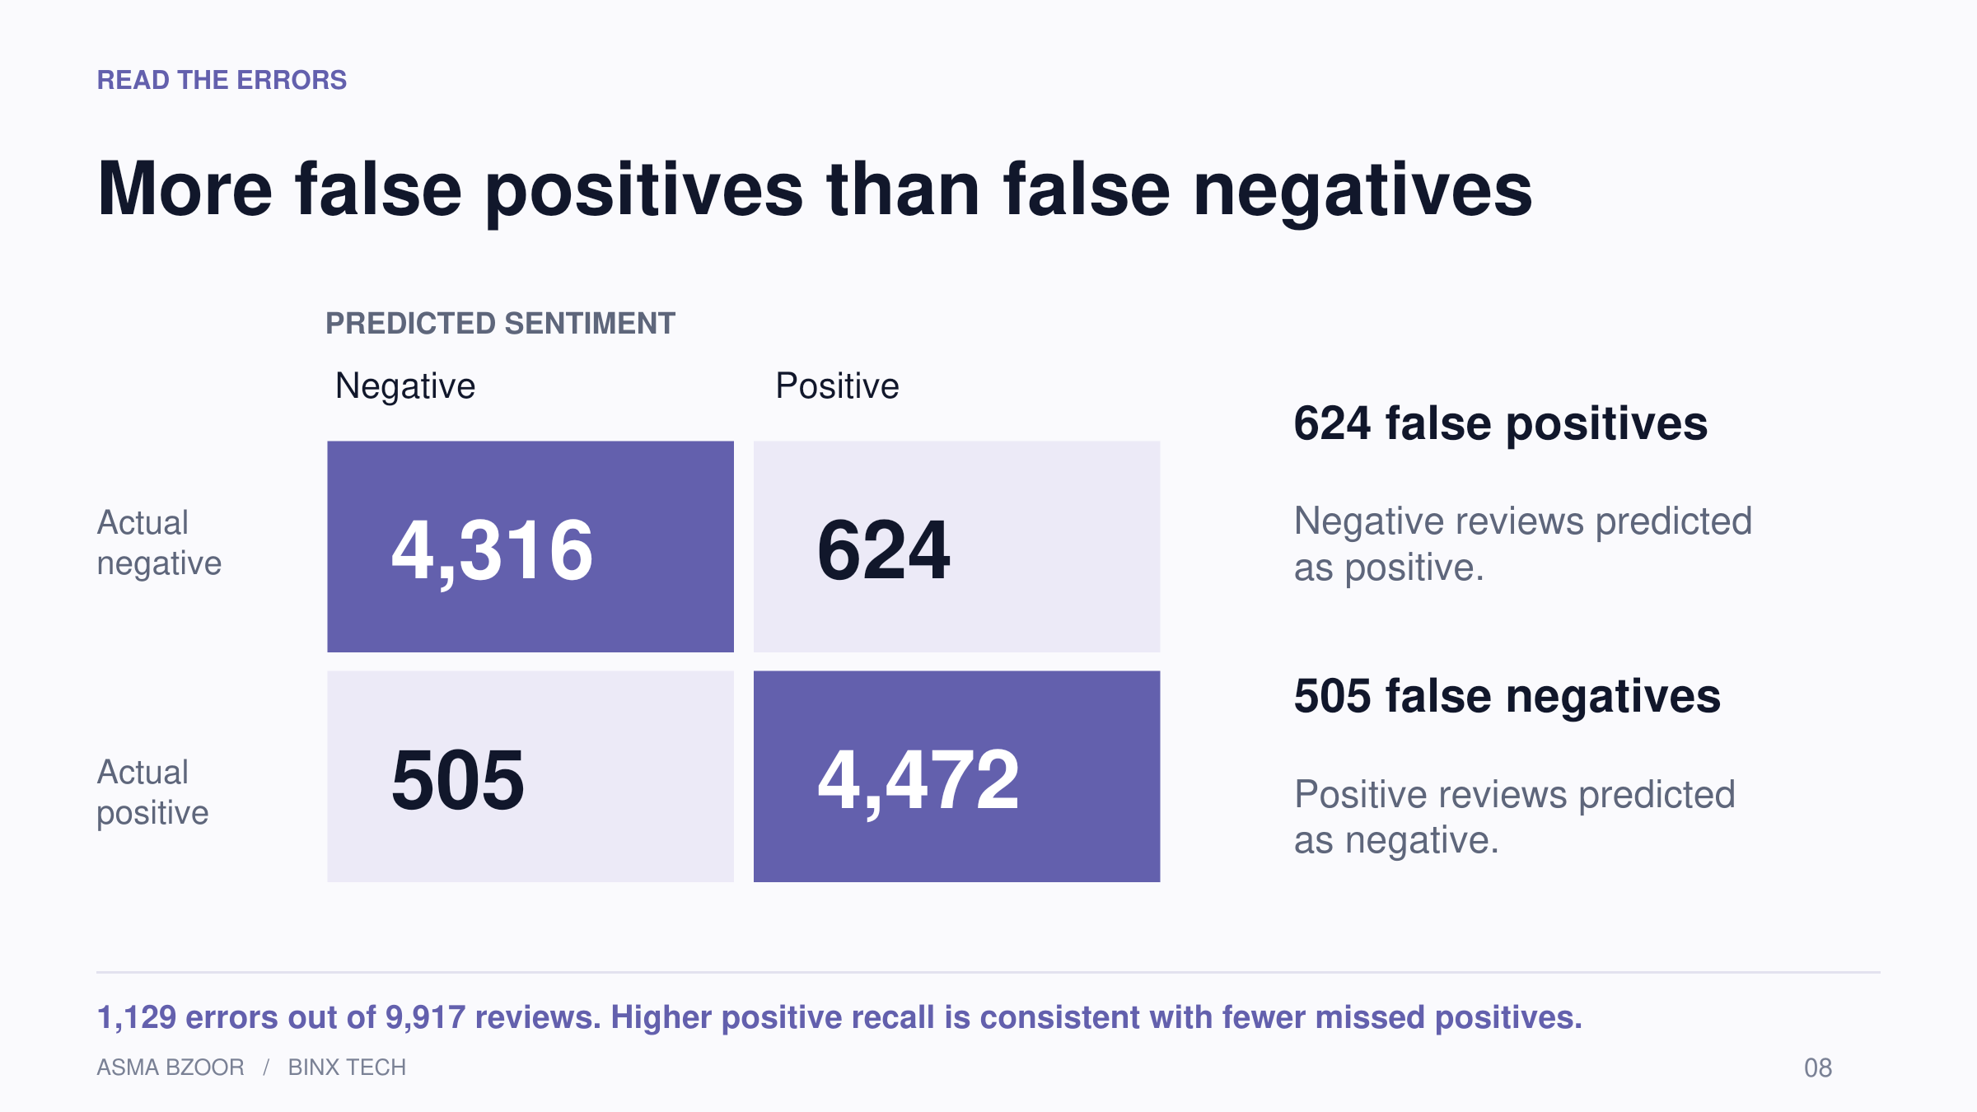
Notes:
[Sources]
Week8_Day2.ipynb, cells 35–36. Saved notebook outputs; no model was rerun.
Original PCA figure: cell 47. Decorative illustrations generated with OpenAI image generation; not data visualizations.
[/Sources]
Matrix reconstructed exactly from the original notebook: TN=4,316; FP=624; FN=505; TP=4,472. Rows are true labels; columns predicted labels.

Slide 9
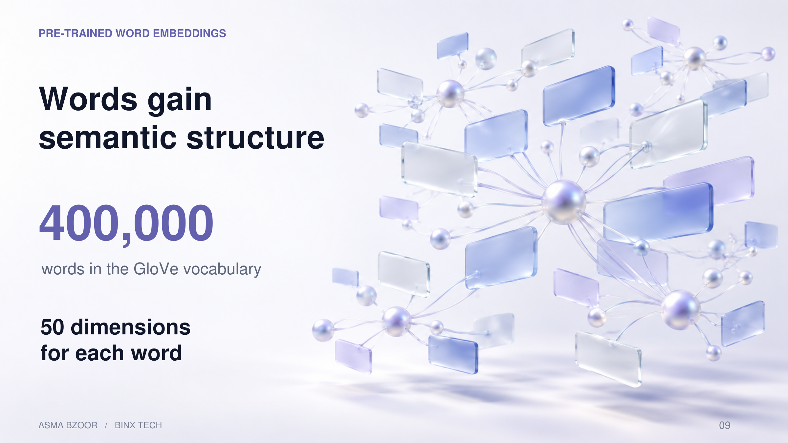
Notes:
[Sources]
Week8_Day2.ipynb, cells 39–42. Saved notebook outputs; no model was rerun.
Original PCA figure: cell 47. Decorative illustrations generated with OpenAI image generation; not data visualizations.
[/Sources]
glove-wiki-gigaword-50. A fixed dense vector per word. Its dimensions are interpreted through relative geometry rather than individually named meanings. This is a pre-trained representation, not an IMDb classifier.

Slide 10
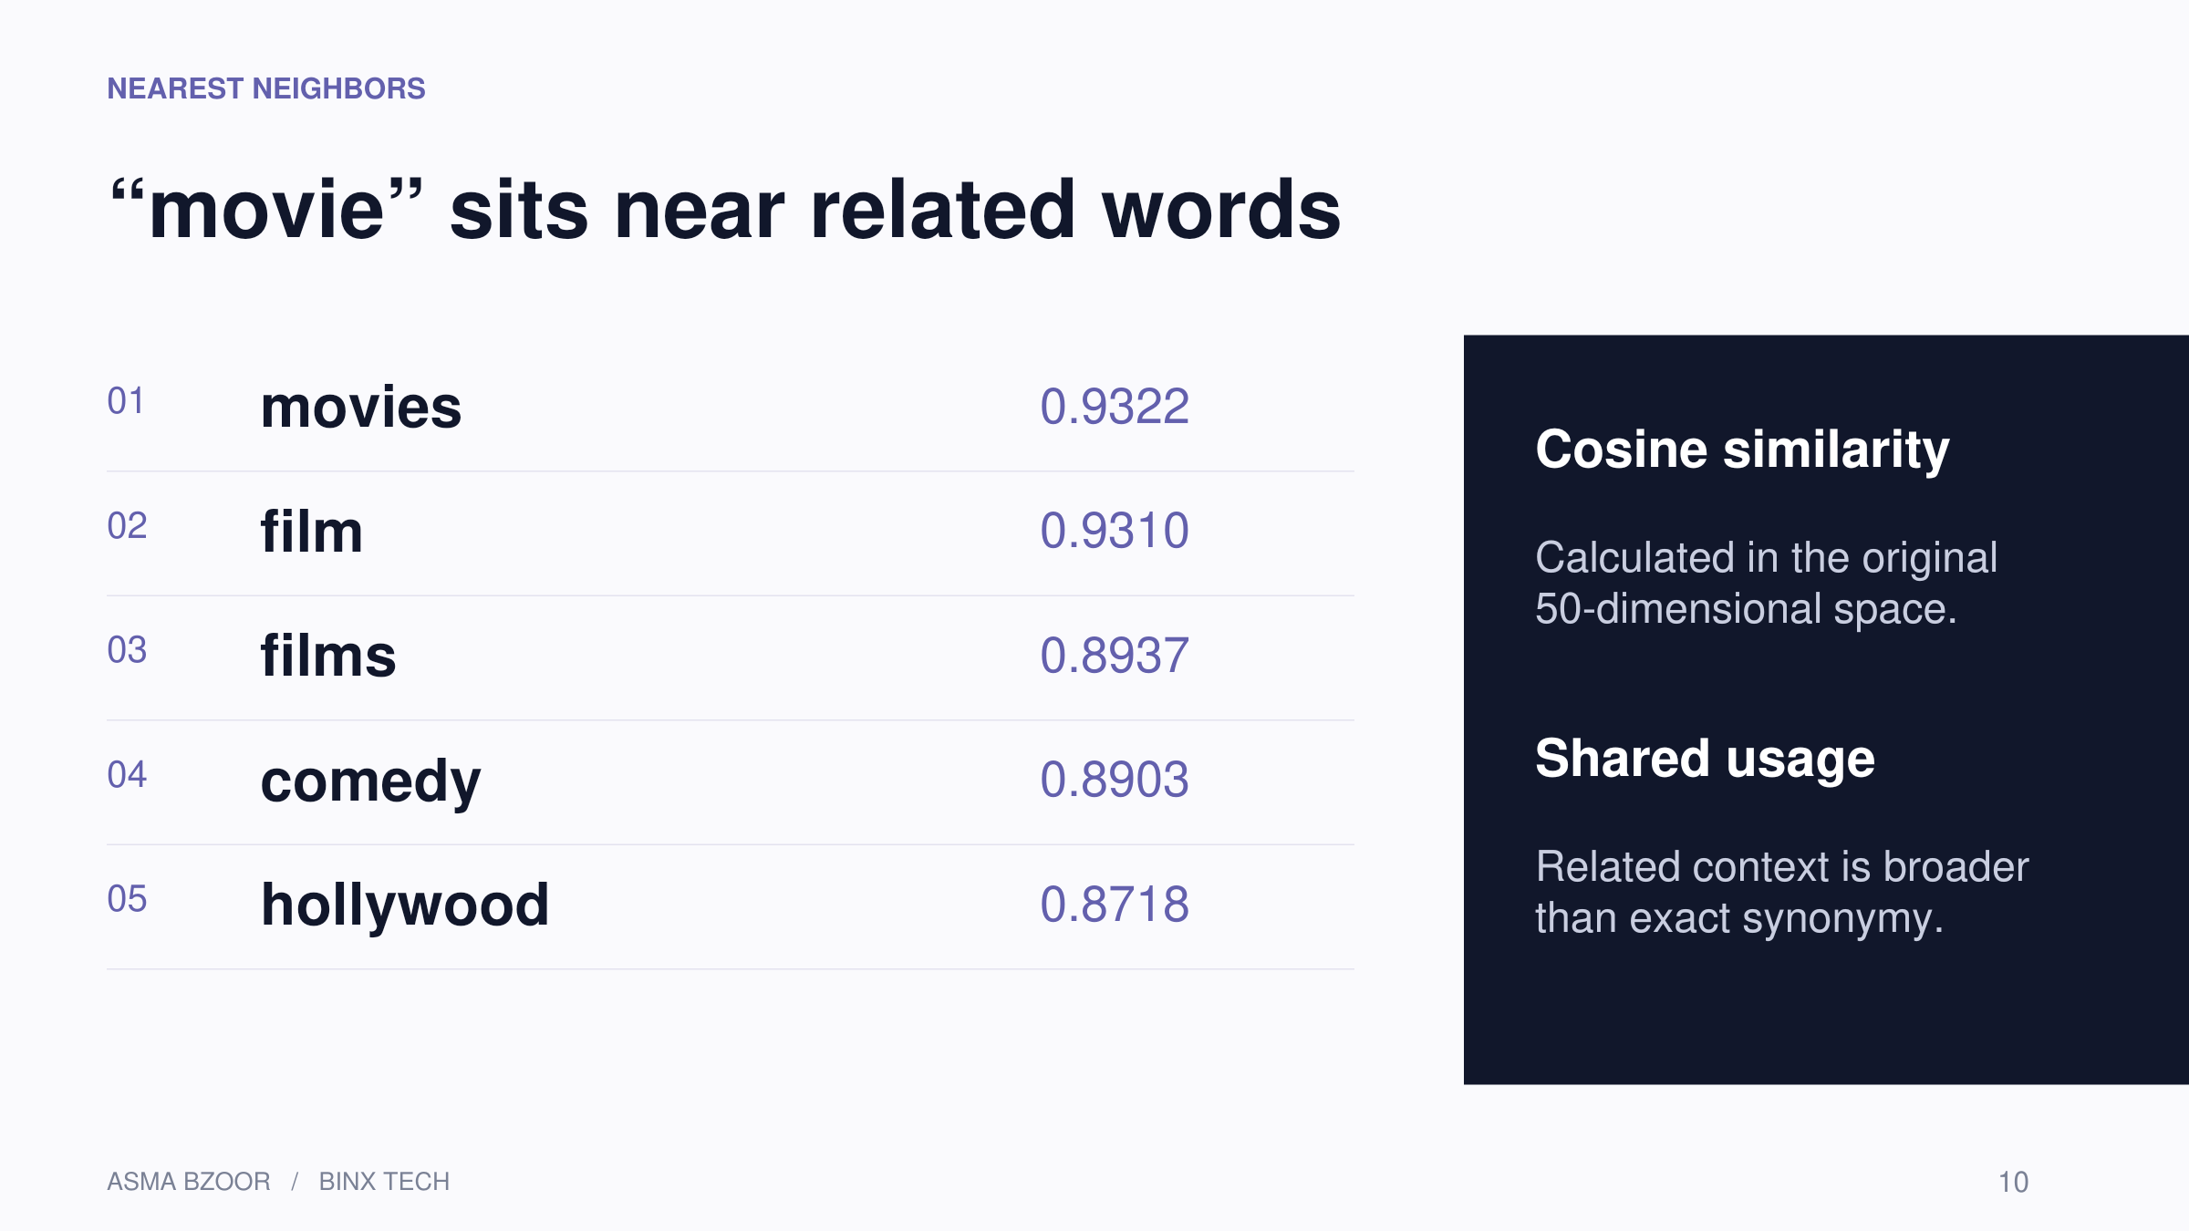
Notes:
[Sources]
Week8_Day2.ipynb, cells 44–45. Saved notebook outputs; no model was rerun.
Original PCA figure: cell 47. Decorative illustrations generated with OpenAI image generation; not data visualizations.
[/Sources]
Nearest neighbors returned by most_similar(word,topn=5). Values are cosine similarities, not probabilities.

Slide 11
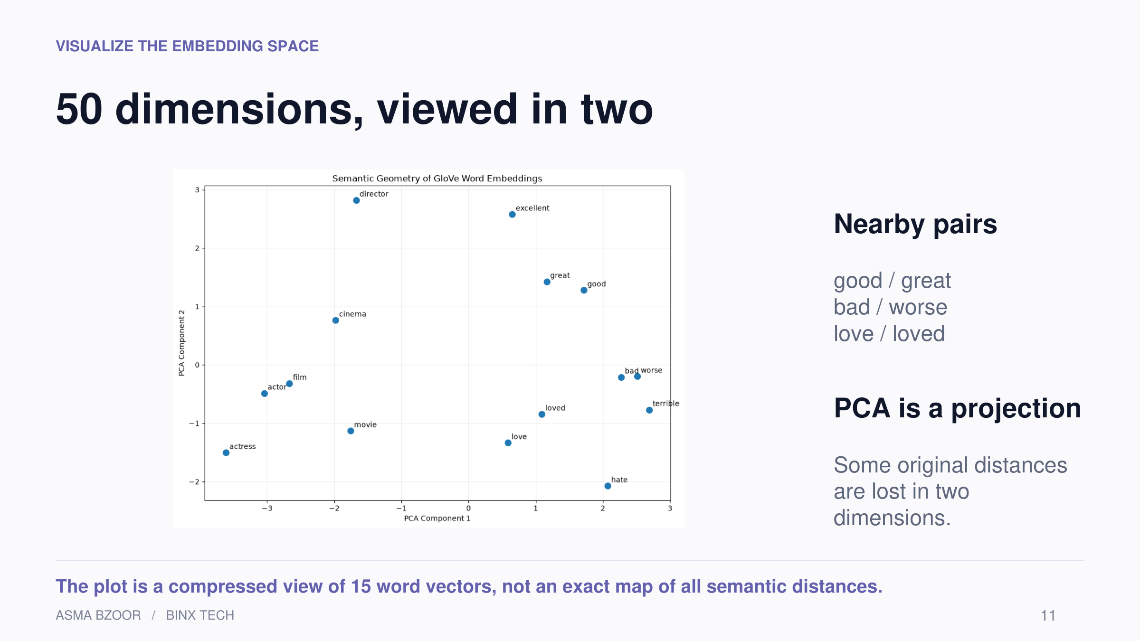
Notes:
[Sources]
Week8_Day2.ipynb, cells 47–48. Saved notebook outputs; no model was rerun.
Original PCA figure: cell 47. Decorative illustrations generated with OpenAI image generation; not data visualizations.
[/Sources]
Original PCA output embedded. Explained variance was not reported. Axes should not be interpreted as positivity/negativity.

Slide 12
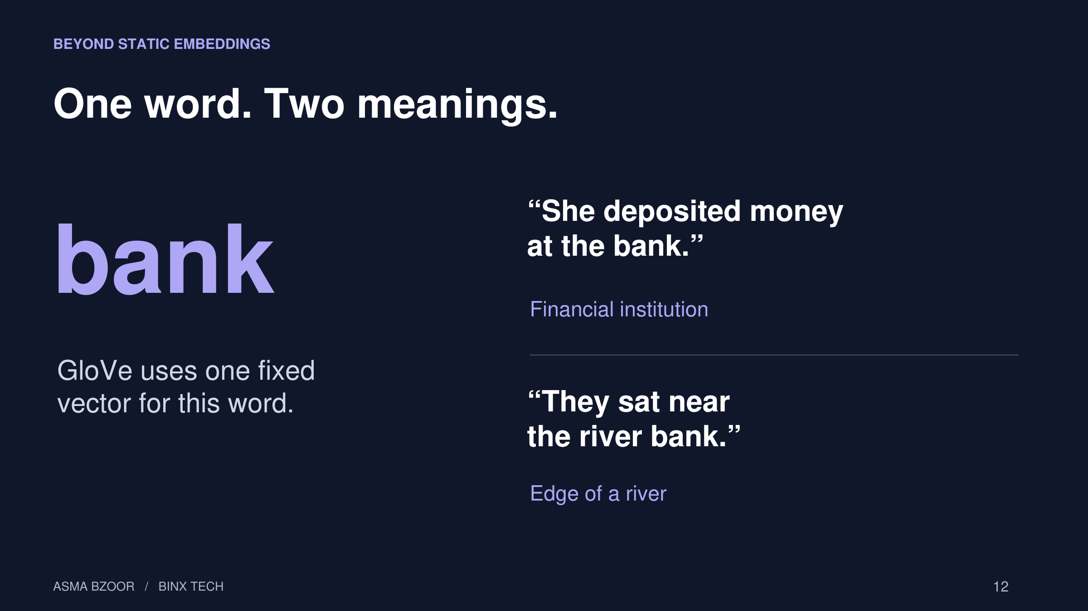
Notes:
[Sources]
Week8_Day2.ipynb, cells 5. Saved notebook outputs; no model was rerun.
Original PCA figure: cell 47. Decorative illustrations generated with OpenAI image generation; not data visualizations.
[/Sources]
Contextual representations such as BERT can change with the sentence. This is conceptual only; no contextual model was evaluated in the notebook.

Slide 13
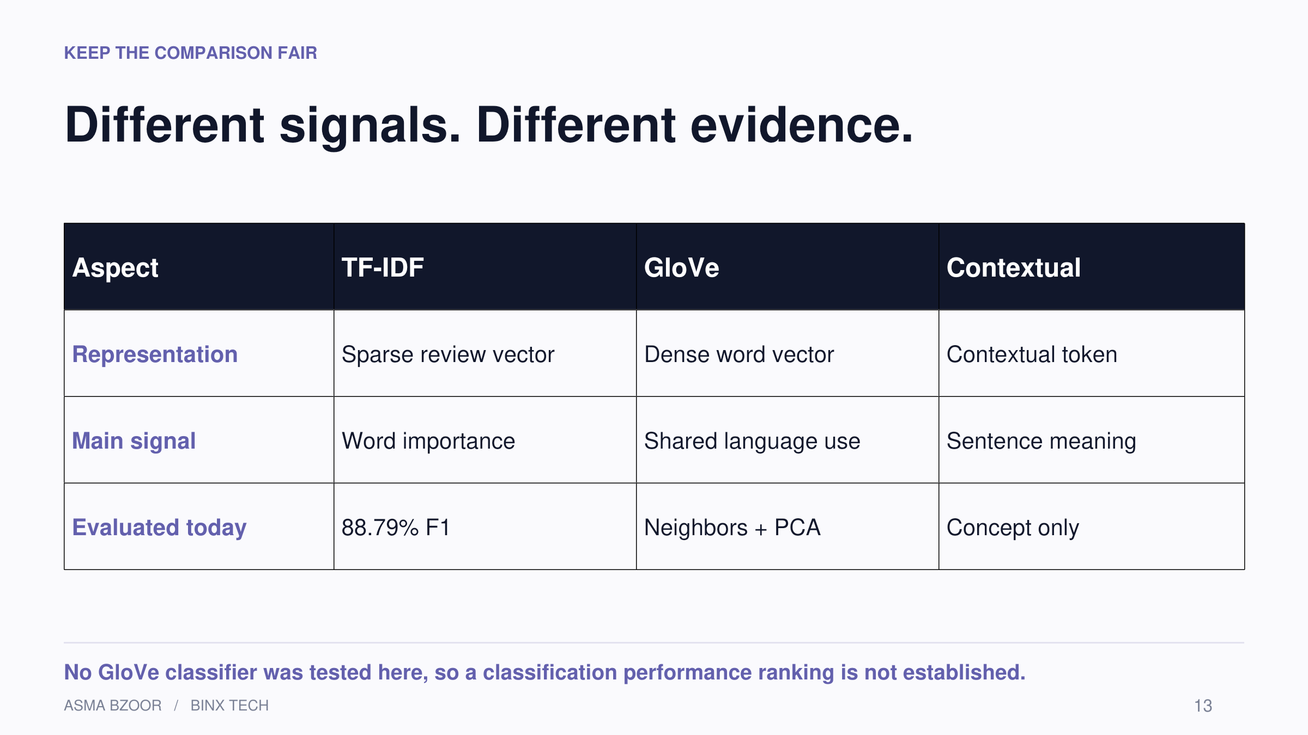
Notes:
[Sources]
Week8_Day2.ipynb, cells 50–52. Saved notebook outputs; no model was rerun.
Original PCA figure: cell 47. Decorative illustrations generated with OpenAI image generation; not data visualizations.
[/Sources]
Do not compare these results with Week 7 experiments on a different dataset. No computational-cost benchmark was performed.

Slide 14
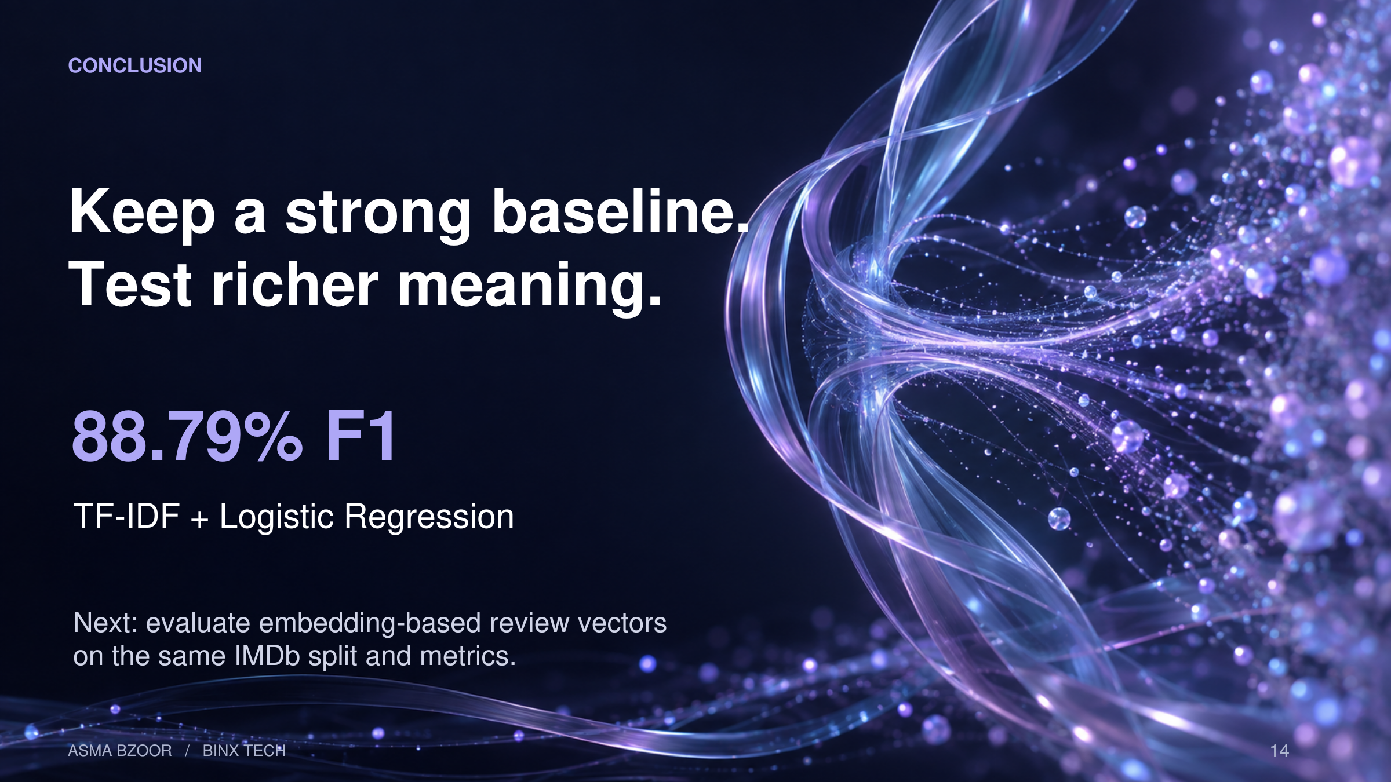
Notes:
[Sources]
Week8_Day2.ipynb, cells 51–53. Saved notebook outputs; no model was rerun.
Original PCA figure: cell 47. Decorative illustrations generated with OpenAI image generation; not data visualizations.
[/Sources]
Use the same split and metrics for a fair next experiment. A method for aggregating word embeddings into review vectors must be chosen.

