Slide 1
“Waterfall, Agile and beyond: The power of an Exploratory tester”
Ajay Balamurugadas

Slide 2



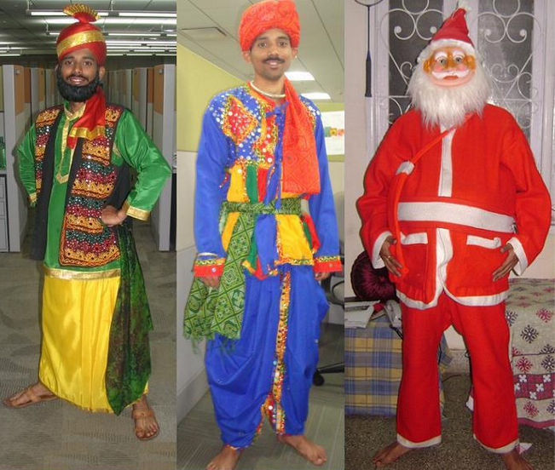

Slide 3
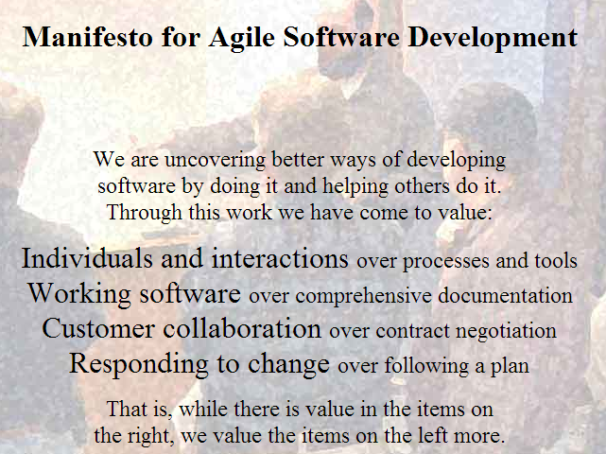
The Manifesto
Source: http://agilemanifesto.org/

Slide 4
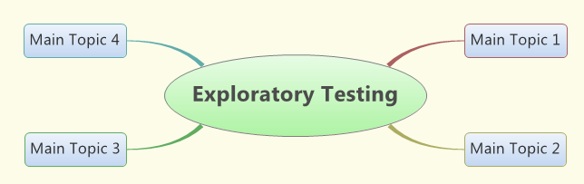

Slide 5

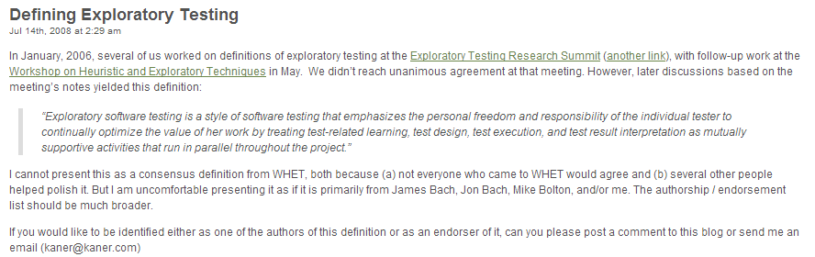
Exploratory Testing
From http://kaner.com/?p=46

Slide 6
ET – good & bad
What is ET and how is an Exploratory Tester more powerful?
Who can do ET?
Why ET is suited for most kinds of projects?
When ET should be performed?
Where do tools fit in ET?

Slide 7
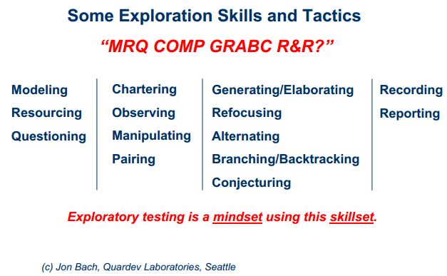
ET Skills

Slide 8
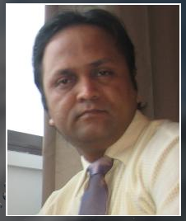

Myths of ET
http://shrinik.blogspot.de/2008/03/18-myths-associated-with-exploratory.html

Slide 9
MY fieldstones today
Exploratory Testing Explained – James Bach
Defining Exploratory Testing – Cem Kaner
Breaking Down (and building up) Exploratory Testing Skill – Jon Bach
Why Exploration has a place in any strategy – James Lyndsay
Ministry of Testing
http://www.ministryoftesting.com/resources/exploratory-testing/
http://www.ministryoftesting.com/resources/mindmaps/

Slide 10


