Slide 1
Beyond the UI
Becoming a More Technical Tester
Erica Walker

Slide 2
Move Beyond the UI

Slide 3
1 Why We Should Become More Technical
2 Encouraging Technical Exploration
3 Steps to Get Started

Slide 4
Why become more technical?

Slide 5
A technical tester challenges software by going beyond the UI in a way
the typical user would not.
Erica Walker, 2015
Notes:
Create your own definition of what it means to be a technical tester.

Slide 6
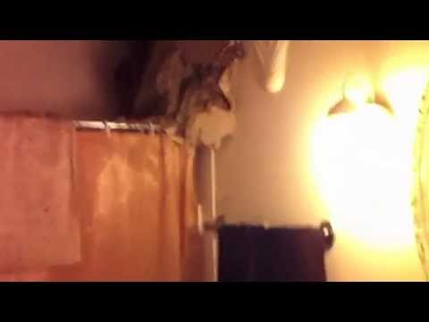
Notes:
Here is a non-technical example of a difficult time in my life, a time when I wish I’d gone beyond the “UI” to recognize a deeper issue.

Slide 7
Encourage Technical Exploration
Notes:
Do something, do anything—just move.

Slide 8
How (and when) to Ask for Help

Slide 9
Be vulnerable, not expensive.
Notes:
Admiting that you don’t know is hard—be vulnerable anyway.
In this process, avoid being “expensive” to others and to yourself. Explore on your own first, or ask someone how you can get started on your own exploration. Do not be expensive to others by spending their time and energy on learning you could do on your own. Also, don’t be expensive to yourself—if you are frustrated, and feel your progress has stalled, reach out for help.

Slide 10
When to Ask for Help
AFTER speaking to the rubber duck
AFTER checking the knowledge base
AFTER searching your friend Google
Rubber ducking from Andrew Hunt & David Thomas, 2000
The Programatic Programmer
Notes:
Don’t have a knowledge base at your work? Create your own. Keeping it organized is important.

Slide 11
How to Ask for Help
Be good to work with
Bring “what you know” with you
Use the correct medium
Find someone who is willing and able
Keep trying
Notes:
With each interaction, work toward building a relationship. This is more than just an exchange of information, you are building a connection.

Slide 12
Social Capital
“Social capital refers to the collective value of all "social networks" [who people know] and the inclinations that arise from these networks to do things for each other ["norms of reciprocity"].”
Saguaro Seminar at the Harvard Kennedy School

Slide 13
Social Capital
“[Helpfulness is] absolutely core to successful teams, and it routinely outperforms individual intelligence. Helpfulness means I don't have to know everything, I just have to work among people who are good at getting and giving help.”
Margaret Heffernan, 2015
TED Talk: Why it’s Time to Forget the Pecking Order at Work
Notes:
Be willing to get and give in order to create a stronger, more effective relationship.

Slide 14
Impostorship
The idea that you lack the ability and the right to be where you are, and that someone will humiliate you by exposing your shortcomings. It is believing that you alone are less than able, and are surrounded by others who are far superior.
Stephen D. Brookfield, 2006
The Skillful Teacher
Notes:
Defuse impostorship by talking about your fears with someone you trust. You are not alone, and you can do it.

Slide 15
Talk Time
What makes you interesting?
What do you like to share about testing?
What baffles you about testing?

Slide 16
Talk Time
What makes you interesting?
Love to play ukuleles
What do you like to share about testing?
Power of social capital
What baffles you about testing?
Automation "checking"

Slide 17
Steps to Get Started
Notes:
This is a compilation of what I’ve gained over the past few years through Social Capital. It really works.

Slide 18
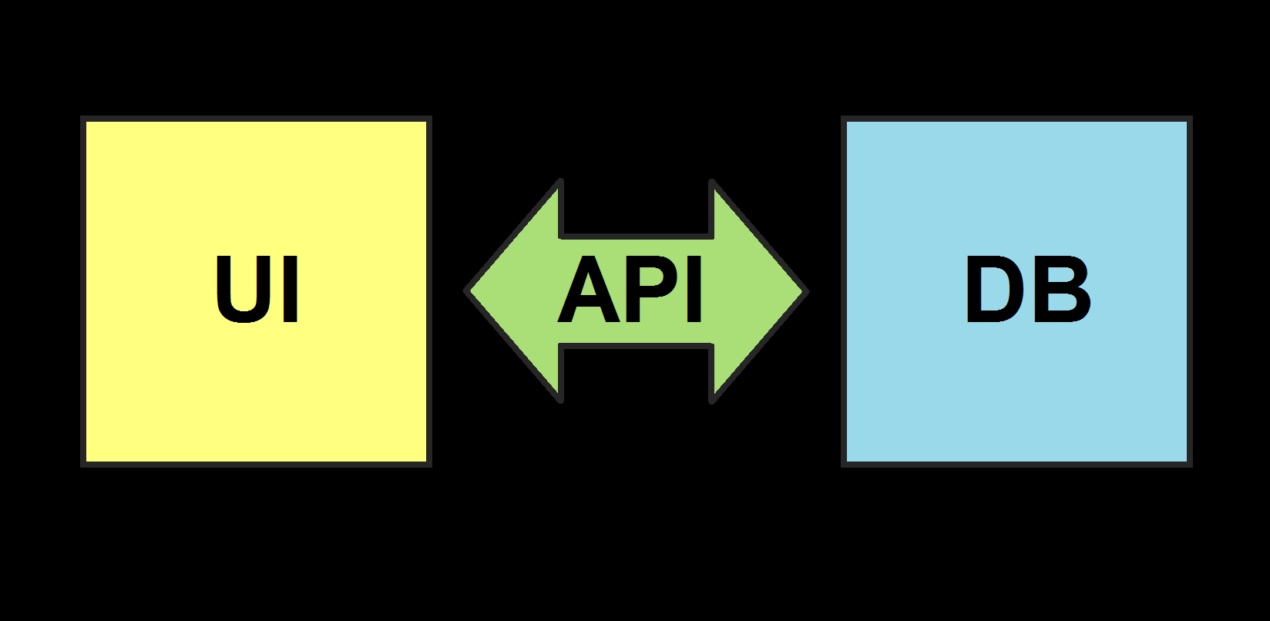

Slide 19
1 Console/Debugger: Devtools, Chrome
2 APIs: PostMAN
3 DB: SQL Fiddle
Notes:
These are a few of my favorite things:
Console/Debugger: DevTools...http://discover-devtools.codeschool.com/
APIs: PostMAN...https://www.getpostman.com/docs/blog_mentions
DB: SQL, SQLFIDDLE ...http://www.w3schools.com/SQl/sql_intro.asp, http://sqlfiddle.com/

Slide 20
1 Console/Debugger: Devtools, Chrome
2 APIs: PostMAN
3 DB: SQL Fiddle

Slide 21
1 Console/Debugger: Devtools, Chrome
2 APIs: PostMAN
3 DB: SQL Fiddle

Slide 22
1 Console/Debugger: Devtools, Chrome
2 APIs: PostMAN
3 DB: SQL Fiddle

Slide 23
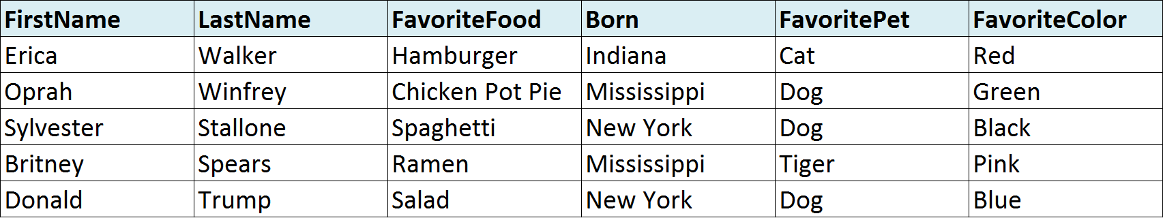
DB: SQL
SELECT *
from TableName

Slide 24
DB: SQL
SELECT FirstName, LastName, FavoriteFood
from TableName

Slide 25
DB: SQL
SELECT *
from TableName
WHERE Born = ‘Mississippi’

Slide 26
1 Why We Should Become More Technical
2 Encouraging Technical Exploration
3 Steps to Get Started

Slide 27
Move Beyond the UI
Notes:
Action Steps
Explore, explore, explore! Open the console in your browser, Download PostMAN, take a look at your DB and diagram it.
If you’re a manager or a member of a team, meet with them and discuss this talk. Give this talk.
My mantra: Be vulnerable, not expensive.

Slide 28
Handout at http://tinyurl.com/Erica-CAST2015

