Slide 1
A leap towards Context-Driven

Slide 2




Erik Brickarp
@brickuz
erik.brickarp@houseoftest.se
http://erik.brickarp.se

Slide 3


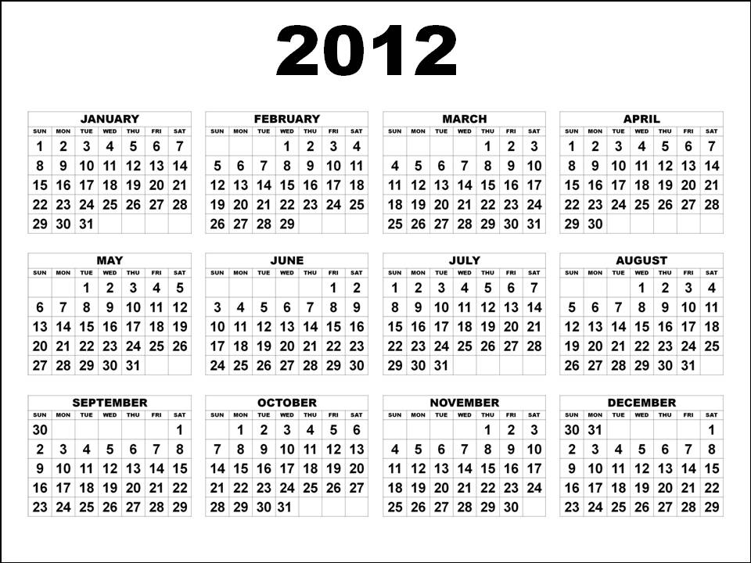

Context
Notes:
http://www.qualityunearthed.co.uk/blog/guess-happiest-weve-years-survey-reveals/

Slide 4
ACT 1 : Starting

Slide 5
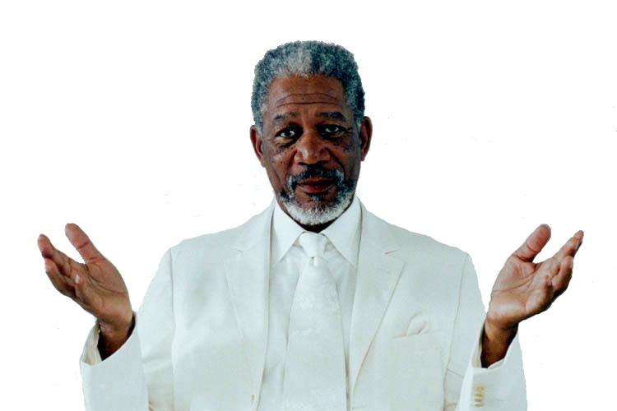
Any limits?
Notes:
http://yourblackworld.net/2012/05/the-presence-of-happy-people-appears-to-raise-suicide-rate/

Slide 6

Disappointment
Notes:
http://sarahmascarah.wordpress.com/2011/12/20/do-something-you-love/

Slide 7

Problems to solve?
Notes:
http://yourblackworld.net/2012/05/the-presence-of-happy-people-appears-to-raise-suicide-rate/

Slide 8
Disappointment
Notes:
http://sarahmascarah.wordpress.com/2011/12/20/do-something-you-love/

Slide 9

Solution?
Notes:
http://michaelmattis.blogspot.se/2013/03/the-5-stages-of-listening-to-what-you.html

Slide 10

Speed!
Notes:
http://mewarnai.us/155333-lightning-mcqueen

Slide 11
ACT 2 : Chaos

Slide 12

Losing track
Notes:
http://expertro1337.blogspot.se/

Slide 13
Solution?
Notes:
http://michaelmattis.blogspot.se/2013/03/the-5-stages-of-listening-to-what-you.html

Slide 14

Saam Eriksson

Slide 15
ACT 3 : Start over

Slide 16

Vacation
Notes:
http://retail.regionaldirectory.us/medical-equipment-and-supplies/

Slide 17

Finally!
Notes:
http://www.redhotmarketingblender.com/2012/09/innovation-work-the-system/

Slide 18
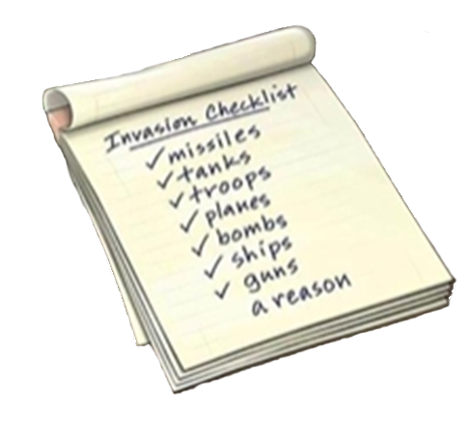
List
Notes:
http://my.englishclub.com/profiles/blogs/check-list

Slide 19
Status

Slide 20
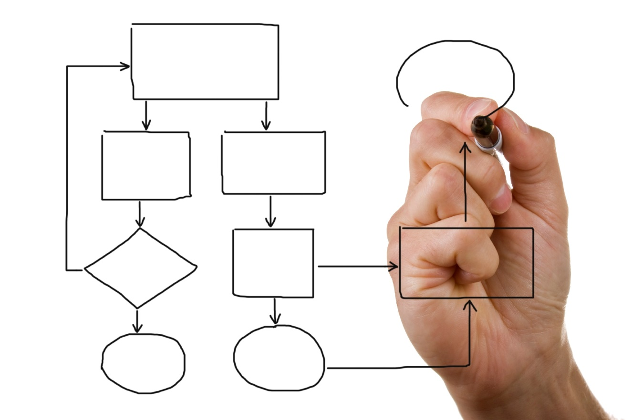
Test Process

Slide 21
ACT 4 : Improving

Slide 22
Test Matrix Tool
Network down
Slow network
Packages lost
Bad answer
Invalid answer code
Invalid ping
…

Slide 23
Guidelines != Rules

Slide 24
ACT 5 : Defending

Slide 25

Curiosity
Notes:
http://brandingyoubetter.com/2011/08/social-media-business-effectiveness-tips-for-engaging-interaction/

Slide 26

Criticism
Notes:
http://malecodependence.com/category/anger/

Slide 27
ACT 6 : Finishing up

Slide 28
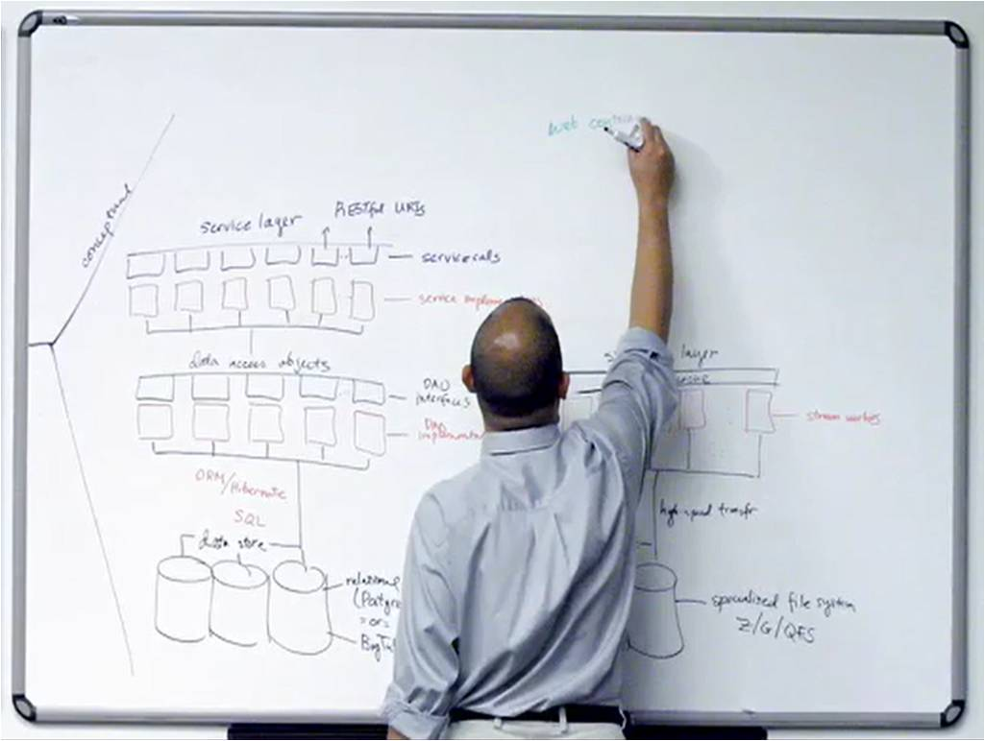
Retrospective
Notes:
http://www.arabianracing.org/product/report-subscription/

Slide 29

End Report
Notes:
http://wiki.openwebanalytics.com/images/3/3d/Mediawiki-logo.png

Slide 30
Lessons

Slide 31
Unprofessional!
Notes:
http://michaelmattis.blogspot.se/2013/03/the-5-stages-of-listening-to-what-you.html

Slide 32

Support
Notes:
http://galleryhip.com/happy-people-png.html

Slide 33

Understand what you’re changing from

Slide 34
Keep track

Slide 35
Reflect
Notes:
http://www.arabianracing.org/product/report-subscription/

Slide 36
Not black and white
Scripted
Exploratory
Ref. James Bach & Michael Bolton, Rapid Software Testing, updated to Formal and Informal though!
Notes:
Picture taken from
http://www.slideshare.net/QualiTest-Group/what-is-exploratory-testing
Explanation
http://www.developsense.com/blog/2014/07/sock-puppets-of-formal-testing/

Slide 37

Get a peer
Notes:
http://www.arabianracing.org/product/report-subscription/

Slide 38




Questions?
Notes:
http://michaelmattis.blogspot.se/2013/03/the-5-stages-of-listening-to-what-you.html

