Slide 1



Slide 2

Worlds First Professional CDT Education
By Martin Nilsson
Notes:
My name is Martin Nilsson, I started out my testing career by mistake at Ericsson Mobile Platforms.
After five years at Ericsson I was headhunted to House of Test for whom I have been consulting at Maersk, Qlik and most recently for EC Education. I am currently on my second half year long parental leave.

Slide 3
Introduction
Who am I?
Notes:
Started my testing career by accident in 2007 at Ericsson. Believed I had applied for a development job, knew nothing about test, best mistake in my professional career.

Slide 4

Get in Touch!
Meet Me at:
EuroStar
Let´s Test
ConTest
@martinnilsson8
#YHTest
Martin.nilsson@houseoftest.se

Slide 5

What is an Yrkeshögskola?
Notes:
Vocational University. When there is a specific need from an industry then an education can be created. In an education there is a board that requires that the industry has representatives to make sure that they can confirm that the education suits their needs.

Slide 6
YHTest
One and a half year long
Professional Education
Two current classes in two cities
Notes:
This particular education is 1,5 year long. It started in September 2014 and ends in December 2015.
It is a professional education meaning that the students should be able to start working directly after graduation.
Currently there are two classes running with additional three starting this September. One class in Malmö and one in Örebro. I have been teaching half of the Malmö class and after going on parental leave Maria Kedemo has taken over. In Örebro we have Erik Brickarp teaching.
The education is sponsored by the government but is organized and by EC Education, a commercial company. They in turn has hired resources to develop and teach the program from House of Test.
This is the first iteration of the education and therefore things might change for upcoming classes. The views and learnings of this presentation is my own, the other teachers might have different views or opinions.

Slide 7
Background
The Past
The Present
The Future
Notes:
The reason this type of educations exists (need for software testers)
How did it look like before it went CDT: ISTQB influenced. The Incubators showed us the results
Why it needed to change: Need for thinking testers (the board members confirmed that)

Slide 8
A Context Driven Approach
The Core of Testing
Notes:
The curriculum was developed by Henrik Andersson.
What would a context driven approach mean? If we scale away everything that is not changing, what is the core of Test?
An YH Test education in Stockholm has a big focus on Selenium testing and automation. It might possibly be useful for that particular market but there is a clear danger that Selenium is, like every other software, replaced by something better and smarter. That means that we have to be careful teaching something that might be obsolete before the education is over.
As a tester I have never specialized in a specific product or tool, instead every new workplace have had a new context and new tools for me to learn. I have always had to throw absolutely everything I got at every problem. But there is a balance, some of my students might have their place in a specific context where they will do wonders.
I need to teach the students about the human context (for who is the product, who is creating it and who needs what information), about the technological context, about problem understand, definition and solving.

Slide 9
The Three Legs
The Theory
The Practical Testing
The Exercises
Notes:
Three legs that the education stands on.
We had the theory were the students needed to understand the theory around test, to read books and to be able to develop themselves once the education is over.
They needed the practical hands on testing, to actually test and to actually report results.
Exercises to teach the students other values such as teamwork, to ask for more information, to rethink a problem.

Slide 10
Social Media
Notes:
I am constantly pushing the students to look at social media. There is a lot of information and a lot of support to be found there. When a conference is running I sometimes let the twitter feed be on the screen during breaks. Also networks such as Linked In might be very beneficial for the students to make themselves visible there when starting to look for jobs.

Slide 11
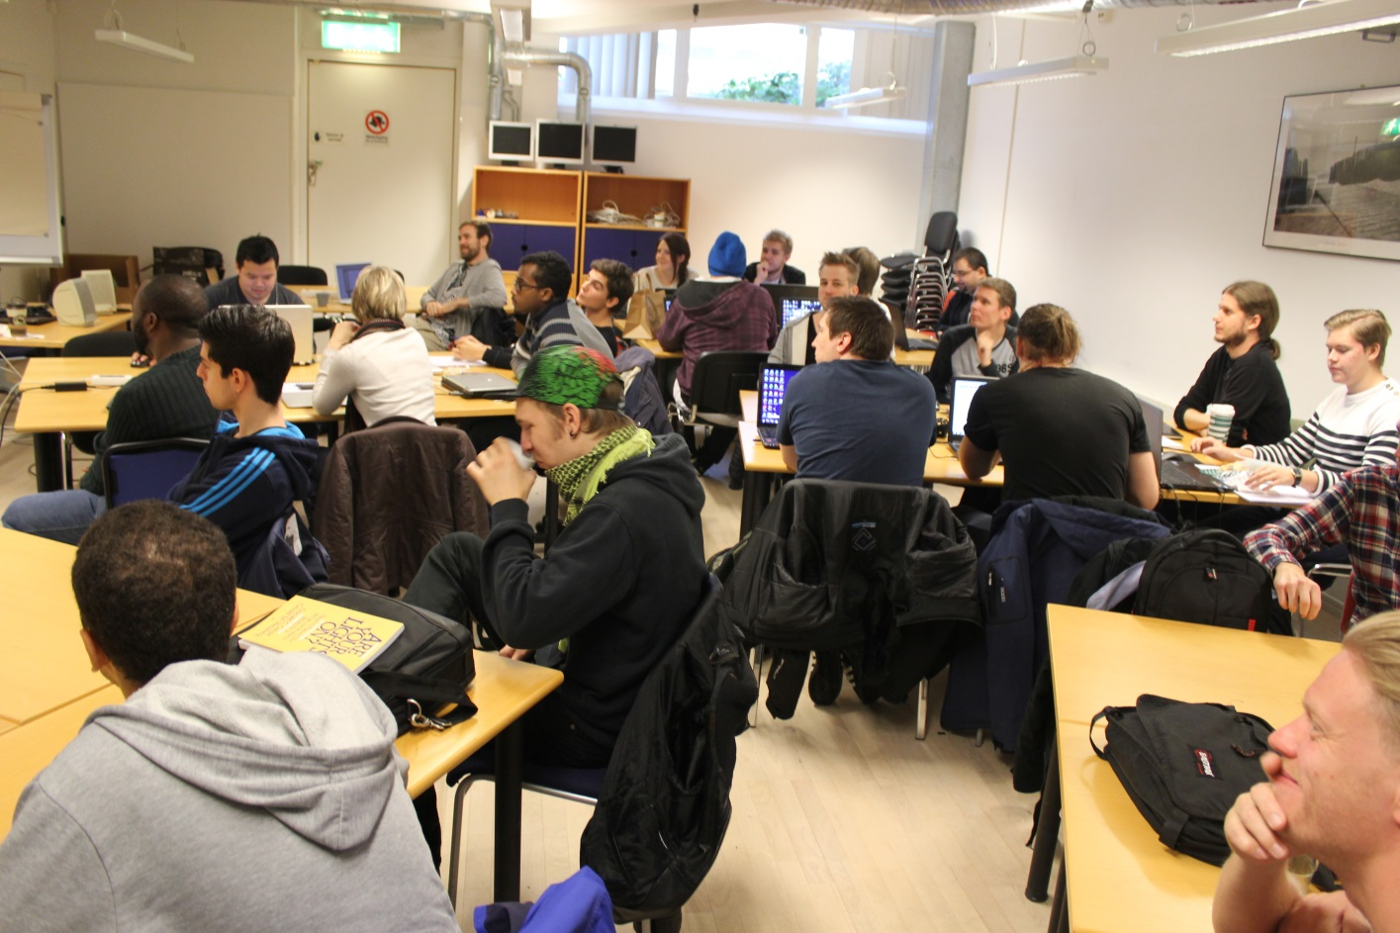
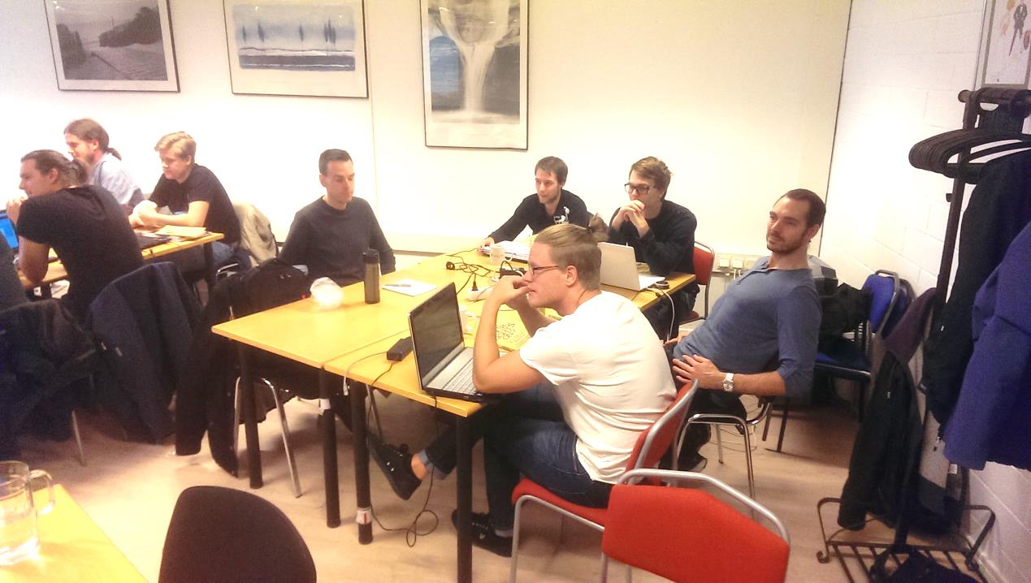
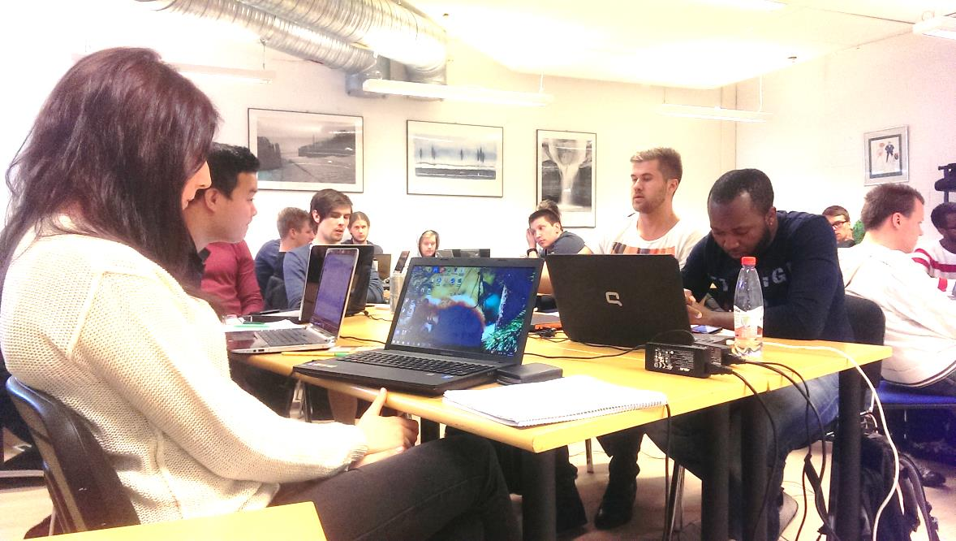
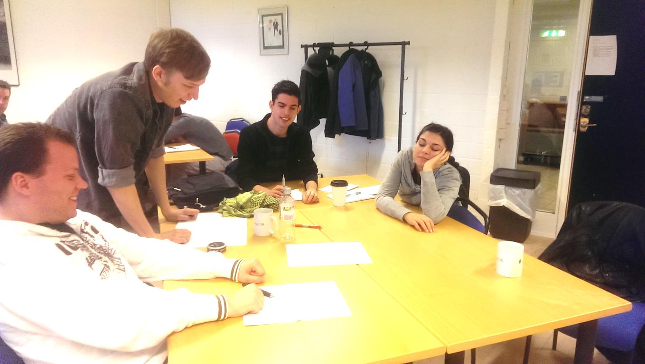
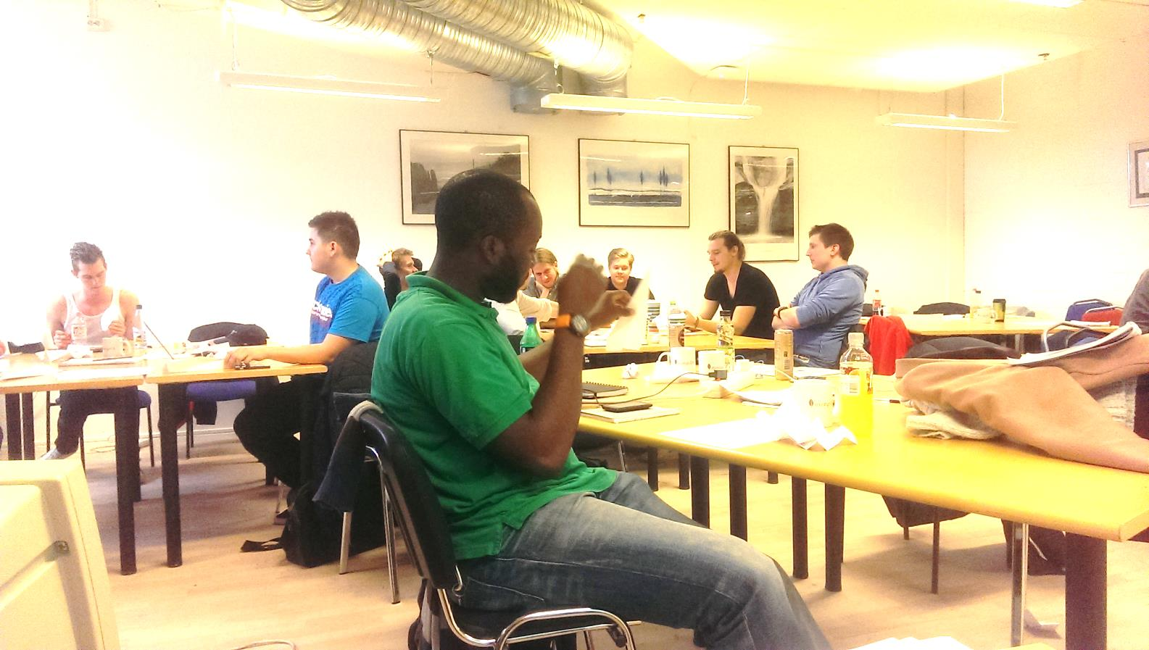
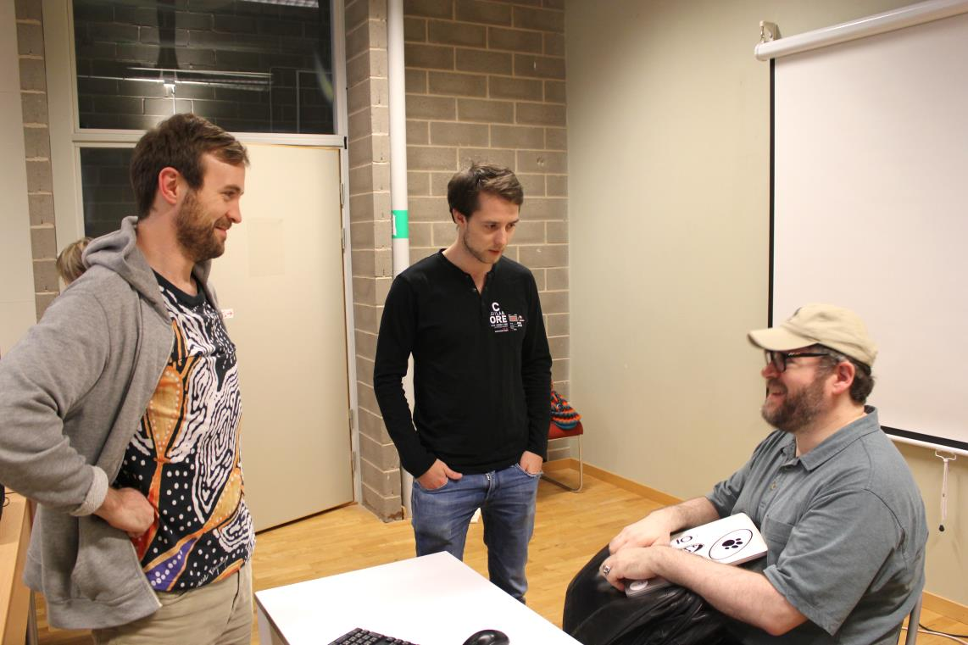
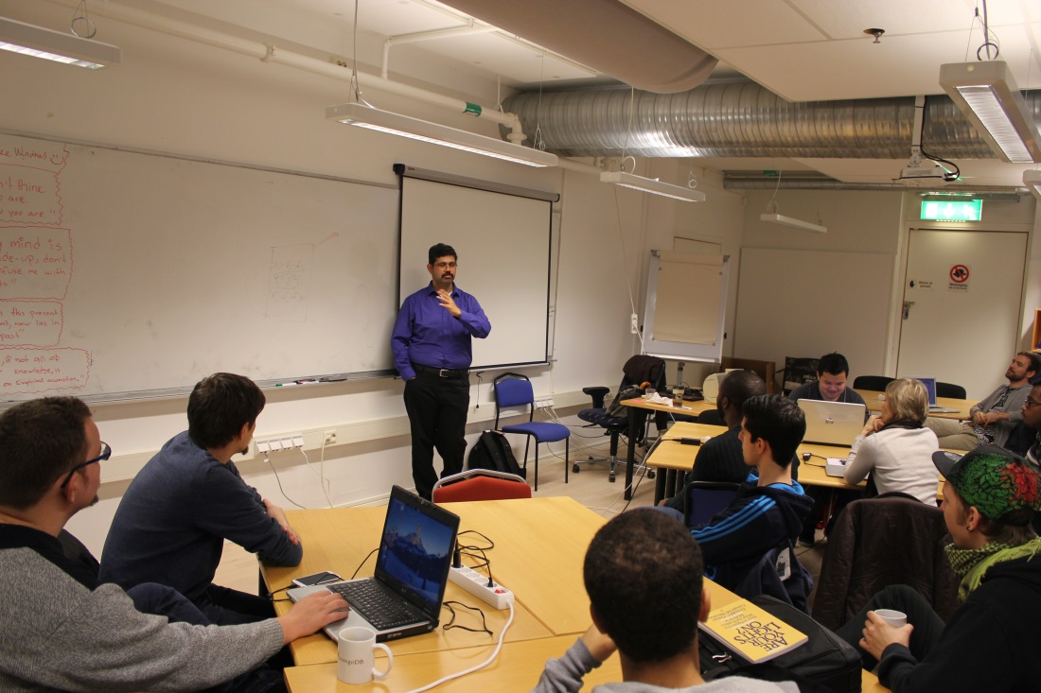
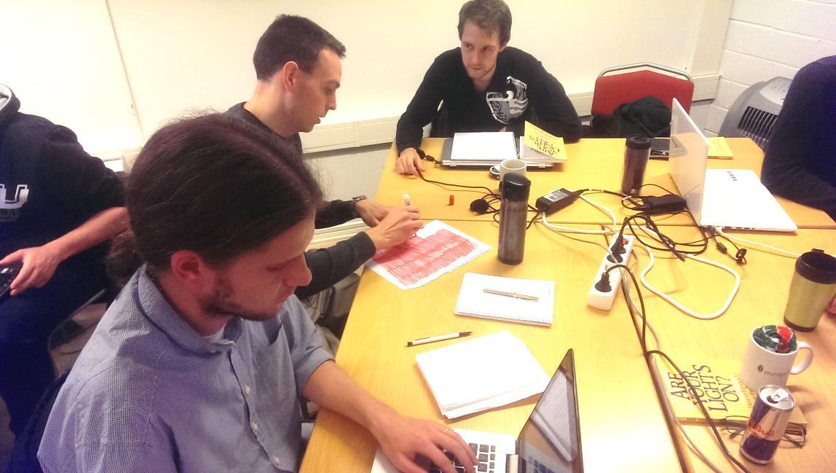
These are the Students of YHTest!
Notes:
The most important context of this education!

Slide 12
Introduction to Test
Questioning a product in order to evaluate it.
James Bach
Testing is an Empirical technical investigation done to provide stakeholders, information about quality of a product or a service.
Cem Kaner
Notes:
The first four week course is called “Introduction to test”. One of the first things the students got to do was to test a simple half done flash game and the students were required to document their testing in a simple ET-style type of document.
The two definitions that we taught the students:
If you haven´t asked a question about a product you haven´t done any testing!
Why do we test? “People are not perfect” – Weinberg
Visualizing!
Touring
What to test Oracles
When are you done?
Coverage
We also tried to show a spectrum of the different things you can work with in Test and hopefully spark different interest in people and letting them pursue their special interests.

Slide 13
A First Attempt at Testing
Sample Charters:
To compare how a beginner at excel works with the program compared to someone who is used to the program.
Write a paragraph of text in three different languages and run through Google Translate and investigate if the original meaning of the text was translated or got lost.
Test the Swedish shortcuts in Mozilla Firefox
Learning session about Mozilla Firefox and checking if there are any obvious issues that can bother beginner users.
Notes:
After the first day in class the students got a homework to do: They were supposed to test anything the liked between an hour and two and they were to document it in an ET style of documentation (they had only had a very very brief introduction to this). It amazed me what interesting charters they came up with and here are some samples shown!

Slide 14
The General Test Approach
Learn about the product. Do different tours!
Analyze the product from a Quality Attribute and Risk perspective.
Decide what is most important to test and create charters.
Execute the Testing and document it.
Report and debrief.
Notes:
In different contexts these steps can differ in different ways but we wanted the students to always have them in mind when testing. They should always be able to have a basic plan for their testing. We do not want the students to not have a clue on what to do when they start working professionally.
Touring FCC CUTS VIDS!

Slide 15
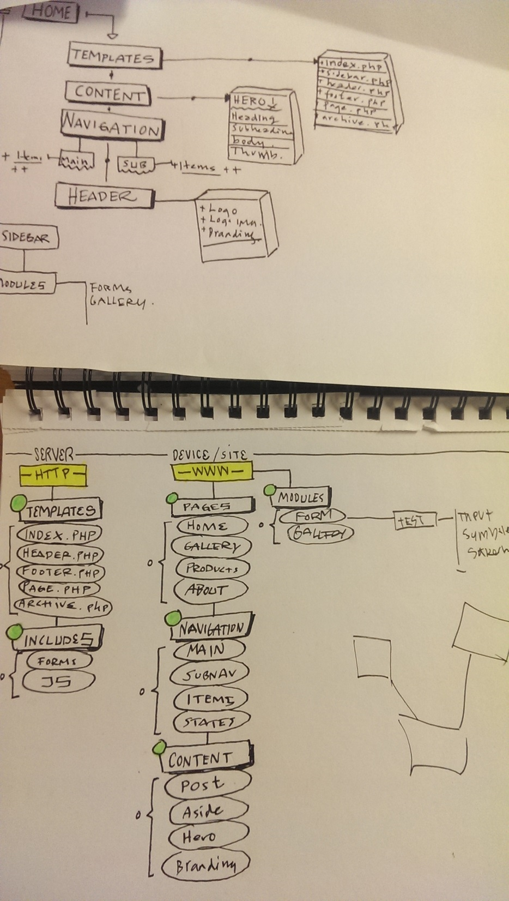
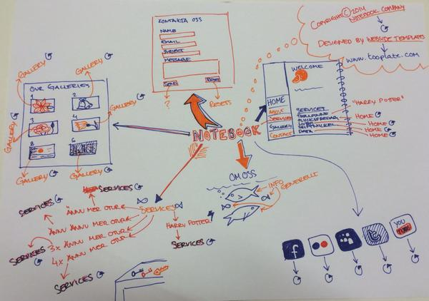
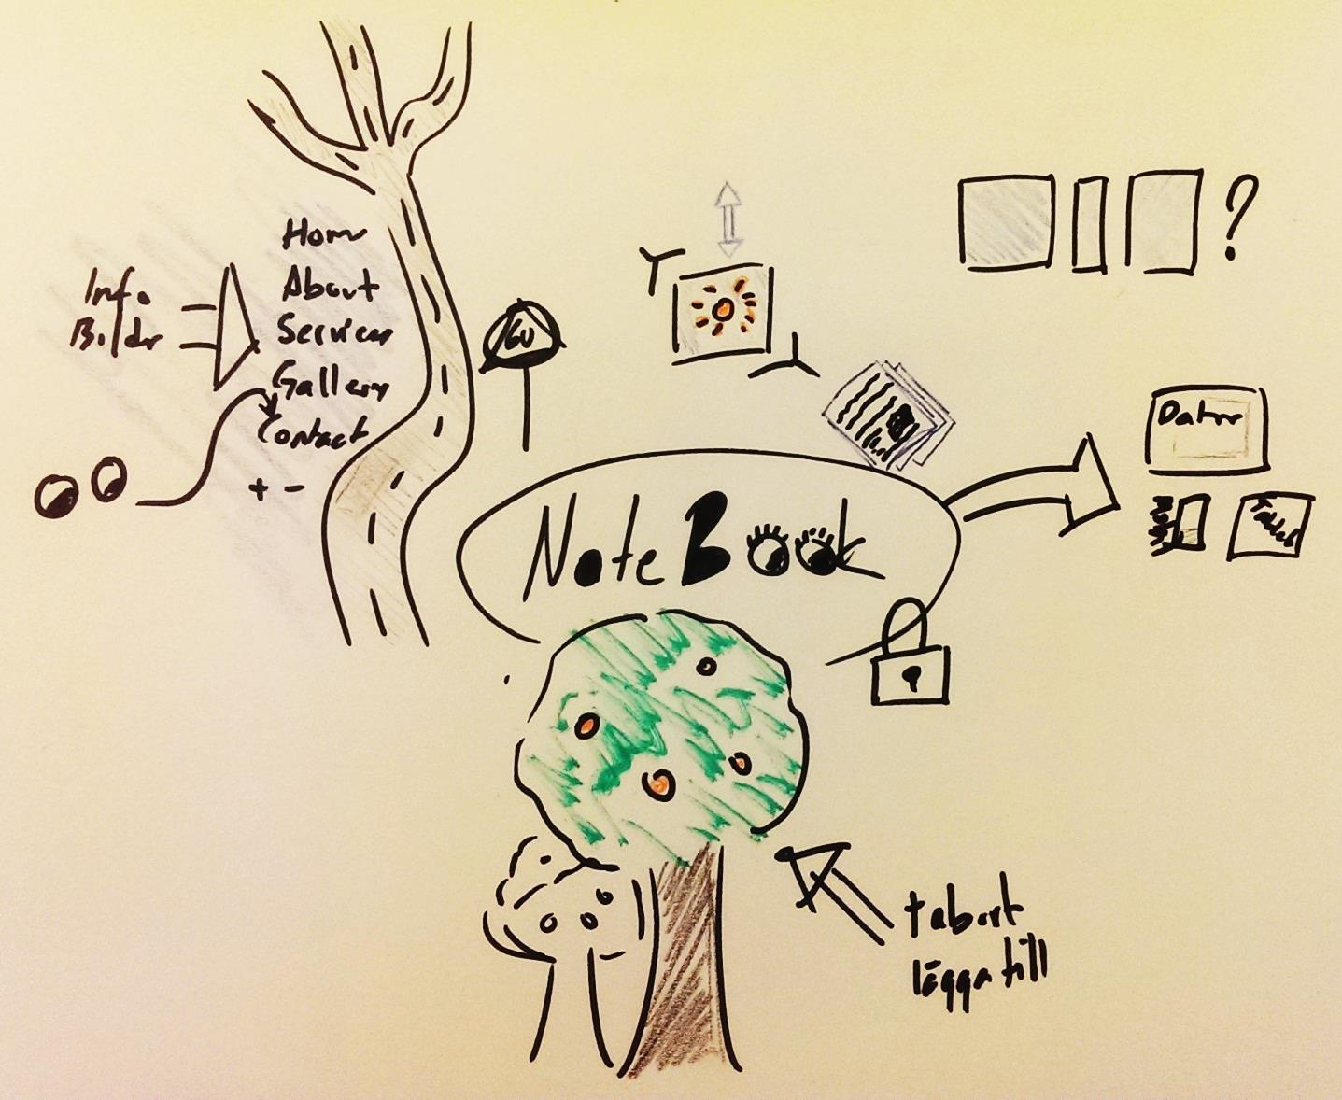
Visualizing
Notes:
This is what some of the students were asked to visualize a product in the form of a website. Combined the different ways of thinking and visualizing a product can boost a discussion about what to test. We could form test ideas from these visualizations that can be more technical, more structured or thinking more of a flow or on different ways that the product could be used.

Slide 16

Thinking like a Tester
Notes:
Lateral Thinking
Critical Thinking
Bias
Heuristics
Modelling
Abstract thinking
Rule of Three
Picture from http://illinoisfamily.org/faith/conservatism-a-thinking-mans-game/

Slide 17
The usage of a Brick
Building:
Build a house
Crash a window
Shield yourself from the outside world
Build a factory that supports the communist regime that oppresses the people
Tools:
Use as a hammer
Use for digging
Mathematics:
Count the holes in the brick
Count the brick
Measure the brick/use it as measurement
Use as weight
Role-play and pretend the brick is Einstein
Religious:
Worship the brick as a god
Write the words of god in the brick
Create a cult around the brick (Brickthulu, a Cthulu -ripoff)
Notes:
Some selected results from an exercise about coming up with as many possible usages for a brick as possible. The exercise might seem silly but finding alternative ways of using a product could help us find issues that might not be revealed until customer tries the product.

Slide 18
The Customer ROUTINE heuristic (1/2)
The Routine to make sure you keep track on how the software fits the customer – By Björn Paulsson
Requirements - What practical requirements do we have on our software to work on customer hardware or software? Are there any other requirements in the customer’s context that needs to be considered?
Outlook - How does the future looks for our customer? Can we expect that the customer will require certain updates or changes? Or new features?
Usability - Is the product easy to use for the customer? Does it need to be simplified for the client?
Notes:
A heuristic create by Björn Paulsson

Slide 19
The Customer ROUTINE heuristic (2/2)
Troubleshooting - If problems occur for the customer, how do we handle them? Do we have a bug reporting system in place? Do we have the customer support that can help?
Improvements - Can the product be improved to fit the customer’s needs better? If the customers requires changes to the product, how easy is it to implement them?
Needs - What are the actual customer needs?
Expectations - What is the customer expecting and does that match the actual needs? What they expect and what they need to solve their problem might not always be the same thing.

Slide 20
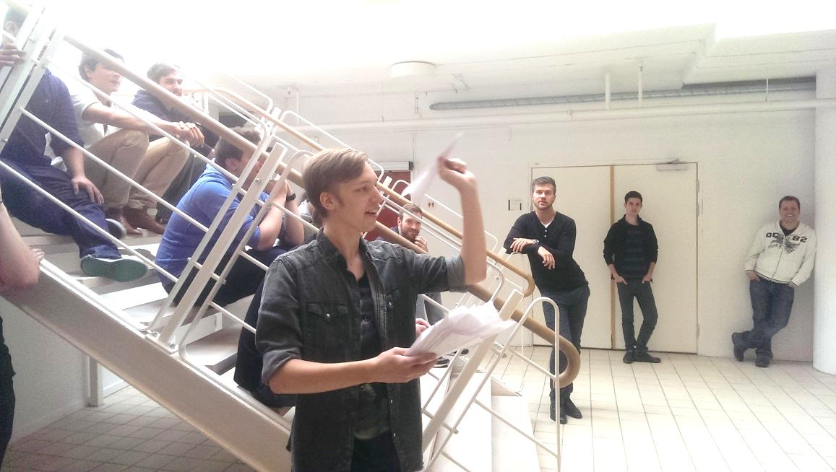
Constructing Paper Planes
Everyone Failed the Exercise
Notes:
The students were given a task to create and throw paper planes as far as possible. The whole class failed because when the time was up no one had demonstrated any paper planes for me. In fact only one out five groups actually asked to the time frame of the exercise and then ignored it. After this exercise the students never failed to ask to the time frame. And this is an important question for a tester to ask when given a test task because then we can easily answer how and what we estimate we can test within that timeframe.

Slide 21


Project Contexts
Notes:
No matter what we personally think about different ways of organizing development, like waterfall styles, we need to teach the students how to be the best they can be in such an context. And therefore they need to understand what the initial thoughts and ideas was behind the models and also what advantages and disadvantages different project setups can provide the tester.
A project might also be forced into working in a specific way due to the context. For example a space rocket might require a more waterfallish way of working with the end test being the actual launch.
Waterfall, V & W
Agile, scrum, the principles. Agile does not mean no documentation, just not favoring documentation.
RUP

Slide 22

Test Methodologies
The Four schools of Test
Notes:
This class was in parts inspred by Bret Petichords “Four schools of Test”: Analytical, Factory, Quality Assurance and CDT.
ISTQB was teached (but no money wasted on the actual certification). Four days of teaching was spent on ISTQB with additional time as homework.
Again important for students to understand why certain people have different views on testing. There is also a point to be made about how the view on test has developed during the years to make predictions about, or to understand, the future of testing. What we know today to be most effective might not be so tomorrow when a new way of thinking develops.

Slide 23
Different Test Reports (1/2)
"One (Test procedure 4.7) of the 600 planned test procedures was not executed at all because of lack of time. All the 599 test procedures that were run had passed at the end of the 3 weeks. During the test 83 incidents were found and 83 were solved. The reported incidents were number 107 to number 189."
Notes:
The students were asked to put them selves into a position where they were going to base a Go/No go decision based on the test report during a meeting where the only had five minutes to investigate the report.

Slide 24
Different Test Reports (2/2)
Quality Attribute | Status | Comments
Capability | OK | No functionality blocked
Reliability | WARNING | Can only handle the required number of users during specific circumstances
Usability | WARNING | A lot of minor issues affects the user experience
Security | OK | Passed External audit
Compatibility | NOK | Not compatible with upcoming IOS version
… | … | …
Notes:
Fictional report but based on real examples

Slide 25
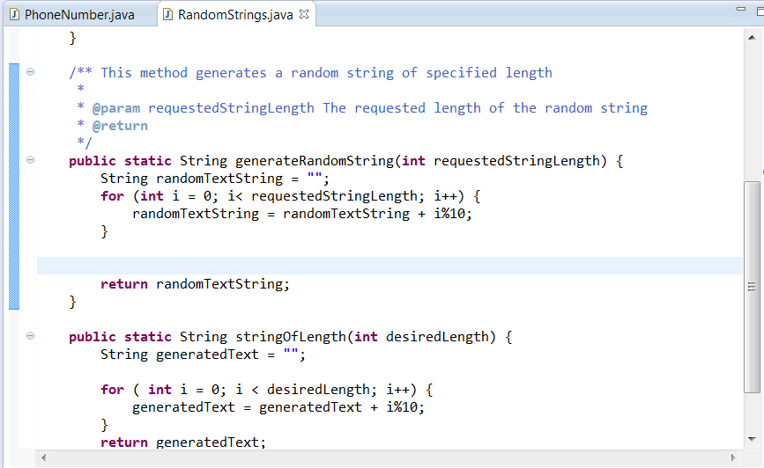
Programming for Testers
Notes:
Java. Why Java? Important to understand how a developer works. A lot of tools are created in java. Relatively easy to port test cases from for example Selenium.
Creating their own tool to inspire them to continue coding!
Biggest challenge so far for both students and me as a teacher. Like a new language. Not possible to learn by studying hard the days before the exam. High threshold to start coding java if one has not coded before.

Slide 26
Future and Ongoing Courses
Test Strategy
Test Design and Techniques
Bug reporting
Test Tools
Internships
Notes:
These are the courses that the students have recently finished, is ongoing or are still to come.
In October the students are done with school and will go on two months of internships.
Because the results from recently finished or ongoing courses are not yet analyzed they are out of scope for this education.

Slide 27
The Results
Learning the Test profession can be fun!
Students can provide (some) value from day one.
The class could as a whole provide good results
Lack of experience lowers the understanding of teachings in class.
Programing was the biggest challenge.
The Testing community has been very supportive!
Notes:
A quote from a student: “For the first time in my life I look forward going to school”. Constant grades from the student between 4.5 and 5.0 (on a scale from 0 to 5.0). Out of 32 starting students 29 are left: One felt he was in the wrong education, one due to sickness and one scored his dream job during the education.
The interest for this type of educations is increasing and the education is expanding this year to include a class in Gothenburg.
The students now have a strategy to organize their testing work so that they can provide value from day one. The value of the information can however be very low because of lack in experience, deeper knowledge in test and test tools but still: some information might be worth gold for the right stakeholder.
The lack of real world experience in software testing is a challenge to the students since the teaching might be difficult to realate to and it might be difficult to understand what is important information and what is not.

Slide 28
Conclusions
Professional Testers from start.
Exploratory Testing is very useful for inexperienced testers
Test niches that can be filled by testers who might be lacking technical expertize.
A lot of learnings might not make much sense for students until they have work experience.
1.5 years is not much time to teach testing on.

Slide 29
The Future
In 2016 the students will find their way out to real testing jobs.
And they will know nothing.
A year or two after that we will see the real results, so keep an eye out for the YHTest testers then!

Slide 30
Acknowledgements
A big thanks to: the students for putting in the effort! To all the people that came for guest lectures! To everyone who supported when doing this education in different ways! To Erik, Henrik and Maria! To the people in the ISST chat!

Slide 31

Q&A
Notes:
Picture from http://www.usfleettracking.com/blog/2014/06/11/critical-question-for-potential-gps-tracking-company/

Slide 32
Get in Touch!
Meet Me at:
EuroStar
Let´s Test
ConTest
@martinnilsson8
#YHTest
Martin.nilsson@houseoftest.se

Slide 33
HEADLINE
Supporting Text or Picture

Slide 34
HEADLINE
Supporting Text or Picture

