Slide 1

Ensemble spaces: a common foundation for probability, information theory and physical theories
Gabriele Carcassi and Christine A. Aidala
Physics Department
University of Michigan
Centennial Workshop on Quantum Probability,
Causality, and Information
Harvard University
September 27, 2026

Slide 2
Outline
Goal: understand exactly if/how classical and quantum probabilistic and informational structures differ, and what is a general structure that fits all physical theories
First: deconstruct quantum mechanics to have a clear understanding of what the mathematical structures represent
Second: start from physical requirements to develop a basic structure that must be present in all physical theories

Slide 3
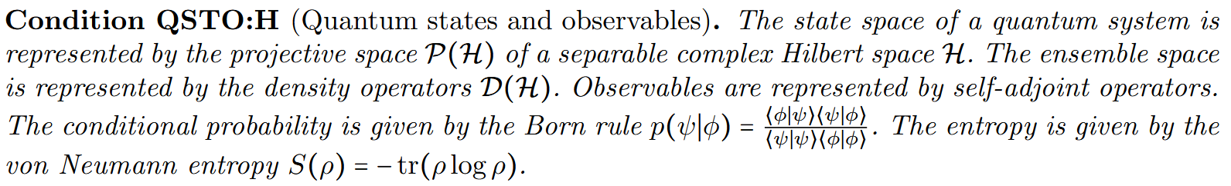
Bunch of things bundled together
How do we analyze this properly?

Slide 4

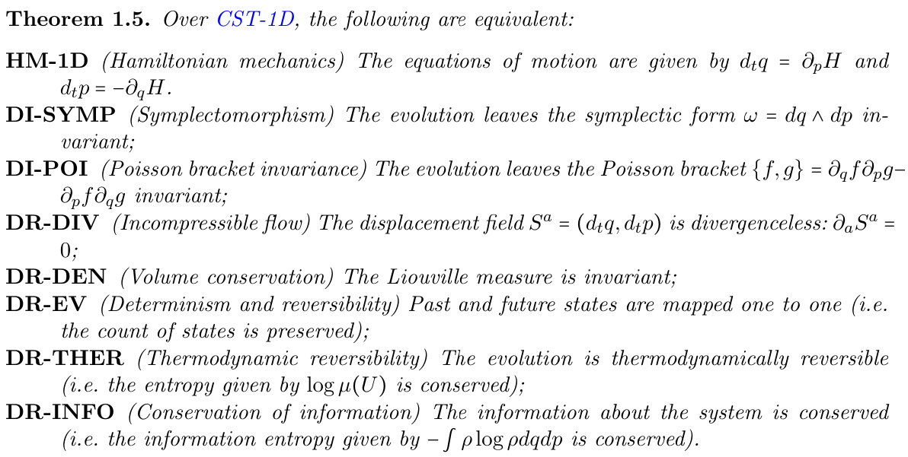
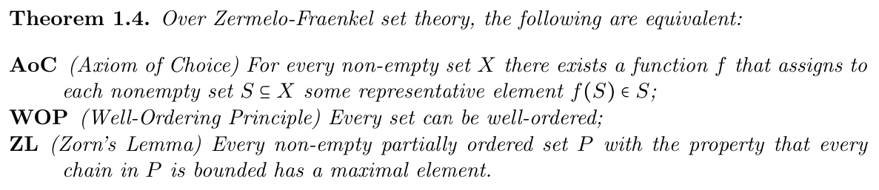
Break physics into different conditions
and study their logical relationships
“When the math is derived from the right physical assumptions,
the physical assumptions can be derived from the math.”
Similar to what is done in the foundations of mathematics
MPPF
LM
FKE
NM
HM
Found. Phys. 52, 40 (2022)
https://arxiv.org/abs/2608.27543
Core assumptions
for classical mechanics
WKE
CST
DR
IR
IND

Slide 5
Note: projective space does not technically require an inner product

Slide 6
Do projective Hilbert spaces pick QM?
Yes. Only quantum state spaces are represented by projective Hilbert spaces.
No. Some classical state spaces can also be represented in that way.
It’s just a bunch of math. I care about physics!
I have no idea

Slide 7
Do projective Hilbert spaces pick QM?
Yes. Only quantum state spaces are represented by projective Hilbert spaces.
No. Some classical state spaces can also be represented in that way.
It’s just a bunch of math. I care about physics!
I have no idea

Slide 8
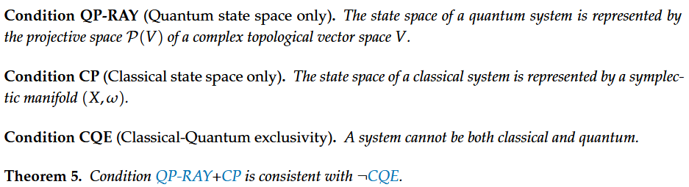
State space of a classical magnetic dipole is a sphere,
which is the complex projective line
In general, every finite-dimensional complex projective space is a symplectic manifold, and therefore allows classical Hamiltonian mechanics

Slide 9
Does the space of ensembles distinguish CM from QM?
Yes.
No. Some quantum systems allow representation by classical probability
(e.g. Husimi Q representation).
Experiments distinguish between theories
I have no idea

Slide 10
Does the space of ensembles distinguish CM from QM?
Yes.
No. Some quantum systems allow representation by classical probability
(e.g. Husimi Q representation).
Experiments distinguish between theories
I have no idea

Slide 11
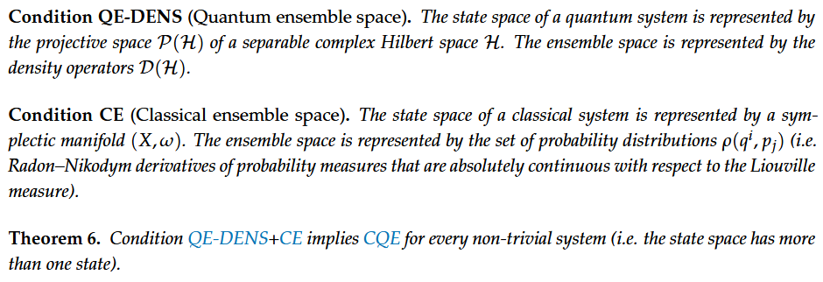
Though we lack a definition of simplex that works in the infinite-dimensional case
In classical mechanics, every ensemble is identified by a UNIQUE probability measure on pure states (i.e. ensemble space is a simplex)
In quantum mechanics, there is NO unique probability measure
The ensemble space distinguishes
between classical and quantum mechanics

Slide 12
Is the ensemble space enough to characterize QM?
Yes. Knowing how ensembles combine during mixtures is enough.
No. You need an additional structure.
This is going nowhere. It’s all about mathematical structures. Where is the physics?
I have no idea

Slide 13
Is the ensemble space enough to characterize QM?
Yes. Knowing how ensembles combine during mixtures is enough.
No. You need an additional structure.
This is going nowhere. It’s all about mathematical structures. Where is the physics?
I have no idea

Slide 14
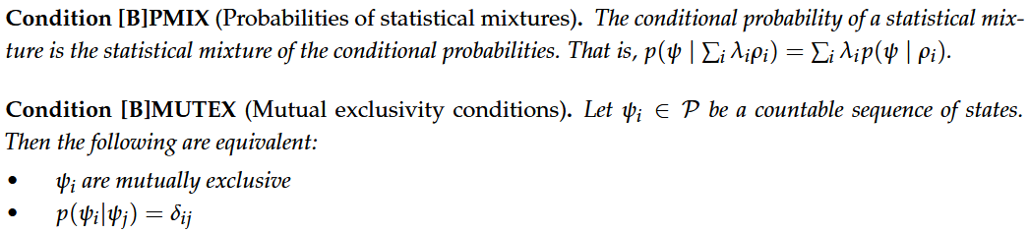
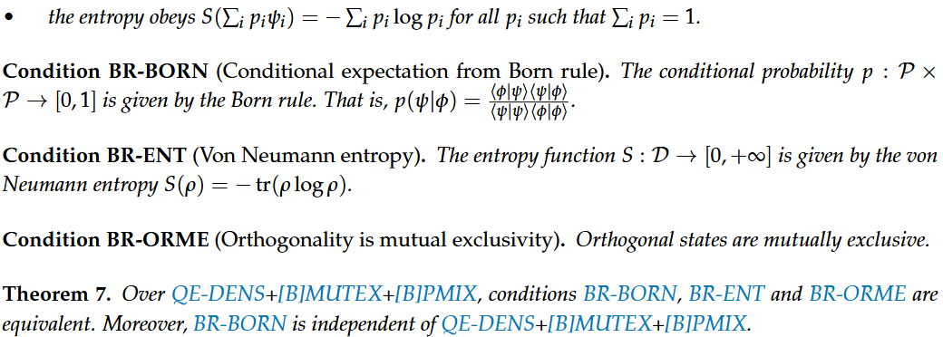
The fact that orthogonal vectors
represent mutually exclusive ensembles
is an additional assumption

Slide 15
QP-RAY – Pure states are rays of a complex Hilbert space
+
Can be classical
QE-DENS – Ensembles are density matrixes
+
Cannot be classical
BR-BORN – Orthogonal states are mutually exclusive
=
Must be quantum
QST:H – Quantum states on a Hilbert space

Slide 16
Can we reconcile evolution and measurements?
No. They have irreconcilable mathematical characteristics.
Yes. There is no problem.
It depends on the interpretation… and I don’t care about the interpretation because I care about the physics
I have no idea

Slide 17
Can we reconcile evolution and measurements?
No. They have irreconcilable mathematical characteristics.
Yes. There is no problem.
It depends on the interpretation… and I don’t care about the interpretation because I care about the physics
I have no idea

Slide 18
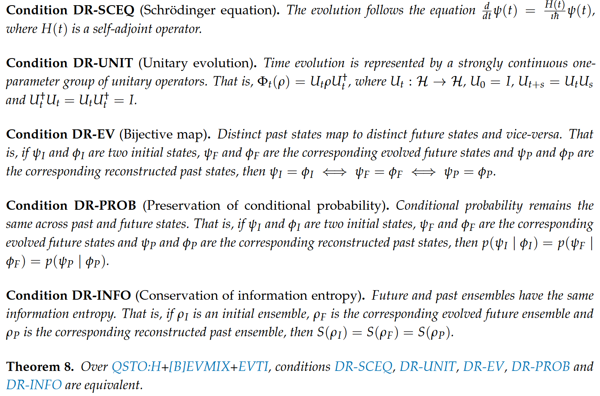
[B]EVMIX – The evolution of the mixture is the mixture of the evolution
Unitary evolution is determinism and reversibility

Slide 19
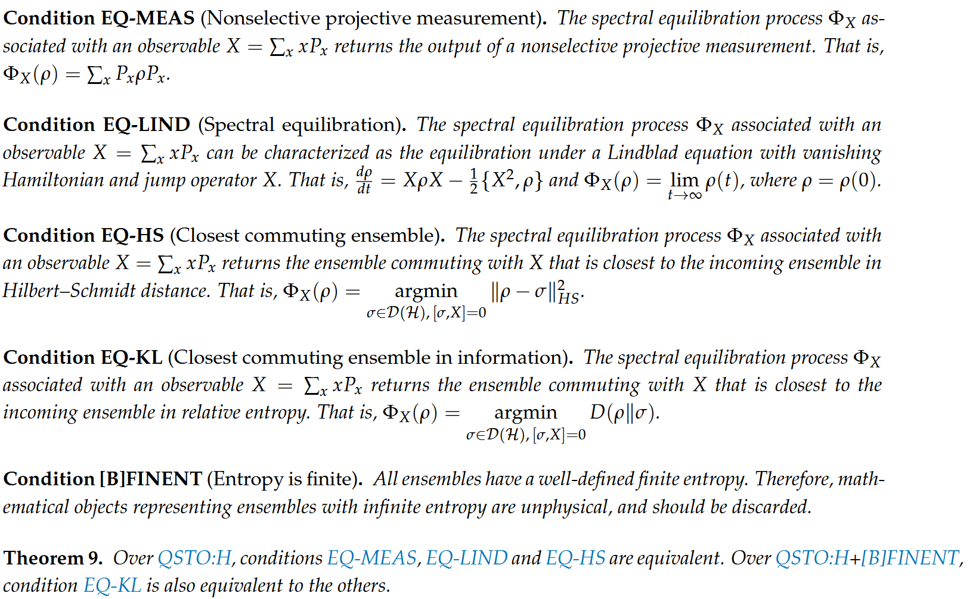


Projective measurement
Step 1: interaction
$$\left|E_{1}\right\rangle$$
Step 2: update
same as classical update
$$|E_{0}⟩$$
Nonselective projective measurements are equilibrations

Slide 20
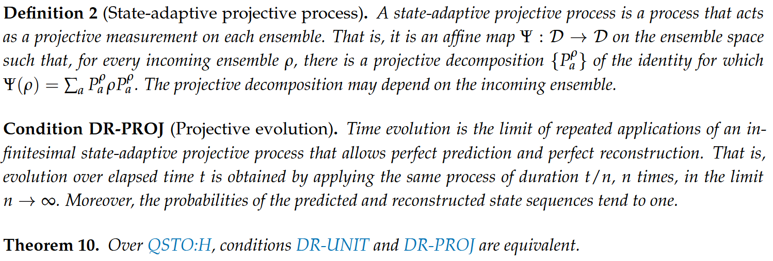




Unitary evolution is a continuous sequence of
infinitesimal adaptive measurements
$$X\left|ψ\right\rangle =x\left|ψ\right\rangle$$
$$X_{t}\left|ψ(t)\right\rangle =x\left|ψ(t)\right\rangle$$
$$\left|ψ(t)\right\rangle =U_{t}\left|ψ\right\rangle$$
$$X_{t}=U_{t}XU_{t}^{†}$$

Slide 21
What do states represent?
An ontological description that exists regardless of what happens
An epistemic description of what the agent knows
It’s physics! It’s about stuff that I can do in the lab! You see, I put this here… and then something happens. It’s about stuff that happens!
I have no idea

Slide 22
What do states represent?
An ontological description that exists regardless of what happens
An epistemic description of what the agent knows
The physics! It’s about stuff that I can do in the lab! You see, I put this here… and then something happens. It’s about stuff that happens!
I have no idea

Slide 23
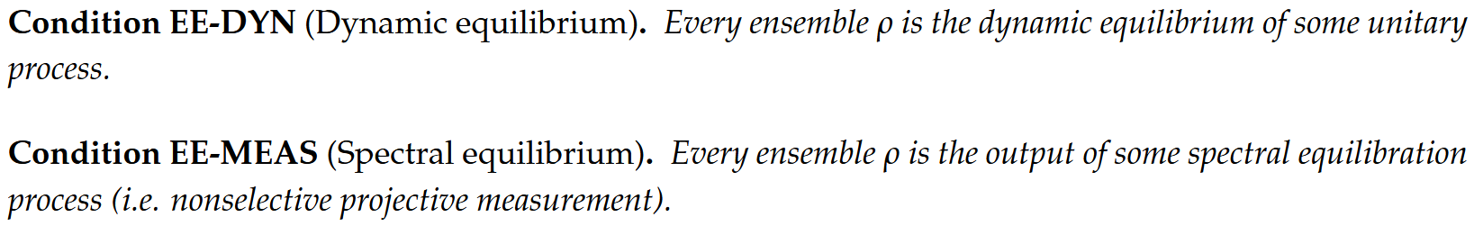
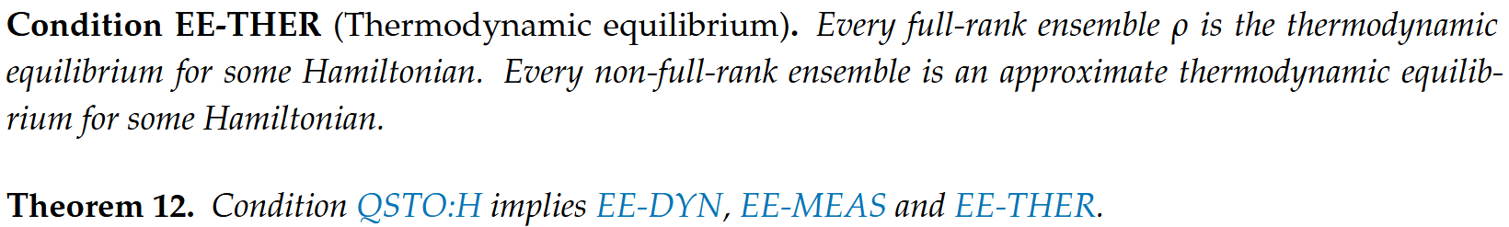
States are the equilibrium ensembles
of some process

Slide 24
How do we turn these insights
into a general theory of physics?
Every formal theory starts with primitive objects
Objects that are NOT defined from other objects
We don’t want to kick the can down the road
Are ensembles the correct primitive objects for physical theories? How do we know?

Slide 25

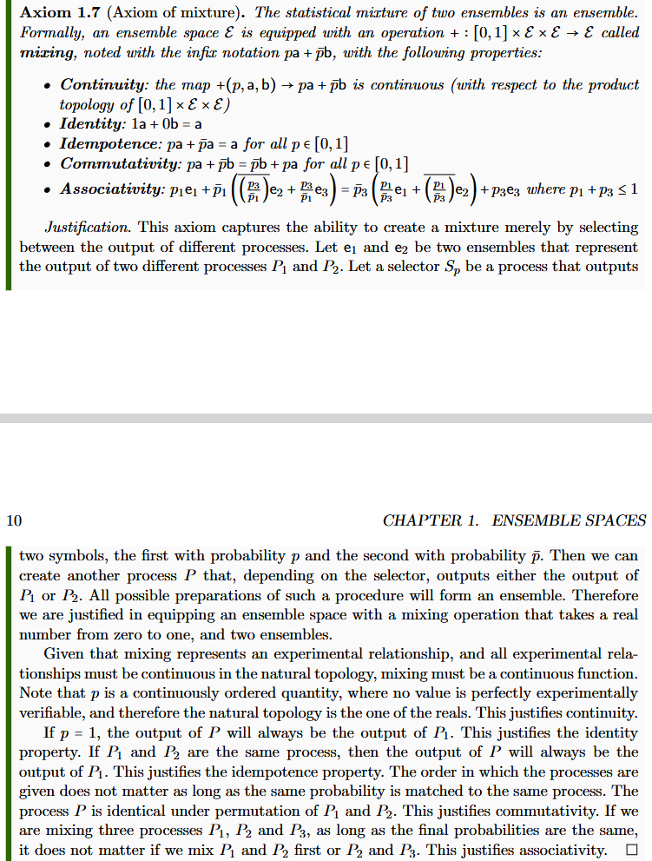
Start from mathematical axioms
with a clear physical justification
Axioms must represent constitutive assumptions
“When physical objects are mapped to the right mathematical objects,
the physical specification maps to the mathematical definitions.”
Informal intuitive requirement
(something that makes sense to a physicist or an engineer)
Formal definition
(something a mathematician will find precise)
Show that the formal definition
follows from the intuitive requirement
Assumptions of Physics, Michigan Publishing (v3 2025)
https://doi.org/10.3998/mpub.12204707

Slide 26


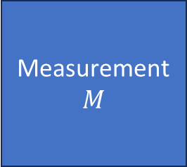




$⇒$ Scientific laws are relationships between ensembles
Preparation
$$P$$
Process
$$U$$
Measurement
$$M$$
$$e_{P}$$
$$e_{U}$$
$$e_{M}$$
Statistical
data
Initial
ensemble
Final
ensemble
Preparation
procedure
$$…$$
Ensemble of outputs

Slide 27


$$t$$
Physics describes the evolution
of a particular system like a movie
$$x\left(t\right)$$

Slide 28
$$t$$
That’s not it!!!
Physics describes the evolution
of a particular system like a movie
$$x\left(t\right)$$

Slide 29
$$t$$
Physics describes the evolution
of similarly prepared systems
Every time I do this…
$$x\left(t\right)$$

Slide 30
$$t$$
Physics describes the evolution
of similarly prepared systems
$$x\left(t\right)$$

Slide 31

Statistical description of preparations
and measurement outcomes
In physics, we can only study relationships that can be reproduced: relationships between ensembles
$$x(t)$$
Statistical description
of all clocks synchronized
at a particular initial event

Slide 32
$$t$$
Even a single preparation/measurement
is an average over a finite time

Slide 33
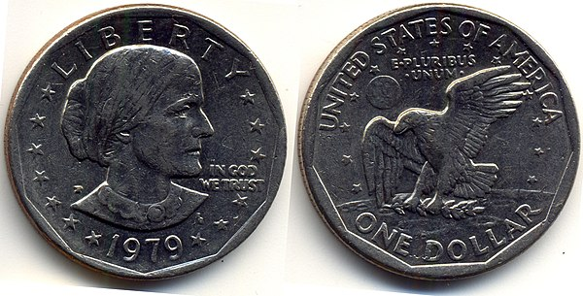
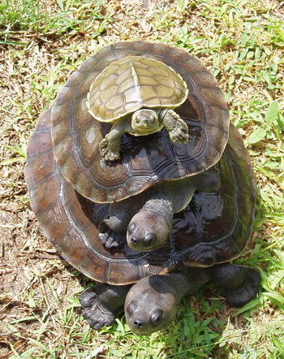
To be able to define a probability distribution over heads or tails, you need first to define what heads and tails are
We can do that because we can leave the coin be, and it remains heads or tails
wikipedia
If it kept changing more than 100 times a second, we wouldn’t perceive heads or tails: just a blur
wikipedia
The state of a system is what remains “stable” for at least a short amount of time
It’s ensembles all the way down

Slide 34
$⇒$ Scientific laws are relationships between ensembles
Ensembles MUST be the foundational primitives
Without a generic theory of ensemble spaces there is no well-defined theory of physics, causality, probability, information theory, …

Slide 35
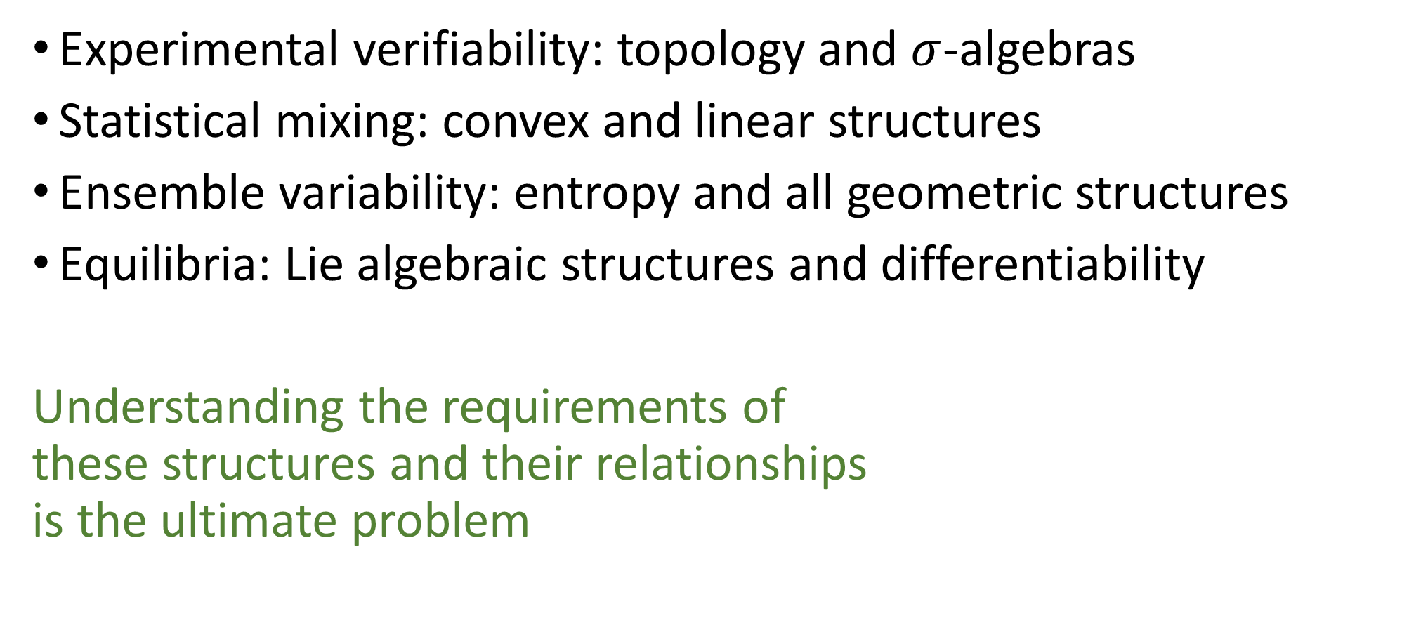
Four foundational pillars
Experimental verifiability: topology and $σ$-algebras
Statistical mixing: convex and linear structures
Ensemble variability: entropy and all geometric structures
Equilibria: Lie algebraic structures and differentiability
Understanding the requirements of
these structures and their relationships
is the ultimate problem

Slide 36
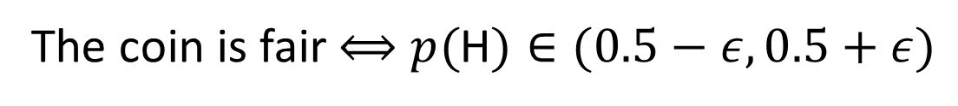
Mass of the photon is 0 eV
Not verifiable!
Verifiable!
Mass of the photon is less than 10⁻¹³ eV
Space of coin tossers
Open set
H: 50%
T: 50%
H: 100%
T: 0%
H: 0%
T: 100%
The coin is fair $⟺$ $p($H$)∈(0.5−ε,0.5+ε)$

Slide 37

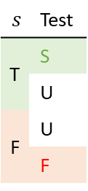



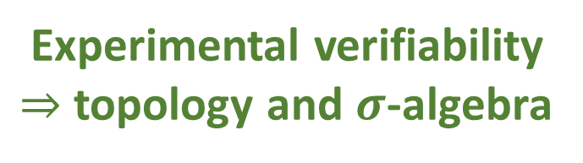
Experimental verifiability
Science is evidence based $⇒$ Statements are associated to experimental tests
Verifiable statement | Test Result
T | SUCCESS (in finite time)
F | UNDEFINED
 | FAILURE (in finite time)
Theoretical statements
$int(A)$ corresponds to the verifiable
part of a statement
$$s$$ | Test
T | S
 | U
F | U
 | F
Verifiable
statements
Possibilities
$∂A$ corresponds to the undecidable
part of a statement
$ext(A)$ corresponds to the falsifiable
part of a statement
Open sets
Points
Inference relationship $𝓇:𝒟_{Y}→𝒟_{X}$ such that $𝓇\left(s\right)≡s$
Borel sets
Experimental verifiability
$⇒$ topology and $σ$-algebra
Experimental relationships must be
topologically continuous
Causal relationship $f:X→Y$ such that $x≼f\left(x\right)$

Slide 38
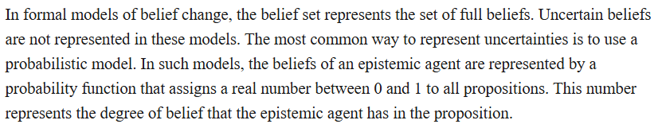
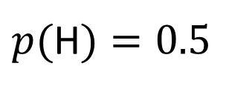
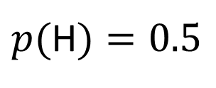
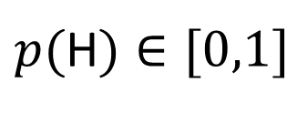
The problem with Bayesianism
This does not work!
Space of coin tossers
“Logic of Belief Revision,” §10.1, Stanford Encyclopedia of Philosophy
H: 50%
T: 50%
The coin is PERFECTLY fair
$p($H$)=0.5$
H: 100%
T: 0%
H: 0%
T: 100%
I have no idea about the fairness of the coin
Imprecise probability
$p($H$)=0.5$
$p($H$)∈[0,1]$
Merging topology with imprecise probability is likely the only way to make probabilistic inference work in the continuum

Slide 39
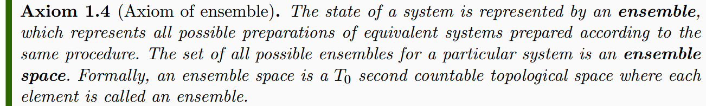



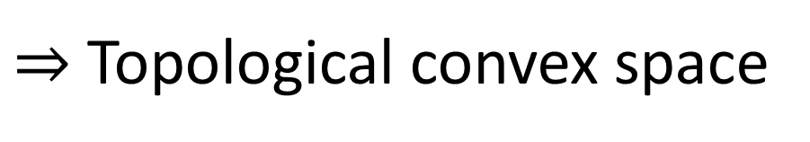




Ensembles can be mixed, and the mixing operation must preserve experimental verifiability (i.e. topologically continuous)
$$P$$
$P_{1}$
$$e_{1}$$
$$S_{p}$$
$$pe_{1}+\left(1−p\right)e_{2}$$
$P_{2}$
$$e_{2}$$
$⇒$ Topological convex space
There is no established theory!

Slide 40
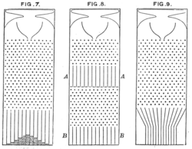

Note: mixing coefficients are NOT probabilities
In general, they are parameters of the preparation procedure
They apply recursively to other ensembles, not to events
$$p_{1}\left(p_{2}a+\overline{p_{2}}b\right)+\overline{p_{1}}(p_{3}a+\overline{p_{3}}c)$$
Galton’s original drawings - wikipedia
Different interpretation of probability
Recovers standard probability in special cases,
likely with propensities for ensembles and frequencies for elements

Slide 41

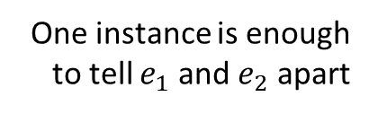


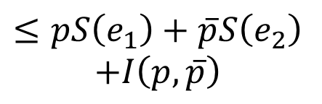
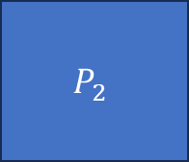
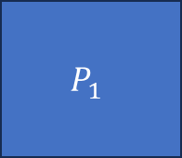


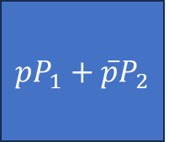


Preparation
Ensemble
Entropy
Variability within
an ensemble
$$e_{1}$$
$$P_{1}$$
$$…$$
$$S\left(e_{1}\right)$$
One instance is enough to tell $e_{1}$ and $e_{2}$ apart
more variability
Mutually exclusive preparations
$$e_{2}$$
$$P_{2}$$
$$…$$
$$S\left(e_{2}\right)$$
Orthogonal
Maximal entropy increase
if orthogonal
$$pe_{1}+\left(1−p\right)e_{2}$$
$$pP_{1}+\overline{p}P_{2}$$
$$≤pS\left(e_{1}\right)+\overline{p}S\left(e_{2}\right)$$
$$+I\left(p,\overline{p}\right)$$

Slide 42
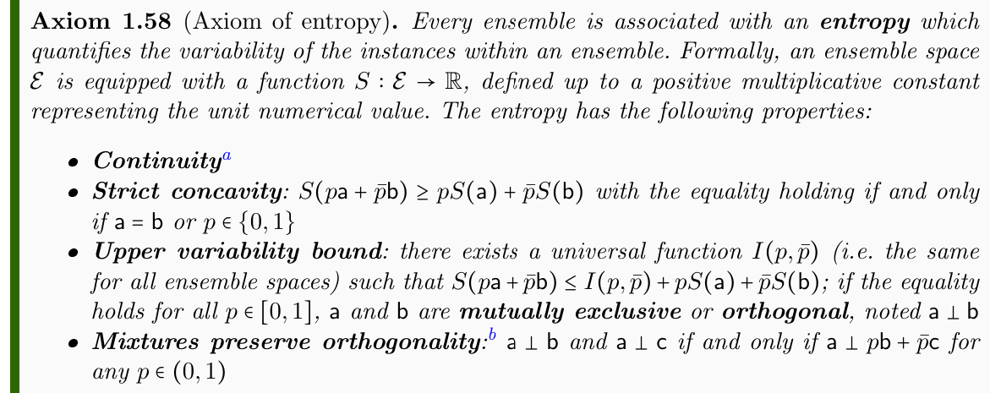
Define entropy axiomatically, just based on bounds and properties
Full justification given
Axiomatization likely does not capture all requirements

Slide 43
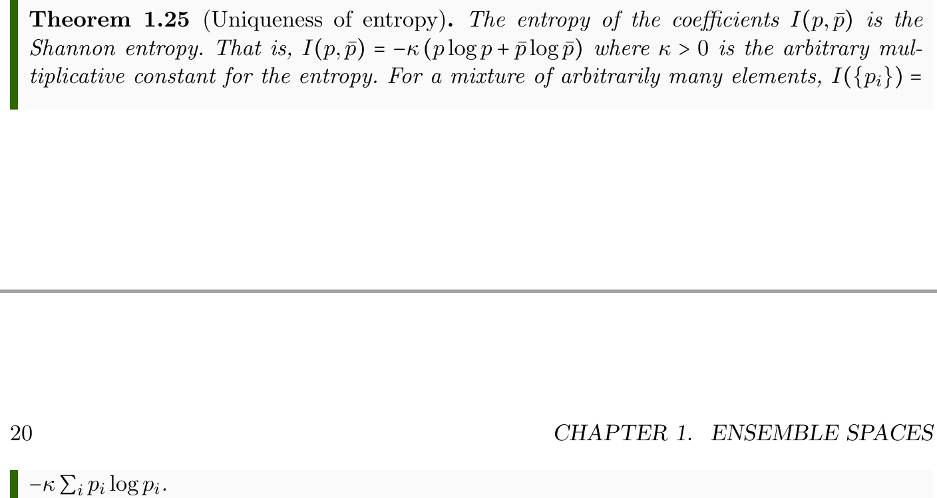
The entropy upper bound $I(p,\overline{p})$ is uniquely determined
Shannon entropy
Maximal increase in variability during mixing
Proof “does not know” whether we are dealing with classical ensembles, quantum ensembles, or ensembles for a theory yet to be discovered

Slide 44









Two ways to define “exclusive” ensembles
Separate ensembles
Orthogonal ensembles
$$⇐$$
No “common component”
Saturate upper entropy bound
such that
Coincide in classical
ensemble spaces
Different in quantum
ensemble spaces
Simple but powerful
definitions from
basic axioms
$${|ψ}_{a}⟩$$
$${|ψ}_{c}⟩$$
disjoint support
$${|ψ}_{b}⟩$$

Slide 45
Preparation
Ensemble
$$e_{1}$$
Identically
prepared
ensemble
$$P_{1}$$
$$…$$
There is no variability in the ensemble
$$e_{2}$$
Pure
ensemble
$$P_{2}$$
$$…$$
No preparation with lower variability
There is no $a$ such that $e_{2}=pa+\overline{p}b$ for some $p∈(0,1)$ and $b≠a$
In classical theories, all pure ensembles are identically prepared
No real distinction between pure preparations and outcomes
In non-classical theories, no identically prepared ensembles
Zero entropy does NOT correspond to identically prepared ensembles

Slide 46
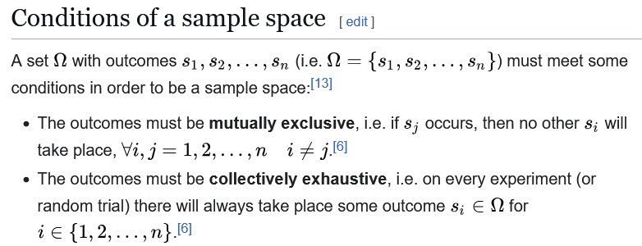
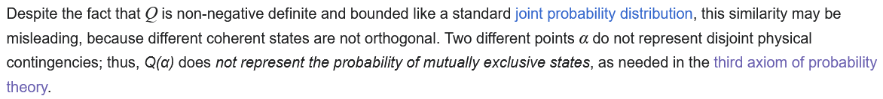


What is classical probability?
All elements of the sample space must be mutually exclusive
preparations!
Classical probability can only be defined
among mutually exclusive preparations
(i.e. orthogonal ensembles)
$$e=∑p_{i}e_{i}$$
$$e_{i}⊥e_{j} ∀i≠j$$
probability $⟺$ decomposition into orthogonal ensembles
Husimi Q representation is NOT probability

Slide 47
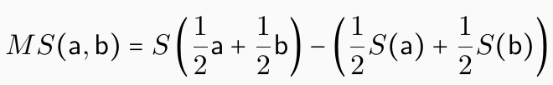
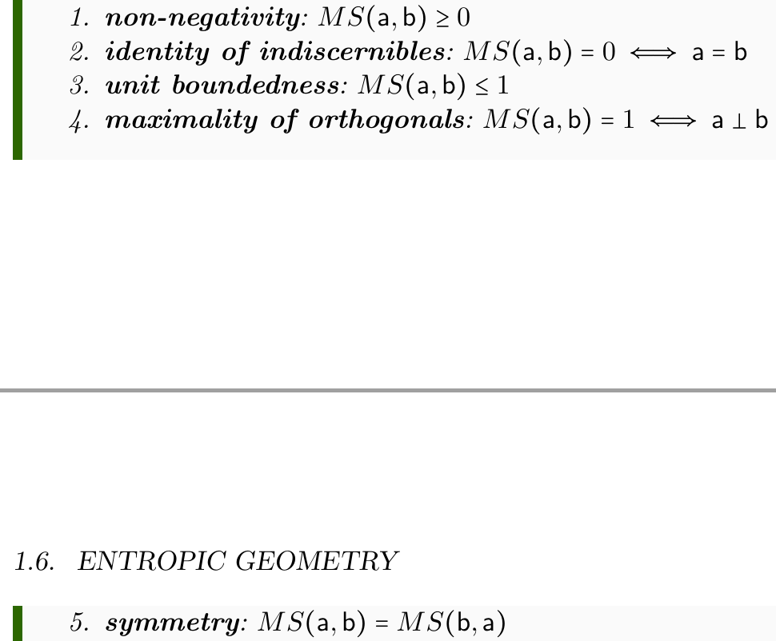
How much does the entropy increase during mixture?
Recovers the Jensen-Shannon divergence (JSD)
(both classical and quantum)
Pseudo-distance defined from the entropy
(does not satisfy the triangle inequality)

Slide 48




Entropy imposes a metric on the ensemble space
$$⇒$$
Entropy strict concavity means the Hessian is negative definite
Recovers Fisher-Rao information metric
(both classical and quantum - BKM)

Slide 49

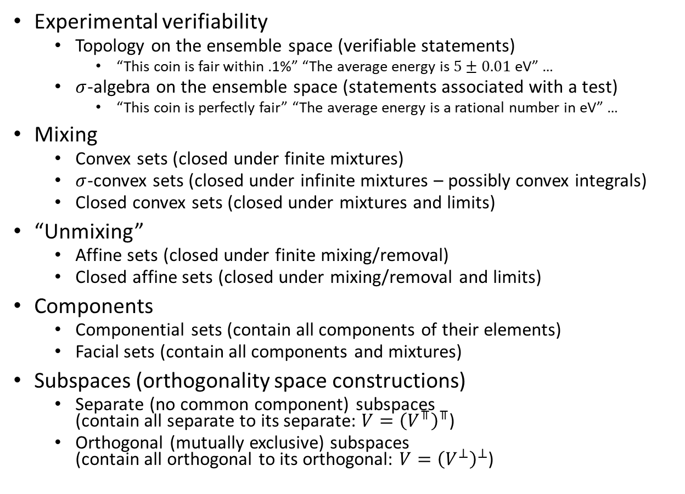

Several useful lattices
■ Closures
Sig
Experimental verifiability
  Topology on the ensemble space (verifiable statements)
    “This coin is fair within .1%” “The average energy is $5±0.01$ eV” …
  $σ$-algebra on the ensemble space (statements associated with a test)
    “This coin is perfectly fair” “The average energy is a rational number in eV” …
Mixing
  Convex sets (closed under finite mixtures)
  $σ$-convex sets (closed under infinite mixtures – possibly convex integrals)
  Closed convex sets (closed under mixtures and limits)
“Unmixing”
  Affine sets (closed under finite mixing/removal)
  Closed affine sets (closed under mixing/removal and limits)
Components
  Componential sets (contain all components of their elements)
  Facial sets (contain all components and mixtures)
Subspaces (orthogonality space constructions)
  Separate (no common component) subspaces
  (contain all separate to its separate: $V={\left(V^{⫪}\right)}^{⫪}$)
  Orthogonal (mutually exclusive) subspaces
  (contain all orthogonal to its orthogonal: $V={\left(V^{⊥}\right)}^{⊥}$)
Conv
Comp
Top
$⫪$Sub
sConv
Aff
cConv
cAff
Face
$⊥$Sub
Classical events
Quantum logic

Slide 50
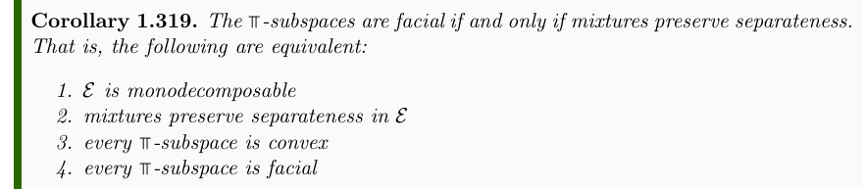
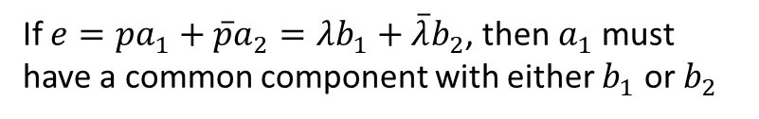

Generalization of Choquet theory
How can we reformulate the idea of a simplex in a more general case?
If $e=pa_{1}+\overline{p}a_{2}=λb_{1}+\overline{λ}b_{2}$, then $a_{1}$ must have a common component with either $b_{1}$ or $b_{2}$
If $e\text{⫪}a$ and $e\text{⫪}b$, then $e\text{⫪}pa+\overline{p}b$
Preliminary result

Slide 51

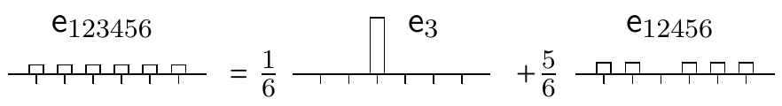
Non-additive “probability measure”
Fraction: how much of one ensemble is made of another?

Slide 52
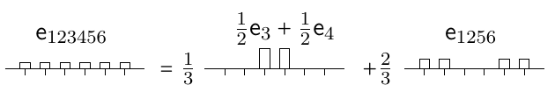
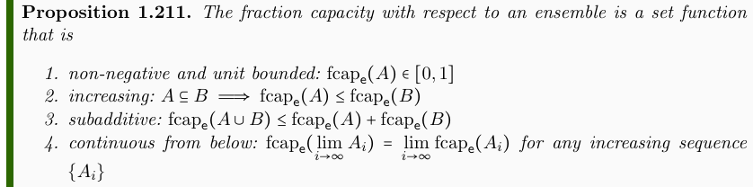
Non-additive “probability measure”
Fraction: how much of one ensemble can be constructed from others?
Recovers probability
over orthogonal subspaces
https://arxiv.org/abs/2602.01470

Slide 53
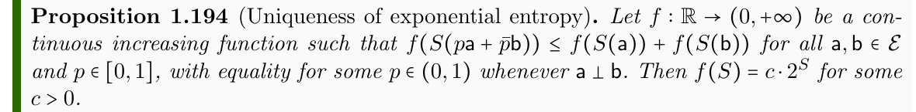
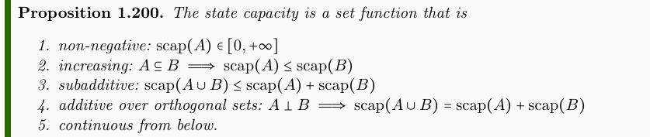
Non-additive state count
Count of states/spread of an ensemble must be given by the exponential of the entropy
Recovers $S\left(ρ_{U}\right)=\log{μ(U)}$ in the classical case and the dimensionality of Hilbert subspaces in quantum

Slide 54





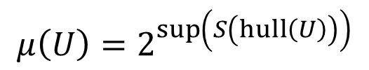
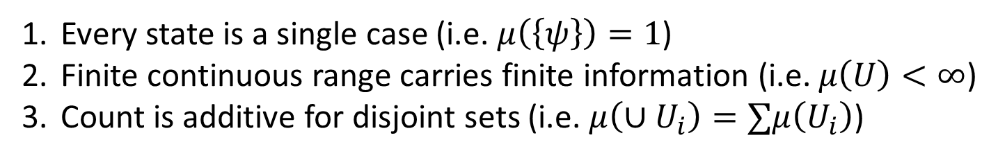







The problem with counting on the continuum
We’d like:
Every state is a single case (i.e. $μ\left(\left\{ψ\right\}\right)=1$)
Finite continuous range carries finite information (i.e. $μ\left(U\right)<∞$)
Count is additive for disjoint sets (i.e. $μ\left(∪U_{i}\right)=∑μ\left(U_{i}\right)$)
Incompatible!
Pick two!
Discard 1 $⇒$ Lebesgue measure
Discard 2 $⇒$ counting measure
sub-additive
Discard 3 $⇒$ “Quantum measure”
$$A$$
Non-orthogonal states: different states but in different contexts; not mutually exclusive
additive
$$C$$
Orthogonal states:
different states all else equal;
mutually exclusive
$$μ\left(U\right)=2^{\sup\left(S\left(hull\left(U\right)\right)\right)}$$
$$B$$
$$μ\left(\left\{A\right\}\right)=2^{0}=1$$
Exponential of the maximum entropy reachable with convex combinations (statistical mixtures) of $U$ (reduces to counting/Liouville measure)
$$μ\left(\left\{A,B\right\}\right)=2^{1}=2$$
$$μ\left(\left\{A,C\right\}\right)<2=μ\left(\left\{A\right\}\right)+μ\left(\left\{C\right\}\right)$$
Quantum mechanics $⇒$ lower bound
on #conf (entropy) on continuous DOF

Slide 55


Conjecture: quantum gravity $⇒$ lower bound on DOF count
#conf
Same problem!
#conf=#DOFs
Every point is a single DOF (i.e. $μ\left(\left\{x\right\}\right)=1$)
Finite volume carries finitely many DOFs (i.e. $μ\left(U\right)<∞$)
Count is additive for disjoint regions (i.e. $μ\left(∪U_{i}\right)=∑μ\left(U_{i}\right)$)
#DOFs
Lower bound
on this…
…requires a lower bound on this
Distant points:
independent DOFs
#DOFs $∼$ Spatial volume $\int_{U}{\sqrt{−g}}d^{3}x$
additive
From QM: Lower bound on state count requires a severe revisitation of particle state space
sub-additive
Close points: DOFs not independent
Does lower bound on DOF count require an equally severe revisitation of space-time?

Slide 56

Conclusion
Ensembles are the natural primitives for physical theories
  The math we use already implicitly assumes that states (even pure ones) are ensembles
  Experimental reproducibility implies that ensembles are the topic of scientific laws
A general theory of ensembles is therefore crucial to the foundation of physics
There are four fundamental requirements
  Experimental verifiability $⇒$ topology and $σ$-algebras
  Statistical mixing $⇒$ convex structure
  Ensemble variability $⇒$ entropic structure $⇒$ geometry
  Ensemble as equilibria $⇒$ symmetries, Lie algebras
Many open problems in math, physics and philosophy
of science find a natural setting in this theory
Lots of interesting work to be done!

