Slide 1


Classical mechanics as the high-entropy limit of quantum mechanics
https://arxiv.org/abs/2411.00972
Gabriele Carcassi¹, Manuele Landini² and Christine A. Aidala¹
¹Physics Department University of Michigan
²Institut für Experimental Physik und Zentrum für Quantenphysik, Universität Innsbruck
Foundations 2025 June 30 – July 2 Gdansk, Poland
https://assumptionsofphysics.org

Slide 2
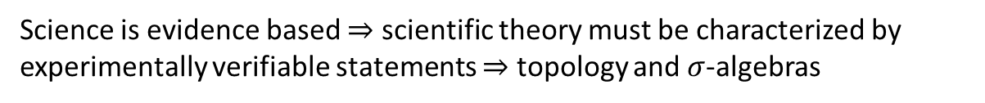


Main goal of the project
Identify a handful of physical starting points from which the basic laws can be rigorously derived
For example:
Infinitesimal reducibility $⇒$ Classical state
Irreducibility $⇒$ Quantum state
https://assumptionsofphysics.org
?
time
time
This also requires rederiving all mathematical structures from physical requirements
For example:
Science is evidence based $⇒$ scientific theory must be characterized by experimentally verifiable statements $⇒$ topology and $σ$-algebras

Slide 3

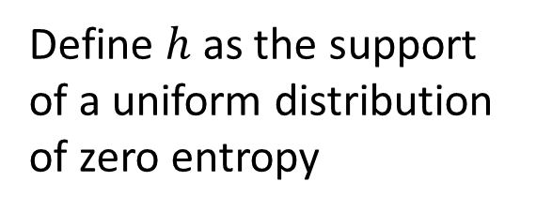

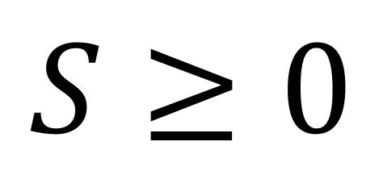

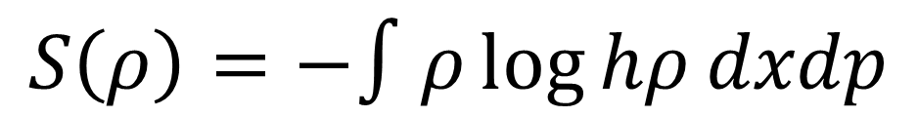
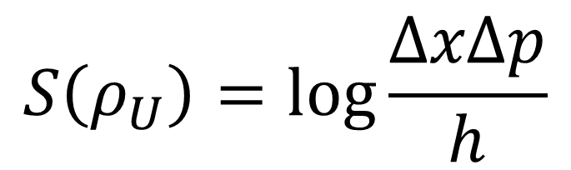

previous results
Third law of thermodynamics
$$S≥0$$
$$p$$
$$S=0$$
Physical entropy is absolute
$$h$$
Statistical mechanics
$$x$$
$$S\left(ρ_{U}\right)=\log{\frac{ΔxΔp}{h}}$$
Define $h$ as the support of a uniform distribution of zero entropy
$$S\left(ρ\right)=−∫ρ\log{hρ}dxdp$$
Fixes units (i.e. log argument is a pure number) and zero of entropy

Slide 4
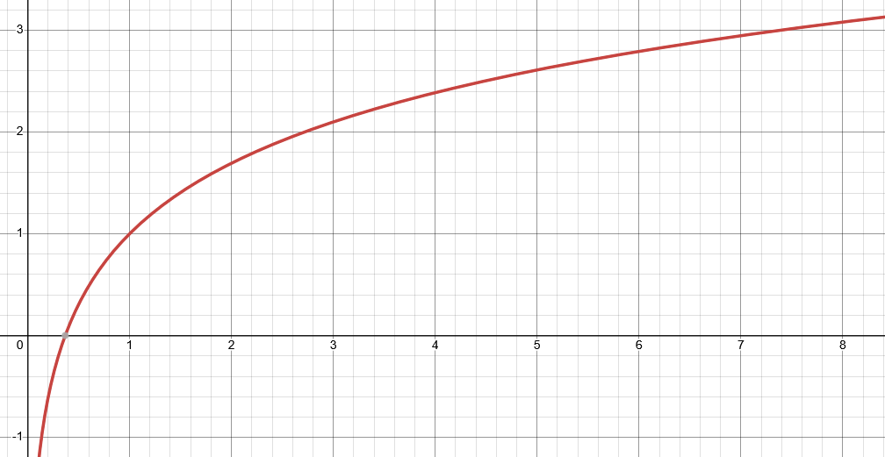
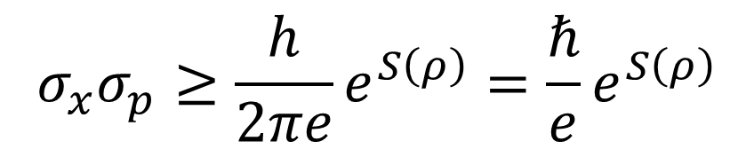

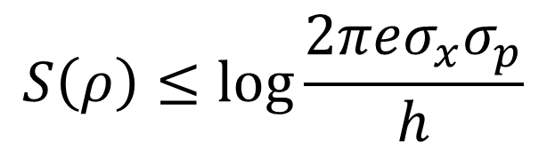
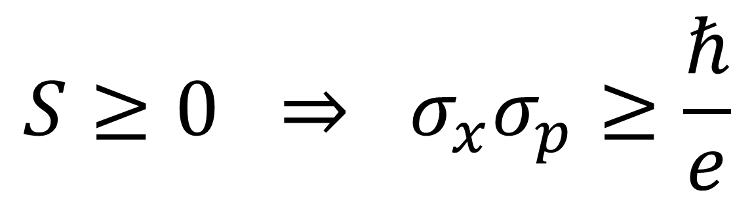

Let’s plot entropy against uncertainty
$$S$$
excluded by gaussian bound
Gaussian maximizes entropy for a given uncertainty
$$S\left(ρ\right)≤\log{\frac{2πeσ_{x}σ_{p}}{h}}$$
$$\frac{σ_{x}σ_{p}}{ℏ}$$
$$σ_{x}σ_{p}≥\frac{h}{2πe}e^{S\left(ρ\right)}=\frac{ℏ}{e}e^{S\left(ρ\right)}$$
excluded by 3rd law of thermodynamics
$$S≥0 ⇒ σ_{x}σ_{p}≥\frac{ℏ}{e}$$
Carcassi and Aidala, Found. Phys. 52:40, 2022
Classical uncertainty principle

Slide 5
Quantum mechanics incorporates the third law while classical mechanics does not
Is this the only difference?
Suppose the lower bound on the entropy is the only difference. Then in the limit of high entropy of quantum mechanics we should recover classical mechanics.
Can we?

Slide 6
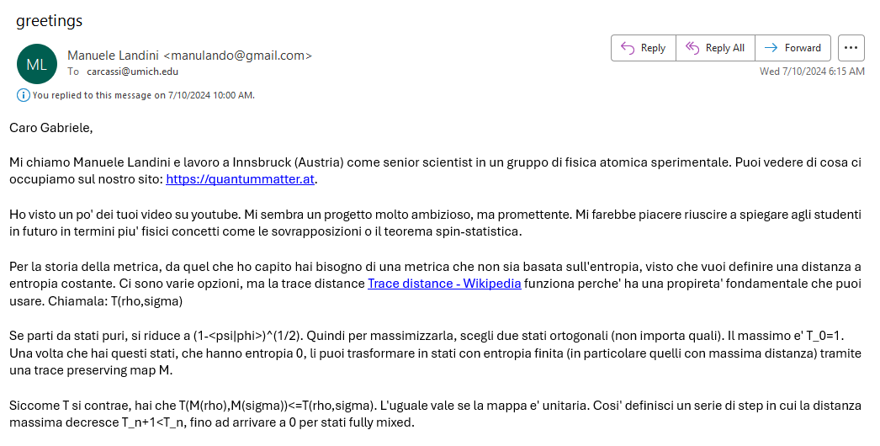
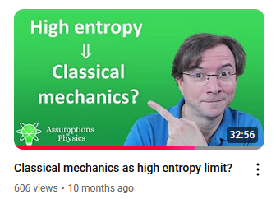
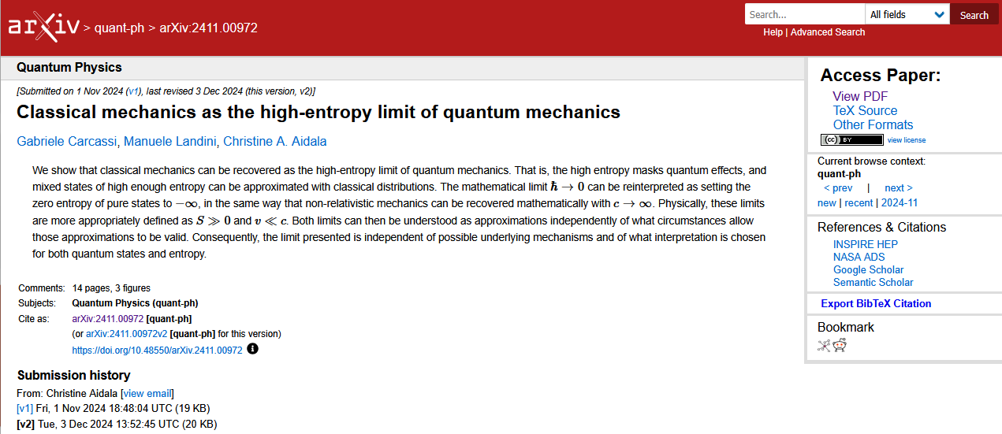
06/01/2024

Slide 7
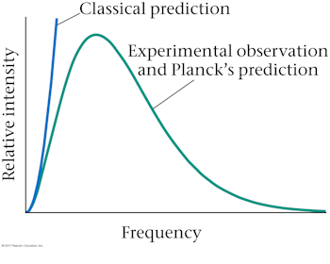

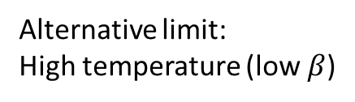
Reinterpreting traditional approaches: Blackbody radiation
Ultraviolet catastrophe – a crisis for classical physics
Failure of classical mechanics was a failure of classical mechanics with respect to statistical mechanics
Classical: Rayleigh-Jeans
Quantum: Planck
Traditional limit: Low frequency
Alternative limit: High temperature (low $β$)
Low $β↔$ high temperature/high entropy

Slide 8
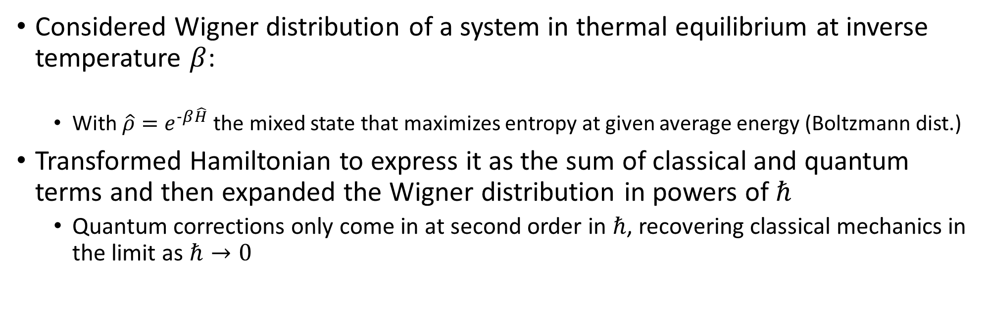
Reinterpreting traditional approaches: Wigner’s quantum correction for thermodynamic equilibrium
Phys. Rev. 40:749–759, 1932
Considered Wigner distribution of a system in thermal equilibrium at inverse temperature $β$:
With $\hat{ρ}=e^{−β\hat{H}}$ the mixed state that maximizes entropy at given average energy (Boltzmann dist.)
Transformed Hamiltonian to express it as the sum of classical and quantum terms and then expanded the Wigner distribution in powers of $ℏ$
Quantum corrections only come in at second order in $ℏ$, recovering classical mechanics in the limit as $ℏ→0$

Slide 9

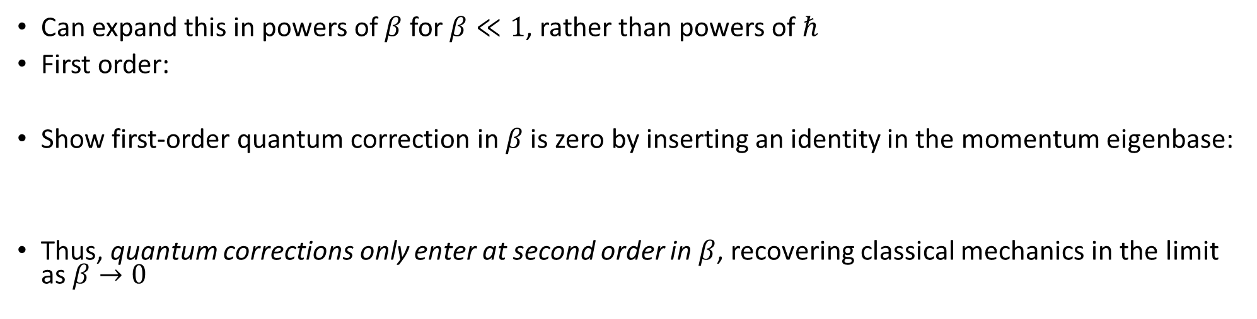



Reinterpreting traditional approaches: Wigner’s quantum correction for thermodynamic equilibrium
Transformed Hamiltonian
classical Hamiltonian
quantum corrections $$≡\hat{Q}$$
Wigner distribution in terms of $\tilde{H}$
Can expand this in powers of $β$ for $β≪1$, rather than powers of $ℏ$
First order:
Show first-order quantum correction in $β$ is zero by inserting an identity in the momentum eigenbase:
Thus, quantum corrections only enter at second order in $β$, recovering classical mechanics in the limit as $β→0$
$$⇒$$
classical
first-order quantum
classical
When entropy $S→∞$, $β→0$
second-order quantum

Slide 10
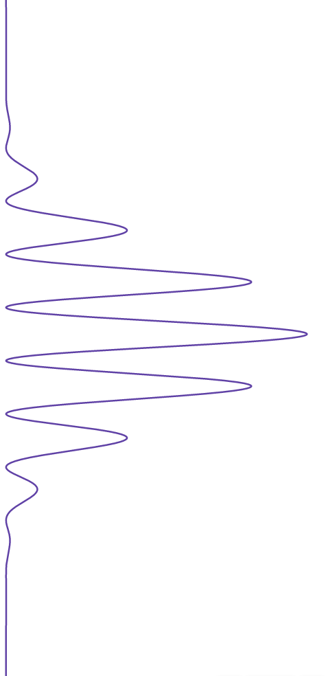
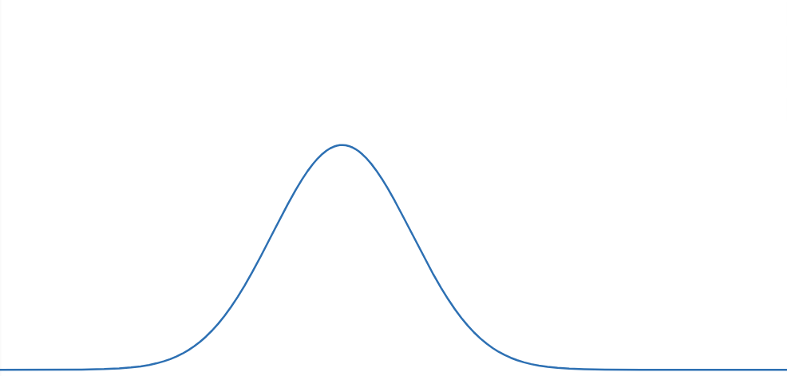
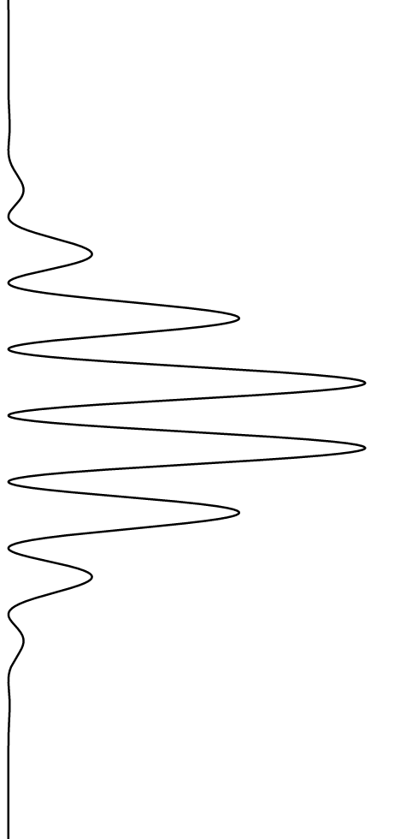
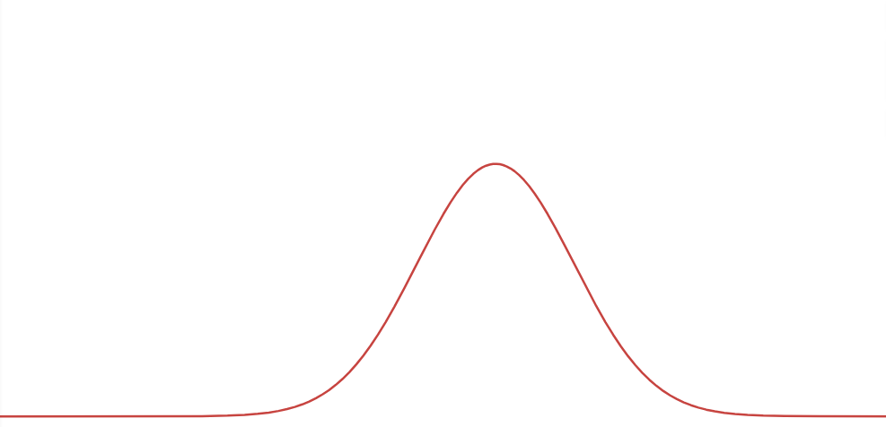
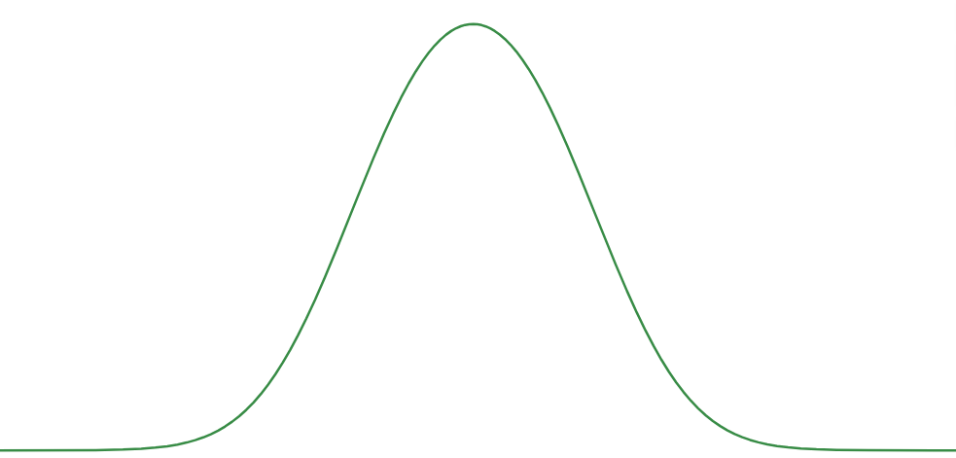







Maximally mixed state obtained by uncertainty on the open slit (uncertainty on classical variable)
Maximally mixed state obtained by uncertainty on the phase difference (quantum variable)
$$|s_{1}⟩$$
$$|i_{π}⟩$$
$$m$$
$$|i_{0}⟩$$
$$s_{1}$$
$$s_{2}$$
$$|s_{2}⟩$$
The case where we randomize the phase is indistinguishable from the case where we randomize the path
Entropic aliasing: high-entropy states allow (approximate) decomposition over incompatible observables

Slide 11
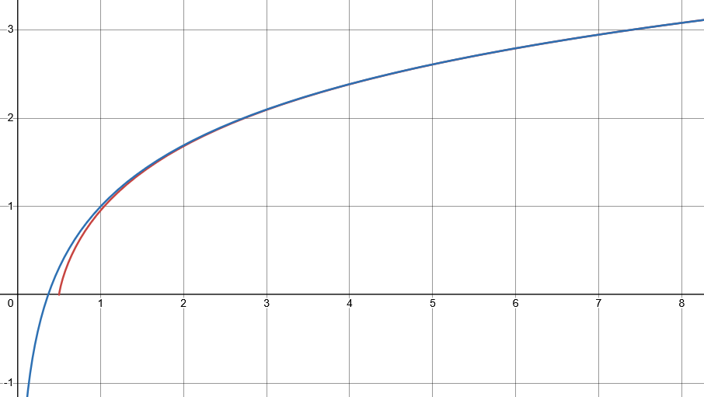
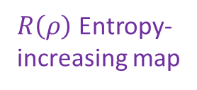




Looking for a map $R(ρ)$ that increases entropy of all mixed states, such that every level set of entropy maps to another level set
$$S$$
$⇒$ Unitary maps must be mapped to unitary maps
excluded by gaussian bound
$R\left(ρ\right)$ Entropy- increasing map
Unitary map
$$\frac{σ_{x}σ_{p}}{ℏ}$$
excluded by 3rd law of thermodynamics
classical
quantum

Slide 12
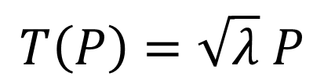
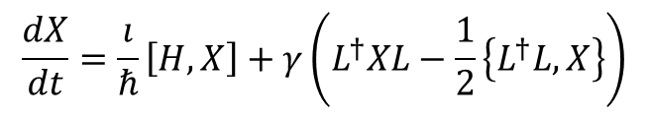
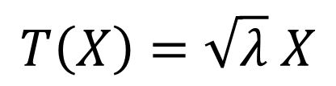


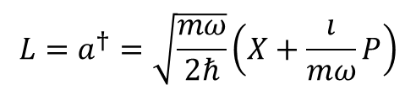
In classical mechanics
$$S\left(R\left(ρ\right)\right)=S\left(ρ\right)+\log{λ}⟺\left\{R\left(x\right),R\left(p\right)\right\}=λ\{x,p\}$$
In quantum mechanics
Jacobian is a constant: all volumes rescaled by the same factor
Stretching map
$$\left[R\left(X\right),R\left(P\right)\right]=λ\left[X,P\right]$$
Pure stretching map
$$T\left(X\right)=\sqrt{λ} X$$
$$T\left(P\right)=\sqrt{λ} P$$
Need to take care of operator ordering!!!
Infinitesimal pure stretching map
$$\frac{dX}{dt}=\frac{ı}{ℏ}\left[H,X\right]+γ\left(L^{†}XL−\frac{1}{2}\left\{L^{†}L,X\right\}\right)$$
Lindblad eq
(open quantum system)
$$L=a^{†}=\sqrt{\frac{mω}{2ℏ}}\left(X+\frac{ı}{mω}P\right)$$
$$γ=λ$$
Anti-normal ordering and Husimi Q are preferred

Slide 13
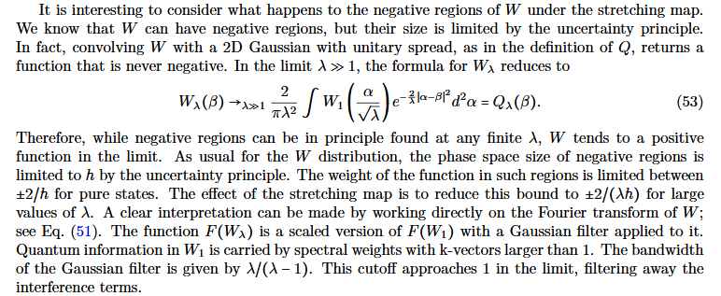
Effects of stretching map on phase-space representations
Husimi Q is simply stretched
Wigner function is stretched and convolved with a Gaussian, and coincides with the Husimi Q in the limit

Slide 14
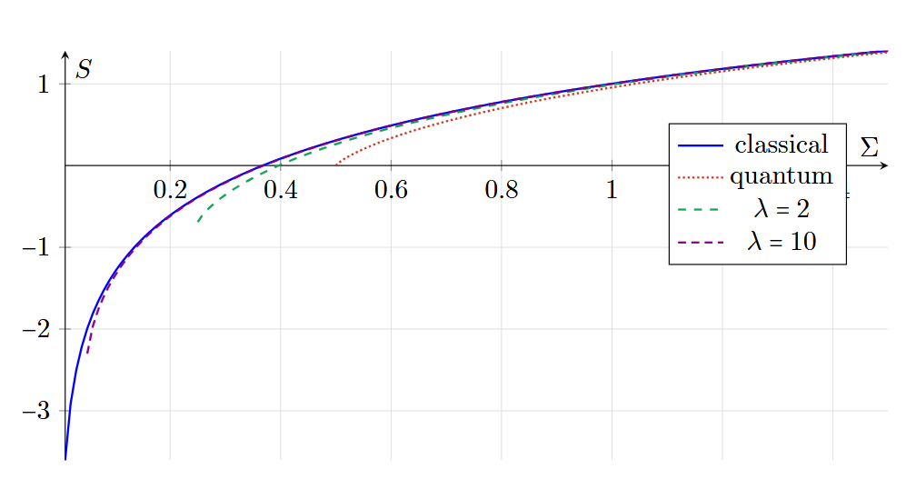
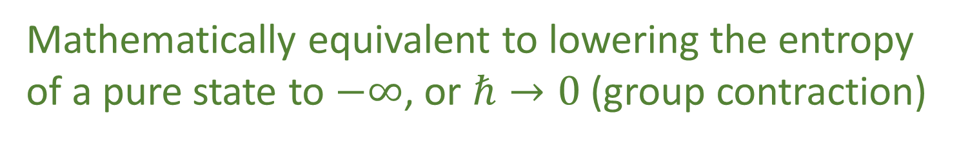
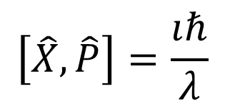



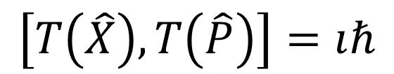

Another perspective: move the pure states to minus infinite entropy
Instead of
$$\left[X,P\right]=ıℏ$$
$$\left[T\left(X\right),T\left(P\right)\right]=λıℏ$$
$$\frac{σ_{x}σ_{p}}{ℏ}$$
Redefine original space such that
$$\left[\hat{X},\hat{P}\right]=\frac{ıℏ}{λ}$$
$$\left[T\left(\hat{X}\right),T\left(\hat{P}\right)\right]=ıℏ$$
$λ→∞ ⇒ \frac{ℏ}{λ}→0$
Mathematically equivalent to lowering the entropy of a pure state to $−∞$, or $ℏ→0$ (group contraction)

Slide 15


Low speed
Speed
“$c→∞$”
Classical Mechanics | Relativistic Mechanics
Quantum Mechanics | Quantum Field Theory
High entropy
“$ℏ→0$”
Entropy
No-mechanism limit (same as non-relativistic limit)

Slide 16
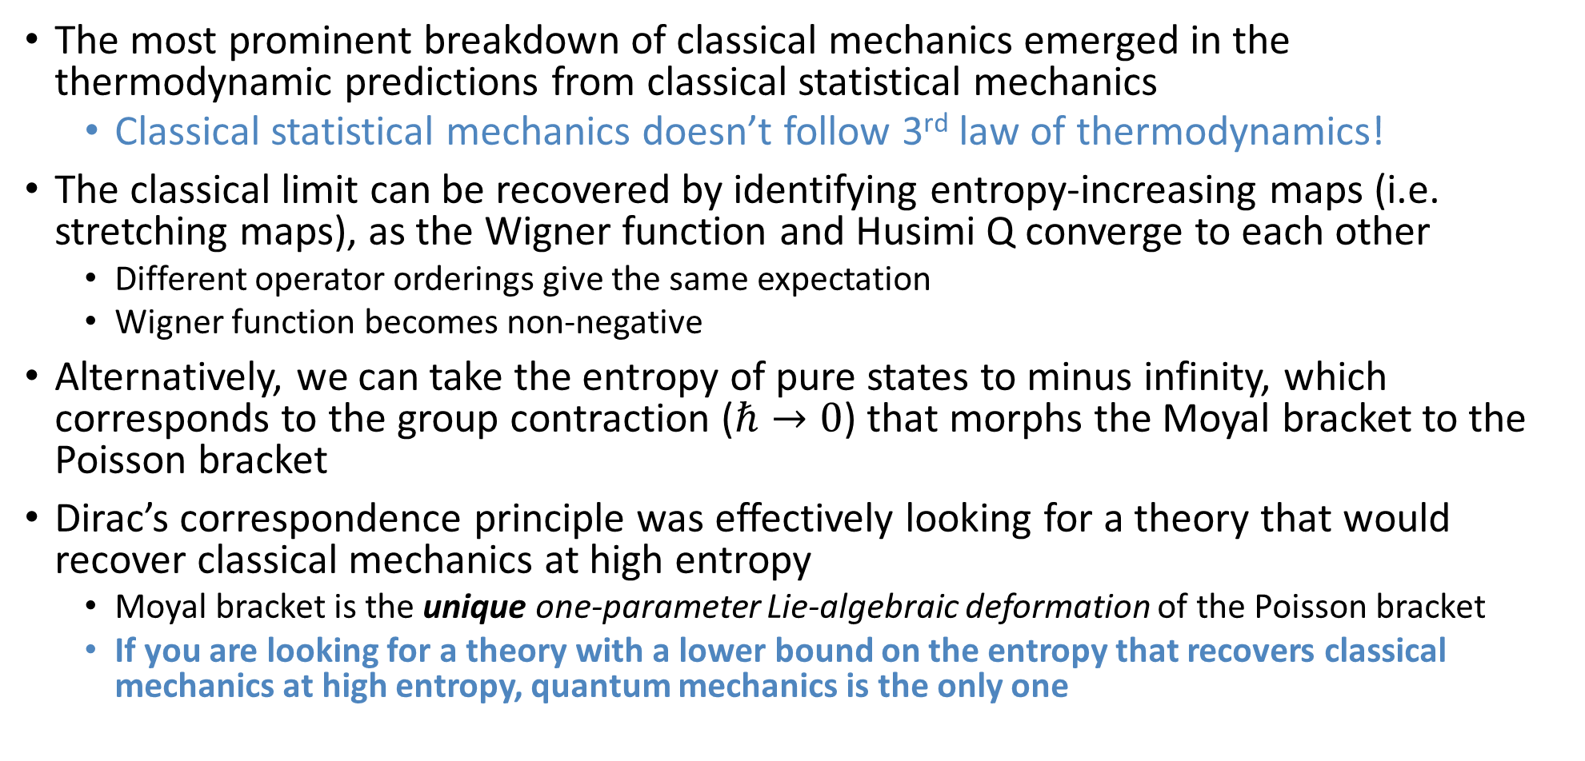
Summary
The most prominent breakdown of classical mechanics emerged in the thermodynamic predictions from classical statistical mechanics
Classical statistical mechanics doesn’t follow 3rd law of thermodynamics!
The classical limit can be recovered by identifying entropy-increasing maps (i.e. stretching maps), as the Wigner function and Husimi Q converge to each other
Different operator orderings give the same expectation
Wigner function becomes non-negative
Alternatively, we can take the entropy of pure states to minus infinity, which corresponds to the group contraction ($ℏ→0$) that morphs the Moyal bracket to the Poisson bracket
Dirac’s correspondence principle was effectively looking for a theory that would recover classical mechanics at high entropy
Moyal bracket is the unique one-parameter Lie-algebraic deformation of the Poisson bracket
If you are looking for a theory with a lower bound on the entropy that recovers classical mechanics at high entropy, quantum mechanics is the only one

Slide 17
More about our project
Project website
https://assumptionsofphysics.org for papers, presentations, …
https://assumptionsofphysics.org/book for our open access book (updated every few years with new results)
YouTube channels
https://www.youtube.com/@gcarcassi Videos with results and insights from the research
https://www.youtube.com/@AssumptionsofPhysicsResearch Research channel, with open questions and livestreamed work sessions
GitHub
https://github.com/assumptionsofphysics Book, research papers, slides for videos...
https://assumptionsofphysics.org
Looking for collaboration with philosophers to fully develop the conceptual implications of different project results

Slide 18
Backup

Slide 19

Entropy vs. uncertainty: Classical and quantum
Entropy in nats
$$\frac{σ_{x}σ_{p}}{ℏ}$$

Slide 20
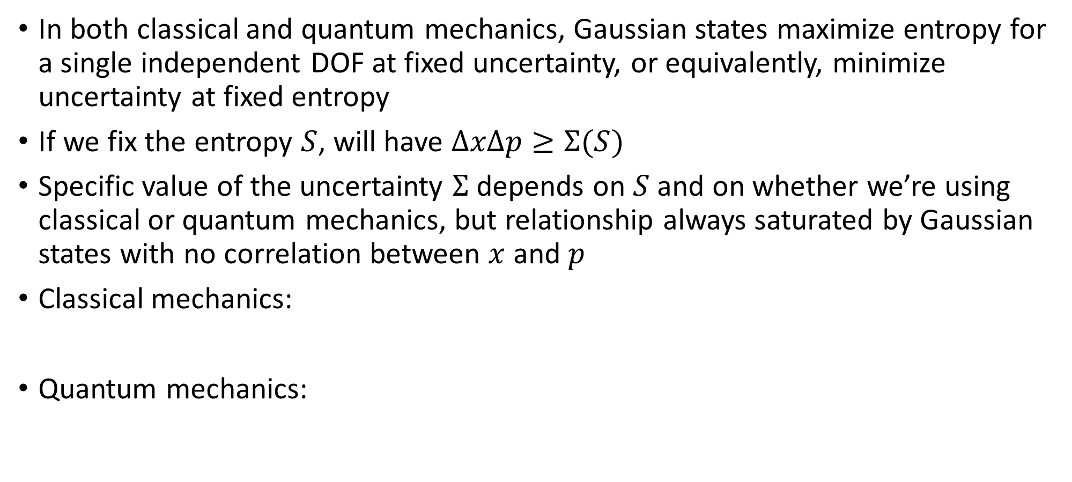
Uncertainty and entropy
In both classical and quantum mechanics, Gaussian states maximize entropy for a single independent DOF at fixed uncertainty, or equivalently, minimize uncertainty at fixed entropy
If we fix the entropy $S$, will have $ΔxΔp≥Σ(S)$
Specific value of the uncertainty $Σ$ depends on $S$ and on whether we’re using classical or quantum mechanics, but relationship always saturated by Gaussian states with no correlation between $x$ and $p$
Classical mechanics:
Quantum mechanics:
See e.g. Pathria + Beale, Statistical Mechanics, Academic Press, 2022 or Cover + Thomas, Elements of Information Theory, Wiley, 2006.
See e.g. Weedbrook et al., Reviews of Modern Physics 84:621, 2012.

Slide 21
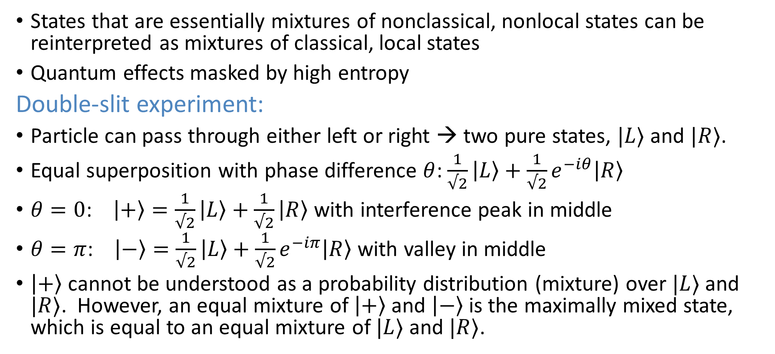
Entropic aliasing
States that are essentially mixtures of nonclassical, nonlocal states can be reinterpreted as mixtures of classical, local states
Quantum effects masked by high entropy
Double-slit experiment:
Particle can pass through either left or right → two pure states, $|L⟩$ and $|R⟩$.
Equal superposition with phase difference $θ$: $\frac{1}{√2}\left|L\right\rangle +\frac{1}{√2}e^{−iθ}\left|R\right\rangle$
$θ=0$: $\left|+\right\rangle =\frac{1}{√2}\left|L\right\rangle +\frac{1}{√2}\left|R\right\rangle$ with interference peak in middle
$θ=π$: $\left|−\right\rangle =\frac{1}{√2}\left|L\right\rangle +\frac{1}{√2}e^{−iπ}\left|R\right\rangle$ with valley in middle
$\left|+\right\rangle$ cannot be understood as a probability distribution (mixture) over $|L⟩$ and $|R⟩$. However, an equal mixture of $\left|+\right\rangle$ and $\left|−\right\rangle$ is the maximally mixed state, which is equal to an equal mixture of $|L⟩$ and $|R⟩$.

