Slide 1

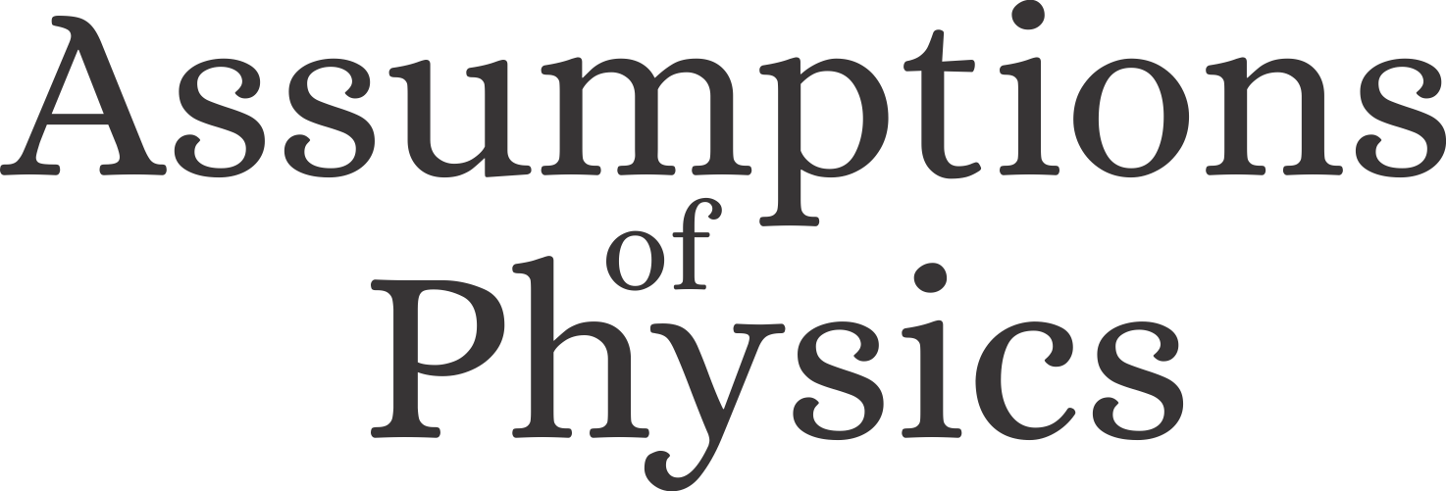
The common logical structure of classical and quantum mechanics (and all scientific theories)
Gabriele Carcassi
Physics Department
University of Michigan

Slide 2

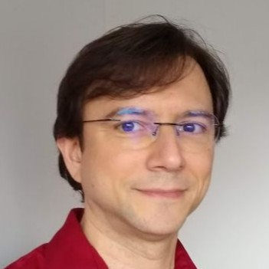
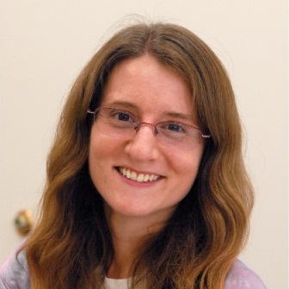
The paper
The common logical structure of classical and quantum mechanics
Andrea Oldofredi, Gabriele Carcassi, Christine A. Aidala
Erkenntnis (2022)
Andrea Oldofredi
Gabriele Carcassi
Christine A. Aidala
University of Lisbon
University of Michigan

Slide 3
Project website: https://assumptionsofphysics.org/
YouTube channel: https://www.youtube.com/user/gcarcassi
Facebook page: https://www.facebook.com/AssumptionsOfPhysics
Main goal: to identify a handful of physical principles from which the basic laws can be rigorously derived
Sub-goal: a sturdier mathematical foundation for physical theories (all mathematical definitions justified from physical requirements)

Slide 4
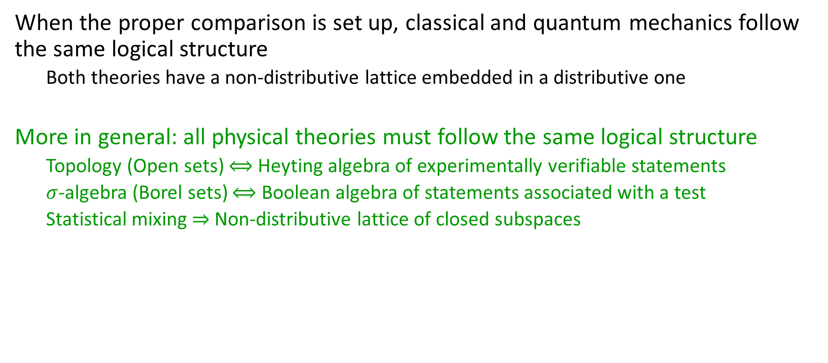
Thesis
When the proper comparison is set up, classical and quantum mechanics follow the same logical structure
Both theories have a non-distributive lattice embedded in a distributive one
More in general: all physical theories must follow the same logical structure
Topology (Open sets) $⟺$ Heyting algebra of experimentally verifiable statements
$σ$-algebra (Borel sets) $⟺$ Boolean algebra of statements associated with a test
Statistical mixing $⇒$ Non-distributive lattice of closed subspaces

Slide 5
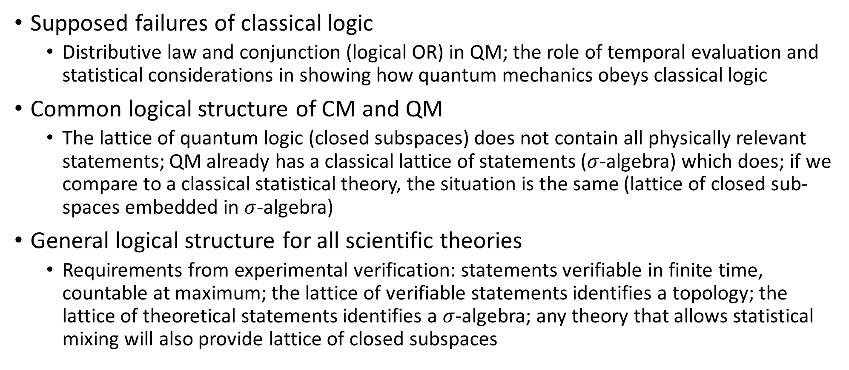
Plan
Supposed failures of classical logic
Distributive law and conjunction (logical OR) in QM; the role of temporal evaluation and statistical considerations in showing how quantum mechanics obeys classical logic
Common logical structure of CM and QM
The lattice of quantum logic (closed subspaces) does not contain all physically relevant statements; QM already has a classical lattice of statements ($σ$-algebra) which does; if we compare to a classical statistical theory, the situation is the same (lattice of closed sub-spaces embedded in $σ$-algebra)
General logical structure for all scientific theories
Requirements from experimental verification: statements verifiable in finite time, countable at maximum; the lattice of verifiable statements identifies a topology; the lattice of theoretical statements identifies a $σ$-algebra; any theory that allows statistical mixing will also provide lattice of closed subspaces

Slide 6
Disclaimer
Andrea Oldofredi is the one fluent in the philosophical and quantum logic literature
My interest and expertise lies in understanding how the details of the mathematical structure map to physical concepts

Slide 7
Supposed failures of classical logic

Slide 8
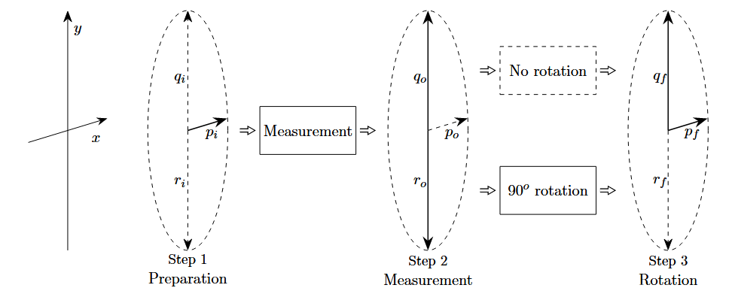
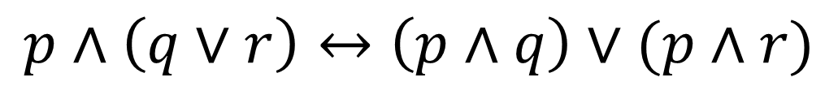
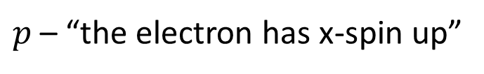
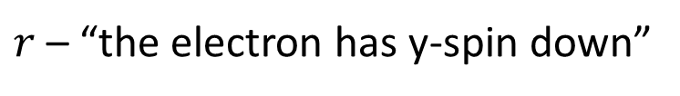
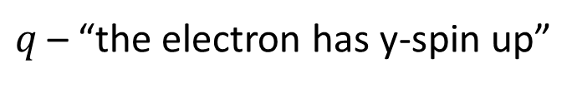
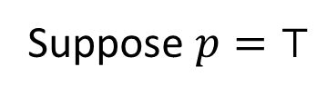
Distributivity law
$$p∧\left(q∨r\right)↔\left(p∧q\right)∨(p∧r)$$
Consider the following statements
$p$ – “the electron has x-spin up”
$q$ – “the electron has y-spin up”
$r$ – “the electron has y-spin down”
Claim: spin in the y direction is either up or down – $q∨r=⊤$
Claim: x and y directions are incompatible – $p∧q=p∧r= ⊥$
Suppose $p=⊤$
Distributivity violated!
$$p∧\left(q∨r\right)=⊤↔\left(p∧q\right)∨\left(p∧r\right)=⊥$$

Slide 9

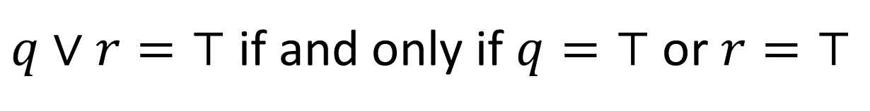
Disjunction
$q∨r=⊤$ if and only if $q=⊤$ or $r=⊤$
Claim: spin in the y direction is either up or down – $q∨r=⊤$
Claim: this is true even if we prepare x-spin up
But if $p=⊤$, then $q=r= ⊥$ even though $q∨r=⊤$
Quantum disjunction works differently!

Slide 10
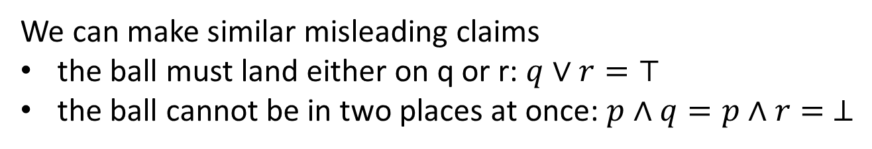
Distributivity law
$$p∧\left(q∨r\right)↔\left(p∧q\right)∨(p∧r)$$
Analog scenarios can be constructed with classical systems
p
A ball can be placed in position p, above a hatch; when the hatch is open, the ball will land in either position q or r with equal probability (due to the symmetry)
q
r
We can make similar misleading claims
the ball must land either on q or r: $q∨r=⊤$
the ball cannot be in two places at once: $p∧q=p∧r= ⊥$
Classical mechanics does not follow classical logic!

Slide 11
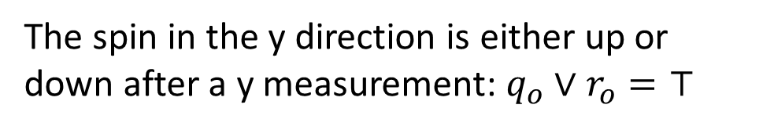
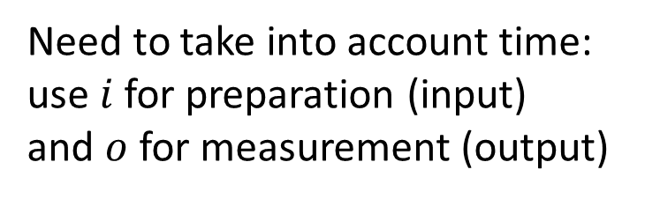
Distributivity law
$$p∧\left(q∨r\right)↔\left(p∧q\right)∨(p∧r)$$
Need to take into account time: use $i$ for preparation (input) and $o$ for measurement (output)
The spin in the y direction is either up or down after a y measurement: $q_{o}∨r_{o}=⊤$
There is no incompatibility between x direction before the measurement and y direction after the measurement: $p_{i}∧q_{o}=⊤$ if we prepared x-up and measured y-up
Distributivity not violated!

Slide 12

Disjunction
$q∨r=⊤$ if and only if $q=⊤$ or $r=⊤$
Yes, if we measure y, we either have y-spin up or y-spin down
Suppose you rotate y-spin down after the measurement: $p_{f}∨q_{f}=⊤$
It does not follow that we must always have x-spin up or y-spin up: $p_{f}∨q_{f}=⊤$ $↛$ $p_{i}∨q_{i}=⊤$ and $p_{f}∨q_{f}=⊤$ $↛$ $p_{o}∨q_{o}=⊤$
So, how does the quantum disjunction work?

Slide 13
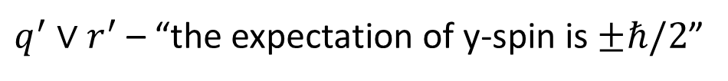
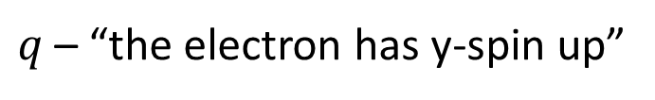
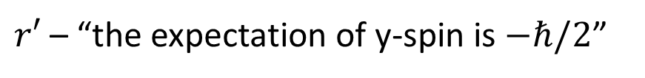
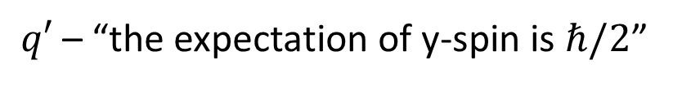
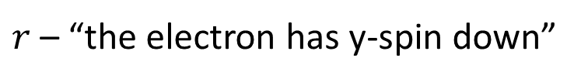
Disjunction
$q∨r=⊤$ if and only if $q=⊤$ or $r=⊤$
Since we have no idea how the disjunction in QM should work, let’s find equivalent statements for which we know how the disjunction works!
$q$ – “the electron has y-spin up”
$q′$ – “the expectation of y-spin is $ℏ/2$”
$r$ – “the electron has y-spin down”
$r′$ – “the expectation of y-spin is $−ℏ/2$”
Because those are extremal values, the statements are equivalent: $q⟷q′$ and $r⟷r′$
$q^{′}∨r^{′}$ – “the expectation of y-spin is $±ℏ/2$”
This is not always true! True and only true if y-spin is up or down!
Quantum disjunction works the same!

Slide 14
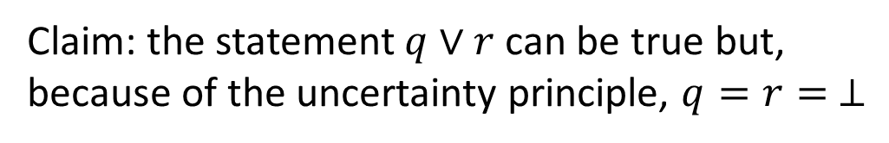

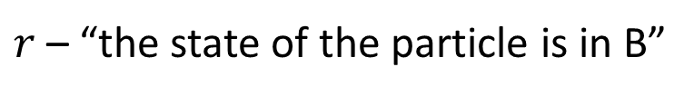
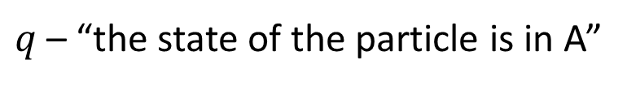


Disjunction
$q∨r=⊤$ if and only if $q=⊤$ or $r=⊤$
$$p$$
$q$ – “the state of the particle is in A”
$$ℏ/4$$
$r$ – “the state of the particle is in B”
A
B
Claim: the statement $q∨r$ can be true but, because of the uncertainty principle, $q=r= ⊥$
$$x$$
Quantum disjunction works differently!

Slide 15
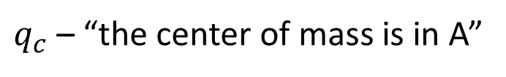
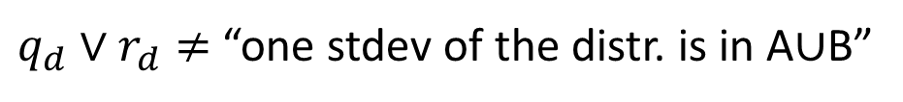

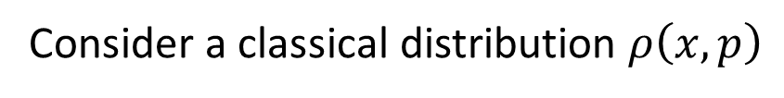
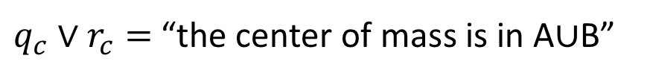
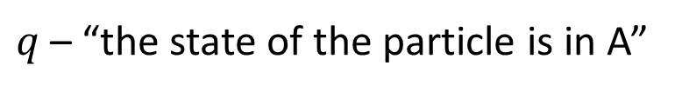
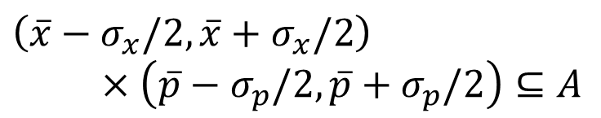



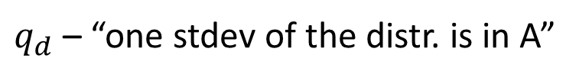
Disjunction
$q∨r=⊤$ if and only if $q=⊤$ or $r=⊤$
Either statistical or probabilistic
$$p$$
Consider a classical distribution $ρ\left(x,p\right)$
$$ℏ/4$$
$q$ – “the state of the particle is in A”
Ambiguous
A
B
$q_{c}$ – “the center of mass is in A”
$q_{d}$ – “one stdev of the distr. is in A”
$$\left[\overline{x},\overline{p}\right]∈A$$
$\left(\overline{x}−σ_{x}/2,\overline{x}+σ_{x}/2\right)$ $×\left(\overline{p}−σ_{p}/2,\overline{p}+σ_{p}/2\right)⊆A$
$$x$$
$q_{c}∨r_{c}=$ “the center of mass is in A$∪$B”
$q_{d}∨r_{d}≠$ “one stdev of the distr. is in A$∪$B”
Half-sigma in A and half-sigma in B
The disjunction does not always map to the union of the region (nothing to do with quantum mechanics)

Slide 16
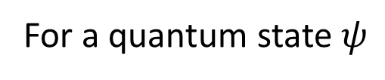
Disjunction
$q∨r=⊤$ if and only if $q=⊤$ or $r=⊤$
$$p$$
For a quantum state $ψ$
$$ℏ/4$$
$q$ – “the state of the particle is in A”
Ambiguous
A
B
$q_{c}$ – “the center of mass is in A”
$q_{d}$ – “one stdev of the distr. is in A”
$$\left[\overline{x},\overline{p}\right]∈A$$
$\left(\overline{x}−σ_{x}/2,\overline{x}+σ_{x}/2\right)$ $×\left(\overline{p}−σ_{p}/2,\overline{p}+σ_{p}/2\right)⊆A$
$$x$$
$q_{c}∨r_{c}=$ “the center of mass is in A$∪$B”
$q_{d}∨r_{d}≠$ “one stdev of the distr. is in A$∪$B”
Half-sigma in A and half-sigma in B
Quantum disjunction works the same!
(just map to quantum expectations)

Slide 17
How to not get confused
Be explicit on the process and the temporal ordering
What processes (e.g. preparations and measurements) is the system subjected to?
When are the statements evaluated?
Be explicit about statistical/probabilistic attributes
Are we discussing center of mass (always well defined), support, standard deviation, … ?
When comparing classical and quantum mechanics, compare apples to apples (i.e. expectation values with expectation values) and oranges to oranges (i.e. support/stdDev with support/stdDev)

Slide 18
Common logical structure of CM and QM

Slide 19
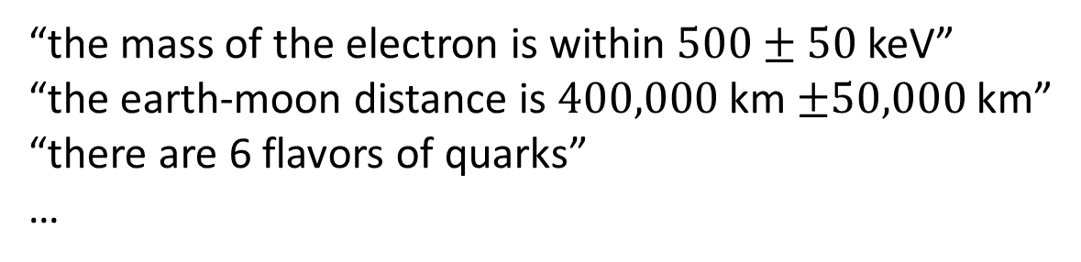
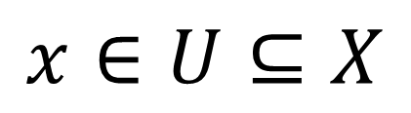

Link between logic and set theory
Consider various scientific statements such as:
“the mass of the electron is within $500±50$ keV”
“the earth-moon distance is $400,000$ km $±50,000$ km”
“there are 6 flavors of quarks”
…
Statement $⟺$ Subset
The object we are describing
They can be modelled mathematically with the following pattern:
The set all possible ways the object can be
$$x∈U⊆X$$
A subset of possible ways the object can be

Slide 20
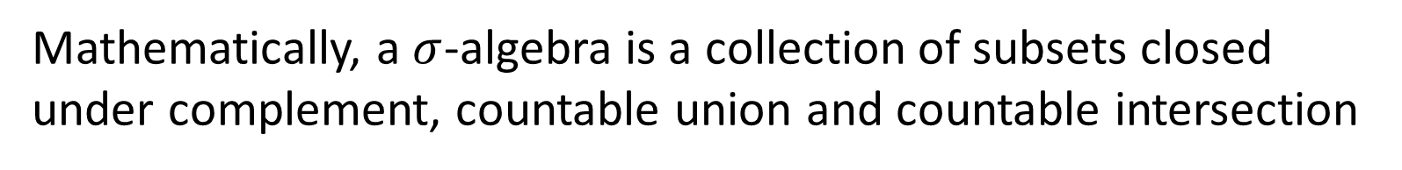
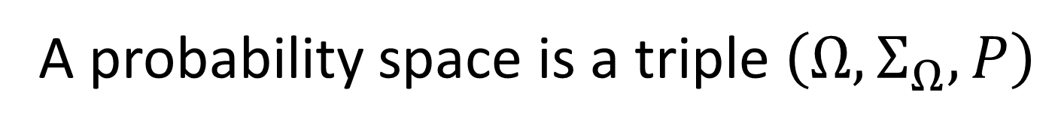
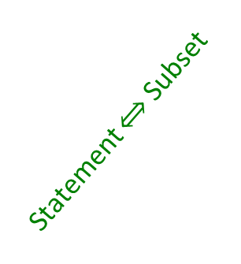
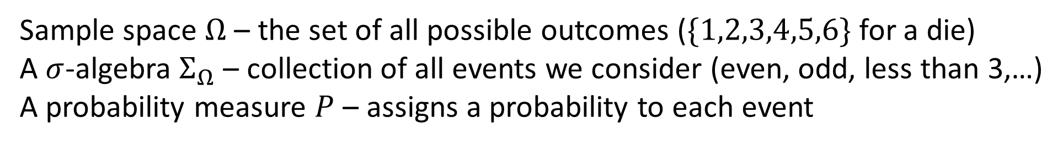
Link between logic and probability theory
A probability space is a triple $\left(Ω, Σ_{Ω}, P\right)$
Sample space $Ω$ – the set of all possible outcomes ($\{1,2,3,4,5,6\}$ for a die)
A $σ$-algebra $Σ_{Ω}$ – collection of all events we consider (even, odd, less than 3,…)
A probability measure $P$ – assigns a probability to each event
Mathematically, a $σ$-algebra is a collection of subsets closed under complement, countable union and countable intersection
Statement $⟺$ Subset
$Σ_{Ω}$is countably complete Boolean algebra of statements
Probability theory requires classical logic

Slide 21

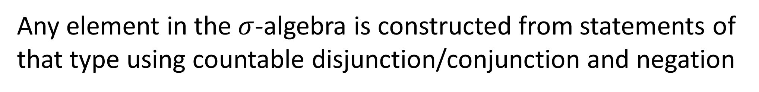

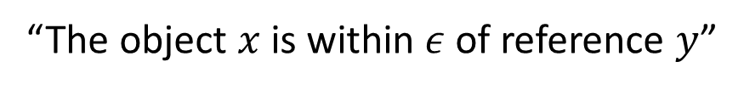
Do Hilbert spaces have a $σ$-algebra?
Yes
Hilbert space $⇒$ normed vector space $⇒$ metric space $⇒$ topological space $⇒$ equipped with a Borel $σ$-algebra
Is the Borel $σ$-algebra something intelligible?
Yes
A metric space defines a distance. A distance allows us to write statements of the type:
“The object $x$ is within $ε$ of reference $y$”
$$s\left(ε,y\right)="d{\left(x,y\right)}^{2}<ε^{2}"$$
Any element in the $σ$-algebra is constructed from statements of that type using countable disjunction/conjunction and negation

Slide 22
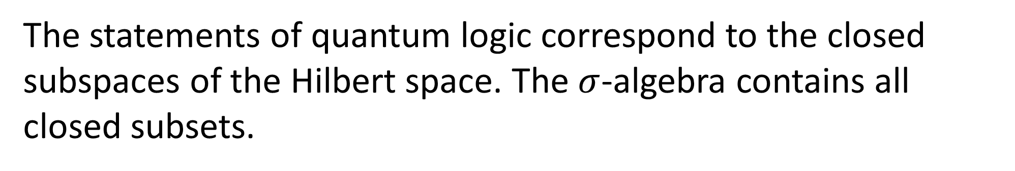

What is the relationship with quantum logic?
The statements of quantum logic correspond to the closed subspaces of the Hilbert space. The $σ$-algebra contains all closed subsets.
The lattice of quantum logic is a proper subset of the $σ$-algebra
$$Σ_{ℋ}$$
QL

Slide 23
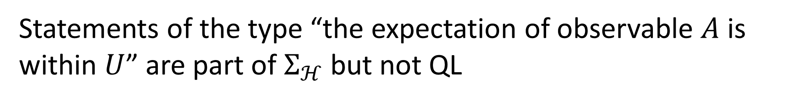
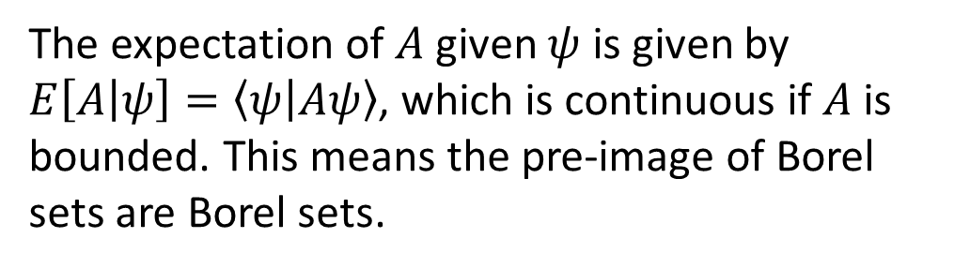
Are the extra statements physically useful?
Yes
Statements of the type “the expectation of observable $A$ is within $U$” are part of $Σ_{ℋ}$ but not QL
E.g.: the average z-spin is zero
The expectation of $A$ given $ψ$ is given by $E\left[A | ψ\right]=\left\langle ψ | Aψ\right\rangle$, which is continuous if $A$ is bounded. This means the pre-image of Borel sets are Borel sets.
Not closed subspace
$$Σ_{ℋ}$$
QL
Plenty of physically meaningful statements!!!

Slide 24








Quantum mechanics
Classical mechanics
$ℋ_{ℂ}$ - $ψ(x)$
$ℋ_{ℝ}$ - $\sqrt{ρ}(x,p)$
Metric induced topology
$${\text{T}}_{ℋ_{ℂ}}$$
Metric induced topology
$${\text{T}}_{ℋ_{ℝ}}$$
Countably complete Boolean algebra of statements
$$Σ_{ℋ_{ℂ}}$$
Countably complete Boolean algebra of statements
$$Σ_{ℋ_{ℝ}}$$
Non-distributive lattice of closed subspaces
$$L(ℋ_{ℂ})$$
Non-distributive lattice of closed subspaces
$$L(ℋ_{ℝ})$$

Slide 25
To summarize
Probability theory requires a countably complete Boolean (classical) lattice of statements
Quantum mechanics comes already equipped with such a lattice of statements (the Borel algebra)
The Borel algebra includes all QL statements (everything QL does can be done in the Borel algebra)
The Borel algebra includes statistical statements, which are of physical interest, that are not part of the QL statements (QL does not allow us to capture all physical statements)
The same structure exists for classical distributions over phase-space
Quantum mechanics and classical mechanics, when properly compared, share a common logical structure
The measure theoretic structure, however, will be different

Slide 26
Common logical structure of all scientific theories

Slide 27
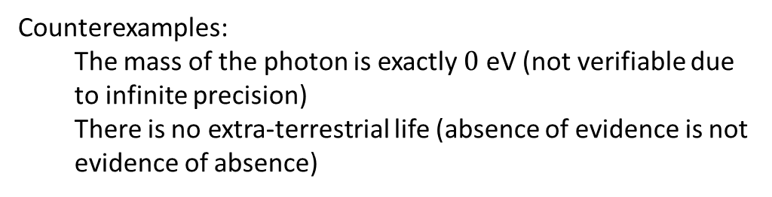
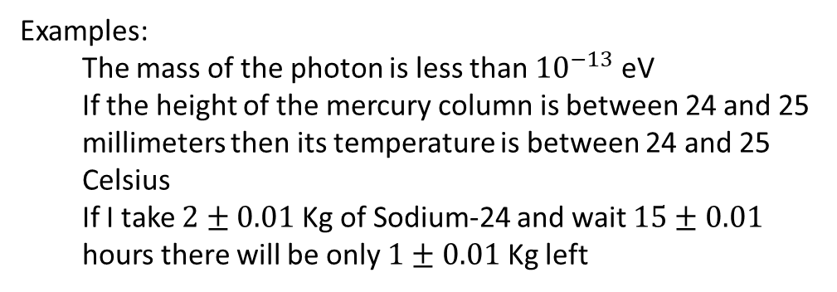

We want to capture the scientific requirement of experimental verification. The basic notion will be verifiable statements: assertions that can be experimentally verified in a finite time
Examples:
The mass of the photon is less than ${10}^{−13}$ eV
If the height of the mercury column is between 24 and 25 millimeters then its temperature is between 24 and 25 Celsius
If I take $2±0.01$ Kg of Sodium-24 and wait $15±0.01$ hours there will be only $1±0.01$ Kg left
Counterexamples:
The mass of the photon is exactly $0$ eV (not verifiable due to infinite precision)
There is no extra-terrestrial life (absence of evidence is not evidence of absence)
We have to keep in mind that the meaning of the statements, their relationships and what truth values are allowed depends on context (e.g. premise, theory, etc…)
The mass of the electron is 511 $±$ 0.5 KeV
When measuring the mass, it is a verifiable hypothesis
When performing particle identification, it is assumed to be true

Slide 28
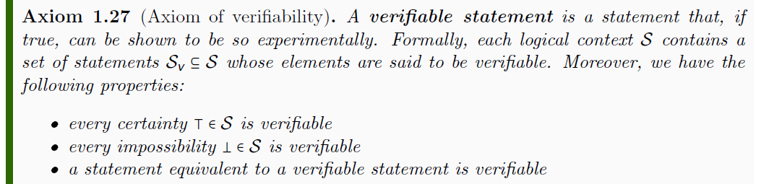
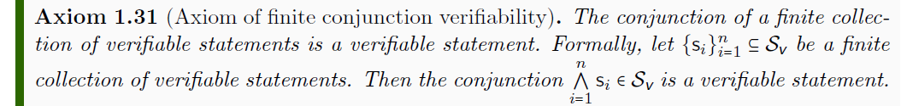
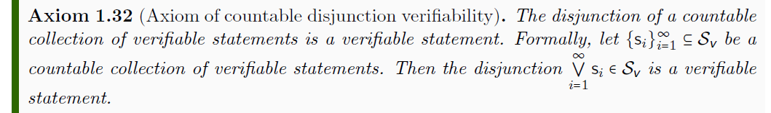


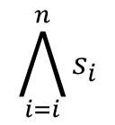

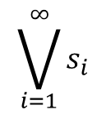








Properties of verifiable statements
$$𝒮$$
$$s_{1}$$ | Test Result
T | SUCCESS (in finite time)
F | FAILURE (in finite time)
 | UNDEFINED
$$𝒮_{\text{v}}$$
$$s_{1}$$
experimental test
$$\bigwedge_{i=i}^{n}{s_{i}}$$
$$s_{1}$$
$$s_{2}$$
$$s_{3}$$
All tests must succeed
$$\bigvee_{i=1}^{∞}{s_{i}}$$
$$s_{1}$$
$$s_{2}$$
$$s_{3}$$
$$…$$
One successful test is sufficient

Slide 29

Requirements of experimental verifiability:
Verifiable statements are closed under finite conjunction and countable disjunction.
We can at most verify countably many statements (in the limit of arbitrarily long time).
Experimental domain $𝒟_{X}$: a set of verifiable statements
closed under finite conjunction and countable disjunction
generated by countably many verifiable statements
Theoretical domain ${\overline{𝒟}}_{X}⊇𝒟_{X}$: all statements with a test, regardless of termination (closure of an experimental domain under negation and countable conjunction/disjunction)
Possibilities $X⊂{\overline{𝒟}}_{X}$: the statements that give the complete picture (i.e. every theoretical statement $s$, they either imply $s$ or $¬s$ – mathematically, the atoms of the lattice ${\overline{𝒟}}_{X}$)

Slide 30

Experimentally distinguishable cases
Statements formally associated with an experimental test
Theoretical statements
Precise map between physical concepts and their mathematical representation
If true, test always succeeds in finite time
Verifiable statements
Possibilities
$σ$-algebra
Borel sets
Points
All proofs can be “translated” into physically meaningful language
Open sets
Topology

Slide 31

Some interesting results
Every set of physically distinguishable cases is a ${\text{T}}_{0}$ second-countable topological space
Every set of physically distinguishable cases can have up to the cardinality of the continuum
Every relationship between two sets of physically distinguishable cases must be topologically continuous, as inference can be used for experimental verification
Every relationship between two real quantities must be analytically continuous with up to countably many discontinuities, and the region of those discontinuities must be verifiable (e.g. we can verify water is in the triple point or undergoing phase transition)
We identified a set of necessary and sufficient physical conditions that lead to ordered quantities (these cannot be assumed valid at Planck scale)
These are general results that must be valid for all theories

Slide 32
Space of the well-posed scientific theories
Physical theories
Specializations of the general theory under the different assumptions
Hamiltonian mechanics
Unitary evolution
Quantum state-space
Classical phase-space
Assumptions
Infinitesimal reducibility
Determinism/
reversibility
Irreducibility
States and processes
General theory
Informational granularity
Basic requirements and definitions valid in all theories
Experimental verifiability

Slide 33

We want to describe the space of states for a system
$⇒$ Set of physically distinguishable elements
$⇒$ Topology ( ) and $σ$-algebra ( )
verifiable statements
theoretical statements
Must allow for ensembles
$$p_{a}s_{a}+p_{b}s_{b}$$
$⇒$ Statistical mixture imposes a linear operation
These are necessary structures for theories that describe objects that can be experimentally defined
$⇒$ Lattice of subspaces

Slide 34

Conclusions
Once the full meaning of quantum propositions is properly taken into account, quantum mechanics follows classical logic
Quantum logic propositions only apply to “single-shot” measurements, and therefore are of very limited use
Hilbert spaces are already equipped with a classical logic lattice (the $σ$-algebra) that includes all quantum logic statements plus all statistical statements
The space of classical statistical distributions is also a Hilbert space, which is equipped with a similar “quantum logic” lattice
This pattern stems from a requirement of experimental verification, and therefore is common to all physical theories
Topology (Open sets) $⟺$ Heyting algebra of experimentally verifiable statements
$σ$-algebra (Borel sets) $⟺$ Boolean algebra of statements associated with a test
Statistical mixing $⇒$ Non-distributive lattice of closed subspaces

Slide 35
Resources
Project website: https://assumptionsofphysics.org/
Papers, presentation slides, list of open problems, …
YouTube channel: https://www.youtube.com/user/gcarcassi
Popularize results of our research, recorded presentations, …
“Reverse physics: from laws to physical assumptions”
https://arxiv.org/abs/2111.09107 (Foundations of Physics 2022)
“Geometrical and physical interpretation of the action principle”
https://arxiv.org/abs/2208.06428 (pre-print)
“The four postulates of quantum mechanics are three”
https://arxiv.org/abs/2003.11007 (Physical Review Letters 2021)
Facebook page
https://www.facebook.com/AssumptionsOfPhysics

