Slide 1


The Assumptions of Physics project
Christine A. Aidala
Physics Department University of Michigan
LHCb Tuesday Meeting 30 May 2023

Slide 2
Introduction
There has been extensive focus and effort for the last half century on developing new theories within physics, searching for beyond-the-Standard-Model physics
We believe that in order to search most effectively for new physical theories, first we should better understand our various established physical theories and their mathematical structures

Slide 3
Lead a project called Assumptions of Physics
https://assumptionsofphysics.org/
Find a set of minimal physical assumptions from which the laws can be rederived
Reverse Physics: Start with the equations, reverse engineer physical assumptions/principles
What are the basic concepts/idealizations behind the different physical theories?
Physical Mathematics: Start from scratch and rederive everything from physical requirements
Which mathematical structures (or which parts) are physical?

Slide 4
Outline
“elevate” the discussion from mathematical constructs to physical principles, assumptions and requirements (reverse physics)
Construct a perfect map between mathematical and physical objects - Understand which mathematical structures are physical and which aren’t –that the current mathematical foundations are not quite what we need for physical theories (need for physical mathematics)
Notes:
Replace w/G’s/add website

Slide 5
Reverse physics: from laws to physical assumptions
Reverse Physics: From Laws to Physical Assumptions
Gabriele Carcassi, Christine A. Aidala
Foundations of Physics (2022) 52:40
https://arxiv.org/abs/2111.09107

Slide 6






Reversing classical Hamiltonian mechanics
one d.o.f.
$$p$$
$$=ξ^{2}$$
Mathematically, fully characterized by an incompressible flow
$$q$$
$$=ξ^{1}$$
$$div\left(S^{a}\right)=0$$
$$|J|\text{ = 1}$$
Physically, equivalent to
(1) Deterministic and reversible evolution
For generalization, independence of d.o.f.’s is the only additional requirement
Count of states (volume) is conserved
(2) Thermodynamically reversible evolution
Thermodynamic entropy (log of volume) is conserved
(3) Conservation of information
(4) Conservation of uncertainty
Determinant of covariance matrix is conserved

Slide 7

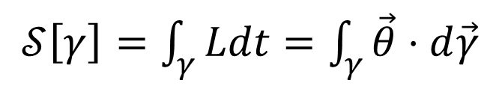






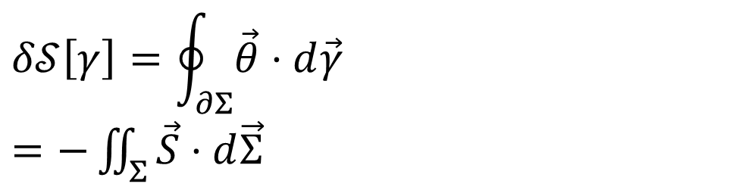

Reversing the principle of least action
$$∇⋅\vec{S}=0$$
$$\vec{S}=−∇×\vec{θ}$$
$𝒮\left[γ\right]=\int_{γ}{Ldt}=\int_{γ}{\vec{θ}⋅d\vec{γ}}$
No state is “lost” or “created” as time evolves
Minus sign to match convention
The action is the line integral of the vector potential (unphysical)
$$p$$
Variation of the action
$$q$$
$$Σ$$
$$δ𝒮\left[γ\right]=\oint_{∂Σ}{\vec{θ}⋅d\vec{γ}}$$ $=−\iint_{Σ}{\vec{S}⋅d\vec{Σ}}$
$$γ$$
Gauge independent, physical!
$$γ′$$
$$t$$
https://arxiv.org/abs/2208.06428
So far rejected without review by five journals because it is not of interest…
Variation of the action measures the flow of states (physical). Variation = 0 → flow of states tangent to the path.

Slide 8
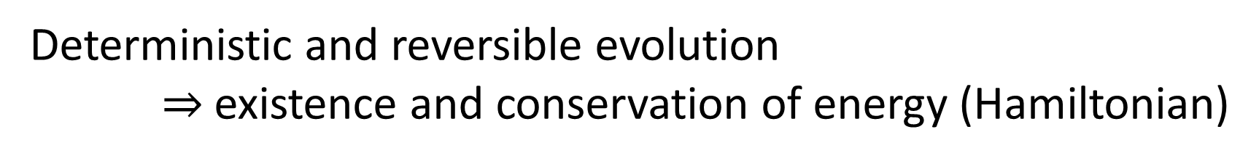
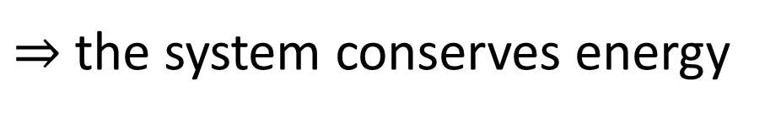
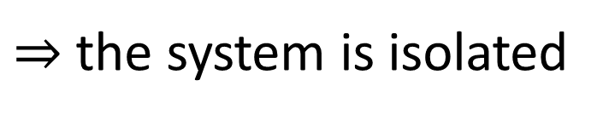
Reverse physics: Understanding links between theories
Deterministic and reversible evolution $⇒$existence and conservation of energy (Hamiltonian)
Why?
Stronger version of the first law of thermodynamics
Deterministic and reversible evolution
$⇒$ past and future depend only on the state of the system
$⇒$ the evolution does not depend on anything else
$⇒$ the system is isolated
First law of thermodynamics!
$⇒$ the system conserves energy
Notes:
[Structure of phase space exactly what is needed to do statistical mechanics - Comes out of invariance of the entropy under coordinate transformations]

Slide 9


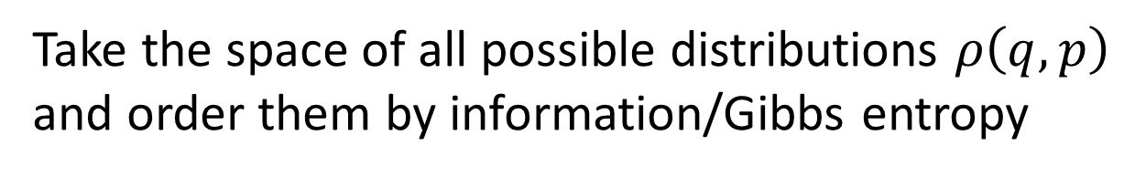



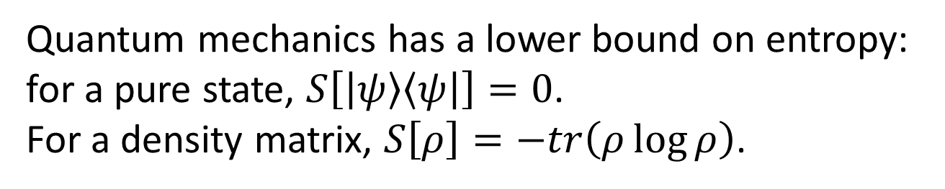
$$S=−∫ρ\log{ρ}$$
Reversing the uncertainty principle
Quantum mechanics has a lower bound on entropy: for a pure state, $S\left[\left|ψ\right\rangle \left\langle ψ\right|\right]=0$.
For a density matrix, $S\left[ρ\right]=−tr\left(ρ\log{ρ}\right)$.
Take the space of all possible distributions $ρ\left(q,p\right)$ and order them by information/Gibbs entropy
$$S_{0}$$
Fix the entropy to a constant $S_{0}$ and consider all distributions with that entropy
$$σ_{q}σ_{p}$$
They satisfy $σ_{q}σ_{p}≥\frac{e^{S_{0}}}{2πe}$
equality for independent Gaussians
Lower bound on entropy $⇒$ lower bound on uncertainty
Inverse does not work: lower bound on uncertainty does not give a lower bound on entropy

Slide 10

Reversing the uncertainty principle
Lower bound for information entropy (Gibbs/von Neumann) $⇒$uncertainty principle (classical/quantum)
We don’t need the full quantum theory to derive the uncertainty principle: only the lower bound on entropy
The difference is that in classical mechanics we can prepare ensembles with arbitrarily low entropy…
… which is actually in contradiction with the third law of thermodynamics!!!
Notes:
It’s the reason that classical mechanics ultimately fails—comes directly from the assumption of infinitesimal reducibility. Can’t extract as much information from the system as you want. There’s a level of description below which you can’t go.

Slide 11
Holistic approach
Assumptions of CM
Classical mechanics
Measure theory
Statistics
Assumptions of physics
Assumptions of QM
Quantum mechanics
Information theory
Differential geometry
Assumptions of TD
Thermo-dynamics
No single fundamental point of view (e.g. “everything is information”)
Foundations of different theories are not disconnected
Find those “conceptual clusters” that span multiple areas of physics, math, …
Notes:
In our approach to the foundations of physics, we don’t focus only on the foundations of QM. We take a holistic approach. QM is NOT the foundation of physics. The foundations of physics need to cut across all of physics.

Slide 12
Reverse physics: Summary
“Reverse physics” is an approach to the foundations of physics that starts from the physical laws and aims to “go back” to a suitable minimum number of physical assumptions
The goal is to fully map conceptual relationships and dependencies between different theories, different aspects of the theories, and to help foster higher level physical reasoning
It is, by its nature, an interdisciplinary endeavor, and it can allow us to think more deeply about physical ideas and their relationships

Slide 13
Physical mathematics: from physical requirements to mathematical structures

Slide 14
Physical mathematics
In modern physics, mathematics is used as the foundation of our physical theories
From Hossenfelder’s Lost in Math: “[…] finding a neat set of assumptions from which the whole theory can be derived, is often left to our colleagues in mathematical physics […]”
But mathematics only deals with formal systems, without any connection to or concern about physical reality. Formal definitions are neither necessary nor sufficient to do physics.
Not useful in a lab
David Hilbert: “Mathematics is a game played according to certain simple rules with meaningless marks on paper.”
Bertrand Russell: “It is essential not to discuss whether the first proposition is really true, and not to mention what the anything is, of which it is supposed to be true.”
Physics is defined in terms of physical objects and operational definitions. Using assumptions and approximations, physical objects and their properties are idealized. The idealized model can then be expressed in the formal system.
The idealization step is the most important part of this process, and it happens outside the formal system!
Notes:
Starting with the math, i.e. the formal system, missing most of the physics!

Slide 15
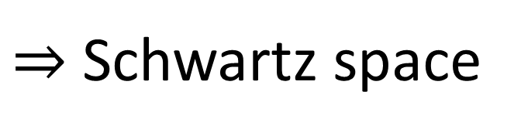
Are Hilbert spaces physical?
Hilbert space: complete inner product vector space
Redundant on finite dimensional spaces. For infinite dimensional spaces, it allows us to construct states with infinite expectation values from states with finite expectation values
Exactly captures superposition/ statistical mixing
Exactly captures measurement probability/entropy of mixtures
Physically required
Physically required
$⇒$ Thus requires us to include unitary transformations (i.e. change of representations and finite time evolution) that change finite expectations into infinite
Extremely physically suspect!!!
Suppose we require all polynomial of position and momentum to have finite expectation
$⇒$ Schwartz space
Only space closed under Fourier transform
Used as starting point of theories of distributions
Maybe more physically appropriate?

Slide 16

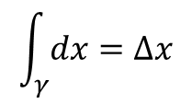
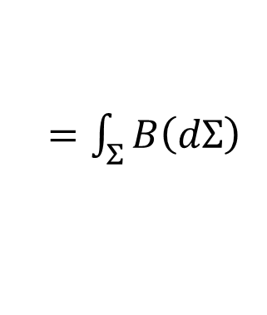
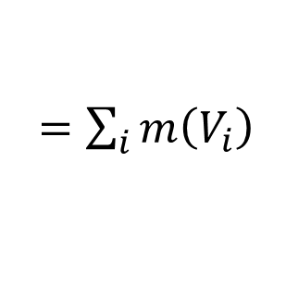


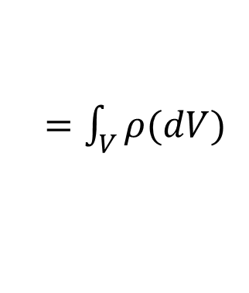



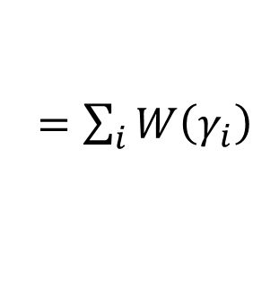

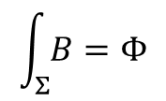
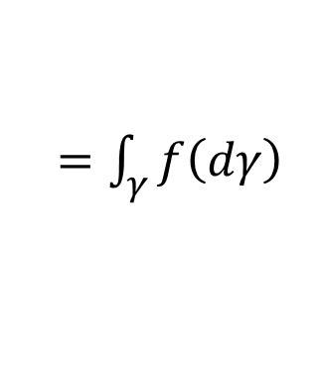
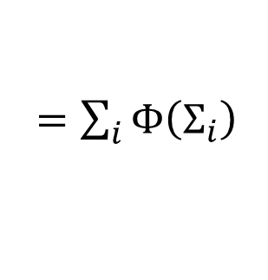


Physical mathematics: differential forms
Differential forms increasing important tool in theoretical physics, but mathematically abstract
Differential forms are fully anti-symmetric function of vectors
Vector defined as derivation
Define integral on top of forms
$$v:C^{∞}\left(ℝ^{n}\right)→C^{∞}\left(ℝ^{n}\right)$$
$$dx:V→ℝ$$
$$B:V×V→ℝ$$
$$\int_{γ}{dx}=Δx$$
$$\int_{Σ}{B}=Φ$$
$$v=v^{i}∂_{i}$$
$$dx\left(v\right)=dx\left(v^{i}∂_{i}\right)=v^{x}$$
$$B\left(v,w\right)=B_{ij}v^{i}w^{j}$$
vector basis
Abstract definitions at points, construct finite from infinitesimal
Concrete definitions on finite, infinitesimal as a limit
Assume quantity is additive on disjoint regions
Start with finite quantities over finite regions
Thinking about finite regions/values leads to better physical intuition
$$m\left(V\right)$$
$=\sum_{i}{m\left(V_{i}\right)}$
$=\int_{V}{ρ(dV)}$
$$Φ(Σ)$$
$=\sum_{i}{Φ\left(Σ_{i}\right)}$
$=\int_{Σ}{B\left(dΣ\right)}$
Makes it clear that the mathematics is contingent upon the assumptions of additivity (if this fails, differential forms are inapplicable)
$$W(γ)$$
$=\sum_{i}{W\left(γ_{i}\right)}$
$=\int_{γ}{f\left(dγ\right)}$
Differential forms: infinitesimal limit

Slide 17
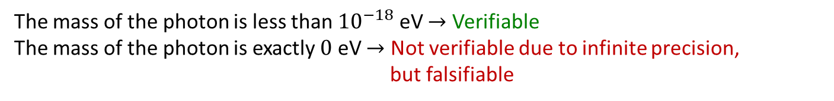


Physical mathematics: Experimental verifiability as the 1st basic requirement
Science deals with assertions whose truth can be defined/ascertained experimentally $⇒$ Verifiable statements: assertions that can be experimentally verified in a finite time
The mass of the photon is less than ${10}^{−18}$ eV $→$ Verifiable
The mass of the photon is exactly $0$ eV $→$ Not verifiable due to infinite precision, but falsifiable
T | SUCCESS (in finite time)
F | UNDEFINED
 | FAILURE (in finite time)
Different logic of verifiable statements:
Finite conjunction/logical AND (all tests must succeed in finite time)
Countable disjunction/logical OR (once one test succeeds, we can stop)
No negation/NOT (FALSE $≠$ FAILURE)
Note: whether a specific statement is experimentally verifiable or even well defined may depend on context (e.g. premises, idealization, theory, etc…)
The mass of the electron is 511 $±$ 0.1 KeV
When measuring the mass, it is a verifiable hypothesis
When performing particle identification, it is assumed to be true

Slide 18
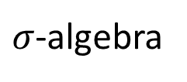
Experimentally distinguishable cases
Statements formally associated with an experimental test
Theoretical statements
Precise map between physical concepts and their mathematical representation
If true, test always succeeds in finite time
Verifiable statements
Possibilities
$σ$-algebra
Borel sets
Points
All proofs can be “translated” into physically meaningful language
Open sets
Topology
Towards a general mathematical theory of experimental science
https://arxiv.org/abs/1807.07896
Notes:
Topology is the foundation for all of differential geometry. Sigma-algebras are the foundation of measure theory, probability theory, and info theory. (The points on top of which the topology is defined.)

Slide 19
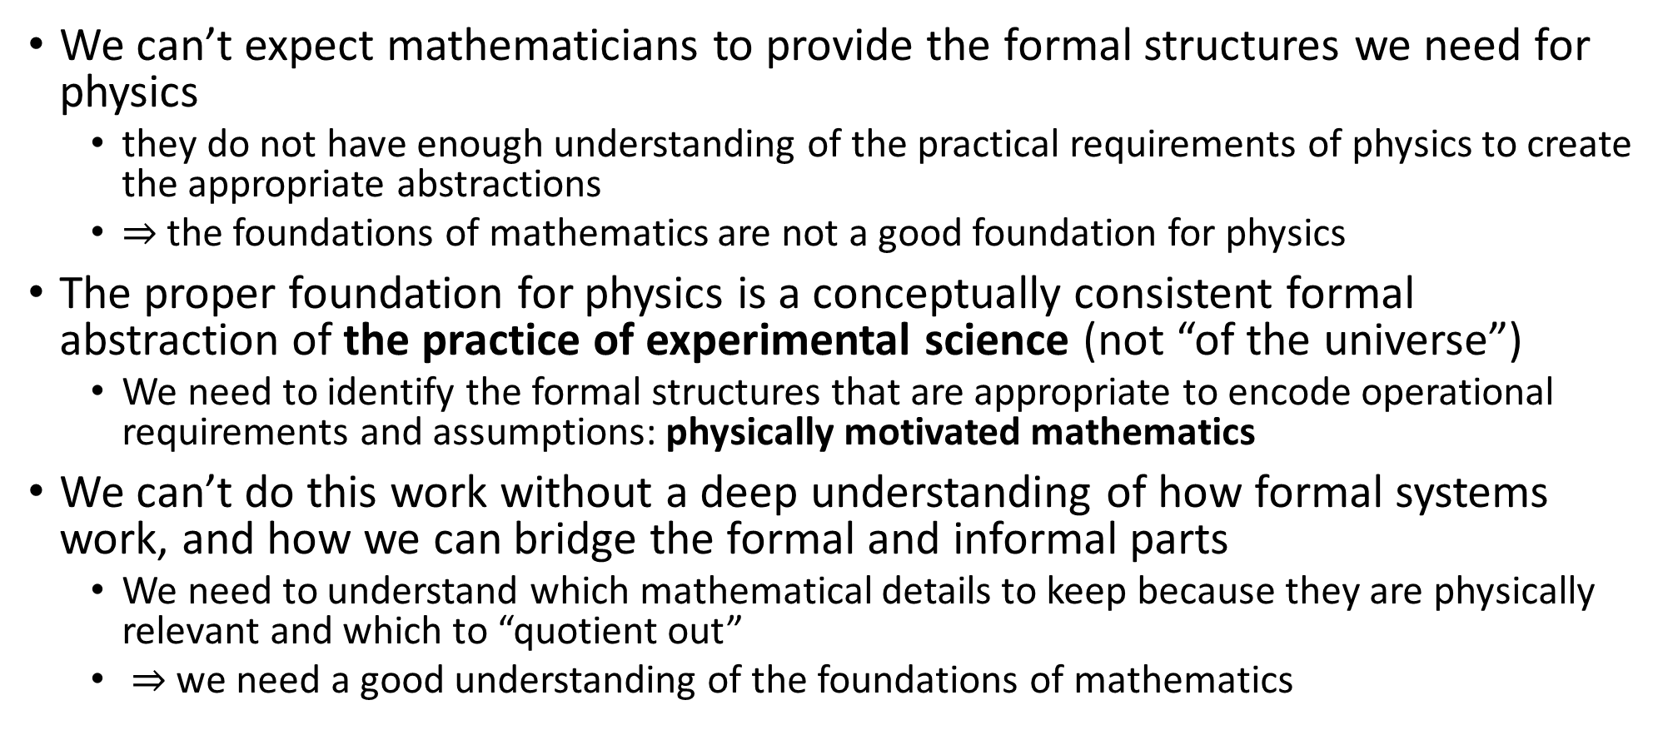
The need for physical mathematics
We can’t expect mathematicians to provide the formal structures we need for physics
they do not have enough understanding of the practical requirements of physics to create the appropriate abstractions
$⇒$ the foundations of mathematics are not a good foundation for physics
The proper foundation for physics is a conceptually consistent formal abstraction of the practice of experimental science (not “of the universe”)
We need to identify the formal structures that are appropriate to encode operational requirements and assumptions: physically motivated mathematics
We can’t do this work without a deep understanding of how formal systems work, and how we can bridge the formal and informal parts
We need to understand which mathematical details to keep because they are physically relevant and which to “quotient out”
$⇒$ we need a good understanding of the foundations of mathematics

Slide 20
Practical problems doing a project like this
High level of specialization of most journals, conferences, and funding programs
Even journals that claim to be general. PRL initially told us that our paper reducing the number of postulates of quantum mechanics was “not of general interest.” We pointed out that the first paper in the latest issue was “Stochastic interpolation of sparsely sampled time series via multipoint fractional Brownian bridges,” and our paper was then accepted (PRL 126, 110402, https://arxiv.org/abs/2003.11007)
Many journals want to publish articles they expect to be highly cited
“This is not what is being discussed in mathematical physics”
People interested in rigorous mathematics often not interested in the physics. People interested in the physics often want to use “trendy” and “fancy” mathematical tools.
Some of our work has been criticized as “not mathematically sophisticated”
Notes:
It doesn’t occur to people that such a program is possible. Not that concepts are complication, but that they’re connected in ways that are unexpected.

Slide 21
Practical problems doing a project like this
Interdisciplinary research often challenging until a new discipline is formed, e.g. biophysics
Some philosophers have a strong technical background and interest in aspects of this project, but philosophy as a discipline has greater pressure for single-author papers. “I don’t collaborate.”
Standard physics curriculum doesn’t typically cover fundamental mathematical tools underpinning [differential geometry, calculus?], i.e. topologies, sigma-algebras, measure theory, [].
People working on “foundations of quantum mechanics” often never studied the mathematical structures of classical mechanics or those underpinning probability and information theory
Theoretical physicists working on beyond-the-SM physics not asking questions such as “What conditions allow me to use a metric?” “…to use a manifold?”
Need space for a small, technical community working on these types of foundational issues, in a spirit similar to the international metrology community

Slide 22
Conclusions
The solution to many open problems in the foundation of physics lies in a better understanding of the current mathematical tools, their physical meaning and the development of fundamentally new tools
Reverse physics helps us reframe the current theories in terms of physical requirements and assumptions, shifting the attention away from math to physical ideas
Physical mathematics helps us understand clearly how physical ideas are encoded into the formal systems, and find physically motivated generalizations
We need to leave space within physics for this type of foundational work!

Slide 23
Supplemental

Slide 24
Reverse Physics
Physics
Smallest set of assumptions required to rederive the theory
Physical theory
Physical result/ effect/prediction
Reverse Mathematics
Mathematics
Smallest set of axioms required to prove the theorem
Theorem
Mathematical result/ corollary/calculation

Slide 25
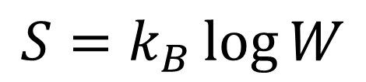


(5) Deterministic and thermodynamically reversible evolution
$$p$$
$$=ξ^{2}$$
$$q$$
$$=ξ^{1}$$
Link between statistical mechanics and thermodynamics
$$S=k_{B}\log{W}$$
Area conservation $⟺$ entropy conservation
$⟺$ thermodynamically reversible evolution
Notes:
To be clear, the previous reversible meant that we can _reconstruct_ the state. This is different from thermodynamic reversibility.

Slide 26
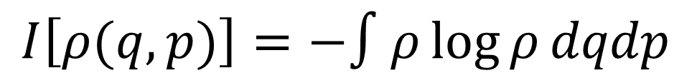

(6) Information conservation
$$p$$
$$=ξ^{2}$$
What about information entropy?
$$q$$
$$=ξ^{1}$$
$$I\left[ρ(q,p)\right]=−∫ρ\log{ρ}dqdp$$
$$I\left[ρ\left(t+dt\right)\right]=I\left[ρ\left(t\right)\right]−∫ρ\log{|J|}dqdp$$
Area conservation $⟺$ information conservation
Notes:
We looked at thermodynamic entropy. What about information entropy?

Slide 27
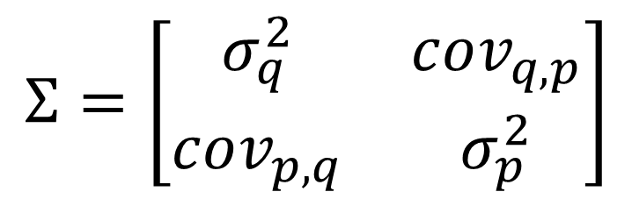

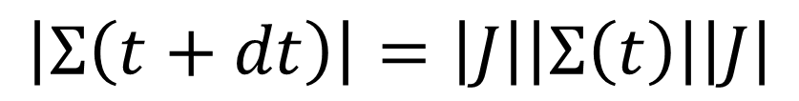
(7) Uncertainty conservation
$$p$$
$$=ξ^{2}$$
What about uncertainty?
covariance matrix
$$q$$
$$=ξ^{1}$$
$$Σ=\left[\begin{matrix}σ_{q}^{2} & cov_{q,p} \\ cov_{p,q} & σ_{p}^{2}\end{matrix}\right]$$
Assuming a “very narrow” distribution
$$\left|Σ\left(t+dt\right)\right|=\left|J\right|\left|Σ\left(t\right)\right|\left|J\right|$$
Area conservation $⟺$ uncertainty conservation
Notes:
Some people link info entropy to uncertainty. Well, what if we think about actual uncertainty? [Relevant for peaked/small-support distributions, for which you can linearize the field]

Slide 28
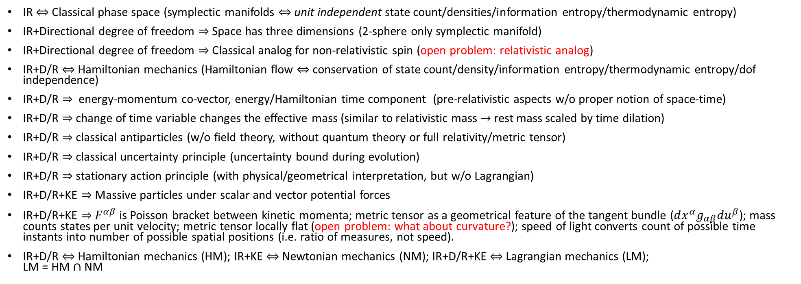
Three fundamental assumptions in Classical Mech
Infinitesimal Reducibility (IR)
Determinism/Reversibility (D/R)
Kinematic Equivalence (KE)
IR $⇔$ Classical phase space (symplectic manifolds $⇔$ unit independent state count/densities/information entropy/thermodynamic entropy)
IR+Directional degree of freedom $⇒$ Space has three dimensions (2-sphere only symplectic manifold)
IR+Directional degree of freedom $⇒$ Classical analog for non-relativistic spin (open problem: relativistic analog)
IR+D/R $⇔$ Hamiltonian mechanics (Hamiltonian flow $⇔$ conservation of state count/density/information entropy/thermodynamic entropy/dof independence)
IR+D/R $⇒$ energy-momentum co-vector, energy/Hamiltonian time component (pre-relativistic aspects w/o proper notion of space-time)
IR+D/R $⇒$ change of time variable changes the effective mass (similar to relativistic mass $→$ rest mass scaled by time dilation)
IR+D/R $⇒$ classical antiparticles (w/o field theory, without quantum theory or full relativity/metric tensor)
IR+D/R $⇒$ classical uncertainty principle (uncertainty bound during evolution)
IR+D/R $⇒$ stationary action principle (with physical/geometrical interpretation, but w/o Lagrangian)
IR+D/R+KE $⇒$ Massive particles under scalar and vector potential forces
IR+D/R+KE $⇒$ $F^{αβ}$ is Poisson bracket between kinetic momenta; metric tensor as a geometrical feature of the tangent bundle ($dx^{α}g_{αβ}du^{β}$); mass counts states per unit velocity; metric tensor locally flat (open problem: what about curvature?); speed of light converts count of possible time instants into number of possible spatial positions (i.e. ratio of measures, not speed).
IR+D/R $⇔$ Hamiltonian mechanics (HM); IR+KE $⇔$ Newtonian mechanics (NM); IR+D/R+KE $⇔$ Lagrangian mechanics (LM); LM = HM $∩$ NM
HM
NM
LM
Notes:
We can analyze which elements of the theory are traceable to which physical assumptions. Some elements of relativity in Hamiltonian mech w/o even having a metric tensor, and some elements of quantum mech already w/in classical mech, i.e. they should be thought of as properties of Hamiltonian systems in general, not particular to classical or quantum

Slide 29
continuum
Quantifying discrete cases is fundamentally different than quantifying cases over the continuum
discrete
finite measure
zero measure
Why? Because fully identifying a discrete case requires finite information (finitely many experimental tests) while identifying a case from a continuum requires infinite information (an infinite sequence of increasingly precise tests)
This is something most physicists haven’t yet fully digested

Slide 30

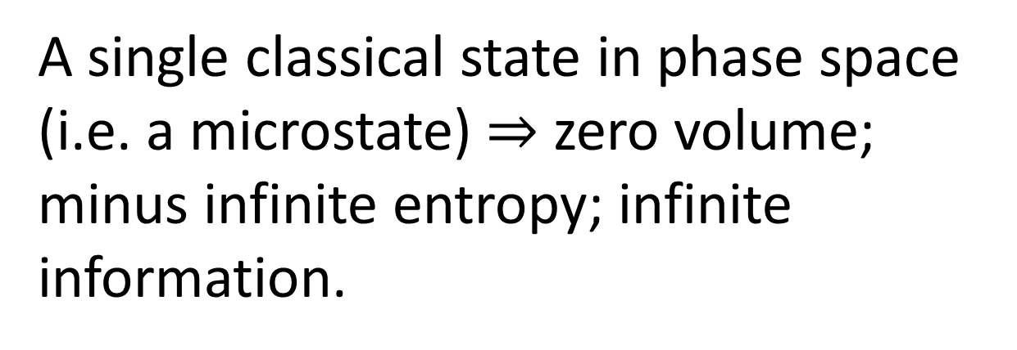
continuum
A single classical state in phase space (i.e. a microstate) $⇒$ zero volume; minus infinite entropy; infinite information.
discrete
finite measure
zero measure
“Empty state” $⇒$ one discrete case; zero entropy; finite information.
quantum: continuum with points of finite measure
Quantum mechanics “fixes” this, by introducing a fixed lower bound on entropy.

Slide 31
New insights lead to new ideas

Slide 32
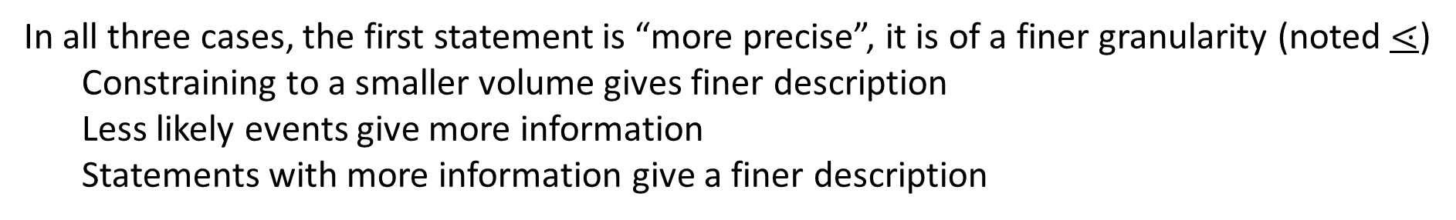
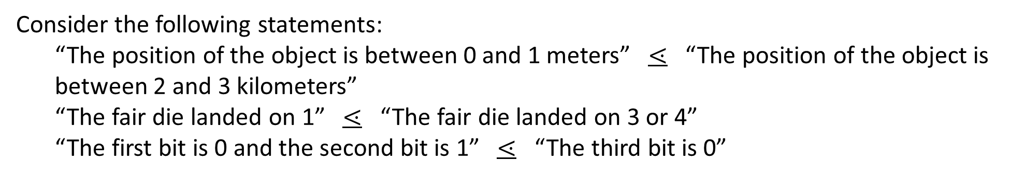
Measure theory plays a foundational role for theories of integration (e.g. geometrical sizes), probability and information theory: common physically motivated underpinning?
Consider the following statements:
“The position of the object is between 0 and 1 meters” $⋖$ “The position of the object is between 2 and 3 kilometers”
“The fair die landed on 1” $⋖$ “The fair die landed on 3 or 4”
“The first bit is 0 and the second bit is 1” $⋖$ “The third bit is 0”
and
and
and
In all three cases, the first statement is “more precise”, it is of a finer granularity (noted $⋖$)
Constraining to a smaller volume gives finer description
Less likely events give more information
Statements with more information give a finer description
Comparing statements based on their granularity is another fundamental feature a physical theory must have

Slide 33

















We need a generalized version of measure theory that covers all cases
Some statements are incomparable:
“The position of the object is between 0 and 1 meters” vs “The velocity of the object is between 2 and 3 meters per seconds”
$$A$$
$$C$$
Comparability cannot be captured by a single measure:
$\left\{A\right\} \left\{B,C\right\} U V$ while $\left\{A\right\} \left\{B,C\right\} U V$
$$U$$
$$B$$
$$⋖$$
$$⋖$$
$$⋖$$
$$⋗$$
$$⋗$$
$$⋗$$
$$∕$$
$$∕$$
$$∕$$
$$V$$
Entropy in quantum mechanics is consistent with first two requirements
Quantization breaks additivity:
Single point is a single case (i.e. $μ\left(\left\{A\right\}\right)=1$) Finite range carries finite information (i.e. $μ\left(U\right)<∞$)
Measure is additive for disjoint sets (i.e. $μ\left(∪U_{i}\right)=∑μ\left(U_{i}\right)$)
$$A$$
$$U$$
From what we understand, this is new mathematics

Slide 34

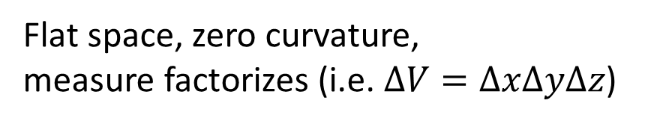







What could a generalized measure theory be useful for?
In a field theory, the value at each point is an independent d.o.f.
$⇒$ Measure of the volume “counts” the independent d.o.f.
Yet, in a singularity this can’t be the case: value of the field at each point loses meaning;
Information encoded on the surface (holographic principle)
Flat space, zero curvature, measure factorizes (i.e. $ΔV=ΔxΔyΔz$)
Singularity, infinite curvature, “volume flattens”
$$ΔV$$
$$ΔV$$
$$Δy$$
$$Δy$$
$$Δy$$
$$Δx$$
$$Δx$$
$$Δx$$
Notes:
Has to happen gradually!

Slide 35
What could a generalized measure theory be useful for?
In a field theory, the value at each point is an independent d.o.f.
$⇒$ Measure of the volume “counts” the independent d.o.f.
Is the curvature an indicator for how independent the values of the fields are? Does “quantizing” space-time mean using a non-additive measure, so that the count of d.o.f. does not go to zero (but to a finite measure)?
Flat space, zero curvature, measure factorizes (i.e. $ΔV=ΔxΔyΔz$)
Singularity, infinite curvature, “volume flattens”
$$ΔV$$
$$ΔV$$
$$Δy$$
$$Δy$$
$$Δy$$
$$Δx$$
$$Δx$$
$$Δx$$

Slide 36
Need a generalized theory of physical systems
codefined
State space
Processes
State space must always be equipped with the processes under which the system is defined
Consistency requirements: state symmetries $↔$ process symmetries; measurement processes $↔$open sets; system decoupling $↔$ measure (and entropy) defined on states; …

