Slide 1

Assumptions of Physics Summer School 2025 Open Problems in Reverse Physics
Gabriele Carcassi and Christine A. Aidala
Physics Department University of Michigan

Slide 2
Overview

Slide 3


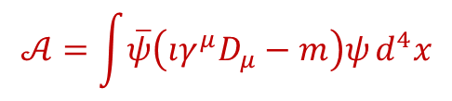
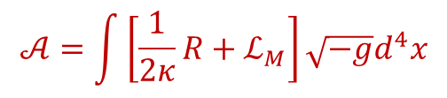
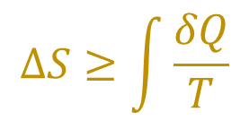
Classical mechanics
Essentially done, though improvements are always possible
Classical field theory
Vague general ideas, more technical work needed
$$d_{t}ξ^{a}ω_{ab}=∂_{b}H$$
$$𝒜=\int{\left[\frac{1}{2κ}R+ℒ_{M}\right]}\sqrt{−g}d^{4}x$$
Quantum mechanics
Core ideas identified, need to be organized and written down
Quantum field theory
No point in starting now, first finish QM and CFT
$$ıℏd_{t}\left|ψ\right\rangle =H\left|ψ\right\rangle$$
$$𝒜=\int{\overline{ψ}\left(ıγ^{μ}D_{μ}−m\right)ψ}d^{4}x$$
Thermodynamics
$$ΔS≥\int{\frac{δQ}{T}}$$
Some ideas identified, need to be finalized

Slide 4
Classical field theory

Slide 5
Status
Actively looking for someone to help generalize Reverse Physics to classical field theory (from finitely many DOFs to continuously many DOFs)
Main conjecture: volumes in space provide a count of DOFs, in the same way that volumes in phase space provide a count of states/configurations
Need to
Find a suitable Hamiltonian/symplectic formulation of field theory (starting with electromagnetism)
Understand how to generalize count of states/entropy/… to field theory
Adapt the arguments from classical mechanics to field theory

Slide 6

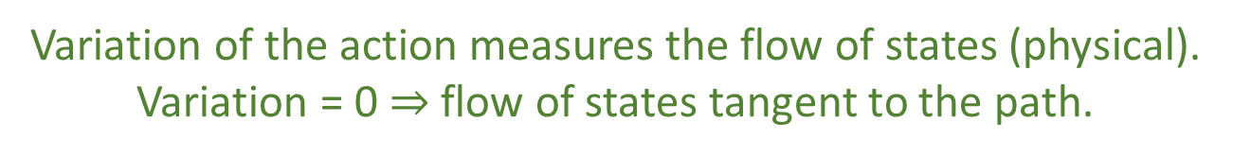
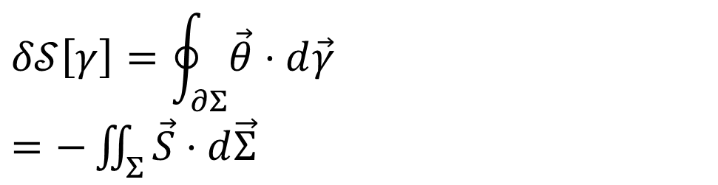


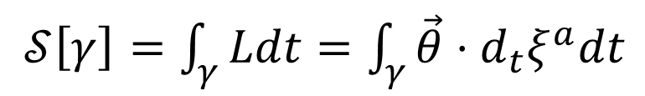







Geometry of principle of least action (SDOF)
DR
$$\left[p,0,−H\right]$$
KE
$$pd_{t}q+0d_{t}p−Hd_{t}t$$
$$∇⋅\vec{S}=0$$
$$\vec{S}=−∇×\vec{θ}$$
$𝒮\left[γ\right]=\int_{γ}{Ldt}=\int_{γ}{\vec{θ}⋅d_{t}ξ^{a}dt}$
No state is “lost” or “created” as time evolves
(Minus sign to match convention)
Sci Rep 13, 12138 (2023)
The action is the line integral of the vector potential (unphysical)
$$p$$
$$q$$
Variation of the action
$$Σ$$
Gauge independent, physical!
$$δ𝒮\left[γ\right]=\oint_{∂Σ}{\vec{θ}⋅d\vec{γ}}$$ $=−\iint_{Σ}{\vec{S}⋅d\vec{Σ}}$
$$γ$$
$$γ′$$
$$t$$
Variation of the action measures the flow of states (physical). Variation = 0 $⇒$ flow of states tangent to the path.

Slide 7


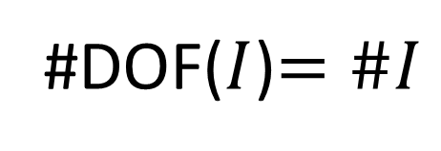

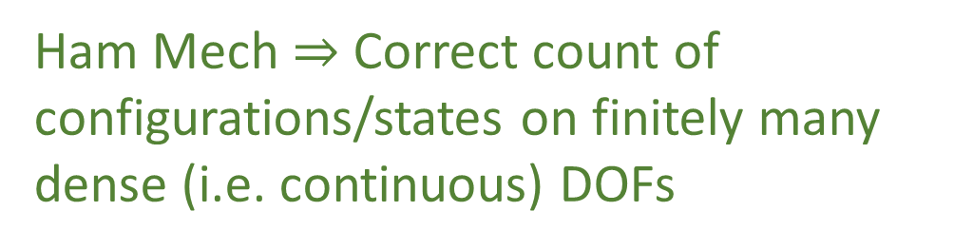

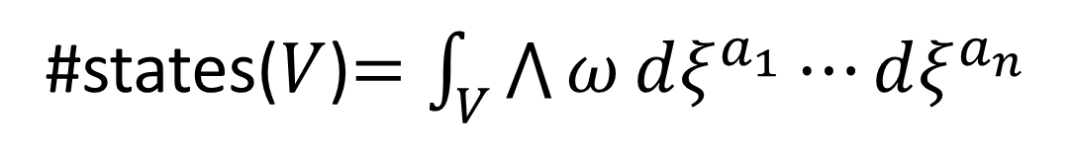
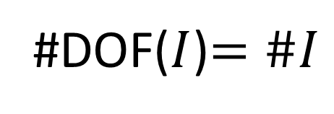


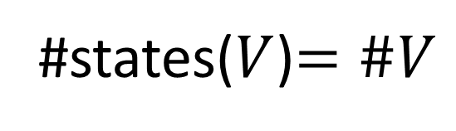
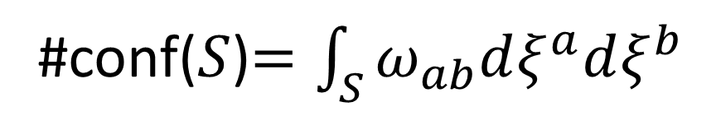


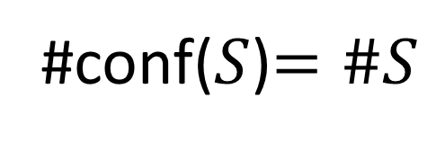


Counting states and configurations
Discrete case
$$S$$
$$q^{2}$$
#conf($S$)$=\#S$
#states($V$)$=\#V$
#DOF($I$)$=\#I$
$$V$$
$$q^{1}$$
Configuration density
State density
Continuous case
$$≠\#V=∞$$
#conf($S$)$=\int_{S}{ω_{ab}dξ^{a}dξ^{b}}$
#states($V$)$=\int_{V}{\bigwedge{ω}dξ^{a_{1}}⋯dξ^{a_{n}}}$
$$(q^{2},p_{2})$$
#DOF($I$)$=\#I$
$$S$$
Ham Mech $⇒$ Correct count of configurations/states on finitely many dense (i.e. continuous) DOFs
$$(q^{1},p_{1})$$
$$V$$
Field theory $⇒$ DOFs themselves are dense (i.e. continuous)
#DOF($I$)$≠\#I$

Slide 8
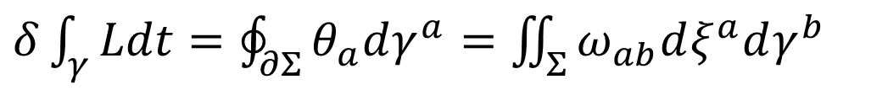

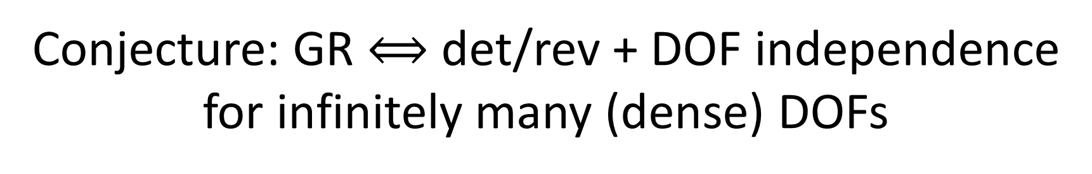

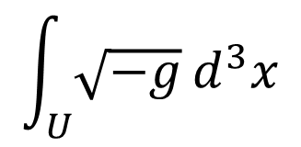
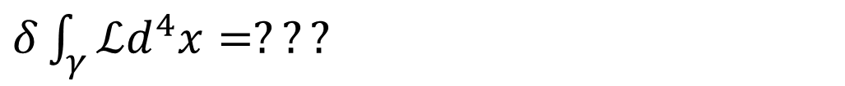
Conjecture: GR $⟺$ det/rev + DOF independence for infinitely many (dense) DOFs
$δ\int_{γ}{Ldt}=\oint_{∂Σ}{θ_{a}dγ^{a}}=\iint_{Σ}{ω_{ab}dξ^{a}dγ^{b}}$
#conf
Flow of states
$$=?$$
$δ\int_{γ}{ℒd^{4}x}=???$
#DOFs
Line integral of the vector potential of the flow of state density?
$$\int_{U}{\sqrt{−g}}d^{3}x$$
#DOFs?
$$ℒ=ℒ_{g}+ℒ_{matter}$$
Flow of DOFs?
Flow of configurations?
We are mapping values between Cauchy surfaces, #DOFs are the points on the Cauchy surface, #conf are the possible field values at each point

Slide 9
Thermodynamics

Slide 10
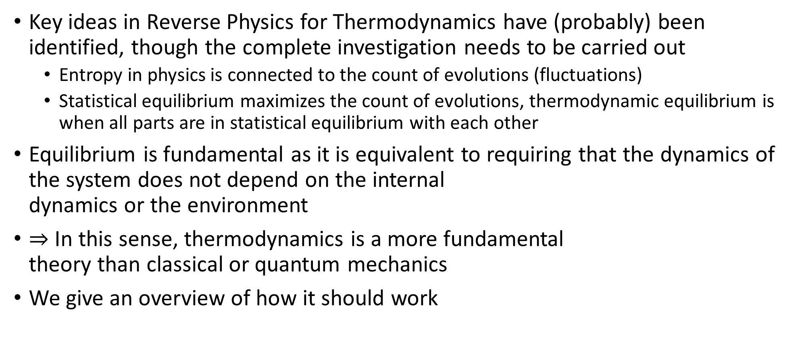
Status
Key ideas in Reverse Physics for Thermodynamics have (probably) been identified, though the complete investigation needs to be carried out
Entropy in physics is connected to the count of evolutions (fluctuations)
Statistical equilibrium maximizes the count of evolutions, thermodynamic equilibrium is when all parts are in statistical equilibrium with each other
Equilibrium is fundamental as it is equivalent to requiring that the dynamics of the system does not depend on the internal dynamics or the environment
$⇒$ In this sense, thermodynamics is a more fundamental theory than classical or quantum mechanics
We give an overview of how it should work

Slide 11
Entropy as logarithm of the count of evolutions

Slide 12
(e.g. classical microstates, quantum state, state of a dynamical system, …)
State space of a system

Slide 13



State space of a system at different times
$$t−Δt$$
$$t$$
$$t+Δt$$

Slide 14
Evolution: complete description of the system at all times
$$t−Δt$$
$$t$$
$$t+Δt$$

Slide 15
A process defines the set of all possible evolutions
$$t−Δt$$
$$t$$
$$t+Δt$$

Slide 16




Each description at each time corresponds to a set of evolutions
We can count the number of evolutions for a particular state $s$ at a particular time with a measure* $μ(s)$ since $s$ identifies a set of evolutions.
$$μ=2$$
$$μ=1$$
$$μ=2$$
$$t−Δt$$
$$t$$
$$t+Δt$$
* The full mathematical characterization may be a bit more complicated (e.g. preorder that leads to a family of measures)…

Slide 17
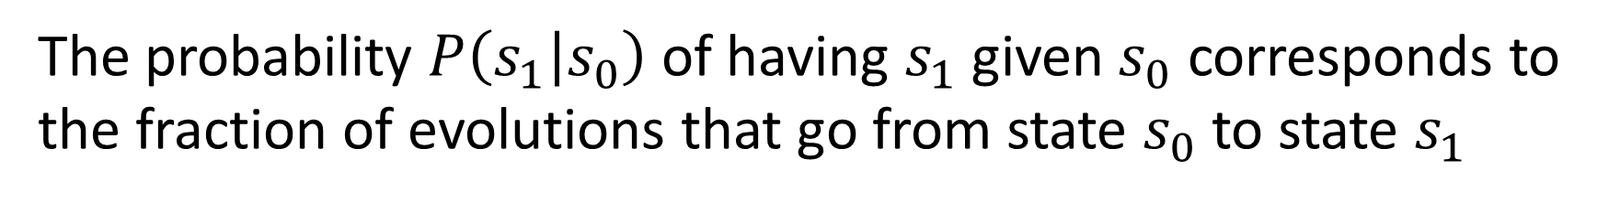


The probability $P\left(s_{1} | s_{0}\right)$ of having $s_{1}$ given $s_{0}$ corresponds to the fraction of evolutions that go from state $s_{0}$ to state $s_{1}$
That is, $P\left(s_{1} | s_{0}\right)=\frac{μ\left(s_{0}∩s_{1}\right)}{μ\left(s_{0}\right)}$
$$50\%$$
$$t−Δt$$
$$t$$
$$t+Δt$$

Slide 18
A process is deterministic if knowing the state at a time allows us to predict the state at a future time
For these processes, we can properly write a law of evolution $s\left(t+Δt\right)=f\left(s\left(t\right)\right)$
$$t−Δt$$
$$t$$
$$t+Δt$$

Slide 19






In a deterministic process, the evolutions can never split, only merge
That is, $μ\left(s\left(t+Δt\right)\right)≥μ\left(s\left(t\right)\right)$
$$μ=1$$
$$μ=2$$
$$μ=1$$
$$μ=1$$
$$μ=3$$
$$t−Δt$$
$$t$$
$$t+Δt$$

Slide 20
A process is reversible if knowing the state at a time allows us to reconstruct the state at a past time
$$t−Δt$$
$$t$$
$$t+Δt$$

Slide 21






In a reversible process, the evolutions can never merge, only split
That is, $μ\left(s\left(t+Δt\right)\right)≤μ\left(s\left(t\right)\right)$
$$μ=1$$
$$μ=3$$
$$μ=2$$
$$μ=1$$
$$μ=1$$
$$t−Δt$$
$$t$$
$$t+Δt$$

Slide 22

In a det/rev process, evolutions can never merge nor split
That is, $μ\left(s\left(t+Δt\right)\right)=μ\left(s\left(t\right)\right)$
$$t−Δt$$
$$t$$
$$t+Δt$$

Slide 23
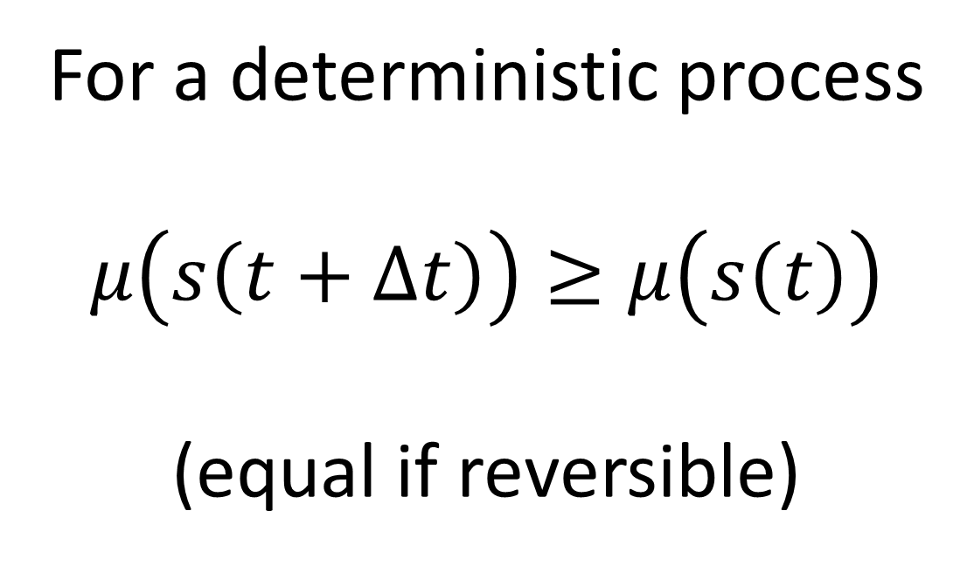
For a deterministic process
$$μ\left(s\left(t+Δt\right)\right)≥μ\left(s\left(t\right)\right)$$
(equal if reversible)

Slide 24
Consider a process where a system reaches a final equilibrium that can be predicted from the initial state
At equilibrium, evolutions cannot merge anymore
$$t−Δt$$
$$t$$
$$t+Δt$$

Slide 25
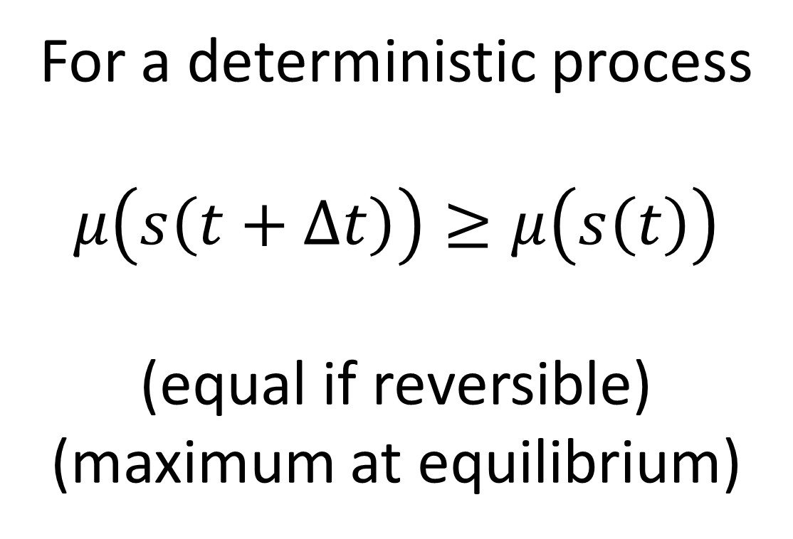
For a deterministic process
$$μ\left(s\left(t+Δt\right)\right)≥μ\left(s\left(t\right)\right)$$
(equal if reversible)
(maximum at equilibrium)

Slide 26






Suppose we have a composite of two systems
$$𝒮_{1}$$
$$𝒮=𝒮_{1}×𝒮_{2}$$
$$\left\{x\left(t\right),y\left(t\right)\right\}$$
$$𝒮_{2}$$
$$x(t)$$
$$y(t)$$
State space is the product
Evolutions, in general, are not the product: there may be correlations

Slide 27

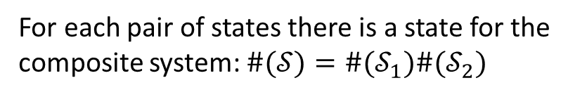
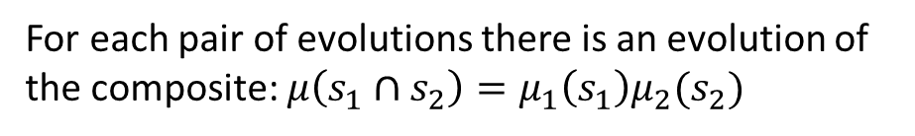

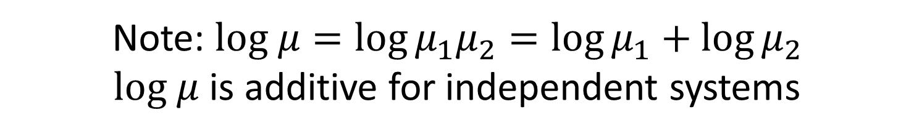
$$\left\{x\left(t\right),y\left(t\right)\right\}$$
If the systems are independent, the evolution of one does not constrain the evolution of the other: all pairs are possible
For each pair of states there is a state for the composite system: $\#(𝒮)=\#(𝒮_{1})\#(𝒮_{2})$
$$x(t)$$
For each pair of evolutions there is an evolution of the composite: $μ\left(s_{1}∩s_{2}\right)=μ_{1}\left(s_{1}\right)μ_{2}(s_{2})$
$$y(t)$$
Note: $log μ=\log{μ_{1}μ_{2}}=\log{μ_{1}}+\log{μ_{2}}$
$log μ$ is additive for independent systems

Slide 28



Define the process entropy as $S=\log{μ}$
The log of the count of evolutions per state
It is additive for independent systems
$$S=S_{1}+S_{2}$$
For a deterministic process
$S\left(s\left(t+Δt\right)\right)≥S\left(s\left(t\right)\right)$ (equal if reversible)
(maximum at equilibrium)

Slide 29

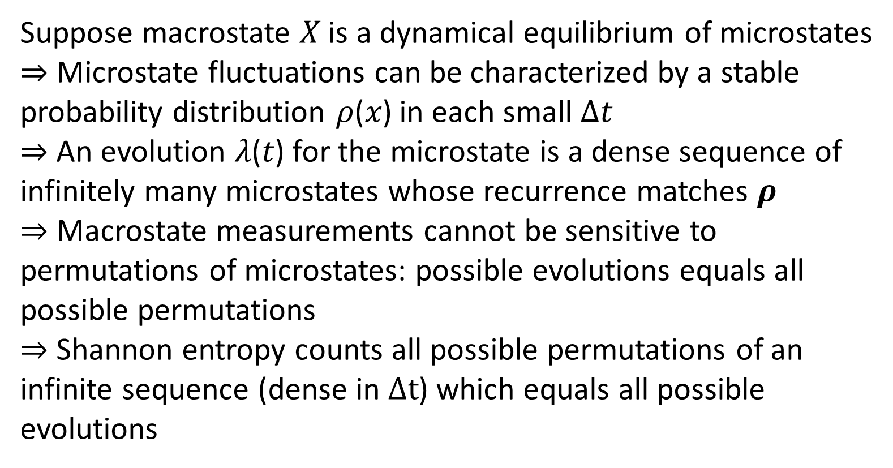

Recover information entropy
$$X$$
Suppose macrostate 𝑋 is a dynamical equilibrium of microstates
$⇒$ Microstate fluctuations can be characterized by a stable probability distribution 𝜌(𝑥) in each small $Δt$
$⇒$ An evolution 𝜆(𝑡) for the microstate is a dense sequence of infinitely many microstates whose recurrence matches 𝝆
$⇒$ Macrostate measurements cannot be sensitive to permutations of microstates: possible evolutions equals all possible permutations
$⇒$ Shannon entropy counts all possible permutations of an infinite sequence (dense in $Δt$) which equals all possible evolutions
$$x$$

Slide 30
Macrostate/equilibrium is a “tube” of evolutions at the lower level
$$X$$
Equilibrium means that no evolution enters or exits the “tube” (i.e. external agents have equilibrated)
The variables describing the macrostate can still change
(i.e. the “tube” moves around in state space)
We can now study the “tube” as if it were single line
(i.e. internal dynamics and environment are decoupled)
$$x$$
Equilibrium = evolution decoupled from environment and from internal dynamics

Slide 31
Physical entropy explained?
We have not mentioned uncertainty, disorder, statistical distributions, information, lack of information, …
Therefore those concepts are not fundamental in this context
We have not discussed what type of state or system we have (classical, quantum, biological, economic, …)
Therefore everything we said is valid independently of the type of system, which would explain the success of thermodynamic ideas outside the realm of physics
The process entropy increase is explained by the definitions and the settings (processes with equilibria that depend on the initial state)
The explanation is straightforward (i.e. does not require a complicated discussion)
The explanation is not mechanical (i.e. given by a particular mechanism)

Slide 32

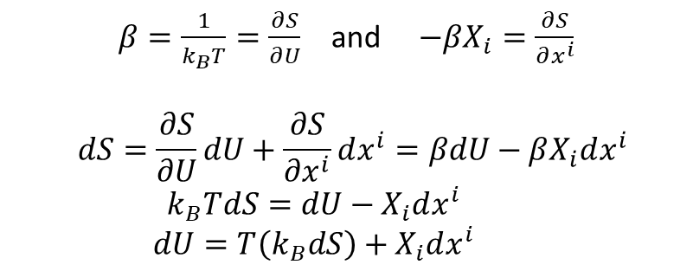

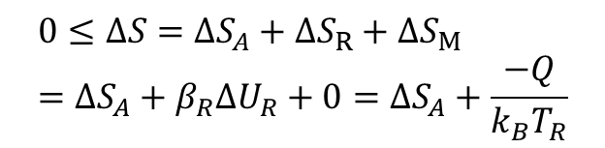


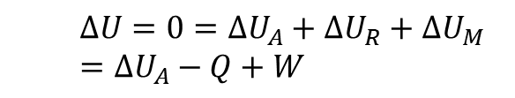




“Reversing” thermodynamics
Assume states are equilibria of faster scale processes
$β=\frac{1}{k_{B}T}=\frac{∂S}{∂U}$ and $−βX_{i}=\frac{∂S}{∂x^{i}}$
$$dS=\frac{∂S}{∂U}dU+\frac{∂S}{∂x^{i}}dx^{i}=βdU−βX_{i}dx^{i} \\ k_{B}TdS=dU−X_{i}dx^{i} \\ dU=T\left(k_{B}dS\right)+X_{i}dx^{i}$$
Define intensive quantities
Assume states identified by extensive properties
Assume one of these quantities is energy $U$
$$S(U,x^{i})$$
Existence of equation of state
Recover usual relationships
Study interplay of changes of energy and entropy
$$ΔU=0=ΔU_{A}+ΔU_{R}+ΔU_{M} \\ =ΔU_{A}−Q+W$$
First law recovered from existence and conservation of Hamiltonian
$$R$$
Reservoir: energy only state variable, entropy linear function of energy
Recover first law
All energy stored in entropy
$$Q$$
$$0≤ΔS=ΔS_{A}+ΔS_{R}+ΔS_{M} \\ =ΔS_{A}+β_{R}ΔU_{R}+0=ΔS_{A}+\frac{−Q}{k_{B}T_{R}}$$
Mechanical system: same entropy for all states
$$A$$
$$M$$
$$W$$
No energy stored in entropy
Recover second law
$$β=\frac{1}{k_{B}T}=0$$
Second law recovered from definition of entropy as count of evolutions

Slide 33
Quantum mechanics

Slide 34
Status
Clear that irreducibility/lower bound on the entropy is the only ingredient that makes quantum mechanics different from classical mechanics
The goal is to develop a “minimal interpretation” based on what, and only what, can be settled experimentally
States are ensembles (pure or mixed) at equilibrium (internal dynamics and environment can be ignored)
Projections are processes of equilibration
Every state is the output of an equilibration process
Measurements are special cases
Unitary evolution is deterministic and reversible dynamics
Can also be recovered as quasi-static evolution (i.e. series of infinitesimal projections)
All elements are probably there, scattered in videos/papers/… and need only to be put together

Slide 35



















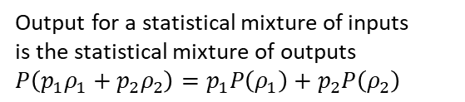
Projections: linear idempotent operations
Output for a statistical mixture of inputs is the statistical mixture of outputs $P\left(p_{1}ρ_{1}+p_{2}ρ_{2}\right)=p_{1}P\left(ρ_{1}\right)+p_{2}P\left(ρ_{2}\right)$
Same result if you do it twice
Same result
Repeat process
$${\left|\left\langle ψ | φ_{i}\right\rangle \right|}^{2}$$
$$[μ,V,T]$$
$$[N_{1},V,T]$$
$$[N_{2},V,T]$$
$𝒫$
$$\left|φ_{1}\right\rangle$$
$𝒫$
$$\left|φ_{1}\right\rangle$$
Different equilibria, different variables
$$[….,V,T]$$
$$\left|φ_{2}\right\rangle$$
$$\left|φ_{2}\right\rangle$$
$$\left|ψ\right\rangle$$
$$\left|φ_{3}\right\rangle$$
$$\left|φ_{3}\right\rangle$$
Spin up meas.
$$\left|φ_{4}\right\rangle$$
$$\left|φ_{4}\right\rangle$$
Equilibria!!!
$$\left|x^{+}\right\rangle$$
$$\left|z^{+}\right\rangle$$
Different contexts, different variables
$$\left|z^{−}\right\rangle$$
Projections are equilibration processes
Quantum contexts are different boundary conditions

Slide 36

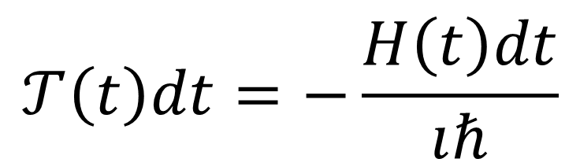
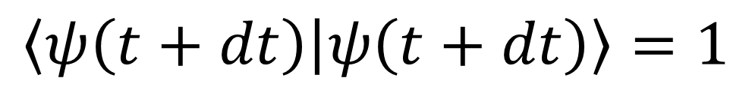

Unitary evolution $⟺$ det/rev evolution
$$\left|ψ\left(t+dt\right)\right\rangle −\left|ψ\left(t\right)\right\rangle =𝒯\left(t\right)dt\left|ψ\left(t\right)\right\rangle$$
Change of states depends only on previous state (determinism)
$$\left\langle ψ\left(t+dt\right) | ψ\left(t+dt\right)\right\rangle =1$$
Final state is normalized (reversibility)
$$=\left\langle (1+𝒯\left(t\right)dt)ψ\left(t\right) | (1+𝒯\left(t\right)dt)ψ\left(t\right)\right\rangle$$
Also recovered from entropy conservation (like in classical mechanics)
$$=\left\langle ψ\left(t\right)\left|{\left(1+𝒯\left(t\right)dt\right)}^{†}\left(1+𝒯\left(t\right)dt\right)\right|ψ\left(t\right)\right\rangle$$
$$=\left\langle ψ\left(t\right)\left|1+𝒯{\left(t\right)}^{†}dt+𝒯\left(t\right)dt+𝒯{\left(t\right)}^{†}𝒯\left(t\right)dt^{2}\right|ψ\left(t\right)\right\rangle$$
Self-adjoint
$$=1+dt\left\langle ψ\left(t\right)\left|𝒯{\left(t\right)}^{†}+𝒯\left(t\right)\right|ψ\left(t\right)\right\rangle +O\left(dt^{2}\right)$$
$$⇒𝒯{\left(t\right)}^{†}=−𝒯\left(t\right)$$
$$𝒯\left(t\right)dt=−\frac{H\left(t\right)dt}{ıℏ}$$

Slide 37















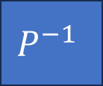



Any process (deterministic or stochastic) is linear over ensembles
$$ρ_{I}$$
$$P$$
$ρ_{O}=P\left(ρ_{I}\right)$
$$P\left(p_{1}ρ_{1}+p_{2}ρ_{2}\right)=p_{1}P\left(ρ_{1}\right)+p_{2}P\left(ρ_{2}\right)$$
complete isolation
$$\left|E_{1}\right\rangle$$
$$\left|E_{1}\right\rangle$$
Deterministic and reversible
Equilibration
$$ρ_{I}$$
$$P$$
$$ρ_{O}$$
$$P^{−1}$$
$$ρ_{I}$$
$$ρ_{I}$$
$$P$$
$$ρ_{O}$$
$$P$$
$$ρ_{O}$$
$$Δθ$$
Conserves entropy/allows an “inverse”
Must be repeatable
$⇒$ Unitary operation
$⇒$ Projection
$$|E_{0}⟩$$
$$|E_{0}⟩$$
Both are idealizations!
No measurement problem, since unitary evolution is not more “real” than projection
However, “states as equilibria” implies existence of equilibration processes (mathematically, Hilbert spaces are Banach spaces + projectors on each subspace): projections are more “fundamental” as they need to be assumed to exist

Slide 38






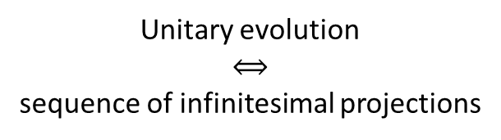




Unitary evolution $⟺$ quasi-static evolution
$𝒫$
$$\left|ψ\left(t+dt\right)\right\rangle$$
$$\left|x_{2}\right\rangle$$
Unitary evolution $$⟺$$ sequence of infinitesimal projections
$$\left|ψ(t)\right\rangle$$
$$\left|x_{3}\right\rangle$$
$$\left|x_{4}\right\rangle$$
$${\left|\left\langle ψ\left(t+dt\right) | ψ\left(t\right)\right\rangle \right|}^{2}=1$$
$$=\left\langle ψ\left(t+dt\right)|ψ\left(t\right)\right\rangle \left\langle ψ\left(t\right)|ψ\left(t+dt\right)\right\rangle$$
$$=\left(1+\left\langle dψ\left(t\right)|ψ\left(t\right)\right\rangle \right)\left(1+\left\langle ψ\left(t\right)|dψ\left(t\right)\right\rangle \right)$$
$$⇒𝒯{\left(t\right)}^{†}=−𝒯\left(t\right)$$
$$=1+\left(\left\langle dψ\left(t\right)|ψ\left(t\right)\right\rangle +\left\langle ψ\left(t\right)|dψ\left(t\right)\right\rangle \right)+O\left(dt^{2}\right)$$
$$=1+dt\left(\left\langle 𝒯\left(t\right)ψ\left(t\right)|ψ\left(t\right)\right\rangle +\left\langle ψ\left(t\right)|𝒯\left(t\right)ψ\left(t\right)\right\rangle \right)+O\left(dt^{2}\right)$$
Projections can be seen as fundamental “black box” processes
Solves the “multilevel problem”

Slide 39
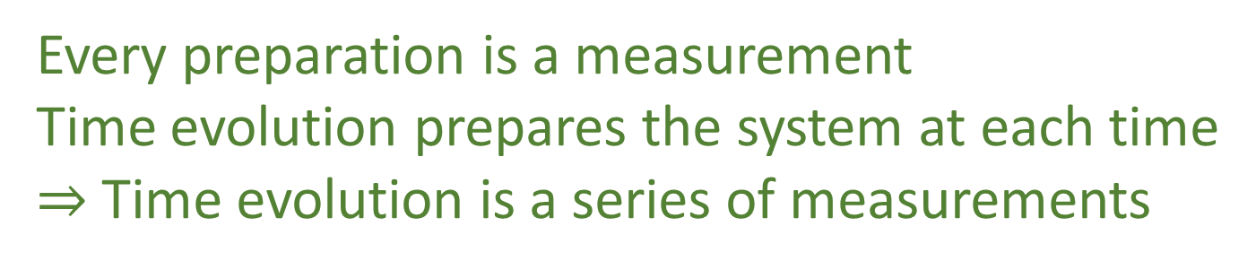
Deterministic and reversible evolution
Black-box process with equilibria
Quasi-static evolution
Unitary evolution
Projection
Every preparation is a measurement Time evolution prepares the system at each time $⇒$ Time evolution is a series of measurements

Slide 40









Quantum mechanics as irreducibility
Classical
Quantum
Entropy
Minimum uncertainty
$$p$$
?
time
0
time
$$q$$
Can prepare ensembles at arbitrarily low entropy: we can study arbitrarily small parts
Entropy is bounded at zero: we cannot study parts
Can’t squeeze ensemble arbitrarily
We always have access to the internal dynamics
No access to the internal dynamics
Superluminar effects that can’t carry information
Probability of transition
Non-locality
$$\left|x^{+}\right\rangle$$
$$\left|y^{+}\right\rangle$$
$$\left|x^{−}\right\rangle$$
$$\left|y^{−}\right\rangle$$
Can’t refine ensembles $⇒$ Can’t interact with parts
Can’t refine ensembles $⇒$ Can’t extract information
$$p\left(x^{+} | y^{−}\right)=p(y^{−}|x^{+})$$
Symmetry of the inner product

Slide 41
Quantum field theory
Let’s wait until both classical field theory and quantum mechanics are done!
Should be simply putting a lower bound on the entropy of fields

Slide 42
Quantum gravity?

Slide 43
Status
Not really aiming to solve this… just connecting some trivial bits
What is quantum mechanics?
According to Reverse Physics, it is putting a lower bound on the entropy (lower bound on the count of states)
What is gravity?
In Reverse Physics, it is conjectured to be the proper handling of the count of DOFs and configurations (entropy) over a continuum of DOFs
Arguably, a lower bound on the entropy/count of states cannot be achieved without imposing a lower bound on the count of DOFs as well
Is this what “quantum gravity” is?

Slide 44




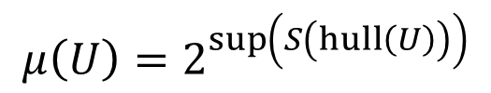
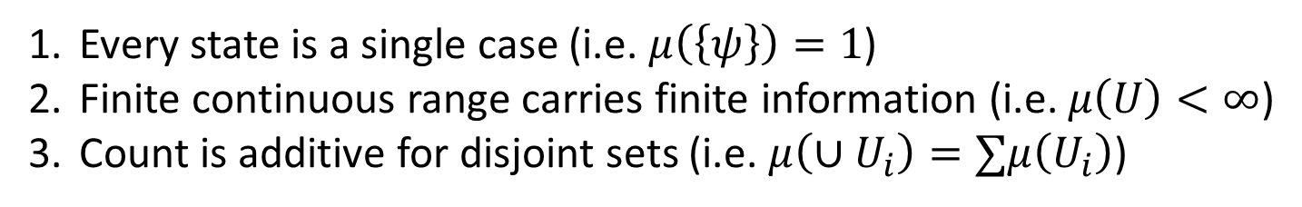







The problem with counting on the continuum
We’d like to say:
Every state is a single case (i.e. $μ\left(\left\{ψ\right\}\right)=1$)
Finite continuous range carries finite information (i.e. $μ\left(U\right)<∞$)
Count is additive for disjoint sets (i.e. $μ\left(∪U_{i}\right)=∑μ\left(U_{i}\right)$)
Incompatible!
Pick two!
Discard 1 $⇒$ Lebesgue measure
Discard 2 $⇒$ counting measure
$$A$$
Non-orthogonal states: different states but in different contexts
Discard 3 $⇒$ “Quantum measure”
additive
$$C$$
sub-additive
Orthogonal states: different states all else equal
$$μ\left(U\right)=2^{\sup\left(S\left(hull\left(U\right)\right)\right)}$$
$$B$$
$$μ\left(\left\{A\right\}\right)=2^{0}=1$$
Exponential of the maximum entropy reachable with convex combinations (statistical mixtures) of $U$ (reduces to counting/Liouville measure)
$$μ\left(\left\{A,B\right\}\right)=2^{1}=2$$
$$μ\left(\left\{A,C\right\}\right)<2=μ\left(\left\{A\right\}\right)+μ\left(\left\{C\right\}\right)$$
Quantum mechanics $⇒$ lower bound on #conf (entropy) on continuous DOF

Slide 45
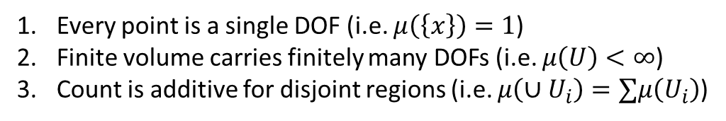
Conjecture: quantum gravity $⇒$ lower bound on DOF count
#conf
Same problem!
#conf=#DOFs
Every point is a single DOF (i.e. $μ\left(\left\{x\right\}\right)=1$)
Finite volume carries finitely many DOFs (i.e. $μ\left(U\right)<∞$)
Count is additive for disjoint regions (i.e. $μ\left(∪U_{i}\right)=∑μ\left(U_{i}\right)$)
#DOFs
Lower bound on this…
…requires a lower bound on this
Distant points: independent DOFs
additive
From QM: Lower bound on state count requires a severe revisitation of particle state space
sub-additive
Close points: DOFs not independent
Does lower bound on DOF count require an equally severe revisitation of space-time?

Slide 46
How to participate and contribute to Reverse Physics
Prerequisite: share the interest in building a conceptual framework that treats physical theories as models of physical systems and nothing else
No theories of everything, interpretations that posit “how the universe works,” …
Passive contribution: make yourself available as a “consultant”
Don’t have to follow the project, called only if there is something relevant that matches your background/expertise
Occasional discussion/review of material to make sure things make sense from multiple perspectives
Active contribution: case-by-case
Need to have sufficient background or be able to get it independently
Much better chance of success if already working/expert in a research area

