Slide 1

Assumptions of Physics Summer School 2025 Open Problems in Physical Mathematics
Gabriele Carcassi and Christine A. Aidala
Physics Department University of Michigan

Slide 2
Overview

Slide 3







States and processes
$P_{1}$
$$e_{1}$$
Starting to come together
States based on the notion of ensembles
$$pe_{1}+\left(1−p\right)e_{2}$$
Process as linear transformation of ensembles
$$S_{p}$$
$P_{2}$
$$e_{2}$$
Information granularity
Need to define, in general, physical dimensions, units, …
Only vague ideas
Last attempt from a few years ago
Experimental verifiability
Theoretical statements
Topologies and $σ$-algebras recovered from empirical requirements
Verifiable statements
Possibilities
Essentially done, though improvements are always possible
Real numbers recovered from idealized measurement references
Open sets
Points
Borel sets

Slide 4
Information granularity: units and information

Slide 5
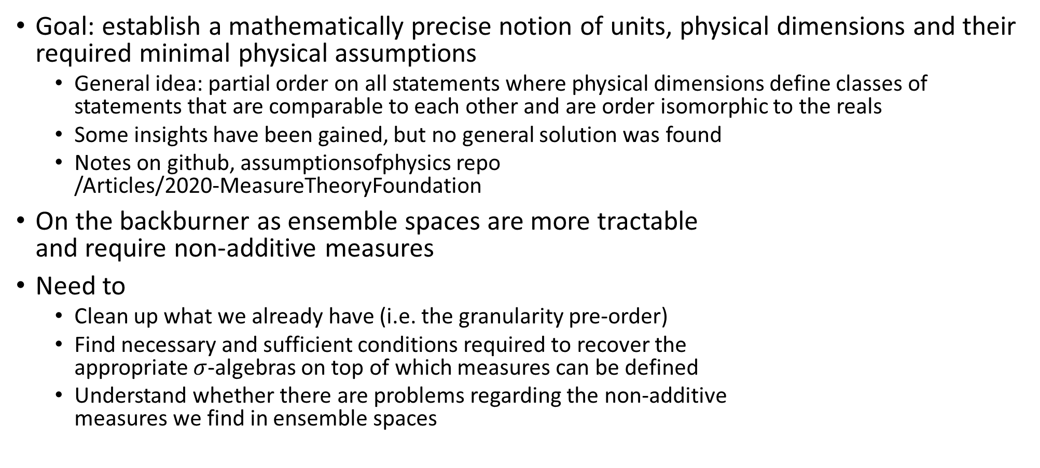
Status
Goal: establish a mathematically precise notion of units, physical dimensions and their required minimal physical assumptions
General idea: partial order on all statements where physical dimensions define classes of statements that are comparable to each other and are order isomorphic to the reals
Some insights have been gained, but no general solution was found
Notes on github, assumptionsofphysics repo /Articles/2020-MeasureTheoryFoundation
On the backburner as ensemble spaces are more tractable and require non-additive measures
Need to
Clean up what we already have (i.e. the granularity pre-order)
Find necessary and sufficient conditions required to recover the appropriate $σ$-algebras on top of which measures can be defined
Understand whether there are problems regarding the non-additive measures we find in ensemble spaces

Slide 6
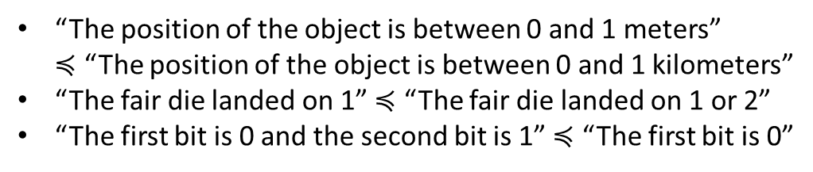
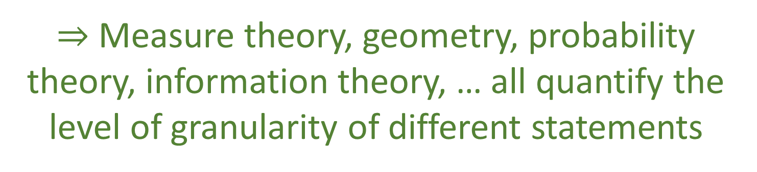
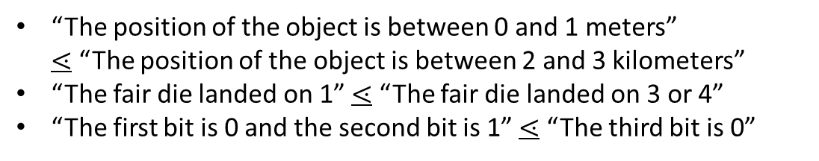
Basic insight
Logical relationships $⟺$ Topology/$σ$-algebra
“The position of the object is between 0 and 1 meters” $≼$ “The position of the object is between 0 and 1 kilometers”
“The fair die landed on 1” $≼$ “The fair die landed on 1 or 2”
“The first bit is 0 and the second bit is 1” $≼$ “The first bit is 0”
The logic layer can compare statements if and only if one is “fully contained” in another
Granularity relationships $⟺$ Geometry/Probability/Information
“The position of the object is between 0 and 1 meters” $⋖$ “The position of the object is between 2 and 3 kilometers”
“The fair die landed on 1” $⋖$ “The fair die landed on 3 or 4”
“The first bit is 0 and the second bit is 1” $⋖$ “The third bit is 0”
$⇒$ Measure theory, geometry, probability theory, information theory, … all quantify the level of granularity of different statements

Slide 7
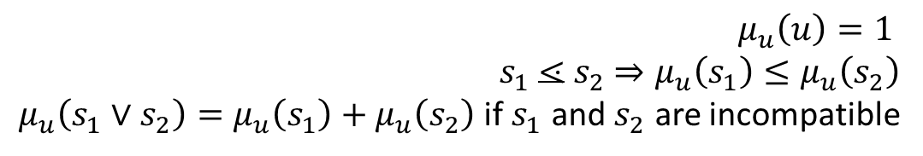




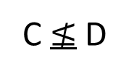

Partial order, physical dimensions and units
Statements over phase space
$$p$$
E
A partially ordered set allows us to compare sizes at different levels of infinity and to keep track of incommensurable quantities (i.e. physical dimensions)
D
“The state of the system is in A”
or B, C, D, …
B
A $⋖$ B $⋖$ C $⋖$ E
C
$$q$$
C $≰$ D
D $≰$ C
A
Once a “unit” is chosen, a measure quantifies the granularity of another statement with respect to the unit
$$μ_{u}:\overline{𝒟}→ℝ$$
$μ_{u}\left(u\right)=1$ $s_{1}$ $⋖$ $s_{2}$ $⇒μ_{u}\left(s_{1}\right)≤μ_{u}\left(s_{2}\right)$
$μ_{u}\left(s_{1}∨s_{2}\right)=μ_{u}\left(s_{1}\right)+μ_{u}\left(s_{2}\right)$ if $s_{1}$ and $s_{2}$ are incompatible

Slide 8
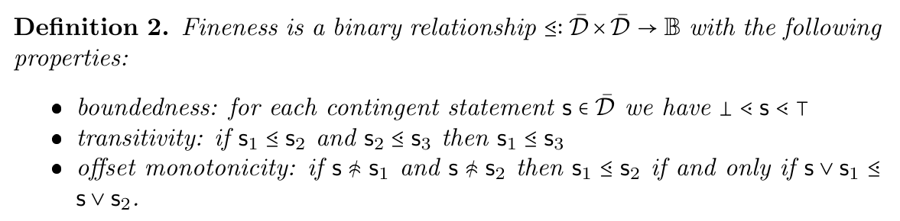
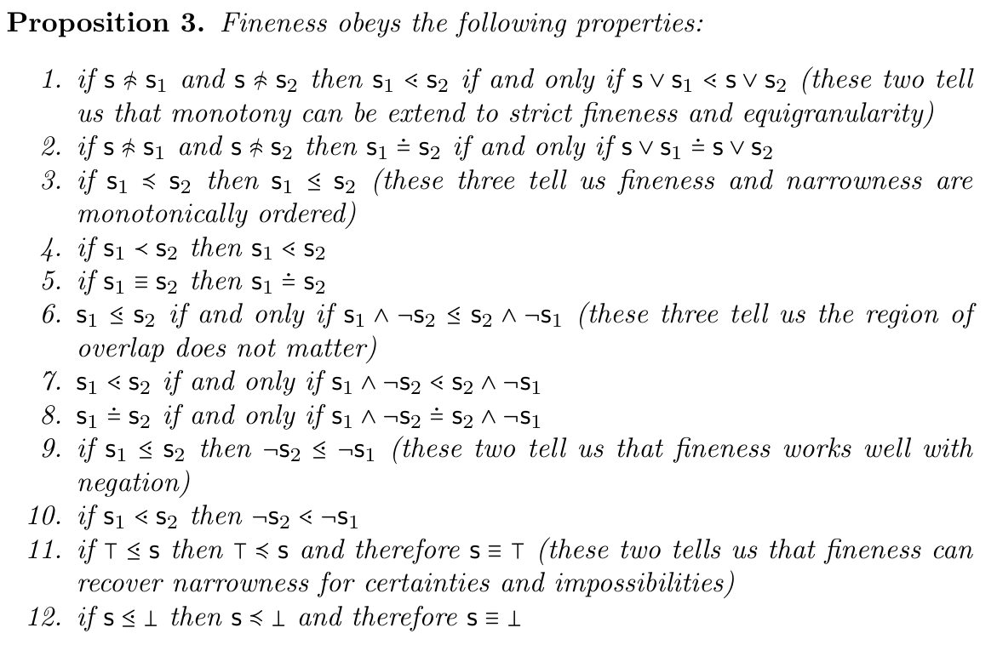
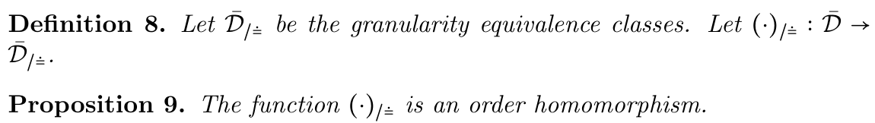
Minimal assumptions,
many consequences
Basic notions probably good

Slide 9
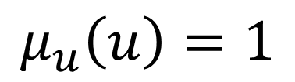

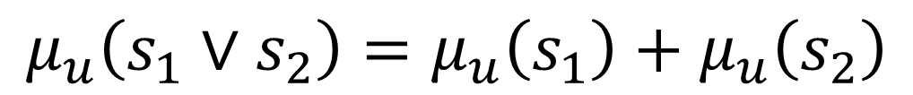

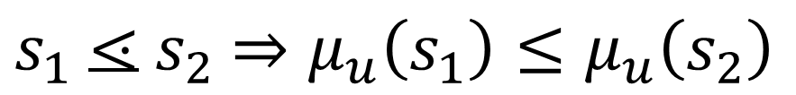
Measure from a unit Given $u∈\overline{𝒟}$, we want to define $μ_{u}:\overline{𝒟_{u}}→[0,+∞]$ such that:
Is the algebra of comparable statements unique?
$$μ_{u}\left(u\right)=1$$
Measure is one on unit statement
$s_{1}$ $⋖$ $s_{2}$ $⇒μ_{u}\left(s_{1}\right)≤μ_{u}\left(s_{2}\right)$
When is the measure unique?
Monotonic
$$μ_{u}\left(s_{1}∨s_{2}\right)=μ_{u}\left(s_{1}\right)+μ_{u}\left(s_{2}\right)$$
if $s_{1}$ and $s_{2}$ are incompatible
Additive
Are there restrictions on which statements can be taken as units or on the initial space?
Are there compatibility requirements with the topology?

Slide 10
Differentiability

Slide 11
Status
Goal: recover differentiability from definitions that are physically clear
Current definitions of tangent space and differentials in differential geometry do not work well for physics; definitions used in variational calculus are closer to what is needed
Good idea of what are the correct physical concepts we are trying to define
An initial prototype is ready
Need to
Finalize the prototype and connect to current literature
Reinterpret/rework the use of differential geometry in physics based on the reworked definitions/concepts
See if the same notion of derivative can be used as a basis for multiple definitions (e.g. exterior derivative and Radon-Nikodym)

Slide 12

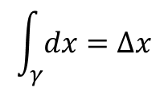

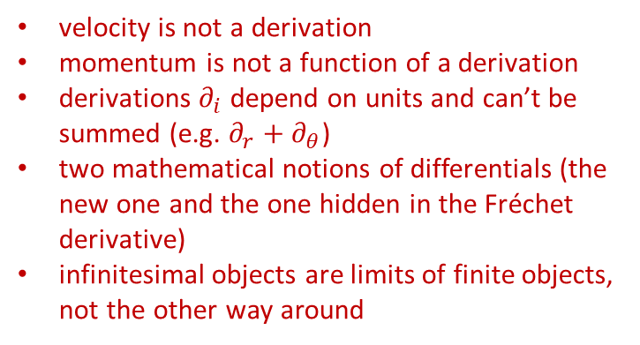


Differentiability in math
Mathematicians have developed increasingly abstract definitions for differentials, derivatives, integrations, tangent vectors… are they suitable for physics?
Differentiable manifold
Manifold
Differentiable structure
Changes of coordinates are differentiable
Vector defined as derivation of a scalar function
Defined on top of Fréchet derivative
$$v:C^{∞}\left(X,ℝ\right)→C^{∞}\left(X,ℝ\right)$$
vector basis
Differentials defined as linear functions of vectors
$$v\left(f\right)=v^{i}∂_{i}f$$
$$dx:V→ℝ$$
So are covectors, like momentum
Does not make sense physically!
$$dx\left(v\right)=dx\left(v^{i}∂_{i}\right)=v^{x}$$
velocity is not a derivation
momentum is not a function of a derivation
derivations $∂_{i}$ depend on units and can’t be summed (e.g. $∂_{r}+∂_{θ}$)
two mathematical notions of differentials (the new one and the one hidden in the Fréchet derivative)
infinitesimal objects are limits of finite objects, not the other way around
Integrals defined on top of differential forms
$$\int_{γ}{dx}=Δx$$

Slide 13






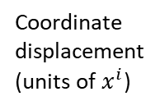




Differentiability in physics
$$dv=\left\{v_{1},v_{2},v_{3},…\right\}$$
Infinitesimal reducibility $⇒$ differentiability
$$\lim_{i→∞}{\frac{v_{i}}{a_{i}}}=t$$
Tangent vector
General notion of differential as an infinitesimal change in ANY vector space
Convergence at all points $⇒$ differentiability of curve
Goal: one notion of derivative
Time
Space
Temperature
Differentiable function: infinitesimal changes map to infinitesimal changes
Manifold displacement (unit free)
t
$$x(t)$$
x
T$(x)$
T
$$dx^{i}e_{i}=dP$$
Quantity
Map between the two
dt
$$\frac{dx}{dt}$$
dx
$$\frac{dT}{dx}$$
dT
Differentiable space: infinitesimal changes are well-defined
Differential
Coordinate displacement
(units of $x^{i}$)
Derivative: map between differentials
$$dx^{i}=\frac{dx^{i}}{dt}dt$$
$$dT=\frac{∂T}{∂x^{i}}dx^{i}$$
gradient (covector)
velocity (vector)

Slide 14
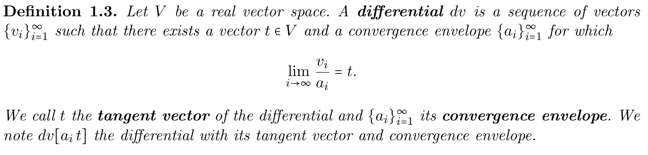
Defines how we go to zero
(locally convex?) topological
Only requires the (topological) vector space structure
Closer to what is used in functional analysis, and therefore usable in variational calculus, field theory, etc…

Slide 15
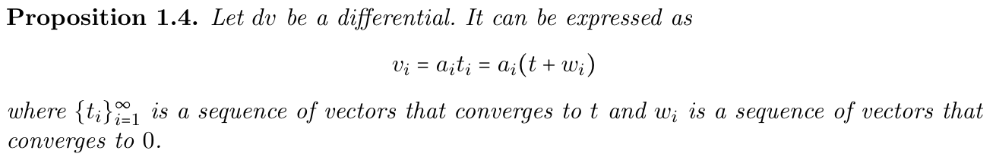
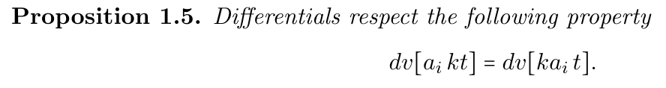
Some useful properties

Slide 16
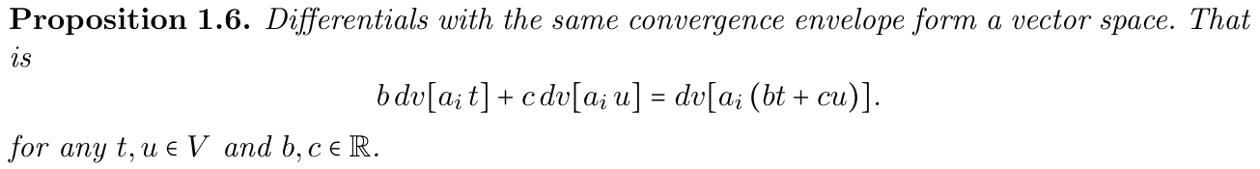

Technically, we have a space of differentials for each $a_{i}$
V
Vector space
In principle, these definitions work for spaces that are locally isomorphic to a vector space of any field
Fixed $a_{i}$
dV
Space of differential
Tangent space

Slide 17
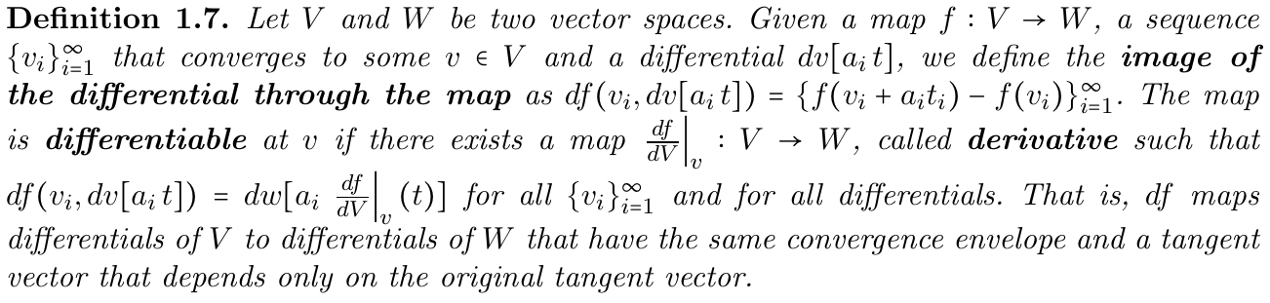
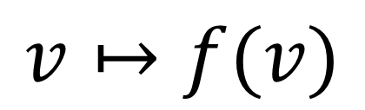
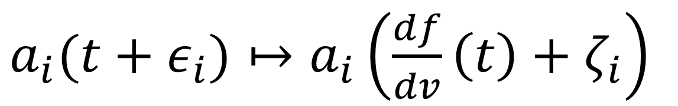
Differentiable maps are those that map differentials to differentials
Only the tangent matters, not the convergence
$$v↦f(v)$$
$a_{i}(t+ε_{i})↦a_{i}\left(\frac{df}{dv}\left(t\right)+ζ_{i}\right)$
Same convergence

Slide 18
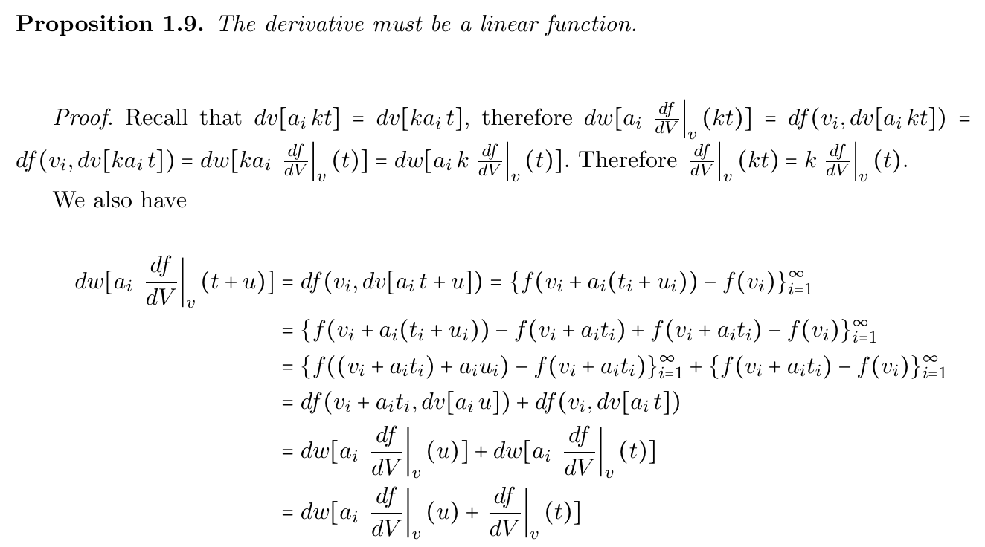
It is automatically linear!
Generalizations of derivative (e.g. Fréchet) are DEFINED to be linear

Slide 19
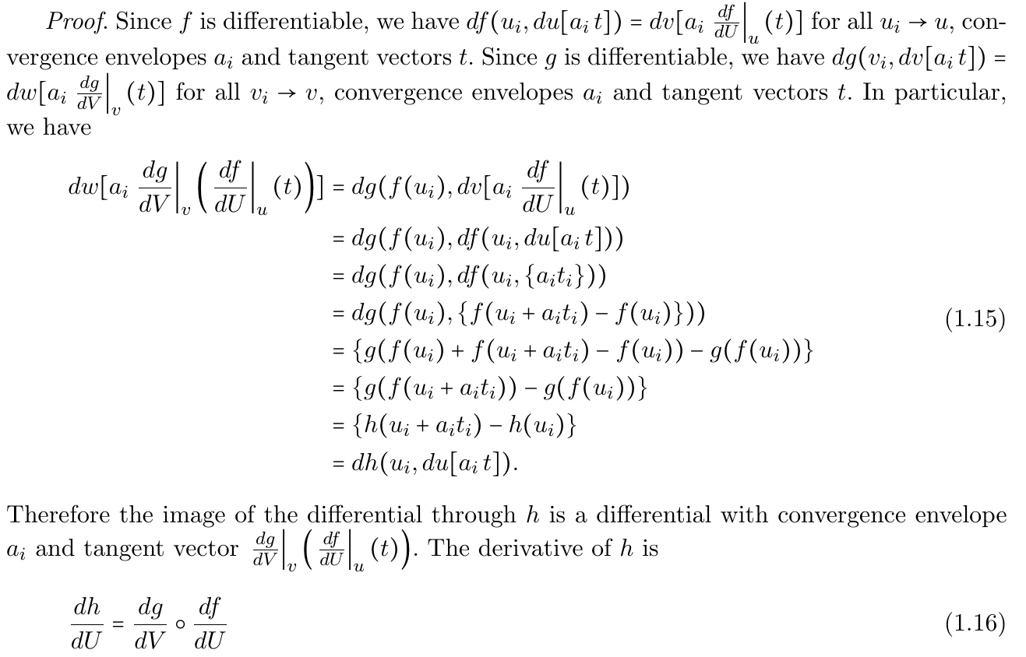







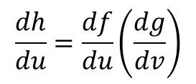




Chain rule is simply function composition
$$h=g(f)$$
$$U$$
$$f$$
$$V$$
$$g$$
$$W$$
$$dU$$
$$\frac{df}{du}$$
$$dV$$
$$\frac{dg}{dv}$$
$$dW$$
$$\frac{dh}{du}=\frac{df}{du}\left(\frac{dg}{dv}\right)$$
Again, proof is half a page

Slide 20
Recovers the standard notion of derivatives in standard cases

Slide 21


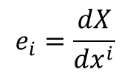

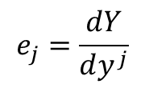
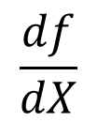








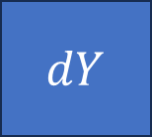

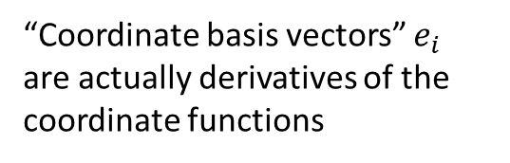


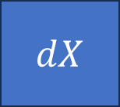


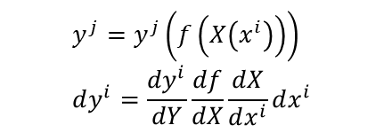
$$y^{j}=f^{j}\left(x^{i}\right)$$
“Coordinate basis vectors” $e_{i}$ are actually derivatives of the coordinate functions
$$x^{i}$$
$$y^{j}$$
$ℝ^{n}$
$$X(x^{i})$$
$$X$$
$$f$$
$$Y$$
$$Y(y^{j})$$
$ℝ^{m}$
$$dX=e_{i}dx^{i}$$
Coordinate/unit independent
Coordinate/unit dependent
$$e_{i}=\frac{dX}{dx^{i}}$$
$$e_{j}=\frac{dY}{dy^{j}}$$
Map from unit dep to unit indep
$$\frac{df}{dX}$$
$$dℝ^{n}$$
$$dX$$
$$dY$$
$$dℝ^{m}$$
Partial derivatives, Jacobian, tensors, … all find a place in this framework
$${dx}^{i}$$
$$dy^{j}=\frac{∂f^{j}}{∂x^{i}}dx^{i}$$
$${dy}^{j}$$
$$y^{j}=y^{j}\left(f\left(X\left(x^{i}\right)\right)\right) \\ dy^{i}=\frac{dy^{i}}{dY}\frac{df}{dX}\frac{dX}{dx^{i}}dx^{i}$$
Ideas are clear, need to clean up all details
Go through all definitions, make sure the notation is actually good for calculation, make sure it works in infinite dimensions (why local convexity?), see what other work exists that it can be integrated with, generalize to non-real vector spaces(?), …

Slide 22
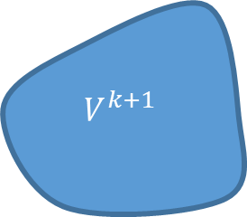







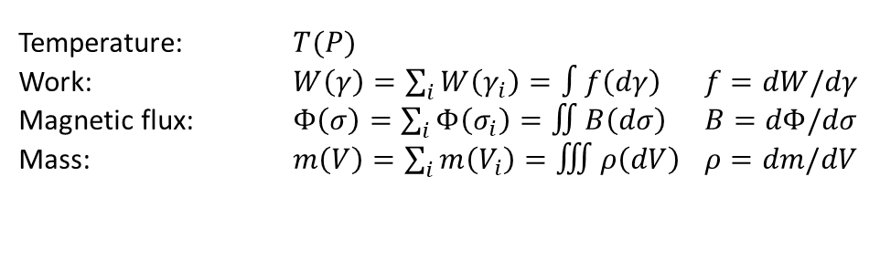

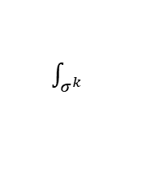









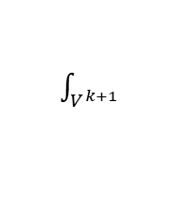
Differentiability: forms and linear functionals
Starting point: finite values defined on finite regions
$k$-functional
$k$-surface
$k$-form
$k$-vector
$$f_{k}\left(σ^{k}\right)=∫θ_{k}(dσ^{k})$$
Thinking in terms of relationships between finite objects leads to better physical intuition
Physically measurable quantities
zero-form
Differential forms: infinitesimal limit
Temperature: $T(P)$
Work: $W\left(γ\right)=\sum_{i}{W\left(γ_{i}\right)}=∫f\left(dγ\right)$ $f=dW/dγ$
Magnetic flux: $Φ\left(σ\right)=\sum_{i}{Φ\left(σ_{i}\right)}=∬B\left(dσ\right)$ $B=dΦ/dσ$
Mass: $m\left(V\right)=\sum_{i}{m\left(V_{i}\right)}=∭ρ\left(dV\right)$ $ρ=dm/dV$
one-form
two-form
The mathematics is contingent upon the assumption of infinitesimal reducibility (e.g. mass in volumes sums only if boundary effects can be neglected)
three-form
Assume additivity over disjoint regions
We can define functionals that act on boundaries
exterior functional
$$g_{k+1}$$
$$f_{k}$$
$$f^{k}$$
Given a functional
$$∂V^{k+1}=σ^{k}$$
$$V^{k+1}$$
$$d/dV^{k+1}$$
$\int_{V^{k+1}}{}$
$$d/dσ^{k}$$
$\int_{σ^{k}}{}$
Define higher dimensional functional that acts on the boundary
$$ω_{k+1}$$
$$∂$$
$$θ_{k}$$
$$g^{k+1}(V^{k+1})≡f^{k}\left(σ^{k}\right)$$
exterior derivative
Exterior functional
$$∂∂f^{k}\left(σ^{k+2}\right)=f^{k}\left(∂∂σ^{k+2}\right)=f^{k}\left(∅\right)=0$$
Reversing the exterior derivative is finding a (non-unique) potential
Boundary of a boundary is the empty set $⇒$ exterior derivative of exterior derivative is zero

Slide 23
Topological convex spaces

Slide 24
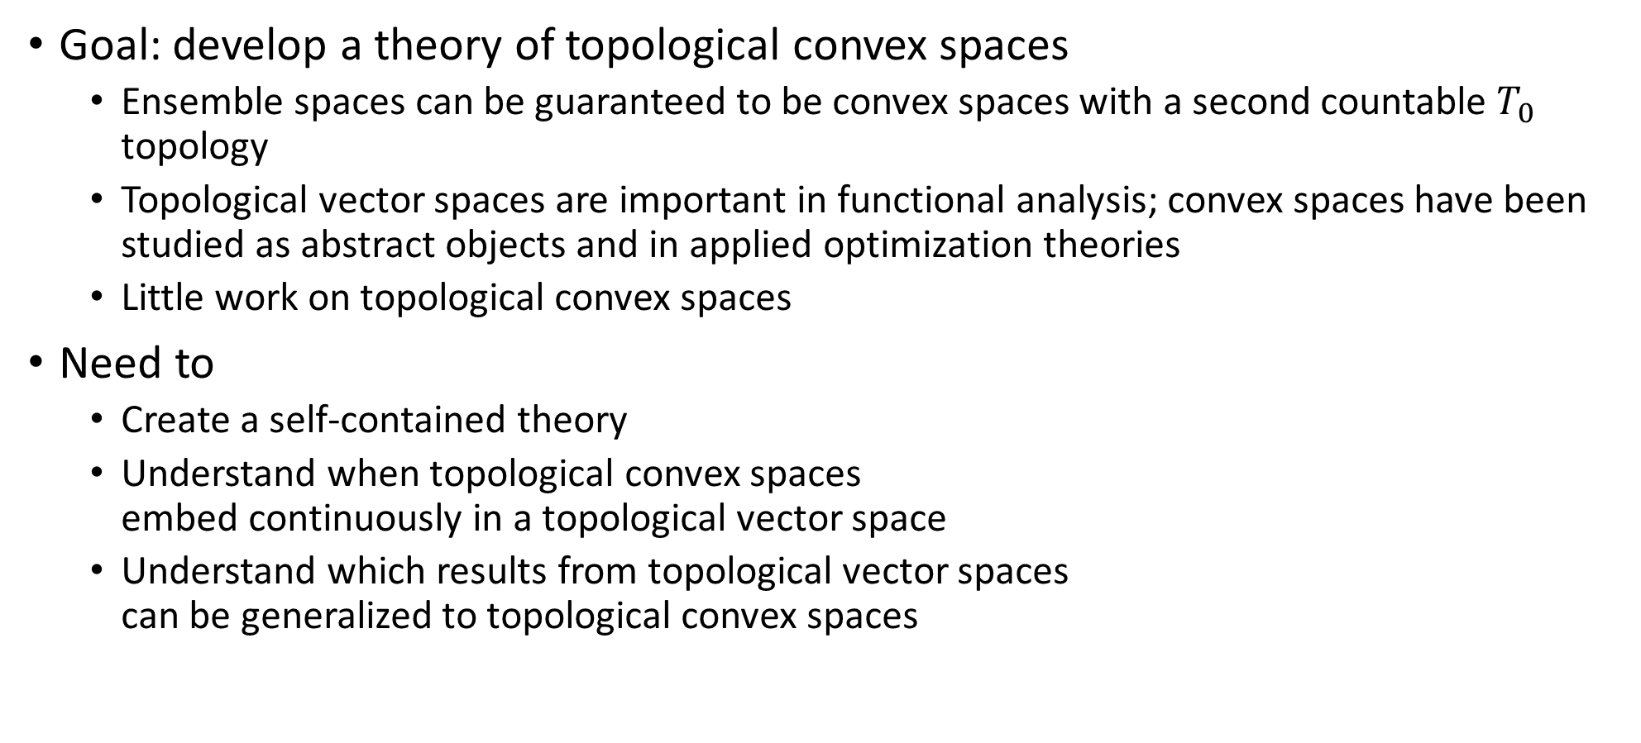
Status
Goal: develop a theory of topological convex spaces
Ensemble spaces can be guaranteed to be convex spaces with a second countable $T_{0}$ topology
Topological vector spaces are important in functional analysis; convex spaces have been studied as abstract objects and in applied optimization theories
Little work on topological convex spaces
Need to
Create a self-contained theory
Understand when topological convex spaces embed continuously in a topological vector space
Understand which results from topological vector spaces can be generalized to topological convex spaces

Slide 25
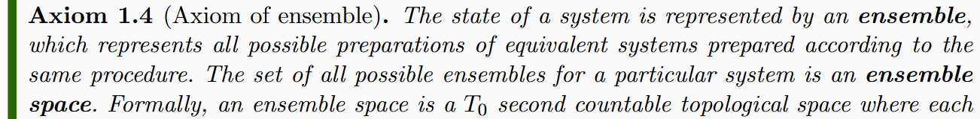
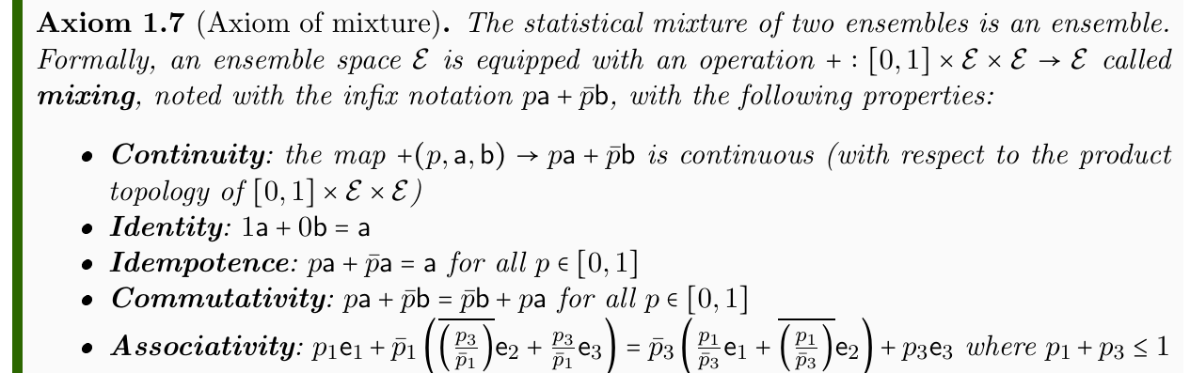
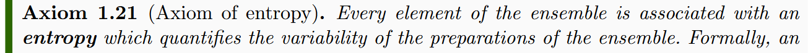

Convex combination: $pa+\overline{p}b$
Ensemble spaces defined from three minimal necessary requirements on physical theories
How do convexity and topology interact?

Slide 26
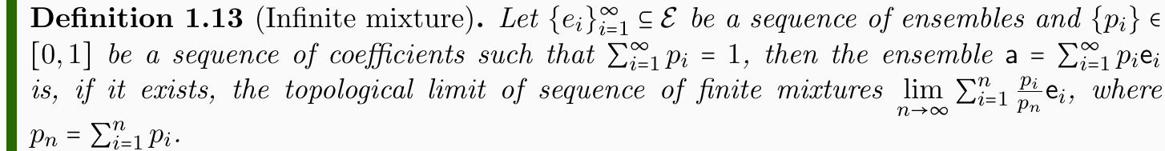
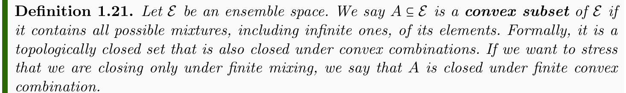
Use the topology to extend finite convex combinations to infinite ones
Extend the notion of convex closure to include infinite convex combinations (i.e. topological closure)

Slide 27
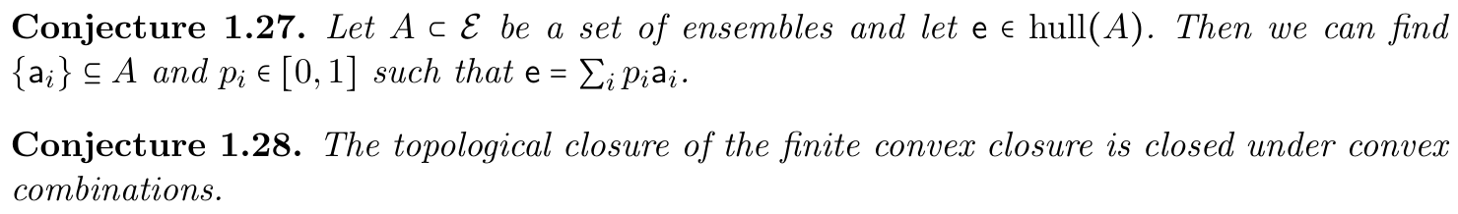
Many conjectures to be proven or disproven

Slide 28
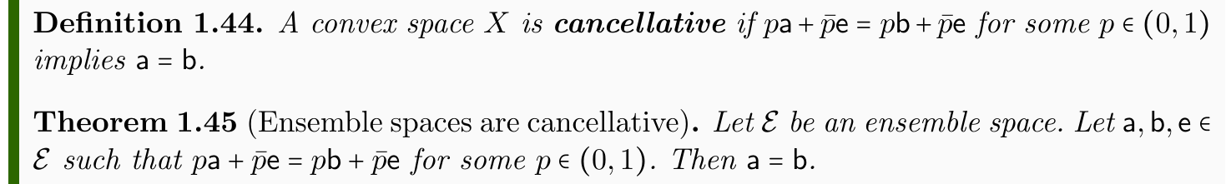
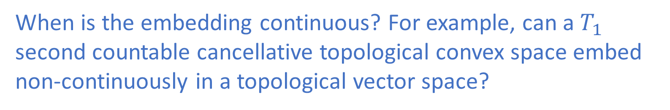
Cancellative convex spaces embed into vector spaces
When is the embedding continuous? For example, can a $T_{1}$ second countable cancellative topological convex space embed non-continuously in a topological vector space?
Finite dimensional topological vector spaces with the same dimension are isomorphic (i.e. they have a unique topology). Does something similar hold for topological convex spaces?

Slide 29



The edges of the topological convex space create topologically “different regions”
Open sets with extreme points are different from open sets with only internal points
$$a$$
$$b$$
Is this the only problem? For example, do two internal points always have two neighborhoods that are isomorphic?
Any second countable $T_{1}$ topological vector space is automatically metrizable
Does something similar hold for topological convex spaces?

Slide 30
Entropic geometry

Slide 31
Status
Goal: derive all geometric structure from a definition of entropy
From Reverse Physics, we know all geometric structures in physics are related to the entropy, so there should be a general theory to recover all results more rigorously
Need to
Understand the role of entropy in defining limits, and therefore the topology of ensemble spaces
Understand what properties can be generalized from classical and quantum spaces, and how can everything work in field theories (connects to the work on differentiability)

Slide 32
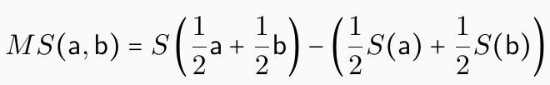
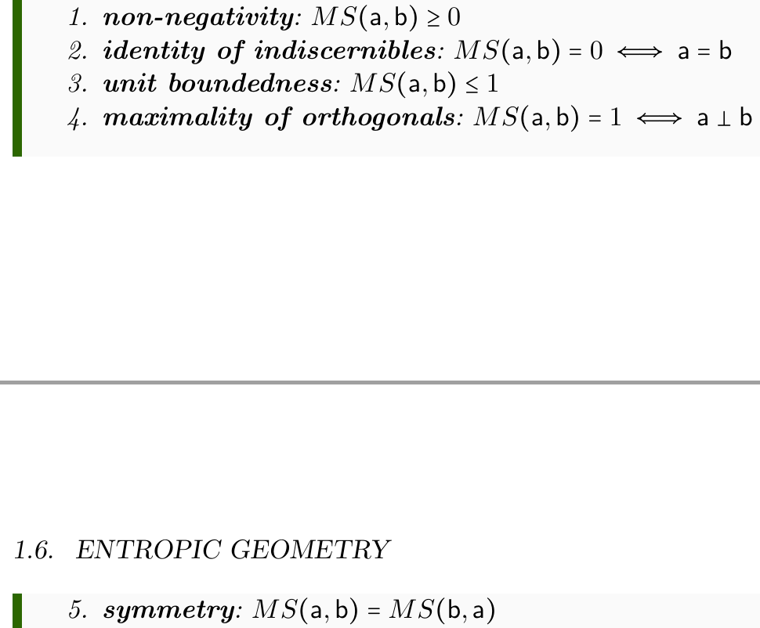
How much does the entropy increase during mixture?
Recovers the Jensen-Shannon divergence (JSD) (both classical and quantum)
Pseudo-distance defined from the entropy
(does not satisfy the triangle inequality)
In classical and quantum spaces, it is the square of a distance function. Is it true in general? Is it true for orthogonally decomposable spaces?

Slide 33
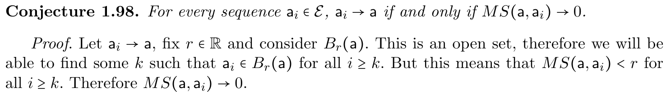

$$0=MS\left(a,a\right)≤MS\left(a,pa+\overline{p}b\right)≤MS\left(a,b\right)$$
$$a$$
$$b$$
$MS$ goes to zero
Does the mixing entropy fully specify the criteria of convergence and therefore the topology?
Second part?
Equivalently: is the topology generated by entropic open balls?
Is the subtopology generated by the entropic open balls metrizable? Does it make the space metrizable?

Slide 34





Classical discrete
(3 states)
Entropic open balls of radius $0.04$
They appear to be convex
Are entropic open balls convex in classical and quantum spaces?
Is this what makes the spaces locally convex?
Quantum
(slice of Bloch sphere)
Not enough in the axiom to make them convex.
In the example to the right, the entropy is given by $−(x^{4}+y^{4})$, which is concave and satisfies the entropic bounds in appropriate units (without ever reaching the upper one)
Are the entropic open balls convex if the space is orthogonally decomposable?
Does it matter?

Slide 35




Entropy imposes a metric on the ensemble space
$$⇒$$
Entropy strict concavity means the Hessian is negative definite
Recovers Fisher-Rao information metric (both classical and quantum)
Make sure this works properly in infinite dimensional cases. Links to the definition of differentiability and notion of information in field theories.

Slide 36

More ill-defined problems
Finding the right problem definition often IS the problem
How does the geometry of the space of ensembles relate to the geometry of the space of the states?
Given that $0≤MS\left(a,b\right)≤1$ with $0$ only when $a=b$ and 1 only when $a⊥b$, can $MS$ be turned into an inner product? Can we show that ensemble spaces are, in general, inner product spaces?
Can we generalize some results from entropic geometry (e.g. Holevo bound) to ensemble spaces?

Slide 37
Generalized measure theory

Slide 38
Status
Goal: find a structure that generalizes classical probability and state count that works on the generalized ensemble space
A non-additive generalization of probability naturally arises by asking what fraction of an ensemble can be recovered from a set of other ensembles
A non-additive generalization of state count naturally arises by asking how many distinguishable states is an ensemble spread over
The idea is to develop a version of non-additive calculus that restricts those measures to a set of “limit states” and recovers the notion of probability density, expectation values, etc…
Need to
Understand how to get the space of limit points
Understand the proper generalization of integral/derivative

Slide 39






Probability space: $\left(X,Σ_{X},p:Σ_{X}→[0,1]\right)$
Probability measure
Probability of positive outcome of a test
Sample space
What can happen
Events
What can be tested
Count of states corresponding to each event
Probability in classical mechanics
State count: $μ:Σ_{X}→[0,+∞]$
Absolutely continuous
Zero states $⇒$ zero probability
$$⇒ρ=\frac{dp}{dμ}$$
Probability density
Radon-Nikodym derivative
Random variable: $f:X→ℝ$
Assigns a value to every possible outcome
$⇒E\left[f\right]=\int{fρdμ}$
Expectation
Average value of the random variable

Slide 40














Mixture
Probability
$$e_{1}$$
$$o_{1}$$
$$λ_{1}$$
$$p_{1}$$
$$e_{2}$$
Ensemble
$$o_{2}$$
Preparations
$$λ_{2}$$
$$p_{2}$$
Outcomes
$$⋮$$
$$⋮$$
$$λ_{n}$$
$$p_{n}$$
$$e_{n}$$
$$o_{n}$$
In classical mechanics, mixtures of preparations and probability of outcomes always coincide
In quantum mechanics, they do not
$⇒$ quantum ensemble spaces not simplexes (i.e. classical probability fails)
Can we have common measure theoretic tools on the preparation side?

Slide 41


Given a set of possible ensembles $A$, the count of configurations is the exponential of the maximum entropy reachable using mixtures. If $A$ is the set of classical distributions over a particular support $U$, the maximum entropy is given by the uniform distribution $⇒$ recovers the usual count of states! If $A$ is the set of density matrices that has zero eigenvalues outside of a subspace $H$, the state capacity recovers the dimensionality of the space $⇒$ count of distinguishable states!
capacity also name of a non-additive measure
fuzzy measure
State capacity is a non-additive measure
additive over orthogonal sets

Slide 42




How much of $e$ is a mixture of other ensembles?
$e=p\left(\sum_{i}{λ_{i}a_{i}}\right)+\overline{p}b$
biggest $p$
fuzzy measure
Fraction capacity is a non-additive probability measure

Slide 43



Statistical quantities (i.e. expectation values on ensembles)
Since ensembles are basic objects, we define quantities as real linear functions of ensembles: they correspond to expectation values of random variables
$$F\left(e\right)=∫fρ_{e}dμ$$
$$F\left(e\right)=tr[O_{f}ρ_{e}]$$
Classical case
Quantum case
Show that statistical quantities are one-to-one with respect to classical random variables and quantum observables

Slide 44




Both fraction capacity and state capacity are defined on the ensemble space
$$scap:Σ_{ℰ}→\left[0,+∞\right]$$
$${fcap}_{e}:Σ_{ℰ}→\left[0,1\right]$$
Need to:
Construct the space of “perfect/pure” states from the ensemble space
E.g. extreme points if they exist (e.g. classical discrete and quantum) limit distributions – delta Diracs – if there are no extreme points (e.g. classical mechanics)
Confirm the fraction capacity uniquely represents each ensemble
Define a notion of derivative and integral such that we can write
$$ρ_{e}=\frac{d{fcap}_{e}}{dscap}$$
$F=E\left[f\right]=\int{fρ_{e}dscap}$

Slide 45


Note: there are already non-additive measure theoretic tools!
Unfortunately, they do not seem to be the right ones…

Slide 46
Generalized Poisson structure

Slide 47
Status
Goal: find a single structure that generalizes classical Poisson brackets and quantum commutators that works on the generalized ensemble space
Saying that “the difference between classical and quantum mechanics is whether observables commute” is nonsensical: the Poisson bracket, which defines classical spaces, is formally equivalent to the commutation relationship, which defines quantum spaces
The algebraic structures are the same, but “implemented” on different spaces
It is likely that this requires another axiom
Need to
Understand how to define this common structure
Create a theory of processes/transformations that is common on all ensemble spaces
Show that this reduces to the one of classical/quantum mechanics in the appropriate conditions

Slide 48





$H$ - generator of the transformation
$$s\left(t\right)→s\left(t+dt\right)$$
$t$ - parameter of the generated transformation
$$\frac{df}{dt}=\left\{f,H\right\}$$
$$\frac{dO}{dt}=\frac{\left[O,H\right]}{ıℏ}$$
A skew-symmetric bracket that tells you how a variable/observable changed during the transformation
This is what we need to generalize

Slide 49





In ensemble space, we have statistical quantities
$$F\left(e\right)=∫fρ_{e}dμ$$
$$F\left(e\right)=tr[O_{f}ρ_{e}]$$
Classical case
Quantum case
Define bracket as
$${\left\{F,G\right\}}_{ℰ}\left(e\right)=$$
$$∫{\left\{f,g\right\}}_{P}ρ_{e}dμ$$
$$tr\left[\left[O_{f},O_{g}\right]ρ_{e}\right]$$

Slide 50




$${\left\{F,G\right\}}_{ℰ}\left(e\right)=$$
$$∫{\left\{f,g\right\}}_{P}ρ_{e}dμ$$
$$tr\left[\left[O_{f},O_{g}\right]ρ_{e}\right]$$
It’s a Lie algebra!
Since both integral and trace are linear operators, properties are inherited from Poisson bracket/commutator

Slide 51
$${\left\{F,G\right\}}_{ℰ}\left(e\right)=$$
$$∫{\left\{f,g\right\}}_{P}ρ_{e}dμ$$
$$tr\left[\left[O_{f},O_{g}\right]ρ_{e}\right]$$
Is it a Poisson bracket?
What would the product be?
It’s not the product of statistical variables because $E\left[fg\right]≠E\left[f\right]E[g]$
Can it be defined in terms of the generator of the composed transformation?
Can we define non-commutativity of variables based on non-commutativity of composed transformations? Can we find a relationship between the expectation of the product and the commutativity, or lack thereof?

Slide 52


What new axiom is needed (if at all)?
$$\frac{df}{dt}=\left\{f,H\right\}$$
$$\frac{dO}{dt}=\frac{\left[O,H\right]}{ıℏ}$$
These are both deterministic and reversible transformations: they leave the entropy unchanged
Also, this structure guarantees us that there are always stationary ensembles under each deterministic and reversible transformation (e.g. Boltzmann distributions)
Can we turn it around? We already assumed ensembles must be equilibria to have an entropy well-defined. Is assuming that every ensemble is a stationary state of some time evolution enough?

Slide 53
Wrapping it up
We strongly believe it is possible to create a solid mathematical framework for all of physics that starts from physical requirements
Mathematicians can be guaranteed those axioms are satisfied
We have a clear idea of what we are talking about
To do so, we need to construct all the needed mathematics from the ground up
Sometimes this means reorganizing core mathematical ideas in a different way that may seem confusing/pointless to a mathematician
On the other hand: new interesting math to be developed!
This is a huge undertaking that spans multiple different branches of math, physics, information theory, …
We need a coordinated effort from a group of very heterogeneous experts

Slide 54
How to contribute to Physical Mathematics
Passive contribution: make yourself available as a “consultant”
Don’t have to follow the project, called only if there is something relevant that matches your background/expertise
Occasional discussion/review of material to make sure things make sense from multiple perspectives
Active contribution: case-by-case
Need to have sufficient background or be able to get it independently
Much better chance of success if already working/expert in a research area

