Slide 1
What is classical?
What is quantum?

Slide 2

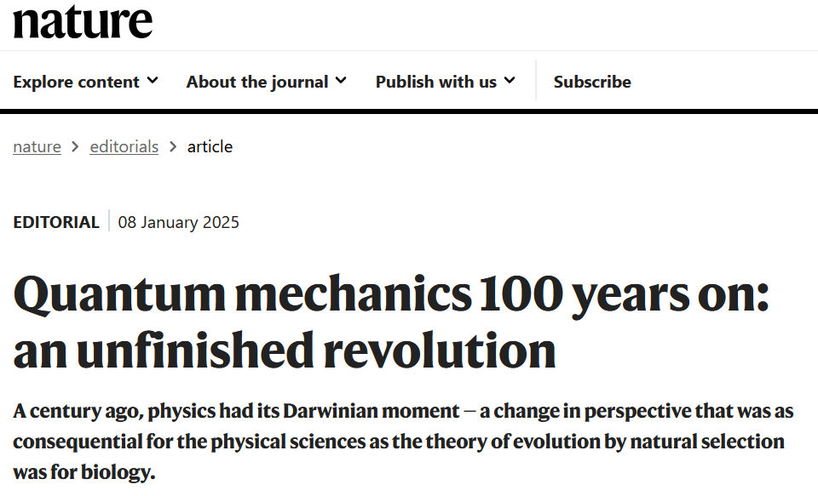
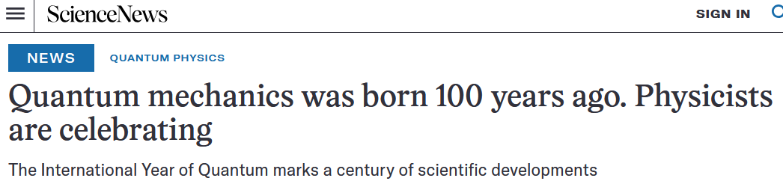
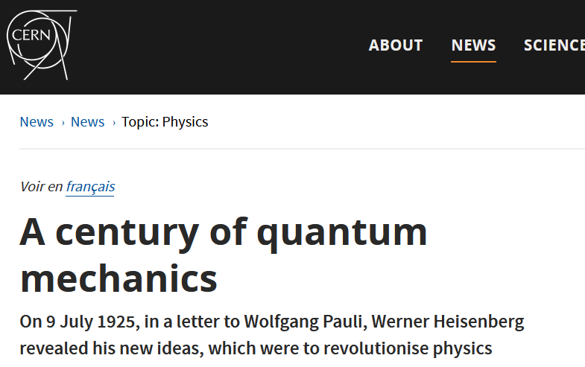
wikipedia

Slide 3

A brief history of quantum mechanics
Blackbody
radiation
Photoelectric
effect
There were problems
with classical physics
Stability of atoms
People futzed around with matrices and waves,
to find something new that has some
correspondence with classical mechanics
$⇒$ Quantum mechanics!

Slide 4



How to quantize a classical theory
Classical mechanics
Quantum mechanics
$$\frac{df}{dt}=\left\{f,H\right\}$$
$$⇒$$
$$\frac{df}{dt}=\frac{\left[f,H\right]}{ıℏ}$$
Quantization!
Dirac’s correspondence principle

Slide 5




$\frac{\left[x,p\right]}{ıℏ}=1$
$$\left\{x,p\right\}=1$$
$\frac{\left[L_{x},L_{y}\right]}{ıℏ}=L_{z}$
$$\left\{L_{x},L_{y}\right\}=L_{z}$$
Quantization is a “formal” operation
(i.e. substitute some symbols with some other symbols)

Slide 6



Not about measurement
Not about measurement
Uncertainty principle
Not about measurement
$$σ_{x}$$
Not about measurement
Not about measurement
Not about measurement
$$σ_{x}σ_{p}≥\frac{1}{2}\left|\left\langle \left[x,p\right]\right\rangle \right|=\frac{ℏ}{2}$$
$$x$$
Spread
over position
Not about measurement
Not about measurement
Not about measurement
Not about measurement
Not about measurement
Not about measurement

Slide 7
Indetermination
Uncertainty principle
$$σ_{x}$$
$$σ_{x}σ_{p}≥\frac{1}{2}\left|\left\langle \left[x,p\right]\right\rangle \right|=\frac{ℏ}{2}$$
$$x$$
Spread
over position
About preparation
not measurement!

Slide 8
Quantum contextuality
Measurements cannot be thought as revealing pre-existing values
Quantum complementarity
For every quantity we prepare, another quantity is indeterminate

Slide 9










During physical processes
During measurements
Schrödinger equation
Projections
$$\left|φ_{1}\right\rangle$$
$$ıℏ\frac{d}{dt}\left|ψ\right\rangle =H\left|ψ\right\rangle$$
$$p_{1}$$
$$p_{2}$$
$$\left|φ_{2}\right\rangle$$
$$\left|ψ\right\rangle$$
$$p_{3}$$
$$\left|φ_{3}\right\rangle$$
$$p_{... }$$
$$\left|…\right\rangle$$
smooth, deterministic and reversible
jumpy, non-deterministic, irreversible
Two laws of evolution
Quantum measurement problem

Slide 10
What is quantum mechanics about?
Hidden variables?
Quantum
reconstructions
Consistent histories?
Interpretations
Many worlds?
Agent information?
Consciousness?

Slide 11
What is the ultimate reason
classical mechanics fails,
and how is it fixed
by quantum mechanics?
Since some of the classical failures are related to thermodynamics,
let’s look at the relationship between entropy and uncertainty in classical mechanics

Slide 12











Entropy in classical mechanics
$$ρ\left(x,p\right)$$
momentum
$$p$$
$S\left(ρ\right)=−∫ρ\log{ρ}dxdp$
$$x$$
Probability
distribution
Logarithm must take
pure number!!!
Entropy
position
$$S\left(ρ_{U}\right)=\log{A\left(U\right)}$$
$$p$$
$ρ=\frac{1}{A\left(U\right)}$
Uniform
distribution
$$x$$
$$A\left(U\right)$$
Area of $U$
Count of states
$$U$$

Slide 13

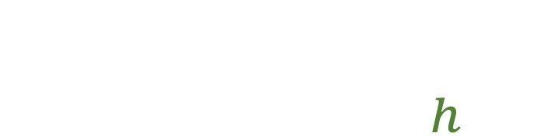


Entropy in classical mechanics
$$ρ\left(q,p\right)$$
momentum
$$p$$
$S\left(ρ\right)=−∫ρ\log{hρ}dxdp$
$$x$$
Entropy
Probability
distribution
Uniform distribution over
area $h$ $⇒$ zero entropy
position
$S\left(ρ_{U}\right)=\log{\frac{A\left(U\right)}{h}}$
$$p$$
$ρ=\frac{1}{A\left(U\right)}$
Uniform
distribution
$$x$$
$$A\left(U\right)$$
Area of $U$
Count of states
$$U$$

Slide 14
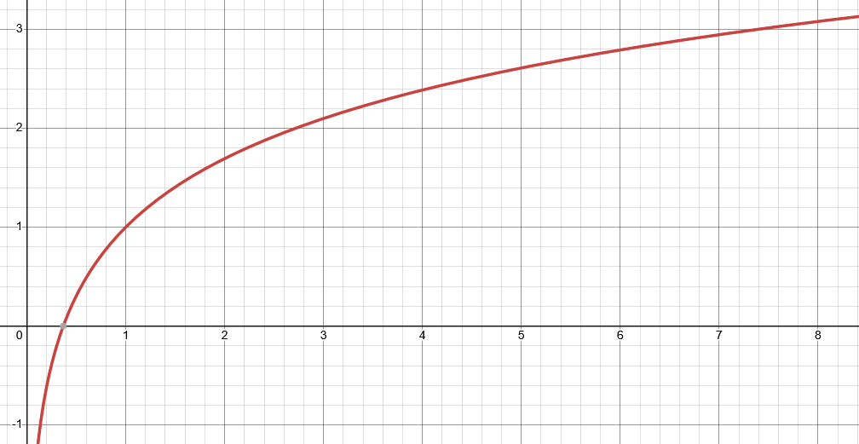




Entropy vs uncertainty
Let’s plot one against the other
$$S$$
excluded by gaussian bound
Gaussian maximizes entropy for a given uncertainty
$$S\left(ρ\right)≤\log{2πe\frac{σ_{x}σ_{p}}{h}}$$
$$\frac{σ_{x}σ_{p}}{ℏ}$$
$$σ_{x}σ_{p}≥\frac{h}{2πe}e^{S\left(ρ\right)}=\frac{ℏ}{e}e^{S\left(ρ\right)}$$
Entropy puts a lower bound
on the uncertainty
Is there a universal lower bound to the entropy?

Slide 15


Enter the 3rd law
$$S$$
excluded by gaussian bound
Every substance has a finite positive entropy, but at the absolute zero of temperature the entropy may become zero, and does so become in the case of perfect crystalline substances.
G. N. Lewis and M. Randall, Thermodynamics and the
free energy of chemical substances (McGraw-Hill, 1923)
$$\frac{σ_{x}σ_{p}}{ℏ}$$
excluded by 3rd law of thermodynamics
$$S≥0 ⇒ σ_{x}σ_{p}≥\frac{ℏ}{e}$$
Classical uncertainty principle
indetermination

Slide 16
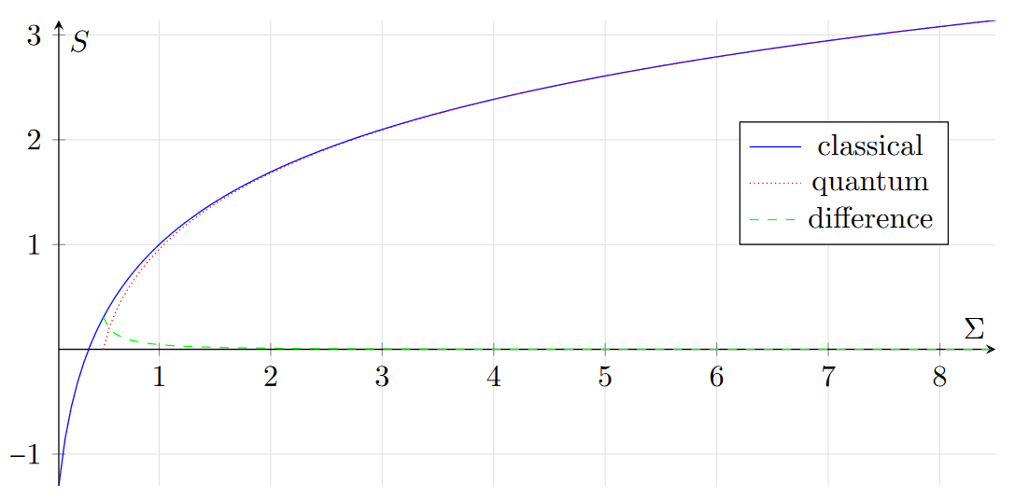





Comparing theories
excluded by gaussian bound
$$σ_{x}σ_{p}≥\frac{ℏ}{e}$$
$$σ_{x}σ_{p}≥\frac{ℏ}{2}$$
classical
quantum
$$\frac{σ_{x}σ_{p}}{ℏ}$$
2.71828…
excluded by 3rd law of thermodynamics
The gaussian bound quickly becomes very similar across theories
$$S_{C}=\ln{eσ}$$
Entropy of quantum states is already non-negative
$S_{Q}=\left(σ+\frac{1}{2}\right)\ln\left(σ+\frac{1}{2}\right)−\left(σ−\frac{1}{2}\right)\ln\left(σ−\frac{1}{2}\right)$
Quantum mechanics incorporates the third law
Classical mechanics does not
Conjecture: does quantum mechanics recover
classical mechanics at high entropy?

Slide 17
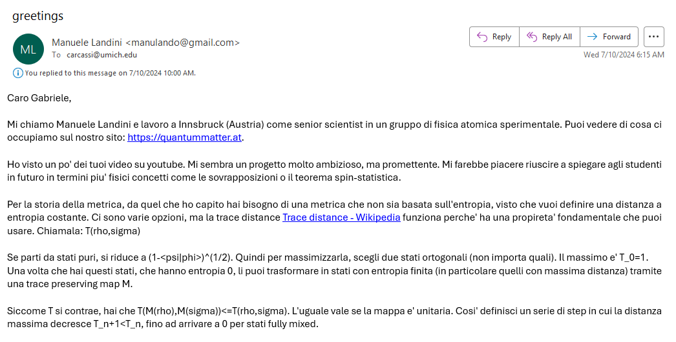
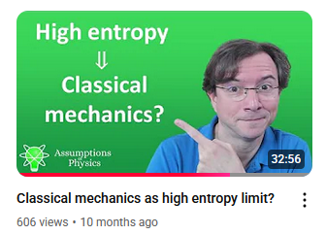
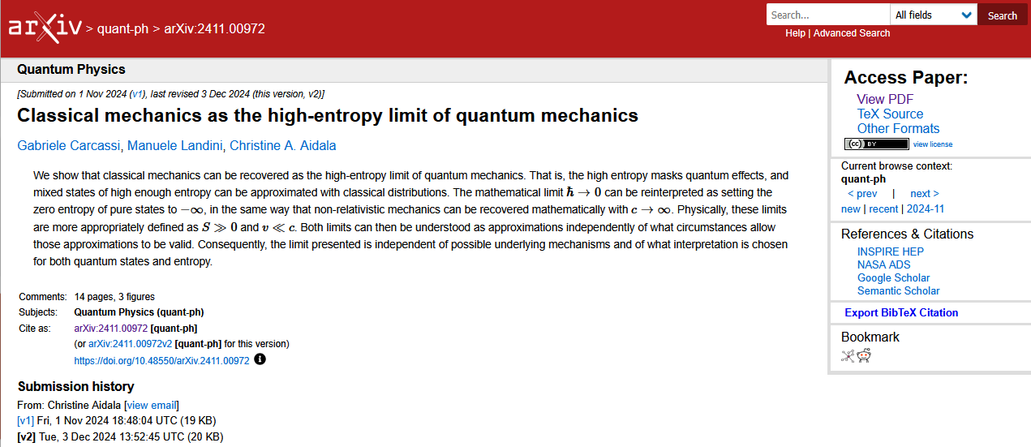
06/01/2024

Slide 18
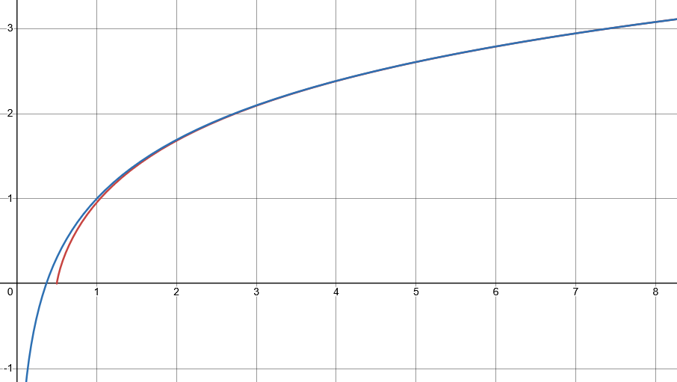

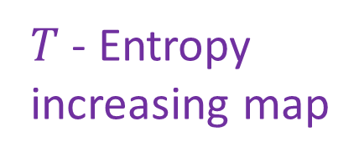




$$S$$
1. Increase the entropy of all states
excluded by gaussian bound
$T$ - Entropy
increasing map
Schrodinger equation
$$\frac{σ_{x}σ_{p}}{ℏ}$$
Spread increase in
position and momentum
excluded by 3rd law of thermodynamics
classical
quantum
$$\frac{\left[x,p\right]}{ıℏ}=1⇒$$
$$\frac{\left[T\left(x\right),T\left(p\right)\right]}{ıℏ}=λ$$
$σ_{T\left(x\right)}σ_{T\left(p\right)}≥\frac{1}{2}\left|\left\langle \left[T\left(x\right),T\left(p\right)\right]\right\rangle \right|=\frac{ℏ}{2}λ$

Slide 19





Mathematical limit
$\frac{\left[x,p\right]}{ıℏ}$
$$→$$
$$ℏ→0$$
$$\left\{x,p\right\}$$
Makes no physical sense!
$ℏ$ is a constant: it doesn’t change

Slide 20
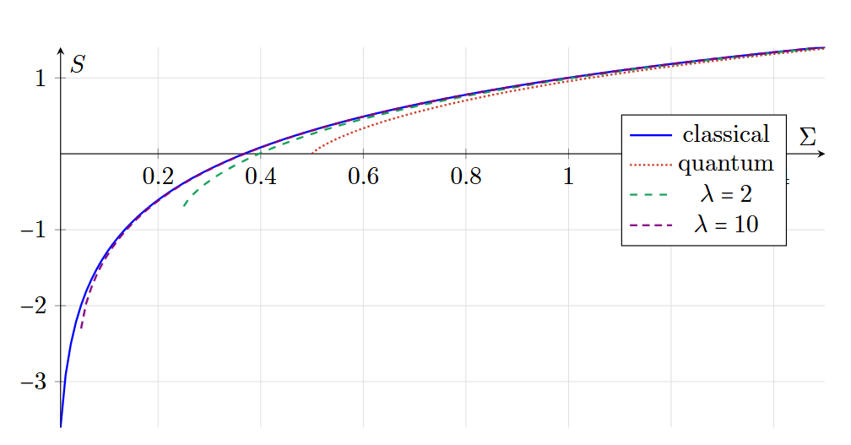






2. Decrease the entropy of pure states
$\frac{\left[X,P\right]}{ıℏ}=\frac{1}{λ}$
$\frac{\left[X,P\right]}{ı\left(ℏ/λ\right)}=1$
$$λ→∞$$
$$→$$
$$\left\{x,p\right\}=1$$
$ℏ/λ→0$

Slide 21


Low speed
Speed
“$c→∞$”
Classical Mechanics | Relativistic Mechanics
Quantum Mechanics | Quantum Field Theory
High entropy
“$ℏ→0$”
Entropy
No-mechanism limit
(same as non-relativistic limit)

Slide 22


Quantum to classical
Classical to quantum
$$\frac{\left[A,B\right]}{ıℏ}⟶\left\{A,B\right\}$$
$$\left\{A,B\right\}⟶\frac{\left[A,B\right]}{ıℏ}$$
High entropy limit
???
Up to isomorphisms, the Moyal bracket is the unique
one-parameter Lie-algebraic deformation of the Poisson bracket
If I asked for a theory that puts a hard lower bound on the entropy,
and recovers classical mechanics at high entropy….
there is only one way to do it

Slide 23
Quantum to classical
Classical to quantum
$$\frac{\left[A,B\right]}{ıℏ}⟶\left\{A,B\right\}$$
$$\left\{A,B\right\}⟶\frac{\left[A,B\right]}{ıℏ}$$
High entropy limit
Entropic lower bound
that recovers classical mechanics
Quantizing a classical theory means putting a lower bound on the entropy

Slide 24
Classical system
Infinitesimally reducible
Internal dynamics
perfectly accessible
time
Quantum system
Irreducible
?
Internal dynamics
inaccessible
time

Slide 25
What is entropy?
Why a lower bound?

Slide 26
What is entropy?
You can think of it as disorder
You can think of it as information
You can think of it as
lack of information

Slide 27

The empire strikes back, Lucasfilm Ltd
Is or is not.
There is no “you can think of it as.”

Slide 28
Suppose you have a (possibly infinite) collection of things
What is the variability of the collection?
How different are the elements within the collection?

Slide 29


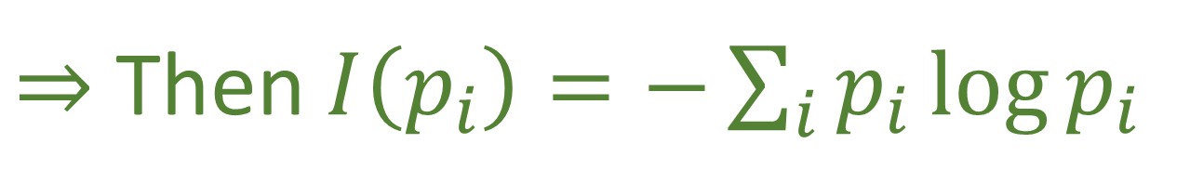
Given a discrete distribution $p_{i}$
we want an indicator $I(p_{i})$ of variability such that:
Continuous in $p_{i}$
Increases if the number of cases increases
Linear in probability
$$I\left(p_{1}{\hat{p}}_{i},p_{2}{\overline{p}}_{j}\right)=I\left(p_{1},p_{2}\right)+p_{1}I\left({\hat{p}}_{i}\right)+p_{2}I\left({\overline{p}}_{j}\right)$$
$⇒$ Then $I\left(p_{i}\right)=−\sum_{i}{p_{i}\log{p_{i}}}$
Proof can be generalized to classical continuum and quantum mechanics
Entropy is variability!

Slide 30
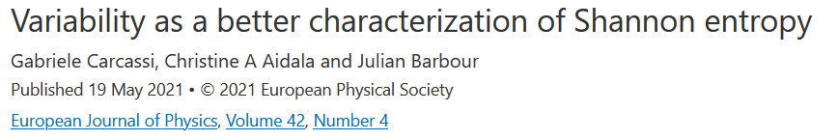


$$…$$

Slide 31
Entropy is not the property
of an element, but of a distribution
A distribution of what?
A statistical distribution of
the molecules of a gas?
A credence distribution of what
an agent may think is there?
A probability distribution of the
outcomes of a measurement?

Slide 32
Not about measurement
Not about measurement
Uncertainty principle
Not about measurement
$$σ_{x}$$
Not about measurement
Not about measurement
Not about measurement
$$σ_{x}σ_{p}≥\frac{1}{2}\left|\left\langle \left[x,p\right]\right\rangle \right|=\frac{ℏ}{2}$$
$$x$$
Spread
over position
Not about measurement
Not about measurement
Not about measurement
Not about measurement
Not about measurement
Not about measurement

Slide 33
Indetermination
Uncertainty principle
$$σ_{x}$$
$$σ_{x}σ_{p}≥\frac{1}{2}\left|\left\langle \left[x,p\right]\right\rangle \right|=\frac{ℏ}{2}$$
$$x$$
Spread
over position
About preparation
not measurement!

Slide 34

Entropy is the variability of an ensemble:
the collection of all outputs
of a reliable preparation procedure
Preparation
procedure
$$…$$
Ensemble of outputs

Slide 35


$$t$$
Physics describes the evolution
of a particular system like a movie
$$x\left(t\right)$$

Slide 36
$$t$$
Physics describes the evolution
of a particular system like a movie
-100 points
$$x\left(t\right)$$

Slide 37
$$t$$
Physics describes the evolution
of similarly prepared systems
Every time I do this…
$$x\left(t\right)$$

Slide 38
$$t$$
Physics describes the evolution
of similarly prepared systems
$$x\left(t\right)$$

Slide 39

Statistical description of preparations
and measurement outcomes
In physics, we can only study relationships that can be reproduced: relationships between ensembles
$$x(t)$$
Statistical description
of all clocks synchronized
at a particular initial event

Slide 40
$$t$$
Even a single measurement is an average over a finite time

Slide 41
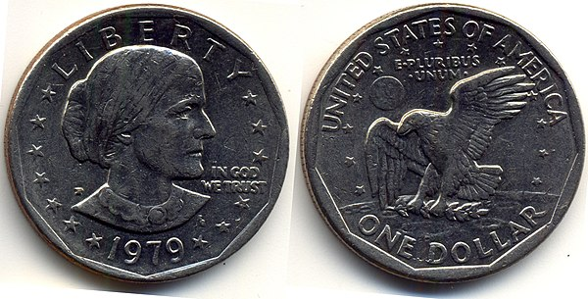
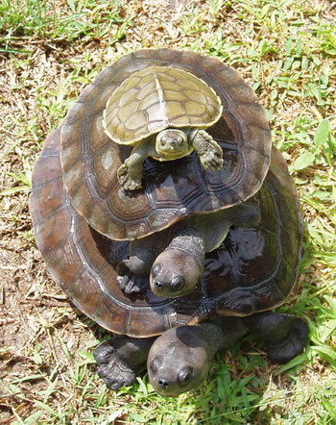
To be able to define a probability distribution over heads or tails, you need first to define what heads and tails are
We can do that because we can leave the coin be, and it remains heads or tails
wikipedia
If it kept changing more than 100 times a second, we wouldn’t perceive heads or tails: just a blur
wikipedia
The state of a system is what remains “stable” for at least a short amount of time
It’s ensembles all the way down

Slide 42
What is entropy?
Variability within a preparation!
Why a lower bound?

Slide 43


Classical mechanics
Preparation
procedure
Assumes we can have
perfect preparations
$$…$$
Preparation
procedure
Concedes that there are
no perfect preparations
$$…$$
Quantum mechanics

Slide 44






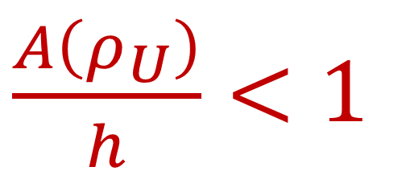

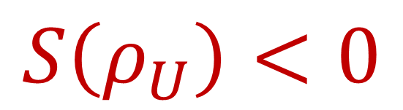
For classical systems
$$ρ_{U}$$
momentum
$$p$$
$S\left(ρ_{U}\right)=\log{\frac{A\left(U\right)}{h}}$
$$q$$
$$U$$
position
Entropy for a uniform
distribution over $U$
Logarithm of the count
of states in $U$
Less than one state!
$\frac{A\left(ρ_{U}\right)}{h}<1$
$$S\left(ρ_{U}\right)<0$$

Slide 45
What is entropy?
Variability within a preparation!
Why a lower bound?
Our preparations cannot be perfect
Regions with “less than one state”
make no sense

Slide 46







The problem with counting (on the continuum)
$$μ\left( \right)=$$
$$a$$
measure
a set of
states
how many states
are there in the set
$$U$$
$$c$$
1. Every state counts as one (i.e. $μ\left(\left\{a\right\}\right)=1$)
$$b$$
Incompatible!
Pick two!
2. Finite regions have finitely many states (i.e. $μ\left(U\right)<∞$)
3. Count is additive for disjoint sets (i.e. $μ\left(∪U_{i}\right)=∑μ\left(U_{i}\right)$)
On a continuum, a finite region
has infinitely many states!

Slide 47

The problem with counting on the continuum
$$μ\left( \right)=$$
$$a$$
measure
a set of
states
how many states
are there in the set
$$U$$
$$c$$
1. Every state counts as one (i.e. $μ\left(\left\{a\right\}\right)=1$)
$$b$$
2. Finite regions have finitely many states (i.e. $μ\left(U\right)<∞$)
3. Count is additive for disjoint sets (i.e. $μ\left(∪U_{i}\right)=∑μ\left(U_{i}\right)$)
$⇒$ Counting measure
What we use in classical discrete case

Slide 48

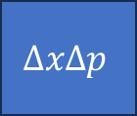
The problem with counting on the continuum
$$μ\left( \right)=$$
$$a$$
measure
a set of
states
how many states
are there in the set
$$U$$
$$c$$
1. Every state counts as one (i.e. $μ\left(\left\{a\right\}\right)=1$)
$$b$$
2. Finite regions have finitely many states (i.e. $μ\left(U\right)<∞$)
3. Count is additive for disjoint sets (i.e. $μ\left(∪U_{i}\right)=∑μ\left(U_{i}\right)$)
$⇒$ Lebesgue measure
$$ΔxΔp$$
What we use in classical continuum case (i.e. classical mechanics)

Slide 49
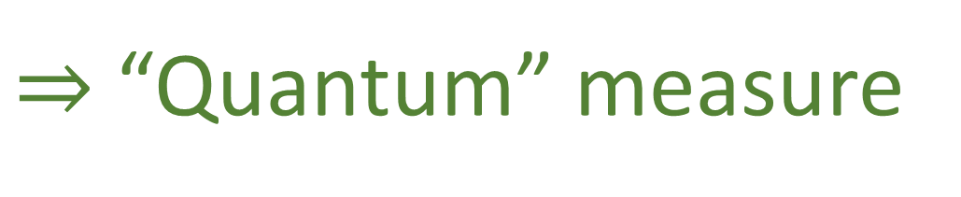
The problem with counting on the continuum
$$μ\left( \right)=$$
$$a$$
measure
a set of
states
how many states
are there in the set
$$U$$
$$c$$
1. Every state counts as one (i.e. $μ\left(\left\{a\right\}\right)=1$)
$$b$$
2. Finite regions have finitely many states (i.e. $μ\left(U\right)<∞$)
3. Count is additive for disjoint sets (i.e. $μ\left(∪U_{i}\right)=∑μ\left(U_{i}\right)$)
$⇒$ “Quantum” measure
What we are implicitly using in quantum mechanics

Slide 50
We saw that thinking about entropy makes us understand how classical mechanics fails and gives rise to quantum mechanics
Can we use similar arguments to understand why quantum mechanics and general relativity are incompatible, and how to fix it?

Slide 51







General relativity is a field theory
Particle mechanics
Finitely many variables
$$\begin{matrix}x^{1} \\ p_{1}\end{matrix}$$
$$\begin{matrix}x^{2} \\ p_{2}\end{matrix}$$
$$\begin{matrix}x^{n} \\ p_{n}\end{matrix}$$
State defined by
position and momentum:
$$…$$
Continuously (infinitely)
many variables
Field theory
$$A(x)$$
$$B(x)$$
$$…$$
State defined by
fields at each point:
How do we count them?!?

Slide 52






The problem with counting (on the continuum)
$$μ\left( \right)=$$
$$z$$
$$y$$
region of
space
Volume proportional to
number of variables
$$a$$
$$U$$
$$x$$
1. Every point has one variable (i.e. $μ\left(\left\{a\right\}\right)=1$)
Incompatible!
2. Finite regions have finite volume (i.e. $μ\left(U\right)<∞$)
3. Count is additive for disjoint sets (i.e. $μ\left(∪U_{i}\right)=∑μ\left(U_{i}\right)$)
On a continuum, a finite region
has infinitely many points!

Slide 53





Seems that “quantizing space-time” means putting a lower bound on the number of variables (degrees of freedom)
In the same way that a region of state space “with less than one state” makes no sense,
a region of physical space with “less than one degree of freedom” makes no sense
I don’t think we have the right math
to specify the problem!
$$z$$
$$y$$
size/
#DOF
$$U$$
$$x$$
$$1$$
radius^3
I don’t think we have the right math
to solve this problem!

Slide 54
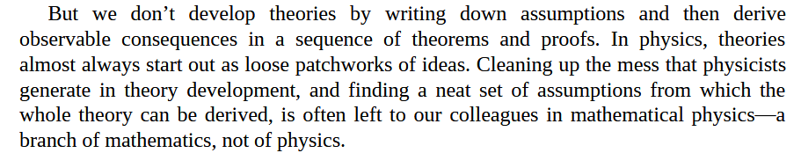
Sabine Hossenfelder – Lost in Math
-100.000 points
Math is not just a tool for calculation:
we use it to specify our theories

Slide 55

Ultimately, it is up to the physicists to develop a clear physical model
Mathematicians can help find holes… and give options
Clear physical model $⟺$ clear math
Clarity, meaningfulness, consistency, … cannot be added after the fact

Slide 56
Big systems that work always come from small systems that work, they never come from big systems that don’t work

Slide 57


The only way forward is to go back and reconstruct everything from a minimal set of physically meaningful assumptions
https://assumptionsofphysics.org
For more information, papers, presentations, …
https://www.youtube.com/@gcarcassi
Videos with results and insights from the research
https://assumptionsofphysics.org/foundation

Slide 59




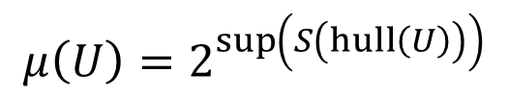
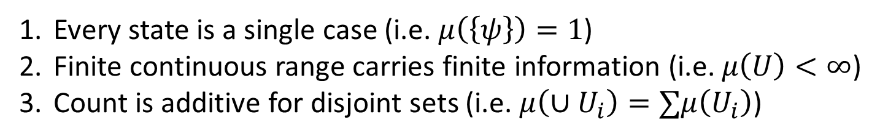







The problem with counting on the continuum
We’d like to say:
Every state is a single case (i.e. $μ\left(\left\{ψ\right\}\right)=1$)
Finite continuous range carries finite information (i.e. $μ\left(U\right)<∞$)
Count is additive for disjoint sets (i.e. $μ\left(∪U_{i}\right)=∑μ\left(U_{i}\right)$)
Incompatible!
Pick two!
Discard 1 $⇒$ Lebesgue measure
Discard 2 $⇒$ counting measure
$$A$$
Non-orthogonal states: different states but in different contexts
Discard 3 $⇒$ “Quantum measure”
additive
$$C$$
sub-additive
Orthogonal states:
different states all else equal
$$μ\left(U\right)=2^{\sup\left(S\left(hull\left(U\right)\right)\right)}$$
$$B$$
$$μ\left(\left\{A\right\}\right)=2^{0}=1$$
Exponential of the maximum entropy reachable with convex combinations (statistical mixtures) of $U$ (reduces to counting/Liouville measure)
$$μ\left(\left\{A,B\right\}\right)=2^{1}=2$$
$$μ\left(\left\{A,C\right\}\right)<2=μ\left(\left\{A\right\}\right)+μ\left(\left\{C\right\}\right)$$
Quantum mechanics $⇒$ lower bound
on #conf (entropy) on continuous DOF

Slide 60
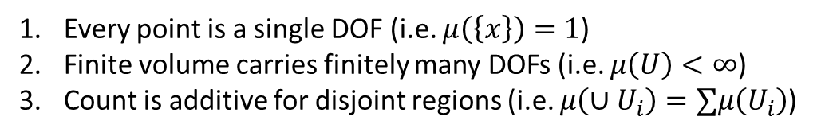
Conjecture: quantum gravity $⇒$ lower bound on DOF count
#conf
Same problem!
#conf=#DOFs
Every point is a single DOF (i.e. $μ\left(\left\{x\right\}\right)=1$)
Finite volume carries finitely many DOFs (i.e. $μ\left(U\right)<∞$)
Count is additive for disjoint regions (i.e. $μ\left(∪U_{i}\right)=∑μ\left(U_{i}\right)$)
#DOFs
Lower bound
on this…
…requires a lower bound on this
Distant points:
independent DOFs
additive
From QM: Lower bound on state count requires a severe revisitation of particle state space
sub-additive
Close points: DOFs not independent
Does lower bound on DOF count require an equally severe revisitation of space-time?

Slide 61


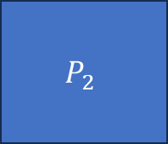

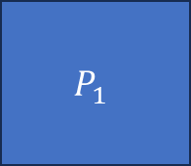

Preparation
Ensemble
$$e_{1}$$
Identically
prepared
ensemble
$$P_{1}$$
$$…$$
There is no variability in the ensemble
$$e_{2}$$
Pure
ensemble
$$P_{2}$$
No process can reduce the variability of the ensemble
$$…$$
There is no $a$ such that $e_{2}=pa+\overline{p}b$ for some $p∈(0,1)$ and $b≠a$
In classical theories, all pure ensembles are identically prepared
No real distinction between ensembles and instances
In non-classical theories, no identically prepared ensembles
Zero entropy does NOT correspond to identically prepared ensembles

Slide 62


The problem with counting on the continuum
$$a$$
$$U$$
$$μ\left( \right)=$$
$$c$$
a set of
states
how many states
are there in the set
$$b$$
1. Every state counts as one (i.e. $μ\left(\left\{a\right\}\right)=1$)
Incompatible!
Pick two!
2. Finite regions have finitely many states (i.e. $μ\left(U\right)<∞$)
3. Count is additive for disjoint sets (i.e. $μ\left(∪U_{i}\right)=∑μ\left(U_{i}\right)$)
On a continuum, a finite region
has infinitely many states!

Slide 63
The problem with counting on the continuum
$$a$$
$$U$$
$$μ\left( \right)=$$
measure
a set of
states
how many states
are there in the set
1. Every state counts as one (i.e. $μ\left(\left\{a\right\}\right)=1$)
Incompatible!
Pick two!
2. Finite regions have finitely many states (i.e. $μ\left(U\right)<∞$)
3. Count is additive for disjoint sets (i.e. $μ\left(∪U_{i}\right)=∑μ\left(U_{i}\right)$)
On a continuum, a finite region
has infinitely many states!

Slide 64

How does the quantum measure work?
$$a$$
$$U$$
$$c$$
$$μ\left(\left\{a\right\}\right)=μ\left(\left\{b\right\}\right)=μ\left(\left\{c\right\}\right)=1$$
$$μ\left(\left\{a,b\right\}\right)=2=μ\left(\left\{a\right\}\right)+μ\left(\left\{b\right\}\right)$$
$$b$$
Additive when states are distinguishable (i.e. mutually exclusive)
$$μ\left(\left\{a,c\right\}\right)<2=μ\left(\left\{a\right\}\right)+μ\left(\left\{c\right\}\right)$$
Sub-additive when states are not distinguishable (i.e. mutually exclusive)
Non-additivity coincides
with non-distinguishability
The measure counts
distinguishable (i.e. mutually
exclusive) states

Slide 65
$$t$$

Slide 66
$$t$$

Slide 68
How should we count states?

Slide 69
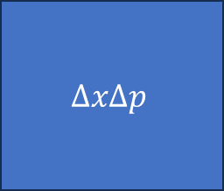
For discrete classical systems
You simply count the points
For continuous classical systems
$$ΔxΔp$$
You use areas of position/momentum
For quantum systems?

Slide 70



For classical systems
$$ρ_{U}$$
momentum
$$p$$
$$2^{S\left(ρ_{U}\right)}=μ\left(U\right)$$
$$q$$
$$U$$
position
Exponential of the entropy
for a uniform
distribution over $U$
Count of states in $U$

Slide 71

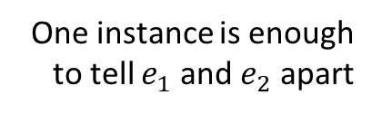
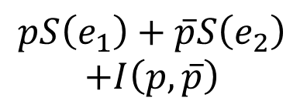

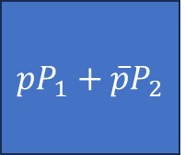


Preparation
Ensemble
Entropy
Variability within
an ensemble
$$e_{1}$$
$$P_{1}$$
$$…$$
$$S\left(e_{1}\right)$$
One instance is enough to tell $e_{1}$ and $e_{2}$ apart
more variability
Mutually exclusive
$$e_{2}$$
$$P_{2}$$
$$…$$
$$S\left(e_{2}\right)$$
Orthogonal
Maximal entropy increase
if orthogonal
$$pe_{1}+\left(1−p\right)e_{2}$$
$$pP_{1}+\overline{p}P_{2}$$
$$pS\left(e_{1}\right)+\overline{p}S\left(e_{2}\right)$$
$$+I\left(p,\overline{p}\right)$$
recovers Shannon entropy
$$I\left(p,\overline{p}\right)=−p\log{p}−\overline{p}\log{\overline{p}}$$

Slide 72
$$t$$

Slide 74
We don’t know what it is
What is a quantum system? What is a classical system?
Electron/Proton/… all described by same equation. What makes them the same? Contextual. Inner dynamics is decoupled (it does not matter). Irreducibility?
Can we reorganize all of physics through simple concepts? Most obvious?
What

Slide 75
100 years of QM: fake history, we got some math but we don’t know what it means
Uncertainty principle, two modes of evolution, contextuality, Dirac’s correspondence principle (quantization)
Interpretations (hidden variables) and reconstructions don’t work
Why does classical mechanics fail? Classical uncertainty principle.
Motivations for the third law. Entropy of nothing. Entropy of one state.
Classical mechanics recovered at high entropy, quantization is putting a lower bound on the entropy
Entropy is about ensembles; physics is about ensembles; this is the fundamental mischaracterization of physics (film strip)
Classical vs quantum: reducibility vs irreducibility; wave particule duality (electron a point particle, state probability distr; or electron a spread out blotch of energy? To tell the difference, needs lower entropy description)
Back to counting states. 3 out of 2
Space-time quantization

