Slide 1


Reverse Physics: uncovering the Assumptions of Physics from its laws
Gabriele Carcassi
Physics Department
University of Michigan

Slide 2


https://assumptionsofphysics.org
To identify a handful of physical principles from which the basic laws can be rigorously derived
What exactly is the action, and why should it be stationary?
Why is a classical state represented by position and momentum?
Can we create a precise and meaningful map between mathematical tools and physical ideas, instead of abstract definitions and analogies?
How do we turn physical requirements into precise mathematics?
Why is a quantum state represented by a ray in a Hilbert space?
Which philosophical questions are useful and which are a distraction?
Gabriele Carcassi
Project Lead
Christine A. Aidala
Principal Investigator
Is there a more general notion of “systems” and “states” across physical theories?
What fundamental physical ideas hide behind the mathematical equations?
Is the ideal of mathematical precision useful in physics?
Are the current mathematical foundations and tools suitable for physics?
What are the realms of applicability of our theories and of the mathematical tools we use to describe them?
What are the most fundamental notions in physics?
Why position/momentum and pressure/volume, and not position/volume?

Slide 3
Reverse Physics
Physics
Smallest set of assumptions required to rederive the theory
Physical theory
Physical result/ effect/prediction
Reverse Mathematics
Mathematics
Smallest set of axioms required to prove the theorem
Theorem
Mathematical result/ corollary/calculation

Slide 4
Reversing Hamiltonian mechanics
one degree of freedom

Slide 5

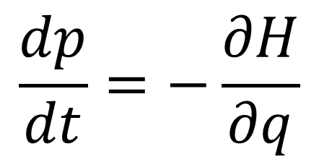
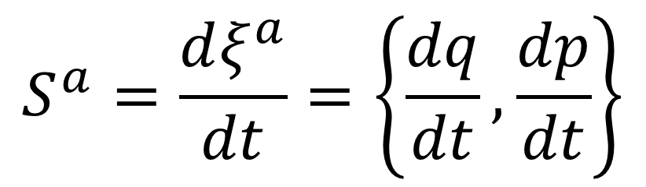
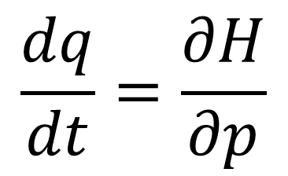

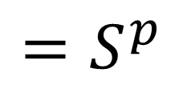

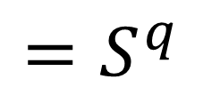
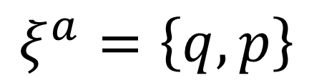

(1) Hamilton’s equations
$$p$$
$$=ξ^{2}$$
$$q$$
$$=ξ^{1}$$
$$\frac{dq}{dt}=\frac{∂H}{∂p}$$
$$=S^{q}$$
$$ξ^{a}=\left\{q,p\right\}$$
$$\frac{dp}{dt}=−\frac{∂H}{∂q}$$
$$=S^{p}$$
$$S^{a}=\frac{dξ^{a}}{dt}=\left\{\frac{dq}{dt},\frac{dp}{dt}\right\}$$

Slide 6

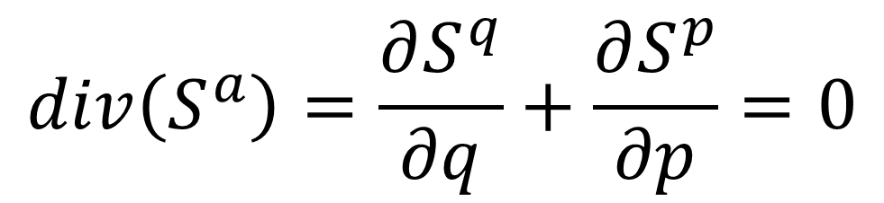
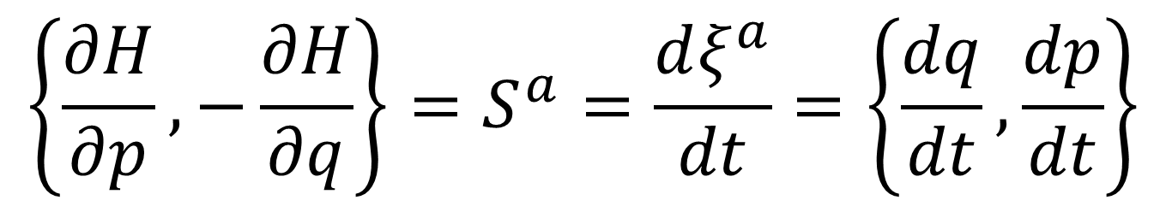

(2) Divergenceless displacement
$$p$$
$$=ξ^{2}$$
Suppose $S^{a}$ divergenceless
$$q$$
$$=ξ^{1}$$
$$div\left(S^{a}\right)=\frac{∂S^{q}}{∂q}+\frac{∂S^{p}}{∂p}=0$$
Then there exists a stream function $H$ such that
$$\left\{\frac{∂H}{∂p},−\frac{∂H}{∂q}\right\}=S^{a}=\frac{dξ^{a}}{dt}=\left\{\frac{dq}{dt},\frac{dp}{dt}\right\}$$

Slide 7
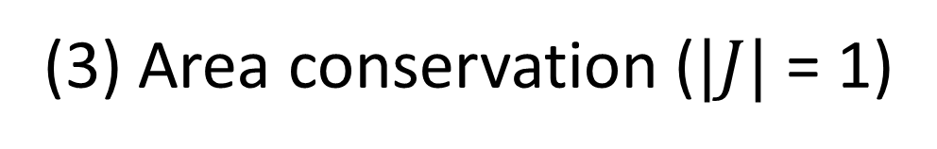
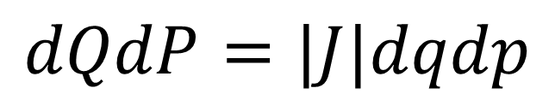
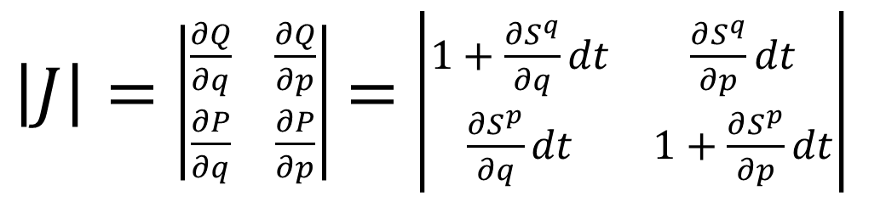

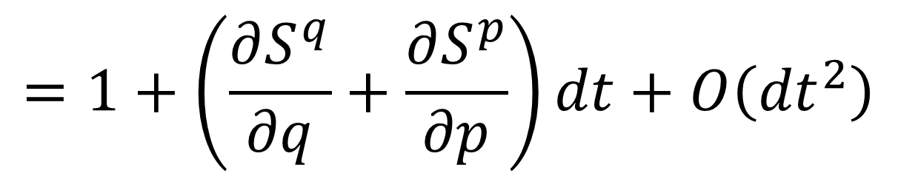
(3) Area conservation ($|J|$ = 1)
$$p$$
$$=ξ^{2}$$
Study how the area evolves
$$q$$
$$=ξ^{1}$$
$$dQdP=|J|dqdp$$
$\left|J\right|=$ $\left|\begin{matrix}\frac{∂Q}{∂q} & \frac{∂Q}{∂p} \\ \frac{∂P}{∂q} & \frac{∂P}{∂p}\end{matrix}\right|$ $=$ $\left|\begin{matrix}1+\frac{∂S^{q}}{∂q}dt & \frac{∂S^{q}}{∂p}dt \\ \frac{∂S^{p}}{∂q}dt & 1+\frac{∂S^{p}}{∂p}dt\end{matrix}\right|$
$$div\left(S^{a}\right)=0$$
$$=1+\left(\frac{∂S^{q}}{∂q}+\frac{∂S^{p}}{∂p}\right)dt+O\left({dt}^{2}\right)$$

Slide 8
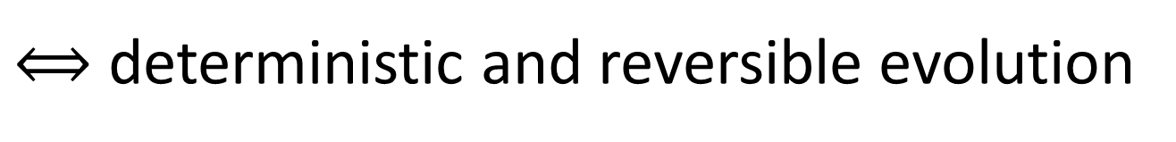


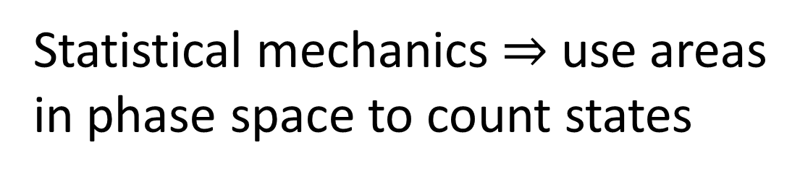



(4) Deterministic and reversible evolution
$$p$$
$$=ξ^{2}$$
$$q$$
$$=ξ^{1}$$
Statistical mechanics $⇒$ use areas in phase space to count states
Area conservation $⟺$ state count conservation
$⟺$ deterministic and reversible evolution
$$p$$
$$=ξ^{2}$$
Key insight: det/rev is not just a bijection! On continuous spaces, counting points is not enough!
$$q$$
$$=ξ^{1}$$
A dissipative force maps points to points, but areas become smaller.

Slide 9
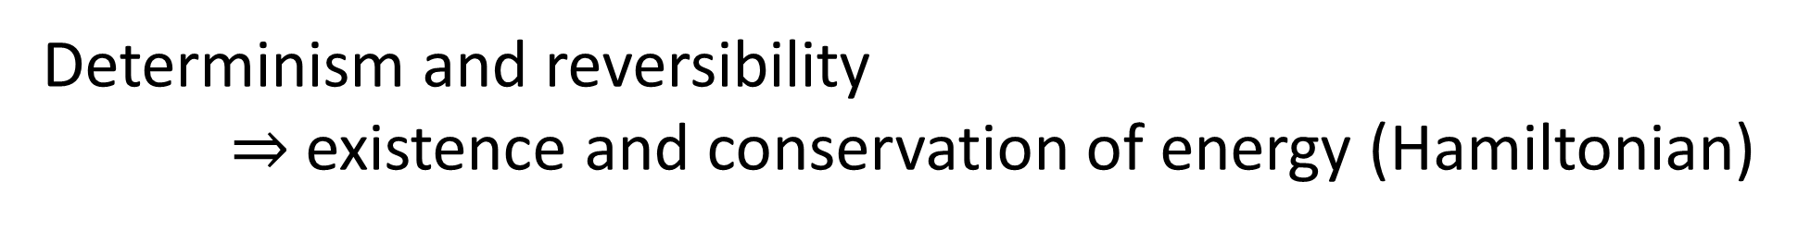
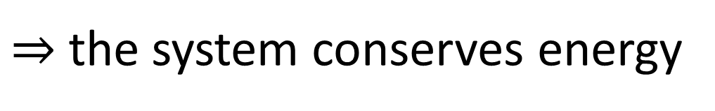

Determinism and reversibility $⇒$existence and conservation of energy (Hamiltonian)
Why?
Stronger version of the first law of thermodynamics
Determinism and reversibility
$⇒$ past and future depend only on the state of the system
$⇒$ the evolution does not depend on anything else
$⇒$ the system is isolated
First law of thermodynamics!
$⇒$ the system conserves energy

Slide 10

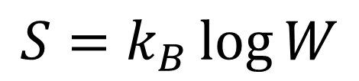

(5) Deterministic and thermodynamically reversible evolution
$$p$$
$$=ξ^{2}$$
$$q$$
$$=ξ^{1}$$
Link between statistical mechanics and thermodynamics
$$S=k_{B}\log{W}$$
Area conservation $⟺$ entropy conservation
$⟺$ thermodynamically reversible evolution

Slide 11
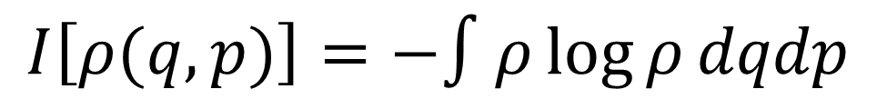

(6) Information conservation
$$p$$
$$=ξ^{2}$$
What about information entropy?
$$q$$
$$=ξ^{1}$$
$$I\left[ρ(q,p)\right]=−∫ρ\log{ρ}dqdp$$
$$I\left[ρ\left(t+dt\right)\right]=I\left[ρ\left(t\right)\right]−∫ρ\log{|J|}dqdp$$
Area conservation $⟺$ information conservation

Slide 12
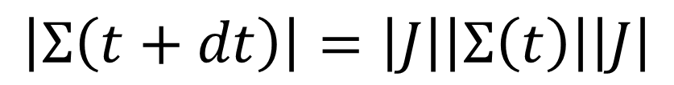
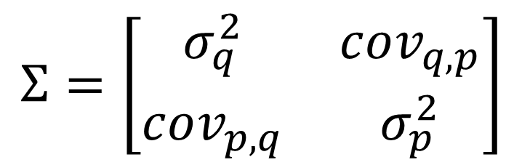

(7) Uncertainty conservation
$$p$$
$$=ξ^{2}$$
What about uncertainty?
covariance matrix
$$q$$
$$=ξ^{1}$$
$$Σ=\left[\begin{matrix}σ_{q}^{2} & cov_{q,p} \\ cov_{p,q} & σ_{p}^{2}\end{matrix}\right]$$
Assuming a “very narrow” distribution
$$\left|Σ\left(t+dt\right)\right|=\left|J\right|\left|Σ\left(t\right)\right|\left|J\right|$$
Area conservation $⟺$ uncertainty conservation

Slide 13
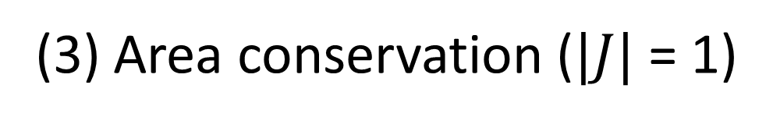
(1) Hamilton’s equations
All equivalent!
(2) Divergenceless displacement
(3) Area conservation ($|J|$ = 1)
(4) Deterministic and reversible evolution (i.e. isolation)
(5) Deterministic and thermodynamically reversible evolution
(6) Information conservation
(7) Uncertainty conservation

Slide 14
Connections between Hamiltonian mechanics, vector calculus, differential (symplectic) geometry, statistical mechanics, thermodynamics, information theory and plain statistics
We can’t study the foundations of one physical theory without looking at the foundations of all of them

Slide 15
Uncertainty principle in classical and quantum mechanics
one degree of freedom

Slide 16

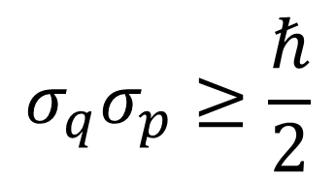
Quantum uncertainty principle
$$σ_{q}σ_{p}≥\frac{ℏ}{2}$$
What is its origin? What “causes” it?
What explains it?
How does $σ_{q}σ_{p}$behave in classical mechanics?

Slide 17
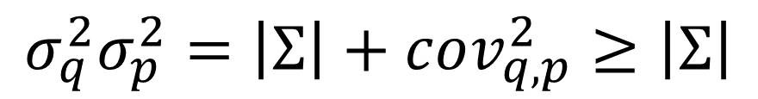
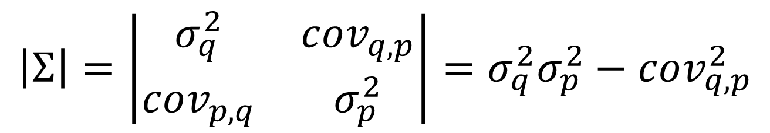


$$\left|Σ\right|=\left|\begin{matrix}σ_{q}^{2} & cov_{q,p} \\ cov_{p,q} & σ_{p}^{2}\end{matrix}\right|=σ_{q}^{2}σ_{p}^{2}−cov_{q,p}^{2}$$
constant of motion
$$σ_{q}^{2}σ_{p}^{2}=\left|Σ\right|+cov_{q,p}^{2}≥\left|Σ\right|$$
Uncertainty is bounded during Hamiltonian evolution
$$p$$
Lowest bound is in absence of correlation
$$q$$
But the bound depends on initial conditions

Slide 18
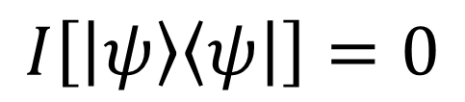
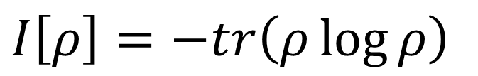

The bound on quantum uncertainty seems to be intrinsic to the nature of the quantum state
Let’s look at the von Neumann entropy
$I\left[ρ\right]=−tr\left(ρ\log{ρ}\right)$
For a pure state $\left|ψ\right\rangle$
lowest possible entropy
$$I\left[\left|ψ\right\rangle \left\langle ψ\right|\right]=0$$
Could this bound, by itself, explain everything?

Slide 19


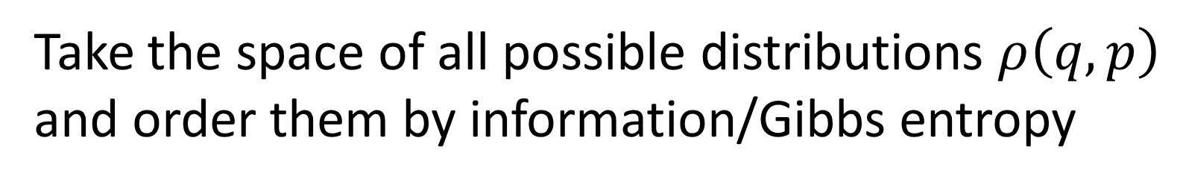



$$−∫ρ\log{ρ}$$
Take the space of all possible distributions $ρ\left(q,p\right)$ and order them by information/Gibbs entropy
Fix the entropy to a constant $I_{0}$ and consider all distributions with that entropy
$$I_{0}$$
They satisfy $σ_{q}σ_{p}≥\frac{e^{I_{0}}}{2πe}$
$$σ_{q}σ_{p}$$
equality for independent Gaussians
Lower bound on entropy $⇒$ lower bound on uncertainty
Inverse does not work: lower bound on uncertainty does not give a lower bound on entropy

Slide 20
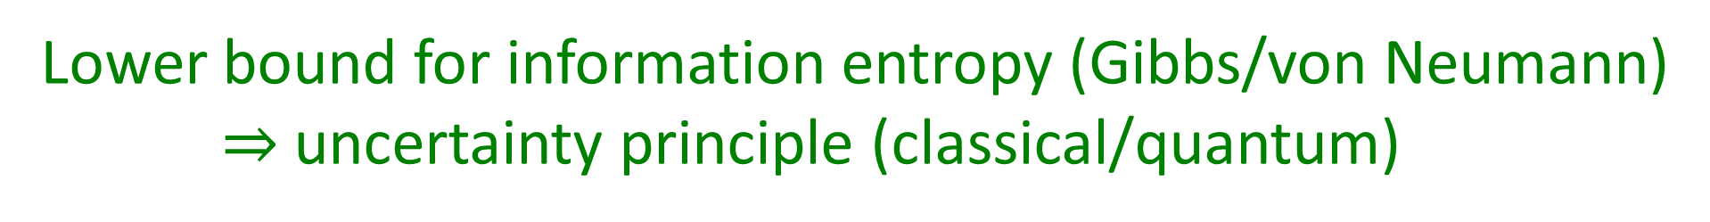
Lower bound for information entropy (Gibbs/von Neumann) $⇒$uncertainty principle (classical/quantum)
We don’t need the full quantum theory to derive the uncertainty principle: only the lower bound on entropy
The difference is that in classical mechanics we can prepare ensembles with arbitrarily low entropy…
But can we really?

Slide 21
The third law of thermodynamics revisited

Slide 22
A lower entropy bound is built into quantum mechanics, but not classical mechanics.
It is also built into thermodynamics in the form of the third law:
Every substance has a finite positive entropy, but at the absolute zero of temperature the entropy may become zero, and does so become in the case of perfect crystalline substances.
G. N. Lewis and M. Randall - Thermodynamics and the free energy of chemical substances
Where does this lower bound come from?

Slide 23

Thermodynamic entropy is additive for independent systems
$$S_{AB}=S_{A}+S_{B}$$
What system acts as a “zero” under system composition?
The empty system $∅$: $A∪∅=A$.
$$S_{∅}=S_{∅∅}=S_{∅}+S_{∅}=0$$

Slide 24
What do the empty system and a crystalline structure at zero temperature have in common?
They both have only one way to be: saying “the crystalline structure is at zero temperature” or “the system is not present” both fully determine the state of the system

Slide 25
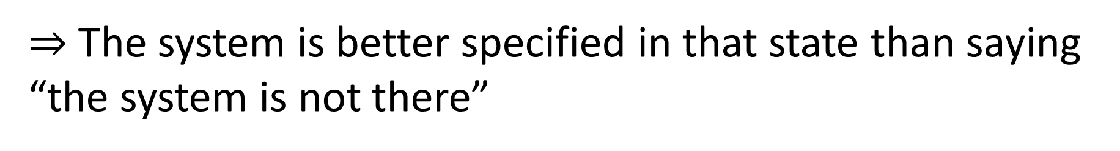
Why can’t we have states with entropy less than that of the empty system?
Suppose we had a system in a negative entropy state
$⇒$ The system is better specified than the empty system
$⇒$ The system is better specified in that state than saying “the system is not there”
But saying “the system is not there” already tells us everything there is to know about the system! Contradiction!

Slide 26
Let us rephrase the third law as:
Principle of maximal description
No state can describe a system more accurately than stating the system is not there in the first place
In practice, this statement is equivalent to the other one we quoted, but it is more of a logical necessity than a phenomenological assumption
It makes for a better foundational starting point

Slide 27
Third law of thermodynamics
A lot more physical insight without requiring crazy metaphysical ideas, weird interpretations … just basic physical considerations!
$⇒$ Lower bound on entropy
$⇒$ Uncertainty principle
Classical ensembles have no lower bound on entropy
$⇒$ At odds with third law of thermodynamics
$⇒$ Classical physics is untenable

Slide 28
A different approach to the foundations of physics

Slide 29
Typical approaches in the foundations of physics
Start with the theory that describes “what really happens”
With the most complicated and most complete description
Gradually derive other theories as approximations
approximation
…
Weak interactions
QED -Electromagnetism
QCD – Strong Interactions
Electro-weak
The Assumptions of Physics project does not proceed in this manner
We want to understand each theory as its own set of assumptions
General Relativity
Grand Unified Theory
Theory of Everything

Slide 30
Typical approaches in the foundations of physics
Focus on a specific theory
E.g. Quantum mechanics
Address ideas and problems related only to that theory
E.g. Give an “interpretation” that solves the “measurement problem”
Quantum mechanics
Measurement problem
The Assumptions of Physics project does not proceed in this manner
It’s ok that QM is incomplete, we just want to understand the limitation
What “really” happens
Ontology of observables
Interpretation

Slide 31
Holistic approach
Assumptions of CM
Classical mechanics
Measure theory
Statistics
Assumptions of physics
Assumptions of QM
Quantum mechanics
Information theory
Differential geometry
Assumptions of TD
Thermo-dynamics
No single fundamental point of view (e.g. everything is information/QM/… )
Foundations of different theories are not disconnected
Find those concepts that span multiple areas of physics, math, …

Slide 32
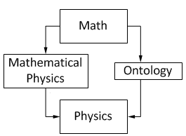
End goal: put physics at the center of physics
Physics
Physical requirements
Semantics
Math
Physical Mathematics
From Wikipedia “Mathematical Physics”
David Hilbert: “Mathematics is a game played according to certain simple rules with meaningless marks on paper.”
Mathematical content of a theory can never tell us the full physical content
What is a state?
How does the theory map to experiments?
Why is one theory appropriate in one context and not in another?

Slide 33
Space of the well-posed scientific theories
Physical theories
Specializations of the general theory under the different assumptions
Hamiltonian mechanics
Unitary evolution
Quantum state-space
Classical phase-space
Assumptions
Infinitesimal reducibility
Determinism/
reversibility
Irreducibility
States and processes
General theory
Informational granularity
Basic requirements and definitions valid in all theories
Experimental verifiability

Slide 34
Conclusions
Assumptions of Physics brings a new approach to the foundations of physics
We want to understand how fundamental physical assumptions lead to physical theories and the mathematics used to express them
As the foundations of mathematics studies the necessary structures for mathematics, we want to understand what are the fundamental features any physical theory must have to be well-posed
Two main approaches: Reverse Physics …
starts from the physical laws and aims to “go back” to a suitable minimum number of assumptions that capture the physics
… and Physical Mathematics
rederives mathematical structures from clearly stated physical requirements
The end goal is to create a holistic understanding of all physical theories and their mathematical structure

Slide 35
Resources
Project website: https://assumptionsofphysics.org/
Papers, presentation slides, list of open problems, …
YouTube channel: https://www.youtube.com/user/gcarcassi
Popularize results of our research, recorded presentations, …
“Reverse physics: from laws to physical assumptions”
https://arxiv.org/abs/2111.09107
“Geometrical and physical interpretation of the action principle”
https://arxiv.org/abs/2208.06428
Subscribe to our mailing list
https://mcommunity.umich.edu/group/Assumptions%20of%20Physics
or to our facebook page
https://www.facebook.com/AssumptionsOfPhysics

Slide 37
Supplemental

Slide 38
Why does classical mechanics fail?
It lacks a lower bound on the entropy, therefore it violates the third law of thermodynamics
What does that mean in physics terms? How can we understand this better?

Slide 39
continuum
Quantifying discrete cases is fundamentally different than quantifying cases over the continuum
discrete
finite measure
zero measure
Why? Because fully identifying a discrete case requires finite information (finitely many experimental tests) while identifying a case from a continuum requires infinite information (an infinite sequence of increasingly precise tests)
This is something most physicists haven’t yet fully digested

Slide 40
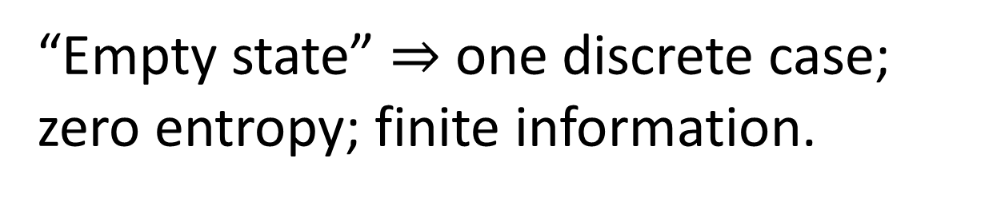
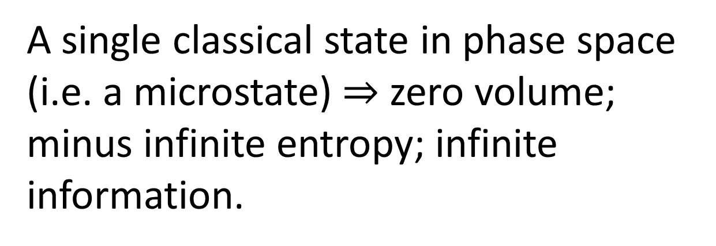
continuum
A single classical state in phase space (i.e. a microstate) $⇒$ zero volume; minus infinite entropy; infinite information.
discrete
finite measure
zero measure
“Empty state” $⇒$ one discrete case; zero entropy; finite information.
quantum: continuum with points of finite measure
Quantum mechanics “fixes” this, by introducing a fixed lower bound on entropy.

