Slide 1
The geometry of quantum mechanics
Gabriele Carcassi

Slide 2



Vector
Hilbert space
Same state (state is not a vector)
$$\left|ψ\right\rangle ∈ℋ$$
$$\left|ψ\right\rangle \sim λ\left|ψ\right\rangle$$
States are represented by one-dimensional subspaces
$$\left\{λ\left|ψ\right\rangle \right\}⊂ℋ$$
i.e. “ray” in Hilbert space
Understand real projective spaces
Understand complex projective spaces
What the inner product means geometrically, how a complex vector space is different from a real one with double dimension, …

Slide 3











Real projective line
Set of all lines that pass through the origin
(one dimensional-subspace, “rays”)
$$0,0$$
$$x,θ$$
$$λ[0,1]$$
$$y$$
$$λ\left[x,1\right]=λ\left[\sin{θ},\cos{θ}\right]$$
$$−1 ,−\frac{π}{4}$$
$$1 ,\frac{π}{4}$$
$$θ$$
$$λ\left[1,0\right]$$
$$−∞,−\frac{π}{2} ; ∞,\frac{π}{2}$$
$$x$$

Slide 4
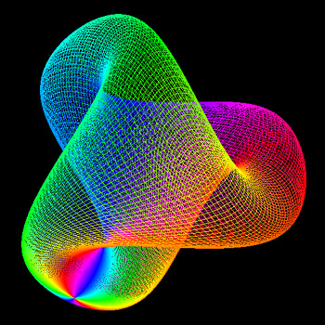






Real projective plane
Set of all lines that pass through the origin
(one dimensional-subspace, “rays”)
$$λ[0,0,1]$$
$$λ\left[0,1,0\right]$$
$$z$$
$$y$$
$$λ\left[1,0,0\right]$$
$$x$$
$$λ\left[x,y,1\right] \\ =λ[\sin{θ}\cos{ φ}, \sin{θ}\sin{φ},\cos{θ}]$$

Slide 5
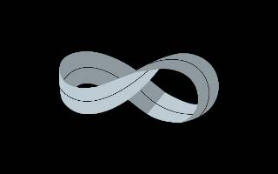
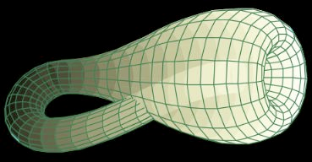
Möbius strip
Klein
bottle
Real projective plane

Slide 6












$$ℝ^{2n}$$
$$x^{4}$$
$$x^{3}$$
$$x^{2}$$
$$ℂ^{n}$$
$$ıx^{2}$$
$$x^{2}$$
$$ıx^{1}$$
$$x^{1}$$
$$x^{1}$$
$$v⋅w=\left|v\right|\left|w\right|\cos{θ}$$
$$\left\langle ψ,φ\right\rangle =\left|ψ\right|\left|φ\right|\cos{θ}e^{iφ}$$
Each direction is independent. One angle defined between two vectors. Can rotate any direction onto any direction.
Directions are bundled into planes. One angle within the plane (phase) and one angle across planes. Can only rotate planes onto planes.

Slide 7


Real space
Complex space
“Ray” = real line that passes through the origin
“Ray” = complex plane that passes through the origin
$$v⋅w=\left|v\right|\left|w\right|\cos{θ}$$
$$\left\langle ψ,φ\right\rangle =\left|ψ\right|\left|φ\right|\cos{θ}e^{iφ}$$
retained in the projective space
NOT retained in the projective space

Slide 8

















Complex projective line
$$x^{1}$$
$$x^{2}$$
$$λ_{ℂ}\left[a+ıb, c+ıd\right]→λ_{ℝ}\left[a+ıb, c+ı0\right]$$
if $c≠0$ and $d≠0$
$$λ[0+ı0,1]$$
$$λ\left[0+ı1,0\right]$$
$$0,(0,⋅)$$
$$c (x^{2})$$
$$b (ıx^{1})$$
$ı ,\left(\frac{π}{4},\frac{π}{2}\right)$
$−1 ,\left(−\frac{π}{4},π\right)$
$1 ,\left(\frac{π}{4},0\right)$
$−ı ,\left(\frac{π}{4},\frac{3π}{2}\right)$
$$λ\left[1+ı0,0\right]$$
$$x^{1}, \left(θ,φ\right)$$
$$a (x^{1})$$
$−∞,\left(−\frac{π}{2},⋅\right); ∞,\left(\frac{π}{2},⋅\right)$
$λ_{ℝ}\left[a+ıb,1\right]$ $=λ_{ℝ}[\sin{θ}\cos{ φ}$ $+ı\sin{θ}\sin{φ},\cos{θ}]$
$=λ_{ℝ}[ρe^{ıφ},$ $\sqrt{1−ρ^{2}}$]

Slide 9












Spin $1/2$ – qubit
$\left|ψ\right\rangle =\cos{θ/2}\left|z^{+}\right\rangle +\sin{θ/2}e^{ıφ}\left|z^{−}\right\rangle$ $=\cos{θ/2}e^{−ıφ/2}\left|z^{+}\right\rangle +\sin{θ/2}e^{ıφ/2}|z^{−}⟩$
$$|z^{+}⟩$$
$$ı|z^{−}⟩$$
$\left|x^{+}\right\rangle =\sqrt{2}/2\left|z^{+}\right\rangle +\sqrt{2}/2|z^{−}⟩$
$\left|y^{+}\right\rangle =\sqrt{2}/2\left|z^{+}\right\rangle +ı\sqrt{2}/2|z^{−}⟩$
$\left|x^{−}\right\rangle =\sqrt{2}/2\left|z^{+}\right\rangle −\sqrt{2}/2|z^{−}⟩$
$\left|y^{−}\right\rangle =\sqrt{2}/2\left|z^{+}\right\rangle −ı\sqrt{2}/2|z^{−}⟩$
$$|z^{−}⟩$$
$$|z^{+}⟩$$
$$|y^{+}⟩$$
$$|x^{−}⟩$$
$$|x^{+}⟩$$
$$|y^{−}⟩$$
spin is double cover
$$|z^{−}⟩$$
angle in vector space is half the angle in physical space

Slide 10



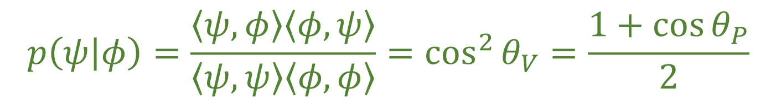

Vector space
Projective space
$$|z^{+}⟩$$
$$|z^{+}⟩$$
$$|y^{+}⟩$$
$$|x^{−}⟩$$
$$|x^{+}⟩$$
$$|y^{−}⟩$$
$$|z^{−}⟩$$
$$|z^{−}⟩$$
The physics is here!
$$\left\langle ψ,φ\right\rangle =\left|ψ\right|\left|φ\right|\cos{θ_{V}}e^{iφ}$$
$$p\left(ψ | φ\right)=\frac{\left\langle ψ,φ\right\rangle \left\langle φ,ψ\right\rangle }{\left\langle ψ,ψ\right\rangle \left\langle φ,φ\right\rangle }=\cos^{2}{θ_{V}}=\frac{1+\cos{θ_{P}}}{2}$$

Slide 11








Superposition of states $≠$ probability distribution
$$|z^{+}⟩$$
$$ı|z^{−}⟩$$
Superpositions are linear decompositions
$$\left|ψ\right\rangle =c_{+}\left|z^{+}\right\rangle +c_{−}\left|z^{−}\right\rangle$$
$$F=f_{x}e^{x}+f_{y}e^{y}$$
$$|z^{−}⟩$$
diagonal force is a superposition of vertical and horizontal force
$$|z^{+}⟩$$
$$|y^{+}⟩$$
$$|x^{−}⟩$$
$$|x^{+}⟩$$
$$|y^{−}⟩$$
Everything is a superposition of everything else
$\left|x^{+}\right\rangle =\sqrt{2}/2\left|z^{+}\right\rangle +\sqrt{2}/2|z^{−}⟩$
$$|z^{−}⟩$$
$\left|z^{+}\right\rangle =\sqrt{2}/2\left|x^{+}\right\rangle +\sqrt{2}/2|x^{−}⟩$

Slide 12
















Schrödinger equation – (unitary) time evolution
$$\left|ψ(t)\right\rangle =U\left(t\right)\left|ψ_{0}\right\rangle =e^{\frac{Ht}{ıℏ}}\left|ψ_{0}\right\rangle$$
$$H\left|ψ\right\rangle =ıℏ∂_{t}\left|ψ\right\rangle$$
diagonalized
$$H=\left[\begin{matrix}E_{1} & 0 \\ 0 & E_{0}\end{matrix}\right]$$
$$U\left(t\right)=e^{\frac{Ht}{ıℏ}}=\left[\begin{matrix}e^{\frac{E_{1}t}{ıℏ}} & 0 \\ 0 & e^{\frac{E_{0}t}{ıℏ}}\end{matrix}\right]$$
Hamiltonian
Time evolution operator
$$θ=θ_{1}−θ_{0}=\frac{\left(E_{1}−E_{0}\right)t}{ℏ}$$
$$ı\left|E_{1}\right\rangle$$
$$\left|E_{1}\right\rangle$$
$$ı\left|E_{0}\right\rangle$$
$$\left|E_{1}\right\rangle$$
$$E$$
$$θ_{1}=\frac{E_{1}t}{ℏ}$$
$$θ_{0}=\frac{E_{0}t}{ℏ}$$
$$θ$$
$$\left|E_{0}\right\rangle$$
$$|E_{0}⟩$$
$$E_{1}≥E_{0}$$

Slide 13
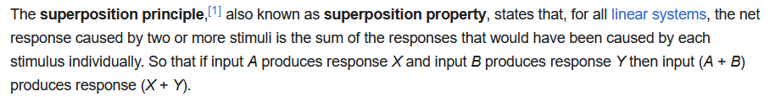

Superposition is a property of ANY linear system
https://en.wikipedia.org/wiki/Superposition_principle
Note: linearity is a property of the VECTOR space,
not of the projective space
Quantum superposition is NOT a physical property!
$\left|x^{+}\right\rangle =\sqrt{2}/2\left|z^{+}\right\rangle +\sqrt{2}/2|z^{−}⟩$
$\left|y^{+}\right\rangle =\sqrt{2}/2\left|z^{+}\right\rangle +ı\sqrt{2}/2|z^{−}⟩$
$\left|x^{−}\right\rangle =\sqrt{2}/2\left|z^{+}\right\rangle −\sqrt{2}/2|z^{−}⟩$
$\left|y^{−}\right\rangle =\sqrt{2}/2\left|z^{+}\right\rangle −ı\sqrt{2}/2|z^{−}⟩$
It is a property of the vector space representation
Coefficients are representation dependent

Slide 14







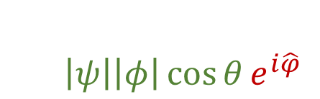
$$m\left(c_{1}\left|z^{+}\right\rangle +c_{2}\left|z^{−}\right\rangle \right)=c_{1}\left|z^{+}\right\rangle +c_{2}e^{ı\frac{\left|c_{2}\right|}{\sqrt{{\left|c_{1}\right|}^{2}+{\left|c_{2}\right|}^{2}}}}\left|z^{−}\right\rangle$$
$$|z^{+}⟩$$
phase shift that depends on both components
vector space
$$\cos{θ}=\frac{\left|c_{2}\right|}{\sqrt{{\left|c_{1}\right|}^{2}+{\left|c_{2}\right|}^{2}}}$$
$$θ$$
Non linear map
$$|z^{−}⟩$$
$m\left(\left|z^{+}\right\rangle \right)=\left|z^{+}\right\rangle m\left(\left|z^{−}\right\rangle \right)=e^{ı}\left|z^{−}\right\rangle$
$m\left(\left|z^{+}\right\rangle +\left|z^{−}\right\rangle \right)=\left|z^{+}\right\rangle +e^{ı/\sqrt{2}}\left|z^{−}\right\rangle$
Preserves the rays: colinear map
$$m\left(λ\left|ψ\right\rangle \right)=m\left(λ\left(c_{1}\left|z^{+}\right\rangle +c_{2}\left|z^{−}\right\rangle \right)\right)=m\left(\left(λc_{1}\right)\left|z^{+}\right\rangle +\left(λc_{2}\right)\left|z^{−}\right\rangle \right) \\ =λc_{1}\left|z^{+}\right\rangle +λc_{2}e^{ı\frac{\left|λc_{2}\right|}{\sqrt{{\left|λc_{1}\right|}^{2}+{\left|λc_{2}\right|}^{2}}}}\left|z^{−}\right\rangle =λc_{1}\left|z^{+}\right\rangle +λc_{2}e^{ı\frac{|λ|\left|c_{2}\right|}{|λ|\sqrt{{\left|c_{1}\right|}^{2}+{\left|c_{2}\right|}^{2}}}}\left|z^{−}\right\rangle =λm(\left|ψ\right\rangle )$$
$\left\langle m(ψ),m\left(φ\right)\right\rangle$ $=\left|ψ\right|\left|φ\right|\cos{θ}e^{i\hat{φ}}$
phase of the inner product will change

Slide 15
The main difference in quantum mechanics is not the use of complex vector spaces, but the use of projective spaces
A quantum state is not a vector in the Hilbert space, but a one-dimensional subspace, a complex plane (i.e. a “ray”)
For a spin 1/2 system, angles in Hilbert space are half the physical angles (half-sphere is “stretched” to a full sphere)
Superposition (linearity) is a property of the vector space, not of the projective space, and therefore not “fully” physical

