Slide 1

Open Problems in
Physical Mathematics
Gabriele Carcassi and Christine A. Aidala
Physics Department
University of Michigan

Slide 2
Outline
Goal: find people that are interested/willing to help
Very brief introduction to Assumptions of Physics, Reverse Physics and Physical Mathematics
Brief introduction to Ensemble Spaces as core structure required by all physical theories
Open problems

Slide 3
Introduction to the Assumptions of Physics research program

Slide 4





Main goal of the project
Identify a handful of physical starting points from which the basic laws can be rigorously derived
For example:
Infinitesimal reducibility $⇒$ Classical state
Irreducibility $⇒$ Quantum state
https://assumptionsofphysics.org
?
time
time
This also requires rederiving all mathematical structures
from physical requirements
For example:
Science is evidence based $⇒$ scientific theory must be characterized by experimentally verifiable statements $⇒$ topology and $σ$-algebras

Slide 5
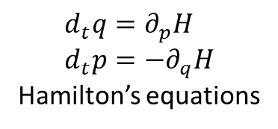


Types of things one does in the foundations of mathematics
$$⟺$$
Reverse mathematics
Axiom of Choice
Zorn’s lemma
Zermelo-Fraenkel set theory
Base theory
When the theorem is derived from the right axioms,
the axioms can be derived from the theorem
Friedman
Types of things we should do in the foundations of physics
Reverse physics
$$d_{t}q=∂_{p}H \\ d_{t}p=−∂_{q}H$$
Hamilton’s equations
$$⟺$$
Determinism and
reversibility
When the math is derived from the right physical assumptions,
the physical assumptions can be derived from the math
Classical states for one degree of freedom
Base theory

Slide 6
Physical world
(informal system)
Mathematical representation
(formal system)
Physical objects are “fuzzy”
Mathematical concepts are “crisper idealizations”
Mapping may not be unique
Some physical concepts may not be formalized
Physical specifications
Mathematical definitions
When physical objects are mapped to the right mathematical objects,
the physical specification maps to the mathematical definitions
Physical mathematics

Slide 7
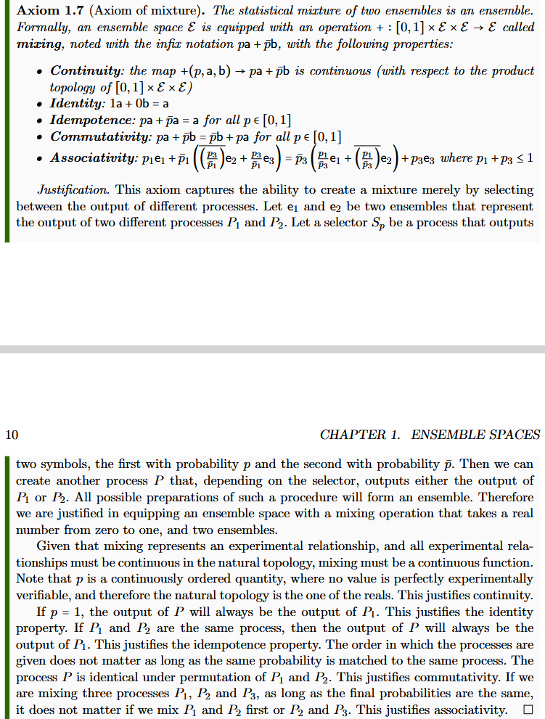
Informal intuitive requirement
(something that makes sense to a physicist or an engineer)

Slide 8
Informal intuitive requirement
(something that makes sense to a physicist or an engineer)
Formal definition
(something a mathematician will find precise)

Slide 9







Informal intuitive requirement
(something that makes sense to a physicist or an engineer)
Formal definition
(something a mathematician will find precise)
Show that the formal definition
follows from the intuitive requirement
$$P$$
Clear idea of what
is being modelled
$P_{1}$
$$e_{1}$$
$$S_{p}$$
$$pe_{1}+\left(1−p\right)e_{2}$$
$P_{2}$
$$e_{2}$$

Slide 10
Ensemble Spaces

Slide 11


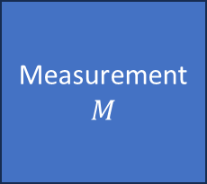




$⇒$ Scientific laws are relationships between ensembles
Preparation
$$P$$
Process
$$U$$
Measurement
$$M$$
$$e_{P}$$
$$e_{U}$$
$$e_{M}$$
Statistical
data
Initial
ensemble
Final
ensemble
Preparation
procedure
$$…$$
Ensemble of outputs

Slide 12
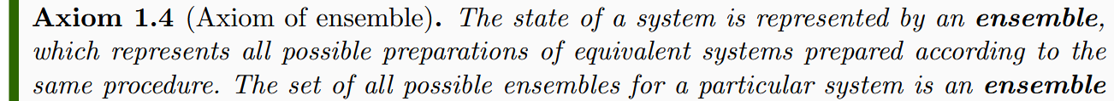
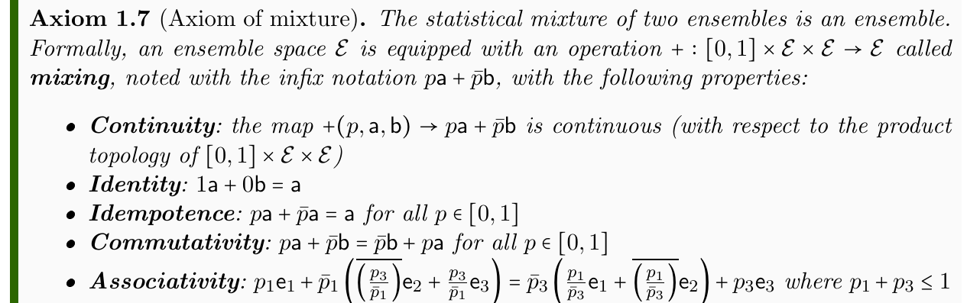
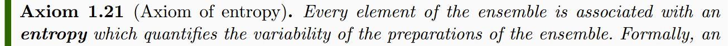



Minimal requirements for an ensemble space
Experimental verifiability $⇒$ Topology
Responsible for all topological structures
Ensembles can be mixed $⇒$ Convex structure
Responsible for all linear structures
Ensemble variability $⇒$Entropy
Responsible for all geometric structures
Still trying to find the right starting point for Poisson/commutator structure

Slide 13
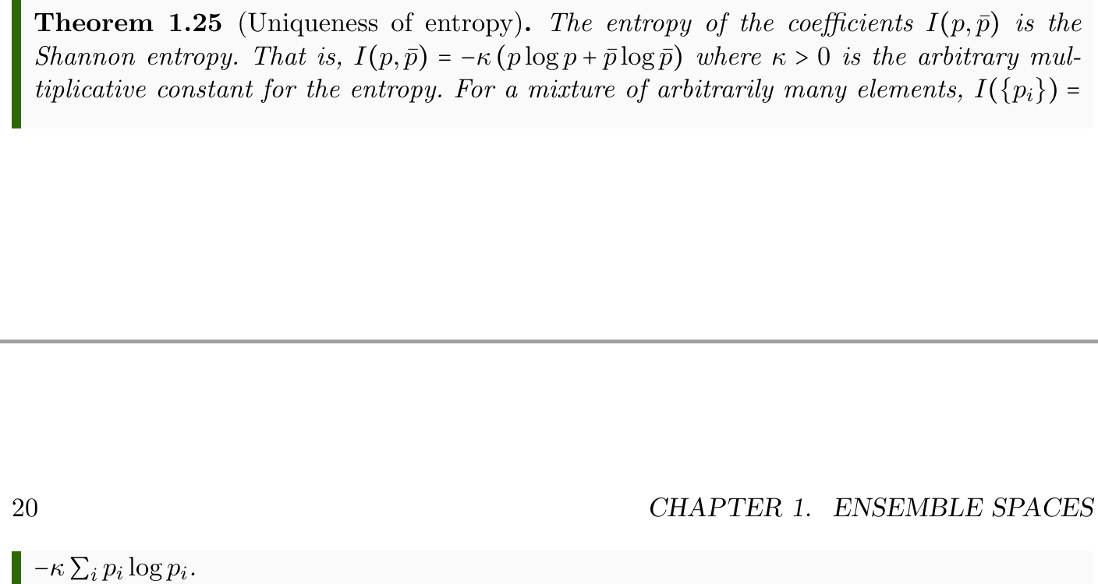
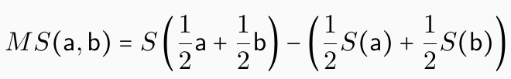


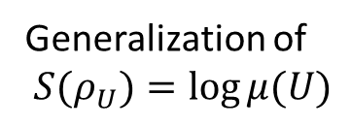
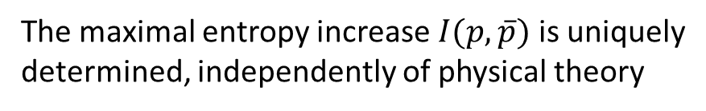
Some general results/constructions
The maximal entropy increase $I(p,\overline{p})$ is uniquely
determined, independently of physical theory
Ensembles embed into a vector space
Entropy increase during mixing generalizes
Jensen-Shannon Divergence (pseudo-distance)
Hessian of the entropy generalizes Fisher-Rao
metric from information geometry
Non-additive
generalization
of probability
Generalization of
$S(ρ_{U})=\log{μ(U)}$

Slide 14
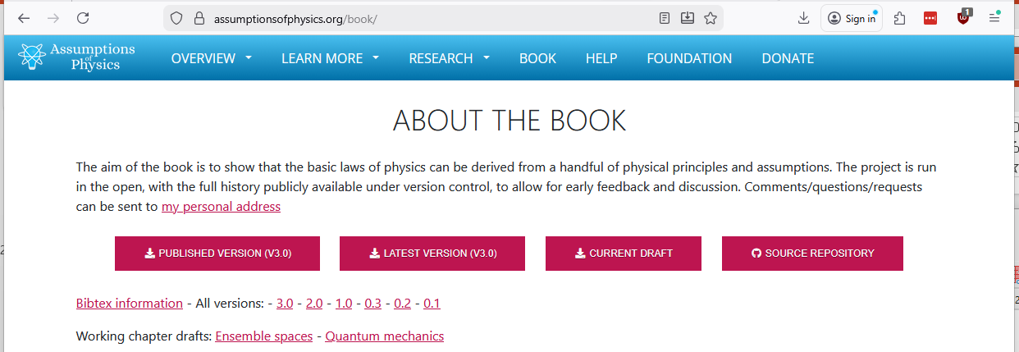
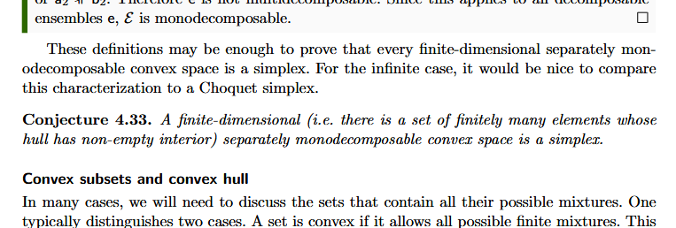
Many open problems and conjectures listed in the book
Book is open access/open source
Open problems and conjectures
are included in the book

Slide 15
Open problems

Slide 16
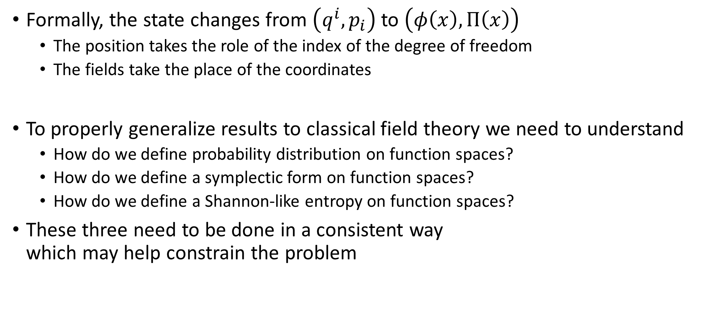
From classical mechanics to field theories
Formally, the state changes from $\left(q^{i},p_{i}\right)$ to $\left(φ\left(x\right), Π\left(x\right)\right)$
  The position takes the role of the index of the degree of freedom
  The fields take the place of the coordinates
To properly generalize results to classical field theory we need to understand
  How do we define probability distribution on function spaces?
  How do we define a symplectic form on function spaces?
  How do we define a Shannon-like entropy on function spaces?
These three need to be done in a consistent way
which may help constrain the problem

Slide 17
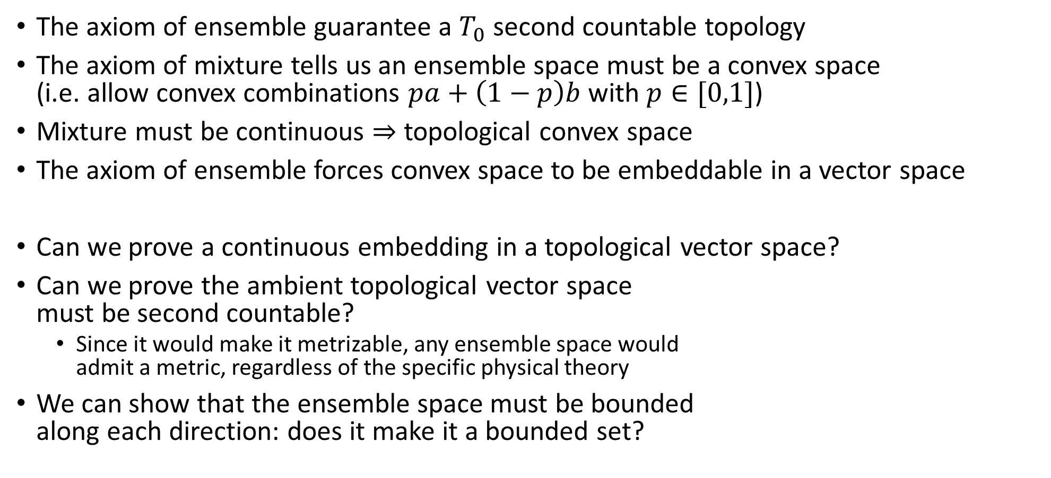
Topological convex spaces
The axiom of ensemble guarantee a $T_{0}$ second countable topology
The axiom of mixture tells us an ensemble space must be a convex space
(i.e. allow convex combinations $pa+\left(1−p\right)b$ with $p∈[0,1]$)
Mixture must be continuous $⇒$ topological convex space
The axiom of ensemble forces convex space to be embeddable in a vector space
Can we prove a continuous embedding in a topological vector space?
Can we prove the ambient topological vector space
must be second countable?
  Since it would make it metrizable, any ensemble space would
  admit a metric, regardless of the specific physical theory
We can show that the ensemble space must be bounded
along each direction: does it make it a bounded set?

Slide 18
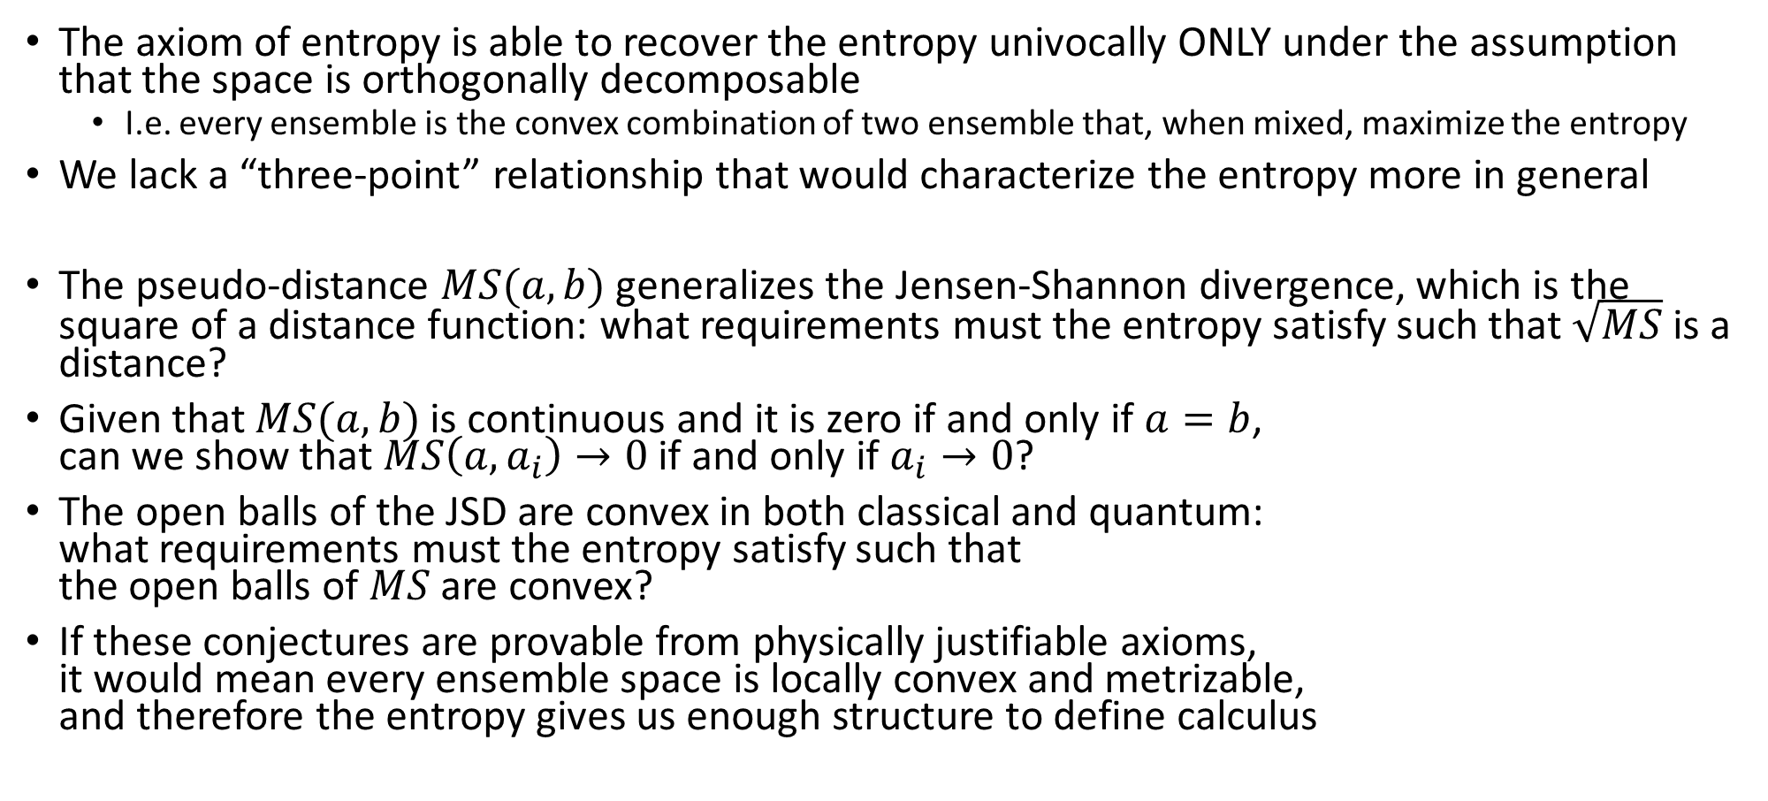
Entropy
The axiom of entropy is able to recover the entropy univocally ONLY under the assumption that the space is orthogonally decomposable
  I.e. every ensemble is the convex combination of two ensemble that, when mixed, maximize the entropy
We lack a “three-point” relationship that would characterize the entropy more in general
The pseudo-distance $MS(a,b)$ generalizes the Jensen-Shannon divergence, which is the square of a distance function: what requirements must the entropy satisfy such that $\sqrt{MS}$ is a distance?
Given that $MS(a,b)$ is continuous and it is zero if and only if $a=b$,
can we show that $MS\left(a,a_{i}\right)→0$ if and only if $a_{i}→0$?
The open balls of the JSD are convex in both classical and quantum:
what requirements must the entropy satisfy such that
the open balls of $MS$ are convex?
If these conjectures are provable from physically justifiable axioms,
it would mean every ensemble space is locally convex and metrizable,
and therefore the entropy gives us enough structure to define calculus

Slide 19
Lie algebraic structure
In both classical mechanics and quantum mechanics, relationships between generators and observables are given by a Lie algebra
  The Poisson brackets in classical mechanics
  The commutators in quantum mechanics
The symplectic nature of both spaces is tied to this structure, and with the identification of generators and observables
We need a generalization that work on a generic ensemble space
How can we define this structure on the ensembles, instead of the pure states?
What exactly is the relationship to the entropy? In both classical
and quantum mechanics, Hamiltonian evolution is connected to
conservation of entropy
How much of this structure is already contained in the
previous axioms? In classical mechanics, we saw that the
existence of the symplectic structure is equivalent to be able
to define an entropy on the states themselves, as opposed
to separately to each coordinate

Slide 20
Recover the points from the ensembles
In general, states do not necessarily correspond to ensembles. For example, given that position and momentum cannot be prepared with infinite precision, Dirac measures over the continuum are not ensembles
  They also would have minus infinite entropy
This means that, in general, the ensemble space does not contain its own extreme points
What recipe can we use to construct the extreme points?
  One attempt was to construct a lattice based on the notion
  of orthogonality as maximization of entropy during mixing,
  and use the Stone representation theorem for Boolean algebras,
  but this returns points that are too fine
  Are the points obtained from the statistical variable
  (i.e. from linear functionals?)

Slide 21
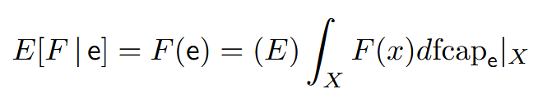
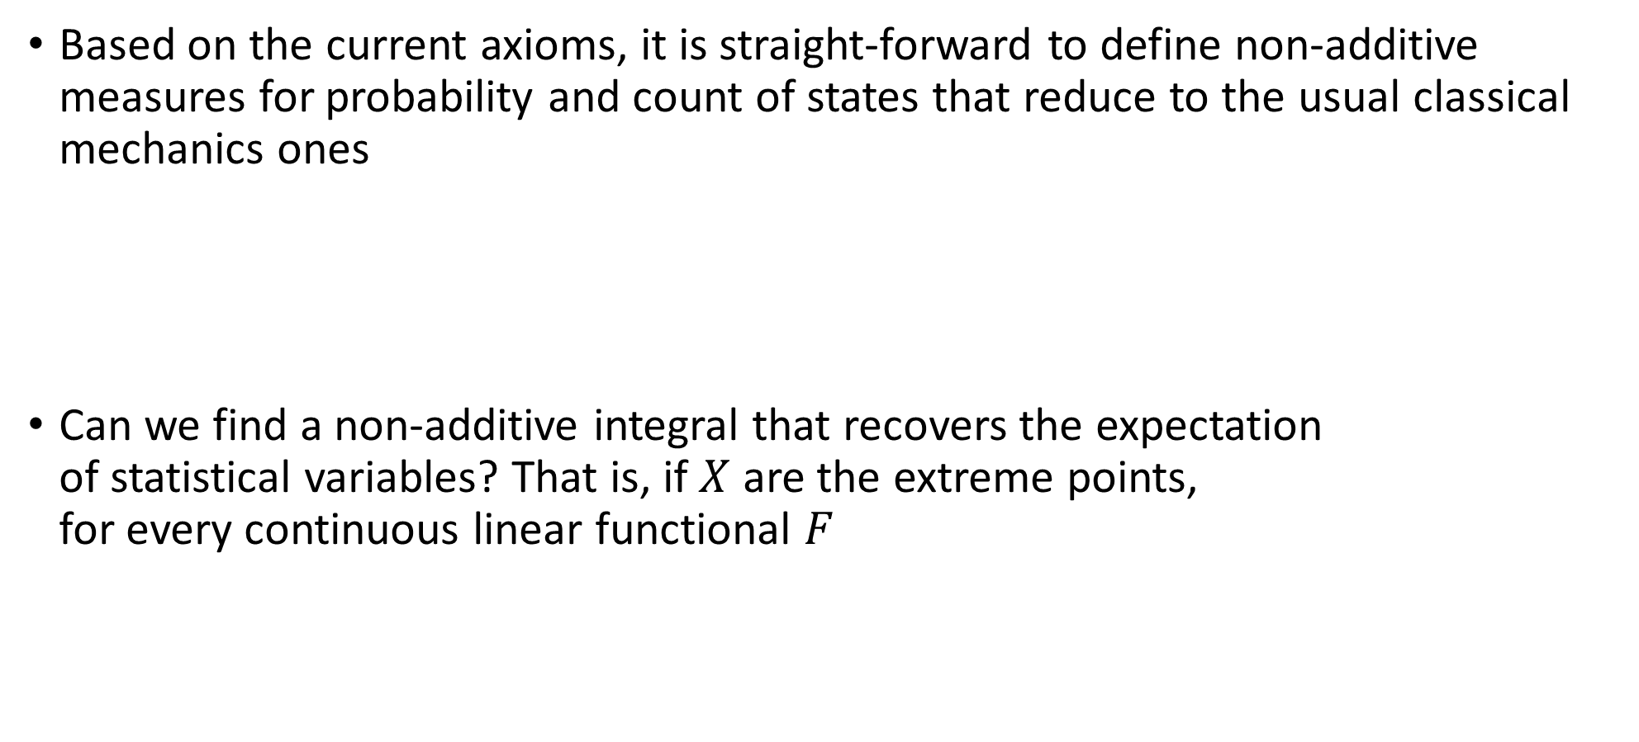
Non-additive measure theory
Based on the current axioms, it is straight-forward to define non-additive measures for probability and count of states that reduce to the usual classical mechanics ones
Can we find a non-additive integral that recovers the expectation
of statistical variables? That is, if $X$ are the extreme points,
for every continuous linear functional $F$

