Slide 1


The Assumptions of Physics project
Christine A. Aidala
Physics Department University of Michigan
Physics Grad Student Symposium
June 8, 2023
Led by Gabriele Carcassi + Christine A. Aidala
https://assumptionsofphysics.org/

Slide 2
Different approach to the foundations of physics
Typical approaches
Construct interpretations
Find ultimate theory
Measurement problem
Role of the observer
approximation
…
Quantum mechanics
Contextuality
Local realism
Weak interactions
QED -Electromagnetism
Ontology of observables
What “really” happens
QCD – Strong Interactions
Electro-weak
Our approach
General Relativity
Grand Unified Theory
Find a minimal set of physical assumptions from which to rigorously rederive the laws
General physical principles and requirements
General mathematical framework
Theory of Everything
Specific assumptions
Clarify our assumptions
Put physics back at the center of the discussion
Give science sturdier mathematical grounds
Foster connections between different fields of knowledge
Provide a way to pose deep questions
Classical mechanics
Quantum mechanics
derivation
Thermodynamics
…
specialization

Slide 3
Reverse physics: Start with the equations, reverse engineer physical assumptions/principles
Reverse Physics
Physics
Smallest set of assumptions required to rederive the theory
Physical theory
Physical result/ effect/prediction
Reverse Mathematics
Mathematics
Smallest set of axioms required to prove the theorem
Theorem
Mathematical result/ corollary/calculation
Goal: “Elevate” the discussion from mathematical constructs to physical principles, assumptions and requirements
Physical mathematics: Start from scratch and rederive all mathematical structures from physical requirements
Physics
Physical requirements
Semantics
Physical mathematics
Goal: Construct a perfect one-to-one map between mathematical and physical objects

Slide 4
Reverse physics
Reverse Physics: From Laws to Physical Assumptions
Gabriele Carcassi, Christine A. Aidala
Foundations of Physics (2022) 52:40
https://arxiv.org/abs/2111.09107

Slide 5














7 equivalent characterizations of Hamiltonian mechanics
one DOF
(1) Hamilton’s equations
(2) Divergenceless displacement
$$p$$
$$S^{q}=\frac{dq}{dt}=\frac{∂H}{∂p}$$
$$div\left(S^{a}\right)=\frac{∂S^{q}}{∂q}+\frac{∂S^{p}}{∂p}=0$$
$$q$$
$$S^{p}=\frac{dp}{dt}=−\frac{∂H}{∂q}$$
(3) Area conservation ($|J|$ = 1)
(4) Deterministic and reversible evolution
Area conservation $⟺$ state count conservation
(5) Deterministic and thermodynamically reversible evolution
$$dQdP=|J|dqdp$$
$⟺$ deterministic and reversible evolution
$$S=k_{B}\log{W}$$
(6) Information conservation
(7) Uncertainty conservation
Area conservation $⟺$ entropy conservation
$⟺$ thermodynamically reversible evolution
$$I\left[ρ\left(t+dt\right)\right]=I\left[ρ\left(t\right)\right]−∫ρ\log{|J|}dqdp$$
$$\left|Σ\left(t+dt\right)\right|=\left|J\right|\left|Σ\left(t\right)\right|\left|J\right|$$
for peaked distributions
A full understanding of classical mechanics means understanding these connections

Slide 6

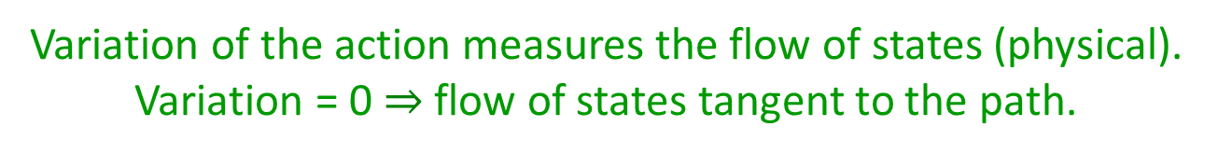
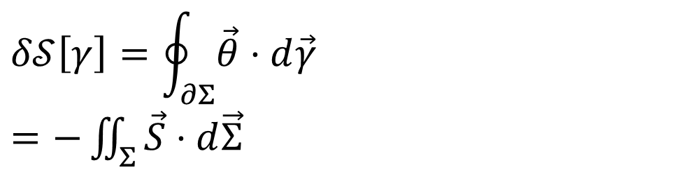


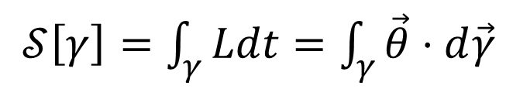





Reversing the principle of least action
$$∇⋅\vec{S}=0$$
$$\vec{S}=−∇×\vec{θ}$$
$𝒮\left[γ\right]=\int_{γ}{Ldt}=\int_{γ}{\vec{θ}⋅d\vec{γ}}$
No state is “lost” or “created” as time evolves
(Minus sign to match convention)
The action is the line integral of the vector potential (unphysical)
$$p$$
Variation of the action
$$q$$
$$Σ$$
$$δ𝒮\left[γ\right]=\oint_{∂Σ}{\vec{θ}⋅d\vec{γ}}$$ $=−\iint_{Σ}{\vec{S}⋅d\vec{Σ}}$
$$γ$$
Gauge independent, physical!
$$γ′$$
$$t$$
Variation of the action measures the flow of states (physical). Variation = 0 $⇒$ flow of states tangent to the path.
https://arxiv.org/abs/2208.06428

Slide 7







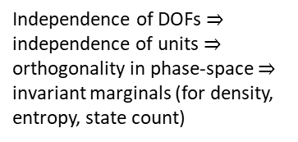

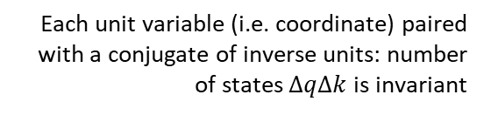

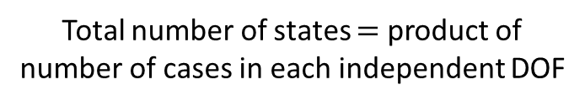




Reversing phase-space
Each unit variable (i.e. coordinate) paired with a conjugate of inverse units: number of states $ΔqΔk$is invariant
$\hat{q}=100 cm/m q$
$$x↦x^{3}$$
$$1$$
$Δk=1 m^{−1}$
$$1$$
$Δ\hat{k}=0.01 cm^{−1}$
$$x$$
$$x^{3}$$
$Δ\hat{q}=100 cm$
$Δq=1 m$
Density, entropy, uniform distributions NOT in general coordinate invariant
Phase space (symplectic) structure is the only one that supports coordinate invariant density, entropy, state count
Independence of DOFs $⇒$ independence of units $⇒$ orthogonality in phase-space $⇒$ invariant marginals (for density, entropy, state count)
Hamiltonian mechanics preserves count of states and DOF independence over time
$$(q^{y},k_{y})$$
Directional DOF
$$ω_{ab}=\left[\begin{matrix}0 & 1 \\ −1 & 0\end{matrix}\right]⊗δ_{j}^{i}$$
$$(q^{x},k_{x})$$
Orthogonality/independence across DOFs
Total number of states $=$ product of number of cases in each independent DOF
Symplectic form (geometric structure of phase space)
Areas/possibilities in each DOF
2-sphere the only symplectic manifold
Only 3 spatial dimensions are possible
Invariance at equal time (relativity) gives us the structure of phase space

Slide 8
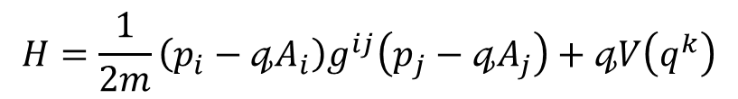
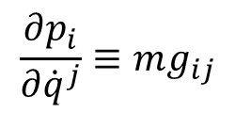
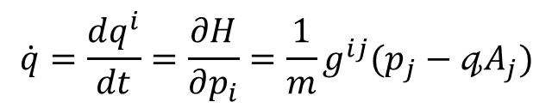

Massive particles under potential forces
Kinematic equivalence assumption: the state can be recovered from space-time trajectories
Integration of the previous expression
$$p_{i}=mg_{ij}{\dot{q}}^{j}+𝓆A_{i}\left(q^{k}\right)$$
$$\dot{q}=\frac{dq^{i}}{dt}=\frac{∂H}{∂p_{i}}=\frac{1}{m}g^{ij}(p_{j}−𝓆A_{j})$$
$$\frac{∂p_{i}}{∂{\dot{q}}^{j}}≡mg_{ij}$$
Must be a linear transformation in terms of coordinates
$$H=\frac{1}{2m}\left(p_{i}−𝓆A_{i}\right)g^{ij}\left(p_{j}−𝓆A_{j}\right)+𝓆V\left(q^{k}\right)$$
Fixes the units
Hamiltonian for massive particles under potential forces
Mass quantifies number of states per unit of velocity
Higher mass $⇒$ more states to go through $⇒$ harder to accelerate
The laws themselves are highly constrained by simple assumptions
BUT
Zero mass $⇒$ zero states within finite range of velocity $⇒$ velocity is fixed

Slide 9




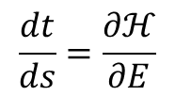


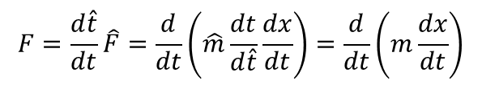



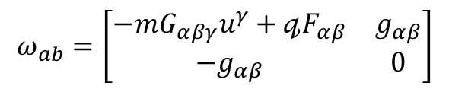
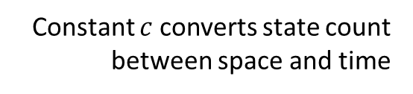


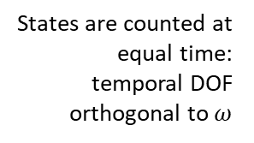

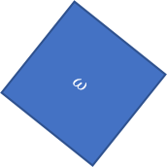


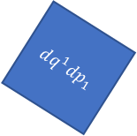
Relativistic mechanics
Relativistic aspects without space-time (i.e. without Kinematic Equivalence)
Classical antiparticles
$$p$$
potential of the displacement
$$F=\frac{d\hat{t}}{dt}\hat{F}=\frac{d}{dt}\left(\hat{m}\frac{dt}{d\hat{t}}\frac{dx}{dt}\right)=\frac{d}{dt}\left(m\frac{dx}{dt}\right)$$
$$q$$
$$\frac{dt}{ds}=\frac{∂ℋ}{∂E}$$
$$θ=[p^{i},−H,0, 0]$$
$$t$$
energy-momentum co-vector
rest mass scaled by time dilation
Affine parameter anti-aligned with time:
parameterization “goes back” in time
Geometric connections
Metric tensor quantifies states charted by position and velocity
Lorentzian relativity is the only “correct” one
Force quantifies states charted by position across DOF
$$θ=[mg_{αβ}u^{β}+𝓆A_{α},0]$$
Minkowski signature appears on the extended phase space
$$ω_{ab}=\left[\begin{matrix}−mG_{αβγ}u^{γ}+𝓆F_{αβ} & g_{αβ} \\ −g_{αβ} & 0\end{matrix}\right]$$
$$ω=dq^{1}dp_{1}+dq^{2}dp_{2}$$
$$ω=dq^{1}dp_{1}−dtdE$$
$$t$$
instants in time
$$ω$$
$$dq^{1}dp_{1}=ω+dtdE$$
$$dq^{2}dp_{2}$$
States are counted at equal time: temporal DOF orthogonal to $ω$
No clear idea what $G_{αβγ}$ is…
Inertial forces?
positions in space
$$dq^{1}dp_{1}$$
$$q$$
$$dq^{1}dp_{1}$$
$$dtdE$$
Constant $c$ converts state count between space and time
$$ω$$
Indep DOF are orthogonal

Slide 10

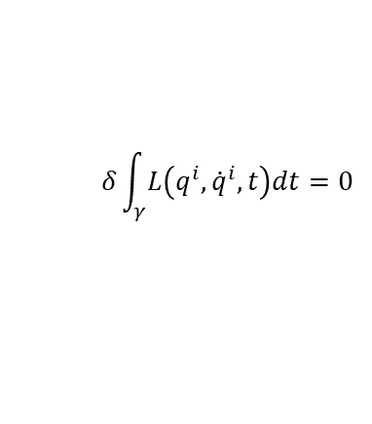










Assumptions of classical mechanics
Newtonian Mechanics
Hamiltonian Mechanics
Lagrangian Mechanics
(IR) Infinitesimal reducibility
$$[q^{i},p_{i}]$$
Classical Phase Space
$$\frac{dq^{i}}{dt}=\frac{∂H}{∂p_{i}}$$
$$\frac{dp_{i}}{dt}=−\frac{∂H}{∂q^{i}}$$
+
Hamiltonian Mechanics
$$δ\int_{γ}{L\left(q^{i},{\dot{q}}^{i},t\right)dt}=0$$
(IND) Degree of freedom independence
+
Lagrangian Mechanics
(DR) Determinism /Reversibility
+
$$ρ_{1}ρ_{2}⇒ρ$$
weak
$$p$$
(KE) Kinematic Equivalence
full
+
$$q$$
Massive particles under potential forces
$$p$$
$$z$$
$$y$$
$$q$$
$$x$$
$$H=\frac{1}{2m}\left(p_{i}−qA_{i}\right)g^{ij}\left(p_{j}−qA_{j}\right)+qV$$

Slide 11
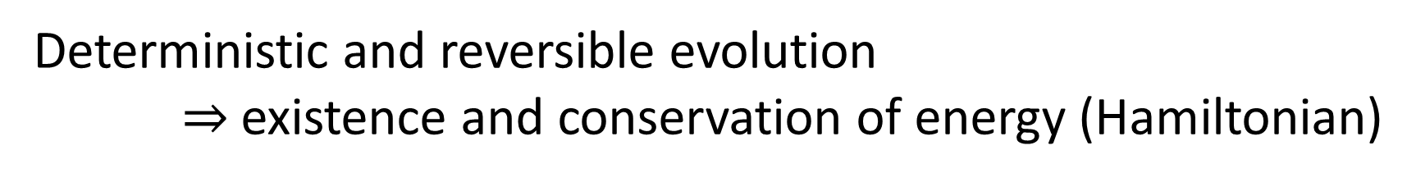
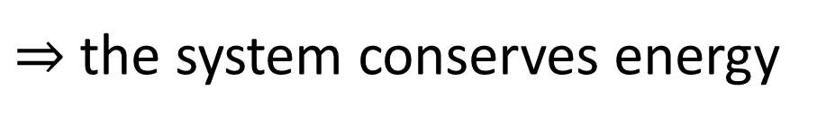
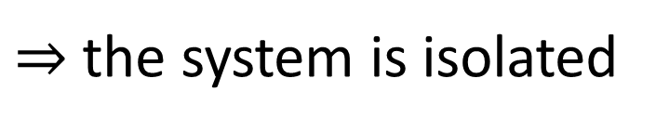
Reverse physics: Understanding links between theories
Deterministic and reversible evolution $⇒$existence and conservation of energy (Hamiltonian)
Why?
Stronger version of the first law of thermodynamics
Deterministic and reversible evolution
$⇒$ past and future depend only on the state of the system
$⇒$ the evolution does not depend on anything else
$⇒$ the system is isolated
First law of thermodynamics!
$⇒$ the system conserves energy
Notes:
Structure of phase space exactly what is needed to do statistical mechanics - Comes out of invariance of the entropy under coordinate transformations

Slide 12
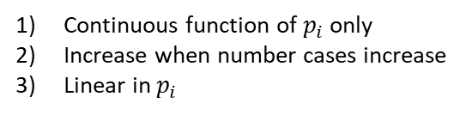
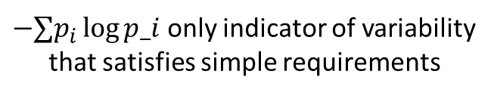


Shannon entropy as variability
Is it alive?
more variability
$−∑p_{i}\log{p_i}$ only indicator of variability that satisfies simple requirements
Is it human made?
Does it live on land?
Continuous function of $p_{i}$ only
Increase when number cases increase
Linear in $p_{i}$
…
…
less variability
Efficient game of twenty questions
…
…
More variability, more questions
Shannon entropy quantifies the variability of the elements within a distribution
Variability is quantified by the expected minimum number of questions required to identify an element
$$W$$
…
Meaning depends on the type of distribution
Statistical distribution: variability of what is there
$$\frac{1}{N}\log{W}≈−∑p_{i}\log{p_{i}}$$
More variability for a distribution at equilibrium, more fluctuations, more physical entropy
?
More variability, more permutations
Probability distribution: variability of what could be there
Variability is also quantified by the logarithm of the number of possible permutations per element
?
Credence distribution: variability of what one believes to be there
This characterization works across disciplines
Eur. J. Phys. 42, 045102 (2021)

Slide 13
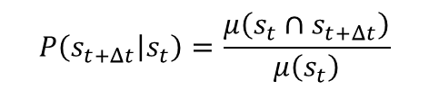

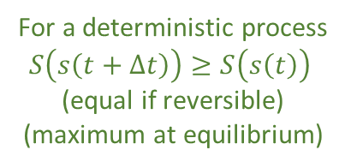


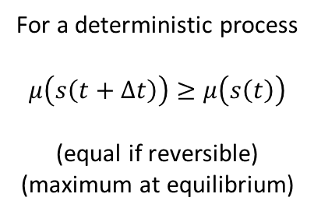


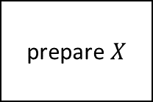


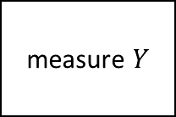


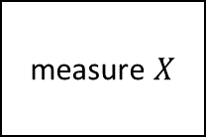


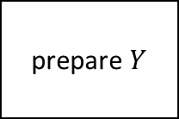
Entropy as logarithm of evolution count
$$P\left(s_{t+Δt} | s_{t}\right)=\frac{μ\left(s_{t}∩s_{t+Δt}\right)}{μ\left(s_{t}\right)}$$
$$μ=2$$
$$μ=1$$
$$μ=2$$
Determinism: evolutions cannot split $μ\left(s\left(t+Δt\right)\right)≥μ\left(s\left(t\right)\right)$
Reversibility: evolutions cannot merge $μ\left(s\left(t+Δt\right)\right)≤μ\left(s\left(t\right)\right)$
$$t−Δt$$
$$t$$
$$t+Δt$$
For a deterministic process
$$μ\left(s\left(t+Δt\right)\right)≥μ\left(s\left(t\right)\right)$$
(equal if reversible)
(maximum at equilibrium)
Process entropy defined as $S=\log{μ}$
The log of the count of evolutions per state
It is additive for independent systems
$$S=S_{1}+S_{2}$$
$$t−Δt$$
$$t$$
$$t+Δt$$
For a deterministic process
$S\left(s\left(t+Δt\right)\right)≥S\left(s\left(t\right)\right)$ (equal if reversible)
(maximum at equilibrium)
System independence: evolutions of the composite are the product of individual systems
$$\left\{x\left(t\right),y\left(t\right)\right\}$$
prepare $X$
inter-action
measure $X$
$$x(t)$$
prepare $Y$
measure $Y$
$$y(t)$$
The flow of the displacement field and Shannon entropy also agree with this definition (respectively, for det/rev evolution and at equilibrium)

Slide 14

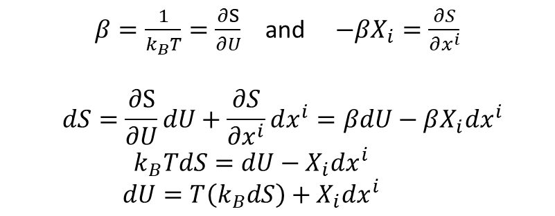

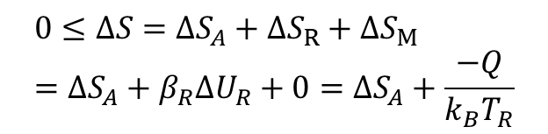


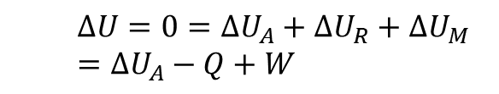




“Reversing” thermodynamics
Assume states are equilibria of faster scale processes
$β=\frac{1}{k_{B}T}=\frac{∂S}{∂U}$ and $−βX_{i}=\frac{∂S}{∂x^{i}}$
$$dS=\frac{∂S}{∂U}dU+\frac{∂S}{∂x^{i}}dx^{i}=βdU−βX_{i}dx^{i} \\ k_{B}TdS=dU−X_{i}dx^{i} \\ dU=T\left(k_{B}dS\right)+X_{i}dx^{i}$$
Define intensive quantities
Assume states identified by extensive properties
Assume one of these quantities is energy $U$
$$S(U,x^{i})$$
Existence of equation of state
Recover usual relationships
Study interplay of changes of energy and entropy
$$ΔU=0=ΔU_{A}+ΔU_{R}+ΔU_{M} \\ =ΔU_{A}−Q+W$$
First law recovered from existence and conservation of Hamiltonian
$$R$$
Reservoir: energy only state variable, entropy linear function of energy
Recover first law
All energy stored in entropy
Second law recovered from definition of entropy as count of evolutions
$$Q$$
$$0≤ΔS=ΔS_{A}+ΔS_{R}+ΔS_{M} \\ =ΔS_{A}+β_{R}ΔU_{R}+0=ΔS_{A}+\frac{−Q}{k_{B}T_{R}}$$
Mechanical system: same entropy for all states
$$A$$
$$M$$
$$W$$
No energy stored in entropy
Recover second law
$$β=\frac{1}{k_{B}T}=0$$

Slide 15




3rd law and principle of maximal description
Can be formulated as:
$$μ=3$$
Count of evolutions
Every substance has a finite positive entropy, but at the absolute zero of temperature the entropy may become zero, and does so become in the case of perfect crystalline substances.
$S=\log{μ(x)}$
Count of evolution can’t be $<1$ therefore $S$ can’t be $<0$
G. N. Lewis and M. Randall
Better “special case” than “crystalline substance”
3rd law can be restated as:
No state can describe a system more accurately than stating the system is not there in the first place.
Null state $∅$: system is absent (e.g. gas with zero particles)
$$A=A∪∅$$
Principle of maximal description
$S_{A}=S_{A∪∅}=S_{A}+S_{∅}⇒S_{∅}=0$
Entropy for the null state of any system must be $0$
We can reformulate the 3rd law of thermodynamics as a logical necessity

Slide 16




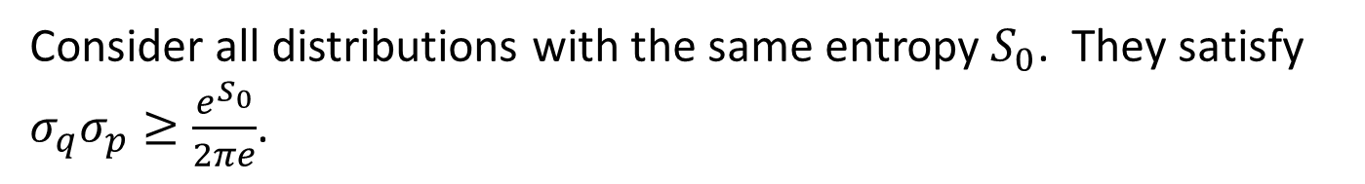

$$S=−∫ρ\log{ρ}$$
Classical uncertainty principle
NB: Quantum mechanics has a lower bound on entropy: zero for a pure state.
Classical mechanics has no lower bound on entropy $⇒$ violates third law! What happens if we impose one?
Take the space of all possible distributions $ρ\left(q,p\right)$ and order them by Shannon/Gibbs entropy
Consider all distributions with the same entropy $S_{0}$. They satisfy $σ_{q}σ_{p}≥\frac{e^{S_{0}}}{2πe}$.
$$S_{0}$$
Equality for independent Gaussians
Lower bound on entropy $⇒$ lower bound on uncertainty
$$σ_{q}σ_{p}$$
Don’t need the full quantum theory to derive the uncertainty principle: only the lower bound on entropy
The difference is that in classical mechanics we can prepare ensembles with arbitrarily low entropy…in contradiction with the third law of thermodynamics!!

Slide 17
3rd law of thermodynamics and uncertainty principle
Classical mechanics
Third law of thermodynamics
Lower bound on entropy
+
Uncertainty principle
Quantum mechanics
Principle of maximal description
No state can describe a system more accurately than stating the system is not there in the first place
We can understand the uncertainty principle as a consequence of the third law
Can we understand the rest of quantum mechanics in the same way?

Slide 18





















Quantum mechanics as irreducibility
Minimum uncertainty
Classical
Quantum
$$p$$
Entropy
$$q$$
?
time
0
time
Can’t squeeze ensemble arbitrarily
Can prepare ensembles at arbitrarily low entropy: we can study arbitrarily small parts
Entropy is bounded at zero: we cannot study parts
Non-locality
We always have access to the internal dynamics
No access to the internal dynamics
Can’t refine ensembles $⇒$ Can’t interact with parts
Superluminar effects that can’t carry information
Probability of transition
Projections are processes with equilibria (eigenstates)
$$\left|x^{+}\right\rangle$$
$$\left|y^{+}\right\rangle$$
Linear
$${\left|\left\langle ψ | φ_{i}\right\rangle \right|}^{2}$$
$𝒫$
$$\left|φ_{1}\right\rangle$$
$𝒫$
$$\left|φ_{1}\right\rangle$$
$$\left|x^{−}\right\rangle$$
$$\left|y^{−}\right\rangle$$
$$\left|ψ\right\rangle$$
$$\left|φ_{2}\right\rangle$$
$$\left|φ_{2}\right\rangle$$
Can’t refine ensembles $⇒$ Can’t extract information
$$\left|φ_{3}\right\rangle$$
$$\left|φ_{3}\right\rangle$$
$$p\left(x^{+} | y^{−}\right)=p(y^{−}|x^{+})$$
$$\left|φ_{4}\right\rangle$$
$$\left|φ_{4}\right\rangle$$
Symmetry of the inner product
Idempotent

Slide 19
QM postulates revisited
$⇒$ Recover mathematical structure of quantum mechanics from properties of ensembles
State postulate: quantum states are rays of a Hilbert space
Linearity of Hilbert space can be recovered from rules of ensemble mixing
Measurement postulate: projection measurement and Born rule
Projections as processes with equilibria
Born rule recoverable from entropy of mixing
Composite system postulate: tensor product for composite system
Derived from other postulates
PRL 126, 110402 (2021)
Evolution postulate: unitary evolution (Schrödinger equation)
Deterministic/reversible evolution

Slide 20

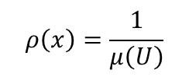








Entropic nature of physical theories
Thermodynamics/Statistical mechanics are not built on top of mechanics
Mechanics is the ideal case of thermodynamics/statistical mechanics
Best preparation $⇒$ pure state
Best process $⇒$ map between pure states
$$μ\left(U\right)$$
Standard probability
$$ρ\left(x\right)=\frac{1}{μ\left(U\right)}$$
The geometric structure of both classical and quantum mechanics is ultimately an entropic structure
Symplectic manifold
$ρ$ uniform over $U$
Information theory
$$H\left(ρ\right)=\log{μ\left(U\right)}$$
We can never prepare/measure pure states. We can only prepare/measure ensembles.
$$\left\langle ψ | φ\right\rangle$$
Quantum probability
$$p\left(ψ | φ\right)={\left|\left\langle ψ | φ\right\rangle \right|}^{2}$$
Projective Hilbert space
It makes sense that ensembles can offer a unified way of thinking about both classical and quantum mechanics.
$$ρ=\frac{1}{2}ρ_{ψ}+\frac{1}{2}ρ_{φ}$$
Quantum information theory
$$H\left(ρ\right)=H\left(\frac{1+\sqrt{p}}{2},\frac{1−\sqrt{p}}{2}\right)$$

Slide 21
Space of the well-posed scientific theories
Physical theories
Specializations of the general theory under the different assumptions
Hamiltonian mechanics
Unitary evolution
Quantum state-space
Classical phase-space
Assumptions
Infinitesimal reducibility
Determinism/
reversibility
Irreducibility
States and processes
General theory
Informational granularity
Basic requirements and definitions valid in all theories
Experimental verifiability

Slide 22
Physical mathematics

Slide 23
Physical mathematics
In modern physics, mathematics is used as the foundation of our physical theories
Mathematical content of a theory can never tell us the full physical content
From Hossenfelder’s Lost in Math: “[…] finding a neat set of assumptions from which the whole theory can be derived, is often left to our colleagues in mathematical physics […]”
David Hilbert: “Mathematics is a game played according to certain simple rules with meaningless marks on paper.”
Bertrand Russell: “It is essential not to discuss whether the first proposition is really true, and not to mention what the anything is, of which it is supposed to be true.”
Physics is defined in terms of physical objects and operational definitions
Informal
Formal
The only way we can have a full understanding of a physical theory is if ALL formal structures are strictly justified by physical requirements
physics
math
Under assumptions, idealizations and approximations, physical objects and their properties are expressed with a formal system through axioms and definitions.
Physics
We need to identify which parts of mathematics are “correct” to capture physical properties in a specific realm of applicability
All physical content is captured by the definitions and axioms
Physical requirements
Semantics
Physical mathematics

Slide 24


Examples: symplectic space and probability spaces
Hamiltonian mechanics
Phase space (symplectic manifold)
Hamiltonian evolution
Differentiable manifold
Symplectic structure
Manifold
Differentiable structure
Determinism/reversibility
Observer independent count of states
Topological space
Locally $ℝ^{n}$
Infinitesimal reducibility
Experimentally distinguishable cases with verifiable statements
Identified by independent continuous quantities
Probability space
Set of points
$σ$-algebra
Measure
We can see what each additional mathematical layer represents and under what assumptions
Experimentally distinguishable cases
Statements associated with experimental tests
Probability that a statement is true

Slide 25







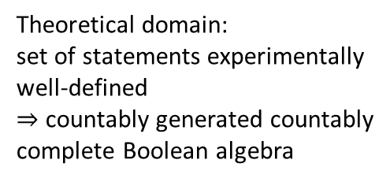




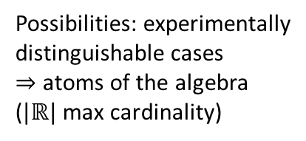

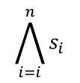


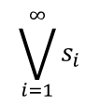
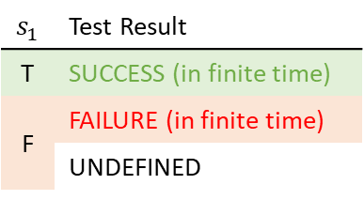

Logic of experimental verifiability
verifiable statements
$$𝒮$$
Finite conjunction (logical AND)
$$\bigwedge_{i=i}^{n}{s_{i}}$$
$$s_{1}$$ | Test Result
T | SUCCESS (in finite time)
F | FAILURE (in finite time)
 | UNDEFINED
$$s_{1}$$
$$s_{2}$$
$$s_{3}$$
$$𝒮_{\text{v}}$$
All tests must succeed
statements
$$s_{1}$$
Countable disjunction (logical OR)
$$\bigvee_{i=1}^{∞}{s_{i}}$$
experimental test
$$s_{1}$$
$$s_{2}$$
$$s_{3}$$
$$…$$
Physical theories (evidence based)
$⇒$ all theoretical statements associated with tests
One successful test is sufficient
Theoretical domain: set of statements experimentally well-defined
$⇒$ countably generated countably complete Boolean algebra
Operator | Gate | Statement | Theoretical Statement | Verifiable Statement | Decidable Statement
Negation | NOT | allowed | allowed | disallowed | allowed
Conjunction | AND | arbitrary | countable | finite | finite
Disjunction | OR | arbitrary | countable | countable | finite
$$𝒮_{d}$$
$$𝒮_{v}$$
$$𝒮_{t}$$
$$𝒮$$
Possibilities: experimentally distinguishable cases $⇒$ atoms of the algebra ($|ℝ|$ max cardinality)
Mathematical theories (formally well-posed) have “too many statements” to be physically meaningful

Slide 26
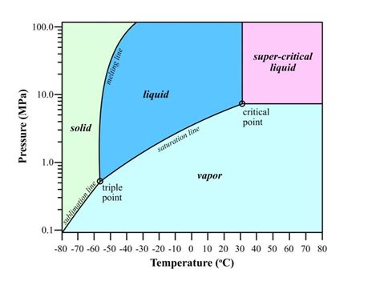

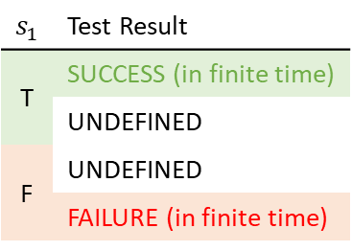


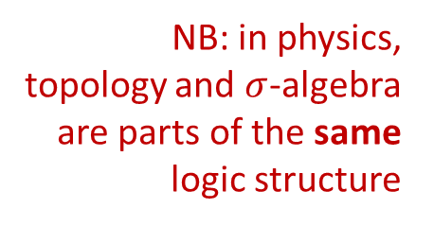





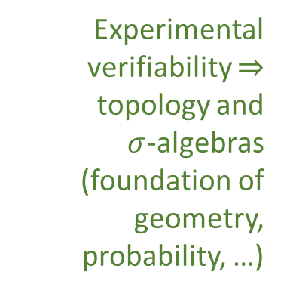

Topology and $σ$-algebra
Experimental verifiability $⇒$ topology and $σ$-algebras (foundation of geometry, probability, …)
Theoretical statements
$int(A)$ corresponds to the verifiable part of a statement
$$s_{1}$$ | Test Result
T | SUCCESS (in finite time)
 | UNDEFINED
F | UNDEFINED
 | FAILURE (in finite time)
Verifiable statements
Possibilities
$∂A$ corresponds to the undecidable part of a statement
$ext(A)$ corresponds to the falsifiable part of a statement
Open sets
Points
Open set $(\text{5}\text{09.5, 510.5})$ $⟺$ Verifiable “the mass of the electron is 510 $±$ 0.5 KeV”
Borel sets
Closed set $[510]$ $⟺$ Falsifiable “the mass of the electron is exactly 510 KeV”
Borel set $ℚ$ ($int\left(ℚ\right)∪ext\left(ℚ\right)=∅$) $⟺$Theoretical “the mass of the electron in KeV is a rational number” (undecidable)
Inference relationship $𝓇:𝒟_{Y}→𝒟_{X}$ such that $𝓇\left(s\right)≡s$
Perfect map between math and physics
$$𝒟_{X}$$
$$𝒟_{Y}$$
Topologically continuous consistent with analytic discontinuity on isolated points
Inference relationship $$⟺$$ Causal relationship
Relationships must be topologically continuous
NB: in physics, topology and $σ$-algebra are parts of the same logic structure
$$X$$
$$Y$$
Causal relationship $f:X→Y$ such that $x≼f\left(x\right)$
Phase transition $⟺$ Topologically isolated regions

Slide 27







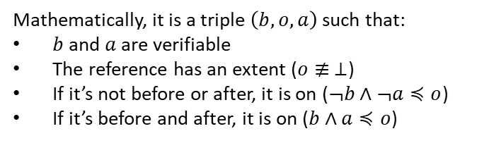










Quantities and ordering
Goal: deriving the notion of quantities and numbers (i.e. integers, reals, …) from an operational (metrological) model
A reference (i.e. a tick of a clock, notch on a ruler, sample weight with a scale) is something that allows us to distinguish between a before and an after
before
on
after
Mathematically, it is a triple $\left(b,o,a\right)$ such that:
$b$ and $a$ are verifiable
The reference has an extent ($o≢ ⊥$)
If it’s not before or after, it is on ($¬b∧¬a≼o$)
If it’s before and after, it is on ($b∧a≼o$)
Numbers defined by metrological assumptions, NOT by ontological assumptions
Dense
$$o_{1}$$
$$o_{3}$$
$$o_{2}$$
$$⇒ \left(X,≤\right)≅(ℝ,≤)$$
To define an ordered sequence of possibilities, the references must be (nec/suff conditions):
+
The hard part is to recover ordering. After that, recovering reals and integers is simple.
Strict
Aligned
Refinable
Sparse
before
on
after
$$b_{2}$$
$$a_{2}$$
$$o_{3}$$
$$o_{1}$$
$$o_{2}$$
$$o_{2}$$
$$⇒ \left(X,≤\right)≅(ℤ,≤)$$
$$o_{1}$$
$$o_{2}$$
$$o_{1}$$
$$b_{1}$$
$$a_{1}$$
Assumptions untenable at Planck scale: no consistent ordering: no “objective” “before” and “after”
$$⇒ \left(X,≤\right)$$
Physica Scripta 95, 084003 (2020)

Slide 28










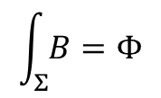






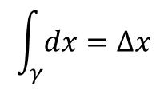

Differentiability in physics
Mathematicians have developed several, increasingly abstract, definitions for differentials, derivatives, integrations, tangent vectors… which one is best for physics?
E.g. in differential topology/geometry
$$dx:V→ℝ$$
$$B:V×V→ℝ$$
$$v:C^{∞}\left(X,ℝ\right)→C^{∞}\left(X,ℝ\right)$$
vector basis
$$dx\left(v\right)=dx\left(v^{i}∂_{i}\right)=v^{x}$$
$$B\left(v,w\right)=B_{ij}v^{i}w^{j}$$
$$v\left(f\right)=v^{i}∂_{i}f$$
$$\int_{γ}{dx}=Δx$$
$$\int_{Σ}{B}=Φ$$
Differential forms are functions of derivations
Vector defined as derivation
Does not make sense physically!
momentum is not a function of a derivation
Integrals defined on top of forms
velocity is not a derivation
derivations $∂_{i}$ depend on units: can’t be summed
infinitesimal objects are the limit of finite objects, not the other way around
Infinitesimal reducibility $⇒$ differentiability
Time
Space
Temperature
Infinitesimal linear change
Differentiable function: infinitesimal changes map to infinitesimal changes
t
$$x(t)$$
x
T$(x)$
T
$$dv=\left(v_{1},v_{2},v_{3},…\right)$$
Quantity
$$\lim_{i→∞}{\frac{v_{i}}{a_{i}}}=t$$
Tangent vector
Convergence at all points $⇒$ differentiability of curve
dt
$$\frac{dx}{dt}$$
dx
$$\frac{dT}{dx}$$
dT
Differentiable space: infinitesimal changes are well-defined
Differential
Infinitesimal surface change
$$dσ=\left((v_{1}⊗w_{1}),(v_{2}⊗w_{2}), …\right)$$
Derivative: map between differentials
$$\lim_{i→∞}{\frac{v_{i}⊗w_{i}}{a_{i}}}=t$$
$$dx^{i}=\frac{dx^{i}}{dt}dt$$
$$dT=\frac{∂T}{∂x^{i}}dx^{i}$$
velocity (vector)
gradient (covector)

Slide 29
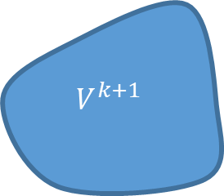







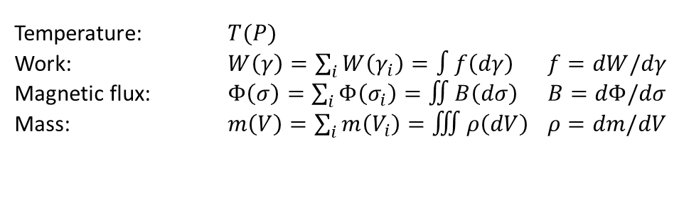

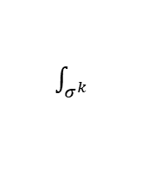










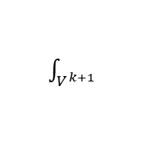
Differentiability: forms and linear functionals
Starting point: finite values defined on finite regions
$k$-functional
$k$-surface
$k$-form
$k$-vector
$$f_{k}\left(σ^{k}\right)=∫θ_{k}(dσ^{k})$$
Thinking in terms of relationships between finite objects leads to better physical intuition
Physically measurable quantities
zero-form
Differential forms: infinitesimal limit
Temperature: $T(P)$
Work: $W\left(γ\right)=\sum_{i}{W\left(γ_{i}\right)}=∫f\left(dγ\right)$ $f=dW/dγ$
Magnetic flux: $Φ\left(σ\right)=\sum_{i}{Φ\left(σ_{i}\right)}=∬B\left(dσ\right)$ $B=dΦ/dσ$
Mass: $m\left(V\right)=\sum_{i}{m\left(V_{i}\right)}=∭ρ\left(dV\right)$ $ρ=dm/dV$
one-form
two-form
The mathematics is contingent upon the assumption of infinitesimal reducibility (e.g. mass in volumes sums only if boundary effects can be neglected)
three-form
Assume additivity over disjoint regions
We can define functionals that acts on boundaries
exterior functional
Generalized Stokes theorem
$$g_{k+1}$$
$$f_{k}$$
$$f^{k}$$
Given a functional
$$\int_{V^{k+1}}{∂θ_{k}}=\int_{∂V^{k+1}}{θ_{k}}$$
$$∂V^{k+1}=σ^{k}$$
$$V^{k+1}$$
$$d/dV^{k+1}$$
$\int_{V^{k+1}}{}$
$$d/dσ^{k}$$
$\int_{σ^{k}}{}$
Define higher dimensional functional that act on the boundary
$$ω_{k+1}$$
$$∂$$
$$θ_{k}$$
$$g^{k+1}(V^{k+1})≡f^{k}\left(σ^{k}\right)$$
exterior derivative
Abstract mathematical definitions at points, finite from infinitesimal
Exterior functional
$$∂∂f^{k}\left(σ^{k+2}\right)=f^{k}\left(∂∂σ^{k+2}\right)=f^{k}\left(∅\right)=0$$
Reversing the exterior derivative is finding a (non-unique) potential
Physical definitions on finite, infinitesimal as a limit
Boundary of a boundary is the empty set $⇒$ exterior derivative of exterior derivative is zero

Slide 30











Information granularity
Logical relationships $⟺$ Topology/$σ$-algebra
Granularity relationships $⟺$ Order theory
“The position of the object is between 0 and 1 meters” $≼$ “The position of the object is between 0 and 1 kilometers”
“The fair die landed on 1” $≼$ “The fair die landed on 1 or 2”
“The first bit is 0 and the second bit is 1” $≼$ “The first bit is 0”
“The position of the object is between 0 and 1 meters” $⋖$ “The position of the object is between 2 and 3 kilometers”
“The fair die landed on 1” $⋖$ “The fair die landed on 3 or 4”
“The first bit is 0 and the second bit is 1” $⋖$ “The third bit is 0”
$⇒$ Measure theory, geometry, probability theory, information theory, … all quantify the level of granularity of different statements
A partially ordered set allows us to compare size at different level of infinity and to keep track of incommensurable quantities (i.e. physical dimensions)
$$p$$
D
E
Once a “unit” is chosen, a measure quantifies the granularity of an other statement with respect to the unit
$$μ_{u}:\overline{𝒟}→ℝ$$
B
C
$μ_{u}\left(u\right)=1$ $s_{1}$ $⋖$ $s_{2}$ $⇒μ_{u}\left(s_{1}\right)≤μ_{u}\left(s_{2}\right)$
$μ_{u}\left(s_{1}∨s_{2}\right)=μ_{u}\left(s_{1}\right)+μ_{u}\left(s_{2}\right)$ if $s_{1}$ and $s_{2}$ are incompatible
A
$$q$$
A $⋖$ B $⋖$ C $⋖$ E
C $≰$ D
D $≰$ C
However, quantum mechanics requires a “twist” at the measure theoretic level

Slide 31






























Need for non-additive measure
entropy of uniform distribution
Single point
Finite continuous range
count of states
$$μ(U)$$
$$\log{μ(U)}$$
$$μ(U)$$
$$\log{μ(U)}$$
$$H\left(ρ_{U}\right)=\log{μ\left(U\right)}$$
Counting measure
Assume usual link between entropy and count of states
$$μ\left(U\right)=\#U$$
$1$
$0$
$+∞$
$+∞$
Number of points
Lebesgue measure
$$A$$
$$μ\left(\left[a,b\right]\right)=b−a$$
$0$
$−∞$
$<∞$
$<∞$
$$C$$
Interval size
“Quantized” measure
$$B$$
$$μ\left(U\right)=2^{H(ρ_{U})}$$
$1$
$0$
$<∞$
$<∞$
$$μ\left(\left\{A\right\}\right)=2^{0}=1$$
Entropy over uniform distribution
$$μ\left(\left\{A,B\right\}\right)=2^{1}=2$$
not additive
Single point is a single case (i.e. $μ\left(\left\{ψ\right\}\right)=1$)
Finite range carries finite information (i.e. $μ\left(U\right)<∞$)
Measure is additive for disjoint sets (i.e. $μ\left(∪U_{i}\right)=∑μ\left(U_{i}\right)$)
$$μ\left(\left\{A,C\right\}\right)<2=μ\left(\left\{A\right\}\right)+μ\left(\left\{C\right\}\right)$$
Pick two!
$$μ\left(\left\{A,B,C\right\}\right)<2=μ\left(\left\{A,B\right\}\right)$$
not monotonic
Physically, we count states all else equal
In quantum mechanics, literally $1+1≤2$
Contextuality $⟺$ non-additive measure

Slide 32

Unphysicality of Hilbert spaces
Hilbert space: complete inner product vector space
Redundant on finite-dimensional spaces. For infinite-dimensional spaces, it allows us to construct states with infinite expectation values from states with finite expectation values
Exactly captures superposition/ statistical mixing
Exactly captures measurement probability/entropy of mixtures
Physically required
Physically required
$⇒$ Thus requires us to include unitary transformations (i.e. change of representations and finite time evolution) that change finite expectation values into infinite ones
Extremely physically suspect!!!
Suppose we require all polynomials of position and momentum to have finite expectation
$⇒$ Schwartz space
Only space closed under Fourier transforms
Used as starting point of theories of distributions
Maybe more physically appropriate?

Slide 33
Conclusion
We strongly believe that this is a much more fruitful approach to the foundations of physics
It helps us better understand what the current physical theories are about; it forces us to spell out all the hidden assumptions we inevitably make when describing physical systems; it forces us to investigate whether the current mathematical structures are the “correct” ones for doing physics
There is a strong connection between different disciplines within and outside of physics
Nature does not care about our academic subdivisions
The goal is ambitious and requires a wide collaboration
Always looking for people to collaborate with in physics, math, philosophy, …

Slide 34
Getting involved
Ideally, we want to run the project as an open source project
Community of people with different backgrounds working toward a common goal
Book is the main output, currently preparing v2.0, which adds Reverse Physics for classical mechanics; v2.1 will add Reverse Physics for thermodynamics.
Many ways to contribute, with different levels of commitment
Help us popularize the project
Simply advertise it, help us understand how/create material to advertise it
“Beta testing”
Review the book and other material
Small contributions
Figures, editing text, literature search, proofs, examples from your field, arguments, …
Incorporate ideas into educational materials
Bigger contributions
Help with part of the research, contribute to research papers …
Feel free to reach out!
caidala@umich.edu
carcassi@umich.edu

