Slide 1

Assumptions of Physics Summer School 2025 Introduction to Physical Mathematics
Gabriele Carcassi and Christine A. Aidala
Physics Department University of Michigan

Slide 2


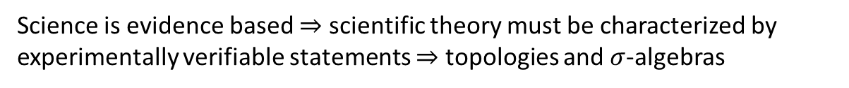


Main goal of the project
Identify a handful of physical starting points from which the basic laws can be rigorously derived
For example:
Infinitesimal reducibility $⇒$ Classical state
Irreducibility $⇒$ Quantum state
https://assumptionsofphysics.org
?
time
time
This also requires rederiving all mathematical structures from physical requirements
For example:
Science is evidence based $⇒$ scientific theory must be characterized by experimentally verifiable statements $⇒$ topologies and $σ$-algebras

Slide 3
Standard view of the foundations of physics
Goal of physics is to find the true laws of the universe!
approximation
…
The “real” physics!
Weak interactions
QED -Electromagnetism
The foundations of physics!
Everything else is an approximation
QCD – Strong Interactions
Electro-weak
General Relativity
Grand Unified Theory
What “really” happens
Theory of Everything
Measurement problem
Hidden variables
Role of the observer
Ontology of observables
Perfect description of the universe
Dark matter/energy

Slide 4
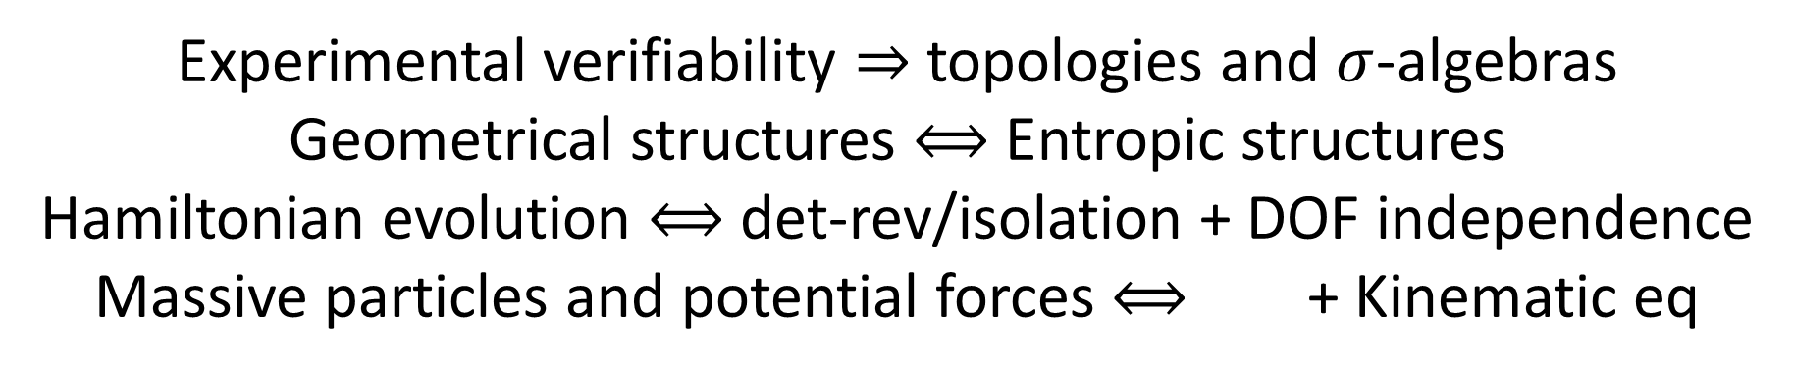
We found:
Experimental verifiability $⇒$ topologies and $σ$-algebras
Geometrical structures $⟺$ Entropic structures
Hamiltonian evolution $⟺$ det-rev/isolation + DOF independence
Massive particles and potential forces $⟺$ + Kinematic eq
Physical requirements and assumptions drive most of the theoretical apparatus
Goal of physics is to find the true laws of the universe!
Goal of physics is to find models that can be empirically tested
Less productive point of view
More productive point of view

Slide 5
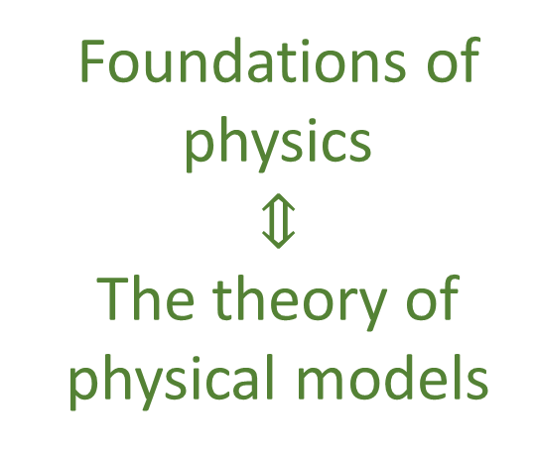
Our view of the foundations of physics
Foundations of physics $$⇕$$ The theory of physical models
General physical principles and requirements
General mathematical framework
Specific assumptions
Classical mechanics
Quantum mechanics
derivation
Thermodynamics
…
specialization

Slide 6
Find the right overall concepts
Reverse physics: Start with the equations, reverse engineer physical assumptions/principles
Reverse Physics
Physics
Smallest set of assumptions required to rederive the theory
Physical theory
Physical result/ effect/prediction
Reverse Mathematics
Mathematics
Smallest set of axioms required to prove the theorem
Theorem
Mathematical result/ corollary/calculation
Found Phys 52, 40 (2022)
Goal: find the right overall physical concepts, “elevate” the discussion from mathematical constructs to physical principles
Physical mathematics: Start from scratch and rederive all mathematical structures from physical requirements
Physics
Physical requirements
Semantics
Physical mathematics
Goal: get the details right, perfect one-to-one map between mathematical and physical objects

Slide 7
The fundamental misunderstanding in the foundations of physics

Slide 8
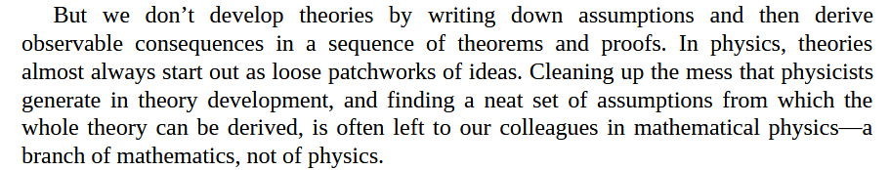
Prevalent attitude among physicists
Math is a just tool for calculation, whose technical details are better left to mathematicians
Sabine Hossenfelder – Lost in Math
Even those that work on the math, they work on it as mathematicians

Slide 9

We use mathematics to specify our models, not just calculations, and specifying physical models is the whole point of physics
Also, there is no single way to “clean up the mess”: each axiom and definition represents a choice in mathematical modeling
Those are physical choices, which mathematicians are ill-equipped to make
So we end up with

Slide 10
Examples of unphysical mathematics

Slide 11





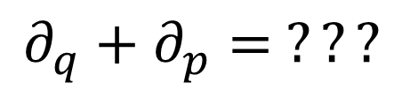



In differential geometry, tangent vectors are derivations
$$v:C^{∞}\left(X\right)→C^{∞}(X)$$
$$v=v^{i}∂_{i}$$
component
basis
In polar coordinates
$$∂_{r}+∂_{θ}= ???$$
$$\left[m\right]$$
$\left[rad\right]$
Doesn’t work with units
In phase space
$$∂_{q}+∂_{p}= ???$$
Mathematically precise $⇏$ physically precise
$\left[m\right]$
$\left[Kg m s^{−1}\right]$

Slide 12
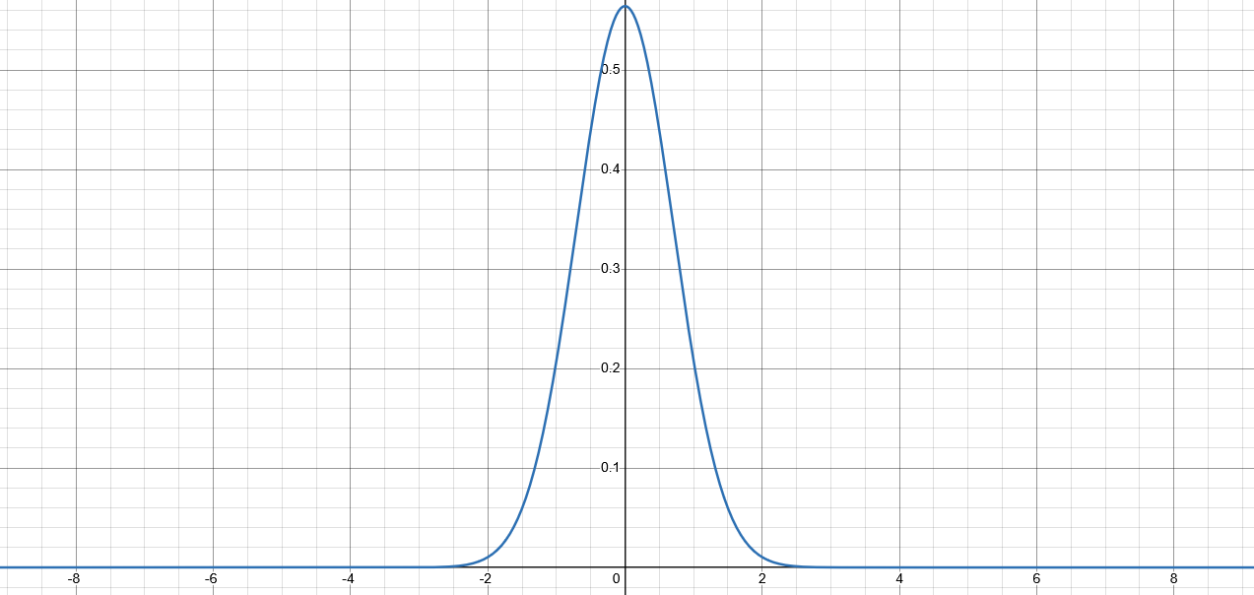
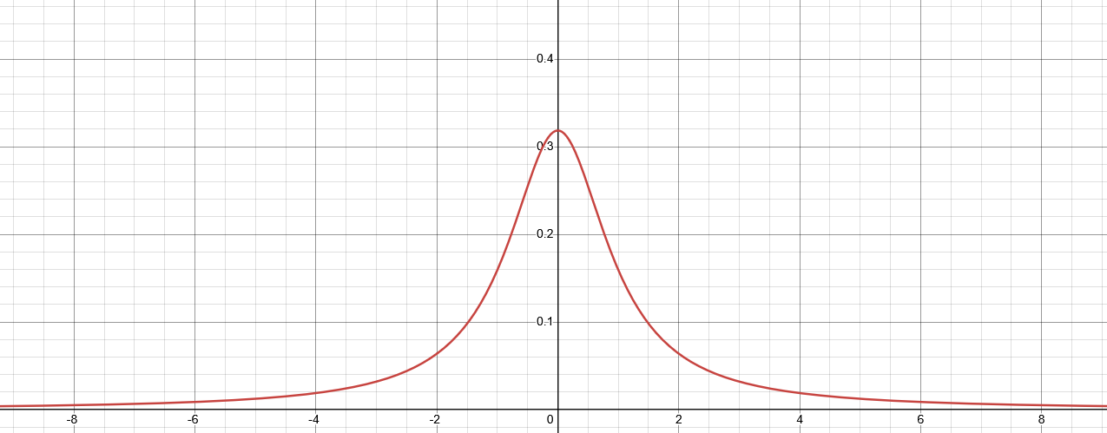

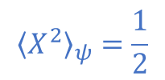

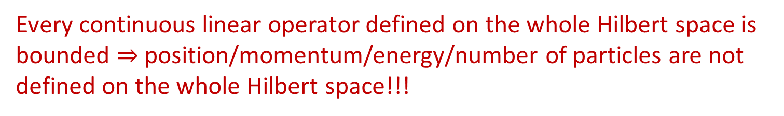


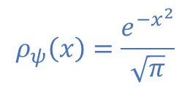

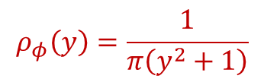
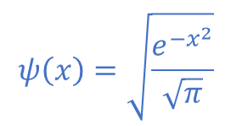
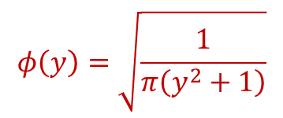
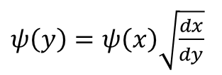
Hilbert space
Quantum states represented by $L^{2}$
Different observers see finite/infinite expectation
$$ψ\left(x\right)=\sqrt{\frac{e^{−x^{2}}}{\sqrt{π}}}$$
$$y=\tan\left(\frac{π}{2}\operatorname{erf}\left(x\right)\right)$$
$$∫{\left|ψ\right|}^{2}dx=1$$
$ψ\left(y\right)=ψ\left(x\right)\sqrt{\frac{dx}{dy}}$
$$ρ_{ψ}\left(x\right)=\frac{e^{−x^{2}}}{\sqrt{π}}$$
$${\left\langle X^{2}\right\rangle }_{ψ}=\frac{1}{2}$$
Expectation can have finite-to-infinite oscillations
$$φ\left(y\right)=\sqrt{\frac{1}{π\left(y^{2}+1\right)}}$$
$$∫{\left|φ\right|}^{2}dx=1$$
$x\left(x_{0},t\right)=x_{0}\cos^{2}{\frac{πt}{2}}+\tan\left(\frac{π}{2}\operatorname{erf}\left(x_{0}\right)\right)\sin^{2}{\frac{πt}{2}}$
$$ρ_{φ}\left(y\right)=\frac{1}{π\left(y^{2}+1\right)}$$
$${\left\langle Y^{2}\right\rangle }_{φ}→∞$$
Every continuous linear operator defined on the whole Hilbert space is bounded $⇒$ position/momentum/energy/number of particles are not defined on the whole Hilbert space!!!

Slide 13
Physical world (informal system)
Mathematical representation
(formal system)
well-defined physical
objects
well-defined mathematical objects
?
?
?
ill-defined
ill-defined
Current state of the art in theoretical physics

Slide 14
Physical world (informal system)
Mathematical representation
(formal system)
well-defined physical
objects
well-defined mathematical objects
Physical specifications
Mathematical definition
A mathematical definition is physical if it captures and only captures an aspect of the physical system

Slide 15
Mathematicians have developed standards of rigor for their discipline
What standard of rigor should we have for physical mathematics?
For the math part, the same as mathematics
What should we do for the physics part?

Slide 16
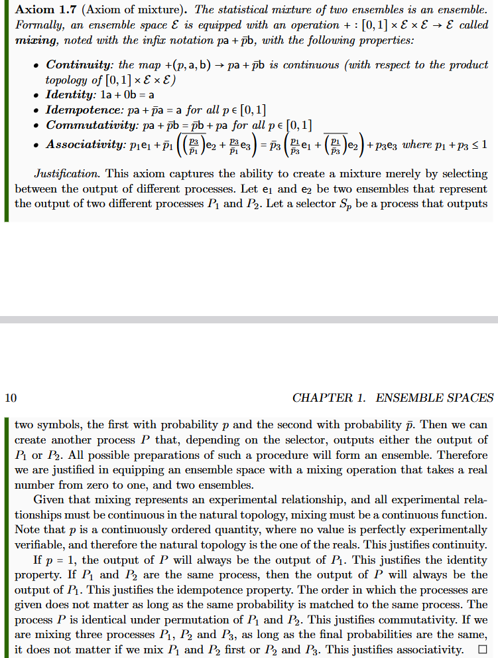
Informal intuitive statement
(something that makes sense to a physicist or an engineer)

Slide 17
Informal intuitive statement
(something that makes sense to a physicist or an engineer)
Formal requirement
(something a mathematician will find precise)

Slide 18







Informal intuitive statement
(something that makes sense to a physicist or an engineer)
Formal requirement
(something a mathematician will find precise)
Show that the formal requirement follows from the intuitive statement
$$P$$
Clear idea of what is being modelled
$P_{1}$
$$e_{1}$$
$$S_{p}$$
$$pe_{1}+\left(1−p\right)e_{2}$$
$P_{2}$
$$e_{2}$$

Slide 19
Informal intuitive statement
(something that makes sense to a physicist or an engineer)
Formal requirement
(something a mathematician will find precise)
Show that the formal requirement follows from the intuitive statement
Justification uses previous findings
$$P$$
Physical mathematics must start with most basic structures
$P_{1}$
$$e_{1}$$
$$S_{p}$$
$$pe_{1}+\left(1−p\right)e_{2}$$
$P_{2}$
$$e_{2}$$

Slide 20

Informal intuitive statement
(something that makes sense to a physicist or an engineer)
Formal requirement
(something a mathematician will find precise)
Show that the formal requirement follows from the intuitive statement
$$\left(1−p_{1}\right)\left(1−\frac{p_{3}}{1−p_{1}}\right)=1−p_{1}−p_{3}=\left(1−p_{3}\right)\left(1−\frac{p_{1}}{1−p_{3}}\right)$$
$$P$$
$P_{1}$
$$e_{1}$$
$$pe_{1}+\left(1−p\right)e_{2}$$
Properties justified by understanding the model
$$S_{p}$$
$P_{2}$
$$e_{2}$$

Slide 21
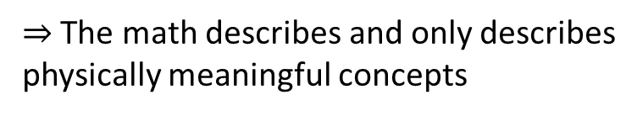
Informal intuitive statement
(something that makes sense to a physicist or an engineer)
Formal requirement
(something a mathematician will find precise)
Show that the formal requirement follows from the intuitive statement
There is no question as to what the math describes
The properties are justified by, are a consequence of, what the model describes
Every math proof can be understood physically
$⇒$ The math describes and only describes physically meaningful concepts
It’s physical mathematics

Slide 22
The goal of physical mathematics is to recover ALL mathematical structures used in physics from clear physical requirements
Physics
Physical requirements
Semantics
Clarify realm of applicability of each mathematical structure
Perfect map between math and physics
Physical mathematics
Provide a generalized structure for all physical theories
It’s a better way to do physics
It forces you to think a lot deeper about physics, what it means to have an experimentally based theory, what it means to define a state, what is entropy or energy, …
It’s not just a “math thing”

Slide 23
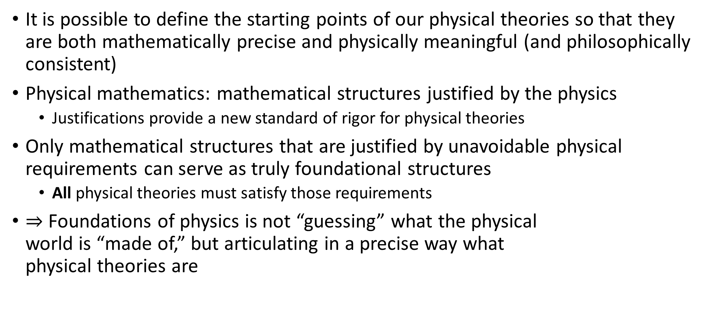
Takeaway
It is possible to define the starting points of our physical theories so that they are both mathematically precise and physically meaningful (and philosophically consistent)
Physical mathematics: mathematical structures justified by the physics
Justifications provide a new standard of rigor for physical theories
Only mathematical structures that are justified by unavoidable physical requirements can serve as truly foundational structures
All physical theories must satisfy those requirements
$⇒$ Foundations of physics is not “guessing” what the physical world is “made of,” but articulating in a precise way what physical theories are

Slide 24
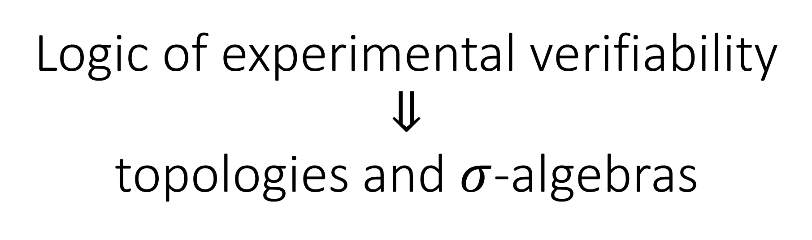
Logic of experimental verifiability $$⇓$$ topologies and $σ$-algebras

Slide 25
$⇒$ Science is about statements that are associated to experimental tests
Statements must be either true or false for everybody
Tests may or may not terminate (i.e. may be inconclusive)
Statement | Test Result
T | SUCCESS (in finite time)
 | UNDEFINED
F | UNDEFINED
 | FAILURE (in finite time)
two-valued logic
three-valued logic
Verifiable statement | Test Result
T | SUCCESS (in finite time)
F | UNDEFINED
 | FAILURE (in finite time)

Slide 26
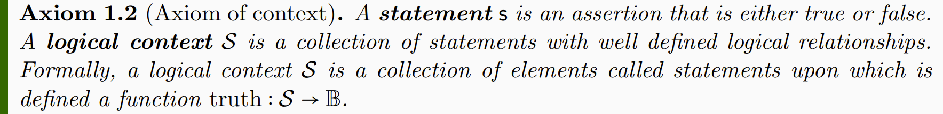
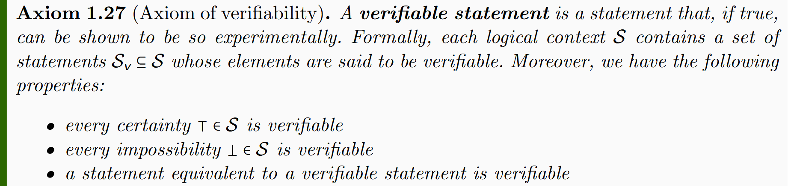
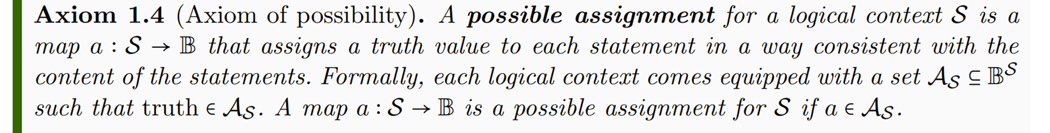
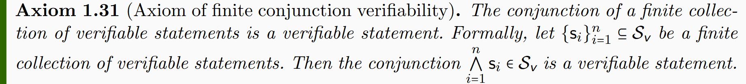
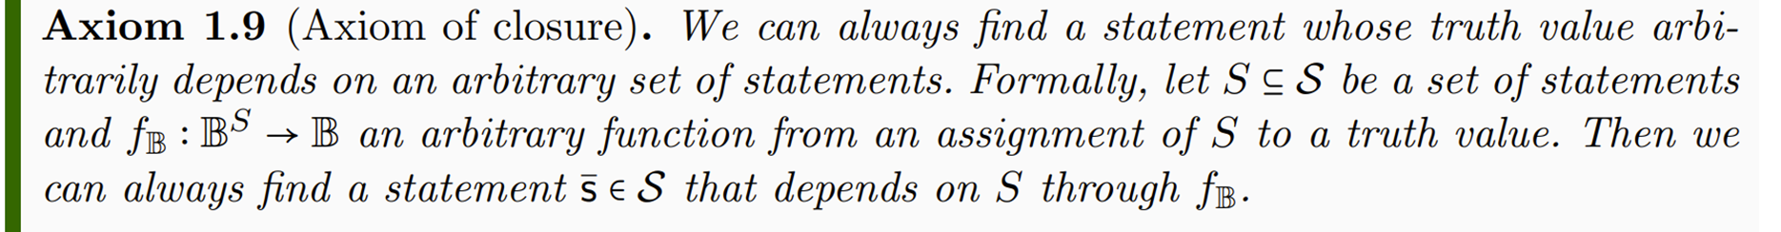
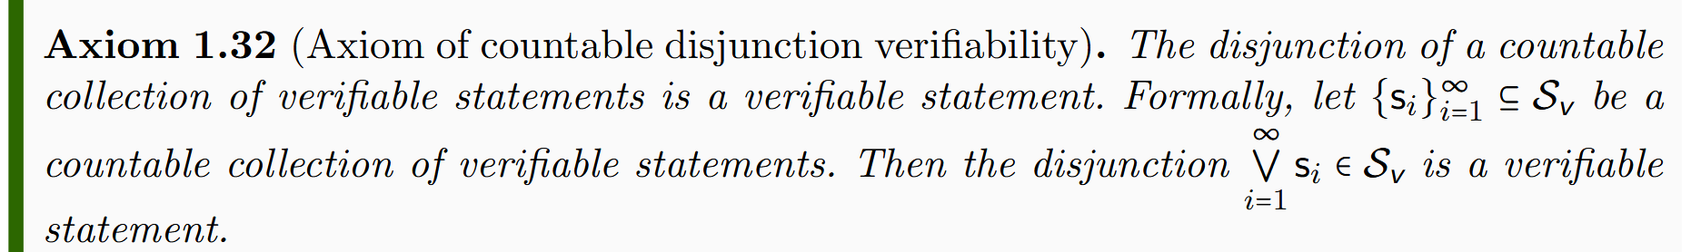
Axioms of logic
Axioms of verifiability
Lead to standard logic (i.e. Boolean algebra)
Lead to intuitionist logic (i.e. Heyting algebra)
two-valued logic
three-valued logic

Slide 27
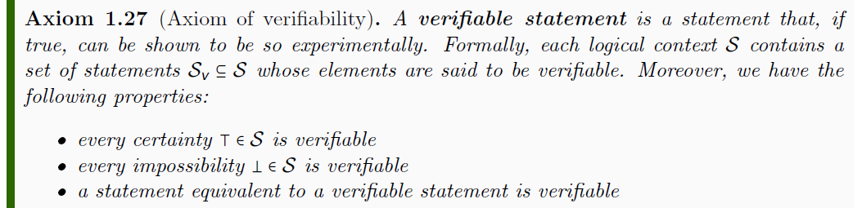



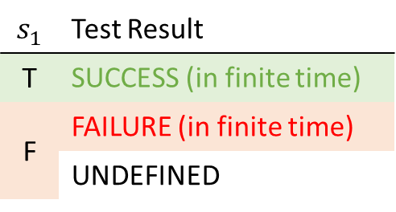
$$𝒮$$
$$s_{1}$$ | Test Result
T | SUCCESS (in finite time)
F | FAILURE (in finite time)
 | UNDEFINED
$$𝒮_{\text{v}}$$
$$s_{1}$$
experimental test
Tests are not part of the formal system

Slide 28
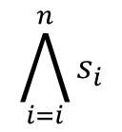



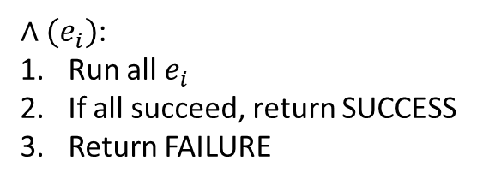
Conjunction (AND) of verifiable statements: check that all tests terminate successfully
$⇒$ Only finite conjunction is guaranteed to terminate
$∧(e_{i})$:
Run all $e_{i}$
If all succeed, return SUCCESS
Return FAILURE
$$\bigwedge_{i=i}^{n}{s_{i}}$$
$$s_{1}$$
$$s_{2}$$
$$s_{3}$$
All tests must succeed

Slide 29

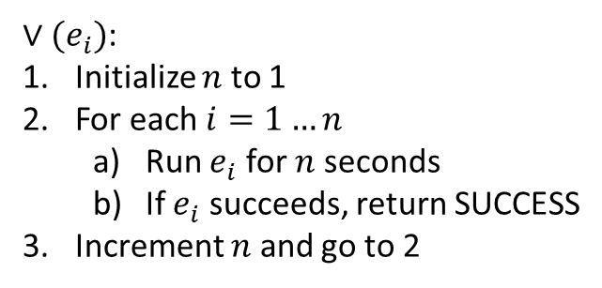
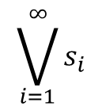
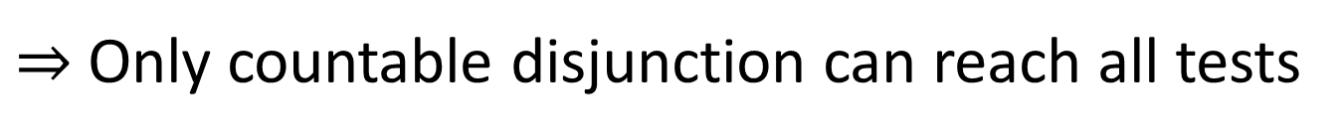



Disjunction (OR) of verifiable statements: check that ONE test terminates successfully
watch out for non-termination!
$⇒$ Only countable disjunction can reach all tests
$∨(e_{i})$:
Initialize $n$ to 1
For each $i=1…n$
Run $e_{i}$ for $n$ seconds
If $e_{i}$ succeeds, return SUCCESS
Increment $n$ and go to 2
$$\bigvee_{i=1}^{∞}{s_{i}}$$
$$s_{1}$$
$$s_{2}$$
$$s_{3}$$
$$…$$
One successful test is sufficient

Slide 30
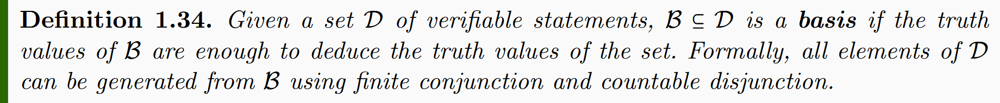




$$𝒟$$
$$ℬ=\{e_{1},e_{2},e_{3},…\}$$
$$ℬ$$
Countable basis
Only finite conjunction and countable disjunction
$$s_{1}=\left(e_{1}∨e_{3}\right)∧e_{2}…$$

Slide 31
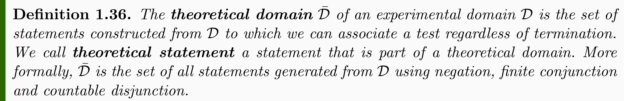
Extend the domain to include all statements that are associated with a test, regardless of termination.
All statements depend on the verifiable statements (which depend on the basis)
No new information is captured

Slide 32
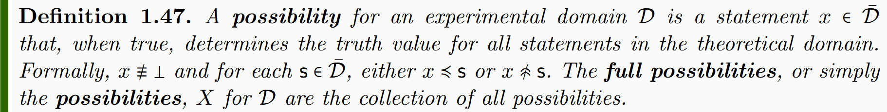
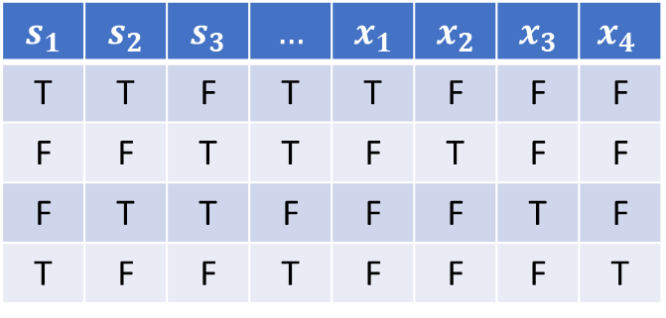
A possibility of a domain is a statement that picks one assignment
$$s_{1}$$ | $$s_{2}$$ | $$s_{3}$$ | $$…$$ | $$x_{1}$$ | $$x_{2}$$ | $$x_{3}$$ | $$x_{4}$$
T | T | F | T | T | F | F | F
F | F | T | T | F | T | F | F
F | T | T | F | F | F | T | F
T | F | F | T | F | F | F | T
Possibilities: experimentally defined alternative cases defined by the verifiable cases

Slide 33

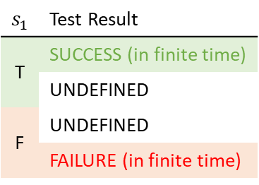
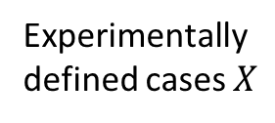






Topology and $σ$-algebra
Theoretical domain ${\overline{𝒟}}_{X}$
$int(A)$ corresponds to the verifiable part of a statement
Experimental domain $𝒟_{X}$
Theoretical statements
$$s_{1}$$ | Test Result
T | SUCCESS (in finite time)
 | UNDEFINED
F | UNDEFINED
 | FAILURE (in finite time)
Verifiable statements
Possibilities
$∂A$ corresponds to the undecidable part of a statement
$ext(A)$ corresponds to the falsifiable part of a statement
Topology ${\text{T}}_{X}$
Experimentally defined cases $X$
Open sets
Points
Borel sets
Borel algebra $Σ_{X}$
Perfect map between math and physics
Open set $(\text{5}\text{09.5, 510.5})$ $⟺$ Verifiable “the mass of the electron is 510 $±$ 0.5 KeV”
Closed set $[510]$ $⟺$ Falsifiable “the mass of the electron is exactly 510 KeV”
Borel set $ℚ$ ($int\left(ℚ\right)∪ext\left(ℚ\right)=∅$) $⟺$Theoretical “the mass of the electron in KeV is a rational number” (undecidable)

Slide 34
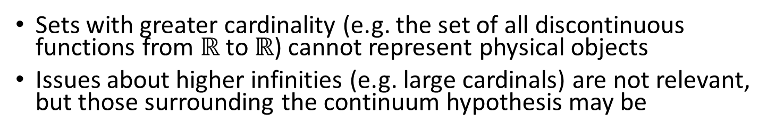



Maximum cardinality of distinguishable cases
$$ℝ$$
Set of distinguishable cases
Each point identified by truth of countably many verifiable stmts
Correspond to binary expansion
FTFFFTTTFTFTT…
TFFTTFTTFFFTF…
FTFFFTTFTFFTF…
FTTFTFTTFTFFT…
0.0100011101011…
0.1001101100010…
0.0100011010010…
0.0110101101001…
1
Most we can test over arbitrarily long time
Correspondence to binary sequence
$\left|X\right|≤|ℝ$|
0
0100011101011…
1001101100010…
0100011010010…
0110101101001…
$$X$$
Sets with greater cardinality (e.g. the set of all discontinuous functions from $ℝ$ to $ℝ$) cannot represent physical objects
Issues about higher infinities (e.g. large cardinals) are not relevant, but those surrounding the continuum hypothesis may be
Notes:
Large cardinals are defined to have a specific property and their existence cannot be proven (or disproven) in standard ZFC.

Slide 35
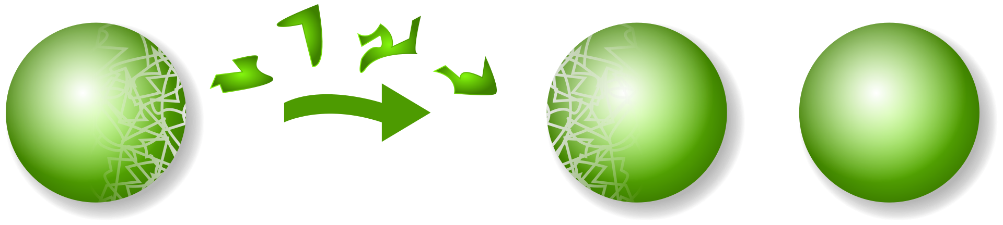
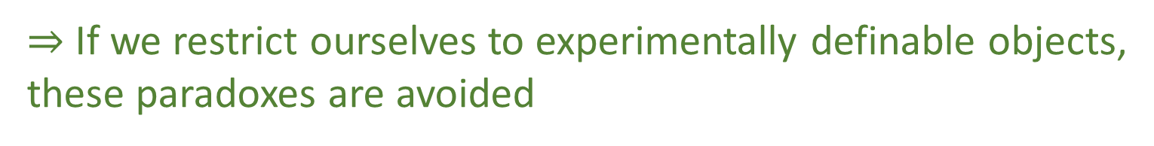
Power set vs Borel algebra
Using the set $2^{ℝ^{n}}$ of all possible subsets for $ℝ^{n}$ is problematic
Notion of size (i.e. measure) cannot be defined on all sets
Using non-measurable sets leads to the Banach-Tarski paradox
wikipedia
These problems are avoided if we restrict ourselves to Borel sets
$⇒$ If we restrict ourselves to experimentally definable objects, these paradoxes are avoided
Physical mathematics can give insight to these foundational issues in mathematics

Slide 36
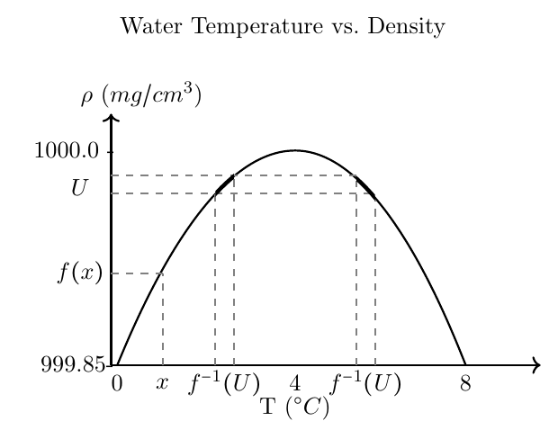








An inference relationship is a map $𝓇:𝒟_{Y}→𝒟_{X}$ such that $𝓇\left(s\right)≡s$
$$𝒟_{X}$$
$$𝒟_{Y}$$
e.g. the water temperature is between 0 and 0.52 Celsius or between 7.6 and 9.12 Celsius
e.g. the water density is between 999.8 and 999.9 kg/m³
$$X$$
$$Y$$
e.g. the water temperature is exactly 4 Celsius
e.g. the water density is exactly 1 kg/m³
A causal relationship is a map $f:X→Y$ such that $x≼f\left(x\right)$
$$∈𝒟_{Y}$$
1) Two domains admit an inference relationship if and only if they admit a causal relationship
2) The causal relationship must be a continuous map in the natural topology
$$∈Y$$
$$∈X$$
$$∈𝒟_{Y}$$

Slide 37
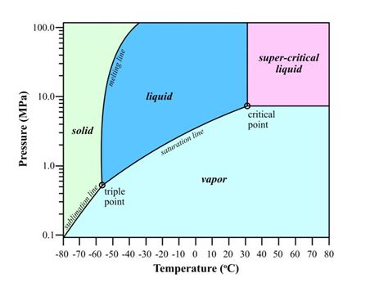
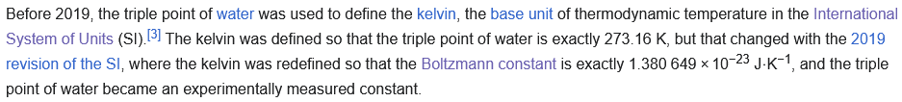
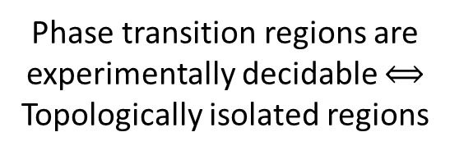

Why functions are well-behaved
Phase transition regions are experimentally decidable $⟺$ Topologically isolated regions
CO2 Phase diagram
Water heat capacity
data from https://www.engineeringtoolbox.com
Figure from https://www.researchgate.net/publication/326492803_Implications_of_Permeability_Uncertainty_During_Three-phase_CO2_Flow_in_a_Basalt_Fracture_Network
Topological continuity $≠$ Analytical continuity
We can verify we are at the triple point
Analytical discontinuity can only happen in regions that are experimentally decidable
We measure the equilibrium of three phases, not the pressure/temperature
from https://en.wikipedia.org/wiki/Triple_point

Slide 38
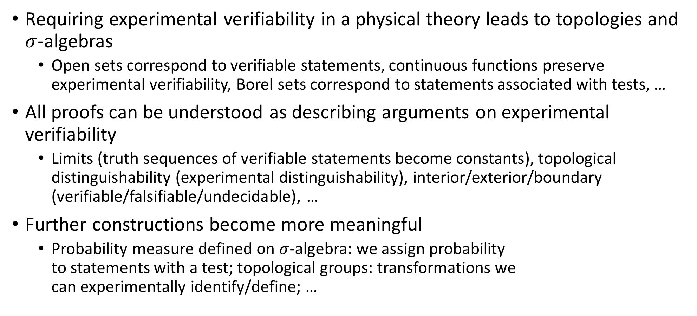
Takeaway
Requiring experimental verifiability in a physical theory leads to topologies and $σ$-algebras
Open sets correspond to verifiable statements, continuous functions preserve experimental verifiability, Borel sets correspond to statements associated with tests, …
All proofs can be understood as describing arguments on experimental verifiability
Limits (truth sequences of verifiable statements become constants), topological distinguishability (experimental distinguishability), interior/exterior/boundary (verifiable/falsifiable/undecidable), …
Further constructions become more meaningful
Probability measure defined on $σ$-algebra: we assign probability to statements with a test; topological groups: transformations we can experimentally identify/define; …

Slide 39
It is possible to develop a foundation of physics that is both mathematically rigorous and physically meaningful
The mathematical definitions ARE the physical requirements and assumptions
Physical world (informal system)
Mathematical representation
(formal system)
No issues of “interpretations”
Clear realm of applicability of mathematical tools
well-defined physical
objects
well-defined mathematical objects
Physical specifications
Mathematical definition

Slide 40
There is no “just math”
Either the math represents physical objects, then it’s describing physics
Or it doesn’t, and therefore it should be stripped away from the physical theory
Only by understanding the full details of the math and physics (and philosophy) can you make that determination
If you do not know what the well-ordering of the reals is, you are precisely a person that cannot determine whether it is physically significant or not

Slide 41
Wrapping it up
Assumptions of Physics: different approach to the foundations of physics
No interpretations, no theories of everything: physically meaningful starting points from which we can rederive the laws and the mathematical frameworks they need
Physical theories are models
Need to clarify exactly what the realm of applicability of each model is
Physical mathematics: derive the math required from physical requirements
In physics, mathematics is used to model physical systems, therefore we need mathematics that is designed specifically for that purpose
You need to start at the lowest level of mathematics
Rigor, precision, meaning, correctness cannot be “sprinkled on top”
“Big systems that work evolve from small systems that work, never from big systems that do not work” (Gall’s law)

Slide 42
To learn more
Project website
https://assumptionsofphysics.org for papers, presentations, …
https://assumptionsofphysics.org/book for our open access book (updated every few years with new results)
YouTube channels
https://www.youtube.com/@gcarcassi Videos with results and insights from the research
https://www.youtube.com/@AssumptionsofPhysicsResearch Research channel, with open questions and livestreamed work sessions
GitHub
https://github.com/assumptionsofphysics Book, research papers, slides for videos...

