Slide 1


Towards a consistent mathematical foundation for all physical theories
Gabriele Carcassi and Christine A. Aidala
Physics Department University of Michigan
https://assumptionsofphysics.org

Slide 2
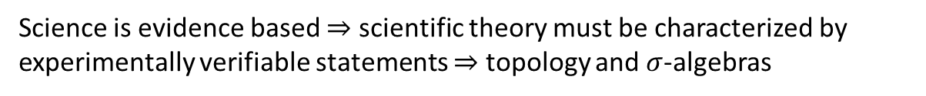


Main goal of the project
Identify a handful of physical starting points from which the basic laws can be rigorously derived
For example:
Infinitesimal reducibility $⇒$ Classical state
Irreducibility $⇒$ Quantum state
https://assumptionsofphysics.org
?
time
time
This also requires rederiving all mathematical structures from physical requirements
For example:
Science is evidence based $⇒$ scientific theory must be characterized by experimentally verifiable statements $⇒$ topology and $σ$-algebras

Slide 3
Find the right overall concepts
Reverse physics: Start with the equations, reverse engineer physical assumptions/principles
Reverse Physics
Physics
Smallest set of assumptions required to rederive the theory
Physical theory
Physical result/ effect/prediction
Reverse Mathematics
Mathematics
Smallest set of axioms required to prove the theorem
Theorem
Mathematical result/ corollary/calculation
Found Phys 52, 40 (2022)
Goal: find the right overall physical concepts, “elevate” the discussion from mathematical constructs to physical principles
Physical mathematics: Start from scratch and rederive all mathematical structures from physical requirements
Physics
Physical requirements
Semantics
Physical mathematics
Goal: get the details right, perfect one-to-one map between mathematical and physical objects

Slide 4
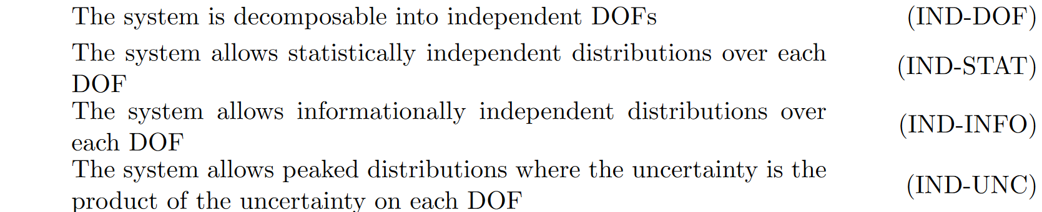
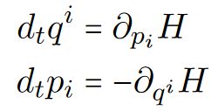





Hamiltonian mechanics $⟺$ Determinism/Reversibility + DOF independence
Assumptions of Physics, Michigan Publishing (v2 2023)
$$⇒$$
$$⇒$$
$$⟺$$

Slide 5


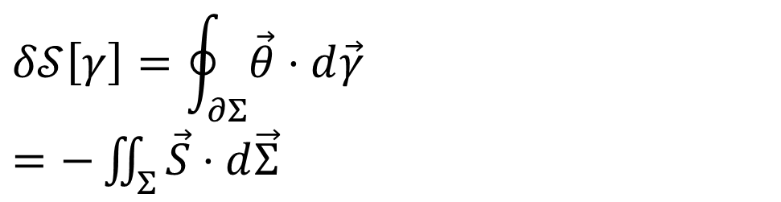


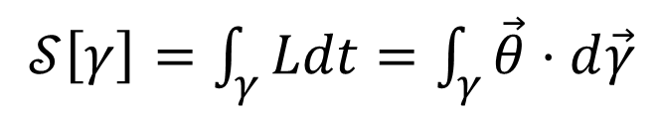






Variation of the action measures the flow of states Variation = 0 $⇒$ flow of states tangent to the path
DR
Geometric and physical interpretation of the action principle,
Sci Rep 13, 12138 (2023)
$$\left[p,0,−H\right]$$
$$∇⋅\vec{S}=0$$
$$\vec{S}=−∇×\vec{θ}$$
$𝒮\left[γ\right]=\int_{γ}{Ldt}=\int_{γ}{\vec{θ}⋅d\vec{γ}}$
No state is “lost” or “created” as time evolves
(Minus sign to match convention)
KE
The action is the line integral of the vector potential (unphysical)
$$p$$
$$q$$
Variation of the action
$$Σ$$
$$δ𝒮\left[γ\right]=\oint_{∂Σ}{\vec{θ}⋅d\vec{γ}}$$ $=−\iint_{Σ}{\vec{S}⋅d\vec{Σ}}$
$$γ$$
$$γ′$$
$$t$$
Gauge independent, physical!

Slide 6
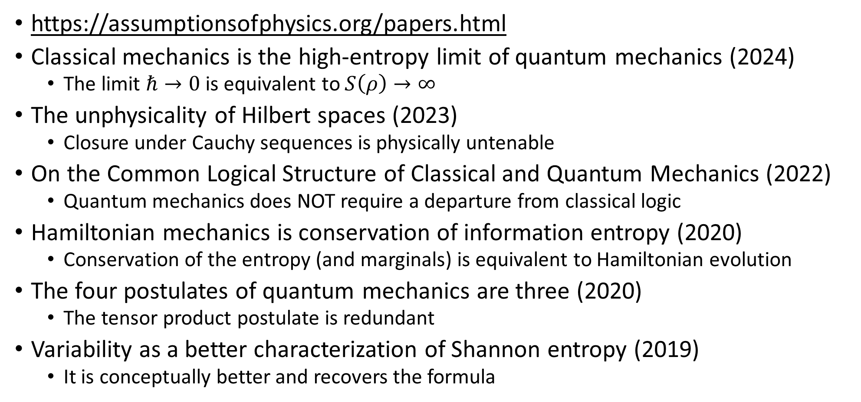
Other results
https://assumptionsofphysics.org/papers.html
Classical mechanics is the high-entropy limit of quantum mechanics (2024)
The limit $ℏ→0$ is equivalent to $S\left(ρ\right)→∞$
The unphysicality of Hilbert spaces (2023)
Closure under Cauchy sequences is physically untenable
On the Common Logical Structure of Classical and Quantum Mechanics (2022)
Quantum mechanics does NOT require a departure from classical logic
Hamiltonian mechanics is conservation of information entropy (2020)
Conservation of the entropy (and marginals) is equivalent to Hamiltonian evolution
The four postulates of quantum mechanics are three (2020)
The tensor product postulate is redundant
Variability as a better characterization of Shannon entropy (2019)
It is conceptually better and recovers the formula

Slide 7
Possible contribution: generalize results to (classical) field theories
Find/develop suitable Hamiltonian/symplectic formulation for classical field theories (e.g. classical EM, general relativity)
Find/develop suitable definition of entropy in the context of field theory
Extend results from classical mechanics to field theories

Slide 8

Physical mathematics
Goal: find the most general mathematical structures that are still physically meaningful
$⇒$ Derive mathematical structure from physically justifiable premises

Slide 9
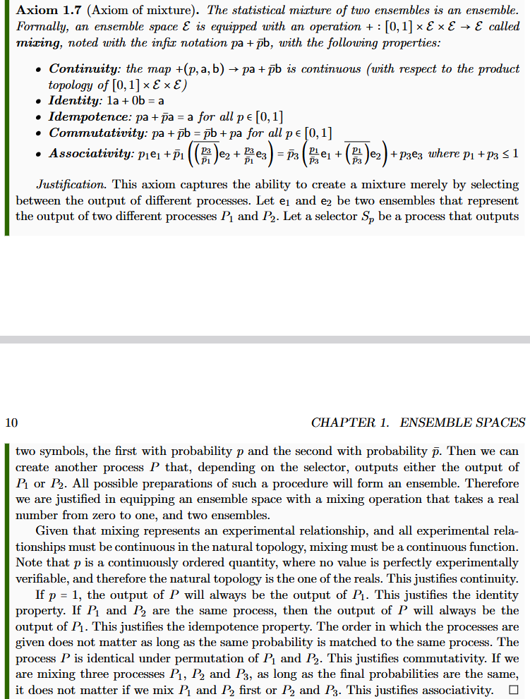
Informal intuitive statement
(something that makes sense to a physicist or an engineer)
Formal requirement
(something a mathematician will find precise)
Show that the formal requirement follows from the intuitive statement

Slide 10
Logic of experimental verifiability
Science is about statements that can be connected to experimental evidence $⇒$

Slide 11
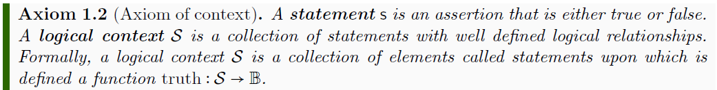
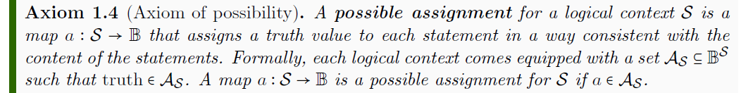
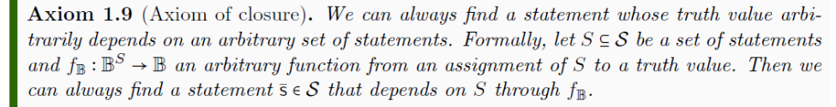




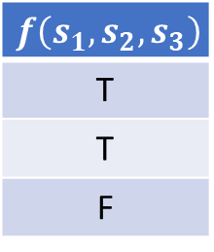
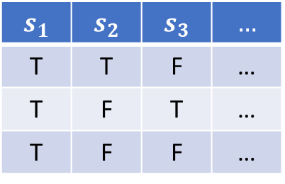

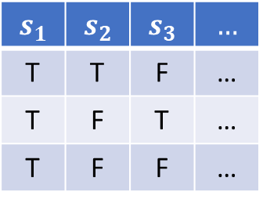
$$𝒮$$
$$s_{1}$$ | $$s_{2}$$ | $$s_{3}$$ | $$…$$
T | T | F | …
T | F | T | …
T | F | F | …
$$a$$
$$𝒜_{𝒮}$$
$⇒$ Statements form a complete Boolean algebra
$$s_{1}$$ | $$s_{2}$$ | $$s_{3}$$ | $$…$$
T | T | F | …
T | F | T | …
T | F | F | …
$$f\left(s_{1},s_{2},s_{3}\right)$$
T
T
F
$$f_{𝔹}$$

Slide 12
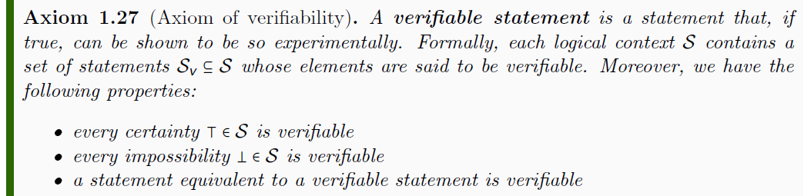
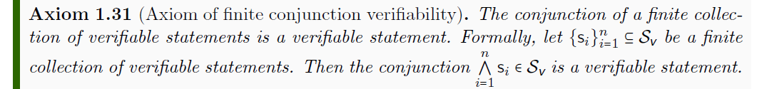
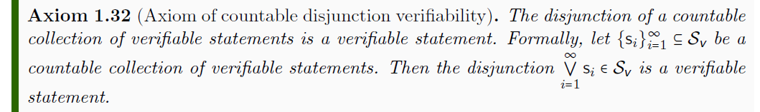


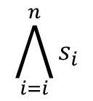
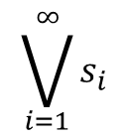









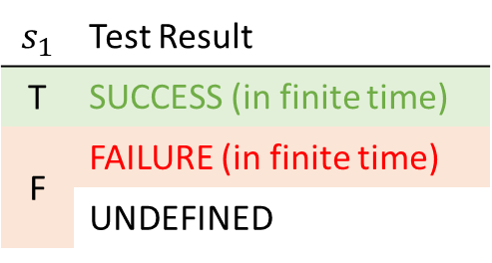
$$𝒮$$
$$s_{1}$$ | Test Result
T | SUCCESS (in finite time)
F | FAILURE (in finite time)
 | UNDEFINED
$$𝒮_{\text{v}}$$
$$s_{1}$$
experimental test
outside the formal system
$$\bigwedge_{i=i}^{n}{s_{i}}$$
$$s_{1}$$
$$s_{2}$$
$$s_{3}$$
All tests must succeed
$$\bigvee_{i=1}^{∞}{s_{i}}$$
$$s_{1}$$
$$s_{2}$$
$$s_{3}$$
$$…$$
One successful test is sufficient
$⇒$ Verifiable statements form a Heyting algebra

Slide 13
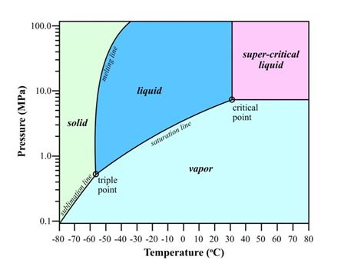

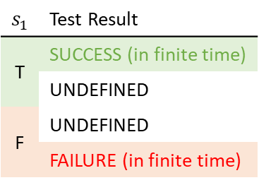


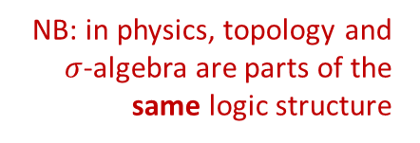





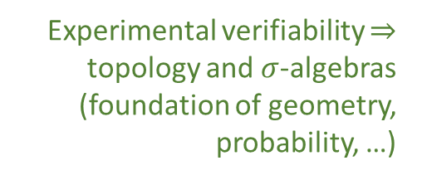

Topology and $σ$-algebra
Experimental verifiability $⇒$ topology and $σ$-algebras (foundation of geometry, probability, …)
Theoretical statements
$int(A)$ corresponds to the verifiable part of a statement
$$s_{1}$$ | Test Result
T | SUCCESS (in finite time)
 | UNDEFINED
F | UNDEFINED
 | FAILURE (in finite time)
Verifiable statements
Perfect map between math and physics
Possibilities
$∂A$ corresponds to the undecidable part of a statement
$ext(A)$ corresponds to the falsifiable part of a statement
NB: in physics, topology and $σ$-algebra are parts of the same logic structure
Open sets
Points
Open set $(\text{5}\text{09.5, 510.5})$ $⟺$ Verifiable “the mass of the electron is 510 $±$ 0.5 KeV”
Borel sets
Closed set $[510]$ $⟺$ Falsifiable “the mass of the electron is exactly 510 KeV”
Borel set $ℚ$ ($int\left(ℚ\right)∪ext\left(ℚ\right)=∅$) $⟺$Theoretical “the mass of the electron in KeV is a rational number” (undecidable)
Inference relationship $𝓇:𝒟_{Y}→𝒟_{X}$ such that $𝓇\left(s\right)≡s$
$$𝒟_{X}$$
$$𝒟_{Y}$$
Topologically continuous consistent with analytic discontinuity on isolated points
Inference relationship $$⟺$$ Causal relationship
Relationships must be topologically continuous
$$X$$
$$Y$$
Causal relationship $f:X→Y$ such that $x≼f\left(x\right)$
Phase transition $⟺$ Topologically isolated regions

Slide 14
Ensemble spaces (generalized state spaces)

Slide 15
Physical laws are about reproducible relationships
statement of the type “whenever we prepare this we have that”
we must be able to “test one more time”
Experimentally, we always prepare ensembles with finite uncertainty
Empirical theories are about ensembles
A physical theory must AT LEAST describe which ensembles are possible within the theory

Slide 16
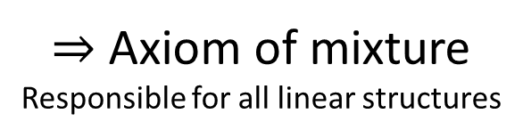
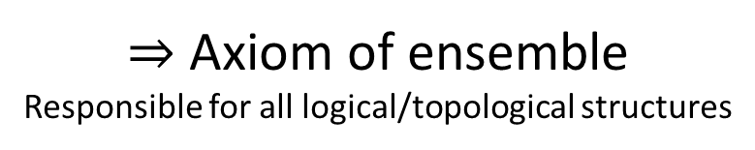
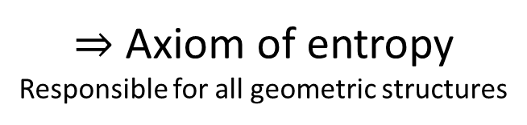
Minimum requirements for ensembles
$⇒$ Axiom of ensemble Responsible for all logical/topological structures
Must be experimentally well-defined
Must allow statistical mixtures
$⇒$ Axiom of mixture Responsible for all linear structures
Must have a well-defined variability
$⇒$ Axiom of entropy Responsible for all geometric structures
Goal: recover as much as possible from just these three axioms

Slide 17

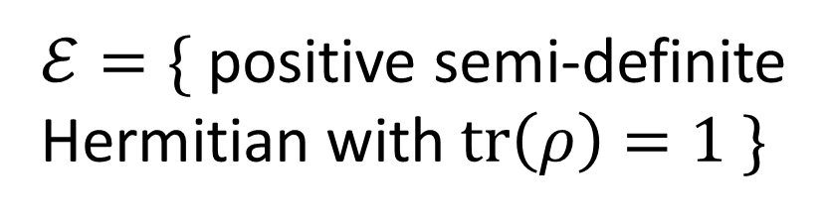


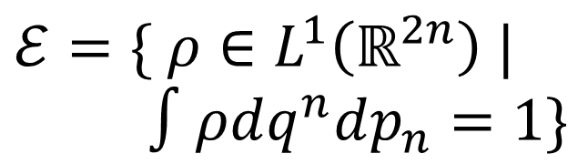

State space
Ensembles
Classical discrete
$$X=\{x_{1},x_{2},…\}$$
$ℰ=\{ p_{i} | \sum_{i}{p_{i}}=1\}$
Phase space Symplectic manifold
$ℰ=\{ ρ∈L^{1}\left(ℝ^{2n}\right) |$ $∫ρdq^{n}dp_{n}=1\}$
Classical continuum
$$X=\{ℝ^{2n},ω\}$$
Projective complex Hilbert space
$ℰ=\{$ positive semi-definite Hermitian with $tr\left(ρ\right)=1 \}$
Quantum mechanics
$$X=P(ℋ)$$

Slide 18
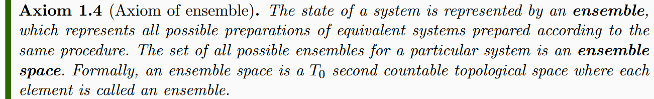
Topology is responsible for handling limits and infinite operations
All other axioms are on finite elements

Slide 19
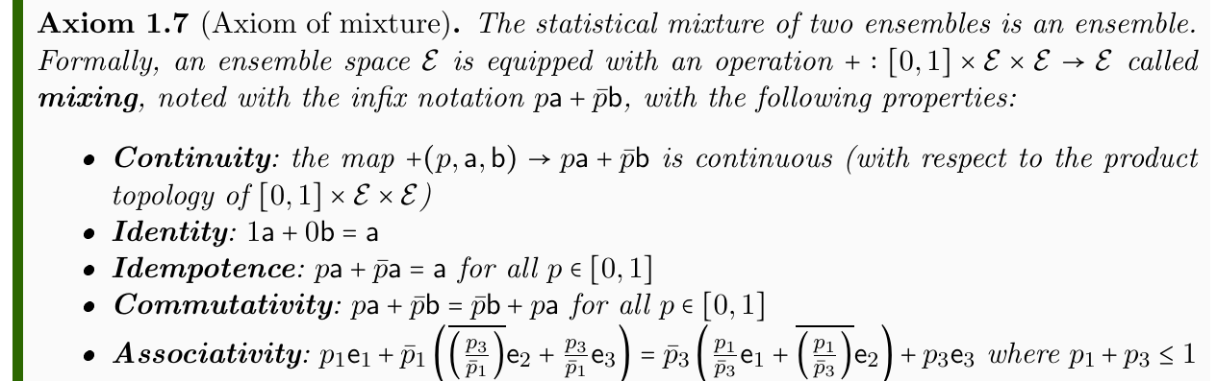

Ensembles can be mixed
a
$⇒$ Convex structure
p
b

Slide 20
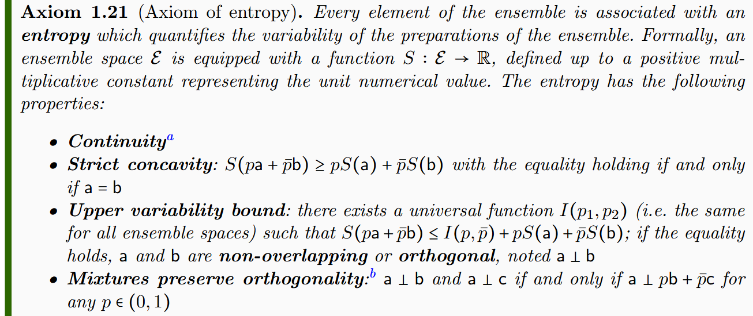
Ensembles must have a well-defined entropy

Slide 21
b
a
Ensembles represent a collection of preparations which are, in general, not identical
Variability: how similar are the preparations to each other?
Entropy is a measure of variability

Slide 22


a
$$S\left(pa+\overline{p}b\right)$$
p
Variability after mixture
Average variability before mixture
b
$$pS\left(a\right)+\overline{p}S\left(b\right)$$
Final variability will be greater than average variability before mixture
If we mix an ensemble with itself, the variability is unchanged

Slide 23
a
$$S\left(pa+\overline{p}b\right)$$
p
Variability after mixture
Average variability before mixture
b
$$pS\left(a\right)+\overline{p}S\left(b\right)$$
Maximum increase when the ensembles are “completely different”
Increase is only a function of the mixing coefficient

Slide 24
a
c
b
If a has no elements in common with b or c,
it has no elements in common with any mixture

Slide 25
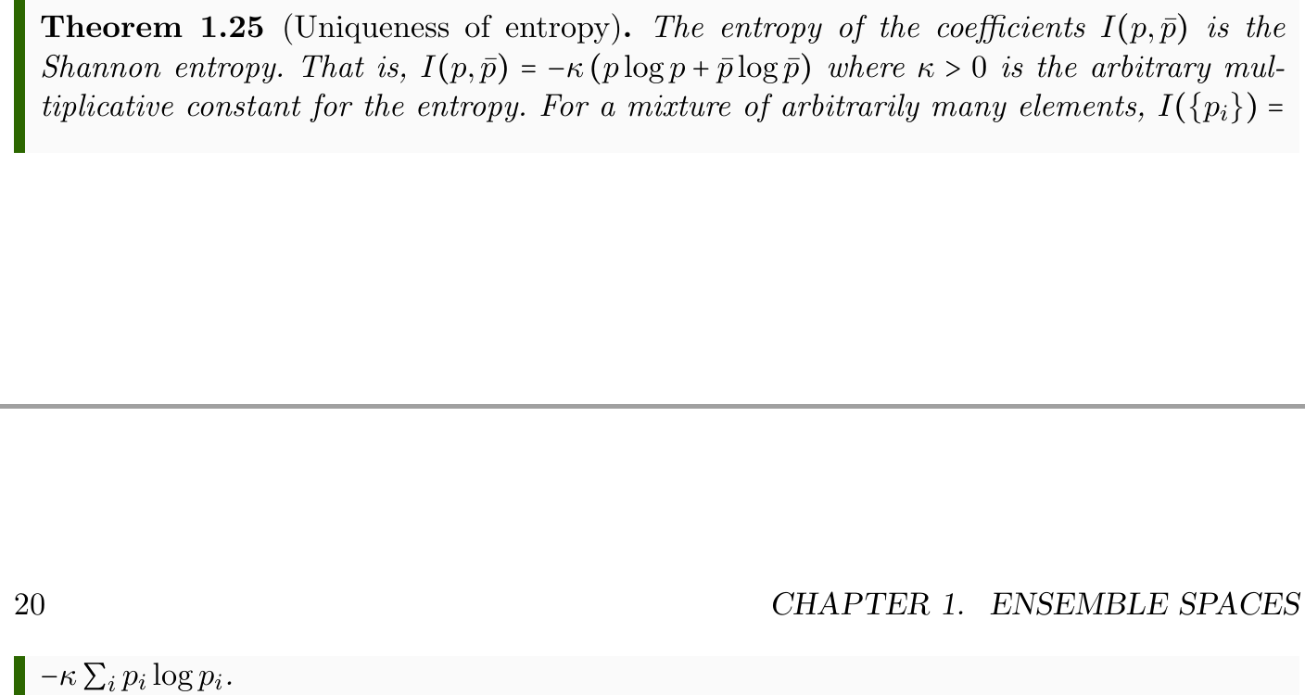
The entropy of the coefficients $I(p,\overline{p})$ is uniquely determined
Shannon entropy
Proof “does not know” whether we are dealing with classical ensembles, quantum ensembles, or ensembles for a theory yet to be discovered

Slide 26









Separate ensembles
Orthogonal ensembles
$$⇐$$
No “common component”
Saturate upper bound
such that
Coincide in classical ensemble spaces
Different in quantum ensemble spaces
$$A$$
$$C$$
disjoint support
$$B$$

Slide 27


Ensemble spaces embed in a compact subset of a vector space
$$V$$
The entropy bounds are responsible for these constraints
$$ℰ$$
Is it a topological vector space? Is it locally convex?

Slide 28
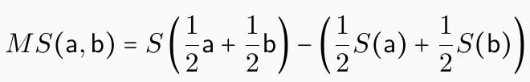
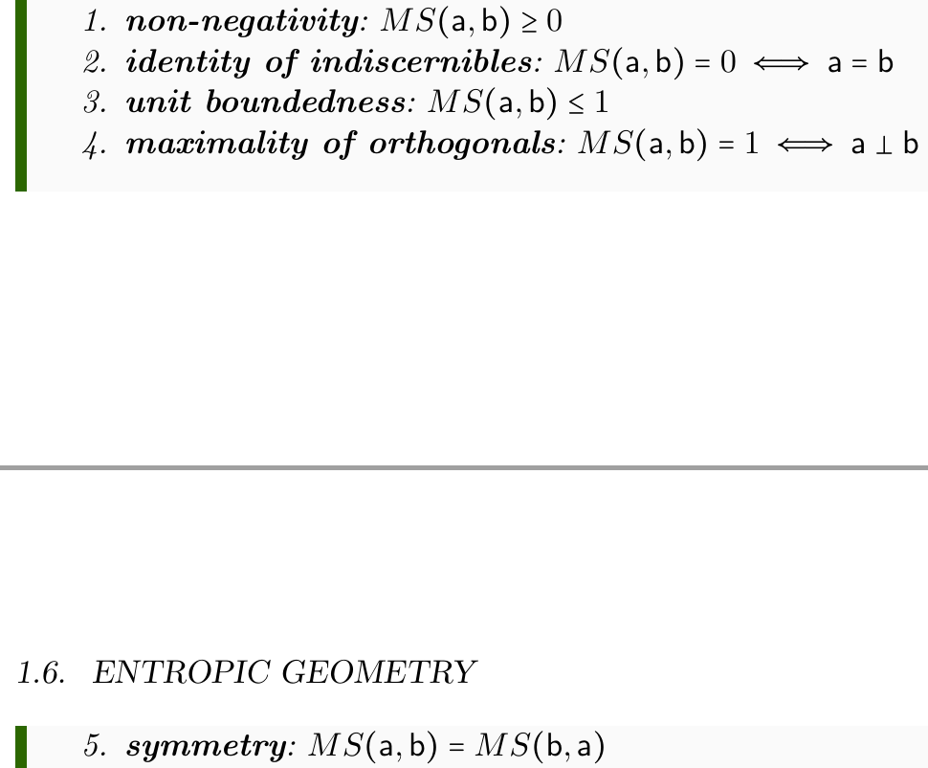
How much does the entropy increase during mixture?
Recovers the Jensen-Shannon divergence (both classical and quantum)
Pseudo-distance from the entropy

Slide 29




Entropy imposes a metric on the affine structure
$$⇒$$
Entropy strict concavity means the Hessian is negative definite
Recovers Fisher-Rao information metric (both classical and quantum)

Slide 30

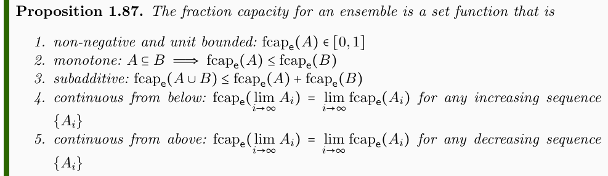

How much of $e$ is a mixture of other ensembles?
fuzzy measure
Fraction capacity is a non-additive probability measure
additive over orthogonal sets

Slide 31
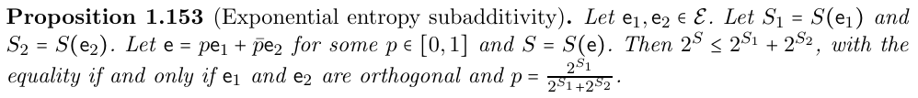
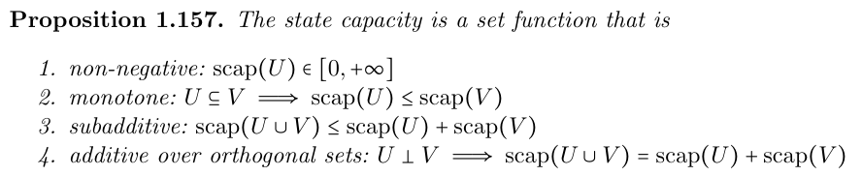
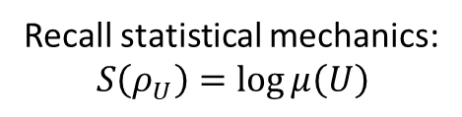
What is the spread of an ensemble in terms of distinguishable states?
Recall statistical mechanics: $$S\left(ρ_{U}\right)=\log{μ\left(U\right)}$$
additive over orthogonal sets
State capacity is a non-additive measure
Recovers Liouville measure in classical mechanics and dimensionality of Hilbert subspaces in quantum mechanics

Slide 32
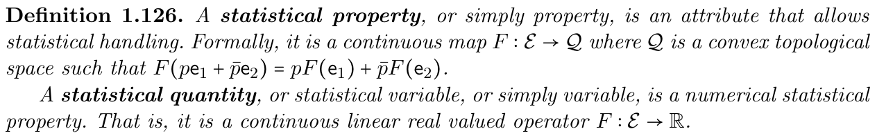
Statistical quantities (i.e. expectation values on ensembles)
If ensembles are identified by a set of statistical quantities, the ambient vector space is a locally convex topological vector space (the quantities induce semi-norms)

Slide 33
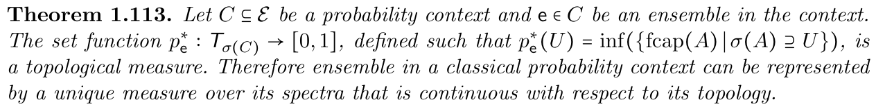
Classical probability contexts
Ensembles closed under affine combinations
Single decomposition in terms of separate ensembles
Classical probability is recovered over classical probability contexts
Classical ensemble spaces are probability contexts
The mixed states that commute with a maximal set of observables form a classical probability context

Slide 34
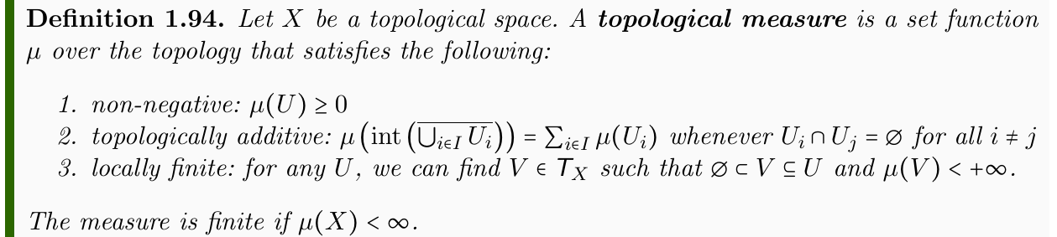
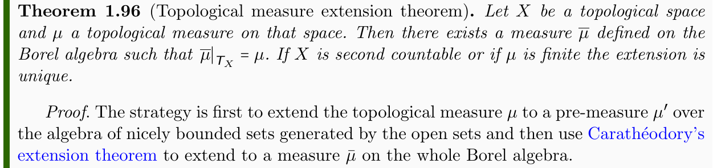
New math needed!
We need to make sure that probability is assigned only to tests that are actually terminating

Slide 35
Still to understand: Poisson structure
Both classical and quantum mechanics have a symplectic/Poisson structure
Poisson brackets for classical observables
Commutators for quantum observables
Need to define one on ensemble spaces
$$A$$
One requirement is that the only quantities that “kill” the Poisson structure are the entropy and all functions of the entropy
$$C$$
$$B$$
This means that entropy provides a foliation of symplectic “manifolds”

Slide 36
Wrapping it up
Assumptions of Physics aims to find a minimal set of physical assumptions from which we can rederive the laws
Physical mathematics aims to derive mathematical structures from well-defined physical requirements: not just mathematics, but physical mathematics
Looking for area experts that want to contribute to this unified goal
Different levels of commitment
Evangelize
Review proofs and have in depth discussions
Prove a conjecture
Literature research for papers (to publish low hanging fruits)
…

Slide 37
Some open problems
https://assumptionsofphysics.org/problems/index.html
Extend current findings (e.g. action principle interpretation) to classical field theory
Find the right Hamiltonian/symplectic formulation of field theories with a suitable entropy
Reformulate results from classical and quantum information theory within ensemble spaces
Reframe spectral theory in the context of ensemble spaces
Turn results for topological measures into a full theory
Help develop a non-additive measure theory, with a generalization of the Radon-Nikodym derivative
…

Slide 40
Underlying perspective
Foundations of physics
Foundations of mathematics
Metaphysical reality
What really exists
Physical reality
What can be accessed experimentally
Philosophy of science
What is the boundary?
What are the requirements?
Physical theories
Idealized account of empirical reality
Empirical reality
What can be reliably studied experimentally
How exactly does the abstraction/idealization process work?

Slide 41
If physics is about creating models of empirical reality, the foundations of physics should be a theory of models of empirical reality
Requirements of experimental verification, assumptions of each theory, realm of validity of assumptions, …

Slide 42
We need people that care about details, eager to acquire a wide range of technical skill, working toward the common goal of a physically meaningful, mathematically precise and philosophically consistent foundations for physics

Slide 43
Different approach to the foundations of physics
Find ultimate theory
approximation
…
Typical approaches
Construct interpretations
Weak interactions
QED -Electromagnetism
Measurement problem
Role of the observer
QCD – Strong Interactions
Electro-weak
Quantum mechanics
Contextuality
Local realism
General Relativity
Grand Unified Theory
Ontology of observables
What “really” happens
Theory of Everything
Our approach
A theory about physical models
General physical principles and requirements
General mathematical framework
Specific assumptions
Classical mechanics
Quantum mechanics
derivation
Thermodynamics
…
specialization

