Slide 1


Assumptions of Physics Summer School 2024 Classical Mechanics
Gabriele Carcassi and Christine A. Aidala
Physics Department University of Michigan
https://assumptionsofphysics.org

Slide 2
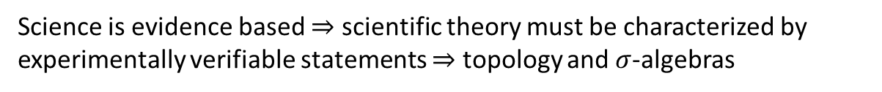


Main goal of the project
Identify a handful of physical starting points from which the basic laws can be rigorously derived
For example:
Infinitesimal reducibility $⇒$ Classical state
Irreducibility $⇒$ Quantum state
https://assumptionsofphysics.org
?
time
time
This also requires rederiving all mathematical structures from physical requirements
For example:
Science is evidence based $⇒$ scientific theory must be characterized by experimentally verifiable statements $⇒$ topology and $σ$-algebras

Slide 3
Underlying perspective
Foundations of physics
Foundations of mathematics
Metaphysical reality
What really exists
Physical reality
What can be accessed experimentally
Philosophy of science
What is the boundary?
What are the requirements?
Physical theories
Idealized account of empirical reality
Empirical reality
What can be reliably studied experimentally
How exactly does the abstraction/idealization process work?

Slide 4
If physics is about creating models of empirical reality, the foundations of physics should be a theory of models of empirical reality
Requirements of experimental verification, assumptions of each theory, realm of validity of assumptions, …

Slide 5
Different approach to the foundations of physics
Find ultimate theory
approximation
…
Typical approaches
Construct interpretations
Weak interactions
QED -Electromagnetism
Measurement problem
Role of the observer
QCD – Strong Interactions
Electro-weak
Quantum mechanics
Contextuality
Local realism
General Relativity
Grand Unified Theory
Ontology of observables
What “really” happens
Theory of Everything
Our approach
A theory about physical models
General physical principles and requirements
General mathematical framework
Specific assumptions
Classical mechanics
Quantum mechanics
derivation
Thermodynamics
…
specialization

Slide 6
Find the right overall concepts
Reverse physics: Start with the equations, reverse engineer physical assumptions/principles
Reverse Physics
Physics
Smallest set of assumptions required to rederive the theory
Physical theory
Physical result/ effect/prediction
Reverse Mathematics
Mathematics
Smallest set of axioms required to prove the theorem
Theorem
Mathematical result/ corollary/calculation
Found Phys 52, 40 (2022)
Goal: find the right overall physical concepts, “elevate” the discussion from mathematical constructs to physical principles
Physical mathematics: Start from scratch and rederive all mathematical structures from physical requirements
Physics
Physical requirements
Semantics
Physical mathematics
Goal: get the details right, perfect one-to-one map between mathematical and physical objects

Slide 7
Reverse Physics: Classical mechanics
This session
Assumptions of Physics, Michigan Publishing (v2 2023)

Slide 8
Compare different formulations

Slide 9











State
Dynamics
Evolution
Newtonian Mechanics:
$x^{i}$ and $v^{i}$
$${F^{i}(x}^{j},v^{k},t)$$
$$F^{i}=d_{t}\left(mv^{i}\right)$$
Are they equivalent?
position
velocity
Lagrangian Mechanics:
$x^{i}$ and $v^{i}$
$${L(x}^{i},v^{j},t)$$
$$∂_{x^{i}}L=d_{t}∂_{v^{i}}L$$
$$\left|∂_{v^{i}}∂_{v^{j}} L\right|≠0$$
required for unique solution
$$d_{t}q^{i}=∂_{p_{i}}H$$
Hamiltonian Mechanics:
$q^{i}$ and $p_{i}$
$${H(q}^{i},p_{j},t)$$
position
conjugate momentum
$$d_{t}p_{i}=−∂_{q^{i}}H$$
Notes:
TODO: transform it into a “Table”
Equations of motion (instead of Evolution of he system)
Mechanics are the rows
TODO: add hyperregularity of Lagrangian

Slide 10
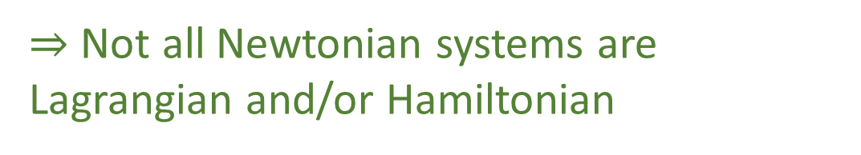



Newtonian: Three independently chosen functions (i.e. the forces) of position and velocity
Hamiltonian: A single function (i.e. the Hamiltonian) of position and momentum
$$[F^{x},F^{y},F^{z}]$$
$$H$$
$$L$$
Lagrangian: A single function (i.e. the Lagrangian) of position and velocity
There is no continuous one-to-one map between the space of a single function and the space of multiple functions!
No homeomorphism
$⇒$ Not all Newtonian systems are
Lagrangian and/or Hamiltonian
Notes:
Create visual of 3 equation vs 1 equation (one can go to three but three can’t go to one)
TODO: the visual should be about F, L and H

Slide 11








$$(x^{i},v^{i})$$
$$(x^{i},v^{i})$$
Newtonian state
Lagrangian state
Lagrangian EoM
$$∂_{x^{i}}L=d_{t}∂_{v^{i}}L$$
$$F^{i}=ma^{i}$$
Newtonian EoM
$${∂_{x^{i}}L=d}_{t}∂_{v^{i}}L=∂_{x^{j}}∂_{v^{i}}L d_{t}x^{j}+∂_{v^{k}}∂_{v^{i}}L d_{t}v^{k}=∂_{x^{j}}∂_{v^{i}}L v^{j}+∂_{v^{k}}∂_{v^{i}}L a^{k}$$
$$∂_{v^{k}}∂_{v^{i}}L a^{k}=∂_{x^{i}}L−∂_{x^{j}}∂_{v^{i}}L v^{j}$$
$\left|∂_{v^{i}}∂_{v^{j}} L\right|≠0$
$≡$ unique solution
$$a^{k}={\left(∂_{v^{k}}∂_{v^{i}}L\right)}^{−1}\left(∂_{x^{i}}L−∂_{x^{j}}∂_{v^{i}}L v^{j}\right)$$
$⇒$All Lagrangian systems are Newtonian
Notes:
To Do: Add derivation

Slide 12
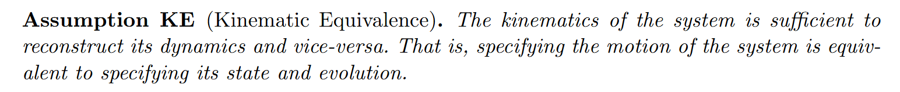

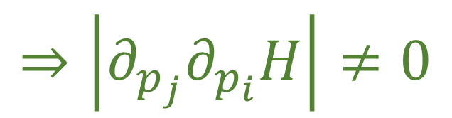




$$(x^{i},v^{i})$$
$$(q^{i},p_{i})$$
Hamiltonian state
Lagrangian state
must be invertible
$$⇒\left|∂_{p_{j}}∂_{p_{i}}H\right|≠0$$
$$v^{i}=d_{t}q^{i}=∂_{p_{i}}H$$
$$\left|∂_{p_{i}}∂_{p_{j}}H\right|=\left|{∂_{p}}_{i}v^{j}\right|={\left|∂_{v^{i}}p_{j}\right|}^{−1}={\left|∂_{v^{i}}∂_{v^{j}}L\right|}^{−1}$$
$$p_{j}=∂_{v^{j}}L$$
required for unique solution
$${|∂}_{v^{i}}∂_{v^{j}}L| ≠0$$
$⇒$All Lagrangian systems are Hamiltonian
Notes:
TODO: missing kinematic equivalence and how it is needed for converting the state
We just proved that kinematic equivalence is an underlying assumption of Lagrangian systems with unique solutions since for any Lagrangian system with a unique solution, we can explicitly wire the acceleration of the system as a function of its state (position, velocity, and time)

Slide 13











Photon as a particle
$$d_{t}q^{i}=∂_{p_{i}}H\text{=} c\frac{p^{i}}{|p|}$$
$$d_{t}p_{i}=−∂_{q^{i}}H =0$$
$$H=ℏ\left|ω\right|=cℏ\left|k\right|=c\left|p\right|$$
$$v$$
$$p$$
$$p$$
not invertible!
$$c$$
$$p$$
$$−c$$
$$q$$
$$H$$
phase-space diagram for a photon treated as a point particle
plot of the Hamiltonian $H=c|p|$

Slide 14
Newtonian
Systems
Lagrangian
Systems
Hamiltonian
Systems

Slide 15
12 equivalent characterizations of Hamiltonian mechanics single DOF

Slide 16






Hamilton’s equations
(HM-1D)
$$\frac{dq}{dt}=\frac{∂H}{∂p}$$
$$d_{t}q=S^{q}(q, p)$$
$$S^{q}=∂_{p}H$$
$$\frac{dp}{dt}=−\frac{∂H}{∂q}$$
$$S^{p}=−∂_{q}H$$
$$d_{t}p=S^{p}(q, p)$$

Slide 17









$\vec{∇}H\left(q,p\right)=\left[\begin{matrix}∂_{p}H \\ ∂_{q}H\end{matrix}\right]$
$$\vec{∇}H\left(q,p\right)$$
$$p$$
$$4$$
$$3$$
$=\left[\begin{matrix}\frac{p}{m} \\ 2kq\end{matrix}\right]$
$$2$$
$$H=1$$
$$q$$
$H=\frac{p^{2}}{2m}+kq^{2}$

Slide 18






$\vec{S}\left(q,p\right)=\left[\begin{matrix}S^{q} \\ S^{p}\end{matrix}\right]$
$$\vec{S}\left(q,p\right)$$
$$p$$
$$4$$
$$=\left[\begin{matrix}d_{t}q \\ d_{t}p\end{matrix}\right]=\left[\begin{matrix}∂_{p}H \\ −∂_{q}H\end{matrix}\right]$$
$$3$$
$$2$$
$$H=1$$
$$q$$
$$={\text{P}}_{}^{90°}\left(\vec{∇}H\right)$$
Notes:
TODO: field should be the previous rotated (with the same origin for the vectors)

Slide 19














$$\vec{S}\left(q,p\right)$$
$$p$$
$$ω=\left[\begin{matrix}0 & 1 \\ −1 & 0\end{matrix}\right]$$
$$\left[ω_{ab}\right]=\left[\begin{matrix}ω_{qq} & ω_{qp} \\ ω_{pq} & ω_{pp}\end{matrix}\right]$$
$$4$$
$$2$$
$$3$$
$$H=1$$
$$q$$
$$\vec{S}=ω \vec{∇}H$$
$$S^{b}ω_{ba}=∂_{a}H$$
$$\left[\begin{matrix}S^{q} \\ S^{p}\end{matrix}\right]=\left[\begin{matrix}0 & 1 \\ −1 & 0\end{matrix}\right]\left[\begin{matrix}∂_{q}H \\ ∂_{p}H\end{matrix}\right]$$
$$=\left[\begin{matrix}∂_{p}H \\ −∂_{q}H\end{matrix}\right]$$
$$S^{q}ω_{qp}=∂_{p}H$$
$$S^{p}ω_{pq}=∂_{q}H$$
(HM-G)

Slide 20

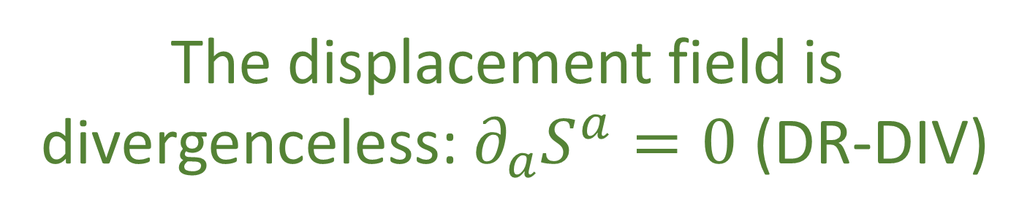
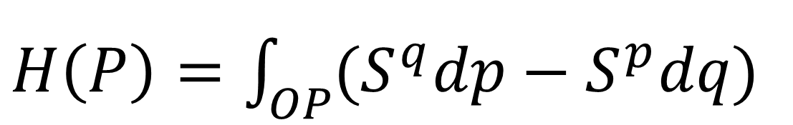

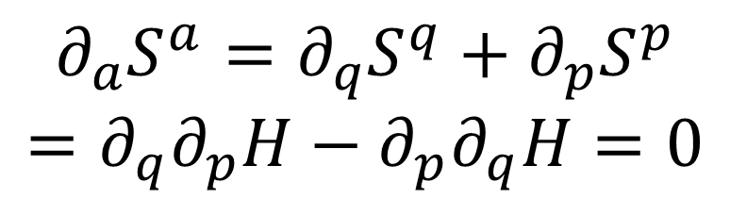



$$p$$
$$∂_{a}S^{a}=∂_{q}S^{q}+∂_{p}S^{p}$$
$$=∂_{q}∂_{p}H−∂_{p}∂_{q}H=0$$
$$P$$
$H\left(P\right)=\int_{OP}{(S^{q}dp−S^{p}dq)}$
$$q$$
$$O$$
HM-1D $⟺$
The displacement field is
divergenceless: $∂_{a}S^{a}=0$ (DR-DIV)

Slide 21




$$\left|∂_{b}{\hat{ξ}}^{a}\right|=\left(1+∂_{q}S^{q}δt\right)\left(1+∂_{p}S^{p}δt\right)−∂_{q}S^{p}∂_{q}S^{q}δt^{2}$$
$$p$$
$$=1+\left(∂_{q}S^{q}+∂_{p}S^{p}\right)δt+O(δt^{2})$$
$\left|∂_{b}{\hat{ξ}}^{a}\right|=1$ $⟺$ $∂_{a}S^{a}=0$
$$q$$
HM-1D $⟺$ DR-DIV $⟺$
The Jacobian of the time evolution is unitary:
$\left|∂_{b}{\hat{ξ}}^{a}\right|=1$ (DR-JAC)

Slide 22
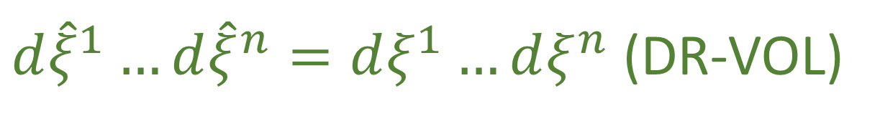





$$\int_{\hat{U}}{d\hat{q}d\hat{p}}=\int_{U}{\left|\begin{matrix}∂_{q}\hat{q} & ∂_{p}\hat{q} \\ ∂_{q}\hat{p} & ∂_{p}\hat{p}\end{matrix}\right|}dqdp$$
$$p$$
$$U$$
$$=\int_{U}{dqdp}$$
$$q$$
$$\hat{U}$$
DR-JAC $⟺$
Volumes are conserved through the evolution:
$d{\hat{ξ}}^{1}…d{\hat{ξ}}^{n}=dξ^{1}…dξ^{n}$ (DR-VOL)

Slide 23



Transformation of densities
$$\left|∂_{b}{\hat{ξ}}^{a}\right|\hat{ρ}\left({\hat{ξ}}^{a}\right)=ρ\left(ξ^{b}\right)$$
$$=\hat{ρ}\left({\hat{ξ}}^{a}\right)$$
DR-JAC $⟺$
Densities are conserved through the
evolution: $\hat{ρ}\left({\hat{ξ}}^{a}\right)=ρ\left(ξ^{b}\right)$ (DR-DEN)

Slide 24













Area$\left(v^{a},w^{a}\right)=v^{q}w^{p}−v^{p}w^{q}=v^{a}ω_{ab }w^{b}$
$$p$$
Area is conserved if
$${\hat{ω}}_{ab}=ω_{ab}$$
$$v$$
$$ω(v,w)$$
$$w$$
$${\hat{v}}^{a}=∂_{b}{\hat{ξ}}^{a}v^{b}$$
$${\hat{w}}^{a}=∂_{b}{\hat{ξ}}^{a}w^{b}$$
$$q$$
$$ω(\hat{v},\hat{w})$$
$$\hat{w}$$
${\hat{v}}^{c}ω_{cd }{\hat{w}}^{d}={v^{a}∂}_{a}{\hat{ξ}}^{c}ω_{cd}∂_{b}{\hat{ξ}}^{d}w^{b}=v^{a}{\hat{ω}}_{ab }w^{b}$
$$\hat{v}$$
DR-VOL $⟺$
The evolution leaves $ω_{ab}$ invariant:
${\hat{ω}}_{ab}=ω_{ab}$ (DI-SYMP)

Slide 25
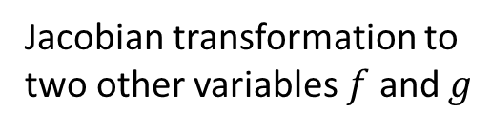
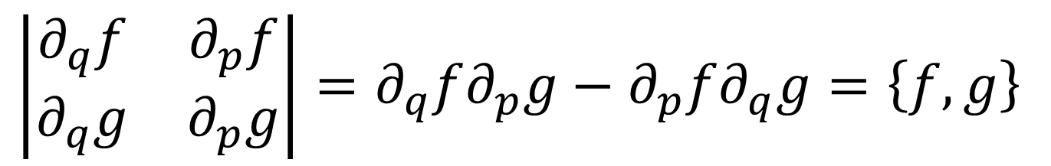

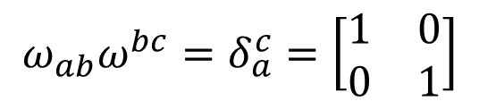

Jacobian transformation to two other variables $f$ and $g$
Poisson bracket!
$$\left|\begin{matrix}∂_{q}f & ∂_{p}f \\ ∂_{q}g & ∂_{p}g\end{matrix}\right|=∂_{q}f∂_{p}g−∂_{p}f∂_{q}g=\left\{f,g\right\}$$
We can express the Poisson bracket:$\left\{f,g\right\}=−∂_{a}fω^{ab}∂_{b}g=∂_{b}gω^{ba}∂_{a}f$
is the inverse of $ω_{ab}$
$$ω_{ab}ω^{bc}=δ_{a}^{c}=\left[\begin{matrix}1 & 0 \\ 0 & 1\end{matrix}\right]$$
DI-SYMP $⟺$
The evolution leaves the Poisson
brackets invariant (DI-POI)

Slide 26
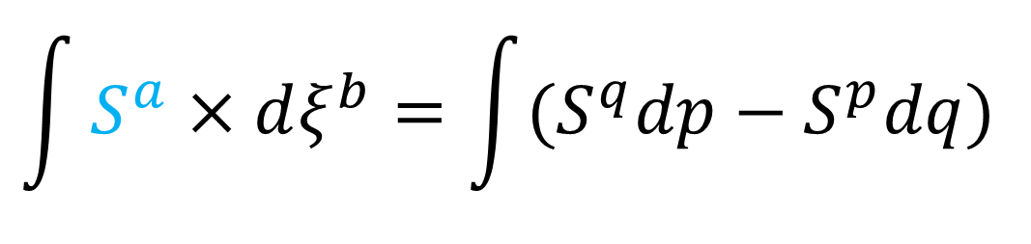

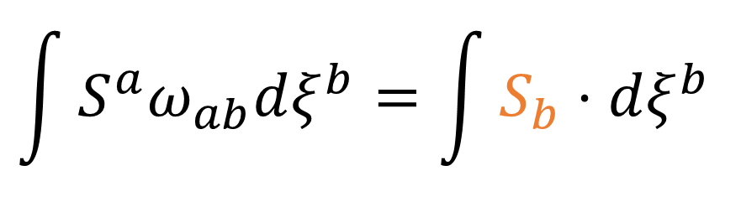


Flow THROUGH the curve
$$p$$
$$\int{S^{a}×dξ^{b}}=\int{{(S}^{q}dp−S^{p}dq)}$$
$$U$$
$$\int{S^{a}ω_{ab}dξ^{b}}=\int{S_{b}⋅dξ^{b}}$$
$$q$$
$$\hat{U}$$
${90}^{∘}$ rotation
Flow ALONG the curve
DR-DIV $⟺$
The rotated displacement field is
curl free: $∂_{a}S_{b}−∂_{b}S_{a}=0$ (DI-CURL)
Notes:
TODO: fix gradient. Select two colors for gradient and flow, color Sa and Sb accordingly

Slide 27
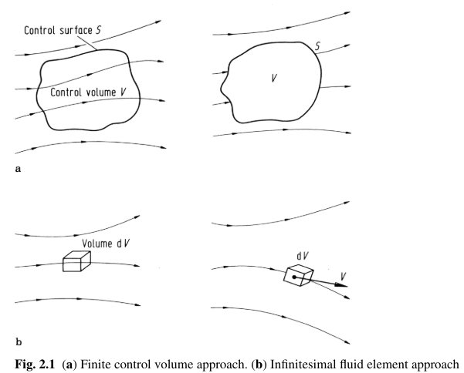
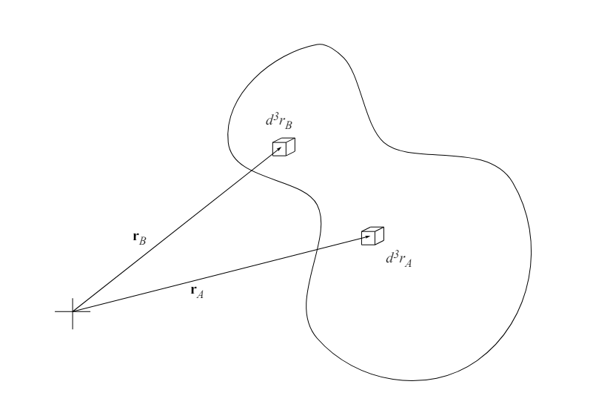
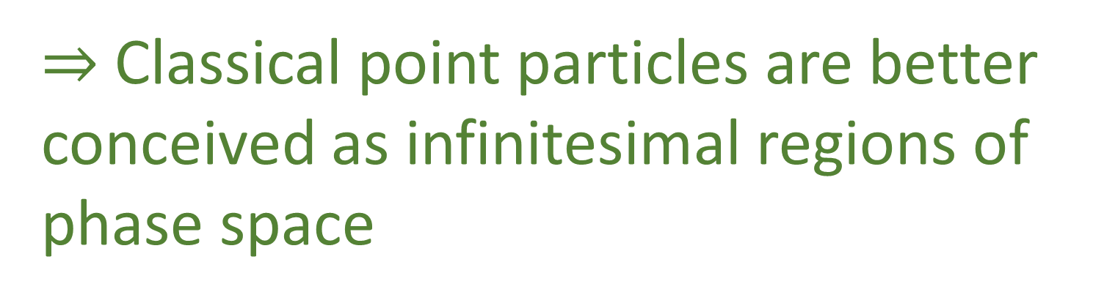
Note: Hamiltonian mechanics is about transporting areas/densities, not just points!
Styer, D. F. (2023)
Statistical Mechanics
$⇒$ Classical point particles are better conceived as infinitesimal regions of phase space
Wendt, J. F. (Ed.). (2008)
Computational Fluid Dynamics
Notes:
TODO: take the picture from the other slide
There would actually be no reason for the Hamiltonian equations of motion to be
differentiable if were about points, since differentiable equations are what is needed
to define the Jacobian, the transport of areas, or of densities defined on those areas

Slide 28


Stat mech: phase space volumes count the number of microstates
Hamiltonian mechanics preserves volumes $⇒$ preserves the number of states
$⇒$ for each initial state there is one and only one final state
DR-VOL $⟺$
The evolution is deterministic and
reversible (DR-EV)
Notes:
From Book: “Note that by reversible here we mean that given the final state we can reconstruct the initial state. Given that areas measure the number of states, DR-EV is equivalent to DR-VOL, which means this is another characterization of Hamiltonian mechanics. We can also see a connection to DR-DEN. If we assign a density to an initial state, and we claim that all and only the elements that start in that initial state will end in a particular final state, we will expect the density of the corresponding final state to match. That is, if the evolution is deterministic and reversible, it may shuffle around a distribution, but it will never be able to spread it or concentrate it”

Slide 29

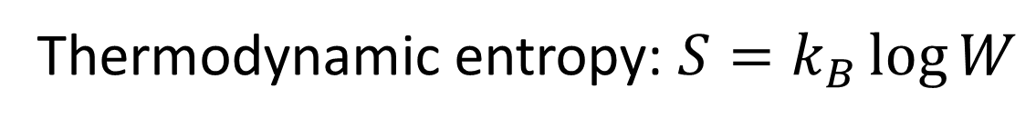
Thermodynamic entropy: $S=k_{B}\log{W}$
Since the logarithm is a bijective function, conservation of areas of
phase space is equivalent to the conservation of entropy.
DR-VOL $⟺$
The evolution is deterministic and
thermodynamically reversible (DR-THER)

Slide 30
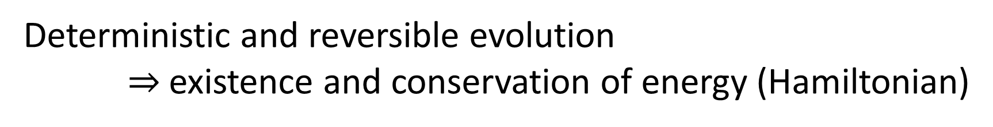
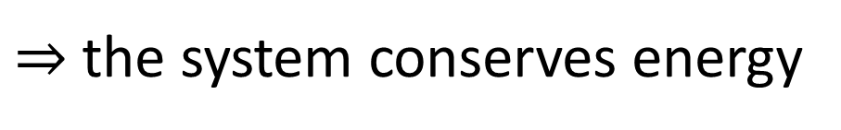
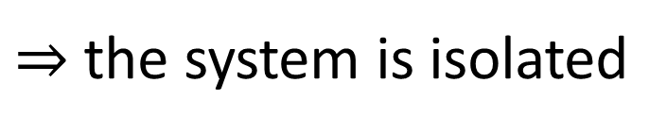
Deterministic and reversible evolution $⇒$existence and conservation of energy (Hamiltonian)
Why?
Stronger version of the first law of thermodynamics
Deterministic and reversible evolution
$⇒$ past and future depend only on the state of the system
$⇒$ the evolution does not depend on anything else
$⇒$ the system is isolated
First law of thermodynamics!
$⇒$ the system conserves energy
Notes:
Structure of phase space exactly what is needed to do statistical mechanics - Comes out of invariance of the entropy under coordinate transformations

Slide 31

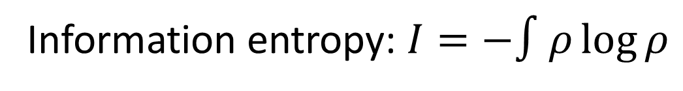

$$I\left[ρ\left(ξ^{a}\right)\right] =I\left[\hat{ρ}\left({\hat{ξ}}^{b}\right)\right]−\int{\hat{ρ}\left({\hat{ξ}}^{b}\right)}\log{{|∂}_{a}{\hat{ξ}}^{b}|dξ^{1}…dξ^{n}}$$
Information entropy: $I=−∫ρ\log{ρ}$
DR-JAC $⟺$
The evolution conserves
information entropy (DR-INFO)

Slide 32

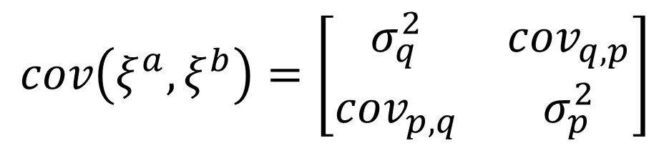
$$\left|cov\left({\hat{ξ}}^{c},{\hat{ξ}}^{d}\right)\right|=\left|∂_{a}{\hat{ξ}}^{c}cov\left(ξ^{a},ξ^{b}\right)∂_{b}{\hat{ξ}}^{d}\right|=\left|∂_{a}{\hat{ξ}}^{c}\right| \left|cov\left(ξ^{a},ξ^{b}\right)\right|\left|∂_{b}{\hat{ξ}}^{d}\right|$$
$$p$$
Covariance matrix:
$$cov\left(ξ^{a},ξ^{b}\right)=\left[\begin{matrix}σ_{q}^{2} & cov_{q,p} \\ cov_{p,q} & σ_{p}^{2}\end{matrix}\right]$$
$$q$$
DR-JAC $⟺$
The evolution conserves the uncertainty
of peaked distributions (DR-UNC)

Slide 33
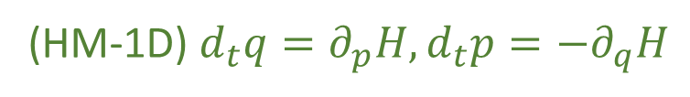
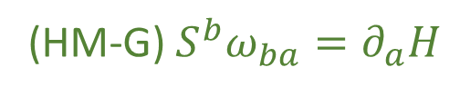
We have found twelve equivalent characterizations for a single degree of freedom
(HM-1D) $d_{t}q=∂_{p}H,d_{t}p=−∂_{q}H$
(HM-G) $S^{b}ω_{ba}=∂_{a}H$
(DR-DIV) The displacement field is divergenceless: $∂_{a}S^{a}=0$
(DR-JAC) The Jacobian of the time evolution is unitary: $\left|∂_{b}{\hat{ξ}}^{a}\right|=1$
(DR-VOL) Volumes are conserved through the evolution: $d{\hat{ξ}}^{1}…d{\hat{ξ}}^{n}=dξ^{1}…dξ^{n}$
(DR-DEN) Densities are conserved through the evolution: $\hat{ρ}\left({\hat{ξ}}^{a}\right)=ρ\left(ξ^{b}\right)$
(DI-SYMP) The evolution leaves $ω_{ab}$ invariant: ${\hat{ω}}_{ab}=ω_{ab}$
(DI-POI) The evolution leaves the Poisson brackets invariant
(DI-CURL) The rotated displacement field is curl free: $∂_{a}S_{b}−∂_{b}S_{a}=0$
(DR-EV) The evolution is deterministic and reversible
(DR-THER) The evolution is deterministic and thermodynamically reversible
(DR-INFO) The evolution conserves information entropy
(DR-UNC) The evolution conserves the uncertainty of peaked distributions
Notes:
TODO: move the tags in front

Slide 34
Takeaways
Hamiltonian mechanics describes a flow of states that is deterministic and reversible
There is a deeper way to understand classical mechanics and we should strive to understand all of physics like this
TODOs:
Help popularize these ideas, more pictures/diagrams in the book/etc…

Slide 35
Hamiltonian mechanics multiple DOFs

Slide 36









HM-G
$$⟺$$
DI-CURL
DR-JAC
$$⟺$$
DR-DIV
$$⇒$$
$$⟺$$
$$⟺$$
$$⟺$$
$$⟺$$
DI-POI
$$⟺$$
DI-SYMP
DR-DEN
$$⟺$$
DR-VOL
For single DOF, volumes are areas
For multiple DOFs, statements about areas are stronger than statements about volumes
Notes:
TODO: reformat, and consolidate the text from other two slides here

Slide 37

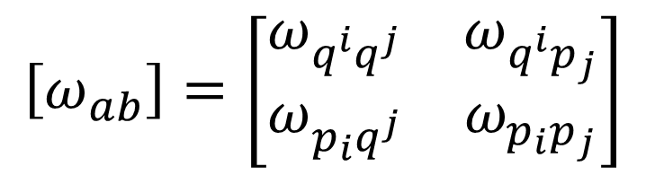
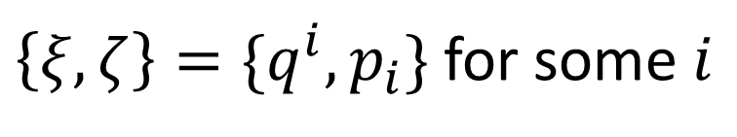

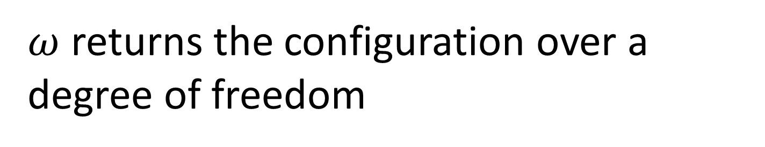
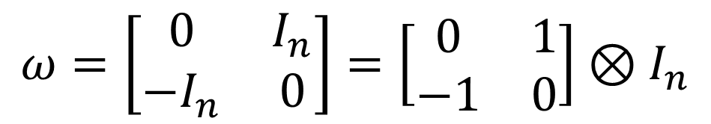

$$ω=\left[\begin{matrix}0 & I_{n} \\ −I_{n} & 0\end{matrix}\right]=\left[\begin{matrix}0 & 1 \\ −1 & 0\end{matrix}\right]⊗I_{n}$$
$$\left[ω_{ab}\right]=\left[\begin{matrix}ω_{q^{i}q^{j}} & ω_{q^{i}p_{j}} \\ ω_{p_{i}q^{j}} & ω_{p_{i}p_{j}}\end{matrix}\right]$$
Pick $\{ξ,ζ\}$ from $\{q^{i},p_{j}\}$
$$ω\left(dξ,dζ\right)≠0$$
$$⟺$$
$\left\{ξ,ζ\right\}=\{q^{i},p_{i}\}$ for some $i$
$ω$ returns the configuration over a degree of freedom
Orthogonality represents independence
Notes:
TODO: in sDOF, omega is just area. In mDOF, omega is area ONLY with matching q and p, and zero for any other combinations => counts configuration within a DOF

Slide 38














HM-G
$$⟺$$
DI-CURL
DR-JAC
$$⟺$$
DR-DIV
$$⇒$$
$$⟺$$
$$⟺$$
$$⟺$$
$$⟺$$
DI-POI
$$⟺$$
DI-SYMP
DR-DEN
$$⟺$$
DR-VOL
$$(y′,{p′}_{y})$$
$$(y,p_{y})$$
$$(x,p_{x})$$
$$(x′,{p′}_{x})$$
Evolution preserves areas and orthogonality
$$⇒$$
Evolution preserves volumes

Slide 39

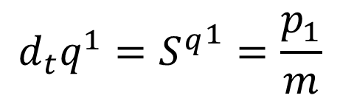






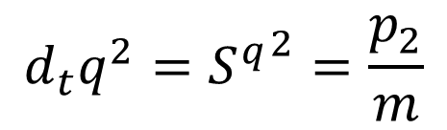

$$d_{t}q^{1}={S^{q}}^{1}=\frac{p_{1}}{m}$$
$$d_{t}p_{1}=S^{p_{1}}=−bp_{1}$$
linear drag
$$d_{t}q^{2}={S^{q}}^{2}=\frac{p_{2}}{m}$$
$$d_{t}p_{2}=S^{p_{2}}=bp_{2}$$
linear acceleration
$$∂_{a}S^{a}=∂_{q^{1}}\frac{p_{1}}{m}+∂_{p_{1}}\left(bp_{1}\right)+∂_{q^{2}}\frac{p_{2}}{m}+∂_{p_{2}}\left(bp_{2}\right)=−b+b=0$$
DR-DIV and DR-VOL satisfied
$$∂_{q^{1}}S_{p_{1}}−∂_{p_{1}}S_{q^{1}}=∂_{q^{1}}S^{q^{1}}ω_{q^{1}p_{1}}−∂_{p_{1}}S^{p_{1}}ω_{p_{1}q^{1}}=∂_{q^{1}}\frac{p_{1}}{m}\left(1\right)−∂_{p_{1}}\left(−bp_{1}\right)\left(−1\right)=−b$$
DI-CURL and DI-SYMP not satisfied
$⇒$ No Hamiltonian
$$(y′,{p′}_{y})$$
$$(y,p_{y})$$
$$(x,p_{x})$$
$$(x′,{p′}_{x})$$
Evolution preserves areas and orthogonality
$$⇍$$
Evolution preserves volumes

Slide 40
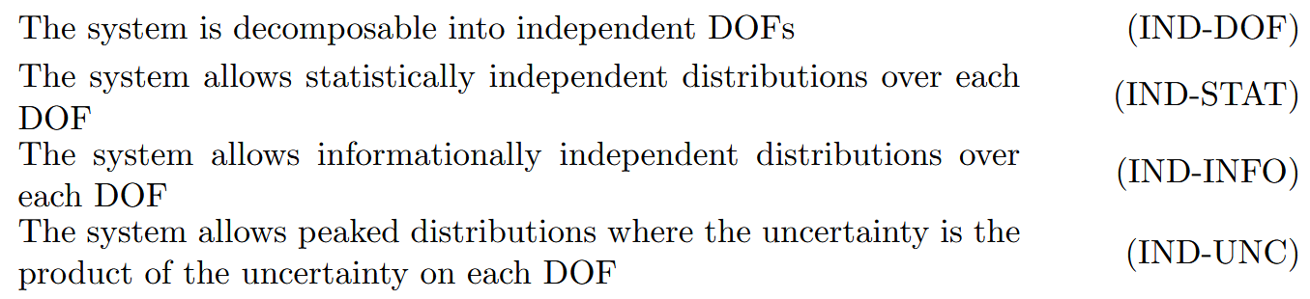
Physical characterizations of DOF independence
Similar to physical characterizations of determinism and reversibility

Slide 41
HM-G
$$⟺$$
DI-CURL
DR-JAC
$$⟺$$
DR-DIV
$$⇒$$
$$⟺$$
$$⟺$$
$$⟺$$
$$⟺$$
DI-POI
$$⟺$$
DI-SYMP
DR-DEN
$$⟺$$
DR-VOL
DR+IND
DR
NOTE: in principle we could have IND without DR

Slide 42
Takeaways
Hamiltonian mechanics is preservation of number of configurations and independence of DOFs
A single mathematical structure may bundle multiple independent physical assumptions
TODOs:
Help popularize these ideas, more pictures/diagrams in the book/etc…

Slide 43
Lagrangian and least action

Slide 44

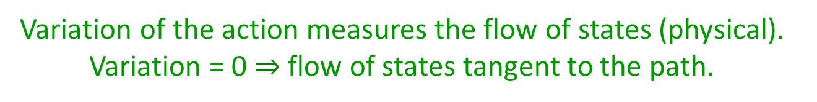
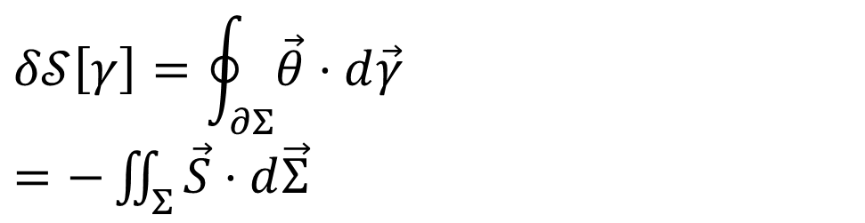


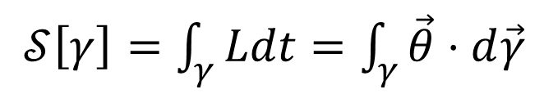





Reversing the principle of least action
DR
KE
$$∇⋅\vec{S}=0$$
$$\vec{S}=−∇×\vec{θ}$$
$𝒮\left[γ\right]=\int_{γ}{Ldt}=\int_{γ}{\vec{θ}⋅d\vec{γ}}$
No state is “lost” or “created” as time evolves
(Minus sign to match convention)
Sci Rep 13, 12138 (2023)
The action is the line integral of the vector potential of the flow of states
$$p$$
$$q$$
Variation of the action
$$Σ$$
Gauge independent, physical!
$$δ𝒮\left[γ\right]=\oint_{∂Σ}{\vec{θ}⋅d\vec{γ}}$$ $=−\iint_{Σ}{\vec{S}⋅d\vec{Σ}}$
$$γ$$
$$γ′$$
$$t$$
Variation of the action measures the flow of states (physical). Variation = 0 $⇒$ flow of states tangent to the path.

Slide 45
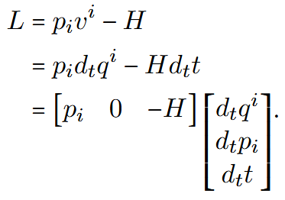



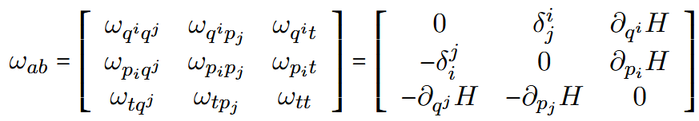
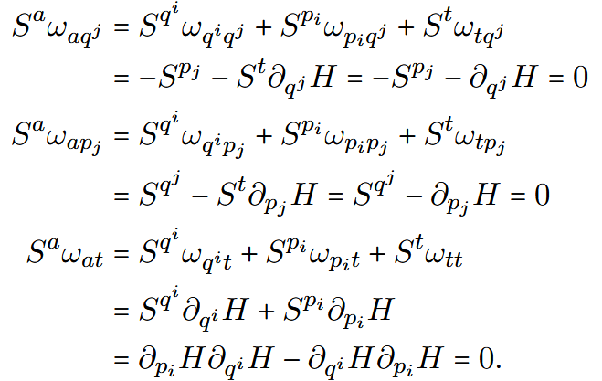



Phase space extended by time
Action is the line integral of $θ$
Encodes both IND and DR: geometry of the flow at equal time and across times
Hamilton’s equations in the extended phase space
Flow is described by $ω$

Slide 46
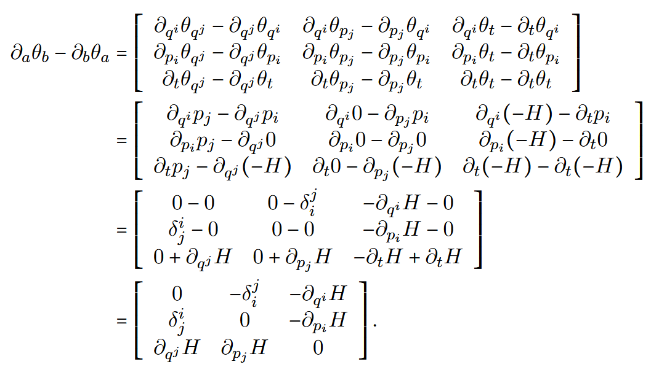

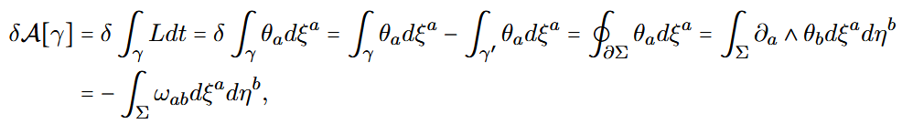








$θ$ is the potential of $ω$
Variation of the action is the flow through enclosed surface
$$p$$
$$q$$
$$γ$$
$$Σ$$
$$\vec{S}$$
$$γ′$$
0 if and only if always tangent to the flow
$$t$$

Slide 47
Note: kinematic equivalence is needed only to write the Lagrangian in terms of position and velocity
Principle of least action works in the extended phase space for Hamiltonian systems that are not Lagrangian!

Slide 48
Takeaways
The principle of least action is just a property of incompressible flows over independent DOFs
The Lagrangian and the action themselves are not “physical” (i.e. you cannot measure the Lagrangian or the action, defined up to an arbitrary choice of gauge)
TODOs:
Help popularize these ideas, more pictures/diagrams in the book/etc…
Generalization to classical field theory
Generalization to quantum (path integral)

Slide 49
Kinematic equivalence and massive particles

Slide 50

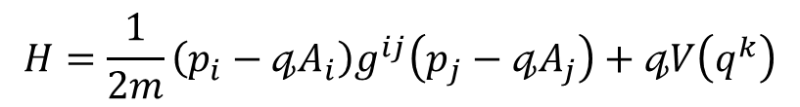

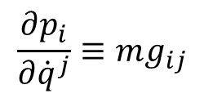

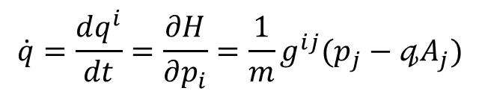



Massive particles under potential forces
Kinematic equivalence assumption: the state can be recovered from space-time trajectories
Integration of the previous expression
$$p_{i}=mg_{ij}{\dot{q}}^{j}+𝓆A_{i}\left(q^{k}\right)$$
$$\dot{q}=\frac{dq^{i}}{dt}=\frac{∂H}{∂p_{i}}=\frac{1}{m}g^{ij}(p_{j}−𝓆A_{j})$$
$$p$$
$$z$$
$$\frac{∂p_{i}}{∂{\dot{q}}^{j}}≡mg_{ij}$$
$$y$$
Must be a linear transformation in terms of coordinates
$$q$$
$$H=\frac{1}{2m}\left(p_{i}−𝓆A_{i}\right)g^{ij}\left(p_{j}−𝓆A_{j}\right)+𝓆V\left(q^{k}\right)$$
$$x$$
Fixes the units
Hamiltonian for massive particles under potential forces
Mass quantifies number of states per unit of velocity
Higher mass $⇒$ more states to go through $⇒$ harder to accelerate
BUT
Zero mass $⇒$ zero states within finite range of velocity $⇒$ velocity is fixed
The laws themselves are highly constrained by simple assumptions

Slide 51
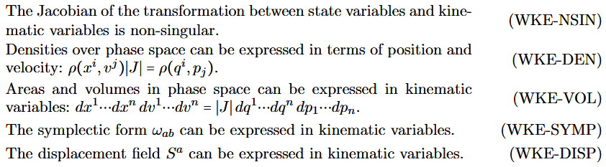

Two flavors of Kinematic Equivalence:
Weak KE: only require invertible relationship
Jacobian $∂_{v^{i}}p_{j}$ exists and is non-singular

Slide 52
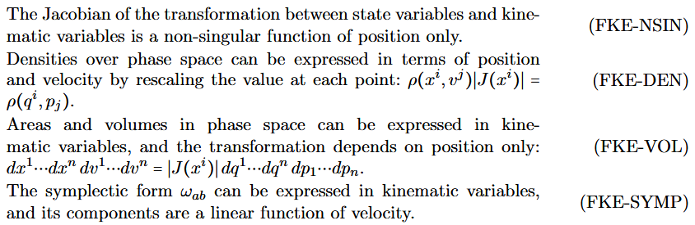




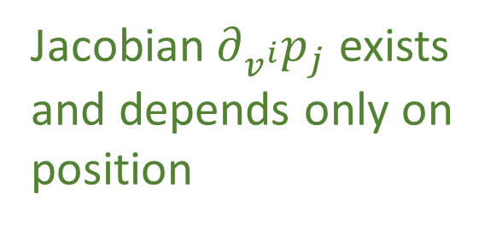
Two flavors of Kinematic Equivalence:
Full KE: linear relationship
Jacobian $∂_{v^{i}}p_{j}$ exists and depends only on position

Slide 53

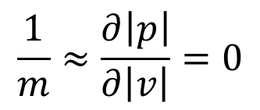
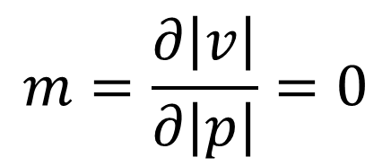

Harder to accelerate heavier bodies because same change of speed means more states to go through
More massive object = more states
$$v_{0}$$
$$v_{1}$$
$$m=\frac{∂\left|v\right|}{∂\left|p\right|}=0$$
Massless particles are impossible to accelerate (not infinitely easy) because states are not spread over velocity
$$\frac{1}{m}≈\frac{∂\left|p\right|}{∂\left|v\right|}=0$$
Zero mass is “kind of the same” as infinite mass

Slide 54
Is full Kinematic Equivalence required?
Full kinematic equivalence is connected to the existence of inertia, the way densities behave in velocity, and the unit system

Slide 55
Takeaways
Weak Kinematic Equivalence recovers Lagrangian mechanics and Full Kinematic Equivalence recovers massive particles under potential forces
Mass is a geometric property of the state space when charted by position and velocity
The basic laws are more constrained than one may think at first
TODOs:
Help popularize these ideas, more pictures/diagrams in the book/etc…
Deeper understanding of FKE: what does a purely WKE system look like?
Inertial mass vs gravitational mass?
With multiple particles, what does it mean that the metric tensor is the same for all? Can be articulated as a property of the unit system? (i.e. we must be able to choose the same units for all particles?)

Slide 56
Relativistic mechanics

Slide 57


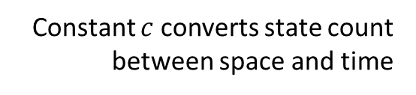

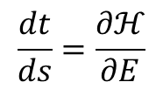


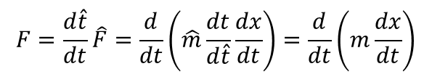












Relativistic mechanics
Relativistic aspects without space-time and in Newtonian mechanics
Classical antiparticles
$$p$$
potential of the displacement
$$F=\frac{d\hat{t}}{dt}\hat{F}=\frac{d}{dt}\left(\hat{m}\frac{dt}{d\hat{t}}\frac{dx}{dt}\right)=\frac{d}{dt}\left(m\frac{dx}{dt}\right)$$
$$q$$
$$\frac{dt}{ds}=\frac{∂ℋ}{∂E}$$
$$θ=[p^{i},−E,0, 0]$$
$$t$$
energy-momentum co-vector
rest mass scaled by time dilation
Affine parameter anti-aligned with time:
parameterization “goes back” in time
Lorentzian relativity is the only “correct” one
No clear idea what $G_{αβγ}$ is…
Inertial forces?
Minkowski signature appears on the extended phase space
Metric tensor quantifies states charted by position and velocity
$$ω=dq^{1}dp_{1}+dq^{2}dp_{2}$$
$$ω=dq^{1}dp_{1}−dtdE$$
$$ω_{ab}=\left[\begin{matrix}−mG_{αβγ}u^{γ}+𝓆F_{αβ} & g_{αβ} \\ −g_{αβ} & 0\end{matrix}\right]$$
$$ω$$
$$dq^{1}dp_{1}=ω+dtdE$$
$$dq^{2}dp_{2}$$
States are counted at equal time: temporal DOF orthogonal to $ω$
$$dq^{1}dp_{1}$$
$$t$$
instants in time
$$dq^{1}dp_{1}$$
positions in space
$$dtdE$$
$$ω$$
$$q$$
Indep DOFs are orthogonal
Constant $c$ converts state count between space and time

Slide 58









Want to extend Hamiltonian mechanics to handle changes of time variable
Recall
$$ξ^{a}(s)$$
Evolution in $s$ (affine parameter)!
Hamilton’s equations
Hamiltonian constraint

Slide 59




FKE in phase space extended by time and energy
Recovers EM Hamiltonian for massive particle
Hamiltonian constraint fixes the rest mass
Recovers geodesic equation

Slide 60






$ω$ in kinematic variables
???
$$ξ^{a}=[ q^{α}, u^{α} ]$$
$$∂_{α}g_{βγ}−∂_{β}g_{αγ}$$
$$∂_{α}A_{β}−∂_{β}A_{α}$$
$$ω_{ab}=\left[\begin{matrix}−mG_{αβγ}u^{γ}−𝔮F_{αβ} & mg_{αβ} \\ −mg_{αβ} & 0\end{matrix}\right]$$
Conservative forces define state density over position/position?
Metric tensor defines state density over position/velocity
Must be encoding some geometric information!
$$∇_{α}A_{β}−∇_{β}A_{α}=∂_{α}A_{β}−∂_{β}A_{α}$$
$$∇^{α}A^{β}−∇^{β}A^{α}=∂^{α}A^{β}−∂^{β}A^{α}+G^{αβγ}A_{γ}$$

Slide 61



Classical anti-particles
This can be negative
$$p$$
$$d_{s}t=∂_{−E}ℋ$$
$$d_{s}q^{i}=∂_{p_{i}}ℋ$$
$$d_{s}(−E)=∂_{t}ℋ$$
$$d_{s}p_{i}=∂_{q^{i}}ℋ$$
$$q$$
$$t$$
Particle: affine parameter aligned with time
Anti-particle: affine parameter anti-aligned with time
Parametrization flows backwards with respect to time
Free particle
Anti-particle = negative energy
An evolution cannot change time alignment

Slide 62




Recover standard Hamiltonian
Over valid states $ℋ=0$ and $E=H$
Assume no $E$ dependence

Slide 63




Hamiltonian constraint can “hide” multiple $H$s
Free particle Hamiltonian constraint
Negative energy
Positive energy

Slide 64





Quantum connection
Free particle Hamiltonian constraint
Density can be non-zero only where $ℋ=0$
$$ℋρ=0$$
Hamiltonian constraint becomes relativistic equations in QM
Gauge covariant derivative related to kinetic momentum

Slide 65

Takeaways
Relativistic mechanics is recovered without additional assumptions: relativity is needed to make densities/entropy invariant over time transformations
Mass is a geometric property of the state space when charted by position and velocity
The basic laws are more constrained than one may think at first
TODOs:
Help popularize these ideas, more pictures/diagrams in the book/etc…
Find out what $G_{αβγ}$ represents
Understand whether there is a link between $g_{αβ}$ and $F_{αβ}$ already in particle mechanics

Slide 66
Reversing phase space

Slide 67
















Reversing phase-space
Hamiltonian Privilege, Erkenn (2023)
Stud Hist Phil 71, 082020, 60-71 (2020)
Each unit variable (i.e. coordinate) paired with a conjugate of inverse units: number of states $ΔqΔk$is invariant
$\hat{q}=100 cm/m q$
$$x↦x^{3}$$
$$1$$
$Δk=1 m^{−1}$
$$1$$
$Δ\hat{k}=0.01 cm^{−1}$
$$x$$
$$x^{3}$$
$Δ\hat{q}=100 cm$
$Δq=1 m$
Density, entropy, uniform distributions NOT in general coordinate invariant
Phase space (symplectic) structure is the only one that supports coordinate invariant density, entropy, state count
Only 3 spatial dimensions are possible
Independence of DOFs $⇒$ independence of units $⇒$ orthogonality in phase-space $⇒$ invariant marginals (for density, entropy, state count)
Hamiltonian mechanics preserves count of states and DOF independence over time
2-sphere the only symplectic manifold
$$(q^{y},k_{y})$$
$$ω_{ab}=\left[\begin{matrix}0 & 1 \\ −1 & 0\end{matrix}\right]⊗δ_{j}^{i}$$
Directional DOF
$$(q^{x},k_{x})$$
Orthogonality/independence across DOFs
Total number of states $=$ product of number of cases in each independent DOF
Symplectic form (geometric structure of phase space)
Areas/possibilities in each DOF
Invariance at equal time (relativity) gives us the structure of phase space

Slide 68
The following three conditions are equivalent, and link the structure of phase space with equal-time changes of coordinates

Slide 69


They can be broken down into two sets of conditions
About orthogonality
About volumes

Slide 70









To reconstruct phase space
$\hat{q}=100 cm/m q$
$$1$$
$Δk=1 m^{−1}$
$$1$$
$Δ\hat{k}=0.01 cm^{−1}$
Space charted by continuous quantities
$Δ\hat{q}=100 cm$
$Δq=1 m$
Some quantities define the unit systems: $q^{i}$
Units are independent (change one without affecting the other)
Volume/density/entropy are unit independent
If one unit variable $q$ changes, unit independent variables
must stay the same, and unit dependent variable must change, while also keeping the volume the same
For each variable $q$ there is a variable $p$ whose units are proportional to the inverse units of $q$, so that the volume stays the same

Slide 71
Takeaways
Structure of phase space is exactly the structure needed to define state densities, thermodynamic entropy, information entropy and statistical uncertainty in a way that satisfies the principle of relativity for equal-time observers
The relativistic version extends those quantities to all observers
TODOs:
Help popularize these ideas, more pictures/diagrams in the book/etc…

Slide 72
Infinitesimal reducibility

Slide 73






Divisible
vs
Reducible
reducible but not divisible
divisible but not reducible
$$𝒫_{t} :𝒮 →𝒮_{1}×𝒮_{2}$$
$$𝒮≡𝒮_{1}×𝒮_{2}$$
time
time

Slide 74








IR-INF: A classical system can be thought of as being made of infinitesimal parts, called particles
$$⇒$$
IR-DIST: classical state is given by a distribution over phase space
Suppose IR-INF
$S_{C}$ state space for the full system
$S_{P}$ state space for the particles
Technically, from the sigma algebra
$s∈S_{C} ⟺ f\left(U\right)∈\left[0,1\right] U⊆S_{P} f$ additive
Assume finitely many $⇒$ manifold
IR-INF $⇒$ $f$ real valued, $S_{P}$ charted by continuous variables
Need to quantify states $⇒μ\left(U\right)∈\left[0,1\right]$
$μ$ and $f$ should be independent of choice of variables, and so should $ρ=\frac{df}{dμ}$ $⇒$ differentiable structure on the manifold
+ IND $⇒$ IR-DIST

Slide 75










Assumptions of classical mechanics
$$\frac{dq^{i}}{dt}=\frac{∂H}{∂p_{i}}$$
$$\frac{dp_{i}}{dt}=−\frac{∂H}{∂q^{i}}$$
$$δ\int_{γ}{L\left(q^{i},{\dot{q}}^{i},t\right)dt}=0$$
$$[q^{i},p_{i}]$$
(IR) Infinitesimal reducibility
Classical Phase Space
Hamiltonian Mechanics
Lagrangian Mechanics
+
+
+
Massive particles under potential forces
(DR) Determinism /Reversibility
weak
+
(IND) Degree of freedom independence
(KE) Kinematic Equivalence
full
$$H=\frac{1}{2m}\left(p_{i}−𝔮A_{i}\right)g^{ij}\left(p_{j}−𝔮A_{j}\right)+𝔮V$$
$$ρ_{1}ρ_{2}⇒ρ$$
$$p$$
$$p$$
$$z$$
$$y$$
$$q$$
$$q$$
$$x$$
Newtonian Mechanics
Hamiltonian Mechanics
Lagrangian Mechanics

Slide 76
Takeaways
Infinitesimal reducibility is what requires the space of infinitesimal parts to be a differentiable manifold (assuming finitely many variables)
Differentiability is exactly the ability to define volumes in arbitrary coordinates
TODOs:
Find a “more mathematical” way to run the argument

Slide 77
Field theories

Slide 78




EM field equations
Fields as infinite dimensional systems (countable assuming fields continuous)
Can we formally generalize the symplectic structure?
What are the units of the conjugate field?
$$ξ^{a}=\left[q^{α} p_{α}\right]$$
$$ξ^{i}(x)=\left[φ^{i}(x) Π_{i}(x)\right]$$
Doesn’t quite seem right…
$$ω\left(dξ^{a},dζ^{b}\right)=∑dq^{α}dp_{α}$$
$$ω\left(dξ^{a},dζ^{b}\right) = ? ∑∫{δφ}^{i}{δΠ}_{i}dx$$
Not sure whether the right mathematical formalism exists…

Slide 79



General relativity
Need a geometric understanding of Einstein field equations
Note: stress-energy-momentum tensor is the derivative of the (matter) action with respect to the metric tensor
The action is the line integral of the vector potential of the flow of states
The metric tensor defines the count of degrees of freedom (double the space, double the DOFs)
Is the relationship between curvature and energy/momentum a relationship between flow and DOFs?
$$S=\int{\left[\frac{1}{2κ}R+ℒ_{m}\right]\sqrt{−g}d^{4}x}$$
$$⇒R_{μν}−\frac{1}{2}g_{μν}R=κT_{μν}$$
$$T_{μν}=\frac{−2}{\sqrt{−g}}\frac{δ\left(\sqrt{−g}ℒ_{m}\right)}{δg^{μν}}$$

Slide 80
Takeaways
In principle, the same assumptions could be applied to field theories
TODOs:
Find or develop the right mathematical framework to do the extension

Slide 81
Wrapping it up
Classical mechanics has been given the full Reverse Physics treatment, and shows that there is a lot of physics hidden within the equations
Still some areas where things can be understood better
Ideally, we want to apply the same approach to all other physical theories

Slide 84







Metric curvature in phase space?
Open problem 3
Details here
$$q^{α}=[ t, q^{i} ]$$
$$p_{α}=[ −E, p_{i} ]$$
$$x^{α}=[ t, x^{i} ]$$
$$Π_{α}=mg_{αβ}u^{β}$$
$$u^{α}=d_{s}x^{a}$$
Canonical variables
$$ω_{ab}=\left[\begin{matrix}0 & I_{n} \\ −I_{n} & 0\end{matrix}\right]$$
$$ξ^{a}=[ q^{α}, p_{α} ]$$

Slide 85








Metric curvature in phase space?
Open problem 3
Details here
$$q^{α}=[ t, q^{i} ]$$
$$p_{α}=[ −E, p_{i} ]$$
$$x^{α}=[ t, x^{i} ]$$
$$Π_{α}=mg_{αβ}u^{β}$$
$$u^{α}=d_{s}x^{a}$$
Particle under EM forces
$$ℋ=\frac{1}{2m}\left(p_{α}−qA_{α}\right)g^{αβ}\left(p_{β}−qA_{β}\right)=\frac{1}{2}mu^{α}g_{αβ}u^{β}$$
$$p_{α}=Π_{α}−qA_{α}$$
Non-canonical variables
$$ω_{ab}=\left[\begin{matrix}−qF^{αβ} & I_{n} \\ −I_{n} & 0\end{matrix}\right]$$
$$ξ^{a}=[ q^{α}, Π_{α} ]$$
$$\left\{Π_{α},Π_{β}\right\}=−qF_{αβ}$$
$$ξ^{a}=[ q^{α}, u^{α} ]$$
???
$$∂_{α}g_{βγ}−∂_{β}g_{αγ}$$
Geometry of EM forces?
$$ω_{ab}=\left[\begin{matrix}−mG_{αβγ}u^{γ}−qF^{αβ} & mg_{αβ} \\ −mg_{αβ} & 0\end{matrix}\right]$$

Slide 86





Metric curvature in phase space?
Open problem 3
Details here
$$d_{s}u^{α}=\left\{u^{α},ℋ\right\}=−g^{αδ}Γ_{δβγ}u^{β}u^{γ}+\frac{q}{m}F^{αγ}g_{γβ}u^{β}$$
$$d_{s}x^{α}=\left\{x^{α},ℋ\right\}=u^{α}$$
$$D_{s}u^{α}=\frac{q}{m}F^{αγ}g_{γβ}u^{β}$$
Equation of the geodesics
Must be encoding some geometrical information!
$$∇_{α}A_{β}−∇_{β}A_{α}=∂_{α}A_{β}−∂_{β}A_{α}$$
$$∇^{α}A^{β}−∇^{β}A^{α}=∂^{α}A^{β}−∂^{β}A^{α}+G^{αβγ}A_{γ}$$
What is the geometry on a hypersurface with $ℋ=\frac{1}{2}mc^{2}$?
$$ω_{ab}=\left[\begin{matrix}−mG_{αβγ}u^{γ}−qF^{αβ} & mg_{αβ} \\ −mg_{αβ} & 0\end{matrix}\right]$$

