Slide 1


Assumptions of Physics Summer School 2024 Quantum Physics
Gabriele Carcassi and Christine A. Aidala
Physics Department University of Michigan
https://assumptionsofphysics.org

Slide 2



Main goal of the project
Identify a handful of physical starting points from which the basic laws can be rigorously derived
For example:
Infinitesimal reducibility $⇒$ Classical state
Irreducibility $⇒$ Quantum state
https://assumptionsofphysics.org
?
time
time
This also requires rederiving all mathematical structures from physical requirements
For example:
Science is evidence based $⇒$ scientific theory must be characterized by experimentally verifiable statements $⇒$ topology and $σ$-algebras

Slide 3
Underlying perspective
Foundations of physics
Foundations of mathematics
Metaphysical reality
What really exists
Physical reality
What can be accessed experimentally
Philosophy of science
What is the boundary?
What are the requirements?
Physical theories
Idealized account of empirical reality
Empirical reality
What can be reliably studied experimentally
How exactly does the abstraction/idealization process work?

Slide 4
If physics is about creating models of empirical reality, the foundations of physics should be a theory of models of empirical reality
Requirements of experimental verification, assumptions of each theory, realm of validity of assumptions, …

Slide 5
Different approach to the foundations of physics
Find ultimate theory
approximation
…
Typical approaches
Construct interpretations
Weak interactions
QED -Electromagnetism
Measurement problem
Role of the observer
QCD – Strong Interactions
Electro-weak
Quantum mechanics
Contextuality
Local realism
General Relativity
Grand Unified Theory
Ontology of observables
What “really” happens
Theory of Everything
Our approach
A theory about physical models
General physical principles and requirements
General mathematical framework
Specific assumptions
Classical mechanics
Quantum mechanics
derivation
Thermodynamics
…
specialization

Slide 6
Find the right overall concepts
Reverse physics: Start with the equations, reverse engineer physical assumptions/principles
Reverse Physics
Physics
Smallest set of assumptions required to rederive the theory
Physical theory
Physical result/ effect/prediction
Reverse Mathematics
Mathematics
Smallest set of axioms required to prove the theorem
Theorem
Mathematical result/ corollary/calculation
Found Phys 52, 40 (2022)
Goal: find the right overall physical concepts, “elevate” the discussion from mathematical constructs to physical principles
Physical mathematics: Start from scratch and rederive all mathematical structures from physical requirements
Physics
Physical requirements
Semantics
Physical mathematics
Goal: get the details right, perfect one-to-one map between mathematical and physical objects

Slide 7
Reverse Physics: Quantum Physics
This session

Slide 8
Classical failure (isolation)

Slide 9
To define a system, we have to define a boundary
The interaction at the boundary determines what states can be defined for the system

Slide 10
Suppose we want to study the motion of a cannonball
Air will scatter off its surface
However, the effect will be negligible
The state of the cannonball can be taken to be a precise value of position and momentum

Slide 11
Suppose we want to study the motion of a speck of dust
Air will scatter off its surface
The effect will not be negligible
The state of the speck of dust will be a probability distribution over position and momentum

Slide 12
Suppose we want to study the motion of a cannonball on the surface of the sun
Plasma will scatter off its surface
The effect will be catastrophic
The cannonball will melt and cease to exist as a cannonball

Slide 13
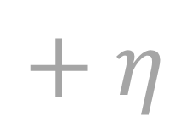
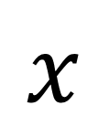
Interaction at the boundary is important for the very definition of a system
Classical mechanics assumes objects can be adequately isolated
Classical mechanics assumes we can study parts of objects, as small as we want
$$x$$
$$+ η$$
These two assumptions are “incompatible”: at some point parts are going to be so small that they cannot be assumed to be adequately isolated

Slide 14
Classical mechanics fails because we can never completely isolate a system
On practical grounds – we simply cannot do it
On theoretical grounds – we cannot shield gravitational interactions, we cannot eliminate thermal radiation
On logical grounds – complete isolation means no possible interaction with the system, signals would pass through, no possible measurement, no gravity, the system disappears from our universe
therefore the most accurate description must be statistical/probabilistic in nature

Slide 15
Classical failure (entropy)

Slide 16








Logarithm of accessible microstates
Gibbs/Shannon entropy
$$\log{W}$$
$$−∫ρ\log{ρ}$$
$W$ is the phase-space volume
$ρ$ is a $δ$-function
volume of a point is zero
$ρ$non-zero only where $ρ→∞$
$$\log{0}→−∞$$
$$−∞\log{∞}→−∞$$
The entropy of a “pure” microstate in classical statistical mechanics is $−∞$

Slide 17
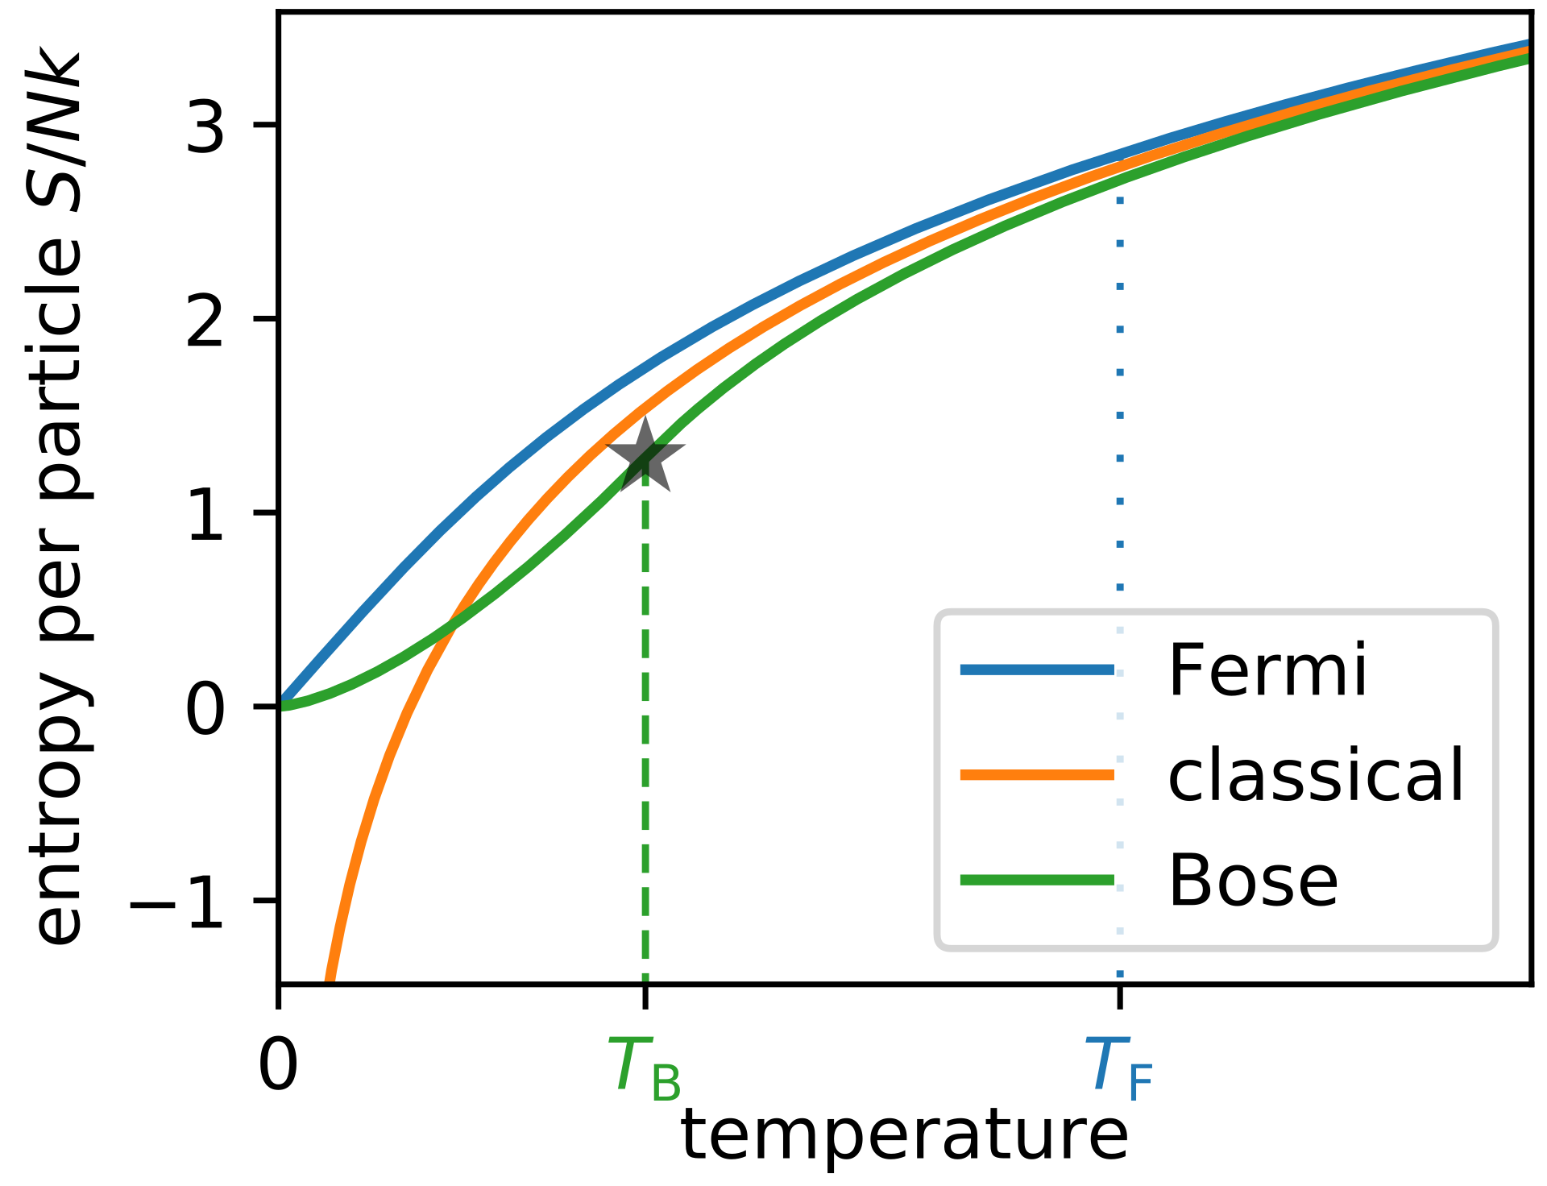
Recall the third law of thermodynamics
Every system has positive finite entropy. The entropy of a perfect crystal at absolute zero temperature is zero
Classical perfect crystal $→$ single microstate $→$ entropy is $−∞$
Classical mechanics is inconsistent with the third law of thermodynamics

Slide 18
Recall the second law of thermodynamics
We cannot create an engine that converts heat into work without increasing entropy
A system with entropy $−∞$ provides a loophole: since $−∞+ΔS=−∞$ for all finite $ΔS$, we can effectively “dump” all the entropy increase into it
We could avoid the effects of the second law of thermodynamics

Slide 19
What is zero entropy?
Entropy is additive for independent systems: $S_{A+B}=S_{A}+S_{B}$
The empty system $∅$ acts as a zero under system combination: $A+∅=A$
Therefore it must be that the entropy of the empty system is zero: $S_{∅}=0$
There is only one possible state for the empty system, and it is a complete description
Entropy lower than zero would correspond to a description that is more refined, more precise, than that of an empty system
From an information theory perspective, no system can have entropy lower than zero

Slide 20
Classical mechanics fails because it allows for the possibility of statistical ensembles that can never exist
On practical grounds – they would allow us to bypass the second law
On theoretical grounds – they fail to respect the third law
On logical grounds – they would provide more information about the system than stating that the system does not exist, which is already a complete description of the system
Quantum mechanics solves this: all pure states have zero entropy and mixed states have positive entropy

Slide 21
Takeaways
Classical mechanics fails at a conceptual level
It doesn’t take into account the relationship between system and environment
It does not provide a lower bound on entropy

Slide 22
Quantum states as equilibrium ensembles

Slide 23






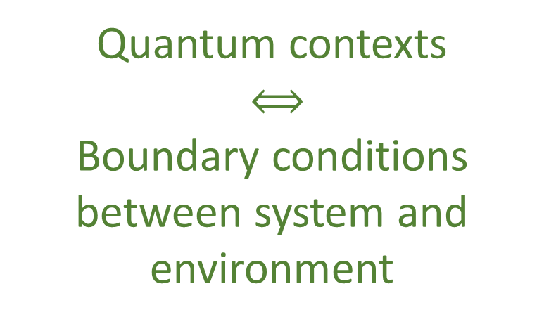





Parallels between QM and thermodynamics
$$U=e^{\frac{OΔt}{ıℏ}}$$
Eigenstates $→$ states unchanged by the process $→$ equilibria of the process
Every state is an eigenstate of some unitary / Hermitian operator $→$ all states are equilibria
Quantum contexts
$⟺$
Boundary conditions between system and environment
Every mixed state commutes with some unitary operator (same eigenstates used to calculate entropy)
Spin up meas.
Equilibration
$$[N_{1},V,T]$$
$$\left|x^{+}\right\rangle$$
$$\left|z^{+}\right\rangle$$
Projections $⟺$ Measurements
$$[μ,V,T]$$
$$\left|z^{−}\right\rangle$$
$$[N_{2},V,T]$$
Unitary $⟺$ Quasi-static
Different equilibria, different variables
Different contexts, different variables
$$[….,V,T]$$

Slide 24









Eigenstates
Eigenvalues
Observable Hermitian operator
$$\left|φ_{1}\right\rangle$$
$$o_{1}$$
$$O$$
$$\left|φ_{2}\right\rangle$$
$$o_{2}$$
$$\left|φ_{3}\right\rangle$$
$$o_{3}$$
$$\left|φ_{4}\right\rangle$$
$$o_{4}$$

Slide 25











Probability
Projection
$${\left|\left\langle ψ | φ_{i}\right\rangle \right|}^{2}$$
$𝒫[O]$
$$\left|φ_{1}\right\rangle$$
$$o_{1}$$
$$\left|φ_{2}\right\rangle$$
$$o_{2}$$
$$\left|ψ\right\rangle$$
$$\left|φ_{3}\right\rangle$$
$$o_{3}$$
$$\left|φ_{4}\right\rangle$$
$$o_{4}$$

Slide 26












Same result
Repeat process
$${\left|\left\langle ψ | φ_{i}\right\rangle \right|}^{2}$$
$𝒫$
$$\left|φ_{1}\right\rangle$$
$𝒫$
$$\left|φ_{1}\right\rangle$$
$$\left|φ_{2}\right\rangle$$
$$\left|φ_{2}\right\rangle$$
$$\left|ψ\right\rangle$$
$$\left|φ_{3}\right\rangle$$
$$\left|φ_{3}\right\rangle$$
$$\left|φ_{4}\right\rangle$$
$$\left|φ_{4}\right\rangle$$
Equilibria!!!
Eigenstates are equilibria of measurements

Slide 27
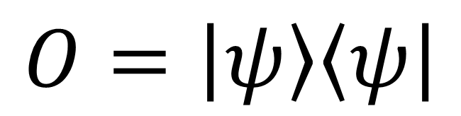
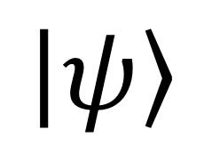


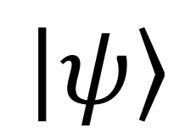
All quantum states are eigenstates of an observable
$$\left|ψ\right\rangle$$
$$1$$
$$\left|ψ\right\rangle$$
$$O=\left|ψ\right\rangle \left\langle ψ\right|$$
all other cases
$$0$$
All quantum states are equilibria of measurements

Slide 28
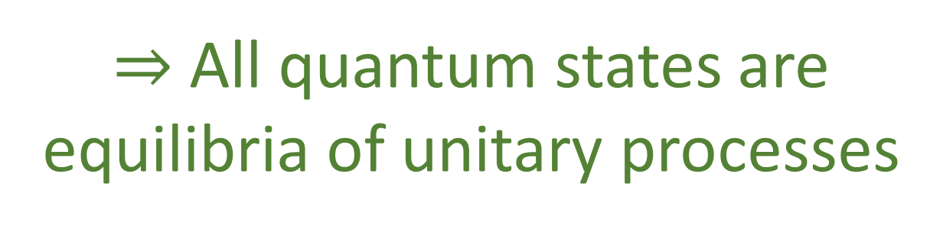
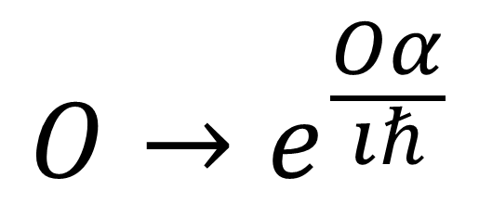
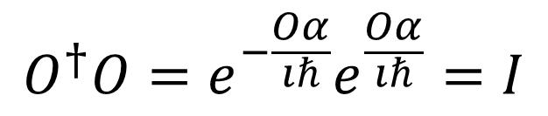
Every observable generates a unitary transformation
$$O→e^{\frac{Odα}{ıℏ}}$$
$$O^{†}O=e^{−\frac{Odα}{ıℏ}}e^{\frac{Odα}{ıℏ}}=I$$
Same eigenstates
$⇒$ All quantum states are equilibria of unitary processes

Slide 29
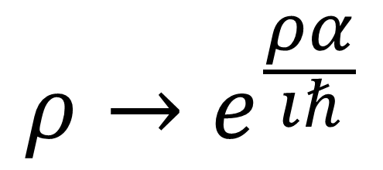
$$ρ→e^{\frac{ρdα}{ıℏ}}$$
Same is true for every mixed state
All quantum states (pure and mixed) are equilibria of some time evolution and some measurement processes

Slide 30
Pure states can be always understood as ensembles with lowest entropy
All quantum states (pure and mixed) are equilibrium ensembles for some time evolution and some measurement processes
Not up to interpretation: mathematical fact in QM

Slide 31

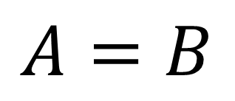

Can we argue the converse?
The goal of physics is to establish laws that are valid in all circumstances
$$F=ma$$
$$A=B$$
$$\vec{∇}⋅\vec{E}=ρ$$
Whenever I prepare this…
… I find this
Repeatability (i.e. whenever) is implicitly assuming ensembles (i.e. infinite copies)

Slide 32






$$H$$
$$2H_{2}+O_{2}→2H_{2}O+Energy$$
$$O$$
$$H$$
To define/manipulate an object it must “stay the same” for long enough
$${}_{6}^{12}C+{}_{2}^{4}{He}→{}_{8}^{16}O+Energy$$
$$n→p+e^{−}+{\overline{ν}}_{e}$$
Every level is an equilibrium of the lower one

Slide 33

$⇒$ Makes sense to assume that states are ensembles in equilibrium

Slide 34

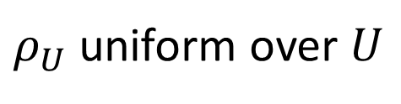

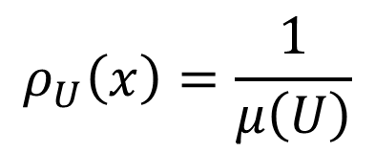
In classical mechanics, we saw connections between geometry, probability and information theory
$$ρ_{U}\left(x\right)=\frac{1}{μ\left(U\right)}$$
$$μ\left(U\right)$$
Classical probability
Symplectic manifold
Information theory
$$H\left(ρ_{U}\right)=\log{μ\left(U\right)}$$
$ρ_{U}$ uniform over $U$
Classical geometric structure is exactly the structure that allows us to define ensembles (i.e. statistics ) and entropy

Slide 35

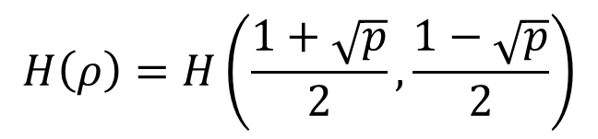
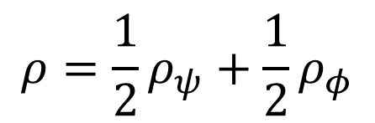

What about quantum mechanics?
$$\left\langle ψ | φ\right\rangle$$
Quantum probability
$$p\left(ψ | φ\right)={\left|\left\langle ψ | φ\right\rangle \right|}^{2}$$
Projective Hilbert space
$$ρ=\frac{1}{2}ρ_{ψ}+\frac{1}{2}ρ_{φ}$$
$$H\left(ρ\right)=H\left(\frac{1+\sqrt{p}}{2},\frac{1−\sqrt{p}}{2}\right)$$
Quantum information theory
Inner product is equivalent to defining entropy of mixtures
Even in quantum mechanics, geometry/probability/information theory are different aspects of the same structure

Slide 36
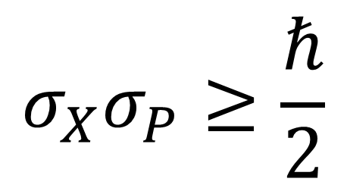
Uncertainty principle makes it look like some states are more determined than others
Property of the ensemble, not of measurement
$$σ_{X}σ_{P}≥\frac{ℏ}{2}$$
Recall, same bound in classical mechanics from imposing lower bound in entropy
But: all pure states have the same entropy

Slide 37

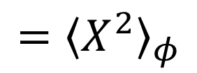



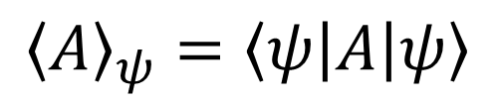

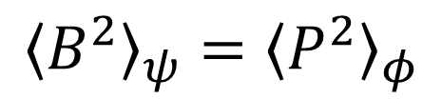
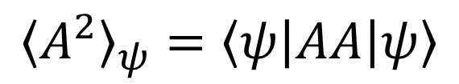
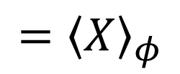
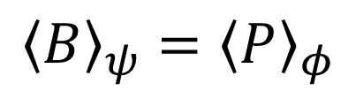
For every state $\left|ψ\right\rangle$, we can find a pair of observables $A$ and $B$ such that $σ_{A}σ_{B}=ℏ/2$
Let $\left|φ\right\rangle$ be a gaussian wave packet for $X$ and $P$
Always exists
Let $U$ be a unitary operator such that $U\left|ψ\right\rangle =\left|φ\right\rangle$
Consider $A=U^{†}XU$ and $B=U^{†}PU$, we have:
$${\left\langle A\right\rangle }_{ψ}=\left\langle ψ\left|A\right|ψ\right\rangle$$
$$=\left\langle ψ\left|U^{†}XU\right|ψ\right\rangle$$
$$=\left\langle φ\left|X\right|φ\right\rangle$$
$$={\left\langle X\right\rangle }_{φ}$$
$${\left\langle A^{2}\right\rangle }_{ψ}=\left\langle ψ\left|AA\right|ψ\right\rangle$$
$$=\left\langle ψ\left|U^{†}XUU^{†}XU\right|ψ\right\rangle$$
$$=\left\langle φ\left|XX\right|φ\right\rangle$$
$$={\left\langle X^{2}\right\rangle }_{φ}$$
$${\left\langle B\right\rangle }_{ψ}={\left\langle P\right\rangle }_{φ}$$
$${\left\langle B^{2}\right\rangle }_{ψ}={\left\langle P^{2}\right\rangle }_{φ}$$

Slide 38
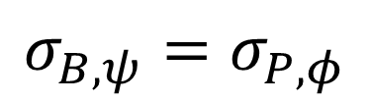
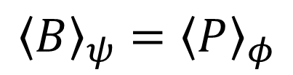
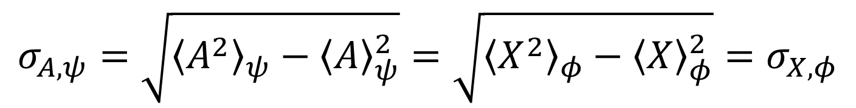
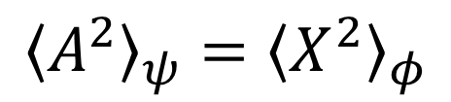
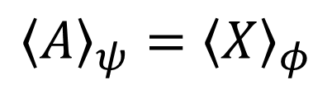
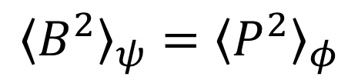
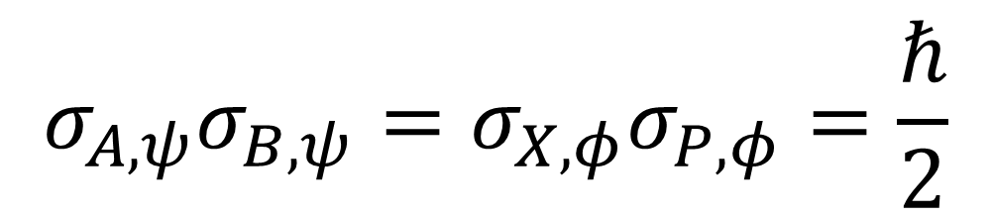
For every state $\left|ψ\right\rangle$, we can find a pair of observables $A$ and $B$ such that $σ_{A}σ_{B}=ℏ/2$
$${\left\langle A\right\rangle }_{ψ}={\left\langle X\right\rangle }_{φ}$$
$${\left\langle A^{2}\right\rangle }_{ψ}={\left\langle X^{2}\right\rangle }_{φ}$$
$${\left\langle B\right\rangle }_{ψ}={\left\langle P\right\rangle }_{φ}$$
$${\left\langle B^{2}\right\rangle }_{ψ}={\left\langle P^{2}\right\rangle }_{φ}$$
$$σ_{A,ψ}=\sqrt{{\left\langle A^{2}\right\rangle }_{ψ}−{\left\langle A\right\rangle }_{ψ}^{2}}=\sqrt{{\left\langle X^{2}\right\rangle }_{φ}−{\left\langle X\right\rangle }_{φ}^{2}}=σ_{X,φ}$$
$$σ_{B,ψ}=σ_{P,φ}$$
$$σ_{A,ψ}σ_{B,ψ}=σ_{X,φ}σ_{P,φ}=\frac{ℏ}{2}$$

Slide 39
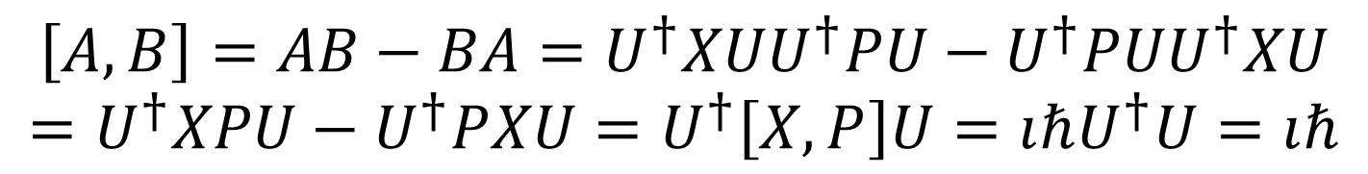

For every state $\left|ψ\right\rangle$, we can find a pair of observables $A$ and $B$ such that $σ_{A}σ_{B}=ℏ/2$
$$\left[A,B\right]=AB−BA=U^{†}XUU^{†}PU−U^{†}PUU^{†}XU$$
$$=U^{†}XPU−U^{†}PXU=U^{†}\left[X,P\right]U=ıℏU^{†}U=ıℏ$$
$$\left[A,B\right]=ıℏ$$
Every state is a Gaussian state for some pair of operators!

Slide 40
Takeaways
Quantum states are (at least) ensembles in equilibrium
It doesn’t take into account relationship between system and environment
TODOs
Clean up and organize the ideas
Connect to other literature (theoretical and experimental)
Typicality, Eigenstate Thermalization Hypothesis, …

Slide 41
Quantum processes

Slide 42



















Time evolution and measurements
$$ρ_{I}$$
$$P$$
$ρ_{O}=P\left(ρ_{I}\right)$
Any process (deterministic or stochastic) will take an ensemble as input and return an ensemble as output
$$P\left(p_{1}ρ_{1}+p_{2}ρ_{2}\right)=p_{1}P\left(ρ_{1}\right)+p_{2}P\left(ρ_{2}\right)$$
$$\left|E_{1}\right\rangle$$
$$\left|E_{1}\right\rangle$$
Deterministic and reversible
Measurement
$$ρ_{I}$$
$$P$$
$$ρ_{O}$$
$$P^{−1}$$
$$ρ_{I}$$
$$ρ_{I}$$
$$P$$
$$ρ_{O}$$
$$P$$
$$ρ_{O}$$
$$Δθ$$
Conserves probability and allows an “inverse”
Must be repeatable
$⇒$ Unitary operation
$⇒$ Projection
$$|E_{0}⟩$$
$$|E_{0}⟩$$
Measurement problem: unitary $⇏$ projections … projections $⇒$ unitary
Unitary evolution $≡$ sequence of infinitesimal projections
Unitary evolution is for det/rev, isolated processes System being measured can’t be isolated

Slide 43










Geometry of mixed states
Pure states: Bloch ball surface
$S=0$
$$|z^{+}⟩$$
$$|y^{+}⟩$$
$$1/2\left|x^{+}\right\rangle \left\langle x^{+}\right|+1/2|x^{−}⟩\left\langle x^{−}\right|$$
$$=1/2\left|z^{+}\right\rangle \left\langle z^{+}\right|+1/2|z^{−}⟩\left\langle z^{−}\right|$$
$$|x^{−}⟩$$
$$|x^{+}⟩$$
$S=1$
$$|y^{−}⟩$$
$$|z^{−}⟩$$
Mixed states: Bloch ball interior

Slide 44







Time evolution
Measurement
Two steps:
$$\left|E_{1}\right\rangle$$
$$E_{1}≥E_{0}$$
$$E$$
$$\left|E_{1}\right\rangle$$
1) Prepare a mixture of possible outcomes entropy-increasing irreversible process
$$Δθ$$
2) Determine the outcome same as classical
Horizontal circular motion
$$|E_{0}⟩$$
$$|E_{0}⟩$$
Horizontal inward motion
Change at constant energy and constant entropy
Change at constant energy that maximizes entropy

Slide 45








Linear and idempotent operator $→$ Projection!
Linear
$${\left|\left\langle ψ | φ_{i}\right\rangle \right|}^{2}$$
$𝒫$
$$\left|φ_{1}\right\rangle$$
$𝒫$
$$\left|φ_{1}\right\rangle$$
$$\left|φ_{2}\right\rangle$$
$$\left|φ_{2}\right\rangle$$
$$\left|ψ\right\rangle$$
$$\left|φ_{3}\right\rangle$$
$$\left|φ_{3}\right\rangle$$
$$\left|φ_{4}\right\rangle$$
$$\left|φ_{4}\right\rangle$$
Idempotent
Projections $⟺$ black-box equilibration processes

Slide 46


$$P\left(N\right)$$
$$N$$
Equilibrium of an open system does not define a unique number of particles

Slide 47
$$P\left(N\right)$$
$$N$$
Equilibrium of a closed system defines a unique number of particles

Slide 48







Close the lid
Grand-canonical ensemble
Canonical ensemble
Fluctuations within the initial equilibrium …
… become a probability distribution over final equilibria
$$P(N)$$
$𝒫$
$$[N_{1},V,T]$$
$$[N_{2},V,T]$$
$$[μ,V,T]$$
$$[N_{3},V,T]$$
$$[N_{4},V,T]$$

Slide 49






$𝒫$
$$\left|x_{1}\right\rangle$$
$$\left|x_{2}\right\rangle$$
$$\left|E_{0}\right\rangle$$
$$\left|x_{3}\right\rangle$$
$$\left|x_{4}\right\rangle$$
Think of quantum states as different ensembles identified by different quantities
$𝒫$
$$[N_{1},V,T]$$
$$[N_{2},V,T]$$
$$[μ,V,T]$$
$$[N_{3},V,T]$$
$$[N_{4},V,T]$$

Slide 50
$𝒫$
$$\left|x_{1}\right\rangle$$
$$\left|x_{2}\right\rangle$$
$$\left|E_{0}\right\rangle$$
$$\left|x_{3}\right\rangle$$
$$\left|x_{4}\right\rangle$$
In both cases, we cannot describe the equilibration process: it is not in terms of equilibrium states!
$𝒫$
$$[N_{1},V,T]$$
$$[N_{2},V,T]$$
$$[μ,V,T]$$
$$[N_{3},V,T]$$
$$[N_{4},V,T]$$

Slide 51
















Schrödinger equation – (unitary) time evolution
$$\left|ψ(t)\right\rangle =U\left(t\right)\left|ψ_{0}\right\rangle =e^{\frac{Ht}{ıℏ}}\left|ψ_{0}\right\rangle$$
$$H\left|ψ\right\rangle =ıℏ∂_{t}\left|ψ\right\rangle$$
diagonalized
$$H=\left[\begin{matrix}E_{1} & 0 \\ 0 & E_{0}\end{matrix}\right]$$
$$U\left(t\right)=e^{\frac{Ht}{ıℏ}}=\left[\begin{matrix}e^{\frac{E_{1}t}{ıℏ}} & 0 \\ 0 & e^{\frac{E_{0}t}{ıℏ}}\end{matrix}\right]$$
Hamiltonian
Time evolution operator
$$θ=θ_{1}−θ_{0}=\frac{\left(E_{1}−E_{0}\right)t}{ℏ}$$
$$ı\left|E_{1}\right\rangle$$
$$\left|E_{1}\right\rangle$$
$$ı\left|E_{0}\right\rangle$$
$$\left|E_{1}\right\rangle$$
$$E$$
$$θ_{1}=\frac{E_{1}t}{ℏ}$$
$$θ_{0}=\frac{E_{0}t}{ℏ}$$
$$θ$$
$$\left|E_{0}\right\rangle$$
$$|E_{0}⟩$$
$$E_{1}≥E_{0}$$

Slide 52

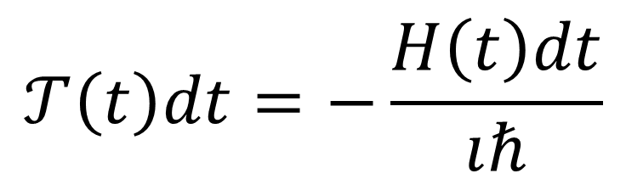
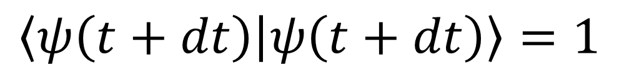

Unitary evolution $⟺$ det/rev evolution
$$\left|ψ\left(t+dt\right)\right\rangle −\left|ψ\left(t\right)\right\rangle =𝒯\left(t\right)dt\left|ψ\left(t\right)\right\rangle$$
Change of states depends only on previous state (determinism)
$$\left\langle ψ\left(t+dt\right) | ψ\left(t+dt\right)\right\rangle =1$$
Map to only one state (reversibility)
$$=\left\langle (1+𝒯\left(t\right)dt)ψ\left(t\right) | (1+𝒯\left(t\right)dt)ψ\left(t\right)\right\rangle$$
$$=\left\langle ψ\left(t\right)\left|{\left(1+𝒯\left(t\right)dt\right)}^{†}\left(1+𝒯\left(t\right)dt\right)\right|ψ\left(t\right)\right\rangle$$
$$=\left\langle ψ\left(t\right)\left|1+𝒯{\left(t\right)}^{†}dt+𝒯\left(t\right)dt+𝒯{\left(t\right)}^{†}𝒯\left(t\right)dt^{2}\right|ψ\left(t\right)\right\rangle$$
Self-adjoint
$$=1+dt\left\langle ψ\left(t\right)\left|𝒯{\left(t\right)}^{†}+𝒯\left(t\right)\right|ψ\left(t\right)\right\rangle +O\left(dt^{2}\right)$$
$$⇒𝒯{\left(t\right)}^{†}=−𝒯\left(t\right)$$
$$𝒯\left(t\right)dt=−\frac{H\left(t\right)dt}{ıℏ}$$

Slide 53






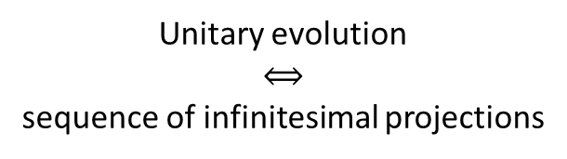


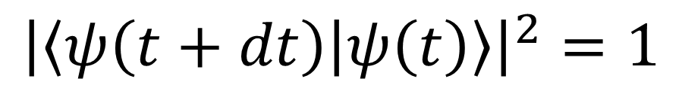

Unitary evolution $⟺$ quasi-static evolution
$𝒫$
$$\left|ψ\left(t+dt\right)\right\rangle$$
$$\left|x_{2}\right\rangle$$
Unitary evolution $$⟺$$ sequence of infinitesimal projections
$$\left|ψ(t)\right\rangle$$
$$\left|x_{3}\right\rangle$$
$$\left|x_{4}\right\rangle$$
$${\left|\left\langle ψ\left(t+dt\right) | ψ\left(t\right)\right\rangle \right|}^{2}=1$$
$$=\left\langle ψ\left(t+dt\right)|ψ\left(t\right)\right\rangle \left\langle ψ\left(t\right)|ψ\left(t+dt\right)\right\rangle$$
$$⇒𝒯{\left(t\right)}^{†}=−𝒯\left(t\right)$$
$$=\left(1+\left\langle dψ\left(t\right)|ψ\left(t\right)\right\rangle \right)\left(1+\left\langle ψ\left(t\right)|dψ\left(t\right)\right\rangle \right)$$
$$=1+\left(\left\langle dψ\left(t\right)|ψ\left(t\right)\right\rangle +\left\langle ψ\left(t\right)|dψ\left(t\right)\right\rangle \right)+O\left(dt^{2}\right)$$
$$=1+dt\left(\left\langle 𝒯\left(t\right)ψ\left(t\right)|ψ\left(t\right)\right\rangle +\left\langle ψ\left(t\right)|𝒯\left(t\right)ψ\left(t\right)\right\rangle \right)+O\left(dt^{2}\right)$$

Slide 54
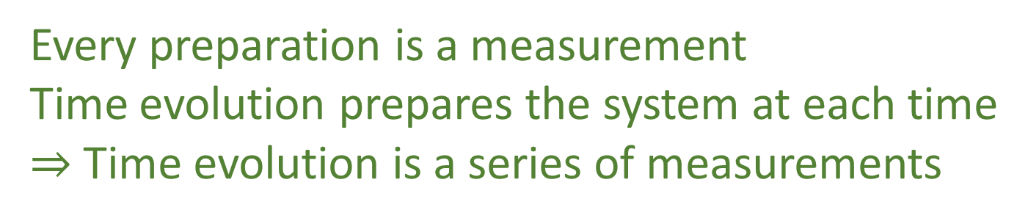
Deterministic and reversible evolution
Black-box process with equilibria
Quasi-static evolution
Unitary evolution
Projection
Every preparation is a measurement Time evolution prepares the system at each time $⇒$ Time evolution is a series of measurements

Slide 55
Takeaways
Projections are processes with equilibria
Measurements are processes with equilibria
Unitary evolution is deterministic and reversible evolution
Solution to the inverse measurement problem: unitary evolution is a series of measurements
TODOs
Clean up and organize the ideas

Slide 56
Quantum irreducibility

Slide 57









Quantum mechanics as irreducibility
Classical
Quantum
Entropy
Minimum uncertainty
$$p$$
?
time
0
time
$$q$$
Can prepare ensembles at arbitrarily low entropy: we can study arbitrarily small parts
Entropy is bounded at zero: we cannot study parts
Can’t squeeze ensemble arbitrarily
We always have access to the internal dynamics
No access to the internal dynamics
Superluminar effects that can’t carry information
Probability of transition
Non-locality
$$\left|x^{+}\right\rangle$$
$$\left|y^{+}\right\rangle$$
$$\left|x^{−}\right\rangle$$
$$\left|y^{−}\right\rangle$$
Can’t refine ensembles $⇒$ Can’t interact with parts
Can’t refine ensembles $⇒$ Can’t extract information
$$p\left(x^{+} | y^{−}\right)=p(y^{−}|x^{+})$$
Symmetry of the inner product

Slide 58
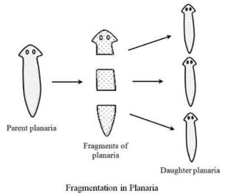
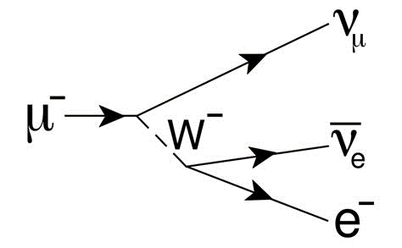
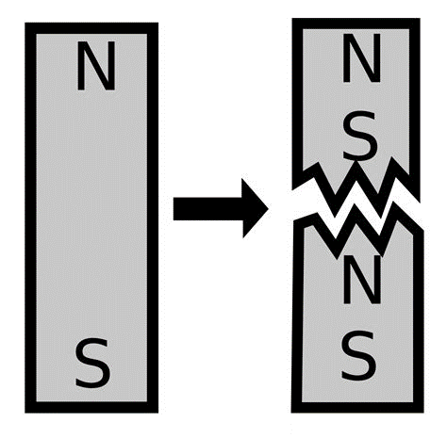
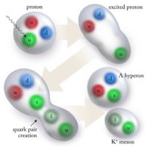


Divisible
vs
Reducible
reducible but not divisible
divisible but not reducible
$$𝒫_{t} :𝒮 →𝒮_{1}×𝒮_{2}$$
$$𝒮≡𝒮_{1}×𝒮_{2}$$
time
time

Slide 59






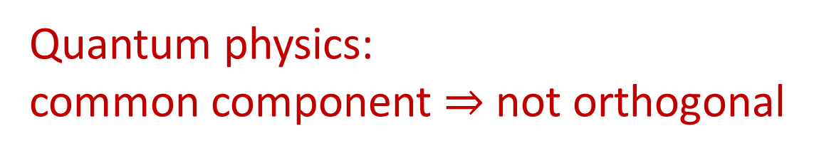

Reducibility in terms of ensembles
Common component
$$ρ_{1}=pρ_{3}+\left(1−p\right)ρ_{4}$$
$$ρ_{1}$$
$$ρ_{2}$$
Detect overlap
$$∃ρ_{3}$$
$$ρ_{2}=λρ_{3}+\left(1−λ\right)ρ_{5}$$
$\int_{X}{ρ_{1}ρ_{2}dx}≠0$
$$ρ_{3}$$
Not orthogonal
Classical physics: common component $⟺$ not orthogonal
If two ensembles have something in common, there exists an ensemble for the common part
Two ensembles can have something in common, but the common part cannot be reliably prepared and studied
Quantum physics:
common component $⇒$ not orthogonal
E.g. spin up and spin left

Slide 60


Statistical distribution: the matter is spread across space
i.e. 50% of the mass is in a particular region
Wave nature of the quantum system
$$ρ\left(x\right)$$
These cases merge in quantum mechanics
The ability to tell statistical from probability distributions requires having access to the ensembles at lower entropy
$$x$$
Probability distribution: the matter is concentrated but “jumps around”
i.e. the whole mass is in a particular region 50% of the time
Particle nature of the quantum system

Slide 61







$S=0$
$S=0$
$$S→−∞$$
$$S=0$$
$$S→+∞$$
$$S→+∞$$
$$S→+∞$$
Quantum
Classical discrete infinite
Classical continuum
Quantum mechanics is a hybrid between discrete and continuum
Quantum pure states form a manifold (like classical continuum) where each state has zero entropy (like classical discrete)
Quantum mixed states have no single decomposition in terms of pure states, classical continuum mixed states have no single decomposition in terms of zero entropy states

Slide 62
Takeaways
Irreducibility is the key difference for quantum systems
All quantum properties can be qualitatively understood in terms of irreducibility
TODOs
Prove mathematically that it is the only difference (i.e. QM can be fully recovered)

Slide 63
Non-additive measures

Slide 64










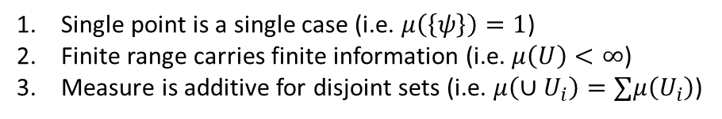


















Need for non-additive measure
Single point
Finite continuous range
Want to generalize $S=log μ$
$$μ(U)$$
$$\log{μ(U)}$$
$$μ(U)$$
$$\log{μ(U)}$$
$$A$$
Counting measure
$$C$$
$$μ\left(U\right)=\#U$$
$1$
$0$
$+∞$
$+∞$
Number of points
$$B$$
Lebesgue measure
$$μ\left(\left\{A\right\}\right)=2^{0}=1$$
$$μ\left(\left[a,b\right]\right)=b−a$$
$0$
$−∞$
$<∞$
$<∞$
$$μ\left(\left\{A,B\right\}\right)=2^{1}=2$$
Interval size
not additive
“Quantized” measure
$$μ\left(\left\{A,C\right\}\right)<2=μ\left(\left\{A\right\}\right)+μ\left(\left\{C\right\}\right)$$
$$μ\left(U\right)=sup(2^{S(hull(U))})$$
$1$
$0$
$<∞$
$<∞$
In quantum mechanics, literally $1+1≤2$
Entropy over uniform distribution
Pick two!
Single point is a single case (i.e. $μ\left(\left\{ψ\right\}\right)=1$)
Finite range carries finite information (i.e. $μ\left(U\right)<∞$)
Measure is additive for disjoint sets (i.e. $μ\left(∪U_{i}\right)=∑μ\left(U_{i}\right)$)
Physically, we count states all else equal
Contextuality $⟺$ non-additive measure

Slide 65
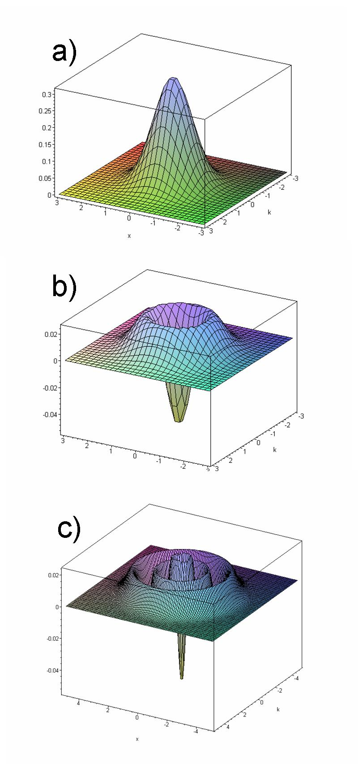


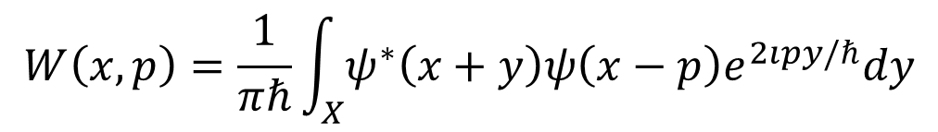

Failure of classical probability in quantum mechanics
CHSH inequality
Bell type theorems
$$\left|E\left(a,b\right)−E\left(a,b^{′}\right)+E\left(a^{′},b^{′}\right)+E\left(a^{′},b\right)\right|≤2$$
In quantum mechanics, $2<|⋅|≤2\sqrt{2}$
Wigner quasiprobability distribution
$$W\left(x,p\right)=\frac{1}{πℏ}\int_{X}{ψ^{∗}\left(x+y\right)ψ\left(x−p\right)e^{2ıpy/ℏ}dy}$$
$${\left|ψ\left(x\right)\right|}^{2}=∫W\left(x,p\right)dp$$
$${\left|ψ\left(p\right)\right|}^{2}=∫W\left(x,p\right)dx$$

Slide 66

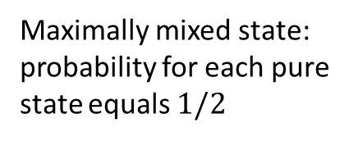



Classical probability
Wigner function
$$∑p\left(x\right)=1$$
$$∫ρ\left(q,p\right)dqdp=1$$
$$∫W\left(q,p\right)dqdp=1$$
Sample space (i.e. classical states)
Not the sample space (i.e. quantum states)
Generalized probability
Probability of a subset: weight for the biggest part that has support in that subset
Maximally mixed state:
probability for each pure state equals $1/2$
$$p\left(x\right)=p\left(x|U\right)p\left(U\right)+p\left(x|U^{C}\right)p\left(U^{C}\right)$$
Non-additive
$$U$$

Slide 67
Takeaways
Classical (Kolmogorov) probability does not work in QM
Successful use of signed probability (e.g. Wigner function)
No physical interpretation for negative probability
Potential use of non-additive measures
TODOs
Construct a full theory of non-additive probability

Slide 68
Classical limit

Slide 69


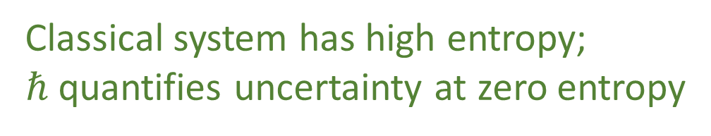

slow $\left(\frac{v}{c}≪1\right)$
fast
$(ℏ→0)$ big
Classical Mechanics
Relativity
high entropy $(S→+∞)$
Quantum Mechanics
Quantum Field Theory
small
low entropy
Quantum effects at large scale
Constants of nature are the same for all systems
Classical statistical mechanics fails at low entropy
Classical system has high entropy;
$ℏ$ quantifies uncertainty at zero entropy

Slide 70
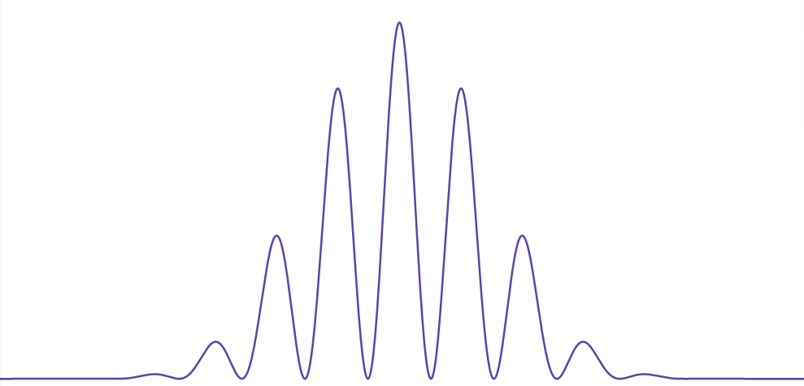
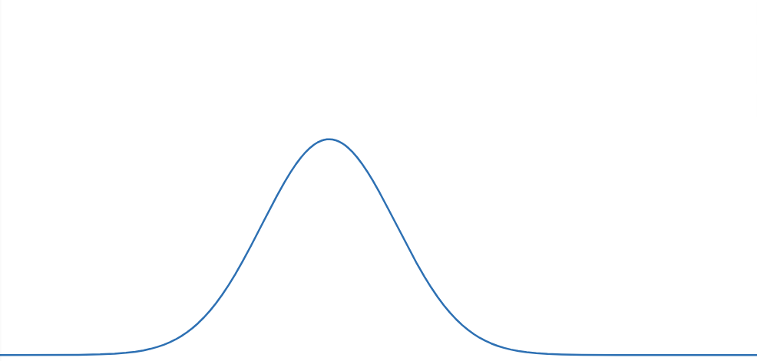
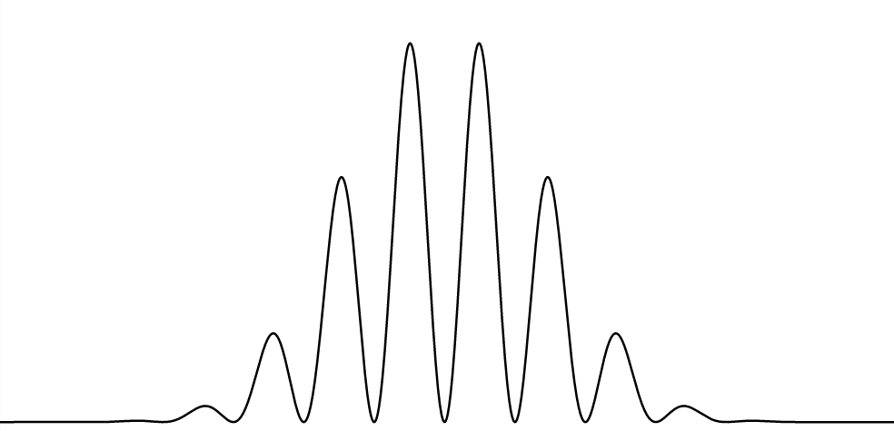
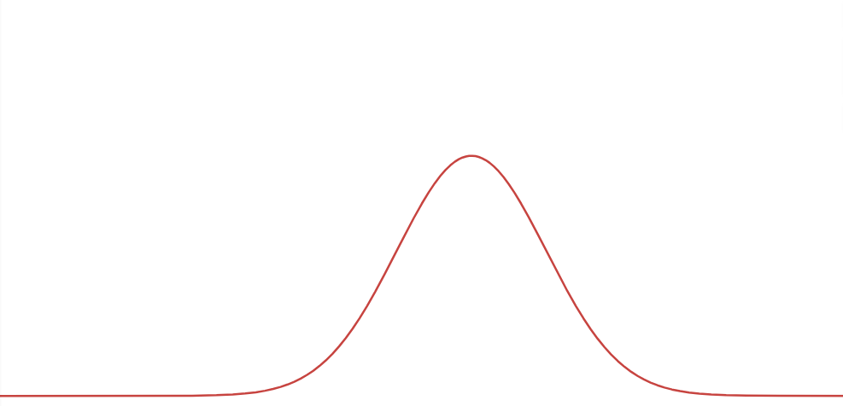








Maximally mixed state obtained by uncertainty on the open slit (uncertainty on classical variable)
Maximally mixed state obtained by uncertainty on the phase difference (quantum variable)
$$|s_{1}⟩$$
$$|i_{π}⟩$$
$$m$$
$$|i_{0}⟩$$
$$s_{1}$$
$$s_{2}$$
$$|s_{2}⟩$$
Uncertainty on quantum variables can be represented by uncertainty on classical variables

Slide 71








May be able to recycle formal proofs $ℏ→0$
$$S$$
$$S→∞$$
$$S$$
Decrease entropy of the pure state
$$0$$
$$0$$
$$S_{0}$$
Limit of entropy difference is the same
Increase entropy of the mixed state
$$S_{0}→−∞$$

Slide 72
Takeaways
Classical mechanics may be recovered for high entropy states
No mechanism: high entropy “hides” quantum effects
TODOs
Actually prove the conjecture

Slide 73
Wrapping it up
Quantum mechanics can be seen as a combination of classical mechanics and thermodynamics
Minimal interpretation: using concepts and only concepts that are strictly in the equations (e.g. ensembles in equilibrium is supported by the math)
Main goal is to clean up all these ideas and make it a consistent theory (conceptual/mathematical) with experimental support

Slide 75
MATERIAL

Slide 76
Hilbert spaces are precisely the Banach spaces where we have a projection for each subspace
Mathematically, it makes sense that quantum states are equilibria
A system to be assigned a state must exist in a stable way for some finite time (even if it may be very short)
Physically, it makes sense that quantum states are equilibria

Slide 77
Reverse Physics: Quantum mechanics

Slide 78










Entropic nature of physical theories
Thermodynamics/Statistical mechanics are not built on top of mechanics
Mechanics is the ideal case of thermodynamics/statistical mechanics
Best preparation $⇒$ pure state
Best process $⇒$ map between pure states
$$μ\left(U\right)$$
Standard probability
$$ρ\left(x\right)=\frac{1}{μ\left(U\right)}$$
The geometric structure of both classical and quantum mechanics is ultimately an entropic structure
Symplectic manifold
We can only prepare/measure ensembles. Ensembles can offer a unified way of thinking about states.
$ρ$ uniform over $U$
Information theory
$$H\left(ρ\right)=\log{μ\left(U\right)}$$
$$\left\langle ψ | φ\right\rangle$$
Quantum probability
$$p\left(ψ | φ\right)={\left|\left\langle ψ | φ\right\rangle \right|}^{2}$$
Projective Hilbert space
$$ρ=\frac{1}{2}ρ_{ψ}+\frac{1}{2}ρ_{φ}$$
Quantum information theory
$$H\left(ρ\right)=H\left(\frac{1+\sqrt{p}}{2},\frac{1−\sqrt{p}}{2}\right)$$

Slide 79


Recovering QM from assumptions on ensembles
$$\left|E_{1}\right\rangle$$
Ensembles can mix $⇒$ Form a convex space
Irreducibility $⇒$ Extreme points in the convex space
Continuous time $⇒$ Extreme points form a manifold (not discrete)
Frame-invariance $⇒$ Manifold is symplectic
$$|E_{0}⟩$$
Homogeneity $⇒$ All two dimensional subspaces are spheres
2-sphere only symplectic sphere
Is this enough to recover complex projective spaces?

Slide 80

Unphysicality of Hilbert spaces
Hilbert space: complete inner product vector space
Redundant on finite-dimensional spaces. For infinite-dimensional spaces, it allows us to construct states with infinite expectation values from states with finite expectation values
Exactly captures measurement probability/entropy of mixtures and superposition/statistical mixing
Physically required
Extremely physically suspect!!!
$⇒$ Thus requires us to include unitary transformations (e.g. change of representations and finite time evolution) that change finite expectation values into infinite ones
Suppose we require all polynomials of position and momentum to have finite expectation
$⇒$ Schwartz space
Maybe more physically appropriate?
Closed under Fourier transforms
Used as starting point for theories of distributions

Slide 81
QM postulates revisited
$⇒$ Recover mathematical structure of quantum mechanics from properties of ensembles
State postulate: states are rays of a complex vector space
Recovered from properties of ensembles and rules of ensemble mixing
Measurement postulate: projection measurement and Born rule
Projections as processes with equilibria
Born rule recoverable from entropy of mixing
Composite system postulate: tensor product for composite system
Derived from other postulates
PRL 126, 110402 (2021)
Evolution postulate: unitary evolution (Schrödinger equation)
Deterministic/reversible evolution

