Slide 1

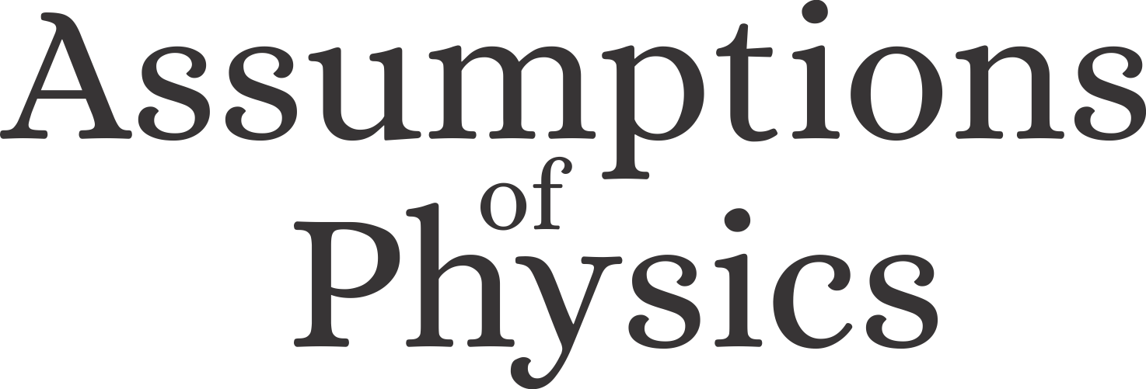
Assumptions of Physics Summer School 2024 Conceptual and Philosophical Foundations
Gabriele Carcassi and Christine A. Aidala
Physics Department University of Michigan
https://assumptionsofphysics.org

Slide 2
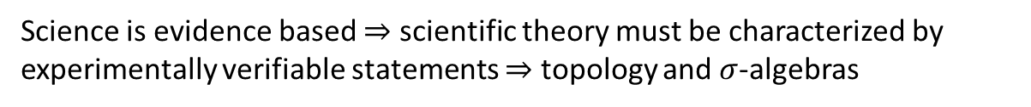


Main goal of the project
Identify a handful of physical starting points from which the basic laws can be rigorously derived
For example:
Infinitesimal reducibility $⇒$ Classical state
Irreducibility $⇒$ Quantum state
https://assumptionsofphysics.org
?
time
time
This also requires rederiving all mathematical structures from physical requirements
For example:
Science is evidence based $⇒$ scientific theory must be characterized by experimentally verifiable statements $⇒$ topology and $σ$-algebras

Slide 3
Underlying perspective
Foundations of physics
Foundations of mathematics
Metaphysical reality
What really exists
Physical reality
What can be accessed experimentally
Philosophy of science
What is the boundary?
What are the requirements?
Physical theories
Idealized account of empirical reality
Empirical reality
What can be reliably studied experimentally
How exactly does the abstraction/idealization process work?

Slide 4
If physics is about creating models of empirical reality, the foundations of physics should be a theory of models of empirical reality
Requirements of experimental verification, assumptions of each theory, realm of validity of assumptions, …

Slide 5
Different approach to the foundations of physics
Find ultimate theory
approximation
…
Typical approaches
Construct interpretations
Weak interactions
QED -Electromagnetism
Measurement problem
Role of the observer
QCD – Strong Interactions
Electro-weak
Quantum mechanics
Contextuality
Local realism
General Relativity
Grand Unified Theory
Ontology of observables
What “really” happens
Theory of Everything
Our approach
A theory about physical models
General physical principles and requirements
General mathematical framework
Specific assumptions
Classical mechanics
Quantum mechanics
derivation
Thermodynamics
…
specialization

Slide 6
Find the right overall concepts
Reverse physics: Start with the equations, reverse engineer physical assumptions/principles
Reverse Physics
Physics
Smallest set of assumptions required to rederive the theory
Physical theory
Physical result/ effect/prediction
Reverse Mathematics
Mathematics
Smallest set of axioms required to prove the theorem
Theorem
Mathematical result/ corollary/calculation
Found Phys 52, 40 (2022)
Goal: find the right overall physical concepts, “elevate” the discussion from mathematical constructs to physical principles
Physical mathematics: Start from scratch and rederive all mathematical structures from physical requirements
Physics
Physical requirements
Semantics
Physical mathematics
Goal: get the details right, perfect one-to-one map between mathematical and physical objects

Slide 7
Conceptual and Philosophical Foundations
This session

Slide 8
Nature of physical theories

Slide 9
What exactly is the boundary between these areas?
Metaphysical reality
What really exists
Physical reality
What can be accessed experimentally
Things that (may) exist: God(s), perfect circles, hidden variables, parallel universes, life after death, …
Things that we can perceive: our own consciousness, our own feelings, historic events, a particular phenomenon at a particular time, …
Physical theories
Idealized account of empirical reality
Empirical reality
What can be reliably studied experimentally
Things that we can study experimentally: motion of an object falling, repeatable processes under similar conditions, objects that we can probe without disruption, …
Things that we describe in our models: objects that are fully described by finitely many infinitesimally precise quantities, objects under simplified assumptions (i.e. no friction, perfect isolation, linearity, …), …

Slide 10
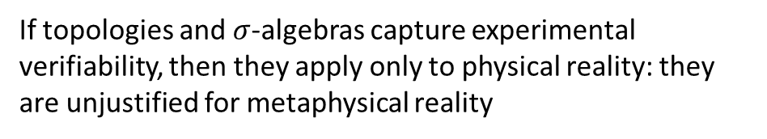
States and laws of evolution do not describe “reality as is”, but empirical accessible part that can be reliably studied under suitable idealizations
Metaphysical reality
What really exists
Physical reality
What can be accessed experimentally
If topologies and $σ$-algebras capture experimental verifiability, then they apply only to physical reality: they are unjustified for metaphysical reality
Physical theories
Idealized account of empirical reality
Empirical reality
What can be reliably studied experimentally
If ensembles capture repeatability of preparations and measurements, then they apply only to empirical reality: they are unjustified for physical reality or metaphysical reality
Mathematical tools have domains of applicability

Slide 11
Takeaways
Physical theories are idealized accounts of the experimentally accessible part of reality that can be studied reliably
A good foundation of physics must understand what the limits and requirements of these idealized accounts are
If physical theories are models, then the foundations of physics should be a theory of models
TODOs
Refine this approach into a “philosophical position”
Can we make an argument that shows how idealization is necessary?

Slide 12
Developing a formal system for experimental science

Slide 13

Formal system:
primitive notions
e.g. Euclidean geometry
Basic objects that are taken as-is, without definition in terms of other objects
E.g. Points and lines
formal language
Symbols and rules to write sentences in the formal system
E.g. $A,B,C$ for points $\overline{AB}$ for segment
axioms
Statements about primitive objects that are to be taken as true
E.g. Given two points, there is a line that joins them

Slide 14
Formal system for all of mathematics:
Sets + first-order logic + Zermelo–Fraenkel axioms (+ axiom of choice)
Formal system for all of physics:
???

Slide 15
formal language
Physics
Not an issue: we can simply use first-order logic
Physical requirements
Semantics
primitive notions
axioms
These should be justified by the physics
Formal system
Choose axioms/primitive notions so that the justification is straightforward
Physical objects live in the physical (informal) world
Informal
Formal
Mathematical objects are representations of physical objects
(e.g. connection to experiment is outside of the formal system)
physics
math
What can or cannot be captured by the formal system?

Slide 16
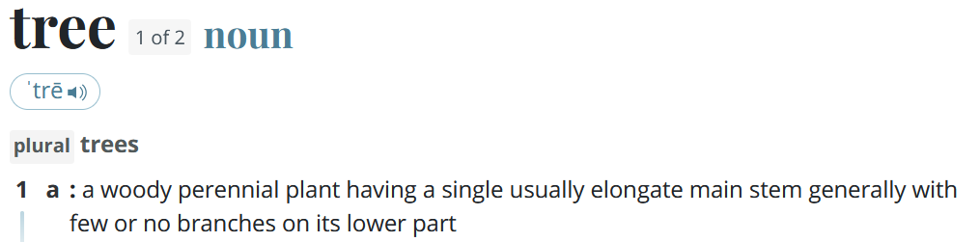
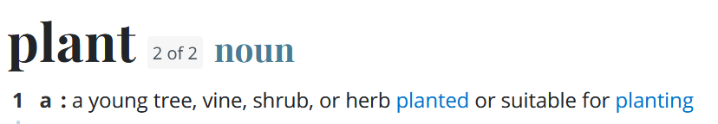
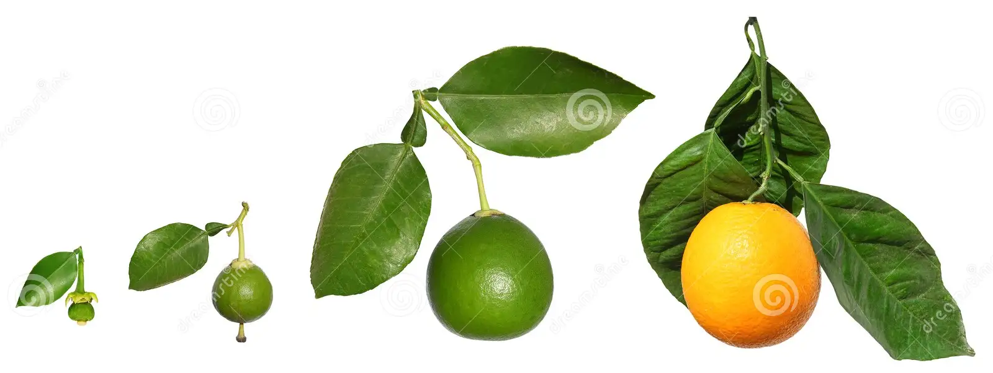
Problems in formalizing physical concepts
From merriam-webster.com:
Web of meaning
No primitive concepts: things are always defined in terms of other things
Conceptual cut
If one looks closely, all physical concepts are well-defined only within a restricted realm of applicability
dreamstime.com
When does an orange become an orange? Can we really define quantities (e.g. distance, time, temperature) with infinite precision? When exactly is an object in thermodynamic equilibrium, such that a temperature is well defined? Since all objects interact gravitationally, does it make sense to talk about isolated systems?

Slide 17
Problems in formalizing physical concepts
Mathematical concepts are “crisper idealizations”
Informal
Formal
Physical concepts are “fuzzy”
physics
math
Mathematical concepts cannot have circular definitions
Physical concepts may have circular definitions
Some concepts will have to remain informal

Slide 18

What should our primitive “informal” notion be?
Guiding principle
Principle of scientific objectivity: science is universal, non-contradictory and evidence based.
Suggest logic as fundamental …
Universal $→$ same for everybody
like mathematics!
Non-contradictory $→$ something is either true or false
Evidence based $→$ truth is determined experimentally
… with some extensions
$⇒$ Logic of experimentally verifiable statements!

Slide 19

Not “verifiable statements”
Chocolate tastes good (not universal)
It is immoral to kill one person to save ten (not universal and/or evidence based)
The number 4 is prime (not evidence based)
This statement is false (not non-contradictory)
The mass of the photon is exactly $0$ eV (not verifiable due to infinite precision)
“Verifiable statements”
The mass of the photon is less than ${10}^{−13}$ eV
If the height of the mercury column is between 24 and 25 millimeters then its temperature is between 24 and 25 Celsius
If I take $2±0.01$ Kg of Sodium-24 and wait $15±0.01$ hours there will be only $1±0.01$ Kg left
A scientific theory needs “at least” the concept of a verifiable statement: good primitive notion

Slide 20


What should be our primitive “formal” notion?
Tempting to try to capture everything into the formal system:
The electron is a fundamental particle and has negative charge
Conversion to formal logic
$$FP\left(e\right)∧NC(e)$$
constant
predicates
Never going to work!
What is an electron? What is charge? What is a physical object? What is a force? …
Web of meaning
Electron vs $β$ particle, particles vs waves
Conceptual cut
Different prime elements/definitions in different theories
When is an object heavy enough to be “unmovable”? How do we group objects into the same system? How do we divide system and environment?
Semantic paradoxes
Berry paradox: the smallest positive integer that cannot be described in fewer than twenty-five words

Slide 21

$⇒$ Statements are primitive notions in the formal system
Informal
Formal
The formal system does not know or care about the syntax or semantics of the statement
physics
math
“The mass of the photon is less than ${10}^{−13}$ eV”
“The position of the ball is between 2 and 3 m”
“…”
“The mass of the photon is exactly 0”
“…”
Should statements be the smallest primitive notion?
Can we guarantee universality, non-contradiction and connection to evidence on each statement alone?
Notes:
The statements are “prime elements”, no specified further (in terms of grammar, etc…), structure and meaning of the assertion is not part of the formal system (because it would be impossible… web of meaning)

Slide 22

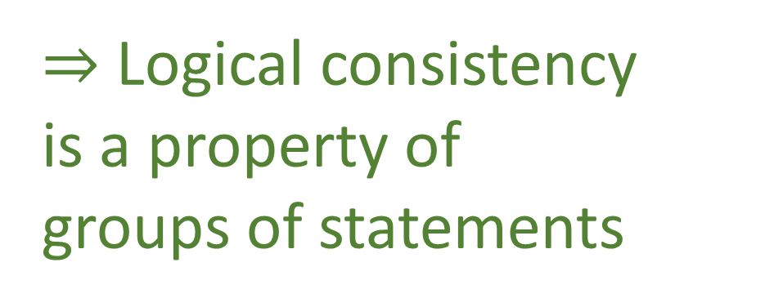

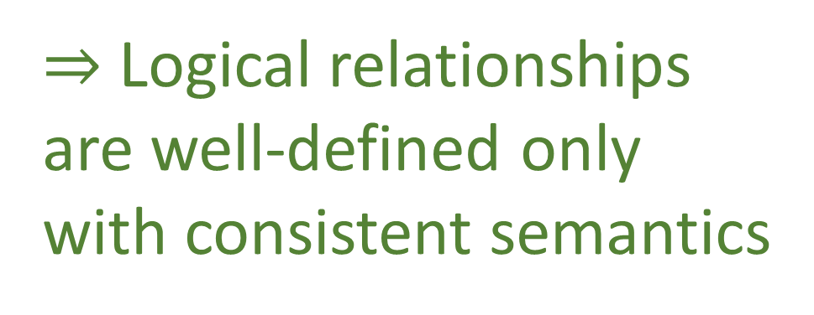
Liar paradox
“This sentence is false”
$⇒$ Logical consistency is a property of groups of statements
No-no paradox
“The next sentence is false”
“The previous sentence is true”
Yablo’s paradox
$S_{1}$: For $i>1$, $S_{i}$ is not true.
$S_{2}$: For $i>2$, $S_{i}$ is not true.
$S_{3}:$ For $i>3$, $S_{i}$ is not true.
…
The pope is the bishop of Rome
$⇒$ Logical relationships are well-defined only with consistent semantics
The bishop can only move diagonally
$⇒$ The pope can only move diagonally

Slide 23

$⇒$ Statements must be grouped into logical contexts
Informal
Formal
Logical context contains all statements that are logically and semantically related
physics
math
$$𝒮$$
“The mass of the photon is less than ${10}^{−13}$ eV”
“The position of the ball is between 2 and 3 m”
“…”
“The mass of the photon is exactly 0”
“…”
Still need connection to experimental evidence!
Notes:
The statements are “prime elements”, no specified further (in terms of grammar, etc…), structure and meaning of the assertion is not part of the formal system (because it would be impossible… web of meaning)

Slide 24

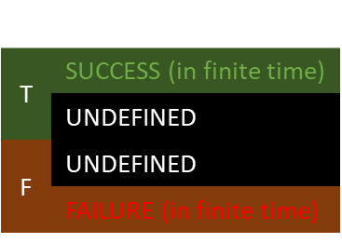
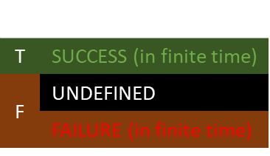

statement
$$s$$ | $$e$$
T | SUCCESS (in finite time)
 | UNDEFINED
F | UNDEFINED
 | FAILURE (in finite time)
Don’t necessarily have a test that always finishes in all cases
$$s$$
$e$
There exists extra terrestrial-life
The mass of the photon is exactly zero
The ratio between the mass of the electron and proton in eV is a rational number
…
experimental test
$$s$$ | $$e$$
T | SUCCESS (in finite time)
F | UNDEFINED
 | FAILURE (in finite time)
Verifiable statement: test guaranteed to finish successfully if and only if the statement is true

Slide 25

$⇒$ Contexts should keep track of verifiable statements
Informal
Formal
physics
math
$$𝒮$$
“The mass of the photon is less than ${10}^{−13}$ eV”
$$𝒮_{V}$$
“The position of the ball is between 2 and 3 m”
“…”
“the mass of the photon is exactly 0”
“…”
Is this primitive enough?
Notes:
The statements are “prime elements”, no specified further (in terms of grammar, etc…), structure and meaning of the assertion is not part of the formal system (because it would be impossible… web of meaning)

Slide 26






$$ℝ$$
$$F=ma$$
“The acceleration is $a±Δa$ m/s²”
“The force is $F±ΔF$ N”
“The mass is $m±Δm$ Kg”
“The mass is $m±Δm$ Kg”$∧$“The acceleration is $a±Δa$ m/s²”
$$⇒$$
“The force is $ma±ΔF$ N”
The equation is really expressing relationships between experimentally verifiable statements

Slide 27
We can construct a formal system for experimental science provided we understand that
Informal
Formal
physics
math
The physics will always live in the informal system
The formal system is made “precise” by removing all things that can’t be captured in a precise way
The logic system needs to be “augmented” to keep track of experimental verifiability (is it enough?)
Primitive notions should be specifically chosen to expose only necessary complexity
Axioms/definitions should be specifically chosen to have straightforward physical justifications

Slide 28
Takeaways
It is possible to construct a formal system for experimental science but…
The physics will always live in the informal system
The formal system is made “precise” by removing all things that can’t be captured in a precise way
Primitive notions should be specifically chosen to expose only necessary complexity
Axioms/definitions should be specifically chosen to have straightforward physical justifications
TODOs
Refine this approach into a “philosophical position”

Slide 29
Logic of experimental verifiability

Slide 30
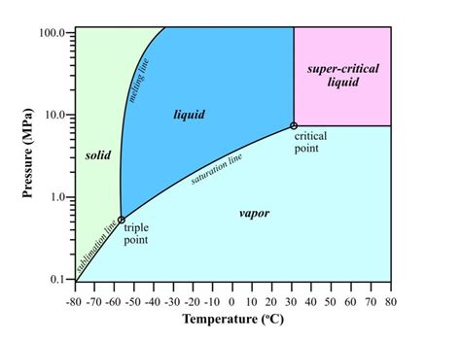

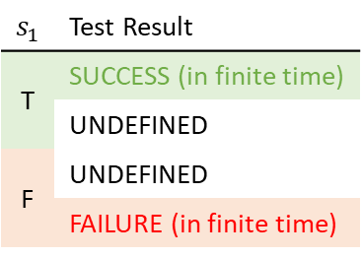


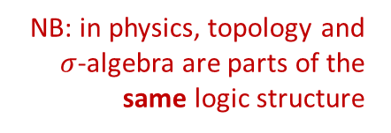





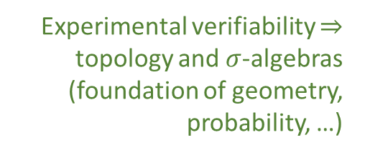

Topology and $σ$-algebra
Experimental verifiability $⇒$ topology and $σ$-algebras (foundation of geometry, probability, …)
Theoretical statements
$int(A)$ corresponds to the verifiable part of a statement
$$s_{1}$$ | Test Result
T | SUCCESS (in finite time)
 | UNDEFINED
F | UNDEFINED
 | FAILURE (in finite time)
Verifiable statements
Perfect map between math and physics
Possibilities
$∂A$ corresponds to the undecidable part of a statement
$ext(A)$ corresponds to the falsifiable part of a statement
NB: in physics, topology and $σ$-algebra are parts of the same logic structure
Open sets
Points
Open set $(\text{5}\text{09.5, 510.5})$ $⟺$ Verifiable “the mass of the electron is 510 $±$ 0.5 KeV”
Borel sets
Closed set $[510]$ $⟺$ Falsifiable “the mass of the electron is exactly 510 KeV”
Borel set $ℚ$ ($int\left(ℚ\right)∪ext\left(ℚ\right)=∅$) $⟺$Theoretical “the mass of the electron in KeV is a rational number” (undecidable)
Inference relationship $𝓇:𝒟_{Y}→𝒟_{X}$ such that $𝓇\left(s\right)≡s$
$$𝒟_{X}$$
$$𝒟_{Y}$$
Topologically continuous consistent with analytic discontinuity on isolated points
Inference relationship $$⟺$$ Causal relationship
Relationships must be topologically continuous
$$X$$
$$Y$$
Causal relationship $f:X→Y$ such that $x≼f\left(x\right)$
Phase transition $⟺$ Topologically isolated regions

Slide 31
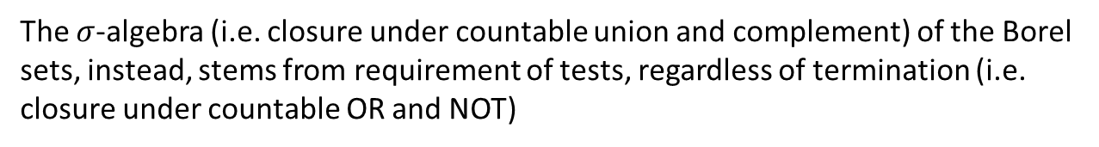
Physical theories are logical structures generated by countably many verifiable statements
Theoretical statements
The topological structure (i.e. closure under finite intersection and arbitrary union) stems from requirement of finite time termination (i.e. closure under finite AND and countable OR)
Verifiable statements
Possibilities
The $σ$-algebra (i.e. closure under countable union and complement) of the Borel sets, instead, stems from requirement of tests, regardless of termination (i.e. closure under countable OR and NOT)
Open sets
Points
Borel sets
Note: nothing “proves” that verifiable tests “exist” strictly speaking
(Conceptual cut, Descartes’ evil demon, problem of inference, …)
But, if they exist, they must follow that structure
and it’s the exact mathematical structure we use for proofs and calculations

Slide 32
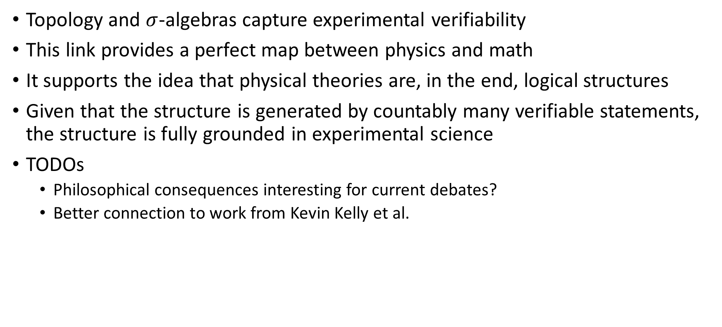
Takeaways
Topology and $σ$-algebras capture experimental verifiability
This link provides a perfect map between physics and math
It supports the idea that physical theories are, in the end, logical structures
Given that the structure is generated by countably many verifiable statements, the structure is fully grounded in experimental science
TODOs
Philosophical consequences interesting for current debates?
Better connection to work from Kevin Kelly et al.

Slide 33
Ensembles as fundamental concept

Slide 34
Typical view: first define “pure states”, then define ensembles as probability distribution over pure states
This is backwards compared to experimental practice
In practice, we can only prepare ensembles, and imagine making them more and more refined.
If we want a theory based on experimental practice, the ensembles are the primary object, and the pure states are particular ensembles that correspond to “best possible preparation”.

Slide 35
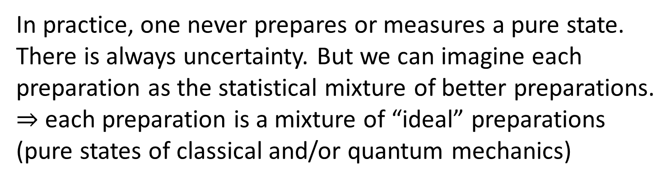
Basic arguments:
In practice, one never prepares or measures a pure state. There is always uncertainty. But we can imagine each preparation as the statistical mixture of better preparations.
$⇒$ each preparation is a mixture of “ideal” preparations (pure states of classical and/or quantum mechanics)
Physical laws represent “if-then” relationships. These rules apply not to a single instance of preparation/measurement, but to all similar preparations/measurements. Therefore, laws relate collections of identically prepared systems: physical laws are about ensembles.

Slide 36
Basic arguments:
Repeatability is intrinsic to science. Repeatability always implies that “we can always do it one more time.” Saying that the electron has a particular value of mass means that we can always produce an electron and repeat the measurement. The value of mass, then, is a property of the collection of all electrons: it is a property of an ensemble.

Slide 37


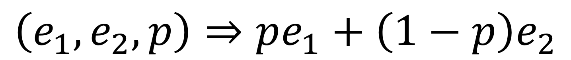



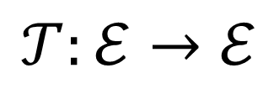
Basic property of ensembles
Statistical mixing $⇒$ Convex structure
$$\left(e_{1},e_{2},p\right)⇒pe_{1}+\left(1−p\right)e_{2}$$
Processes $⇒$ Linear transformations
$$𝒯:ℰ→ℰ$$
$$𝒯\left(pe_{1}+\left(1−p\right)e_{2}\right)=p𝒯\left(e_{1}\right)+\left(1−p\right)𝒯\left(e_{2}\right)$$
Quantities $⇒$ Linear operators
$$O:ℰ→ℝ$$
$$O\left(pe_{1}+\left(1−p\right)e_{2}\right)=pO\left(e_{1}\right)+\left(1−p\right)O\left(e_{2}\right)$$
all?
Ensembles $⇒$ Linear structures in physics

Slide 38

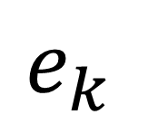

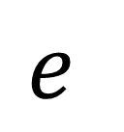
A classical measurement “refines” the ensemble
Mere “update” to more precise ensemble
Preparation
Measurement
/ selection
$$e$$
$$e_{k}$$
$$(=∑p_{i}e_{i})$$
$e_{k}$ part of the original decomposition
Final ensemble has lower entropy

Slide 39

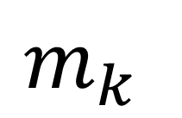


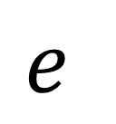
A quantum measurement may also reprepare the system
Measurement
$$e$$
Preparation
$$e′$$
Selection
$$m_{k}$$
$$(=∑p_{i}e_{i})$$
$$(=∑p_{i}m_{i})$$
Measurement output
In general, not a mixture of possible measurement outcomes
Closest ensemble that is a mixture of possible measurement outcomes
First part can increase entropy
Second part can decrease entropy

Slide 40
Takeaways
Ensembles are necessary fundamental objects in physics
All processes are linear maps from ensembles to ensembles
TODOs
Cleanup and refine

Slide 41
System definition

Slide 42
What are basic requirements to define a system?
Establish a system/environment boundary
Independence from environment,
internal dynamics and other systems

Slide 43
System/environment boundary
Environment
Needs to define what is in the system and what is not
This includes which properties are relevant
System
Interaction at the boundary determines the system and its properties
System can only exist in equilibrium with environment
System property is well-defined only if unchanged by the environment
All physics (science) is contextual

Slide 44
System independence
Environment
Systems can be defined only if, in some circumstances, they can be described and studied independently
System
From environment, other systems and internal dynamics
Description of system must decouple from all the rest
Clearly idealized assumption
Similar condition of equilibria as system decoupling we saw in thermodynamics
State are ensembles in equilibrium

Slide 45
Environment
Contexts are different sys/env equilibria
Evolution of system is also evolution of context
Immutable fundamental objects do not necessarily exist
System
Same “energy/matter” takes different form in different contexts
Measurement apparatus is part of the environment
“State of the whole universe” is problematic

Slide 46
Takeaways
Definition and description of a system is also description of sys/env boundary
States are ensembles in equilibrium
TODOs
Cleanup and refine

Slide 47
Foundations of probability

Slide 48
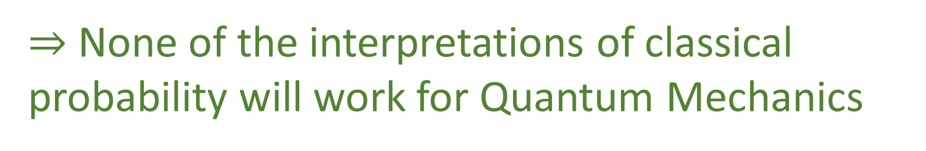
Quantum mechanics does not follow classical Kolmogorov probability
$⇒$ None of the interpretations of classical probability will work for Quantum Mechanics
Need a generalization of probability that makes physical sense and recovers classical probability

Slide 49


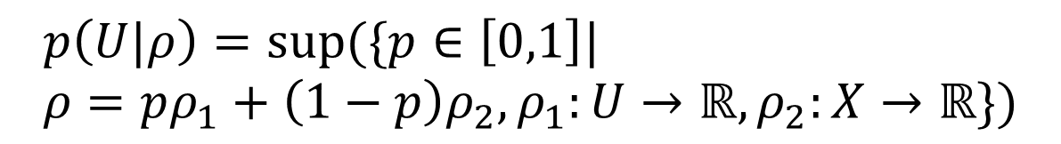

additive
Probability space
$$(Ω,Σ,p:Σ→\left[0,1\right])$$
$p\left(A∪B\right)=p\left(A\right)+p\left(B\right)$if $A∩B=∅$
How to generalize?
Probability of a subset: weight for the biggest part that has support in that subset
$$p\left(x\right)=p\left(x|U\right)p\left(U\right)+p\left(x|U^{C}\right)p\left(U^{C}\right)$$
$$U$$
$$p\left(U|ρ\right)=sup(\{p∈\left[0,1\right]| \\ ρ=pρ_{1}+\left(1−p\right)ρ_{2}, ρ_{1}:U→ℝ,ρ_{2}:X→ℝ\})$$

Slide 50

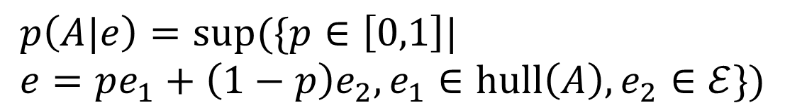




mixing
entropy
$$A∈Σ_{ℰ}$$
Set of ensembles
Ensemble space
$$(ℰ,+,S:ℰ→ℝ)$$
$$hull(A)$$
All mixtures of $A$
$$p\left(A|e\right)=sup(\{p∈\left[0,1\right]| \\ e=pe_{1}+\left(1−p\right)e_{2}, e_{1}∈hull\left(A\right), e_{2}∈ℰ\})$$
Mixing coefficient of the biggest component of $e$ reachable with mixtures of $A$
Disjunct ensembles: when mixing provide the maximum entropy increase
$$U$$
Correspond to orthogonal elements
Can be discriminated with an experiment
$p$ is sub-additive in general but additive for disjunct sets

Slide 51
Primitive notion is not frequency, propensity, …
It’s ensemble mixing
Survives in quantum mechanics as well
Entropy is what defines classical contexts
Lattice of subspaces where two disjoint subspaces are also disjunct (i.e. maximize entropy during mixing)

Slide 52
Takeaways
We need an approach to probability that works for both classical and quantum mechanics
We can construct one where ensembles are primitives
It also requires a new interpretation of probability in terms of ensemble mixing
TODOs
Construct a full philosophical approach

Slide 53
Physical theories as assumptions

Slide 54
Infinitesimal reducibility
+
Determinism/reversibility
Classical Hamiltonian Mechanics
+
Independence of DOFs
Necessary and sufficient assumptions
Physical theory
Assumptions not only identify the realm of applicability of the theory, but they are exactly the theory
$⇒$ Studying the nature of the assumptions means studying the nature of physical theories

Slide 55
Some assumptions come from requirements of experimental science
Theory must be generated by countably many verifiable statements
Not about nature
Ensembles are the fundamental physical objects
Some assumptions are specific to the system at hand
Infinitesimal reducibility, deterministic and reversible evolution, …
Some assumptions are somewhat in between
System isolation

Slide 56
Incompatibility between theories is, in the end, incompatibility of assumptions
Projections during measurements are change of equilibrium with environment
Einstein's equations come from a Lagrangian, assume det/rev evolution, no abrupt change in sys/env boundary (?)
$⇒$ Projections and general relativity are incompatible
A “theory of everything” would need ALWAYS valid assumptions
Is that possible?
All scientific explanations are “reduction to assumptions”
Reducing everything to the same assumptions may not provide the best explanation

Slide 57
Thus my first answer to the implied question about the unreasonable effectiveness of mathematics is that we approach the situations with an intellectual apparatus so that we can only find what we do in many cases. It is both that simple, and that awful. What we were taught about the basis of science being experiments in the real world is only partially true. Eddington went further than this; he claimed that a sufficiently wise mind could deduce all of physics. I am only suggesting that a surprising amount can be so deduced. Eddington gave a lovely parable to illustrate this point. He said, “Some men went fishing in the sea with a net, and upon examining what they caught they concluded that there was a minimum size to the fish in the sea.”
- Richard Hamming
THE UNREASONABLE EFFECTIVENESS OF MATHEMATICS

Slide 58
Takeaways
Scientific theories are, in the end, equivalent to the assumptions that define them
Scientific explanations, in the end, can only say why a given assumption leads to a particular phenomenon
TODOs
Probably many connections to current philosophy of math and physics

Slide 59
Wrapping it up
Providing more solid foundations for physics means also fixing its philosophical foundations
The goal is not to do philosophy for philosophy’s sake, but to clearly specify the starting point from which to rederive the math and the physics
Problems that are not critical to derive the math and the physics, or where people can disagree, are not in scope
Ideally, we would find people in the philosophy community who would help us make progress

