Slide 1


Assumptions of Physics Summer School 2024 States and Processes
Gabriele Carcassi and Christine A. Aidala
Physics Department University of Michigan
https://assumptionsofphysics.org

Slide 2
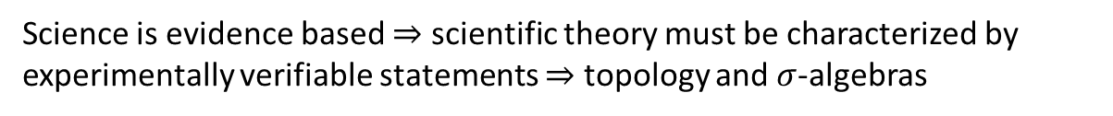


Main goal of the project
Identify a handful of physical starting points from which the basic laws can be rigorously derived
For example:
Infinitesimal reducibility $⇒$ Classical state
Irreducibility $⇒$ Quantum state
https://assumptionsofphysics.org
?
time
time
This also requires rederiving all mathematical structures from physical requirements
For example:
Science is evidence based $⇒$ scientific theory must be characterized by experimentally verifiable statements $⇒$ topology and $σ$-algebras

Slide 3
Underlying perspective
Foundations of physics
Foundations of mathematics
Metaphysical reality
What really exists
Physical reality
What can be accessed experimentally
Philosophy of science
What is the boundary?
What are the requirements?
Physical theories
Idealized account of empirical reality
Empirical reality
What can be reliably studied experimentally
How exactly does the abstraction/idealization process work?

Slide 4
If physics is about creating models of empirical reality, the foundations of physics should be a theory of models of empirical reality
Requirements of experimental verification, assumptions of each theory, realm of validity of assumptions, …

Slide 5
Different approach to the foundations of physics
Find ultimate theory
approximation
…
Typical approaches
Construct interpretations
Weak interactions
QED -Electromagnetism
Measurement problem
Role of the observer
QCD – Strong Interactions
Electro-weak
Quantum mechanics
Contextuality
Local realism
General Relativity
Grand Unified Theory
Ontology of observables
What “really” happens
Theory of Everything
Our approach
A theory about physical models
General physical principles and requirements
General mathematical framework
Specific assumptions
Classical mechanics
Quantum mechanics
derivation
Thermodynamics
…
specialization

Slide 6
Find the right overall concepts
Reverse physics: Start with the equations, reverse engineer physical assumptions/principles
Reverse Physics
Physics
Smallest set of assumptions required to rederive the theory
Physical theory
Physical result/ effect/prediction
Reverse Mathematics
Mathematics
Smallest set of axioms required to prove the theorem
Theorem
Mathematical result/ corollary/calculation
Found Phys 52, 40 (2022)
Goal: find the right overall physical concepts, “elevate” the discussion from mathematical constructs to physical principles
Physical mathematics: Start from scratch and rederive all mathematical structures from physical requirements
Physics
Physical requirements
Semantics
Physical mathematics
Goal: get the details right, perfect one-to-one map between mathematical and physical objects

Slide 7
Physical Mathematics: States and Processes
This session
Assumptions of Physics, Michigan Publishing (v2 2023)

Slide 8












Space of ensembles $ℰ$
Ensembles must have an entropy well defined
$$S:ℰ→ℝ$$
Ensembles can be mixed
Strictly concave function on convex structure
$$e=pe_{1}+\left(1−p\right)e_{2}$$
Semi-metric
Jensen-Shannon divergence ($JSD$)
Convex structure
$0≤S\left(\frac{1}{2}e_{1}+\frac{1}{2}e_{2}\right)−\frac{1}{2}\left(S\left(e_{1}\right)+S\left(e_{2}\right)\right)≤1$
Assume unique complement
$\left(e, p,e_{1}\right)→e_{2}$
Orthogonality
Vector space structure
Riemannian “manifold”
$e_{1}⊥e_{2}$ if $JSD(e_{1},e_{2})$= 1
$$g_{ij}=−∂_{i}∂_{j}S$$
Assume differentiability
Fisher-Rao metric
Subspaces
$$U={U^{⊥}}^{⊥}$$
Sub-additive probability measure
Additivity over contexts
$$p_{e}\left(U\right)=sup\{ p \left| pe_{1}+\left(1−p\right)e_{2} \right\}$$
Contexts
Sub-additive “extent” measure
Classical probability
$$U_{1}∩U_{2}=0⇒U_{1}⊥U_{2}$$
$μ\left(U\right)=sup\{2^{hull\left(U\right)}\}$

Slide 9
All names are placeholders
So feedback like “I wouldn’t call it that”, “the name is confusing”, … is not useful. We don’t even know what the right concepts are. Good naming is the final step.

Slide 10
Axioms of mixture and convex spaces

Slide 11
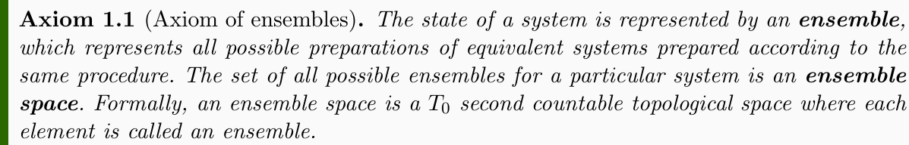
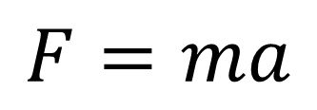
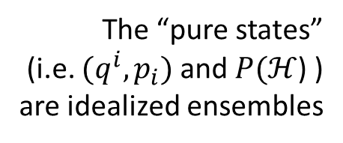

Can be defined experimentally
Physical laws are not about single instances: they are about reproducible relationships
$$F=ma$$
whenever this
then that
Reproducibility already implies infinitely many copies
(you can always check one more time)
The “pure states”
(i.e. $(q^{i},p_{i})$ and $P(ℋ$) ) are idealized ensembles
Also, preparations are never perfect
(can’t prepare perfect initial conditions)
$⇒$ Ensemble is the basic object for describing systems and states

Slide 12

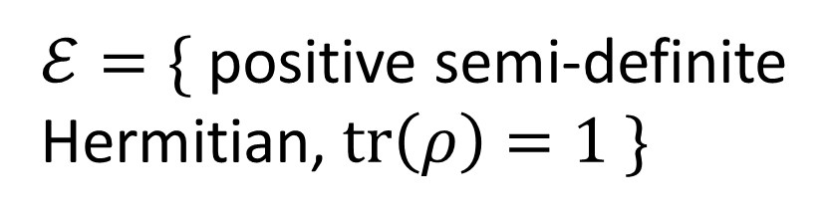


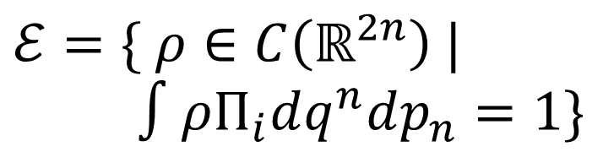

States
Ensembles
Classical discrete
$$X=\{x_{1},x_{2},…\}$$
$ℰ=\{ p_{i} | \sum_{i}{p_{i}}=1\}$
Phase space Symplectic manifold
$ℰ=\{ ρ∈C\left(ℝ^{2n}\right) |$ $∫ρΠ_{i}dq^{n}dp_{n}=1\}$
Classical continuum
$$X=\{ℝ^{2n},ω\}$$
Projective complex Hilbert space
$ℰ=\{$ positive semi-definite Hermitian, $tr\left(ρ\right)=1 \}$
Quantum mechanics
$$X=P(ℋ)$$

Slide 13
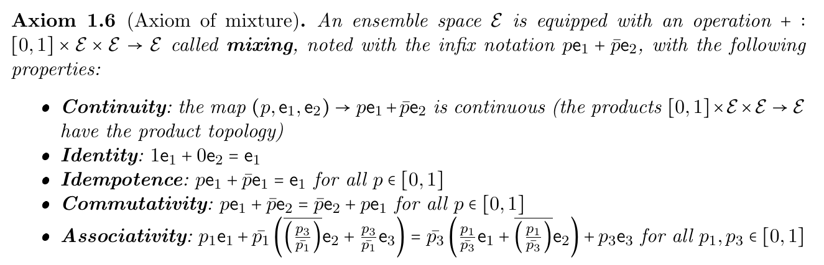

Ensembles can be mixed
$⇒$ Convex structure
Classical probability distributions and quantum density operators have a convex structure

Slide 14









$$e$$
$$b=λc+\overline{λ}e$$
mixtures of $a$ and $b$
$$b$$
$$d$$
$$a$$
common component of $a$ and $b$
$$a=pc+\overline{p}d$$
$$c$$

Slide 15
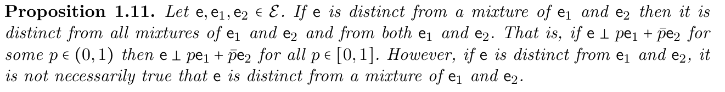
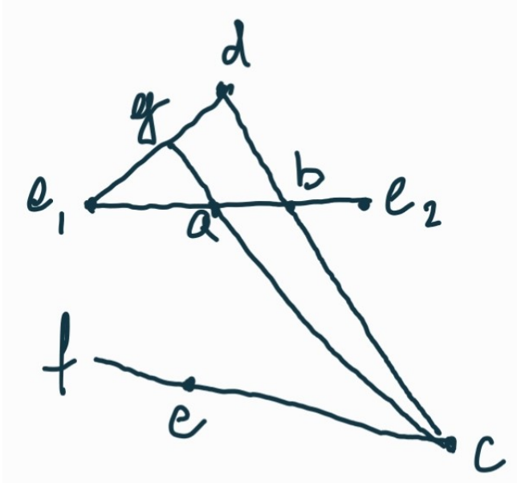

Suppose $e$ distinct from $a$ but not $b$

Slide 16
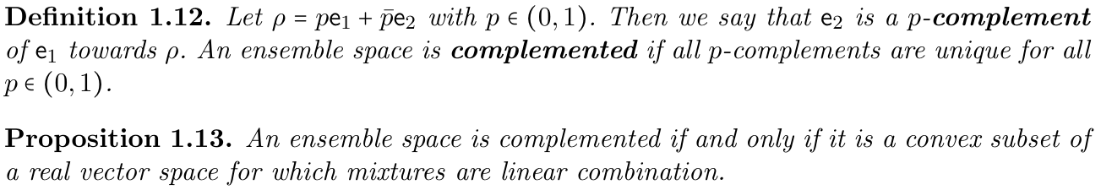




The mixing axioms allow us to get the same mixture just by changing one component
$$a$$
$$pa+\overline{p}b=pa+\overline{p}c$$
$$b$$
Requiring unique complement (i.e. cancellation axiom, unique inverse) recovers vector spaces
$$c$$
Both classical and quantum mechanics are complemented, but at this point it is not clear whether it is a necessary axiom

Slide 17
Takeaways
Ensemble mixing provides a convex structure
Invertibility of mixture recovers convex spaces
TODOs:
Gather useful results for convex spaces
Understand how to recover topological vector spaces

Slide 18
Entropy

Slide 19
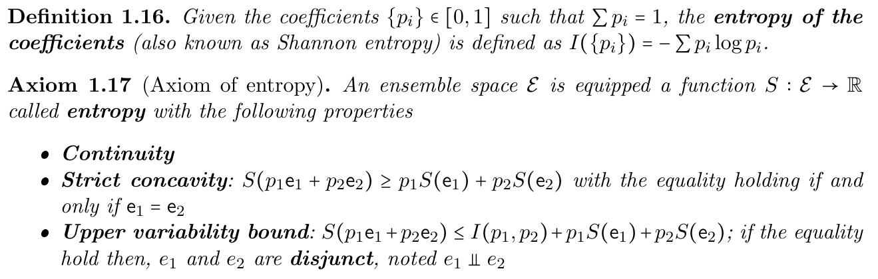
Entropy must be strictly concave: it cannot decrease during mixing, and it stays the same only when mixing an ensemble with itself
Maximum entropy increase is when ensembles are “completely different” (disjunct); in that case, the increase is only given by the choice of the ensemble
Assuming entropy is the variability within the ensemble

Slide 20
In classical mechanics, disjunct ensembles correspond to probability distributions with disjoint support
In quantum mechanics, disjunct ensembles correspond to density operators in orthogonal subspaces

Slide 21



The difference between disjunctness and distinctness proves to be crucial
Classical
Distinct: no common subdistribution
Disjunct: equal mixture raises the entropy by 1
Quantum
$$A$$
$$C$$
All pure states are distinct (no common component)
Only orthogonal states are disjunct (equal mixture raises the entropy by 1)
$$B$$
The entropic structure (disjunctness) tells us how much the ensembles are similar or not The convex structure (distinctness) tells us how much the common part can be separately studied

Slide 22
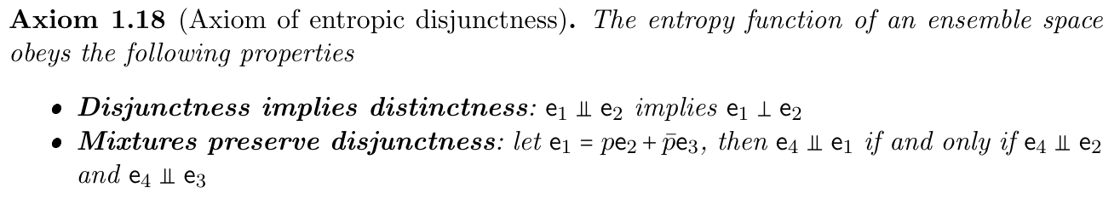
Conceptually, disjunctness is a stronger property than distinctness
The above axioms can be justified from the physics
Can they be proved from the previous axioms or not?

Slide 23
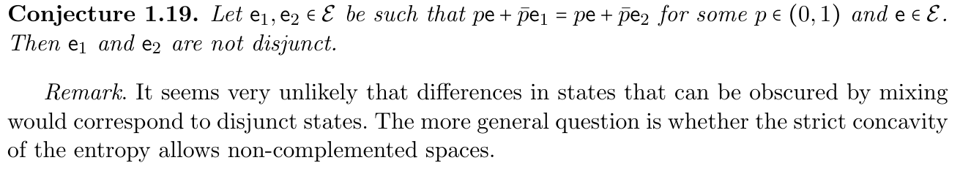
Is there any other interplay between convex structure and entropic structure?

Slide 24
Takeaways
Entropy provides an additional structure
Disjunctness allows us to recognize orthogonal elements
TODOs:
Better understand the interplay between convex and entropic structure
Entropy may be crucial to recover topological vector spaces

Slide 25
Dimensions of a subset of ensembles

Slide 26



Classical statistical mechanics links count of states and entropy
$$S\left(ρ_{U}\right)=\log{μ\left(U\right)}$$
Count of states
Shannon/Gibbs entropy
Uniform distribution over $U$
Fundamental postulate of statistical mechanics
Quantum statistical mechanics has a somewhat related expression
$$S\left(ρ_{U}\right)≤\log\left(\dim_{ℂ}{(\operatorname{span}\left(U\right)}\right)$$
Equal for a uniform distribution over $\operatorname{span}\left(U\right)$
Von Neumann entropy
Uniform distribution over $U$
Dimensionality of subspace
Want a generalization of these relationships

Slide 27
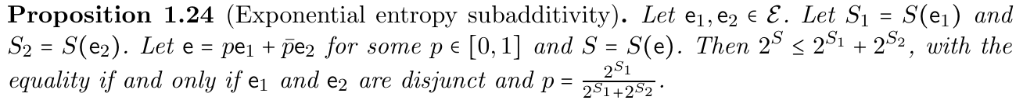
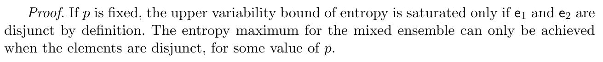
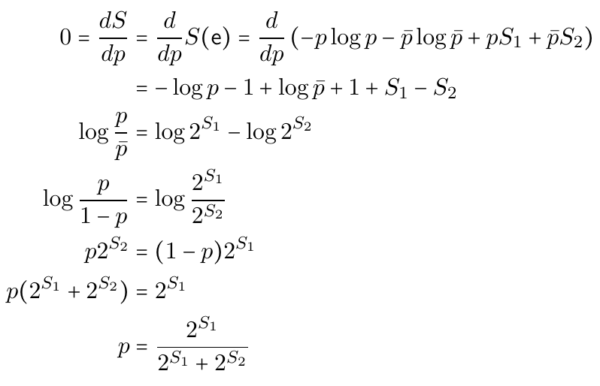
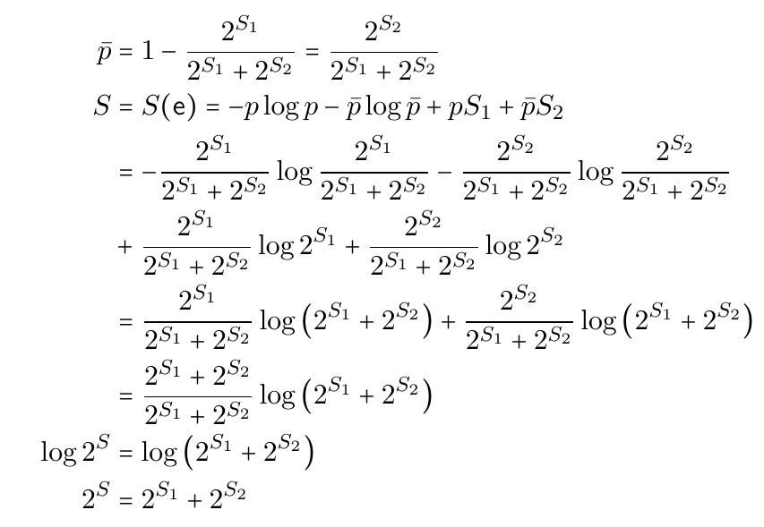
Exponential of the entropy has key property

Slide 28
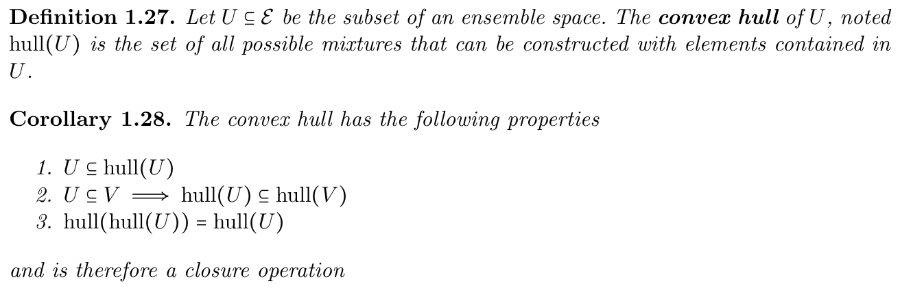

Slide 29
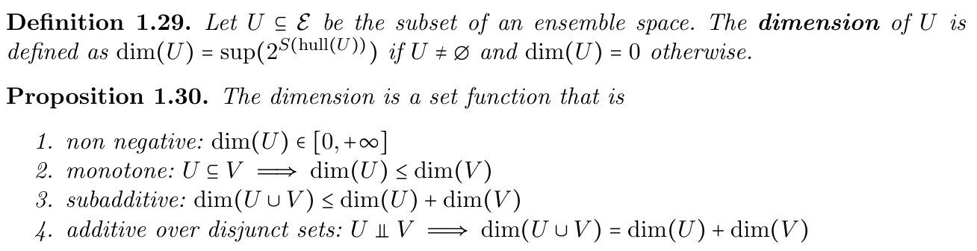

Dimension is the exponential of the highest entropy reachable through convex combinations
Highest entropy is reached by uniform distribution of disjunct elements
Recovers
$$S\left(ρ_{U}\right)≤\log{dim\left(U\right)}$$
But it is not additive!

Slide 30









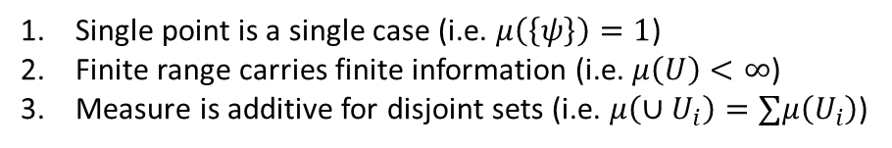















Need for non-additive measure
Single point
Finite continuous range
$$A$$
$$μ(U)$$
$$\log{μ(U)}$$
$$μ(U)$$
$$\log{μ(U)}$$
$$C$$
Counting measure
$$μ\left(U\right)=\#U$$
$1$
$0$
$+∞$
$+∞$
$$B$$
Number of points
$$μ\left(\left\{A\right\}\right)=2^{0}=1$$
Lebesgue measure
$$μ\left(\left\{A,B\right\}\right)=2^{1}=2$$
not additive
$$μ\left(\left[a,b\right]\right)=b−a$$
$0$
$−∞$
$<∞$
$<∞$
$$μ\left(\left\{A,C\right\}\right)<2=μ\left(\left\{A\right\}\right)+μ\left(\left\{C\right\}\right)$$
Interval size
“Quantized” measure
In quantum mechanics, literally $1+1≤2$
$$μ\left(U\right)=sup(2^{S(hull(U))})$$
$1$
$0$
$<∞$
$<∞$
Entropy over uniform distribution
Pick two!
Single point is a single case (i.e. $μ\left(\left\{ψ\right\}\right)=1$)
Finite range carries finite information (i.e. $μ\left(U\right)<∞$)
Measure is additive for disjoint sets (i.e. $μ\left(∪U_{i}\right)=∑μ\left(U_{i}\right)$)
Physically, we count states all else equal
Contextuality $⟺$ non-additive measure

Slide 31
Takeaways
Upper entropy bound leads to a natural notion of “size” of a set which recovers statistical mechanics relationships in the general case
This notion of size is, in general, not additive
It is additive over disjunct sets
In classical mechanics, distinct = disjunct, so the measure is additive over pure states
In quantum mechanics, disjunct = orthogonal, so the measure is additive only over an orthogonal basis (i.e. measurement context)
TODOs:
Better characterize the non-additivity

Slide 32
Entropic geometry

Slide 33

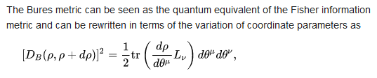
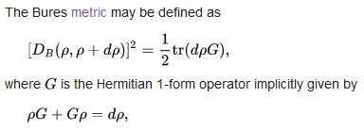
The space of classical statistical manifolds has a natural metric
There is a quantum analogue
Want a generalization of these objects

Slide 34
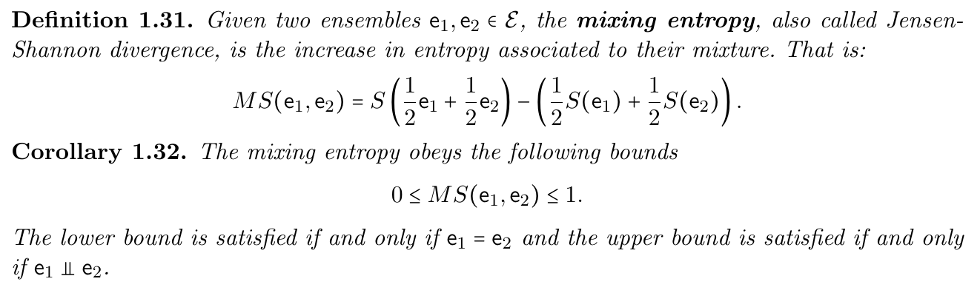
It is a semi-metric (does not satisfy triangle inequality)
It generalizes the Jensen-Shannon divergence

Slide 35
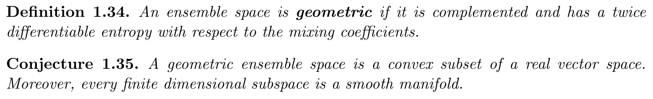
We need a vector space with a differentiable structure

Slide 36
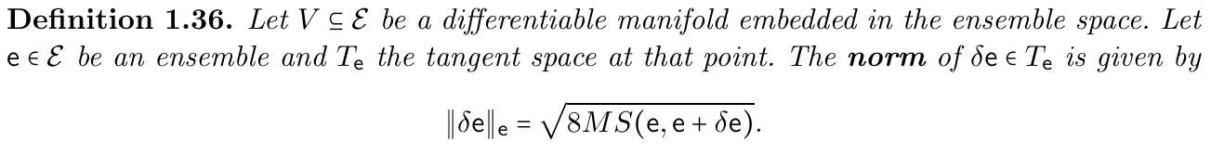
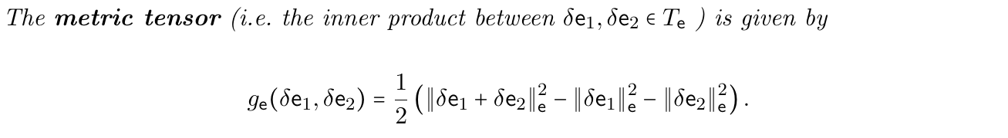
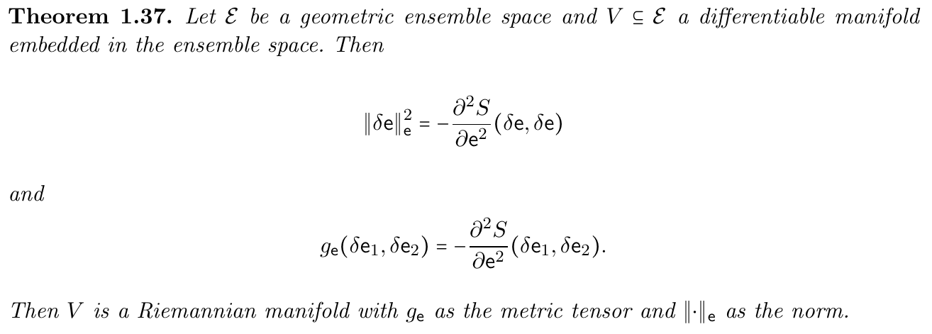
Recover a geometric structure in general
Metric tensor is just the Hessian of the entropy

Slide 37
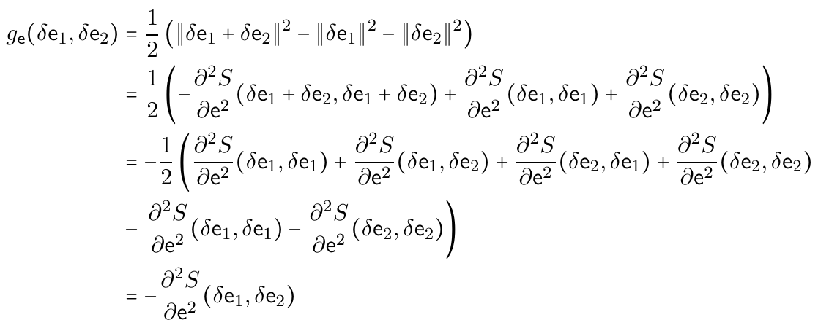
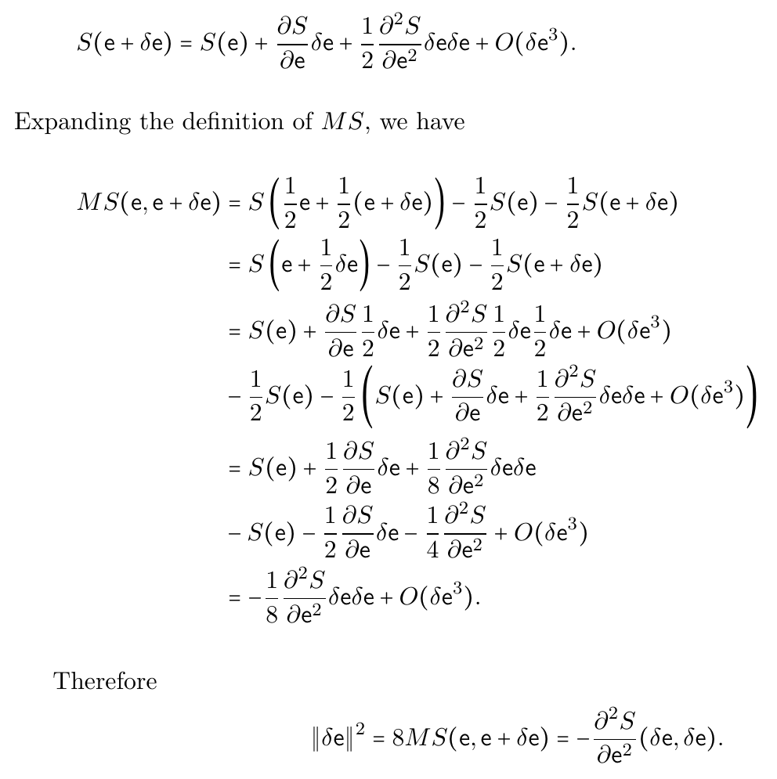
Proofs are trivial

Slide 38
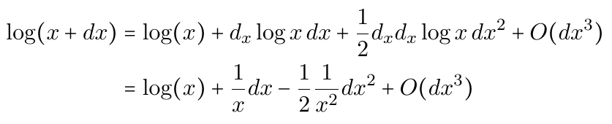
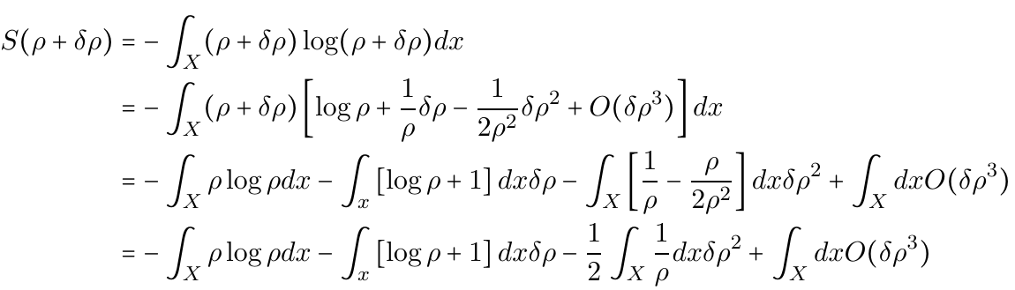
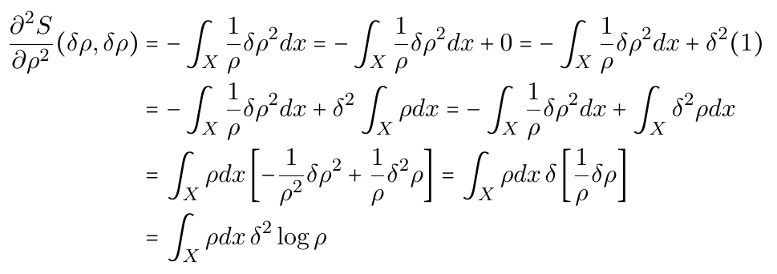
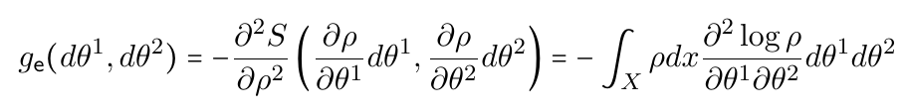
Proofs are mere calculations

Slide 39
Takeaways
The geometric structure of the ensemble space is due to the strict concavity of the entropy, and therefore it is fully general
TODOs:
Recover the quantum case
In both the classical and quantum case, the JSD is the square of a distance function: can this be proven in general?
NOTE: differential geometry is limited to manifolds (i.e. finite dimensional spaces). Yet, what we find is more general.
Can we find a more general notion of differentiability, tangent spaces, etc… ?

Slide 40
Differentiability

Slide 41

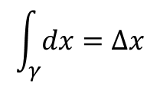

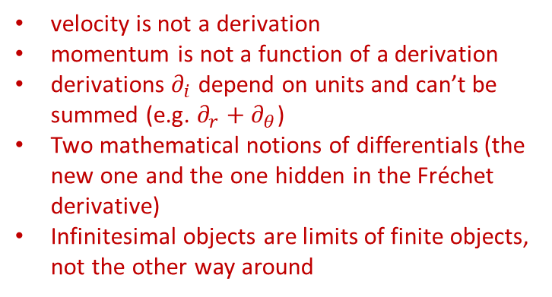


Differentiability in math
Mathematicians have developed several, increasingly abstract, definitions for differentials, derivatives, integrations, tangent vectors… are they suitable for physics?
Differentiable manifold
Manifold
Differentiable structure
Changes of coordinates are differentiable
Vector defined as derivation of a scalar function
Defined on top of Fréchet derivative
$$v:C^{∞}\left(X,ℝ\right)→C^{∞}\left(X,ℝ\right)$$
vector basis
Differentials defined as linear functions of vectors
$$v\left(f\right)=v^{i}∂_{i}f$$
$$dx:V→ℝ$$
So are convectors, like momentum
Does not make sense physically!
$$dx\left(v\right)=dx\left(v^{i}∂_{i}\right)=v^{x}$$
velocity is not a derivation
momentum is not a function of a derivation
derivations $∂_{i}$ depend on units and can’t be summed (e.g. $∂_{r}+∂_{θ}$)
Two mathematical notions of differentials (the new one and the one hidden in the Fréchet derivative)
Infinitesimal objects are limits of finite objects, not the other way around
Integrals defined on top of differential forms
$$\int_{γ}{dx}=Δx$$

Slide 42






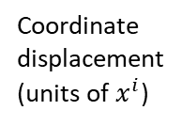




Differentiability in physics
$$dv=\left\{v_{1},v_{2},v_{3},…\right\}$$
Infinitesimal reducibility $⇒$ differentiability
$$\lim_{i→∞}{\frac{v_{i}}{a_{i}}}=t$$
Tangent vector
General notion of differential as an infinitesimal change in ANY vector space
Convergence at all points $⇒$ differentiability of curve
Goal: one notion of derivative
Time
Space
Temperature
Differentiable function: infinitesimal changes map to infinitesimal changes
Manifold displacement (unit free)
t
$$x(t)$$
x
T$(x)$
T
$$dx^{i}e_{i}=dP$$
Quantity
Map between the two
dt
$$\frac{dx}{dt}$$
dx
$$\frac{dT}{dx}$$
dT
Differentiable space: infinitesimal changes are well-defined
Differential
Coordinate displacement
(units of $x^{i}$)
Derivative: map between differentials
$$dx^{i}=\frac{dx^{i}}{dt}dt$$
$$dT=\frac{∂T}{∂x^{i}}dx^{i}$$
gradient (covector)
velocity (vector)

Slide 43
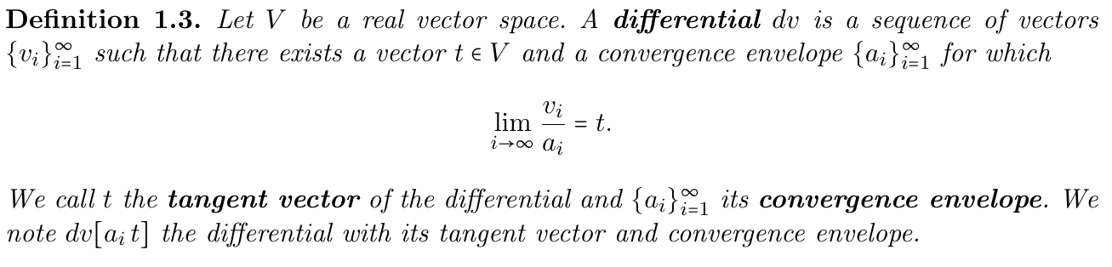
Defines how we go to zero
Only requires the (topological) vector space structure

Slide 44
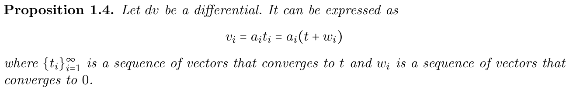
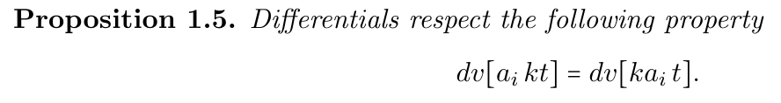
Some useful properties

Slide 45
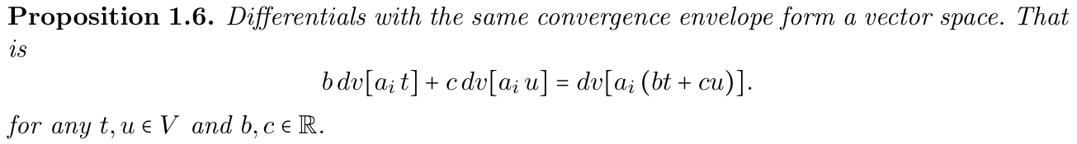
Technically, we have a space of differentials for each $a_{i}$

Slide 46
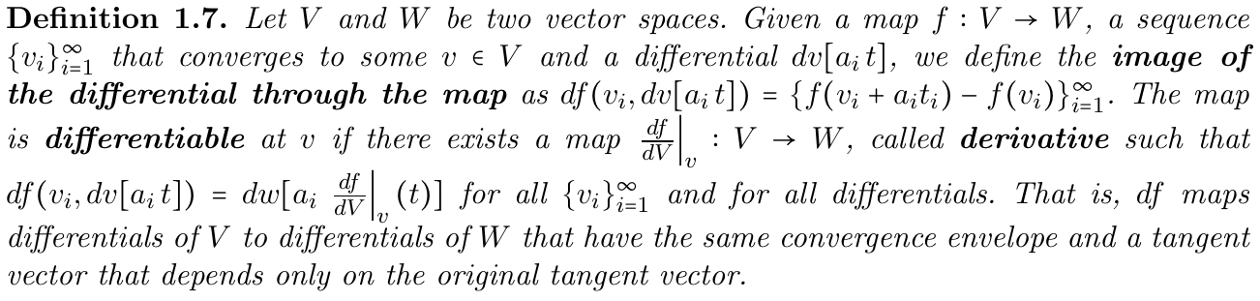
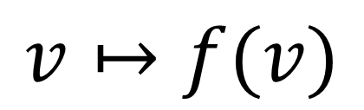
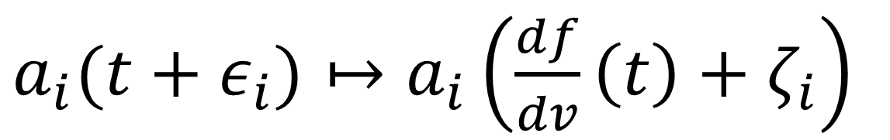
Differentiable maps are those that map differentials to differentials
Only the tangent matters, not the convergence
$$v↦f(v)$$
$a_{i}(t+ε_{i})↦a_{i}\left(\frac{df}{dv}\left(t\right)+ζ_{i}\right)$
Same convergence

Slide 47
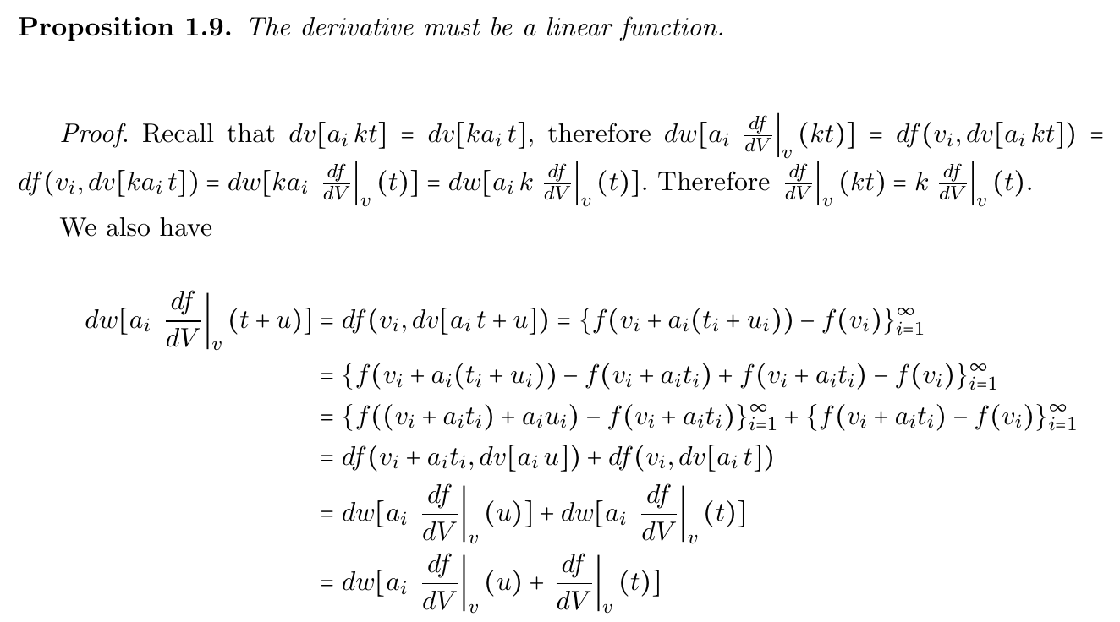
It is automatically linear!
Generalizations of derivative (e.g. Fréchet) are DEFINED to be linear

Slide 48
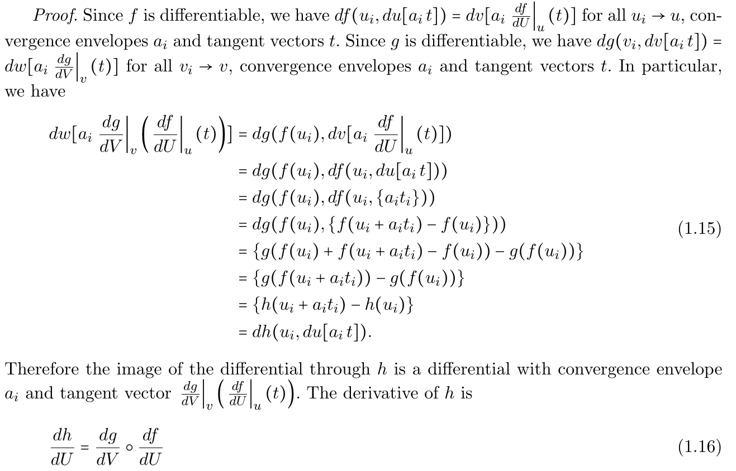







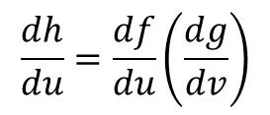




Chain rule is simply function composition
$$h=g(f)$$
$$U$$
$$f$$
$$V$$
$$g$$
$$W$$
$$dU$$
$$\frac{df}{du}$$
$$dV$$
$$\frac{dg}{dv}$$
$$dW$$
$$\frac{dh}{du}=\frac{df}{du}\left(\frac{dg}{dv}\right)$$
Again, proof is half a page

Slide 49
Coincides with standard notion of derivatives in specific cases

Slide 50
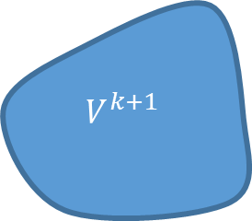







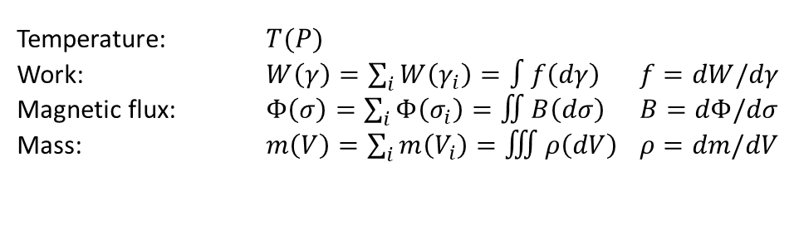

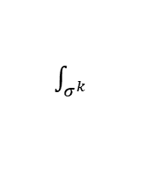









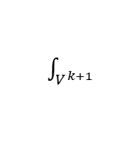
Differentiability: forms and linear functionals
Starting point: finite values defined on finite regions
$k$-functional
$k$-surface
$k$-form
$k$-vector
$$f_{k}\left(σ^{k}\right)=∫θ_{k}(dσ^{k})$$
Thinking in terms of relationships between finite objects leads to better physical intuition
Physically measurable quantities
zero-form
Differential forms: infinitesimal limit
Temperature: $T(P)$
Work: $W\left(γ\right)=\sum_{i}{W\left(γ_{i}\right)}=∫f\left(dγ\right)$ $f=dW/dγ$
Magnetic flux: $Φ\left(σ\right)=\sum_{i}{Φ\left(σ_{i}\right)}=∬B\left(dσ\right)$ $B=dΦ/dσ$
Mass: $m\left(V\right)=\sum_{i}{m\left(V_{i}\right)}=∭ρ\left(dV\right)$ $ρ=dm/dV$
one-form
two-form
The mathematics is contingent upon the assumption of infinitesimal reducibility (e.g. mass in volumes sums only if boundary effects can be neglected)
three-form
Assume additivity over disjoint regions
We can define functionals that act on boundaries
exterior functional
$$g_{k+1}$$
$$f_{k}$$
$$f^{k}$$
Given a functional
$$∂V^{k+1}=σ^{k}$$
$$V^{k+1}$$
$$d/dV^{k+1}$$
$\int_{V^{k+1}}{}$
$$d/dσ^{k}$$
$\int_{σ^{k}}{}$
Define higher dimensional functional that acts on the boundary
$$ω_{k+1}$$
$$∂$$
$$θ_{k}$$
$$g^{k+1}(V^{k+1})≡f^{k}\left(σ^{k}\right)$$
exterior derivative
Exterior functional
$$∂∂f^{k}\left(σ^{k+2}\right)=f^{k}\left(∂∂σ^{k+2}\right)=f^{k}\left(∅\right)=0$$
Reversing the exterior derivative is finding a (non-unique) potential
Boundary of a boundary is the empty set $⇒$ exterior derivative of exterior derivative is zero

Slide 51
Takeaways
We can define a more general notion of derivative that is more in line with the old ideas of infinitesimals but still rigorous
We can get better physical intuition because we can understand all infinitesimal objects as limits/decompositions on finite objects (on which the physics is actually defined)
TODOs:
Complete the theory
Construct the analogue of differentiable manifold (i.e. topological space that is homeomorphic to a topological vector space at each point)

Slide 52
Subspaces

Slide 53
The basic definition do not tell us what are the spaces on which the ensembles are defined
We need to recover them… in a general way
Disjunctness allows us to detect disjoint support in classical mechanics and orthogonality in quantum mechanics
Use disjunctness to define subspaces

Slide 54


Will be disjunctness in the end
All the elements that are orthogonal to all elements in $U$
Get a lot of properties out of very little

Slide 55

Nothing is orthogonal to itself
Last few properties

Slide 56


Subspaces defined as subsets that are the complement of their complement
This is usually a property for subspaces of vector spaces. We use it as the defining characteristic
Recovers the notion of closed vector subspaces

Slide 57

Now we apply the more general construction to our specific case
Note that this construction only uses the entropic structure
Valid even if there is not vector space structure (i.e. non-complemented space)
Recovers the correct notions
In the classical case, a subspace is the set of all distributions with support within a set $U$
In the quantum case, a subspace is the set of all density operators within a subspace of the Hilbert space

Slide 58

To recover the topology of the base space on top of which distributions are defined, the distributions must be continuous
Physically justifiable: experimental relationships are continuous functions
A continuous function is zero only on an open set
Hilbert spaces in quantum mechanics cannot work: $L^{2}\left(ℝ\right)≡L^2(ℝ^{n})$
Schwartz spaces do work: $S\left(ℝ\right)≢S(ℝ^{n})$

Slide 59

Points can be recovered by looking for sequences of subspaces that become “smaller and smaller”
They are definitely not pure states…

Slide 60
Takeaways
We can define a general notion of subspaces of ensembles based on disjunctness
The geometry of the vector spaces (i.e. the inner product, orthogonality) is also uniquely defined by the entropy
TODOs:
Complete the theory
Can we also define a notion of inner product from the entropy?

Slide 61
Probability and measure theory

Slide 62

Classical probability
Possibilities (experimentally defined cases)
Theoretical statements (statements with tests)
Probability each theoretical statement is true
Does not work for quantum mechanics!
Want a generalization for both

Slide 63



Given a set of ensembles, the probability is the biggest mixing coefficient associated to the biggest component of the target ensemble
$$p\left(x\right)=p\left(x|U\right)p\left(U\right)+p\left(x|U^{C}\right)p\left(U^{C}\right)$$
$$e=e_{1}p+e_{2}(1−p)$$
$$U$$

Slide 64

Non-additive in general. When do we recover additivity?
Non-additivity comes out when distinct ensembles are not disjunct.
Restrict to structure where distinct = disjunct.

Slide 65

The entire lattice of subspaces of CM is a context
Lattice of orthonormal subspaces in QM (i.e. a basis) is a context
Results from Quantum Logic can be reused at this point

Slide 66
Takeaways
We can define a general of non-additive probability that is physically motivated and works for both classical and quantum mechanics (and beyond)
The mixing coefficients are more fundamental and the probability comes out of decomposition of ensembles into parts
TODOs:
Fully develop a non-additive measure theoretical parallel

Slide 67
Other missing things
Symplectic structure should be imposed on the space of ensembles to have coordinate invariance of entropy… How?
Composite systems (i.e. product spaces) and independence of DOFs
Quantities (linear maps from ensembles to real numbers… or other topological spaces?)
Processes (linear ensemble maps)
Deterministic and reversible processes (entropy preserving processes)
Equilibration process (projections)
Extension to field theory

Slide 68
Wrapping it up
We should be able to construct a general theory of states and processes on minimal requirements
Same concepts for all theories
Lots of interesting mathematical work to do

