Slide 1
Classical mechanics as the high-entropy limit of quantum mechanics
Gabriele Carcassi¹, Manuele Landini² and Christine A. Aidala¹
¹Physics Department University of Michigan
²Institut für Experimental Physik und Zentrum für Quantenphysik, Universität Innsbruck

Slide 2





Main goal of the project
Identify a handful of physical starting points from which the basic laws can be rigorously derived
For example:
Infinitesimal reducibility $⇒$ Classical state
Irreducibility $⇒$ Quantum state
https://assumptionsofphysics.org
?
time
time
This also requires rederiving all mathematical structures from physical requirements
For example:
Science is evidence based $⇒$ scientific theory must be characterized by experimentally verifiable statements $⇒$ topology and $σ$-algebras

Slide 3

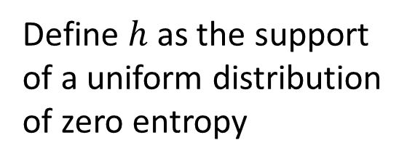

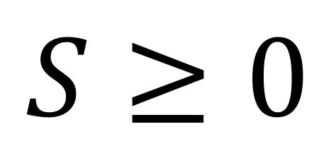

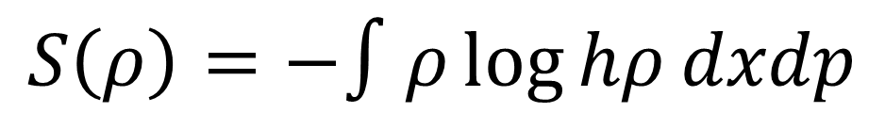
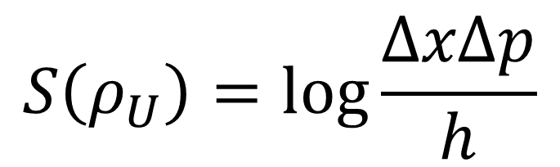

previous results
Third law of thermodynamics
$$S≥0$$
$$p$$
$$S=0$$
Physical entropy is absolute
$$h$$
Statistical mechanics
$$x$$
$$S\left(ρ_{U}\right)=\log{\frac{ΔxΔp}{h}}$$
Define $h$ as the support of a uniform distribution of zero entropy
$$S\left(ρ\right)=−∫ρ\log{hρ}dxdp$$
Fixes units (i.e. log argument is a pure number) and zero of entropy

Slide 4
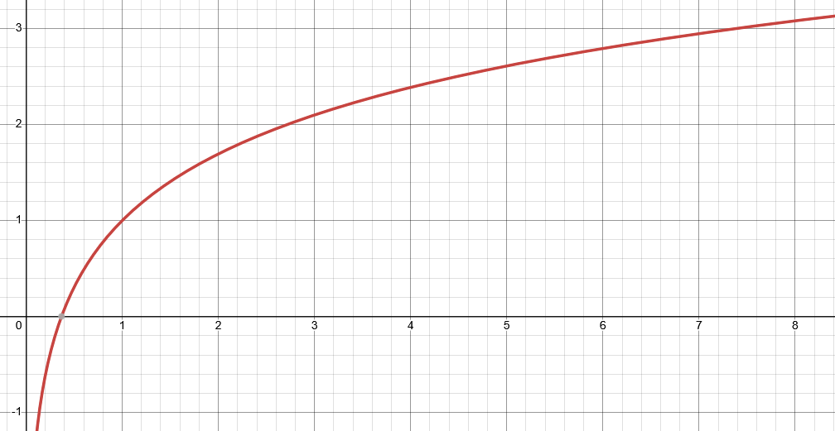
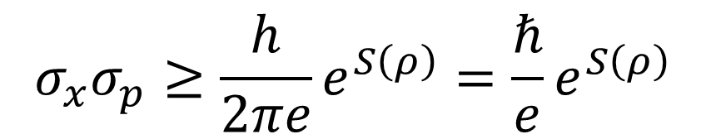

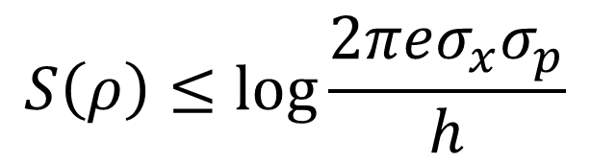
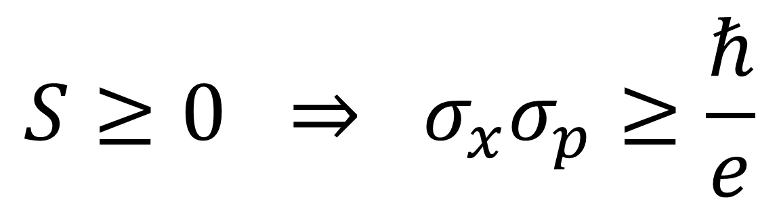

Let’s plot entropy against uncertainty
$$S$$
excluded by gaussian bound
Gaussian maximizes entropy for a given uncertainty
$$S\left(ρ\right)≤\log{\frac{2πeσ_{x}σ_{p}}{h}}$$
$$\frac{σ_{x}σ_{p}}{ℏ}$$
$$σ_{x}σ_{p}≥\frac{h}{2πe}e^{S\left(ρ\right)}=\frac{ℏ}{e}e^{S\left(ρ\right)}$$
excluded by 3rd law of thermodynamics
$$S≥0 ⇒ σ_{x}σ_{p}≥\frac{ℏ}{e}$$
Classical uncertainty principle

Slide 5
Quantum mechanics incorporates the third law while classical mechanics does not
Is this the only difference?
Suppose the lower bound on the entropy is the only difference, then in the limit of high entropy of quantum mechanics we should recover classical mechanics
Can we?

Slide 6
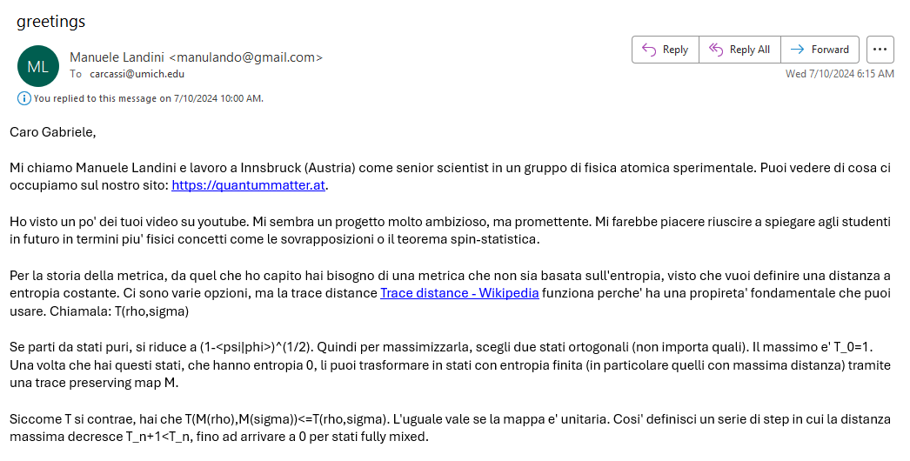
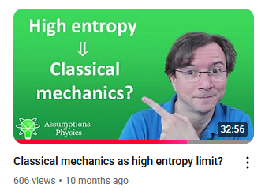
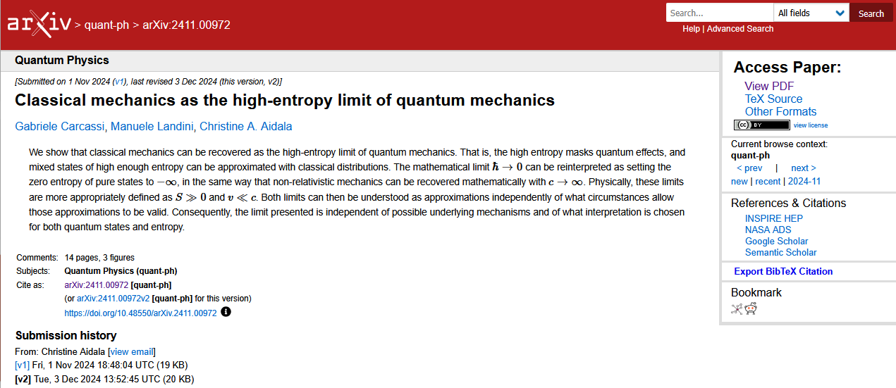
06/01/2024

Slide 7
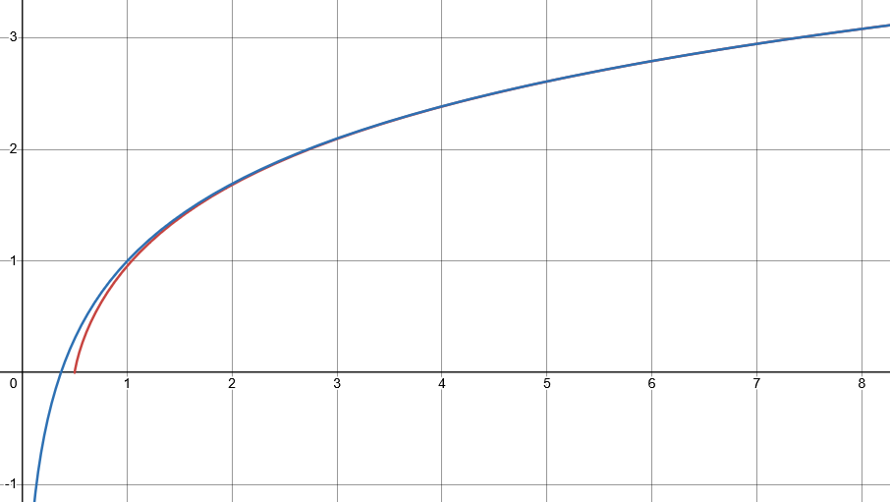
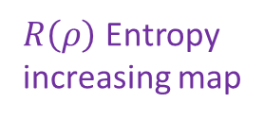




Looking for a map $R(ρ)$ that increases entropy of all mixed states, such that every level set of entropy maps to another level set
$$S$$
$⇒$ Unitary must be mapped to unitary
excluded by gaussian bound
$R\left(ρ\right)$ Entropy increasing map
Unitary map
$$\frac{σ_{x}σ_{p}}{ℏ}$$
excluded by 3rd law of thermodynamics
classical
quantum

Slide 8
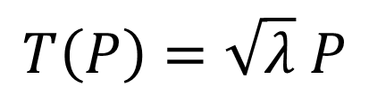
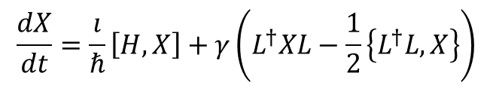
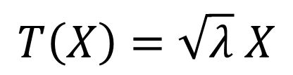


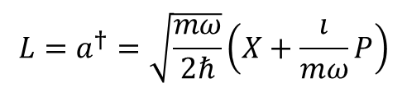
In classical mechanics
$$S\left(R\left(ρ\right)\right)=S\left(ρ\right)+\log{λ}⟺\left\{R\left(x\right),R\left(p\right)\right\}=λ\{x,p\}$$
In quantum mechanics
Jacobian is a constant: all volumes rescaled by the same factor
Stretching map
$$\left[R\left(X\right),R\left(P\right)\right]=λ\left[X,P\right]$$
Pure stretching map
$$T\left(X\right)=\sqrt{λ} X$$
$$T\left(P\right)=\sqrt{λ} P$$
Need to take care of operator ordering!!!
Infinitesimal pure stretching map
$$\frac{dX}{dt}=\frac{ı}{ℏ}\left[H,X\right]+γ\left(L^{†}XL−\frac{1}{2}\left\{L^{†}L,X\right\}\right)$$
Lindblad eq
(open quantum system)
$$L=a^{†}=\sqrt{\frac{mω}{2ℏ}}\left(X+\frac{ı}{mω}P\right)$$
$$γ=λ$$
Anti-normal ordering and Husimi Q are preferred

Slide 9
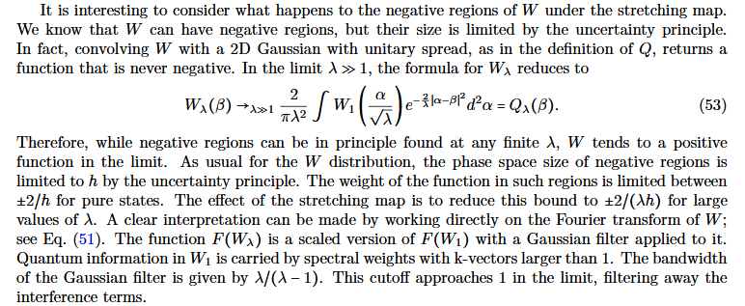
Effects of stretching map on phase space representations
Husimi Q is simply stretched
Wigner function is stretched and convolved with a gaussian, and coincides with the Husimi Q in the limit

Slide 10
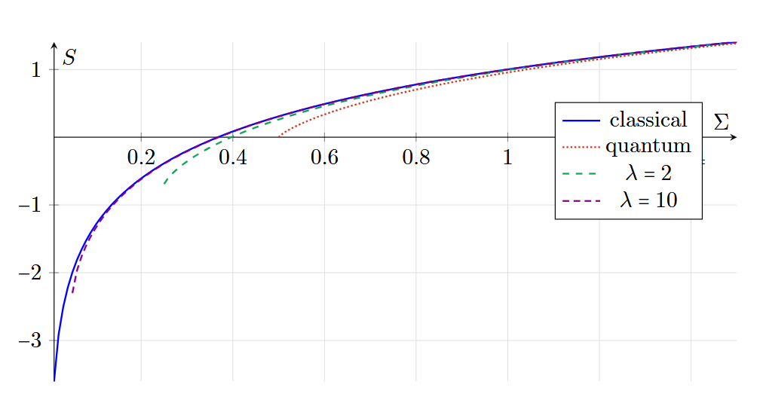
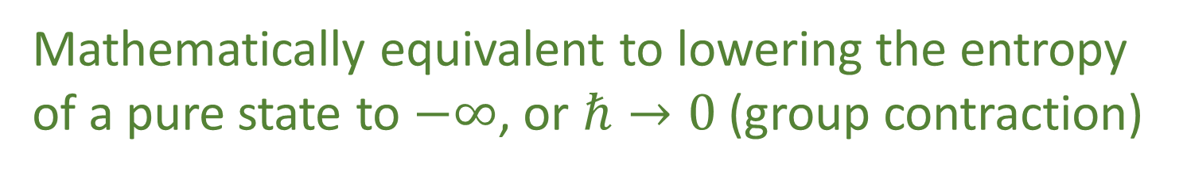
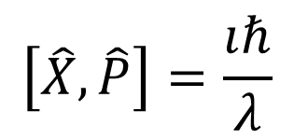



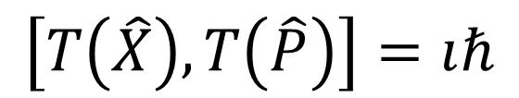
Another perspective: move the pure states to minus infinite entropy
Instead of
$$\left[X,P\right]=ıℏ$$
$$\left[T\left(X\right),T\left(P\right)\right]=λıℏ$$
Redefine original space such that
$$\left[\hat{X},\hat{P}\right]=\frac{ıℏ}{λ}$$
$$\left[T\left(\hat{X}\right),T\left(\hat{P}\right)\right]=ıℏ$$
$λ→∞ ⇒ \frac{ℏ}{λ}→0$
Mathematically equivalent to lowering the entropy of a pure state to $−∞$, or $ℏ→0$ (group contraction)

Slide 11


Low speed
Speed
“$c→∞$”
Classical Mechanics | Relativistic Mechanics
Quantum Mechanics | Quantum Field Theory
High entropy
“$ℏ→0$”
Entropy
No-mechanism limit (same as non-relativistic limit)

Slide 12
More about our project
Project website
https://assumptionsofphysics.org for papers, presentations, …
https://assumptionsofphysics.org/book for our open access book (updated every few years with new results)
YouTube channels
https://www.youtube.com/@gcarcassi Videos with results and insights from the research
https://www.youtube.com/@AssumptionsofPhysicsResearch Research channel, with open questions and livestreamed work sessions
GitHub
https://github.com/assumptionsofphysics Book, research papers, slides for videos...

