Slide 1


Developing a general theory for statistical ensembles
Gabriele Carcassi, Christine A. Aidala, Tobias Thrien
Physics Department University of Michigan

Slide 2


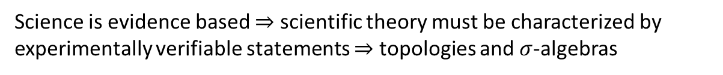


Main goal of the program
Identify a handful of physical starting points from which the basic laws can be rigorously derived
For example:
Infinitesimal reducibility $⇒$ Classical state
Irreducibility $⇒$ Quantum state
https://assumptionsofphysics.org
?
time
time
This also requires rederiving all mathematical structures from physical requirements
For example:
Science is evidence based $⇒$ scientific theory must be characterized by experimentally verifiable statements $⇒$ topologies and $σ$-algebras

Slide 3


Break physics into different conditions and study their logical relationships
“When the math is derived from the right physical assumptions, the physical assumptions can be derived from the math.”
Similar to what is done in the foundations of mathematics
$$⟺$$
MPPF
LM
Each assumption is an equivalence class of different conditions
FKE
NM
HM
WKE
CST
DR
IR
IND
Core assumptions for classical mechanics

Slide 4

Base theory for all of physics
Collection of conditions that MUST be true in all physical theories
Base theory $≠$ Theory of everything
Reverse Physics only works on theories we have, which is not enough!

Slide 5

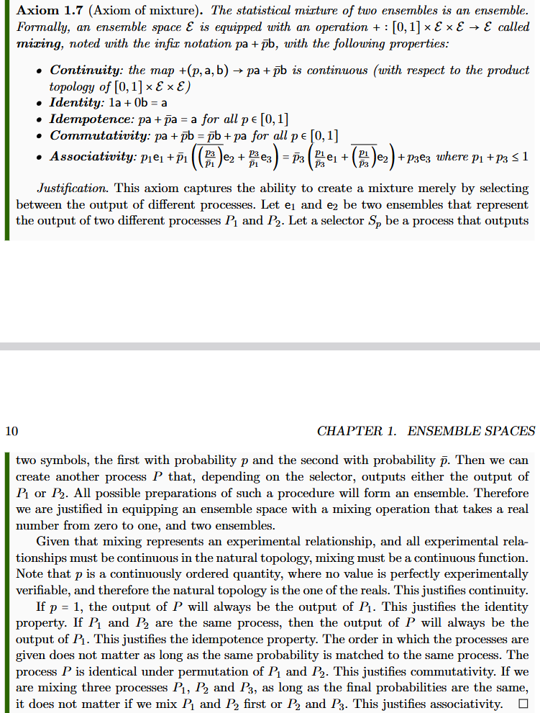
Start from mathematical axioms with a clear physical justification
Axioms must represent constitutive assumptions
“When physical objects are mapped to the right mathematical objects, the physical specification maps to the mathematical definitions.”
Informal intuitive requirement
(something that makes sense to a physicist or an engineer)
Formal definition
(something a mathematician will find precise)
Show that the formal definition follows from the intuitive requirement

Slide 6


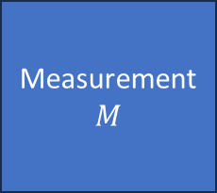




$⇒$ Scientific laws are relationships between ensembles
Preparation $$P$$
Process $$U$$
Measurement $$M$$
$$e_{P}$$
$$e_{U}$$
$$e_{M}$$
Statistical data
Initial ensemble
Final ensemble
Preparation procedure
$$…$$
Ensemble of outputs

Slide 7
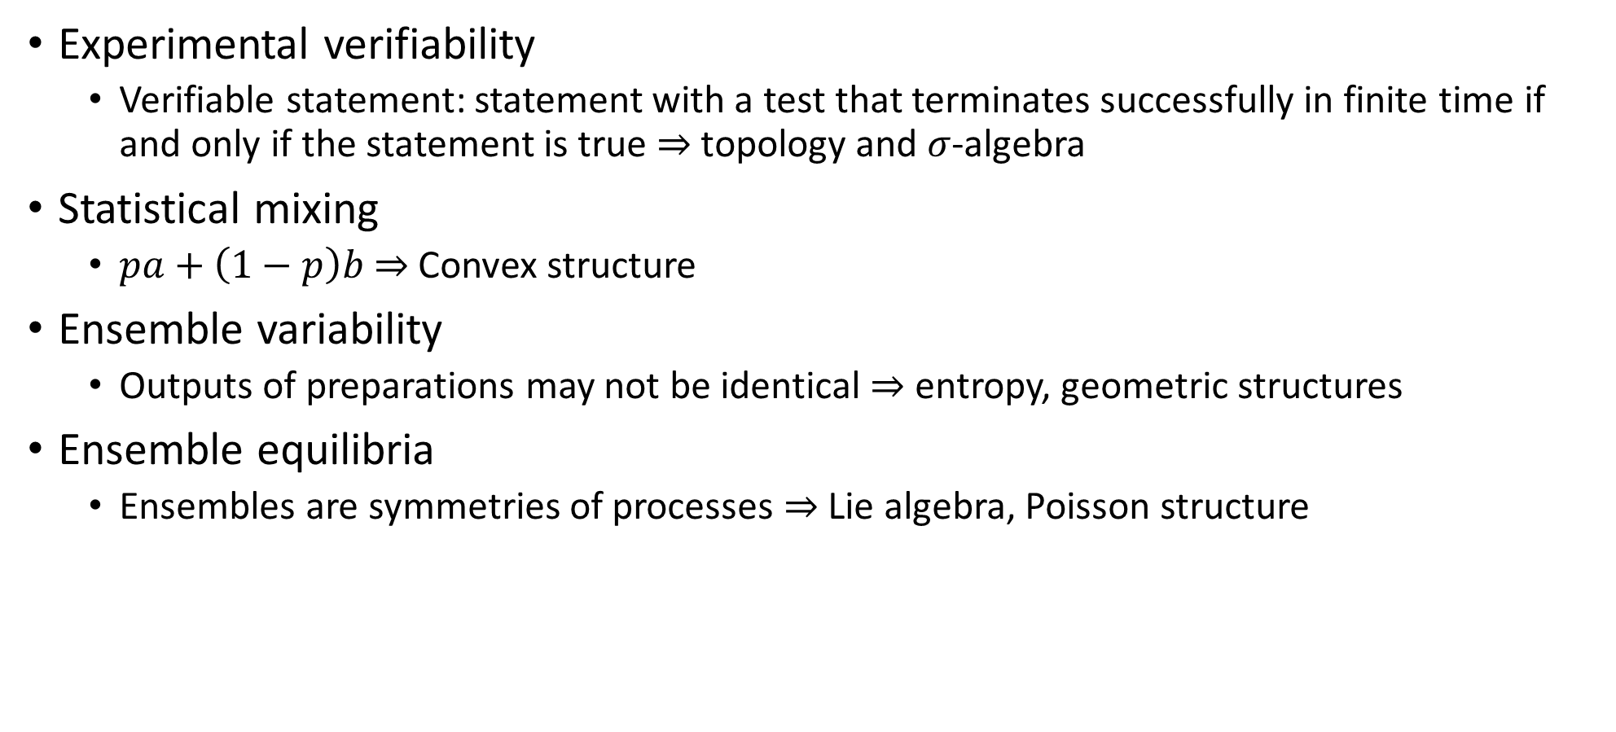
Minimal requirements for an ensemble space
Experimental verifiability
Verifiable statement: statement with a test that terminates successfully in finite time if and only if the statement is true $⇒$ topology and $σ$-algebra
Statistical mixing
$pa+\left(1−p\right)b$ $⇒$ Convex structure
Ensemble variability
Outputs of preparations may not be identical $⇒$ entropy, geometric structures
Ensemble equilibria
Ensembles are symmetries of processes $⇒$ Lie algebra, Poisson structure

Slide 8
Goals for the workshop
What is the relationship between probability as used in physics and as used in a more generalized sense?
Probability is/can be applied as an inference tool to non-repeatable events (e.g. political elections)
Probability can be defined on spaces that lack physical structures (e.g. we need a symplectic structure to define classical phase space and Hamiltonian evolution, but not to define probability measures)
Can the converse happen?
Conjecture: if probabilities are defined in terms of bets, and we are applying those bets to physical systems, is the physical knowledge of the state space EXACTLY the knowledge of all the sure bets?
Given that the entropy plays a fundamental role in characterizing ensemble spaces, is that knowledge equivalent to the entropic structure?

Slide 9
Goals for the workshop
Can we use non-additive measures to characterize statistical ensembles when mutual exclusivity cannot be assumed?
In Kolmogorov probability, additivity is equivalent to assuming that all elements of the sample space are mutually exclusive
In classical mechanics, additivity of the Liouville measure (i.e. count of states) is equivalent to assuming states are mutually exclusive
Sub-additive measures may be used to describe the case where mutual exclusivity is lost: there is some “overlap” even between the “pure” ensembles
What integral/derivative can we use to generalize probability calculus?

Slide 10
Goals for the workshop
How can we generalize the Lie algebraic structures of classical (Poisson brackets) and quantum (commutators) mechanics, and what independent structures are they describing?
What is the right Poisson structure to put on the space of ensembles so that the standard ones are recovered in the classical and quantum case?
Should we understand the elements of the structure as observables (i.e. linear functionals) or as generators (i.e. derivatives of one parameter groups)?
What is the right product for the generalized Poisson structure?

Slide 11
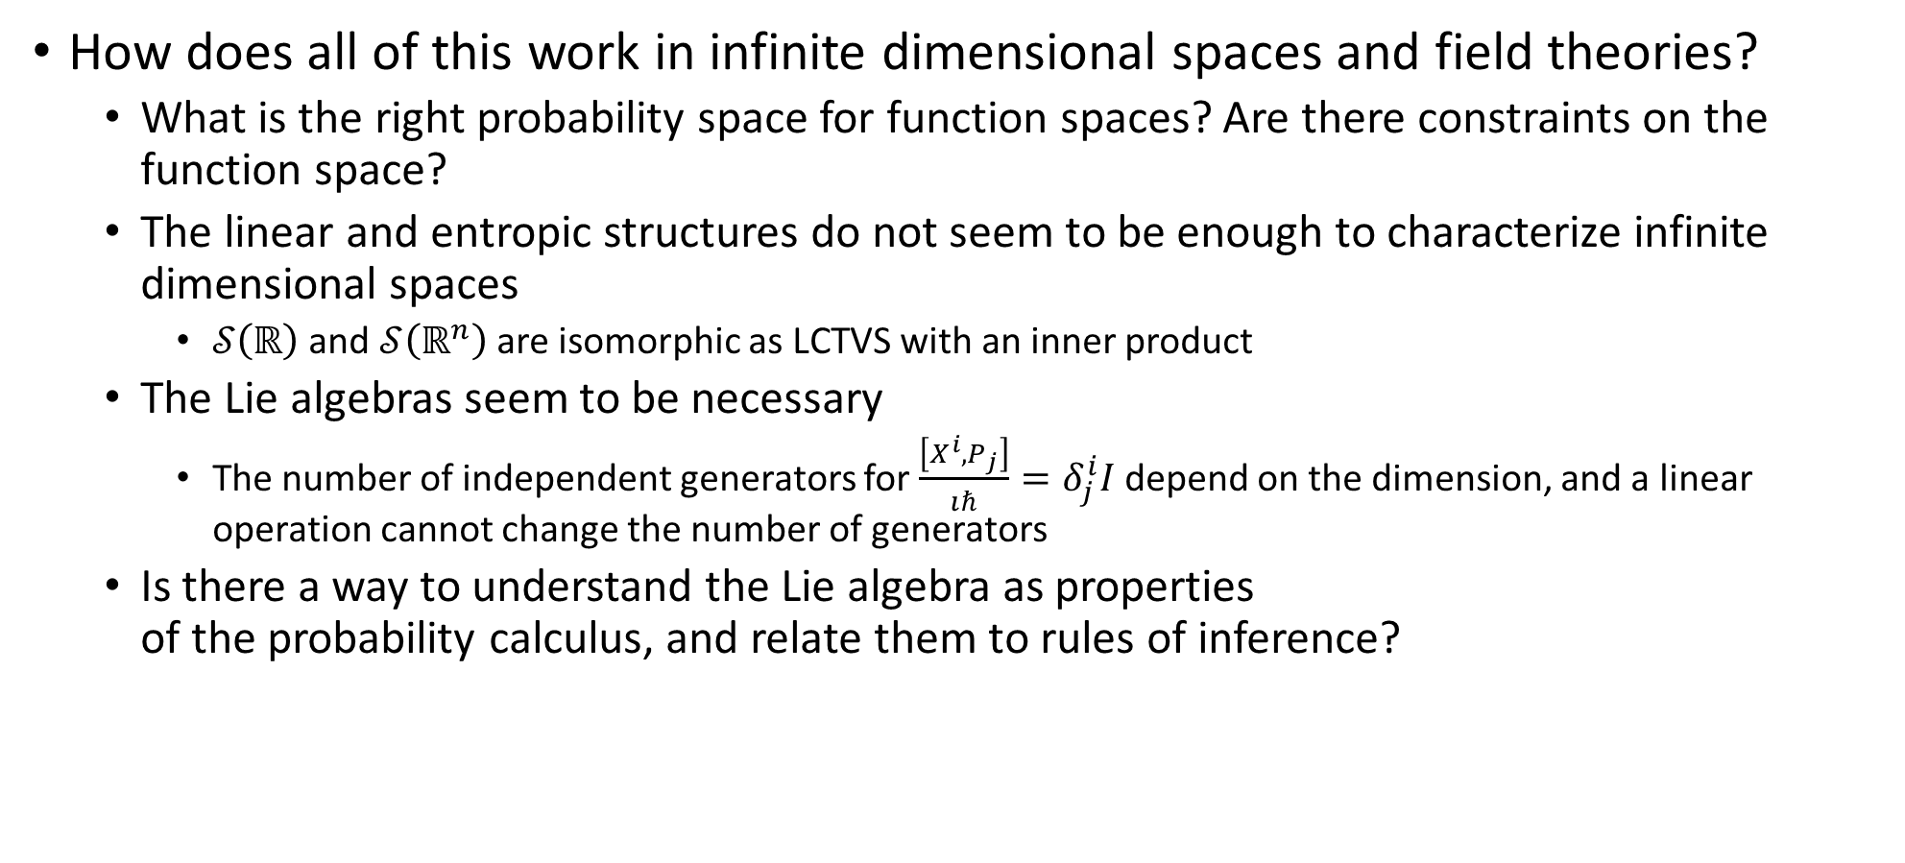
Goals for the workshop
How does all of this work in infinite dimensional spaces and field theories?
What is the right probability space for function spaces? Are there constraints on the function space?
The linear and entropic structures do not seem to be enough to characterize infinite dimensional spaces
$𝒮\left(ℝ\right)$ and $𝒮\left(ℝ^{n}\right)$ are isomorphic as LCTVS with an inner product
The Lie algebras seem to be necessary
The number of independent generators for $\frac{\left[X^{i},P_{j}\right]}{ıℏ}=δ_{j}^{i}I$ depend on the dimension, and a linear operation cannot change the number of generators
Is there a way to understand the Lie algebra as properties of the probability calculus, and relate them to rules of inference?

Slide 12
Basic structures

Slide 13
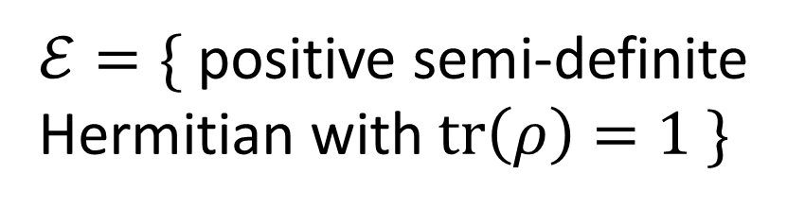


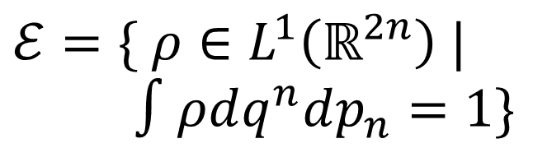


State space
Ensembles
Classical discrete
$$X=\{x_{1},x_{2},…\}$$
$ℰ=\{ p_{i} | \sum_{i}{p_{i}}=1\}$
Phase space Symplectic manifold
$ℰ=\{ ρ∈L^{1}\left(ℝ^{2n}\right) |$ $∫ρdq^{n}dp_{n}=1\}$
Classical continuum
$$X=\{ℝ^{2n},ω\}$$
Projective complex Hilbert space
$ℰ=\{$ positive semi-definite Hermitian with $tr\left(ρ\right)=1 \}$
Quantum mechanics
$$X=P(ℋ)$$
Concrete examples
with some caveats

Slide 14
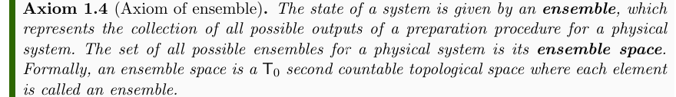
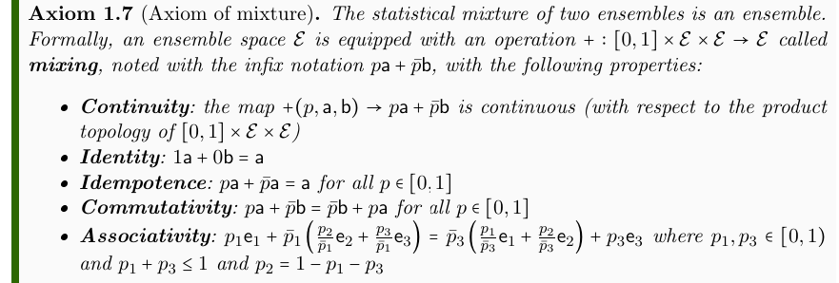
Topology and convex structure
Experimental verifiability justifies ensemble spaces to be ${\text{T}}_{0}$ second-countable topological spaces
Statistical mixing justifies ensemble spaces to have a continuous convex structure

Slide 15
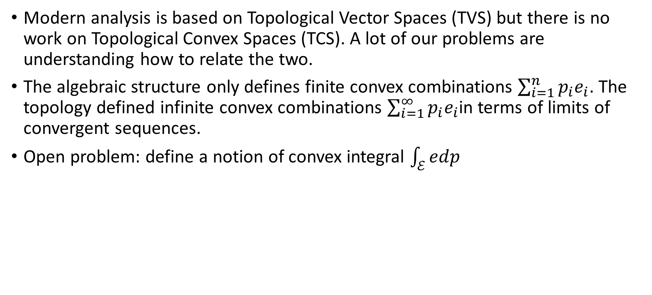
Topological convex spaces (TCS)
Modern analysis is based on Topological Vector Spaces (TVS) but there is no work on Topological Convex Spaces (TCS). A lot of our problems are understanding how to relate the two.
The algebraic structure only defines finite convex combinations $\sum_{i=1}^{n}{p_{i}e_{i}}$. The topology defined infinite convex combinations $\sum_{i=1}^{∞}{p_{i}e_{i}}$in terms of limits of convergent sequences.
Open problem: define a notion of convex integral $\int_{ℰ}{edp}$

Slide 16
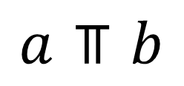
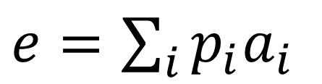
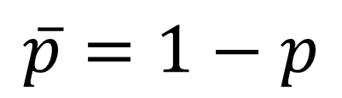
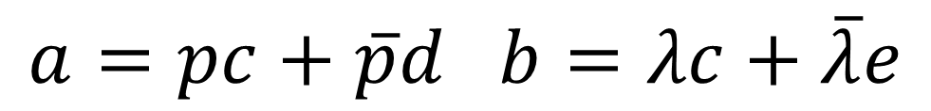
Some terminology
$e=\sum_{i}{p_{i}a_{i}}$
$$\overline{p}=1−p$$
components
mixture
mixing coefficient
$$a=pc+\overline{p}d b=λc+\overline{λ}e$$
have a common component
$$a⫪b$$
separate, don’t have a common component

Slide 17
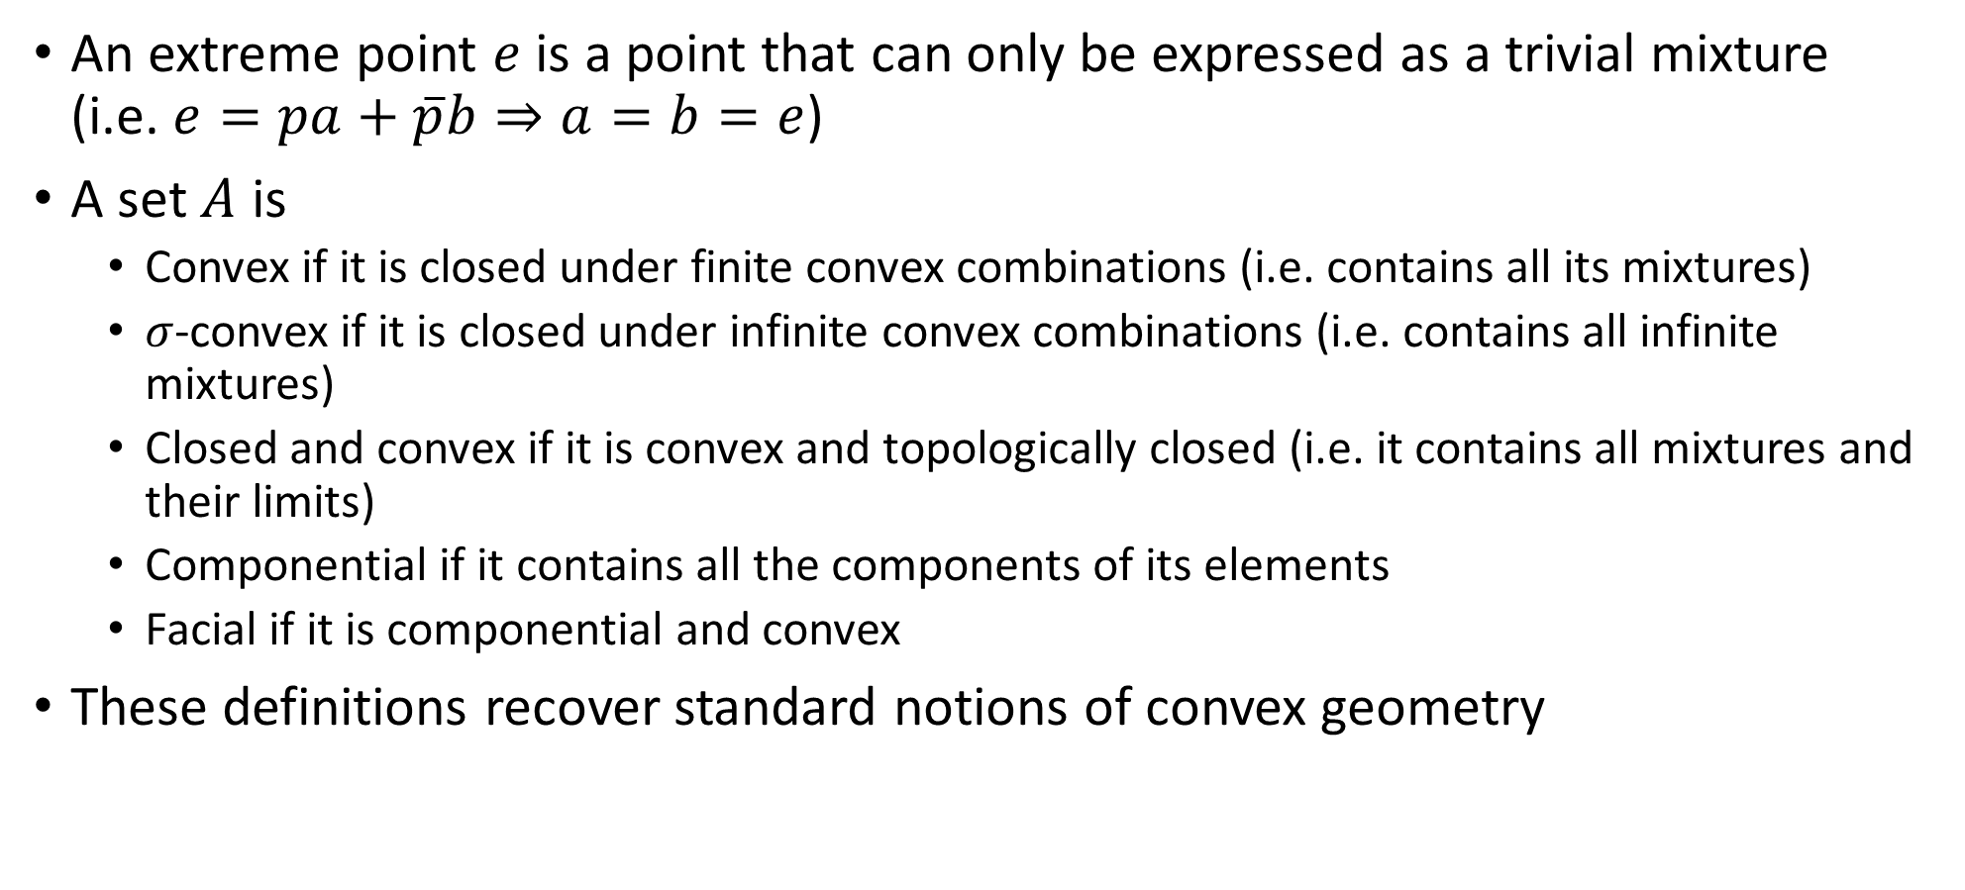
More terminology
An extreme point $e$ is a point that can only be expressed as a trivial mixture (i.e. $e=pa+\overline{p}b⇒a=b=e$)
A set $A$ is
Convex if it is closed under finite convex combinations (i.e. contains all its mixtures)
$σ$-convex if it is closed under infinite convex combinations (i.e. contains all infinite mixtures)
Closed and convex if it is convex and topologically closed (i.e. it contains all mixtures and their limits)
Componential if it contains all the components of its elements
Facial if it is componential and convex
These definitions recover standard notions of convex geometry

Slide 18

Limitations of TCS for probability/physics
This structure is not enough for physics:
The space of probability measures over $ℝ^{2}$ is the same regardless of what volume measure (i.e. state count) is chosen: no unique Hamiltonian/statistical mechanics
TCS can’t tell if extreme points are mutually exclusive
Set of all probability distributions over 3 mutually exclusive events
Subset of distributions: vertices are NOT mutually exclusive
Also, expectation values are NOT enough to recover mutual exclusivity

Slide 19
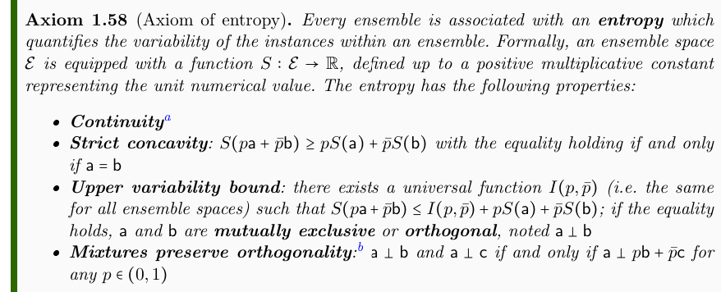
Entropy definition
Small ensemble changes, small variability changes
Average variability cannot decrease during mixtures
Maximal increase with mutual exclusivity
Statistical mixing preserves mutual exclusivity
May not be ALL the properties we need… but enough for many things

Slide 20
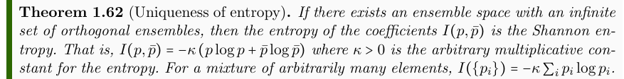
Entropy upper bound uniqueness
Shannon entropy is recovered as maximal increase
We have a Shannon-type entropy without having defined what the actual states are, only their maximum increase during mixing.
Typical derivations of entropy use product spaces, knowledge of the “points,” etc… This proof only uses decomposability over mutually exclusive preparations.

Slide 21
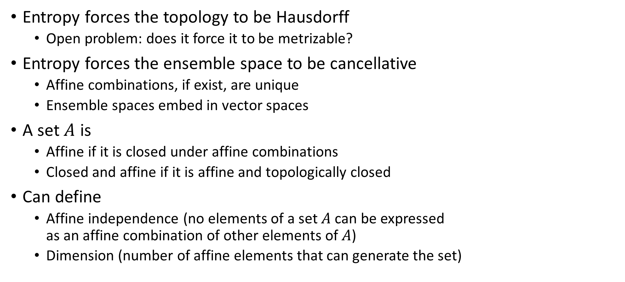
Constraints from the entropy
Entropy forces the topology to be Hausdorff
Open problem: does it force it to be metrizable?
Entropy forces the ensemble space to be cancellative
Affine combinations, if exist, are unique
Ensemble spaces embed in vector spaces
A set $A$ is
Affine if it is closed under affine combinations
Closed and affine if it is affine and topologically closed
Can define
Affine independence (no elements of a set $A$ can be expressed as an affine combination of other elements of $A$)
Dimension (number of affine elements that can generate the set)

Slide 22
Constraints from the entropy
Finite-dimensional affine subsets (still finalizing proofs)
Embed continuously in TVS
Are bounded
Infinite-dimensional affine subsets
May not embed continuously in TVS (strawman counterexample found)
Will not be bounded (physically meaningful counterexample)

Slide 23
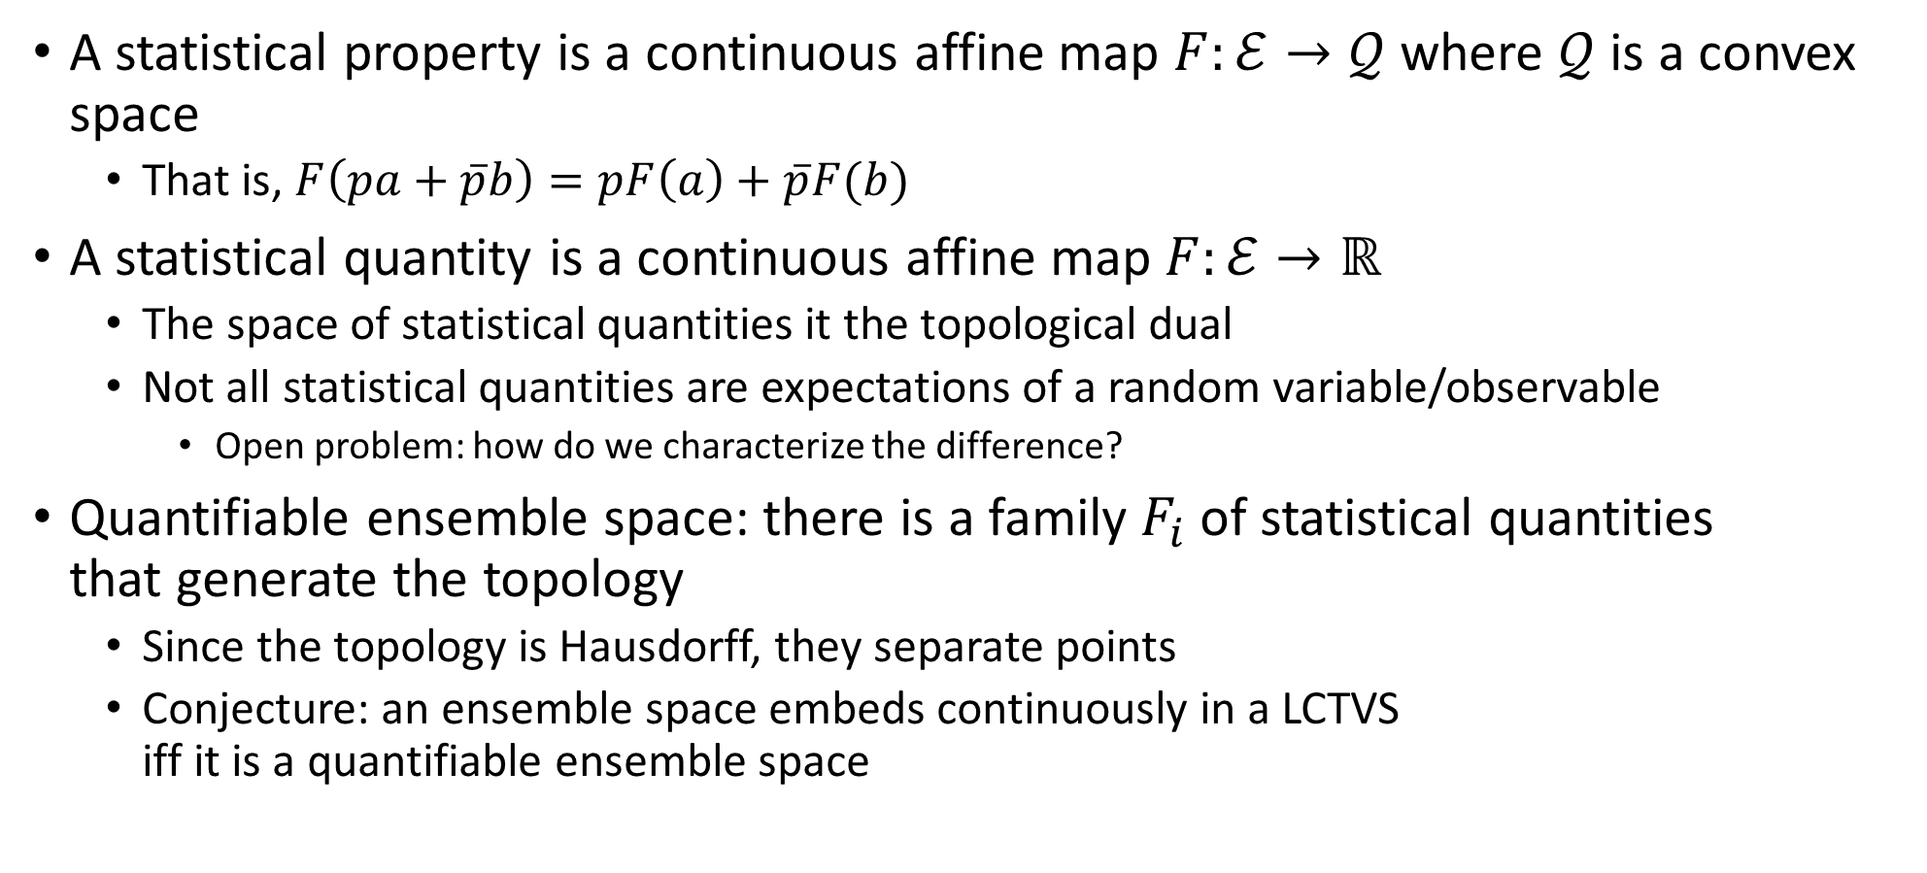
Statistical quantities (affine functionals)
A statistical property is a continuous affine map $F:ℰ→𝒬$ where $𝒬$ is a convex space
That is, $F\left(pa+\overline{p}b\right)=pF\left(a\right)+\overline{p}F(b)$
A statistical quantity is a continuous affine map $F:ℰ→ℝ$
The space of statistical quantities it the topological dual
Not all statistical quantities are expectations of a random variable/observable
Open problem: how do we characterize the difference?
Quantifiable ensemble space: there is a family $F_{i}$ of statistical quantities that generate the topology
Since the topology is Hausdorff, they separate points
Conjecture: an ensemble space embeds continuously in a LCTVS iff it is a quantifiable ensemble space

Slide 24
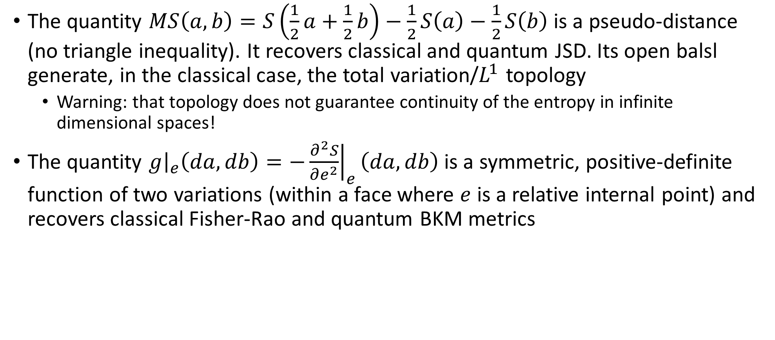
Geometry from the entropy
The quantity $MS\left(a,b\right)=S\left(\frac{1}{2}a+\frac{1}{2}b\right)−\frac{1}{2}S\left(a\right)−\frac{1}{2}S\left(b\right)$ is a pseudo-distance (no triangle inequality). It recovers classical and quantum JSD. Its open balsl generate, in the classical case, the total variation/$L^{1}$ topology
Warning: that topology does not guarantee continuity of the entropy in infinite dimensional spaces!
The quantity $g{\left.​\right|}_{e}\left(da,db\right)=−{\left.\frac{∂^{2}S}{∂e^{2}}\right|}_{e}\left(da,db\right)$ is a symmetric, positive-definite function of two variations (within a face where $e$ is a relative internal point) and recovers classical Fisher-Rao and quantum BKM metrics

Slide 25









Two ways to define “non-overlapping” ensembles
Separate ensembles
Orthogonal ensembles
$$⇐$$
No “common component”
Saturate upper entropy bound
such that
Coincide in classical ensemble spaces
Different in quantum ensemble spaces
$${|ψ}_{a}⟩$$
$${|ψ}_{c}⟩$$
disjoint support
$${|ψ}_{b}⟩$$

Slide 26





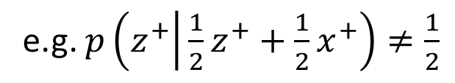

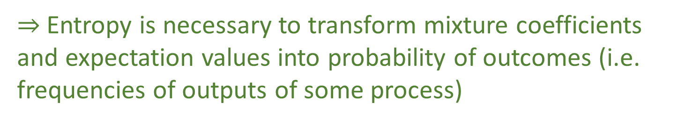








Mixture coefficient vs probability
Mixture
Probability
$$e_{1}$$
$$o_{1}$$
$$λ_{1}$$
$$p_{1}$$
$$e_{2}$$
Ensemble
$$o_{2}$$
Preparations
$$λ_{2}$$
$$p_{2}$$
Outcomes
$$⋮$$
$$⋮$$
$$λ_{n}$$
$$p_{n}$$
$$e_{n}$$
$$o_{n}$$
In general, mixtures of preparations and probability of outcomes do NOT coincide
e.g. $p\left(z^{+} | \frac{1}{2}z^{+}+\frac{1}{2}x^{+}\right)≠\frac{1}{2}$
They coincide only if the ensembles are mutually exclusive
$⇒$Entropy is necessary to transform mixture coefficients and expectation values into probability of outcomes (i.e. frequencies of outputs of some process)

Slide 27
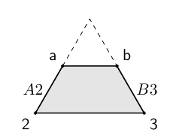
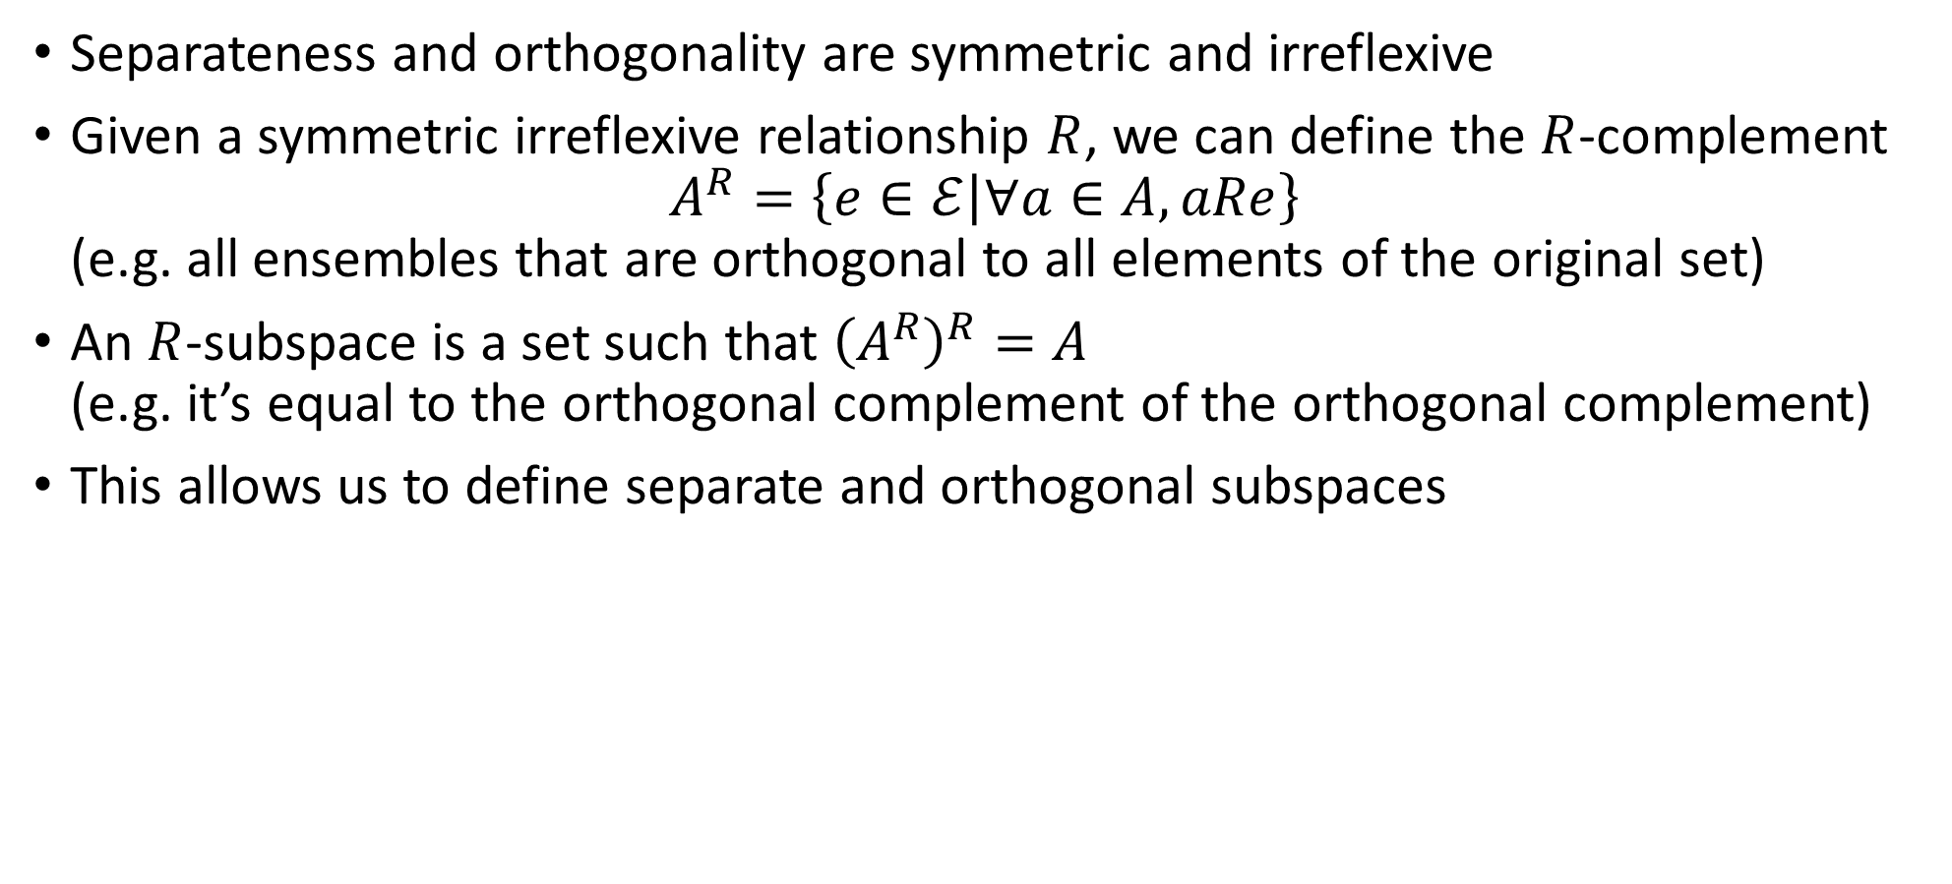

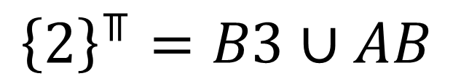
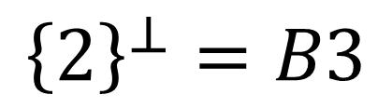
Orthogonal and separate subspaces
Separateness and orthogonality are symmetric and irreflexive
Given a symmetric irreflexive relationship $R$, we can define the $R$-complement $A^{R}=\left\{e∈ℰ | ∀a∈A,aRe\right\}$ (e.g. all ensembles that are orthogonal to all elements of the original set)
An $R$-subspace is a set such that ${\left(A^{R}\right)}^{R}=A$ (e.g. it’s equal to the orthogonal complement of the orthogonal complement)
This allows us to define separate and orthogonal subspaces
$${\left\{2\right\}}^{⊥}=B3$$
$$AB$$
$${\left\{2\right\}}^{⫪}=B3∪AB$$

Slide 28
Order structures – lattices

Slide 29

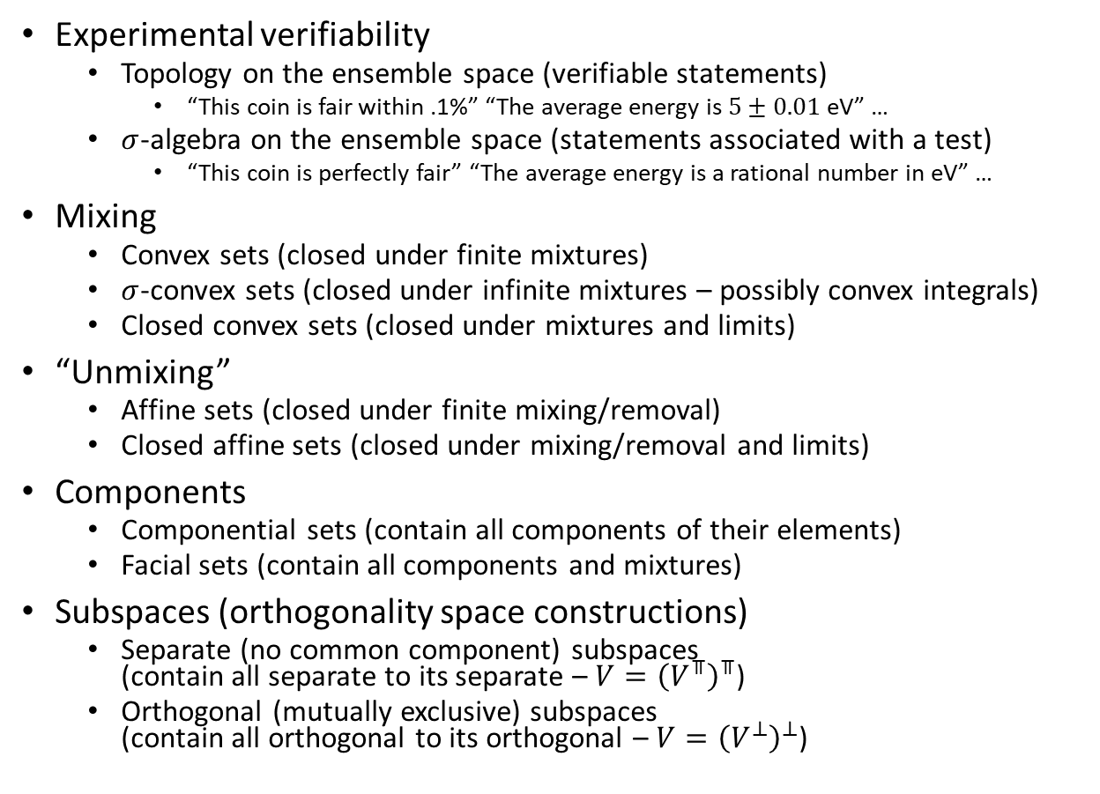

Several useful lattices
capacities
■ Closures
Sig
Experimental verifiability
Topology on the ensemble space (verifiable statements)
“This coin is fair within .1%” “The average energy is $5±0.01$ eV” …
$σ$-algebra on the ensemble space (statements associated with a test)
“This coin is perfectly fair” “The average energy is a rational number in eV” …
Mixing
Convex sets (closed under finite mixtures)
$σ$-convex sets (closed under infinite mixtures – possibly convex integrals)
Closed convex sets (closed under mixtures and limits)
“Unmixing”
Affine sets (closed under finite mixing/removal)
Closed affine sets (closed under mixing/removal and limits)
Components
Componential sets (contain all components of their elements)
Facial sets (contain all components and mixtures)
Subspaces (orthogonality space constructions)
Separate (no common component) subspaces (contain all separate to its separate – $V={\left(V^{⫪}\right)}^{⫪}$)
Orthogonal (mutually exclusive) subspaces (contain all orthogonal to its orthogonal – $V={\left(V^{⊥}\right)}^{⊥}$)
Conv
Comp
Top
$⫪$Sub
sConv
Aff
cConv
cAff
Face
$⊥$Sub
Classical events Quantum logic

Slide 30
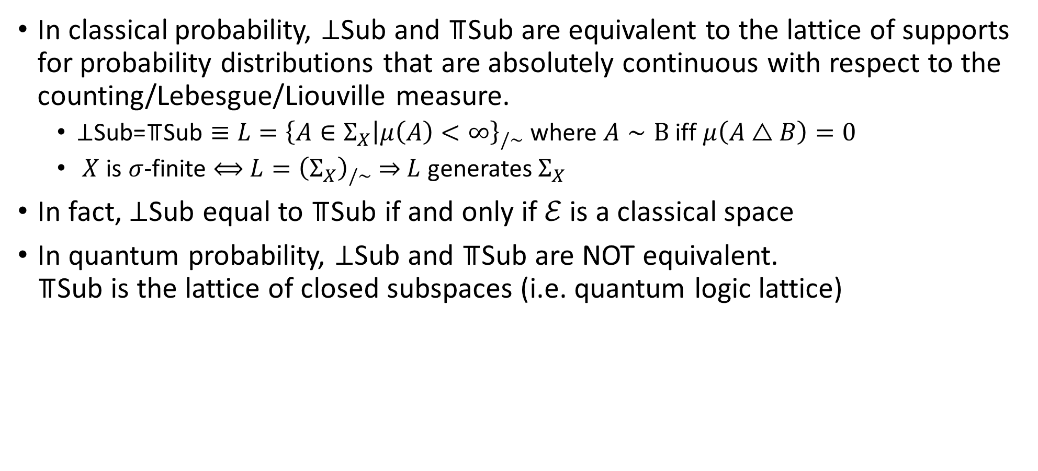
Subspace lattices in classical/quantum probability
In classical probability, ⊥Sub and ⫪Sub are equivalent to the lattice of supports for probability distributions that are absolutely continuous with respect to the counting/Lebesgue/Liouville measure.
$\text{⊥}\text{Sub}\text{=}\text{⫪}\text{Sub}≡L={\left\{A∈Σ_{X} | μ\left(A\right)<∞\right\}}_{/∼}$ where $A∼B$ iff $μ\left(A△B\right)=0$
$X$ is $σ$-finite $⟺$ $L={\left(Σ_{X}\right)}_{/∼}$ $⇒$ $L$ generates $Σ_{X}$
In fact, ⊥Sub equal to ⫪Sub if and only if $ℰ$ is a classical space
In quantum probability, ⊥Sub and ⫪Sub are NOT equivalent. ⫪Sub is the lattice of closed subspaces (i.e. quantum logic lattice)

Slide 31
Beyond classical/quantum probability
In general, ⊥Sub and ⫪Sub are not equivalent, and ⫪Sub is not orthomodular
Conjecture: ⫪Sub is orthomodular if the space is orthogonally decomposable (i.e. every decomposable ensemble is orthogonally decomposable)
Currently, there is no guarantee that orthogonal elements even exist. In that case, ⫪Sub may be trivial. No “quantum logic type” lattice would exist.

Slide 32
Measures

Slide 33
State counting measure
Probability measure
Hilbert space dimensionality
State capacity
Fraction capacity

Slide 34
Probability measure and fraction capacity

Slide 35














Fraction capacity
Fix a target ensemble $e$ and let $A$ be a set of ensembles.
What is the biggest fraction of $e$ that can be expressed as a convex combination of elements of $A$?
$${fcap}_{e}(A)=sup⁡(\{p∈[0, 1] | ∃a∈hull(A),b∈ℰ \text{s}\text{.}\text{t}\text{.} e=pa+(1−p)b\})$$
$$ℰ$$
$$hull(A)$$
$$a$$
$$e$$
$$a$$
$$b$$
$$p$$
$$A$$
$$e$$
$$p_{c}$$
$$c$$
$$b$$
$$c$$

Slide 36

Properties of fraction capacity
${fcap}_{e}:Σ_{ℰ}→\left[0,1\right]$ is
increasing : $A⊆B⇒ {fcap}_{e}\left(A\right)≤{fcap}_{e}\left(B\right)$
subadditive: ${fcap}_{e}\left(A∪B\right)≤{fcap}_{e}\left(A\right)+{fcap}_{e}\left(B\right)$
additive for orthogonal/mutually exclusive elements: if $A⊥B$ and $e∈hull\left(A∪B\right)$then ${fcap}_{e}\left(A∪B\right)={fcap}_{e}\left(A\right)+{fcap}_{e}\left(B\right)$
continuous from below
$σ$-subadditive?

Slide 37
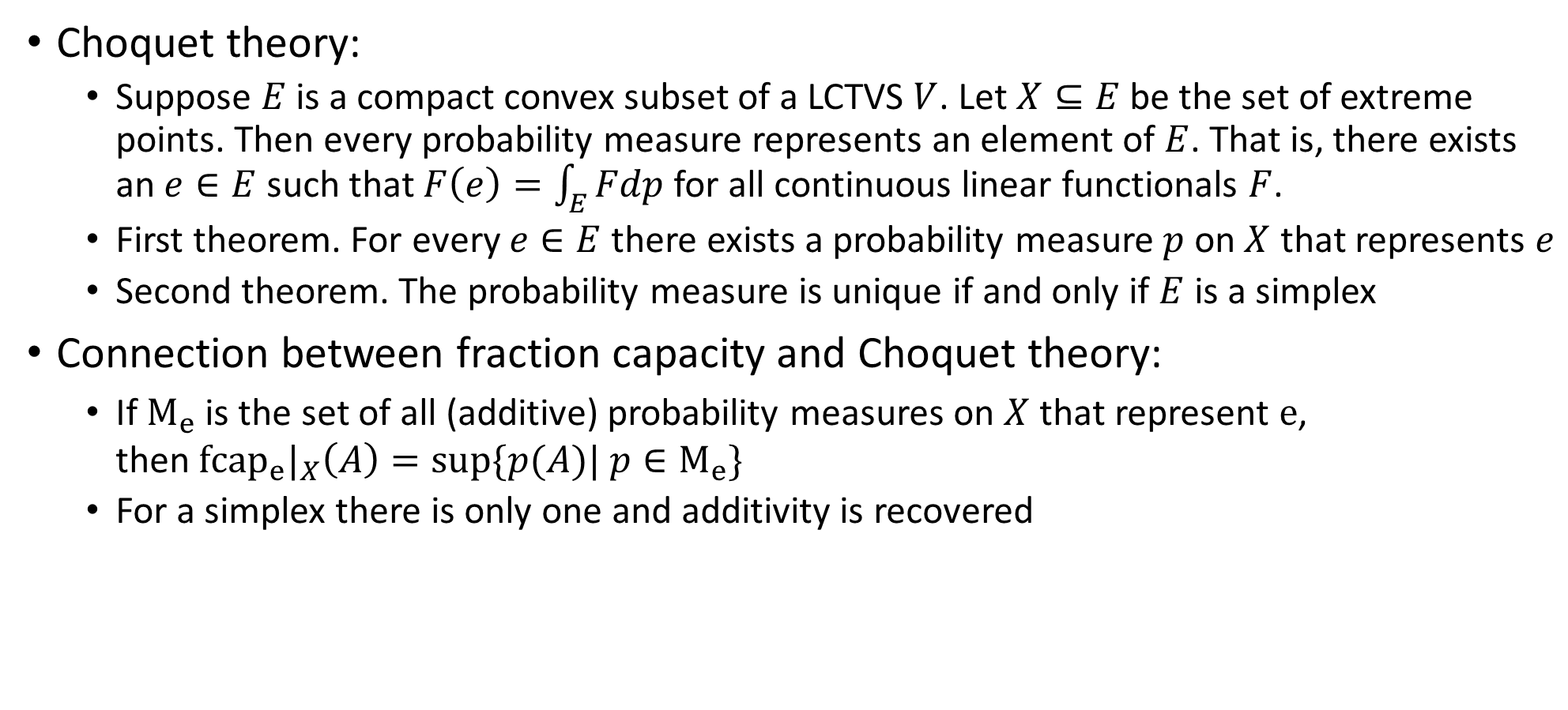
Connection to Choquet theory
Choquet theory:
Suppose $E$ is a compact convex subset of a LCTVS $V$. Let $X⊆E$ be the set of extreme points. Then every probability measure represents an element of $E$. That is, there exists an $e∈E$ such that $F\left(e\right)=\int_{E}{Fdp}$ for all continuous linear functionals $F$.
First theorem. For every $e∈E$ there exists a probability measure $p$ on $X$ that represents $e$
Second theorem. The probability measure is unique if and only if $E$ is a simplex
Connection between fraction capacity and Choquet theory:
If $M_{e}$ is the set of all (additive) probability measures on $X$ that represent $e$, then ${fcap}_{e}|_{X}\left(A\right)=sup⁡\{p(A)| p∈M_{e}\}$
For a simplex there is only one and additivity is recovered

Slide 38
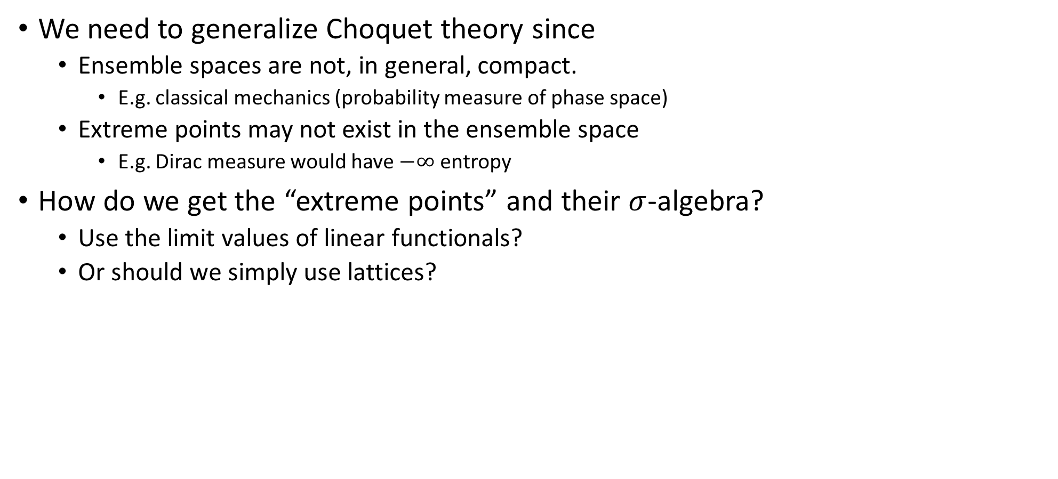
Generalization of Choquet theory
We need to generalize Choquet theory since
Ensemble spaces are not, in general, compact.
E.g. classical mechanics (probability measure of phase space)
Extreme points may not exist in the ensemble space
E.g. Dirac measure would have $−∞$ entropy
How do we get the “extreme points” and their $σ$-algebra?
Use the limit values of linear functionals?
Or should we simply use lattices?

Slide 39
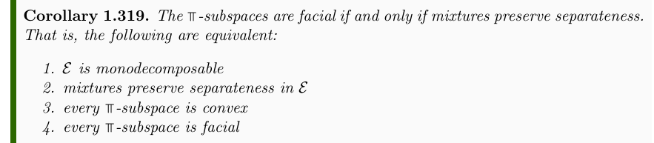
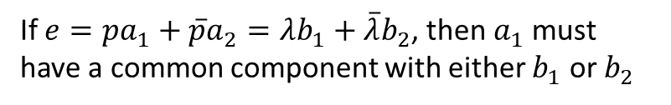

Generalization of Choquet theory
How can we reformulate the idea of a simplex in a more general case?
If $e=pa_{1}+\overline{p}a_{2}=λb_{1}+\overline{λ}b_{2}$, then $a_{1}$ must have a common component with either $b_{1}$ or $b_{2}$
If $e\text{⫪}a$ and $e\text{⫪}b$, then $e\text{⫪}pa+\overline{p}b$
Preliminary result

Slide 40
Connection to imprecise probability?
In the case where extreme points are definable, each ensemble can be understood as a collection of precise probabilities
Is this the upper probability in imprecise probability?
Can we say that, in the classical case, a state corresponds to a single precise probability, while in quantum mechanics it corresponds to an imprecise probability, where the indeterminancy is exactly the impossibility of recovering the precise preparation procedure?

Slide 41
Connection to imprecise probability?
Differently from imprecise probability, the different probability measures represent the same outcome. That is, there is no observable/random variable/process that can tell the difference
The ensemble is exactly the equivalence class of preparation probabilities that always give the same outcome
Can we say, in some precise sense, that the quantum indeterminacy is exactly that lost information?

Slide 42
State counting measure and state capacity

Slide 43
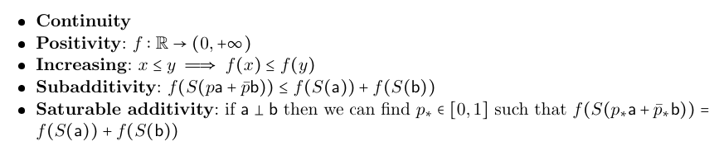

State capacity
How much is the “spread” of a target ensemble $e$?
Must be a function $f$ of the entropy with the following properties:
Small change of entropy gives small change in spread
Spread must be positive
More spread, more entropy
Spread can at most sum, and it must sum under orthogonality

Slide 44
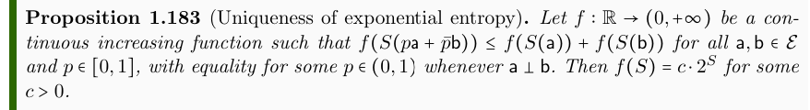

Properties of the state capacity
(Preliminary) The “spread,” or ensemble volume, must be the exponential of the entropy
State capacity of $A$ is defined as $scap\left(A\right)=\sup\left(2^{S\left(hull\left(A\right)\right)}∪\left\{0\right\}\right)$

Slide 45
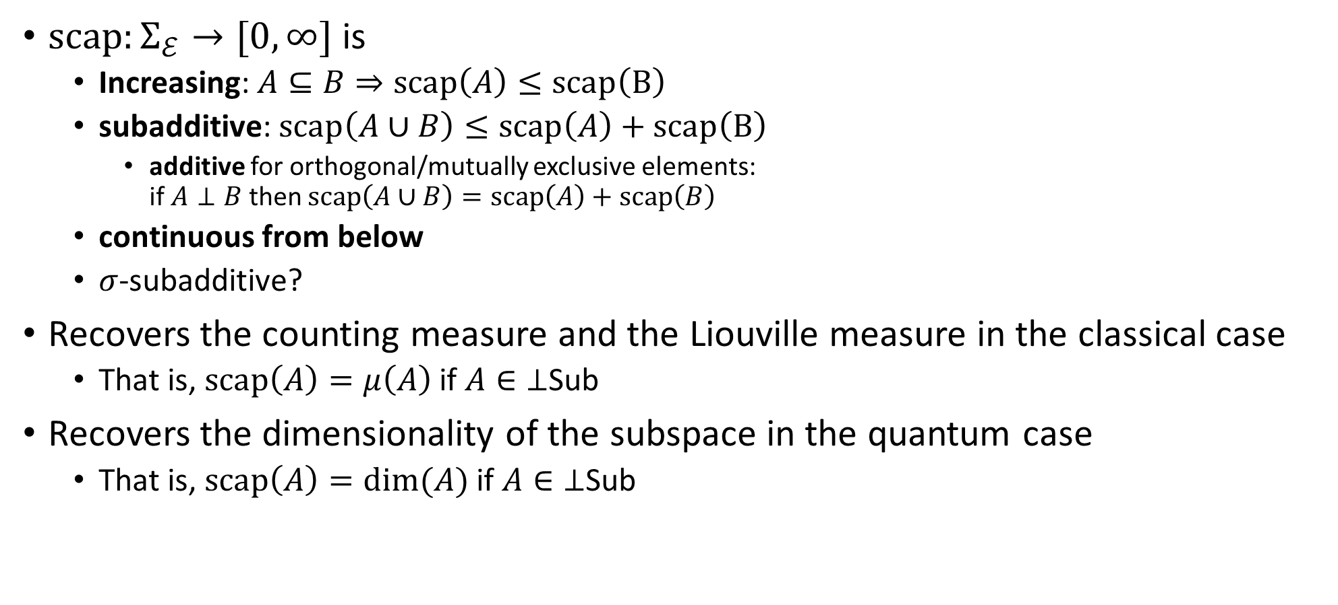
State capacity
$scap:Σ_{ℰ}→[0,∞]$ is
Increasing: $A⊆B⇒scap\left(A\right)≤scap\left(B\right)$
subadditive: $scap\left(A∪B\right)≤scap\left(A\right)+scap\left(B\right)$
additive for orthogonal/mutually exclusive elements: if $A⊥B$ then $scap\left(A∪B\right)=scap\left(A\right)+scap\left(B\right)$
continuous from below
$σ$-subadditive?
Recovers the counting measure and the Liouville measure in the classical case
That is, $scap\left(A\right)=μ\left(A\right)$ if $A∈\text{⊥}\text{Sub}$
Recovers the dimensionality of the subspace in the quantum case
That is, $scap\left(A\right)=\dim{(A)}$ if $A∈\text{⊥}\text{Sub}$

Slide 46
Non-additive probability calculus?

Slide 47
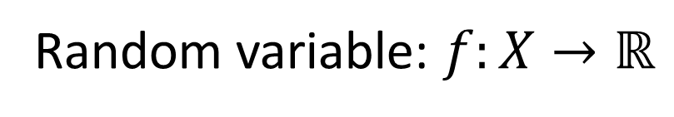
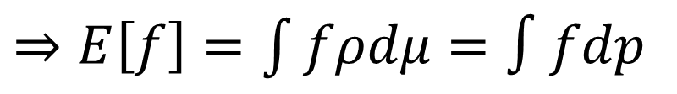
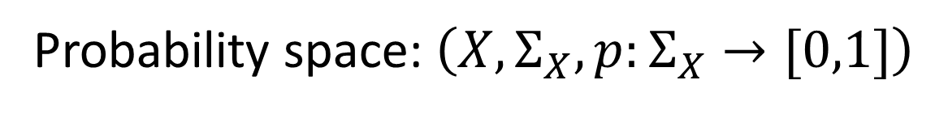

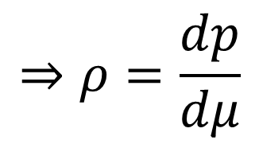
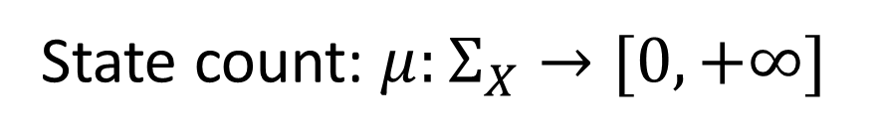
Probability space: $\left(X,Σ_{X},p:Σ_{X}→[0,1]\right)$
Probability measure
Probability of positive outcome of a test
Sample space
What can happen
Events
What can be tested
Count of states corresponding to each event
Probability in classical mechanics
State count: $μ:Σ_{X}→[0,+∞]$
Absolutely continuous
Zero states $⇒$ zero probability
$$⇒ρ=\frac{dp}{dμ}$$
Probability density
Radon-Nikodym derivative
Random variable: $f:X→ℝ$
Assigns a value to every possible outcome
$⇒E\left[f\right]=\int{fρdμ}=∫fdp$
Expectation
Average value of the random variable

Slide 48
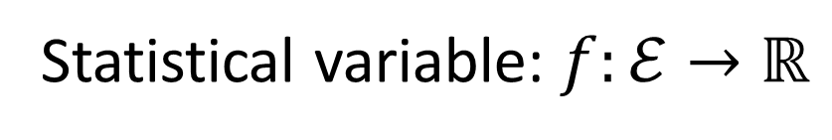
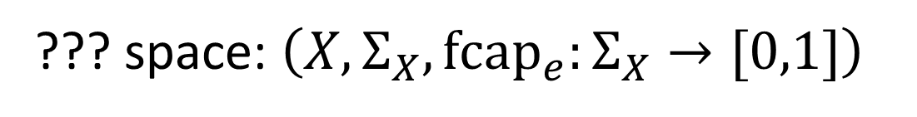
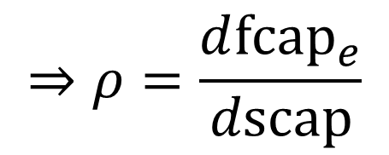
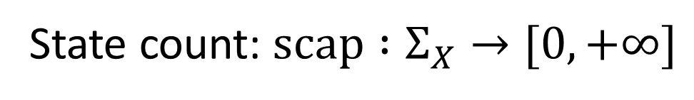
??? space: $\left(X,Σ_{X},{fcap}_{e}:Σ_{X}→[0,1]\right)$
Fraction capacity
Fraction that can be prepared from a set of preparations
Extreme points
Ideal preparations
Events
Sets of ideal preps
Count of states corresponding to each event
Non-additive probability in general
State count: $scap :Σ_{X}→[0,+∞]$
Absolutely continuous
Zero states $⇒$ zero probability
$$⇒ρ=\frac{d{fcap}_{e}}{dscap}$$
Probability density
??? derivative
Statistical variable: $f:ℰ→ℝ$
Assigns a value to ensembles and extreme points
$⇒f(e)=\left(E\right)\int{fρdscap}=\left(E\right)∫fd{fcap}_{e}$
Expectation

Slide 49
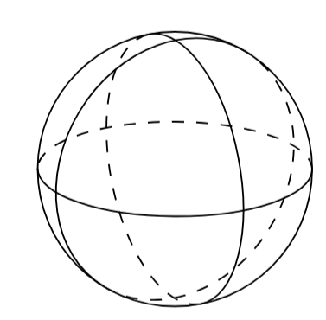




What integral?
On a simplex, the integral must recover the standard integral
I.e. it must reduce to the Riemann integral in the additive case
This rules out the Sugeno integral
Quantum mechanics provides a counterexample for the Choquet integral
Simplest example: two-state system (e.g., spin ½, $c_{+}\left|↑\right\rangle +c_{−}\left|↓\right\rangle$) → Bloch ball
Any observable/linear functional $F$ is defined by its values ($a$ and $b$) at two points along an axis
e.g., $S\left[\left|↑\right\rangle \right]=+\frac{1}{2}$ and$S\left[\left|↓\right\rangle \right]=−\frac{1}{2}$
Everything else is a linear/affine combination of these
center $o$ gets assigned $\frac{1}{2}a+\frac{1}{2}b$
The integral gives $\frac{1}{2}a+\frac{1}{2}b+\frac{1}{2}\left(b−a\right)\ln{2}$
$$a$$
$$o$$
$$b$$

Slide 50




Counterexample for the Choquet integral
Want to integrate the fraction capacity of the center of the sphere
$s$ is a linear function in the vertical direction
max
Sets of extreme points that have a value greater than a given $s$
min

Slide 51





Counterexample for the Choquet integral
Choquet integral does not work What integral does?
Should be $\frac{1}{2}a+\frac{1}{2}b$!

Slide 52
What derivative?
Even less clear…

Slide 53
Lie algebras

Slide 54





Lie algebras in physics
$H$ - generator of the transformation
$$s\left(t\right)→s\left(t+dt\right)$$
$t$ - parameter of the generated transformation
$$\frac{df}{dt}=\left\{f,H\right\}$$
$$\frac{dO}{dt}=\frac{\left[O,H\right]}{ıℏ}$$
A skew-symmetric bracket that tells you how a variable/observable changed during the transformation

Slide 55






Lie algebras in physics
$$F\left(e\right)=∫fρ_{e}dμ$$
$$F\left(e\right)=tr[O_{f}ρ_{e}]$$
Classical case
Quantum case
Define bracket as
$${\left\{F,G\right\}}_{ℰ}\left(e\right)=$$
$$∫{\left\{f,g\right\}}_{P}ρ_{e}dμ$$
$$tr\left[\frac{\left[O_{f},O_{g}\right]}{ıℏ}ρ_{e}\right]$$
Same Lie algebra in classical/quantum mechanics
$${\left\{X,P\right\}}_{ℰ}=I$$

Slide 56




$${\left\{F,G\right\}}_{ℰ}\left(e\right)=$$
$$∫{\left\{f,g\right\}}_{P}ρ_{e}dμ$$
$$tr\left[\left[O_{f},O_{g}\right]ρ_{e}\right]$$
It’s a Lie algebra!
Since both integral and trace are linear operators, properties are inherited from Poisson bracket/commutator

Slide 57
$${\left\{F,G\right\}}_{ℰ}\left(e\right)=$$
$$∫{\left\{f,g\right\}}_{P}ρ_{e}dμ$$
$$tr\left[\left[O_{f},O_{g}\right]ρ_{e}\right]$$
Is it a Poisson bracket?
What would the product be?
It’s not the product of statistical variables because $E\left[fg\right]≠E\left[f\right]E[g]$
Can it be defined in terms of the generator of the composed transformation?
Can we define non-commutativity of variables based on non-commutativity of composed transformations? Can we find a relationship between the expectation of the product and the commutativity, or lack thereof?

Slide 58


What new axiom is needed (if at all)?
$$\frac{df}{dt}=\left\{f,H\right\}$$
$$\frac{dO}{dt}=\frac{\left[O,H\right]}{ıℏ}$$
These are both deterministic and reversible transformations: they leave the entropy unchanged
Also, this structure guarantees us that there are always stationary ensembles under each deterministic and reversible transformation (e.g. Boltzmann distributions)
Can we turn it around? We already assumed ensembles must be equilibria to have an entropy well-defined. Is assuming that every ensemble is a stationary state of some time evolution enough?

