Slide 1

Assumptions of Physics: the role of entropy in reconstructing physical theories
Gabriele Carcassi
Physics Department University of Michigan

Slide 2





Main goal of the project
Identify a handful of physical starting points from which the basic laws can be rigorously derived
For example:
Infinitesimal reducibility $⇒$ Classical state
Irreducibility $⇒$ Quantum state
https://assumptionsofphysics.org
?
time
time
This also requires rederiving all mathematical structures from physical requirements
For example:
Science is evidence based $⇒$ scientific theory must be characterized by experimentally verifiable statements $⇒$ topology and $σ$-algebras

Slide 3
Standard view of the foundations of physics
Goal of physics is to find the true laws of the universe!
approximation
…
The “real” physics!
Weak interactions
QED -Electromagnetism
The foundations of physics!
Everything else is an approximation
QCD – Strong Interactions
Electro-weak
General Relativity
Grand Unified Theory
What “really” happens
Theory of Everything
Measurement problem
Hidden variables
Role of the observer
Ontology of observables
Perfect description of the universe
Dark matter/energy

Slide 4
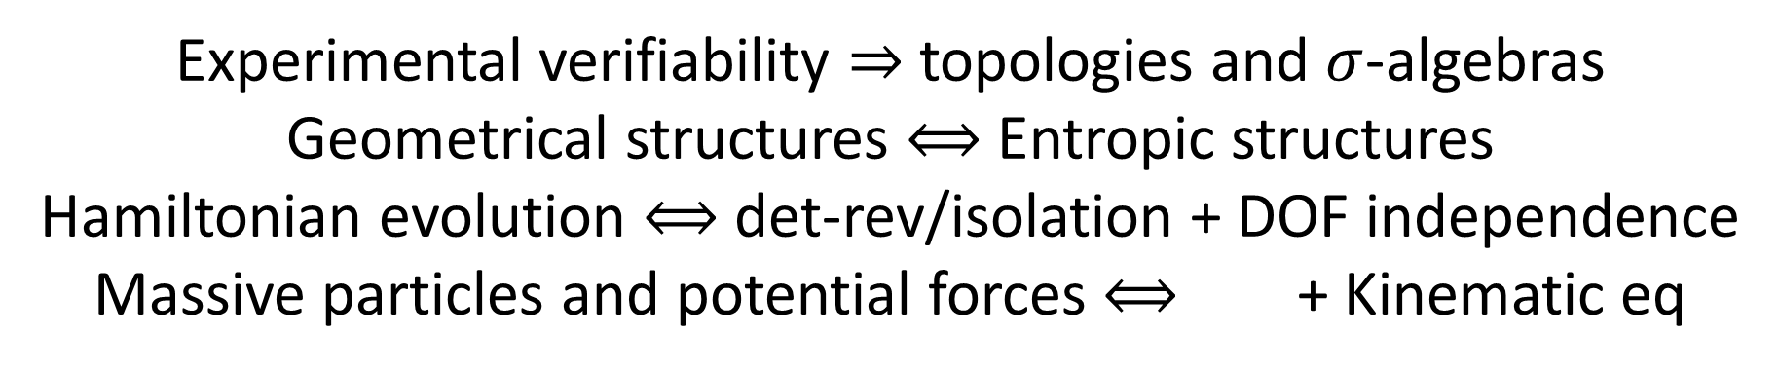
We found:
Experimental verifiability $⇒$ topologies and $σ$-algebras
Geometrical structures $⟺$ Entropic structures
Hamiltonian evolution $⟺$ det-rev/isolation + DOF independence
Massive particles and potential forces $⟺$ + Kinematic eq
Physical requirements and assumptions drive most of the theoretical apparatus
Goal of physics is to find the true laws of the universe!
Goal of physics is to find models that can be empirically tested
Less productive point of view
More productive point of view

Slide 5
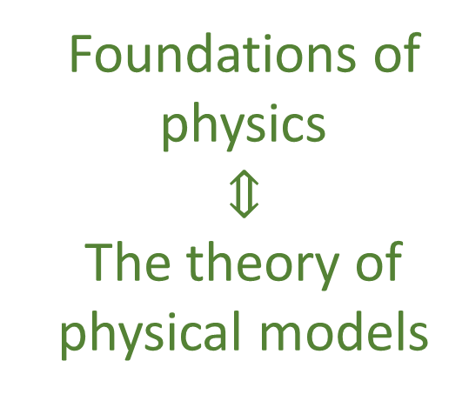
Our view of the foundations of physics
Foundations of physics $$⇕$$ The theory of physical models
General physical principles and requirements
General mathematical framework
Specific assumptions
Classical mechanics
Quantum mechanics
derivation
Thermodynamics
…
specialization

Slide 6
Find the right overall concepts
Reverse physics: Start with the equations, reverse engineer physical assumptions/principles
Reverse Physics
Physics
Smallest set of assumptions required to rederive the theory
Physical theory
Physical result/ effect/prediction
Reverse Mathematics
Mathematics
Smallest set of axioms required to prove the theorem
Theorem
Mathematical result/ corollary/calculation
Found Phys 52, 40 (2022)
Goal: find the right overall physical concepts, “elevate” the discussion from mathematical constructs to physical principles
Physical mathematics: Start from scratch and rederive all mathematical structures from physical requirements
Physics
Physical requirements
Semantics
Physical mathematics
Goal: get the details right, perfect one-to-one map between mathematical and physical objects

Slide 7
Reverse Physics
Assumptions of Physics, Michigan Publishing (v2 2023)
J. Phys. Commun. 2 045026 (2018)

Slide 8
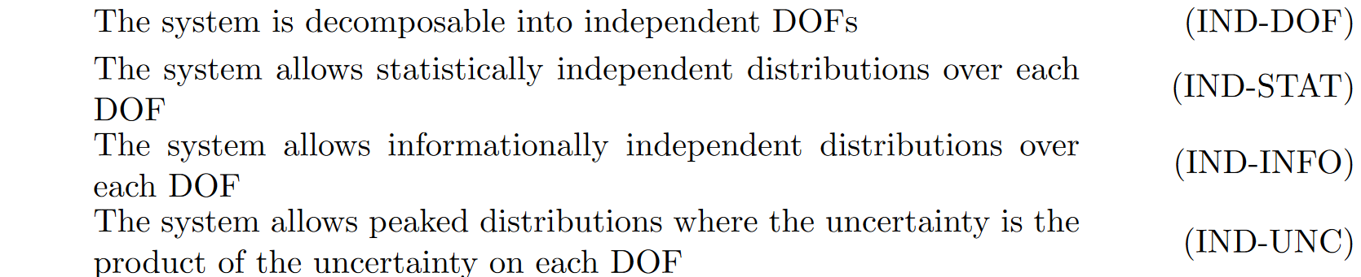
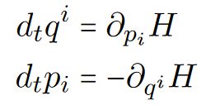




$$⇔$$
$$⇔$$
$$⟺$$

Slide 9

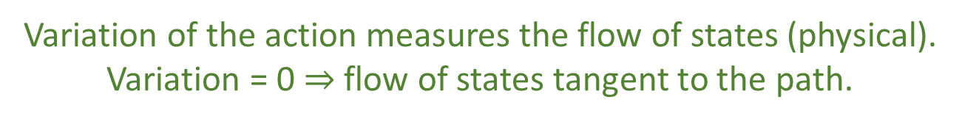
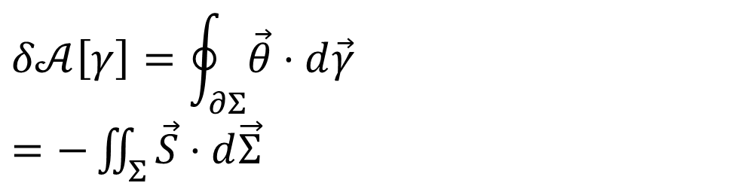


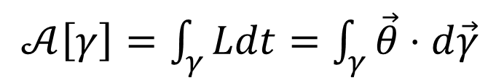







Reversing the principle of least action
DR
$p\frac{dq}{dt}+0\frac{dp}{dt}−H\frac{dt}{dt}$
$$\left[p,0,−H\left(q,p\right)\right]$$
KE
$$∇⋅\vec{S}=0$$
$$\vec{S}=−∇×\vec{θ}$$
$𝒜\left[γ\right]=\int_{γ}{Ldt}=\int_{γ}{\vec{θ}⋅d\vec{γ}}$
No state is “lost” or “created” as time evolves
(Minus sign to recover Ham eq)
Sci Rep 13, 12138 (2023)
unphysical
The action is the line integral of the vector potential of the flow of states
$$p$$
$$q$$
Variation of the action
$$Σ$$
Gauge independent, physical!
$$δ𝒜\left[γ\right]=\oint_{∂Σ}{\vec{θ}⋅d\vec{γ}}$$ $=−\iint_{Σ}{\vec{S}⋅d\vec{Σ}}$
$$γ$$
$$γ′$$
$$t$$
Variation of the action measures the flow of states (physical). Variation = 0 $⇒$ flow of states tangent to the path.

Slide 10
Is the uncertainty principle really a feature of quantum mechanics alone?

Slide 11


$$⇒$$
$$⇒$$
$$⟺$$

Slide 12
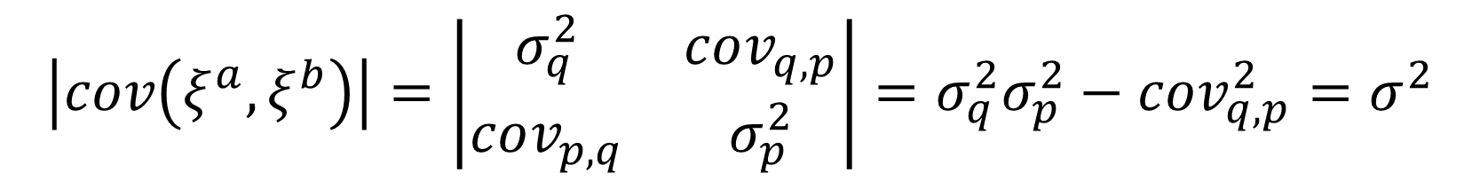



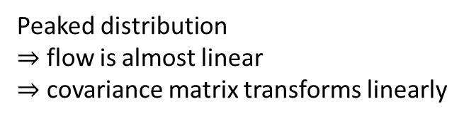
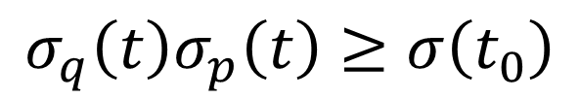
evolution of covariance matrix
Determinant of covariance matrix:
$$p$$
$$\left|cov\left(ξ^{a},ξ^{b}\right)\right|=\left|\begin{matrix}σ_{q}^{2} & cov_{q,p} \\ cov_{p,q} & σ_{p}^{2}\end{matrix}\right|=σ_{q}^{2}σ_{p}^{2}−cov_{q,p}^{2}=σ^{2}$$
Peaked distribution
$⇒$ flow is almost linear $⇒$ covariance matrix transforms linearly
$$q$$
$$\left|cov\left(ξ^{a}\left(t\right),ξ^{b}\left(t\right)\right)\right|=\left|J\right| \left|cov\left(ξ^{a}\left(t_{0}\right),ξ^{b}\left(t_{0}\right)\right)\right|\left|J\right|$$
$$σ_{q}^{2}\left(t\right)σ_{p}^{2}\left(t\right)−cov_{q,p}^{2}\left(t\right)=σ^{2}\left(t_{0}\right)$$
1 under Hamiltonian flow
$$σ_{q}\left(t\right)σ_{p}\left(t\right)≥σ\left(t_{0}\right)$$
Uncertainty is bounded during classical evolution
Notes:
TODO: put the axis on the ellipses. Make them move according to the map

Slide 13
$$⇒$$
$$⇒$$
$$⟺$$

Slide 14
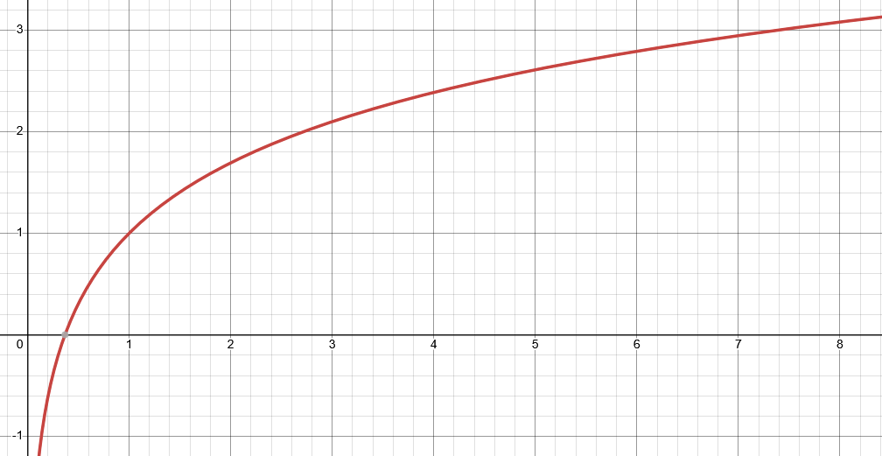



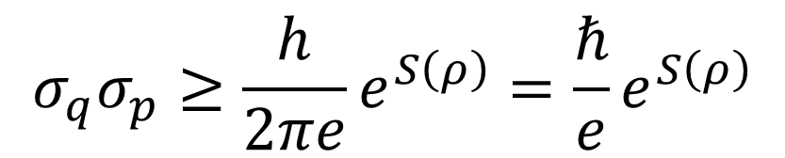
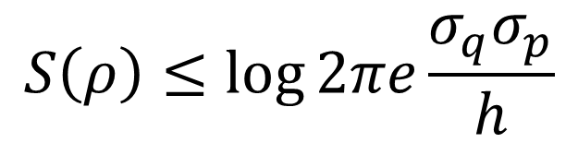
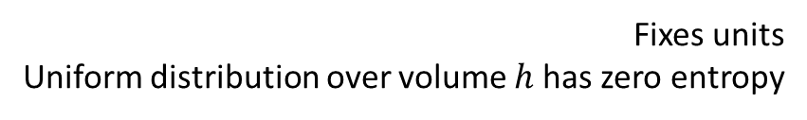
Let’s plot entropy against uncertainty
$S\left(ρ\right)=−∫ρ\log{hρ}dqdp$
$$S\left(ρ\right)≤\log{2πe\frac{σ_{q}σ_{p}}{h}}$$
Fixes units Uniform distribution over volume $h$ has zero entropy
$$S$$
Gaussian maximizes entropy for a given uncertainty
excluded by gaussian bound
$$σ_{q}σ_{p}≥\frac{h}{2πe}e^{S\left(ρ\right)}=\frac{ℏ}{e}e^{S\left(ρ\right)}$$
$$σ_{q}σ_{p}$$
Entropy puts a lower bound on the uncertainty
Hamiltonian evolution conserves entropy

Slide 15
Is there anything that puts a lower bound on the entropy?
Every substance has a finite positive entropy, but at the absolute zero of temperature the entropy may become zero, and does so become in the case of perfect crystalline substances.
G. N. Lewis and M. Randall, Thermodynamics and the
free energy of chemical substances (McGraw-Hill, 1923)
The third law of thermodynamics!

Slide 16
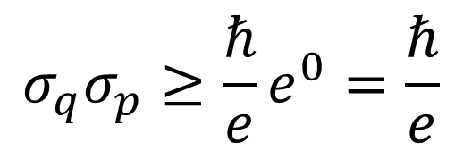


Third law puts a lower bound on the entropy which puts a lower bound on the uncertainty
$$S$$
excluded by gaussian bound
$$σ_{q}σ_{p}≥\frac{ℏ}{e}e^{0}=\frac{ℏ}{e}$$
$$σ_{q}σ_{p}$$
excluded by 3rd law of thermodynamics
Classical uncertainty principle!

Slide 17
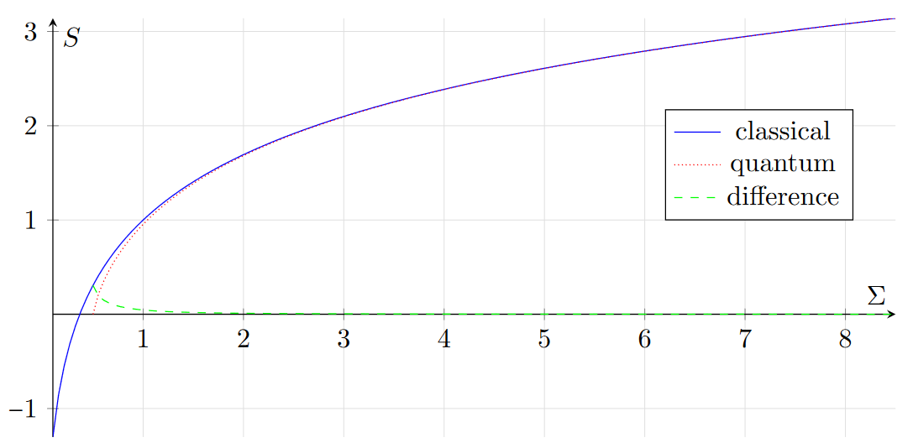
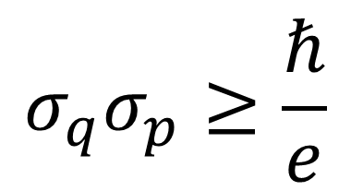
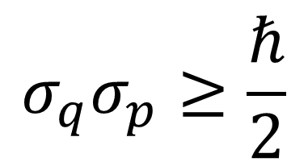



Comparing theories
excluded by gaussian bound
$$σ_{q}σ_{p}≥\frac{ℏ}{e}$$
$$σ_{q}σ_{p}≥\frac{ℏ}{2}$$
classical
quantum
$$\frac{σ_{q}σ_{p}}{ℏ}$$
2.71828…
excluded by 3rd law of thermodynamics
Entropy of quantum states is already non-negative
$$S_{C}=\ln{eσ}$$
The gaussian bound quickly becomes very similar across theories
$S_{Q}=\left(σ+\frac{1}{2}\right)\ln\left(σ+\frac{1}{2}\right)−\left(σ−\frac{1}{2}\right)\ln\left(σ−\frac{1}{2}\right)$
Quantum mechanics incorporates the third law Classical mechanics does not
Is this the only difference?

Slide 18
Suppose the lower bound on the entropy is the only difference, then in the limit of high entropy of quantum mechanics we should recover classical mechanics
Can we?

Slide 19
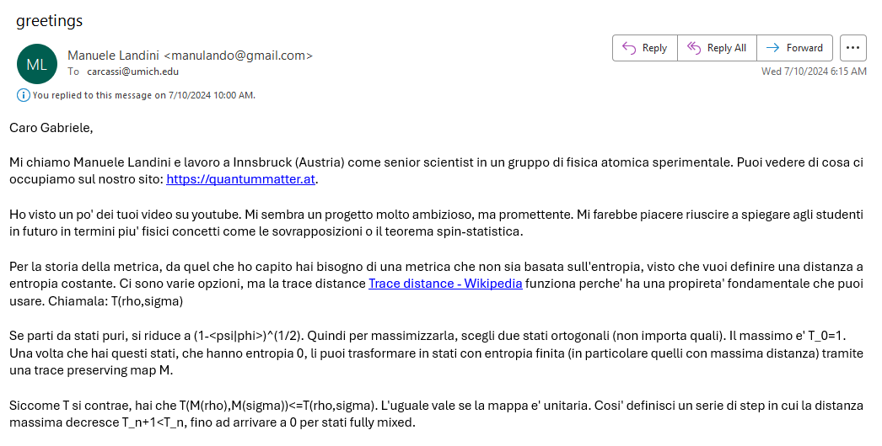
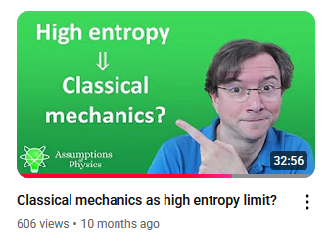
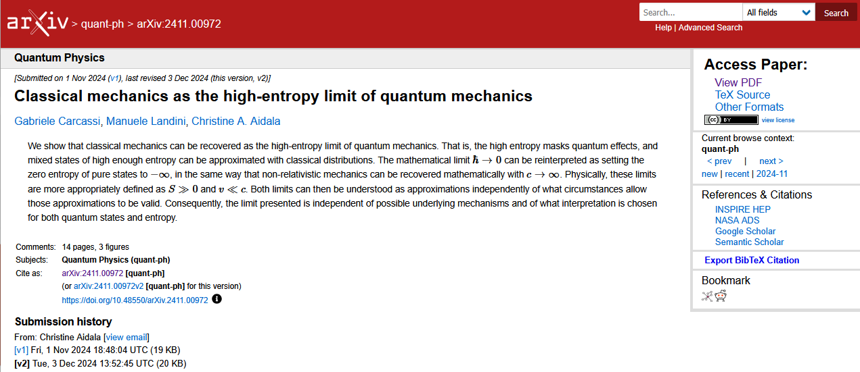
06/01/2024

Slide 20
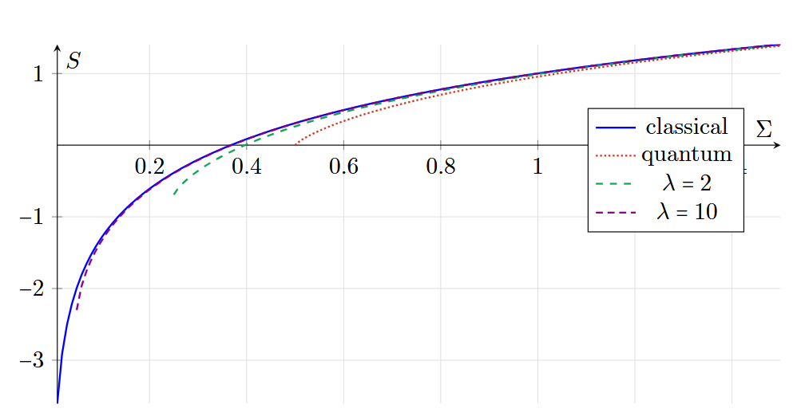

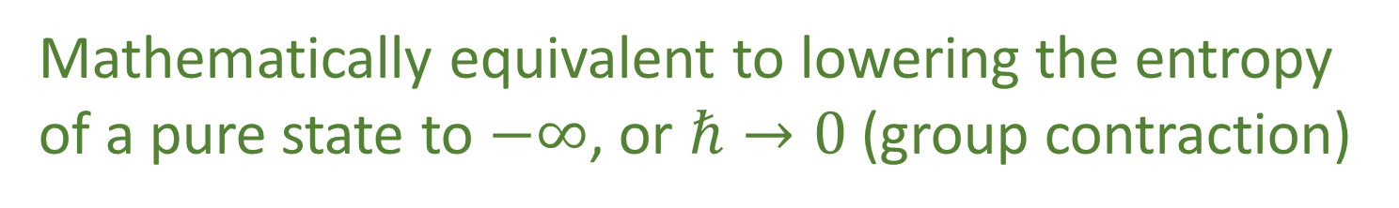


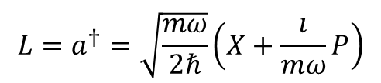
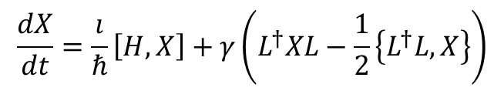
Recovering classical mechanics from quantum mechanics
To simplify
We are looking for a continuous entropy increasing process that “preserves” unitary evolution
$$\frac{σ_{q}σ_{p}}{ℏ}$$
$$\left[T_{Q}\left(X\right),T_{Q}\left(P\right)\right]=λ\left[X,P\right]$$
$$\frac{dX}{dt}=\frac{ı}{ℏ}\left[H,X\right]+γ\left(L^{†}XL−\frac{1}{2}\left\{L^{†}L,X\right\}\right)$$
Lindblad eq
(open quantum system)
$$L=a^{†}=\sqrt{\frac{mω}{2ℏ}}\left(X+\frac{ı}{mω}P\right)$$
$$γ=λ$$
Mathematically equivalent to lowering the entropy of a pure state to $−∞$, or $ℏ→0$ (group contraction)

Slide 21


“$c→∞$”
Speed
Classical Mechanics | Relativistic Mechanics
Quantum Mechanics | Quantum Field Theory
“$ℏ→0$”
Entropy

Slide 22

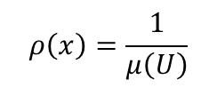

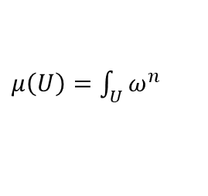



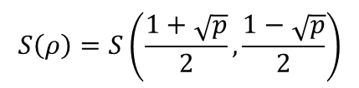
Geometry is entropy!
The geometric structures of both classical and quantum mechanics are equivalent to the entropic structure
Standard probability
$$ρ\left(x\right)=\frac{1}{μ\left(U\right)}$$
Thermodynamics/Statistical mechanics are not built on top of mechanics
$μ\left(U\right)=\int_{U}{ω^{n}}$
Symplectic manifold
Mechanics is the ideal case of thermodynamics/statistical mechanics
$ρ$ uniform over $U$
Information theory
$$S\left(ρ\right)=\log{μ\left(U\right)}$$
$$\left\langle ψ | φ\right\rangle$$
Quantum probability
$$p\left(ψ | φ\right)={\left|\left\langle ψ | φ\right\rangle \right|}^{2}$$
Projective Hilbert space
$$ρ=\frac{1}{2}ρ_{ψ}+\frac{1}{2}ρ_{φ}$$
Quantum information theory
$$S\left(ρ\right)=S\left(\frac{1+\sqrt{p}}{2},\frac{1−\sqrt{p}}{2}\right)$$

Slide 23
Extracting principles/assumptions behind the laws gives us solid intuition that cuts across fields and leads to new insights/results
Not enough: you can’t truly claim to understand higher-level structures without fully understanding the lower-level structures

Slide 24
Physical mathematics
Assumptions of Physics, Michigan Publishing (v2 2023)

Slide 25
Examples of unphysical mathematics

Slide 26





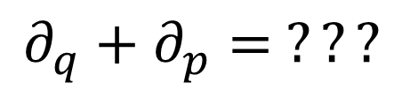



In differential geometry, tangent vectors are derivations
$$v:C^{∞}\left(X\right)→C^{∞}(X)$$
$$v=v^{i}∂_{i}$$
component
basis
In polar coordinates
$$∂_{r}+∂_{θ}= ???$$
$$\left[m\right]$$
$\left[rad\right]$
Doesn’t work with units
In phase space
$$∂_{q}+∂_{p}= ???$$
Mathematically precise $⇏$ physically precise
$\left[m\right]$
$\left[Kg m s^{−1}\right]$

Slide 27
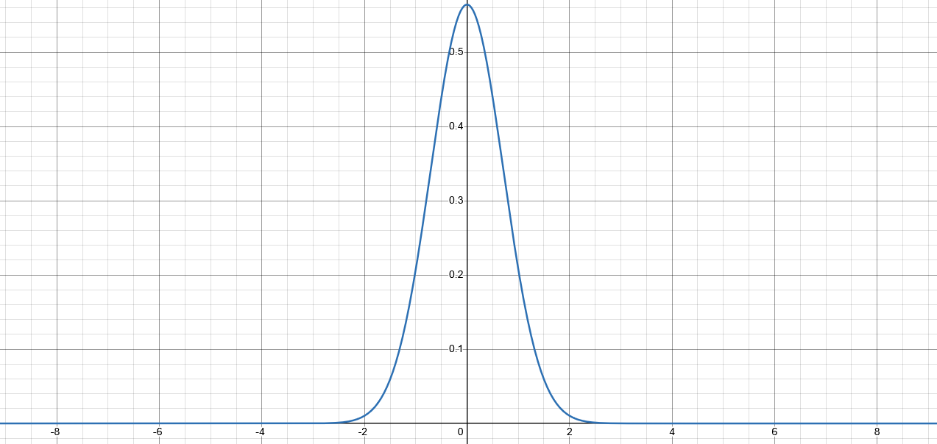
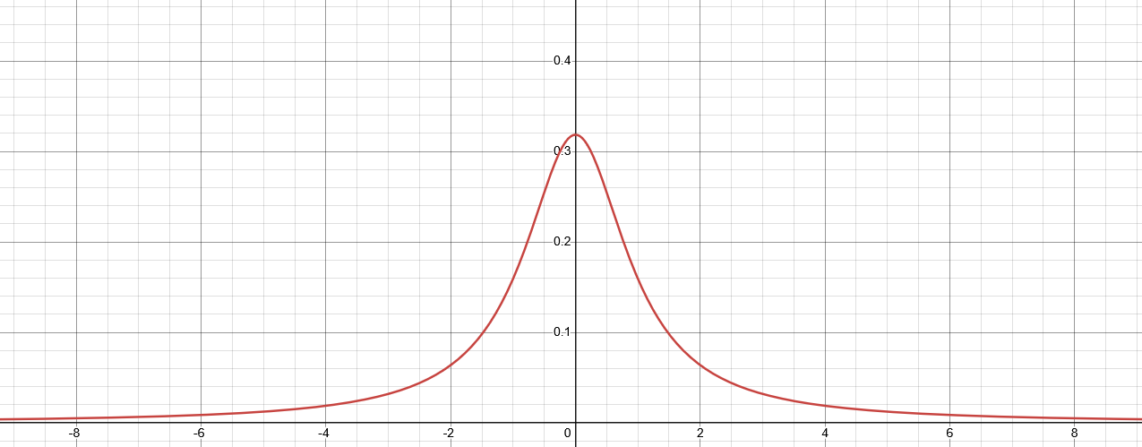

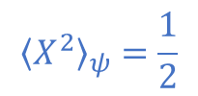

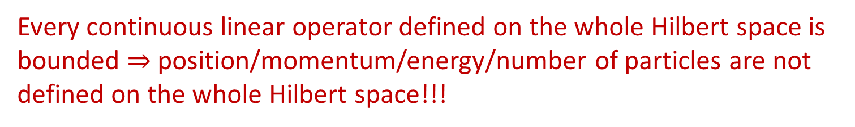


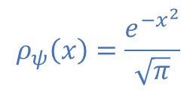

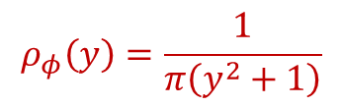
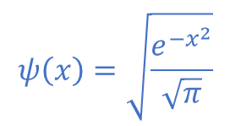
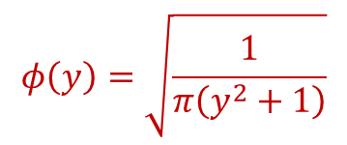
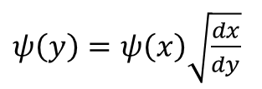
Hilbert space
Quantum states represented by $L^{2}$
Different observers see finite/infinite expectation
$$ψ\left(x\right)=\sqrt{\frac{e^{−x^{2}}}{\sqrt{π}}}$$
$$y=\tan\left(\frac{π}{2}\operatorname{erf}\left(x\right)\right)$$
$$∫{\left|ψ\right|}^{2}dx=1$$
$ψ\left(y\right)=ψ\left(x\right)\sqrt{\frac{dx}{dy}}$
$$ρ_{ψ}\left(x\right)=\frac{e^{−x^{2}}}{\sqrt{π}}$$
$${\left\langle X^{2}\right\rangle }_{ψ}=\frac{1}{2}$$
Expectation can have finite/infinite oscillations
$$φ\left(y\right)=\sqrt{\frac{1}{π\left(y^{2}+1\right)}}$$
$$∫{\left|φ\right|}^{2}dx=1$$
$x\left(x_{0},t\right)=x_{0}\cos^{2}{\frac{πt}{2}}+\tan\left(\frac{π}{2}\operatorname{erf}\left(x_{0}\right)\right)\sin^{2}{\frac{πt}{2}}$
$$ρ_{φ}\left(y\right)=\frac{1}{π\left(y^{2}+1\right)}$$
$${\left\langle Y^{2}\right\rangle }_{φ}→∞$$
Every continuous linear operator defined on the whole Hilbert space is bounded $⇒$ position/momentum/energy/number of particles are not defined on the whole Hilbert space!!!

Slide 28
Physical world (informal system)
Mathematical representation
(formal system)
well-defined physical
objects
well-defined mathematical objects
?
?
?
ill-defined
ill-defined
Current state of the art in theoretical physics

Slide 29
Physical world (informal system)
Mathematical representation
(formal system)
well-defined physical
objects
well-defined mathematical objects
Physical specifications
Mathematical definition
A mathematical definition is physical if it captures and only captures an aspect of the physical system

Slide 30
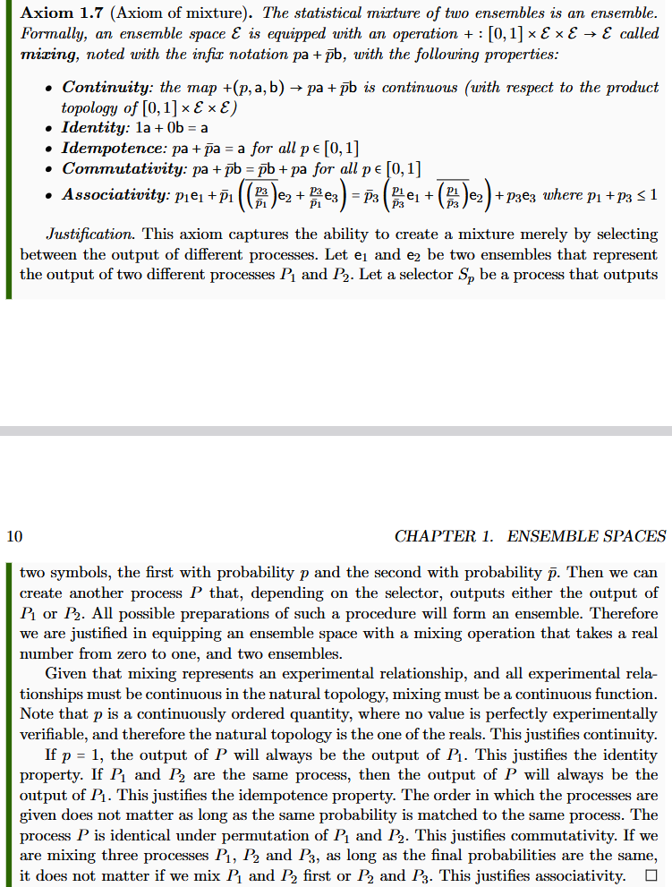
Informal intuitive statement
(something that makes sense to a physicist or an engineer)

Slide 31
Informal intuitive statement
(something that makes sense to a physicist or an engineer)
Formal requirement
(something a mathematician will find precise)

Slide 32
Informal intuitive statement
(something that makes sense to a physicist or an engineer)
Formal requirement
(something a mathematician will find precise)
Show that the formal requirement follows from the intuitive statement

Slide 33
$⇒$ Science is about statements that are associated to experimental tests
Statements must be either true or false for everybody
Tests may or may not terminate (i.e. be conclusive)
Statement | Test Result
T | SUCCESS (in finite time)
 | UNDEFINED
F | UNDEFINED
 | FAILURE (in finite time)
Verifiable statement | Test Result
T | SUCCESS (in finite time)
F | UNDEFINED
 | FAILURE (in finite time)

Slide 34
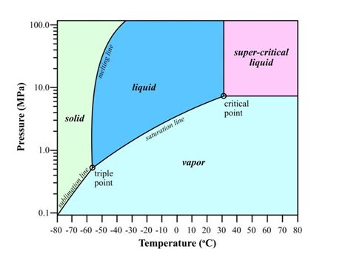

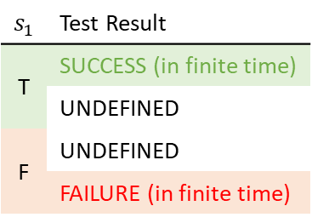


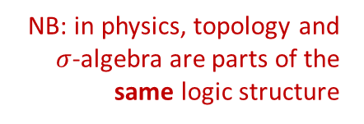





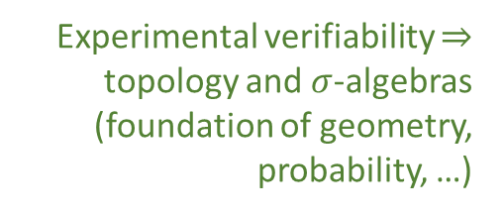

Topology and $σ$-algebra
Experimental verifiability $⇒$ topology and $σ$-algebras (foundation of geometry, probability, …)
Theoretical statements
$int(A)$ corresponds to the verifiable part of a statement
$$s_{1}$$ | Test Result
T | SUCCESS (in finite time)
 | UNDEFINED
F | UNDEFINED
 | FAILURE (in finite time)
Verifiable statements
Perfect map between math and physics
Possibilities
$∂A$ corresponds to the undecidable part of a statement
$ext(A)$ corresponds to the falsifiable part of a statement
NB: in physics, topology and $σ$-algebra are parts of the same logic structure
Open sets
Points
Open set $(\text{5}\text{09.5, 510.5})$ $⟺$ Verifiable “the mass of the electron is 510 $±$ 0.5 KeV”
Borel sets
Closed set $[510]$ $⟺$ Falsifiable “the mass of the electron is exactly 510 KeV”
Borel set $ℚ$ ($int\left(ℚ\right)∪ext\left(ℚ\right)=∅$) $⟺$Theoretical “the mass of the electron in KeV is a rational number” (undecidable)
Inference relationship $𝓇:𝒟_{Y}→𝒟_{X}$ such that $𝓇\left(s\right)≡s$
$$𝒟_{X}$$
$$𝒟_{Y}$$
Topologically continuous consistent with analytic discontinuity on isolated points
Inference relationship $$⟺$$ Causal relationship
Relationships must be topologically continuous
$$X$$
$$Y$$
Causal relationship $f:X→Y$ such that $x≼f\left(x\right)$
Phase transition $⟺$ Topologically isolated regions

Slide 35
$⇒$ Scientific laws are relationships between ensembles
Preparation procedure
Initial ensemble
Physical process
Final ensemble
Measurement procedure
Statistical data

Slide 36
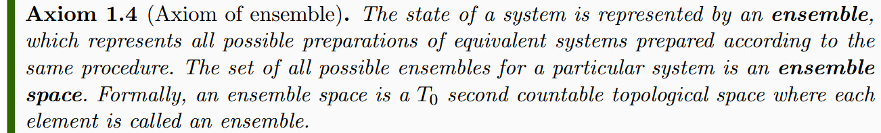

Experimental verifiability $⇒$ topological space

Slide 37
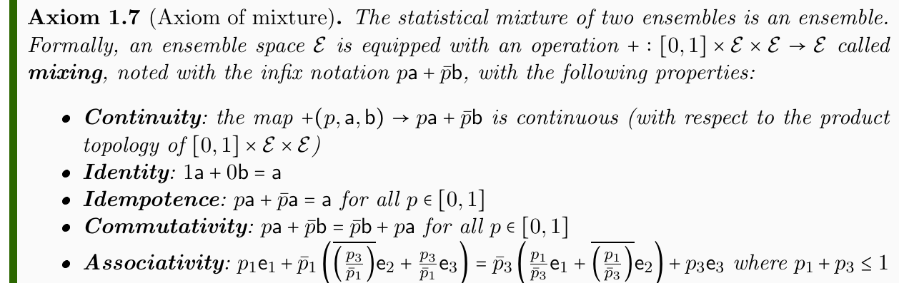




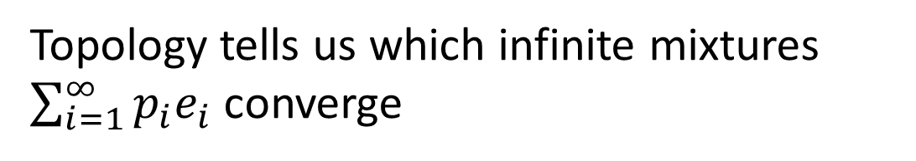
Ensembles can be mixed $⇒$ Convex structure
$$pa+\overline{p}b$$
$$a$$
$$b$$
Only finite mixtures $\sum_{i=1}^{n}{p_{i}e_{i}}$are guaranteed
Topology tells us which infinite mixtures $\sum_{i=1}^{∞}{p_{i}e_{i}}$ converge
I.e. where experimental verifiability converges

Slide 38
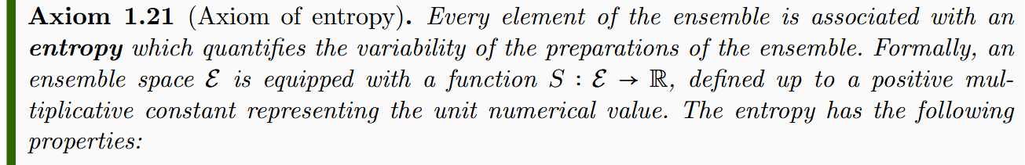





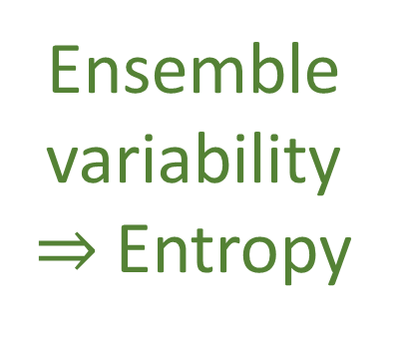
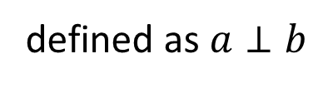
Ensemble variability $⇒$Entropy
$$a=b$$
defined as $a⊥b$
$$pS\left(a\right)+\overline{p}S\left(b\right)≤S\left(pa+\overline{p}b\right)≤I\left(p,\overline{p}\right)+pS\left(a\right)+\overline{p}S\left(b\right)$$
Maximum entropy increase $⇒$ orthogonality
$$a$$
$$pa+\overline{p}b$$
$$b$$

Slide 39









Separate ensembles
Orthogonal ensembles
$$⇐$$
No “common component”
Saturate upper entropy bound
such that
Coincide in classical ensemble spaces
Different in quantum ensemble spaces
$${|ψ}_{a}⟩$$
$${|ψ}_{c}⟩$$
disjoint support
$${|ψ}_{b}⟩$$

Slide 40
And now a series of results implied by the existence of an entropy

Slide 41
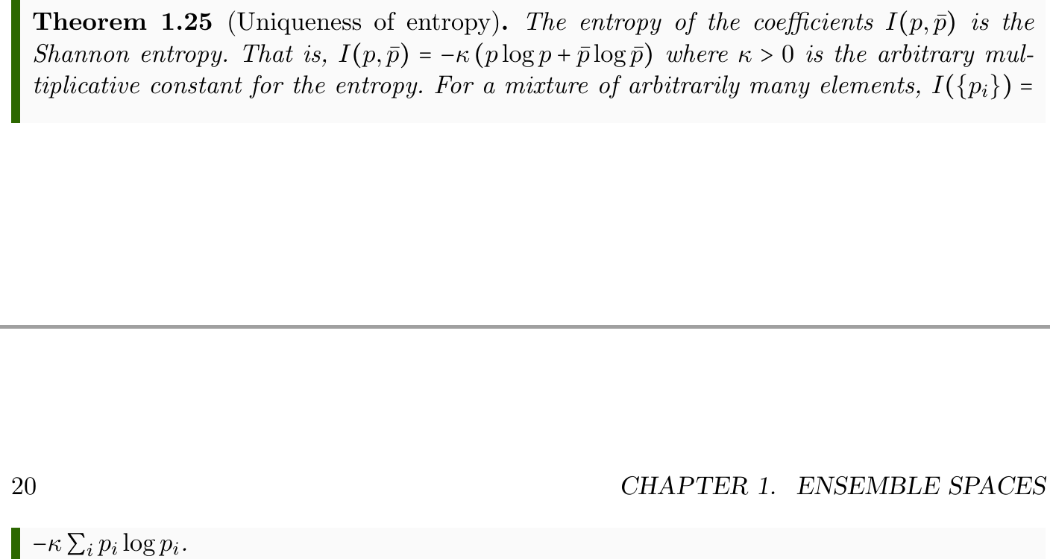
The entropy upper bound $I(p,\overline{p})$ is uniquely determined
Shannon entropy
Proof “does not know” whether we are dealing with classical ensembles, quantum ensembles, or ensembles for a theory yet to be discovered

Slide 42




Entropy bounds force mixing to be “invertible”
Is the inverse continuous?
$$a$$
$$b$$
$$ra+\overline{r}b$$
Can define affine combinations (i.e. negative probabilities)

Slide 43

Ensemble spaces embed into vector spaces
Connection to analysis
Do they embed continuously in a topological vector space?

Slide 44




$$V$$
$$ℰ$$
Ensemble spaces are bounded in all directions
Entropy bounds $⇒$ green point between blue and purple line
Entropy
Fix three points (i.e. origin, blue and red points)
Ensembles over a line

Slide 45


How much does the entropy increase during mixture?
Recovers the Jensen-Shannon divergence (JSD) (both classical and quantum)
Pseudo-distance from the entropy

Slide 46




Entropy imposes a metric on the affine structure
$$⇒$$
Entropy strict concavity means the Hessian is negative definite
Recovers Fisher-Rao information metric (both classical and quantum)

Slide 47

New structures:
non-additive measures for counting states and “mixing probability”

Slide 48





$$μ=2^{S\left(∑λ_{i}a_{i}\right)}$$
Let’s generalize $S(ρ_{U})=\log{μ(U)}$
biggest $S$
capacity also name of a non-additive measure
fuzzy measure
State capacity is a non-additive measure
additive over orthogonal sets
Recovers Liouville measure in classical mechanics and dimensionality of Hilbert subspaces in quantum mechanics

Slide 49














Mixture
Probability
$$e_{1}$$
$$o_{1}$$
$$λ_{1}$$
$$p_{1}$$
$$e_{2}$$
Ensemble
$$o_{2}$$
Preparations
$$λ_{2}$$
$$p_{2}$$
Outcomes
$$⋮$$
$$⋮$$
$$λ_{n}$$
$$p_{n}$$
$$e_{n}$$
$$o_{n}$$
In classical mechanics, mixtures of preparations and probability of outcomes always coincide
In quantum mechanics, they do not
$⇒$ ensemble space not a simplex (i.e. classical probability fails)
Can we have common measure theoretic tools on the preparation side?

Slide 50




How much of $e$ is a mixture of other ensembles?
$$e=p\left(∑λ_{i}a_{i}\right)+\overline{p}b$$
biggest $p$
fuzzy measure
Fraction capacity is a non-additive probability measure

Slide 51

Fraction capacity is a non-additive probability measure
State capacity is a non-additive measure
Fuzzy measures!
Is there a suitable generalization of calculus to this non-additive case, which would be valid for all physical theories?
Is there a notion of integral and derivative so that we can write $e=\int_{ℰ}{ρ_{e} dscap}$ and $ρ_{e}=\frac{dfcap_{e}}{dscap}$?
Is the type of uncertainty we are characterizing
with fuzzy measures compatible with that literature?

Slide 52

Experimental verifiability: topologies/$σ$-algebras
Ensembles: convex space, entropy
Connections to: measure theory, vector spaces, functional analysis, differential geometry, …
Foundations of physics $$⇕$$ The theory of physical models
General physical principles and requirements
General mathematical framework
Specific assumptions
Classical mechanics
Quantum mechanics
derivation
Thermodynamics
…
specialization
It must be a concerted effort across physics, math, information theory, philosophy, …
… and I can’t know everything!

Slide 53
Assumption of Physics is an open project
Our main output is an open access book: https://assumptionsofphysics.org/book/
All our material is developed on GitHub: https://github.com/assumptionsofphysics
Livestream discussions
One YouTube channel dedicated to publicize results: https://www.youtube.com/user/gcarcassi
Another YouTube channel dedicated to research: https://www.youtube.com/@AssumptionsofPhysicsResearch
Activities coordinated through a Discord server (contact me for an invite)
Always looking for experts to gain insights and/or help
Always looking for collaborations
Always looking for editors/journals/conferences that are sympathetic to the mission

Slide 54

Wrapping it up
Different approach to the foundations of physics
No interpretations, no theories of everything: physically meaningful starting points from which we can rederive the laws and the mathematical frameworks they need
Reverse physics (reverse engineer principles from the known laws)
Classical mechanics is “completed”; very good ideas for both thermodynamics and quantum mechanics; still do not know how to generalize to field theories
Physical mathematics (rederive the mathematical structures from scratch)
Topology and $σ$-algebras are derived from experimental verifiability; Good progress on a generic theory of states
The goal is ambitious and requires a wide collaboration
Always looking for people to collaborate with in physics, math, philosophy, …

Slide 55
To learn more
Project website
https://assumptionsofphysics.org for papers, presentations, …
https://assumptionsofphysics.org/book for our open access book (updated every few years with new results)
YouTube channels
https://www.youtube.com/@gcarcassi Videos with results and insights from the research
https://www.youtube.com/@AssumptionsofPhysicsResearch Research channel, with open questions and livestreamed work sessions
GitHub
https://github.com/assumptionsofphysics Book, research papers, slides for videos...

Slide 57
$⇒$ Science is about statements that are associated to experimental tests
Statements must be either true or false for everybody
Tests may or may not terminate (i.e. be conclusive)
Statement | Test Result
T | SUCCESS (in finite time)
 | UNDEFINED
F | UNDEFINED
 | FAILURE (in finite time)

Slide 58
















$$𝒮$$
$$s_{1}$$ | Test Result
T | SUCCESS (in finite time)
F | FAILURE (in finite time)
 | UNDEFINED
$$𝒮_{\text{v}}$$
$$s_{1}$$
experimental test
outside the formal system
$$\bigwedge_{i=i}^{n}{s_{i}}$$
$$s_{1}$$
$$s_{2}$$
$$s_{3}$$
All tests must succeed
$$\bigvee_{i=1}^{∞}{s_{i}}$$
$$s_{1}$$
$$s_{2}$$
$$s_{3}$$
$$…$$
One successful test is sufficient
$⇒$ Verifiable statements form a frame/Heyting algebra

Slide 59









Disjunction (OR) of verifiable statements: check that ONE test terminates successfully
$$s_{1}$$ | Test Result
T | SUCCESS (in finite time)
F | FAILURE (in finite time)
 | UNDEFINED
$∨(e_{i})$:
Initialize $n$ to 1
For each $i=1…n$
Run $e_{i}$ for $n$ seconds
If $e_{i}$ succeeds, return SUCCESS
Increment $n$ and go to 2
watch out for non-termination!
$$\bigvee_{i=1}^{∞}{s_{i}}$$
$$s_{1}$$
$$s_{2}$$
$$s_{3}$$
$$…$$
$⇒$ Only countable disjunction can reach all tests

