Slide 1


How experimental requirements shape the mathematics of the laws of physics
Christine Aidala + Gabriele Carcassi
Physics Department University of Michigan
ICASU Inaugural Conference UIUC May 19, 2022

Slide 2
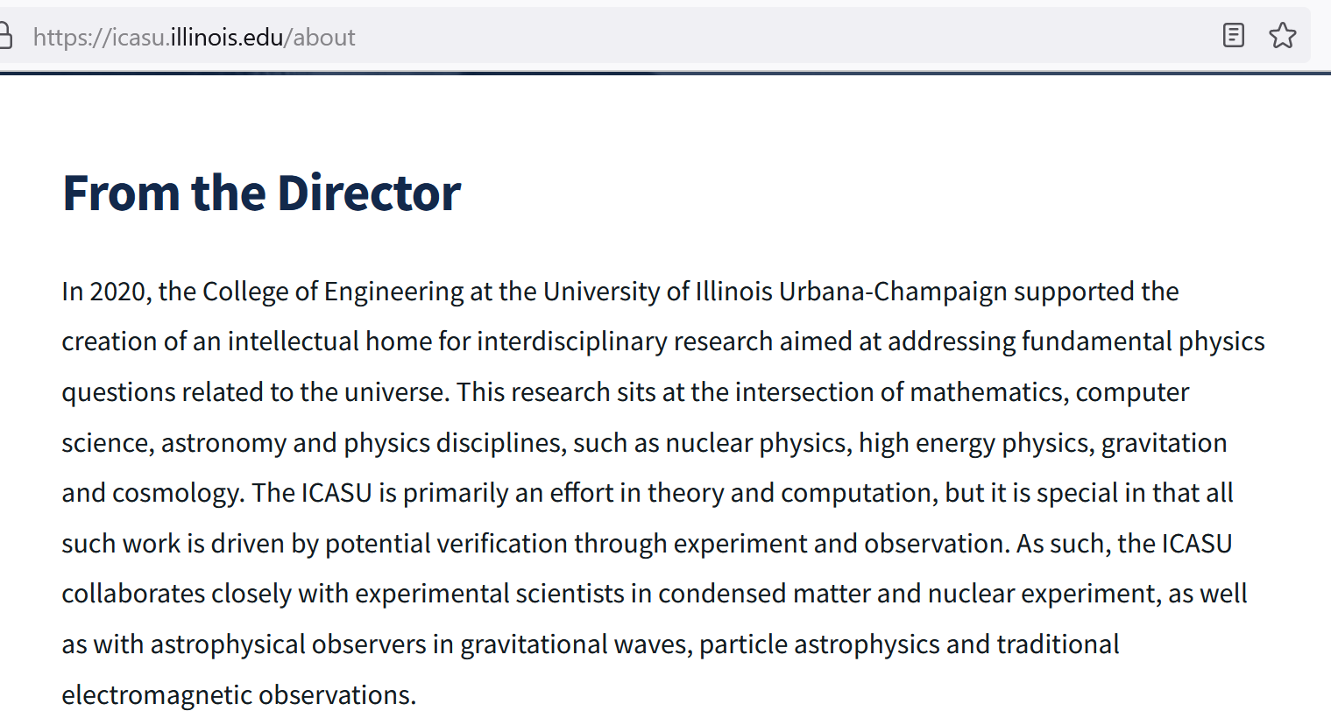

Slide 3


The project
Gabriele Carcassi
Christine A. Aidala
University of Michigan
https://assumptionsofphysics.org/

Slide 4
Introduction
Past successes in fundamental physics have been reached through mathematical ideas (e.g. Einstein equations, Dirac equation, Yang-Mills theories, Higgs mechanism, …)
This trend has been continuing (e.g. supersymmetry, supergravity, string theory, …) producing theories that are more esoteric and, sometimes, disconnected from experimental verification
As a reaction, there is now an increased emphasis on developing theories that make verifiable predictions
We believe we need to go further: the operational requirements of experimental verification are the actual foundational aspect of physics and they must play a central role in physical theories
We shouldn’t just look for theories that give verifiable predictions (not a side feature); they must incorporate the requirements of experimental verifiability at their core (the driving point)

Slide 5
Outline
Show how we can “elevate” the discussion from mathematical constructs to physical principles, assumptions and requirements (reverse physics)
Show that the current mathematical foundations are not quite what we need for physical theories (need for physical mathematics)
See what new ideas can come out of this new outlook

Slide 6
Reverse Physics: from laws to physical assumptions
Reverse Physics: From Laws to Physical Assumptions
Gabriele Carcassi, Christine A. Aidala
Foundations of Physics (2022) 52:40

Slide 7
Reverse Physics
Physics
Smallest set of assumptions required to rederive the theory
Physical theory
Physical result/ effect/prediction
Reverse Mathematics
Mathematics
Smallest set of axioms required to prove the theorem
Theorem
Mathematical result/ corollary/calculation

Slide 8

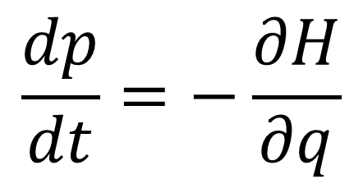
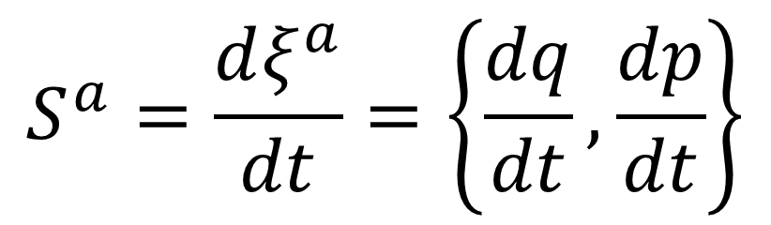
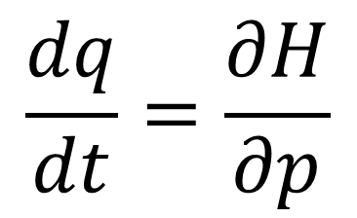

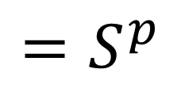

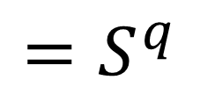
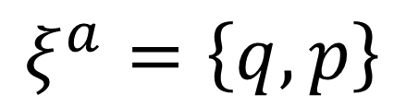

(1) Hamilton’s equations
$$p$$
$$=ξ^{2}$$
$$q$$
$$=ξ^{1}$$
$$\frac{dq}{dt}=\frac{∂H}{∂p}$$
$$=S^{q}$$
$$ξ^{a}=\left\{q,p\right\}$$
$$\frac{dp}{dt}=−\frac{∂H}{∂q}$$
$$=S^{p}$$
$$S^{a}=\frac{dξ^{a}}{dt}=\left\{\frac{dq}{dt},\frac{dp}{dt}\right\}$$

Slide 9

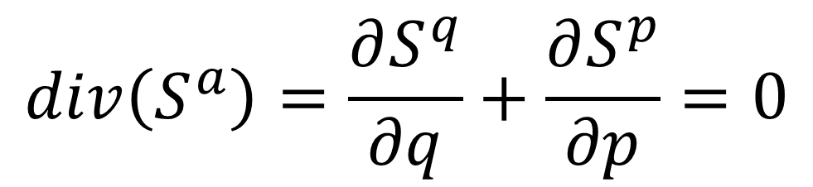
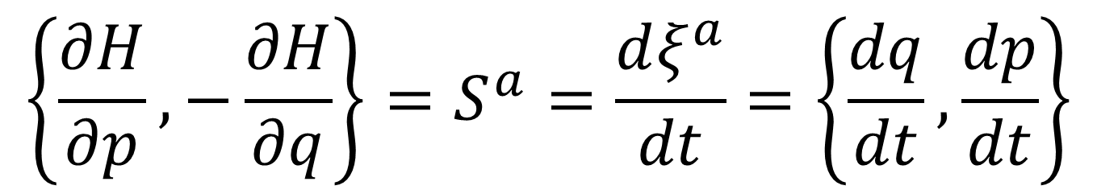

(2) Divergenceless displacement
$$p$$
$$=ξ^{2}$$
Suppose $S^{a}$ divergenceless
$$q$$
$$=ξ^{1}$$
$$div\left(S^{a}\right)=\frac{∂S^{q}}{∂q}+\frac{∂S^{p}}{∂p}=0$$
Then there exists a stream function $H$ such that
$$\left\{\frac{∂H}{∂p},−\frac{∂H}{∂q}\right\}=S^{a}=\frac{dξ^{a}}{dt}=\left\{\frac{dq}{dt},\frac{dp}{dt}\right\}$$

Slide 10
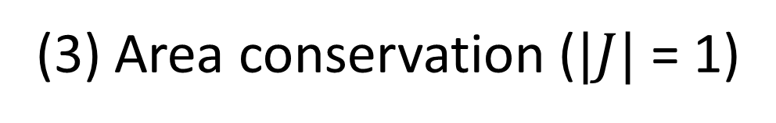
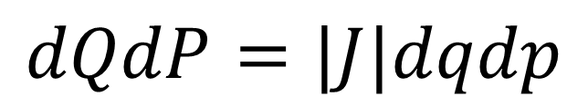
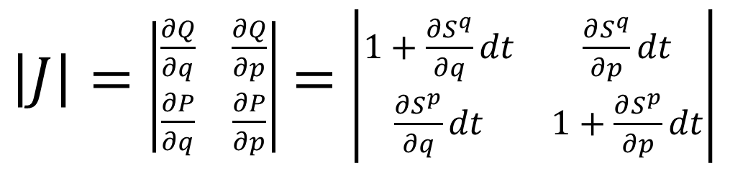

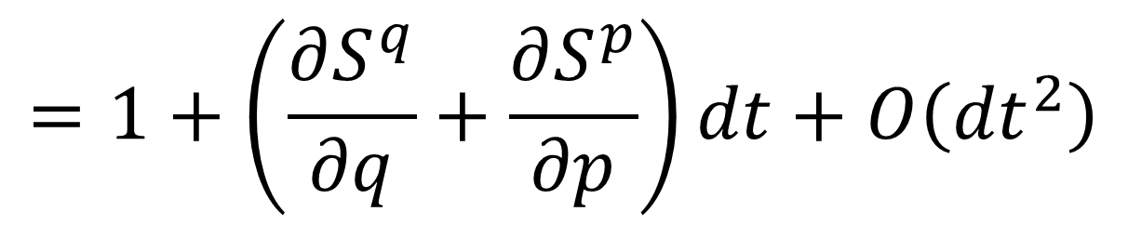
(3) Area conservation ($|J|$ = 1)
$$p$$
$$=ξ^{2}$$
Study how the area evolves
$$q$$
$$=ξ^{1}$$
$$dQdP=|J|dqdp$$
$\left|J\right|=$ $\left|\begin{matrix}\frac{∂Q}{∂q} & \frac{∂Q}{∂p} \\ \frac{∂P}{∂q} & \frac{∂P}{∂p}\end{matrix}\right|$ $=$ $\left|\begin{matrix}1+\frac{∂S^{q}}{∂q}dt & \frac{∂S^{q}}{∂p}dt \\ \frac{∂S^{p}}{∂q}dt & 1+\frac{∂S^{p}}{∂p}dt\end{matrix}\right|$
$$div\left(S^{a}\right)=0$$
$$=1+\left(\frac{∂S^{q}}{∂q}+\frac{∂S^{p}}{∂p}\right)dt+O\left({dt}^{2}\right)$$

Slide 11


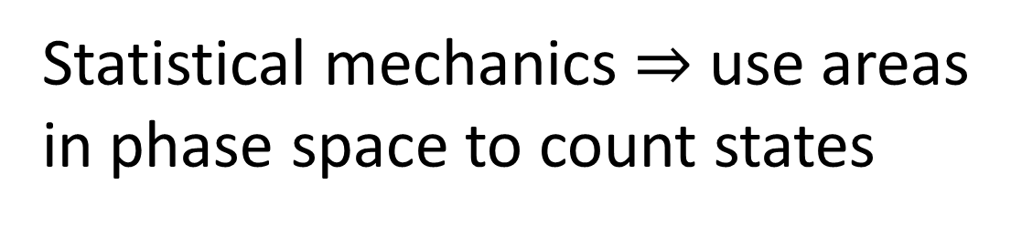



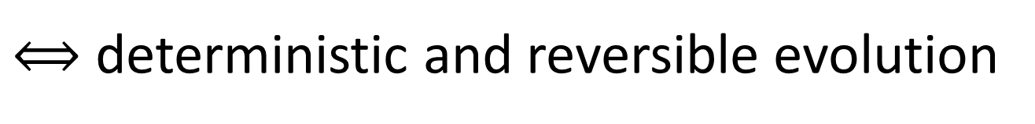
(4) Deterministic and reversible evolution
$$p$$
$$=ξ^{2}$$
$$q$$
$$=ξ^{1}$$
Statistical mechanics $⇒$ use areas in phase space to count states
Area conservation $⟺$ state count conservation
$⟺$ deterministic and reversible evolution
$$p$$
$$=ξ^{2}$$
Key insight: det/rev is not just a bijection! On continuous spaces, counting points is not enough!
$$q$$
$$=ξ^{1}$$
A dissipative force maps points to points, but areas become smaller.
Notes:
The three equivalent conditions on the previous slides were all mathematical. We would like to talk about physical conditions. So what’s a physical condition equivalent to the previous? Det/rev ev

Slide 12
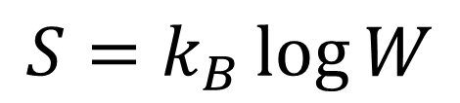


(5) Deterministic and thermodynamically reversible evolution
$$p$$
$$=ξ^{2}$$
$$q$$
$$=ξ^{1}$$
Link between statistical mechanics and thermodynamics
$$S=k_{B}\log{W}$$
Area conservation $⟺$ entropy conservation
$⟺$ thermodynamically reversible evolution
Notes:
To be clear, the previous reversible meant that we can _reconstruct_ the state. This is different from thermodynamic reversibility.

Slide 13
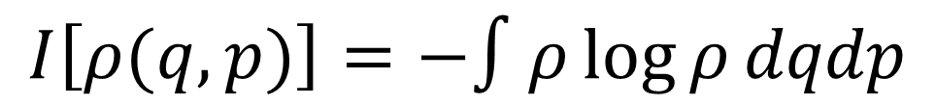

(6) Information conservation
$$p$$
$$=ξ^{2}$$
What about information entropy?
$$q$$
$$=ξ^{1}$$
$$I\left[ρ(q,p)\right]=−∫ρ\log{ρ}dqdp$$
$$I\left[ρ\left(t+dt\right)\right]=I\left[ρ\left(t\right)\right]−∫ρ\log{|J|}dqdp$$
Area conservation $⟺$ information conservation
Notes:
We looked at thermodynamic entropy. What about information entropy?

Slide 14
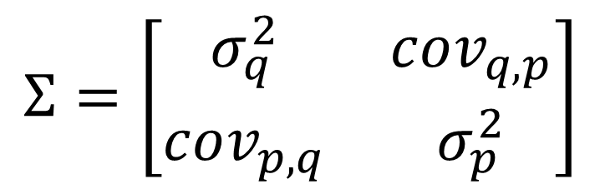

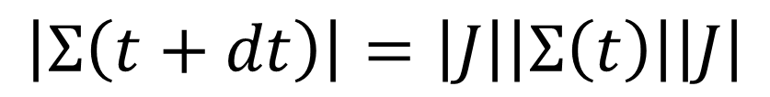
(7) Uncertainty conservation
$$p$$
$$=ξ^{2}$$
What about uncertainty?
covariance matrix
$$q$$
$$=ξ^{1}$$
$$Σ=\left[\begin{matrix}σ_{q}^{2} & cov_{q,p} \\ cov_{p,q} & σ_{p}^{2}\end{matrix}\right]$$
Assuming a “very narrow” distribution
$$\left|Σ\left(t+dt\right)\right|=\left|J\right|\left|Σ\left(t\right)\right|\left|J\right|$$
Area conservation $⟺$ uncertainty conservation
Notes:
Some people link info entropy to uncertainty. Well, what if we think about actual uncertainty? [Relevant for peaked/small-support distributions, for which you can linearize the field]

Slide 15
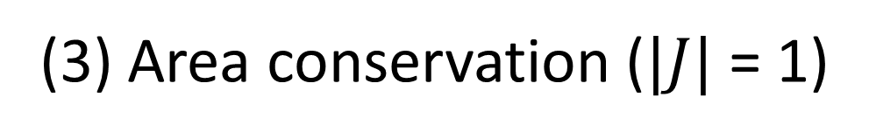
(1) Hamilton’s equations
All equivalent!
(2) Divergenceless displacement
(3) Area conservation ($|J|$ = 1)
They should be thought as a “conceptual cluster”: a series of ideas that “belong together”
(4) Deterministic and reversible evolution (i.e. isolation)
“Inverse” of Liouville’s theorem
(5) Deterministic and thermodynamically reversible evolution
(6) Information conservation
(7) Uncertainty conservation
Notes:
7 different conditions, 3 mathematical, 4 physical. 7 ways to understand the problem.

Slide 16
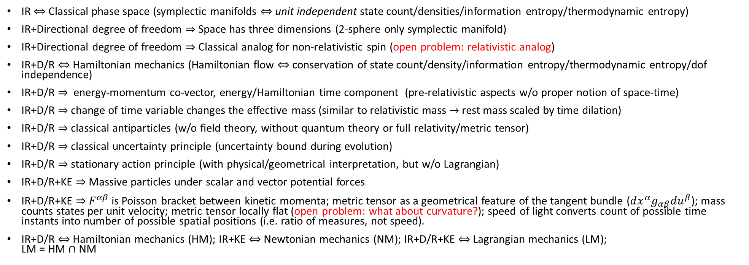
Three fundamental assumptions in Classical Mech
Infinitesimal Reducibility (IR)
Determinism/Reversibility (D/R)
Kinematic Equivalence (KE)
IR $⇔$ Classical phase space (symplectic manifolds $⇔$ unit independent state count/densities/information entropy/thermodynamic entropy)
IR+Directional degree of freedom $⇒$ Space has three dimensions (2-sphere only symplectic manifold)
IR+Directional degree of freedom $⇒$ Classical analog for non-relativistic spin (open problem: relativistic analog)
IR+D/R $⇔$ Hamiltonian mechanics (Hamiltonian flow $⇔$ conservation of state count/density/information entropy/thermodynamic entropy/dof independence)
IR+D/R $⇒$ energy-momentum co-vector, energy/Hamiltonian time component (pre-relativistic aspects w/o proper notion of space-time)
IR+D/R $⇒$ change of time variable changes the effective mass (similar to relativistic mass $→$ rest mass scaled by time dilation)
IR+D/R $⇒$ classical antiparticles (w/o field theory, without quantum theory or full relativity/metric tensor)
IR+D/R $⇒$ classical uncertainty principle (uncertainty bound during evolution)
IR+D/R $⇒$ stationary action principle (with physical/geometrical interpretation, but w/o Lagrangian)
IR+D/R+KE $⇒$ Massive particles under scalar and vector potential forces
IR+D/R+KE $⇒$ $F^{αβ}$ is Poisson bracket between kinetic momenta; metric tensor as a geometrical feature of the tangent bundle ($dx^{α}g_{αβ}du^{β}$); mass counts states per unit velocity; metric tensor locally flat (open problem: what about curvature?); speed of light converts count of possible time instants into number of possible spatial positions (i.e. ratio of measures, not speed).
IR+D/R $⇔$ Hamiltonian mechanics (HM); IR+KE $⇔$ Newtonian mechanics (NM); IR+D/R+KE $⇔$ Lagrangian mechanics (LM); LM = HM $∩$ NM
HM
NM
LM
Notes:
We can analyze which elements of the theory are traceable to which physical assumptions. Some elements of relativity in Hamiltonian mech w/o even having a metric tensor, and some elements of quantum mech already w/in classical mech, i.e. they should be thought of as properties of Hamiltonian systems in general, not particular to classical or quantum

Slide 17
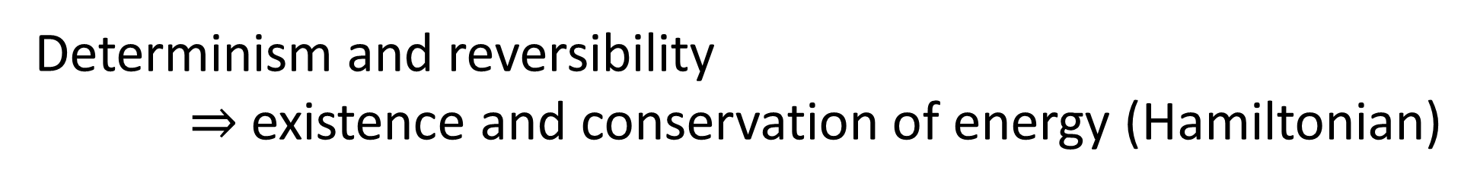
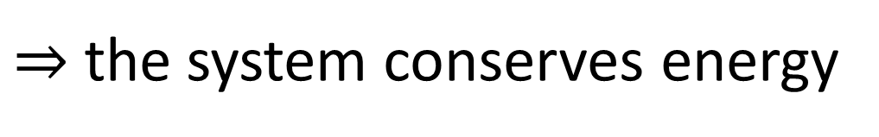
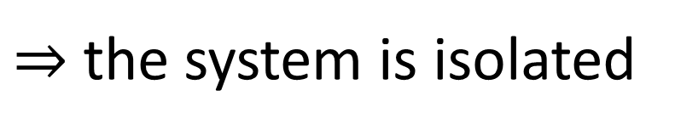
Determinism and reversibility $⇒$existence and conservation of energy (Hamiltonian)
Why?
Stronger version of the first law of thermodynamics
Determinism and reversibility
$⇒$ past and future depend only on the state of the system
$⇒$ the evolution does not depend on anything else
$⇒$ the system is isolated
First law of thermodynamics!
$⇒$ the system conserves energy

Slide 18
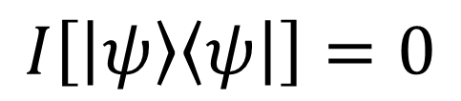
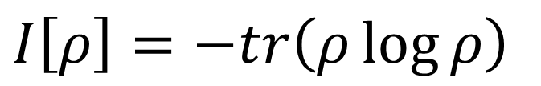

Where does the bound on quantum uncertainty come from? Are there already other bounds in QM?
Let’s look at the von Neumann entropy
$I\left[ρ\right]=−tr\left(ρ\log{ρ}\right)$
For a pure state $\left|ψ\right\rangle$
lowest possible entropy
$$I\left[\left|ψ\right\rangle \left\langle ψ\right|\right]=0$$
Could this bound, by itself, explain everything?

Slide 19


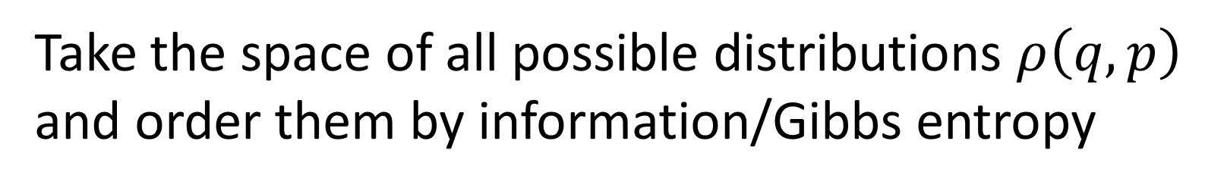



$$−∫ρ\log{ρ}$$
Take the space of all possible distributions $ρ\left(q,p\right)$ and order them by information/Gibbs entropy
Fix the entropy to a constant $I_{0}$ and consider all distributions with that entropy
$$I_{0}$$
They satisfy $σ_{q}σ_{p}≥\frac{e^{I_{0}}}{2πe}$
$$σ_{q}σ_{p}$$
equality for independent Gaussians
Lower bound on entropy $⇒$ lower bound on uncertainty
Inverse does not work: lower bound on uncertainty does not give a lower bound on entropy

Slide 20
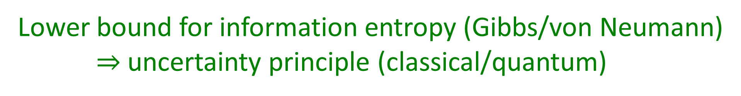
Lower bound for information entropy (Gibbs/von Neumann) $⇒$uncertainty principle (classical/quantum)
We don’t need the full quantum theory to derive the uncertainty principle: only the lower bound on entropy
The difference is that in classical mechanics we can prepare ensembles with arbitrarily low entropy…
… which is actually in contradiction with the third law of thermodynamics!!!
Notes:
It’s the reason that classical mechanics ultimately fails—comes directly from the assumption of infinitesimal reducibility. Can’t extract as much information from the system as you want. There’s a level of description below which you can’t go.

Slide 21
Holistic approach
Assumptions of CM
Classical mechanics
Measure theory
Statistics
Assumptions of physics
Assumptions of QM
Quantum mechanics
Information theory
Differential geometry
Assumptions of TD
Thermo-dynamics
No single fundamental point of view (e.g. “everything is information”)
Foundations of different theories are not disconnected
Find those “conceptual clusters” that span multiple areas of physics, math, …
Notes:
In our approach to the foundations of physics, we don’t focus only on the foundations of QM. We take a holistic approach. QM is NOT the foundation of physics. The foundations of physics need to cut across all of physics.

Slide 22
Reverse Physics
“Reverse Physics” is an approach to the foundations of physics that starts from the physical laws and aims to “go back” to a suitable minimum number of physical assumptions
Reformulation – find better physical starting points.
Dependency analysis – find which part of a theory causes which effect.
Reconceptualization – substitute concepts with more general ones
The goal is to fully map conceptual relationships and dependencies between different theories, different aspects of the theories, and to help foster higher level physical reasoning
It is, by its nature, an interdisciplinary endeavor, and it can allow us to think more deeply about physical ideas and their relationships

Slide 23
Physical mathematics: from physical requirements to mathematical structures

Slide 24
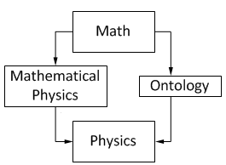
In modern physics, mathematics is used as the foundation of our physical theories
From Hossenfelder’s Lost in Math: “[…] finding a neat set of assumptions from which the whole theory can be derived, is often left to our colleagues in mathematical physics […]”
But mathematics only deals with formal systems, without any connection to or concern about physical reality
From Wikipedia “Mathematical Physics”
David Hilbert: “Mathematics is a game played according to certain simple rules with meaningless marks on paper.”
THIS CAN’T WORK!
Bertrand Russell: “It is essential not to discuss whether the first proposition is really true, and not to mention what the anything is, of which it is supposed to be true.”
Formal definitions are neither necessary nor sufficient to do physics
Not useful in a lab
Moreover, there are choices at the foundations of mathematics
Do we accept the axiom of choice or the continuum hypothesis?

Slide 25
Physics is defined in terms of physical objects and operational definitions
Physics
Physical requirements
Semantics
Using assumptions and approximations, physical objects and their properties are idealized
Physical Mathematics
The idealized model can then be expressed in the formal system
The idealization step is the most important part of this process, and it happens outside the formal system!
Starting with the math (i.e. the formal system) misses most of the physics
Notes:
The math loses the semantics, because math—by design--doesn’t know what it’s talking about.

Slide 26
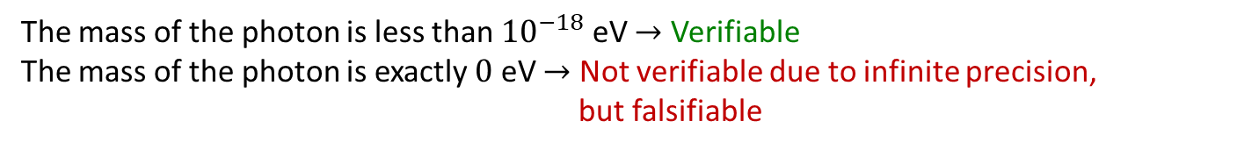
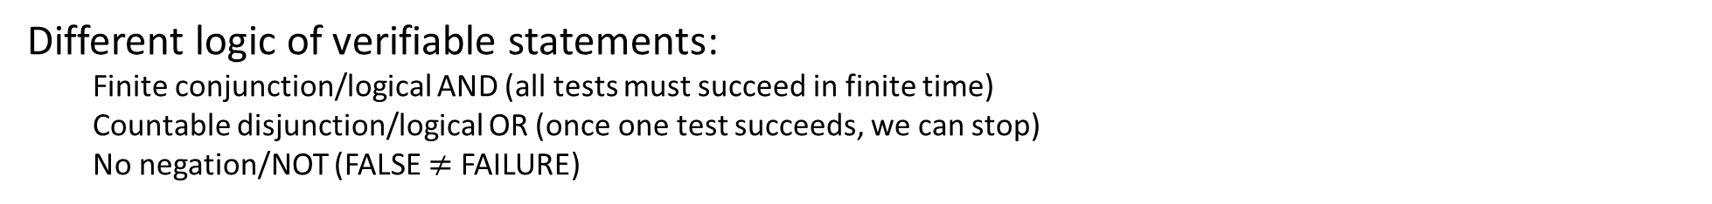

1st basic requirement: experimental verifiability
Science deals with assertions whose truth can be defined/ascertained experimentally $⇒$ Verifiable statements: assertions that can be experimentally verified in a finite time
The mass of the photon is less than ${10}^{−18}$ eV $→$ Verifiable
The mass of the photon is exactly $0$ eV $→$ Not verifiable due to infinite precision, but falsifiable
T | SUCCESS (in finite time)
F | UNDEFINED
 | FAILURE (in finite time)
Different logic of verifiable statements:
Finite conjunction/logical AND (all tests must succeed in finite time)
Countable disjunction/logical OR (once one test succeeds, we can stop)
No negation/NOT (FALSE $≠$ FAILURE)
Note: whether a specific statement is experimentally verifiable or even well defined may depend on context (e.g. premises, idealization, theory, etc…)
The mass of the electron is 511 $±$ 0.1 KeV
When measuring the mass, it is a verifiable hypothesis
When performing particle identification, it is assumed to be true

Slide 27
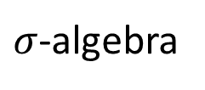
Experimentally distinguishable cases
Statements formally associated with an experimental test
Theoretical statements
Precise map between physical concepts and their mathematical representation
If true, test always succeeds in finite time
Verifiable statements
Possibilities
$σ$-algebra
Borel sets
Points
All proofs can be “translated” into physically meaningful language
Open sets
Topology
Notes:
Topology is the foundation for all of differential geometry. Sigma-algebras are the foundation of measure theory, probability theory, and info theory. (The points on top of which the topology is defined.) Segue to next: Okay, so one requirement for a physical theory is to capture experimental verifiability. But how do we capture the physical objects, physical definitions?

Slide 28
How do we define physical objects, e.g. time?
Formal definition (in math): some set with some properties (e.g. a variable that can be used as a parameter for the evolution of a system)
Ontological definition (in philosophy): some intrinsic feature of reality (e.g. continued sequence of existence and events)
These types of answers do not help us in a lab
An operational definition is necessary and sufficient: time is what is measured by a clock
What is a clock?
examples
The sun, the seasons, heart (pulse), a pendulum, ….
…, and anything else that can be synchronized to another clock.
operational feature of a general clock
$⇒$ If you can’t synchronize clocks, you have a problem…

Slide 29
How do we formally model a clock?
What operational requirements lead to time as a real number?
A reference (i.e. a tick of a clock) is something that allows us to distinguish between a before and an after (mathematically, a triple of statements $\left(b,o,a\right)$ with some properties)
A clock is a collection of references (synchronization $⇒$ clocks have corresponding references)
To define an ordered sequence of “instants”, the references must be (nec/suff conditions):
Strict – an event is strictly before/on/after the reference (doesn’t extend over the tick)
Aligned – shared notion of before and after (logical relationship between statements)
Refinable – overlaps can always be resolved
Additionally: between any two references we can have another reference $⇒$ real numbers
These conditions are idealizations
Notes:
(Don’t go into the conditions) 3 conditions give us order. 4th gives us the reals.

Slide 30
How does this model of time break down?
The ticks of a clock have an extent and so do the events (references not strict)
If clocks have jitter, they cannot achieve perfect synchronization (references not aligned)
We cannot make clock ticks as narrow as we want (references not refinable)
No consistent ordering: no “objective” “before” and “after”
In relativity, different observers measure time differently, but the order is the same. We should expect this to fail at “small” scales.
A better understanding of space-time means creating a more realistic formal model that accounts for those failures
Notes:
Never mind using real numbers—we don’t even have ordering!

Slide 31
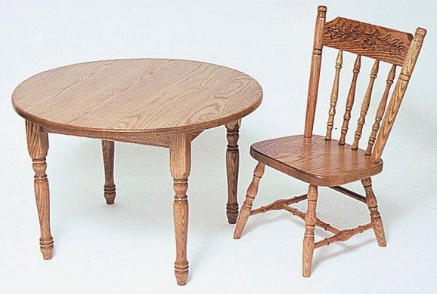
How do we define a system?
We can talk about a chair because we can manipulate it independently from the rest
If the table moved every time the chair moved, we would talk about a chair-table system
We can talk about a chair here on the surface of the earth
If we were on the surface of the sun, the chair would not exist for long
We can talk about a chair insofar that the internal dynamics is irrelevant
If the detailed motion of each molecule were important, we would talk about a set of molecules
Defining a system is contingent upon the existence of processes that render it “independent” from the internal dynamics and the environment

Slide 32
Identifying conditions/processes for independent subsystems in QCD: factorization
When we manipulate a proton as a whole, we are not generally sensitive to the internal dynamics of quarks and gluons. A proton is defined as a proton exactly when that internal dynamics is decoupled
For inelastic proton collisions, sensitive to internal proton structure/dynamics, the QCD community has worked hard over the decades to identify (only a handful of) factorizable scattering processes in which it’s a good approximation to think of independent subsystems—quarks and gluons—interacting
But the vast majority of QCD processes cannot be treated as the interaction of simple independent subsystems
Are there identifiable subsystems within the proton at intermediate length/time scales?

Slide 33
Need a generalized theory of physical systems
codefined
State space
Processes
State space must always be equipped with the processes under which the system is defined
Consistency requirements: state symmetries $↔$ process symmetries; measurement processes $↔$open sets; system decoupling $↔$ measure (and entropy) defined on states; …

Slide 34
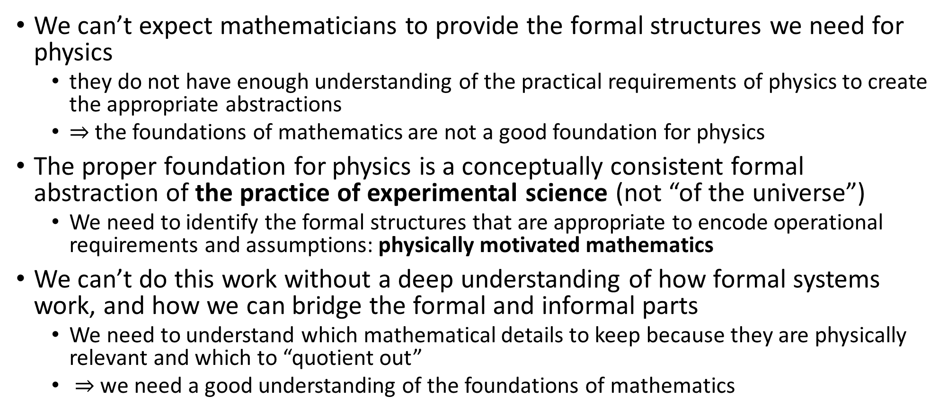
The need for physical mathematics
We can’t expect mathematicians to provide the formal structures we need for physics
they do not have enough understanding of the practical requirements of physics to create the appropriate abstractions
$⇒$ the foundations of mathematics are not a good foundation for physics
The proper foundation for physics is a conceptually consistent formal abstraction of the practice of experimental science (not “of the universe”)
We need to identify the formal structures that are appropriate to encode operational requirements and assumptions: physically motivated mathematics
We can’t do this work without a deep understanding of how formal systems work, and how we can bridge the formal and informal parts
We need to understand which mathematical details to keep because they are physically relevant and which to “quotient out”
$⇒$ we need a good understanding of the foundations of mathematics

Slide 35
New insights lead to new ideas

Slide 36
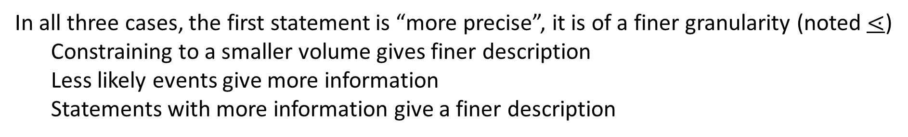
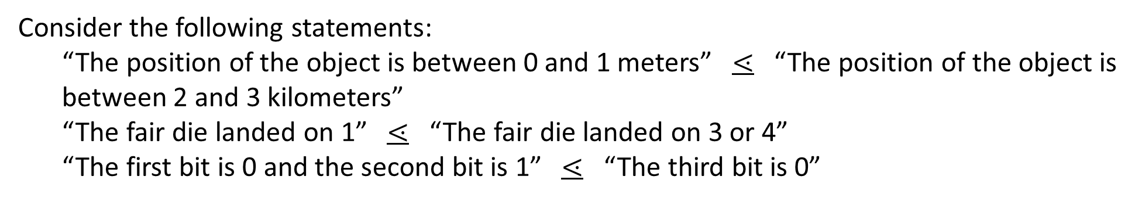
Measure theory plays a foundational role for theories of integration (e.g. geometrical sizes), probability and information theory: common physically motivated underpinning?
Consider the following statements:
“The position of the object is between 0 and 1 meters” $⋖$ “The position of the object is between 2 and 3 kilometers”
“The fair die landed on 1” $⋖$ “The fair die landed on 3 or 4”
“The first bit is 0 and the second bit is 1” $⋖$ “The third bit is 0”
and
and
and
In all three cases, the first statement is “more precise”, it is of a finer granularity (noted $⋖$)
Constraining to a smaller volume gives finer description
Less likely events give more information
Statements with more information give a finer description
Comparing statements based on their granularity is another fundamental feature a physical theory must have

Slide 37






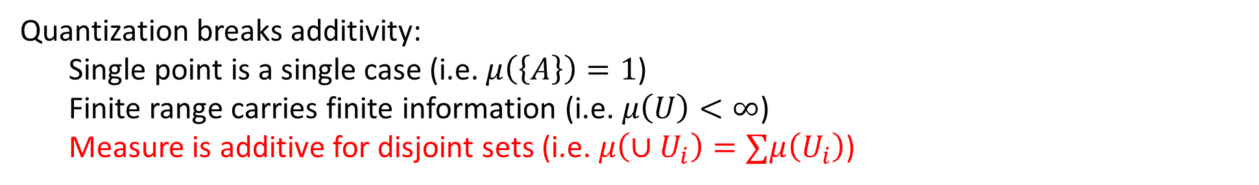










We need a generalized version of measure theory that covers all cases
Some statements are incomparable:
“The position of the object is between 0 and 1 meters” vs “The velocity of the object is between 2 and 3 meters per seconds”
$$A$$
$$C$$
Comparability cannot be captured by a single measure:
$\left\{A\right\} \left\{B,C\right\} U V$ while $\left\{A\right\} \left\{B,C\right\} U V$
$$U$$
$$B$$
$$⋖$$
$$⋖$$
$$⋖$$
$$⋗$$
$$⋗$$
$$⋗$$
$$∕$$
$$∕$$
$$∕$$
$$V$$
Entropy in quantum mechanics is consistent with first two requirements
Quantization breaks additivity:
Single point is a single case (i.e. $μ\left(\left\{A\right\}\right)=1$) Finite range carries finite information (i.e. $μ\left(U\right)<∞$)
Measure is additive for disjoint sets (i.e. $μ\left(∪U_{i}\right)=∑μ\left(U_{i}\right)$)
$$A$$
$$U$$
From what we understand, this is new mathematics

Slide 38

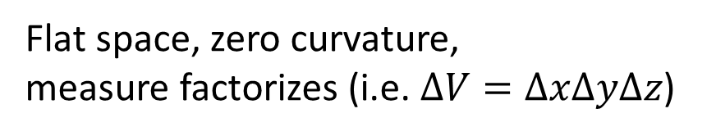







What could a generalized measure theory be useful for?
In a field theory, the value at each point is an independent d.o.f.
$⇒$ Measure of the volume “counts” the independent d.o.f.
Yet, in a singularity this can’t be the case: value of the field at each point loses meaning;
Information encoded on the surface (holographic principle)
Flat space, zero curvature, measure factorizes (i.e. $ΔV=ΔxΔyΔz$)
Singularity, infinite curvature, “volume flattens”
$$ΔV$$
$$ΔV$$
$$Δy$$
$$Δy$$
$$Δy$$
$$Δx$$
$$Δx$$
$$Δx$$
Notes:
Has to happen gradually!

Slide 39
What could a generalized measure theory be useful for?
In a field theory, the value at each point is an independent d.o.f.
$⇒$ Measure of the volume “counts” the independent d.o.f.
Is the curvature an indicator for how independent the values of the fields are? Does “quantizing” space-time mean using a non-additive measure, so that the count of d.o.f. does not go to zero (but to a finite measure)?
Flat space, zero curvature, measure factorizes (i.e. $ΔV=ΔxΔyΔz$)
Singularity, infinite curvature, “volume flattens”
$$ΔV$$
$$ΔV$$
$$Δy$$
$$Δy$$
$$Δy$$
$$Δx$$
$$Δx$$
$$Δx$$

Slide 40
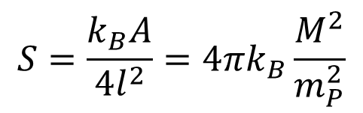









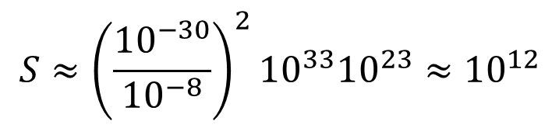
Fundamental particle: object with no discernible substructure
BUT
Black hole: has no discernible substructure
$$S$$
$$S=\frac{k_{B}A}{4l^{2}}=4πk_{B}\frac{M^{2}}{m_{P}^{2}}$$
All pure states have zero entropy: all fundamental particles have zero entropy
Should same relationship apply?
$$γ$$
$$ν$$
$$e$$
$$m$$
Because relationship is quadratic, zero entropy IS a good approximation for small masses
BUT: macroscopic objects are made of MANY particles
Mass of Sun $≈{10}^{33}$ g
#$e$ in 1 g of H $≈{10}^{23}$
Mass of $e$ $≈{10}^{−30}$ Kg
$$S≈{\left(\frac{{10}^{−30}}{{10}^{−8}}\right)}^{2}{10}^{33}{10}^{23}≈{10}^{12}$$
Planck mass $≈{10}^{−8}$ Kg
Notes:
So we’ve talked about how the measure theory becomes different. What other things might need to be rethought if we are to combine quantum mechanics and general relativity? [. . .] If each fundamental particle in fact comes with its own small but nonzero entropy, then we need a correction to QFT and quantum statistical mechanics/quantum information theory.

Slide 41
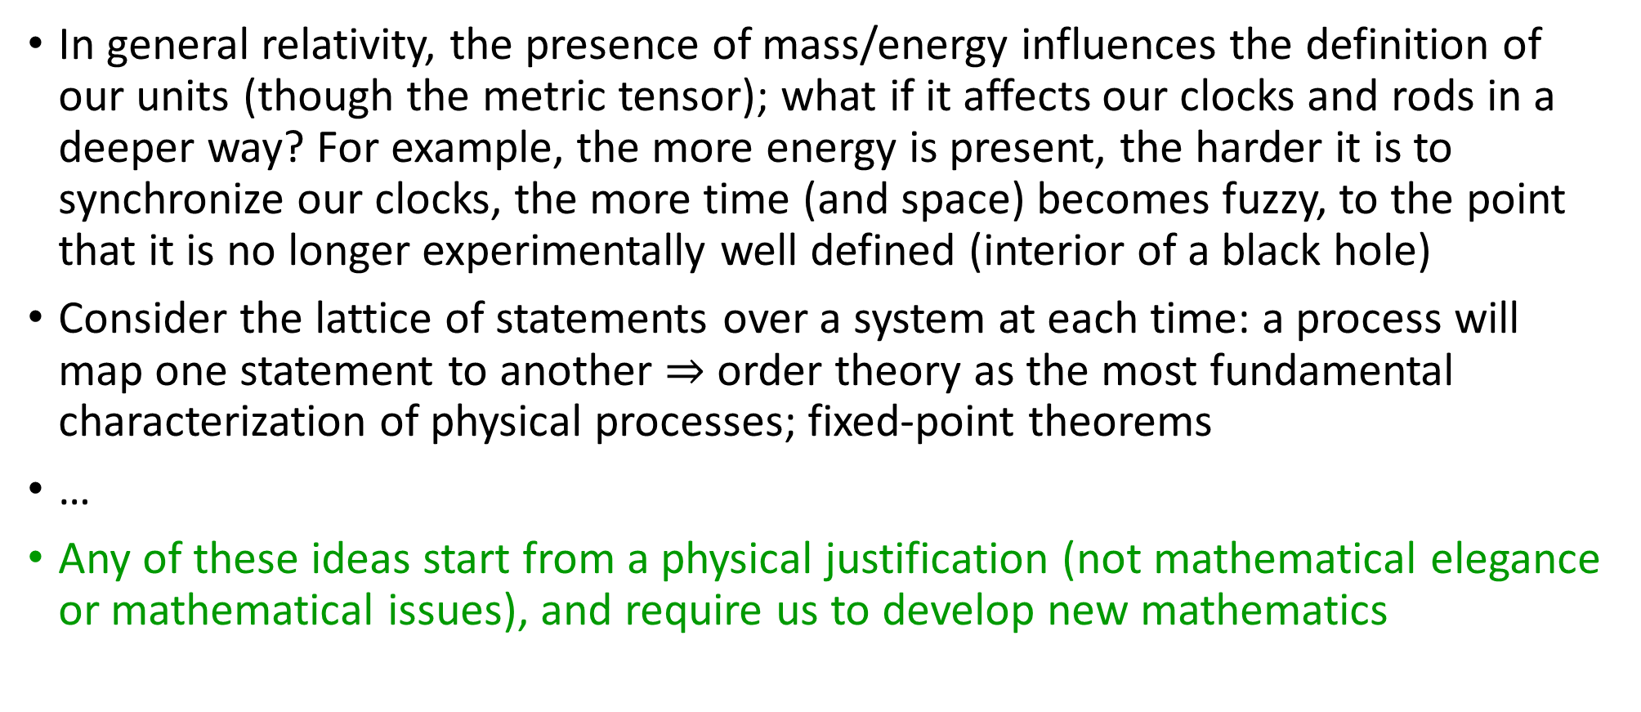
Other things to explore
In general relativity, the presence of mass/energy influences the definition of our units (though the metric tensor); what if it affects our clocks and rods in a deeper way? For example, the more energy is present, the harder it is to synchronize our clocks, the more time (and space) becomes fuzzy, to the point that it is no longer experimentally well defined (interior of a black hole)
Consider the lattice of statements over a system at each time: a process will map one statement to another $⇒$ order theory as the most fundamental characterization of physical processes; fixed-point theorems
…
Any of these ideas start from a physical justification (not mathematical elegance or mathematical issues), and require us to develop new mathematics

Slide 42
Conclusion
The solution to many open problems in the foundation of physics lies in a better understanding of the current mathematical tools, their physical meaning and the development of fundamentally new tools
Reverse physics helps us reframe the current theories in terms of physical requirements and assumptions, shifting the attention away from math to physical ideas
Physical mathematics helps us understand clearly how physical ideas are encoded into the formal systems, and find physically motivated generalizations
In both cases, it is clear that what really drives the theoretical apparatus are the operational requirements, so that should be the focus of the foundations of physics

Slide 43
Supplemental

Slide 44
continuum
Quantifying discrete cases is fundamentally different than quantifying cases over the continuum
discrete
finite measure
zero measure
Why? Because fully identifying a discrete case requires finite information (finitely many experimental tests) while identifying a case from a continuum requires infinite information (an infinite sequence of increasingly precise tests)
This is something most physicists haven’t yet fully digested

Slide 45

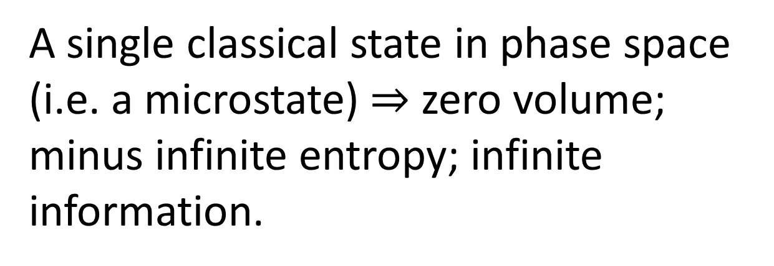
continuum
A single classical state in phase space (i.e. a microstate) $⇒$ zero volume; minus infinite entropy; infinite information.
discrete
finite measure
zero measure
“Empty state” $⇒$ one discrete case; zero entropy; finite information.
quantum: continuum with points of finite measure
Quantum mechanics “fixes” this, by introducing a fixed lower bound on entropy.

