Slide 1


From Laws to Physical Assumptions
Christine A. Aidala
Physics Department
University of Michigan
Physics Department Colloquium
Duke University

Slide 2
Standard view of the foundations of physics
Goal of physics is to find the true laws of the universe!
approximation
…
The “real” physics!
Weak interactions
QED -Electromagnetism
The foundations
of physics!
Everything else
is an approximation
QCD – Strong Interactions
Electro-weak
General Relativity
Grand Unified Theory
What “really” happens
Theory of Everything
Measurement problem
Hidden variables
Role of the observer
Ontology of observables
Perfect description of the universe
Dark matter/energy

Slide 3
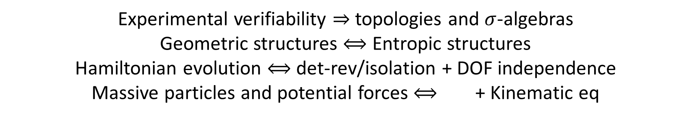
We found:
Physical requirements and assumptions drive most of the theoretical apparatus,
for example:
Experimental verifiability $⇒$ topologies and $σ$-algebras
Geometric structures $⟺$ Entropic structures
Hamiltonian evolution $⟺$ det-rev/isolation + DOF independence
Massive particles and potential forces $⟺$ + Kinematic eq
Goal of physics is to find the true laws of the universe!
Goal of physics is to find models that can be empirically tested
Less productive point of view
More productive point of view

Slide 4
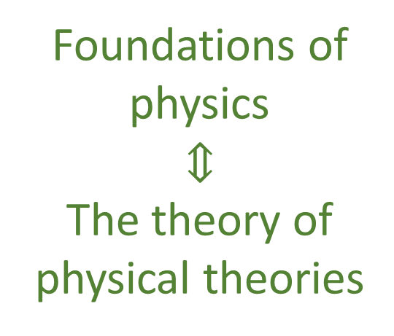
Our view of the foundations of physics
Foundations of physics
$$⇕$$
The theory of physical theories
General physical principles
and requirements
General mathematical framework
Specific assumptions
Classical mechanics
Quantum mechanics
derivation
Thermodynamics
…
specialization

Slide 5
Reverse Physics:
Start with the equations,
reverse engineer physical assumptions/principles
Reverse Physics
Physics
Smallest set of assumptions required to rederive the theory
Physical theory
Physical result/
effect/prediction
Reverse Mathematics
Mathematics
Smallest set of axioms required to prove the theorem
Theorem
Mathematical result/
corollary/calculation
Found. Phys. 52, 40 (2022)
Goal: find the right overall physical concepts, “elevate” the discussion from mathematical constructs to physical principles
Physical Mathematics: Start from scratch and rederive all mathematical structures from physical requirements
Physics
Physical requirements
Semantics
Physical mathematics
Goal: get the details right, perfect one-to-one map between mathematical and physical objects

Slide 6
“When the math is derived from the right physical assumptions,
the physical assumptions can be derived from the math.”
Reverse Physics aims to adopt approaches that are more in line with the foundations of mathematics, to break physics into a set of physical and mathematical conditions with well-understood logical relationships.
A new methodology for the foundations of physics
Assumptions of Physics, Michigan Publishing (v3 2025)
https://doi.org/10.3998/mpub.12204707
https://arxiv.org/abs/2608.27543
Found. Phys. 52 40 (2022)
https://link.springer.com/article/10.1007/s10701-022-00555-z
J. Phys. Commun. 2 045026 (2018)
http://iopscience.iop.org/article/10.1088/2399-6528/aaba25

Slide 7
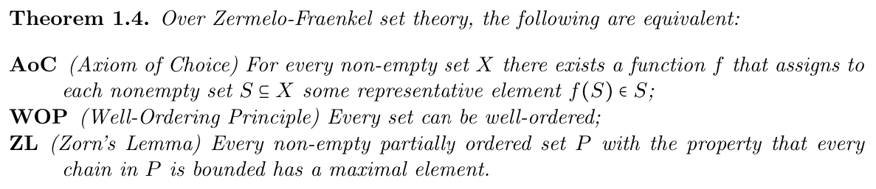
Break physics into different conditions
and study their logical relationships
Similar to what is done in the foundations of mathematics
“The Axiom of Choice is obviously true, the well-ordering principle obviously false,
and who can tell about Zorn’s lemma?”
Jerry Bona, quoted in E. Schechter, Handbook of Analysis and Its Foundations, 1997
Clarifying what any given starting point commits us to is particularly valuable when intuition can be faulty!

Slide 8
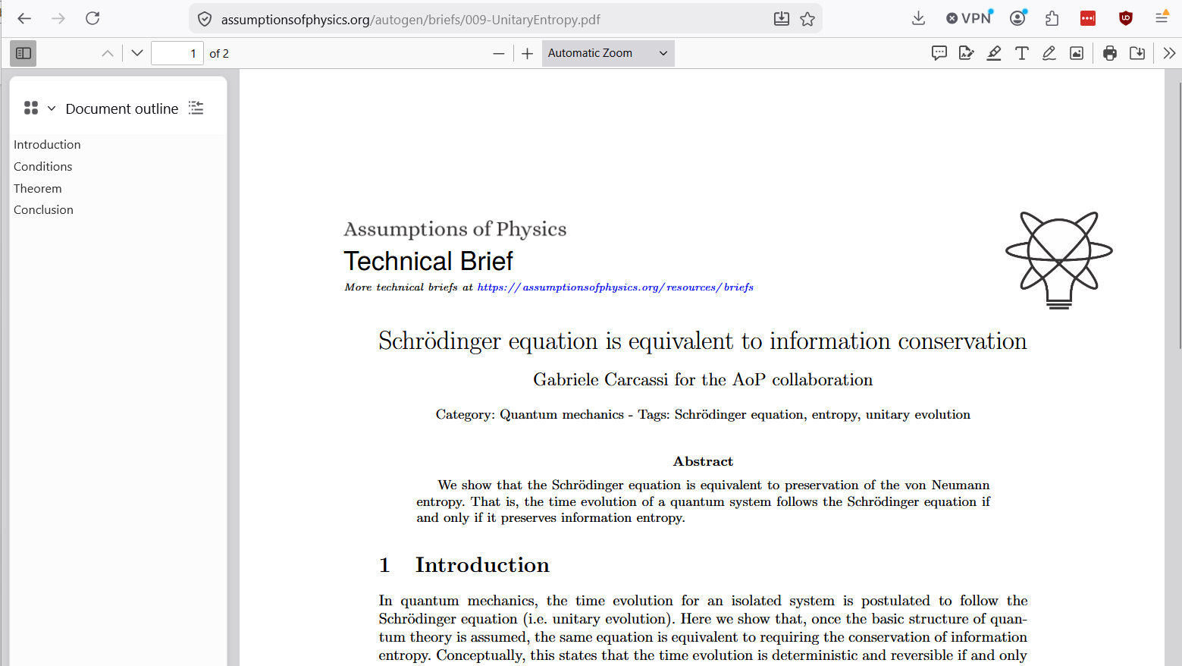
Goals of Reverse Physics
(and structure of the talk)
Examine the actual content of mathematical structures used in physics
Uncover “paradoxes” and develop standards of rigor appropriate for physics
Clarify the logical dependencies of physical/mathematical conditions
Identify core constitutive requirements of physical theories
Must be framework/interpretation/formulation neutral!
Where relevant throughout,
QR codes and links to papers or technical briefs

Slide 9
Examining the actual content of mathematical structures

Slide 10




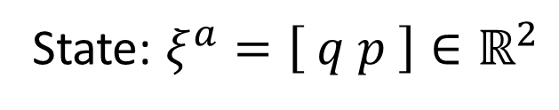







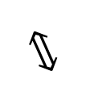
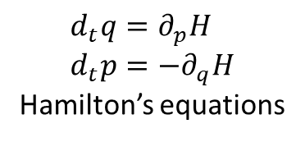


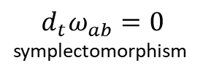

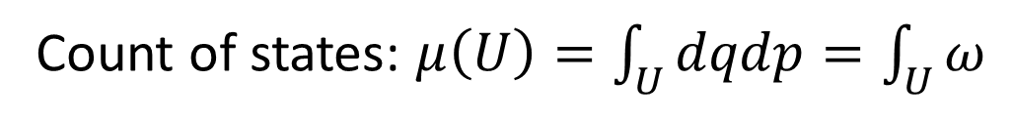
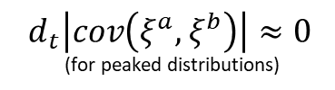


Reversing classical Hamiltonian mechanics in 1 DOF
$$d_{t}μ\left(U\right)=0$$
$$⟺$$
$$d_{t}\log{μ\left(U\right)}=0$$
$$⟺$$
$$⟺$$
$d_{t}\int{−ρ\log{ρ}dμ}=0$
$$⟺$$
Conservation of
state count
Conservation of
thermodynamic entropy
$$⟺$$
$$⟺$$
Conservation of
information entropy
$$⟺$$
$$⟺$$
$$⟺$$
$$⟺$$
$$d_{t}\left|cov\left(ξ^{a},ξ^{b}\right)\right|≈0$$
(for peaked distributions)
$$d_{t}ω_{ab}=0$$
symplectomorphism
Determinism and
reversibility
$$⟺$$
$$⟺$$
$$⟺$$
Conservation of
uncertainty
$$d_{t}q=∂_{p}H \\ d_{t}p=−∂_{q}H$$
Hamilton’s equations
All equivalent conditions!!!
Base theory:
State: $ξ^{a}=\left[ q p \right]∈ℝ^{2}$
Count of states: $μ\left(U\right)=\int_{U}{dqdp}=\int_{U}{ω}$
https://assumptionsofphysics.org/book/AssumptionsOfPhysicsV3.0.pdf#section.1.1.4
Notes:
Over this base theory, all these conditions are equivalent

Slide 11




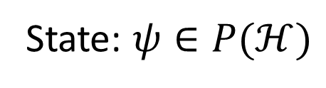






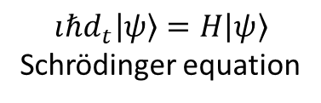


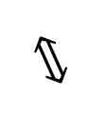
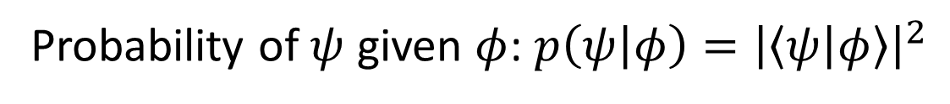
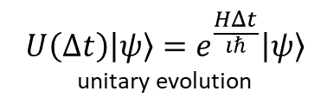

Reversing unitary evolution
$ψ(0)=φ$ iff $ψ(t)=e^{\frac{HΔt}{ıℏ}}φ$
$$⟺$$
$$d_{t}\text{tr}\left(−ρ\log{ρ}\right)=0$$
$$⟺$$
$$…$$
$$⟺$$
$$⟺$$
Bijective map of
state and probability
Conservation of
information entropy
$$⟺$$
$$⟺$$
…
$$⟺$$
$$⟺$$
$$⟺$$
$$U\left(Δt\right)\left|ψ\right\rangle =e^{\frac{HΔt}{ıℏ}}\left|ψ\right\rangle$$
unitary evolution
Determinism and
reversibility
$$⟺$$
$$ıℏd_{t}\left|ψ\right\rangle =H\left|ψ\right\rangle$$
Schrödinger equation
All equivalent conditions!!!
Base theory:
State: $ψ∈P(ℋ)$
Probability of $ψ$ given $φ$: $p\left(ψ | φ\right)={\left|\left\langle ψ | φ\right\rangle \right|}^{2}$
https://assumptionsofphysics.org/autogen/briefs/009-UnitaryEntropy.pdf

Slide 12
Why does classical mechanics fail?
What is quantum mechanics fixing?

Slide 13
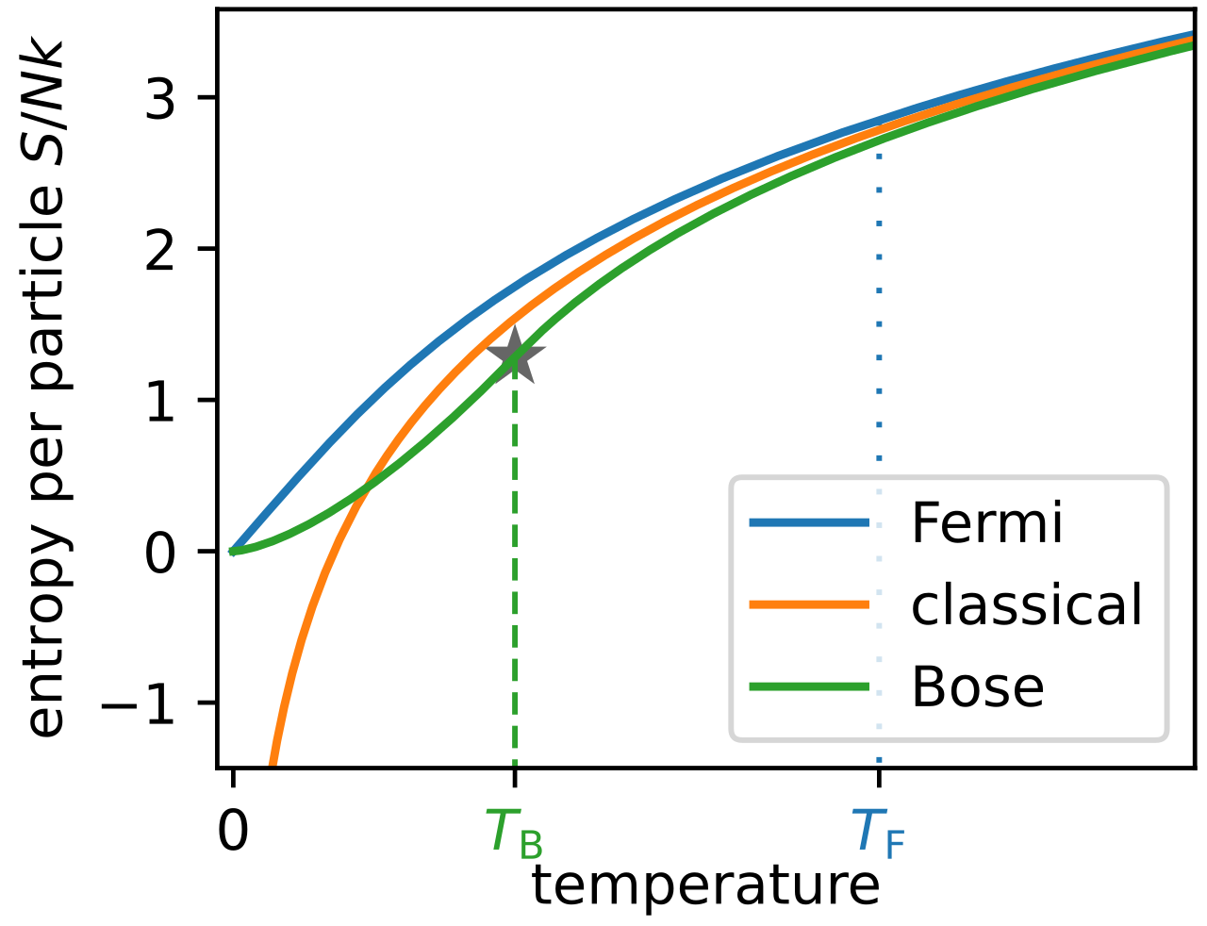


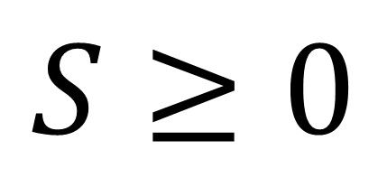


Wikipedia
Third law of
thermodynamics
Temperature/entropy
curve for ideal gases
to minus infinity!
Every substance has a finite positive entropy, but at the absolute zero of temperature the entropy may become zero, and does so become in the case of perfect crystalline substances.
$$p$$
G. N. Lewis and M. Randall, Thermodynamics and the
free energy of chemical substances (McGraw-Hill, 1923)
$$S≥0$$
$$S=\log{ΔqΔp}$$
$$q$$
For a single microstate
$$S=\log{0}=−∞$$
Classical physics allows arbitrarily small entropy…
… but thermodynamics doesn’t!!!

Slide 14
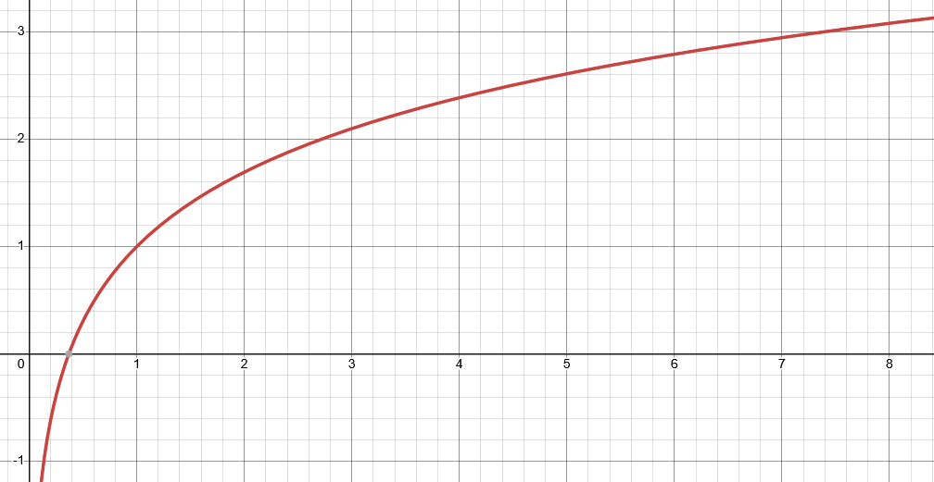

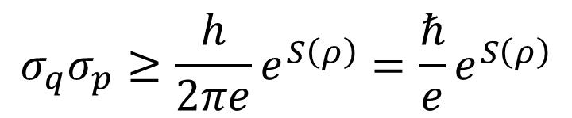


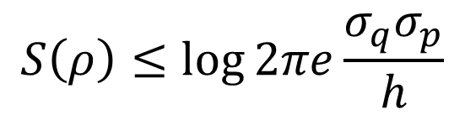
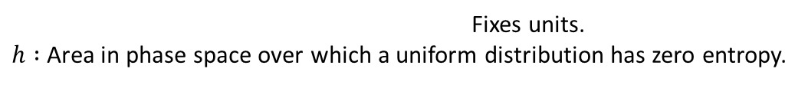


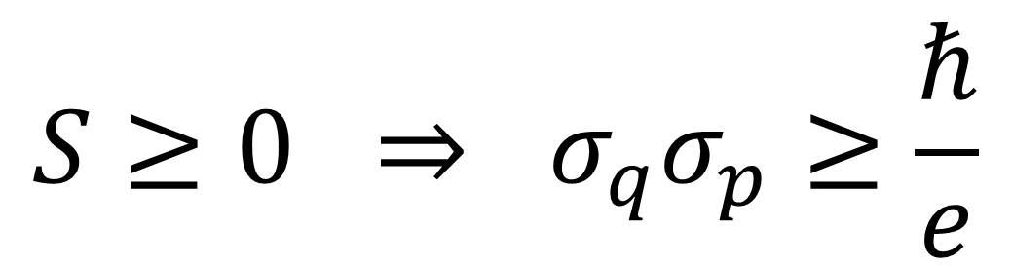
Classical uncertainty principle
Found. Phys. 52, 40 (2022)
$S\left(ρ\right)=−∫ρ\log{ ρ}dqdp$
$S\left(ρ\right)=−∫ρ\log{hρ}dqdp$
$$S$$
Fixes units.
$h :$ Area in phase space over which a uniform distribution has zero entropy.
excluded by gaussian bound
$$S\left(ρ\right)≤\log{2πe\frac{σ_{q}σ_{p}}{h}}$$
$$\frac{σ_{q}σ_{p}}{ℏ}$$
Gaussian maximizes entropy
for a given uncertainty
excluded by 3rd law of thermodynamics
$$σ_{q}σ_{p}≥\frac{h}{2πe}e^{S\left(ρ\right)}=\frac{ℏ}{e}e^{S\left(ρ\right)}$$
Entropy puts a lower bound
on the uncertainty
$$S≥0 ⇒ σ_{q}σ_{p}≥\frac{ℏ}{e}$$
https://assumptionsofphysics.org/autogen/briefs/004-ClassicalUncertaintyPrinciple.pdf
https://link.springer.com/article/10.1007/s10701-022-00555-z

Slide 15
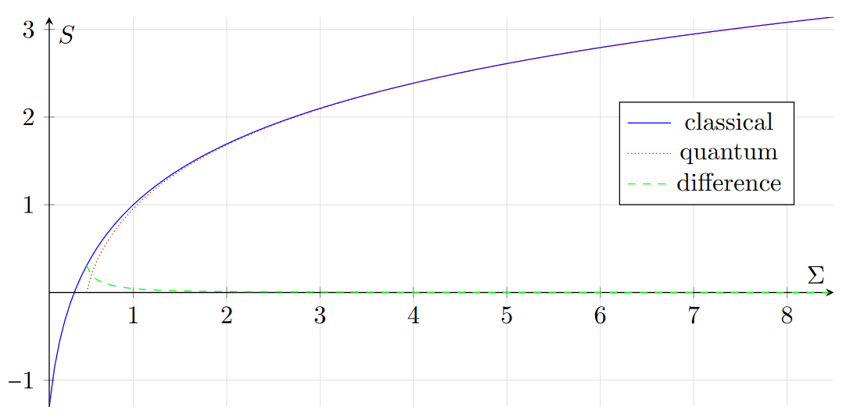
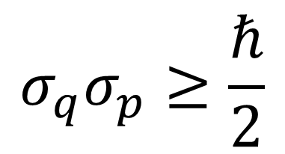



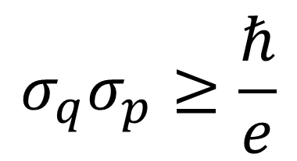
Comparing theories
excluded by gaussian bound
$$σ_{q}σ_{p}≥\frac{ℏ}{e}$$
$$σ_{q}σ_{p}≥\frac{ℏ}{2}$$
classical
quantum
$$\frac{σ_{q}σ_{p}}{ℏ}$$
2.71828…
excluded by 3rd law of thermodynamics
Entropy of quantum states is already non-negative
$$S_{C}=\ln{eσ}$$
The gaussian bound quickly becomes very similar across theories
$S_{Q}=\left(σ+\frac{1}{2}\right)\ln\left(σ+\frac{1}{2}\right)−\left(σ−\frac{1}{2}\right)\ln\left(σ−\frac{1}{2}\right)$
Quantum mechanics incorporates the third law.
Classical mechanics does not.
Is this the only difference?
Notes:
Quantum: entropy of a Gaussian mixed state as a fcn of the uncertainty sigma_q*sigma_p/hbar

Slide 16
Suppose the lower bound on the entropy is the only difference,
then in the limit of high entropy of quantum mechanics we should recover classical mechanics
Can we?

Slide 17
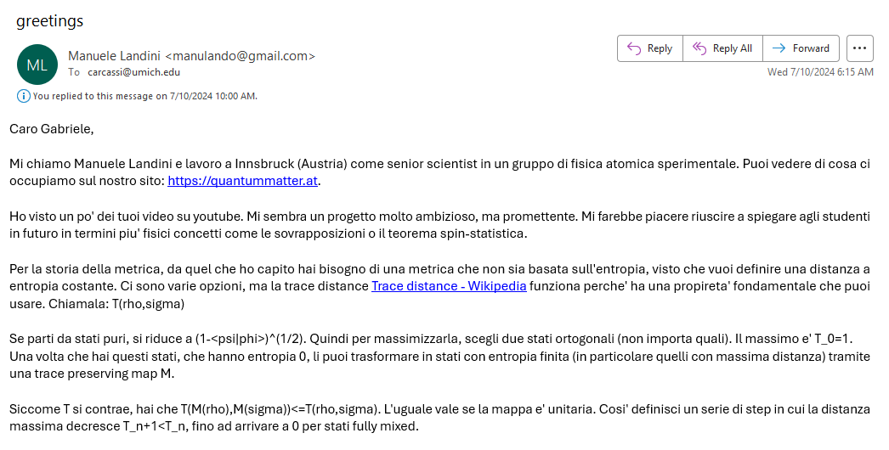
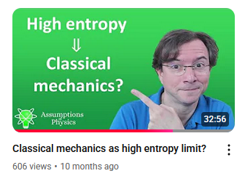
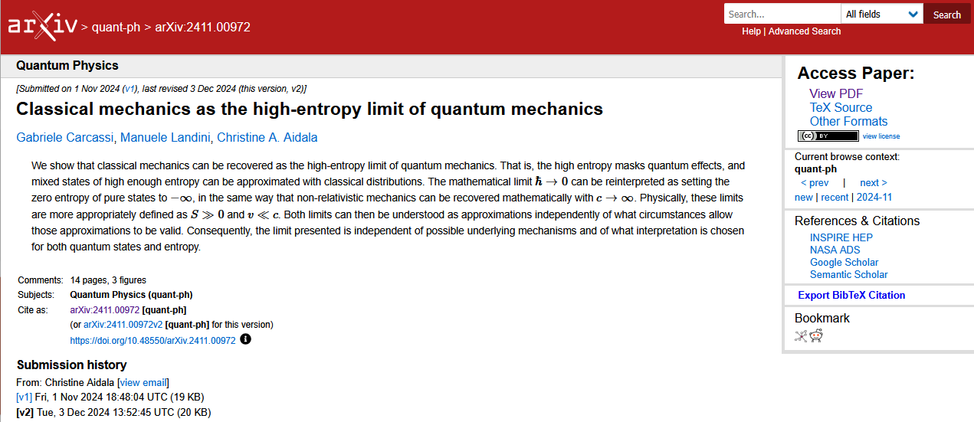
06/01/2024

Slide 18
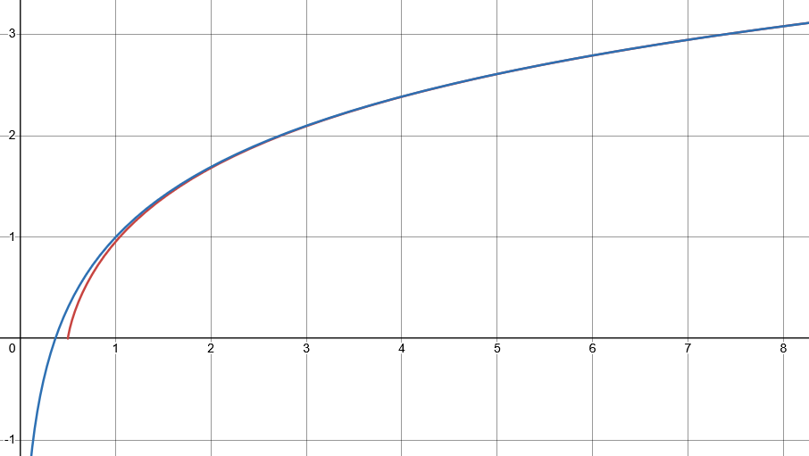

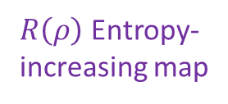




Looking for a map $R(ρ)$ that increases entropy of all mixed states,
such that every level set of entropy maps to another level set
In the limit!
$$S$$
$⇒$ Unitary maps must be
mapped to unitary maps
excluded by gaussian bound
$R\left(ρ\right)$ Entropy-
increasing map
Unitary map
$$\frac{σ_{x}σ_{p}}{ℏ}$$
excluded by 3rd law of thermodynamics
classical
quantum
https://arxiv.org/pdf/2411.00972
https://iopscience.iop.org/article/10.1088/1402-4896/ae3a20

Slide 19
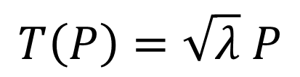
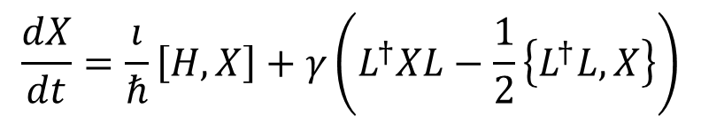
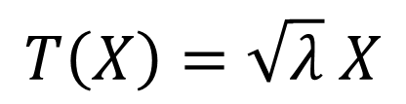

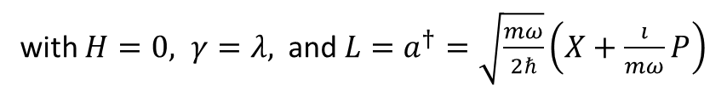

In classical mechanics – stretch phase space
$$S\left(R\left(ρ\right)\right)=S\left(ρ\right)+\log{λ}⟺\left\{R\left(x\right),R\left(p\right)\right\}=λ\{x,p\}$$
In quantum mechanics
Jacobian is a constant: all volumes rescaled by the same factor
Stretching map
$$\left[R\left(X\right),R\left(P\right)\right]=λ\left[X,P\right]$$
Pure stretching map
$$T\left(X\right)=\sqrt{λ} X$$
$$T\left(P\right)=\sqrt{λ} P$$
Need to take care of operator ordering!!!
Infinitesimal pure
stretching map must satisfy:
$$\frac{dX}{dt}=\frac{ı}{ℏ}\left[H,X\right]+γ\left(L^{†}XL−\frac{1}{2}\left\{L^{†}L,X\right\}\right)$$
Lindblad equation
(open quantum system)
with $H=0, γ=λ,$and $L=a^{†}=\sqrt{\frac{mω}{2ℏ}}\left(X+\frac{ı}{mω}P\right)$
No unitary/conservative part:
purely entropy-increasing
Need anti-normal ordering ($aa^{†}$), associated with
Husimi Q quasiprobability distribution in phase space
Physica Scripta 101, 065105 (2026)

Slide 20
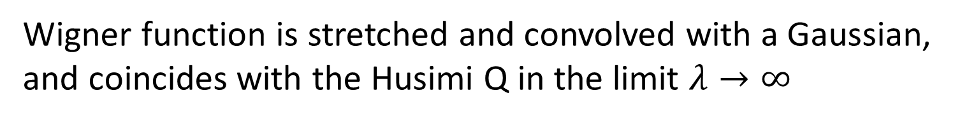
Effects of stretching map on phase-space representations
Husimi Q distribution is simply stretched
Wigner function is stretched and convolved with a Gaussian, and coincides with the Husimi Q in the limit $λ→∞$

Slide 21
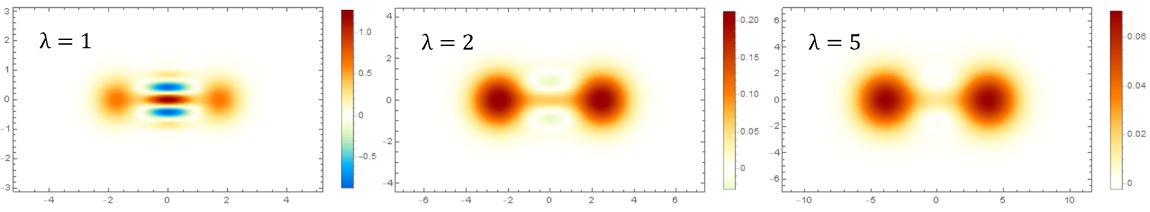
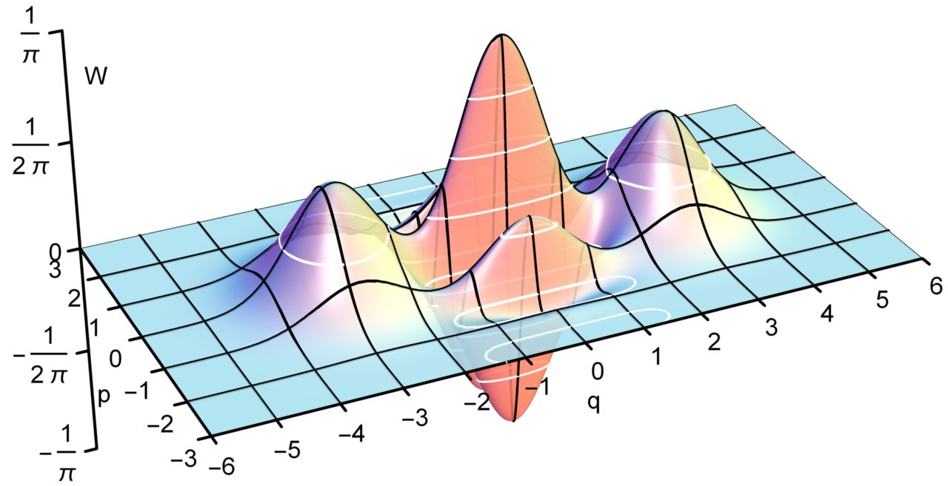
Stretching a cat state
- a quantum superposition of two macroscopically distinct states
Physica Scripta 101, 065105 (2026)
Wigner quasiprobability distribution for a cat state
Wikipedia
Notes:
e.g. two coherent states of a single optical mode of light

Slide 22
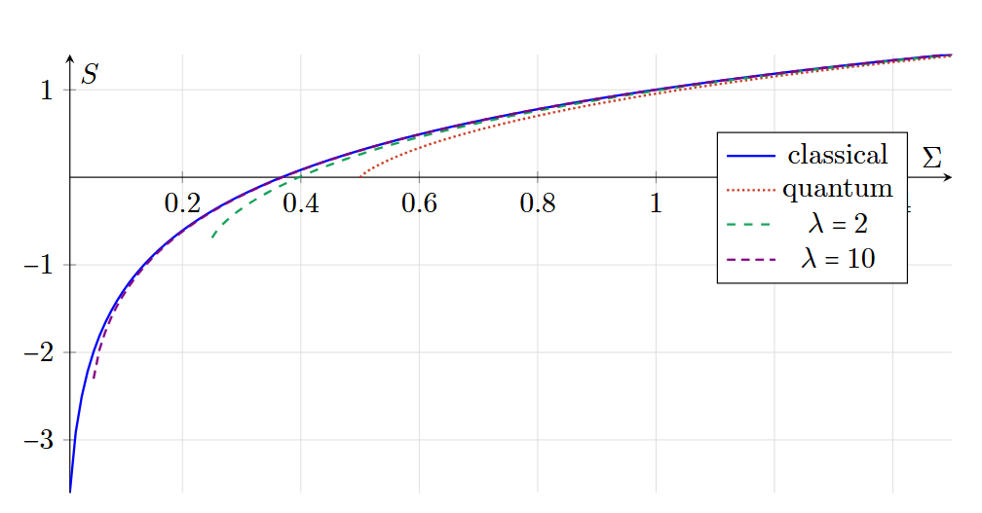
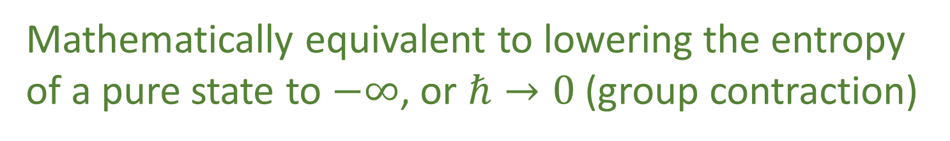
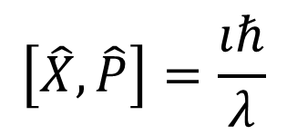



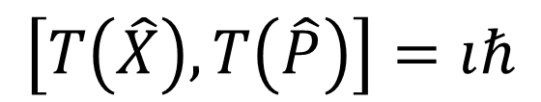
Another perspective: move the pure states to minus infinite entropy
Instead of
$$\left[X,P\right]=ıℏ$$
$$\left[T\left(X\right),T\left(P\right)\right]=λıℏ$$
Redefine original space such that
$$\left[\hat{X},\hat{P}\right]=\frac{ıℏ}{λ}$$
$$\left[T\left(\hat{X}\right),T\left(\hat{P}\right)\right]=ıℏ$$
$λ→∞ ⇒ \frac{ℏ}{λ}→0$
Mathematically equivalent to lowering the entropy of a pure state to $−∞$, or $ℏ→0$ (group contraction)
Physica Scripta 101, 065105 (2026)

Slide 23


“$c→∞$”
Speed
Classical Mechanics | Relativistic Mechanics
Quantum Mechanics | Quantum Field Theory
“$ℏ→0$”
Entropy
No-mechanism limit
(same as non-relativistic limit)
Physica Scripta 101, 065105 (2026)

Slide 24
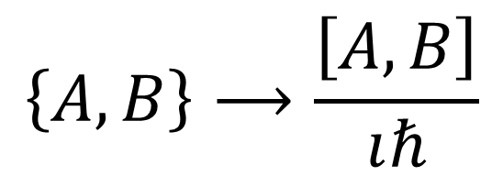
$$\left\{A,B\right\}⟶\frac{\left[A,B\right]}{ıℏ}$$
Dirac’s correspondence principle: give me a theory with an entropic lower bound that recovers the classical one at high entropy
Only one way to do it
Moyal bracket is the unique one-parameter Lie-algebraic deformation of the Poisson bracket
Quantizing a classical theory means putting a lower bound on the entropy
Physica Scripta 101, 065105 (2026)
Notes:
In the Weyl–Wigner representation, the quantum commutator is represented by the
Moyal bracket. A result from deformation theory states that, up to a change of representation, the Moyal bracket is the unique non-trivial formal differentiable deformation of the Poisson bracket on canonical phase space. Moreover, it reduces to the Poisson bracket when hbar becomes negligible.

Slide 25

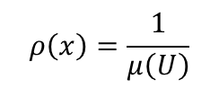

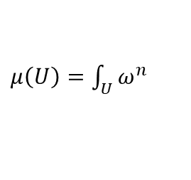



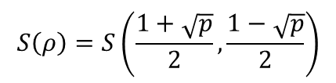
Geometry is entropy!
The geometric structures of both classical and quantum mechanics are equivalent to the entropic structures
Standard probability
$$ρ\left(x\right)=\frac{1}{μ\left(U\right)}$$
Thermodynamics/Statistical mechanics
are not built on top of mechanics
$μ\left(U\right)=\int_{U}{ω^{n}}$
Symplectic manifold
(phase space)
Mechanics is the ideal case of
thermodynamics/statistical mechanics
$ρ$ uniform over $U$
Information theory
$$S\left(ρ\right)=\log{μ\left(U\right)}$$
$$\left\langle ψ | φ\right\rangle$$
Quantum probability
$$p\left(ψ | φ\right)={\left|\left\langle ψ | φ\right\rangle \right|}^{2}$$
Projective Hilbert space
$$ρ=\frac{1}{2}ρ_{ψ}+\frac{1}{2}ρ_{φ}$$
Quantum information theory
$$S\left(ρ\right)=S\left(\frac{1+\sqrt{p}}{2},\frac{1−\sqrt{p}}{2}\right)$$

Slide 26
Illuminating paradoxes and developing standards of rigor

Slide 27

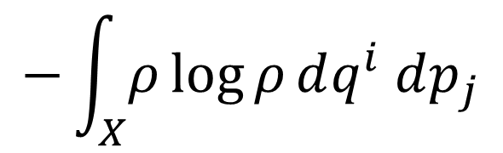

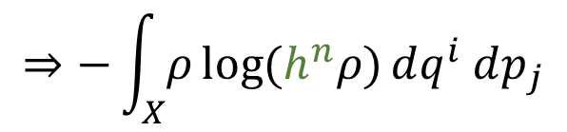
Poor dimensional checking in statistical mechanics
Example 1: Definition of Gibbs entropy
$$−\int_{X}{ρ\log{ρ}dq^{i} dp_{j}}$$
$$⇒−\int_{X}{ρ\log{(h^{n}ρ)}dq^{i} dp_{j}}$$
Density in phase space
is not a pure number!
Need to make a dimensionless argument by multiplying by the volume in phase space corresponding to zero entropy for a uniform distribution
Example 2: When deriving Sackur–Tetrode equation for the entropy of a monatomic ideal gas
You can’t “approximate physical dimensions”!!!
$$length^{N}≄length^{N−1}$$

Slide 28
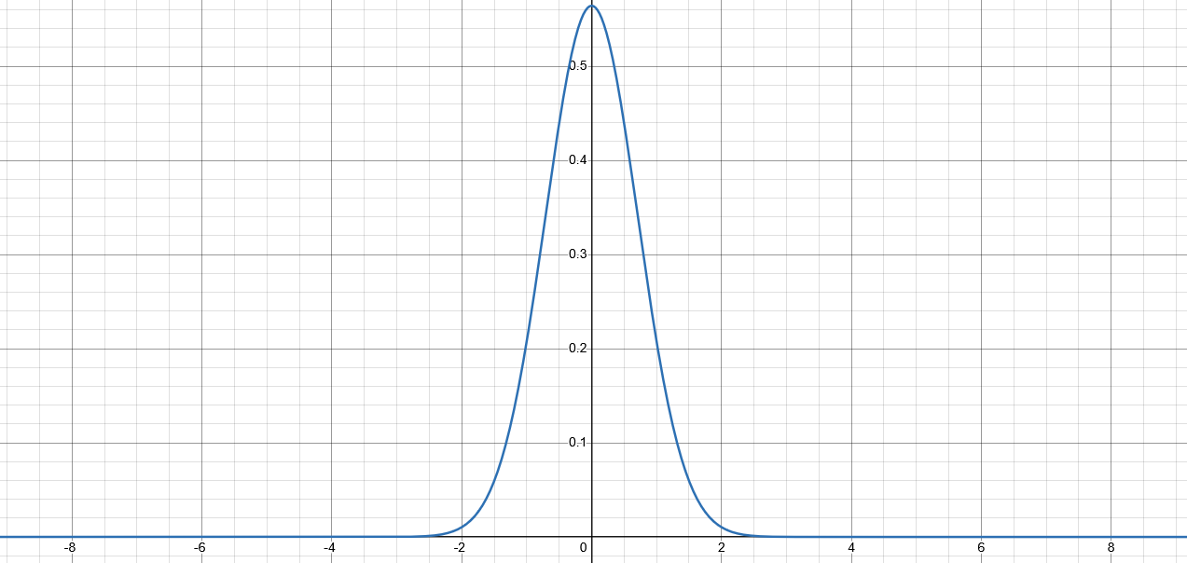
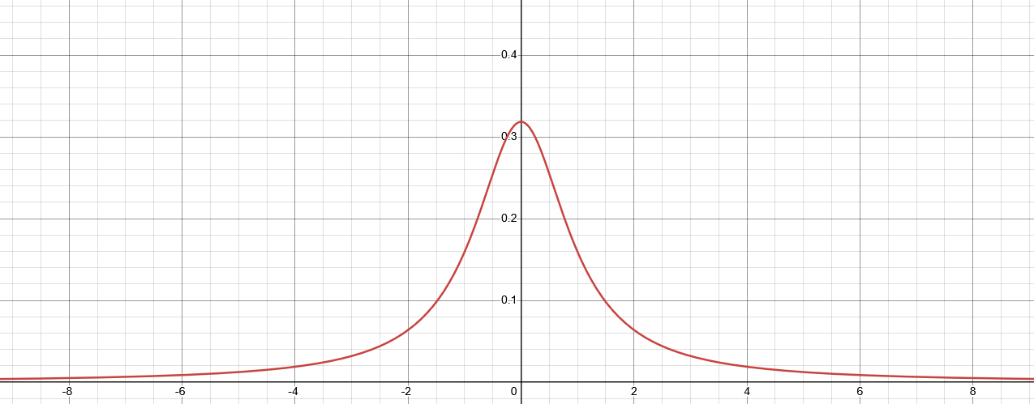















Inconsistent expectations in Hilbert spaces
Quantum Stud.: Math. Found. 12, 13 (2025)
$$ψ\left(x\right)=\sqrt{\frac{e^{−x^{2}}}{\sqrt{π}}}$$
Re-expressing the same state in a different coordinate system can turn a finite expectation value into an infinite one—unphysical!!!
$$∫{\left|ψ\right|}^{2}dx=1$$
$$y=\tan\left(\frac{π}{2}\operatorname{erf}\left(x\right)\right)$$
$$ρ_{ψ}\left(x\right)=\frac{e^{−x^{2}}}{\sqrt{π}}$$
$${\left\langle X^{2}\right\rangle }_{ψ}=\frac{1}{2}$$
$ψ\left(y\right)=ψ\left(x\right)\sqrt{\frac{dx}{dy}}$
Expectation of position² finite in terms of $x$…
$$φ\left(y\right)=\sqrt{\frac{1}{π\left(y^{2}+1\right)}}$$
Expectations can also oscillate between finite and infinite in finite time—unphysical!!!
$$∫{\left|φ\right|}^{2}dy=1$$
$x\left(x_{0},t\right)=x_{0}\cos^{2}{\frac{πt}{2}}+\tan\left(\frac{π}{2}\operatorname{erf}\left(x_{0}\right)\right)\sin^{2}{\frac{πt}{2}}$
$$ρ_{φ}\left(y\right)=\frac{1}{π\left(y^{2}+1\right)}$$
$${\left\langle Y^{2}\right\rangle }_{φ}→∞$$
…but infinite in terms of $y$!
Every continuous linear operator defined on the whole Hilbert space is bounded $⇒$ position/momentum/energy/number of particles are not defined on the whole Hilbert space!!!
https://arxiv.org/pdf/2308.06669
https://link.springer.com/article/10.1007/s40509-024-00357-0

Slide 29




Inconsistent convergence in Hilbert spaces
Consider the sequence of quantum harmonic oscillator states given by:
$\left|ψ_{i}\right\rangle =\sqrt{\frac{i−1}{i}}\left|0\right\rangle +\sqrt{\frac{1}{i}}\left|i\right\rangle$ for $i=1,…,∞$
In the limit that $i→∞$, the state converges to the ground state:
$$\left|ψ_{i}\right\rangle →\left|0\right\rangle$$
But the energy level converges to the first level—inconsistent!!
$$\left\langle ψ_{i}\left|\hat{N}\right|ψ_{i}\right\rangle =\frac{i−1}{i}\left\langle 0\left|\hat{N}\right|0\right\rangle +\frac{1}{i}\left\langle i\left|\hat{N}\right|i\right\rangle$$
$$=\frac{i−1}{i}\left(0\right)+\frac{1}{i}\left(i\right)=1→1$$
https://assumptionsofphysics.org/autogen/briefs/006-InconsistentConvergence.pdf

Slide 30
Identifying logical dependencies and clarifying base conditions

Slide 31













Assumptions of classical mechanics
$$\frac{dq^{i}}{dt}=\frac{∂H}{∂p_{i}}$$
$$\frac{dp_{i}}{dt}=−\frac{∂H}{∂q^{i}}$$
$$δ\int_{γ}{L\left(q^{i},{\dot{q}}^{i},t\right)dt}=0$$
$$[q^{i},p_{i}]$$
(IR) Infinitesimal reducibility
Classical Phase Space
Hamiltonian
Mechanics
Lagrangian
Mechanics
+
+
+
Massive particles under potential forces
(DR) Determinism
/Reversibility
weak
+
(IND) Degree of freedom independence
(KE) Kinematic Equivalence
full
$$H=\frac{1}{2m}\left(p_{i}−𝔮A_{i}\right)g^{ij}\left(p_{j}−𝔮A_{j}\right)+𝔮V$$
$$ρ_{1}ρ_{2}⇒ρ$$
$$p$$
$$p$$
$$z$$
$$y$$
$$q$$
$$q$$
$$x$$

Slide 32


Classical conditions and their relationships
MPPF
Core assumptions
Physical theories
CST: Classical STates
NM: Newtonian Mechanics
HM: Hamiltonian Mechanics
LM: Lagrangian Mechanics
MPPF: Massive Particles under Potential Forces
LM
IR: Infinitesimal Reducibility
IND: INDependent DOF
W/FKE: Weak/Full Kinematic Equivalence
DR: Determinism+Reversibility
FKE
NM
HM
WKE
CST
DR
Each assumption is an equivalence class of multiple conditions
IR
IND
https://assumptionsofphysics.org/book/AssumptionsOfPhysicsV3.0.pdf#section.1.1.4

Slide 33

Currently applying Reverse Physics methodology
to quantum mechanics
Bunch of things bundled together
How do we analyze this properly?
https://arxiv.org/pdf/2608.27543

Slide 34
Reverse Physics for quantum mechanics:
Some results so far
QP-RAY – Pure states are rays of a complex Hilbert space
Can be classical
+
Not sufficient to distinguish QM from CM, e.g. state space of a classical magnetic dipole is a sphere, which is the complex projective line.
QE-DENS – Ensembles are density matrices
Cannot be classical
+
In CM, the ensemble space is a simplex. In QM, it is not.
BR-BORN – Orthogonal states are mutually exclusive
Must be quantum
=
The fact that orthogonal vectors represent mutually exclusive
ensembles is an additional assumption.
QST:H – Quantum states on a Hilbert space

Slide 35

Developing a base theory for all of physics
Collection of conditions that MUST be true in all physical theories
General physical principles
and requirements
General mathematical framework
Specific assumptions
Classical mechanics
Quantum mechanics
derivation
Thermodynamics
…
specialization
Base theory $≠$ Theory of everything

Slide 36
Foundational pillars
Core constitutive requirements of physical theories:
Experimental verifiability
Reproducibility and ensembles
Ensemble variability
Equilibria

Slide 37





Experimental verifiability
Science is evidence based $⇒$ Statements are associated to experimental tests
Verifiable statement | Test Result
T | SUCCESS (in finite time)
F | UNDEFINED
 | FAILURE (in finite time)
Theoretical statements
$int(A)$ corresponds to the verifiable
part of a statement
$$s$$ | Test
T | S
 | U
F | U
 | F
Verifiable
statements
Possibilities
$∂A$ corresponds to the undecidable
part of a statement
$ext(A)$ corresponds to the falsifiable
part of a statement
Open sets
Points
Borel sets
Experimental verifiability
$⇒$ topology and $σ$-algebra
Experimental relationships must be
topologically continuous
https://assumptionsofphysics.org/book/AssumptionsOfPhysicsV3.0.pdf#section.2.1.1

Slide 38









Reproducibility and ensembles
Scientific laws describe reproducible relationships $⇒$ Ensembles
$$P$$
Ensembles are outputs of repeatable processes
$P_{1}$
$$e_{1}$$
$$S_{p}$$
$$pe_{1}+\left(1−p\right)e_{2}$$
Statistical mixing $⇒$ Linear structures in physics
$P_{2}$
$$e_{2}$$
Note: mixing coefficients are parameters of the preparation, NOT probabilities in the ordinary sense

Slide 39






Ensemble variability
Variability of the elements within an ensemble $⇒$ Entropy
$$e_{1}$$
$$…$$
Mutually exclusive $⟺$ orthogonality
$⇕$
Maximal variability increase
during mixing
$$e_{2}$$
more variability
$$…$$
Variability $⇒$ Probabilities, inner product and geometry
Probability $⟺$ Mixtures of mutually exclusive ensembles
Classical mechanics/probability $⟺$ All pure states are mutually exclusive
Pure states $⟺$ Best preparations $⇎$ No variability

Slide 40






Equilibria
States must exist for at least a short time $⇒$ Equilibria
$$X(t)$$
$$\left\{x\left(t\right),y\left(t\right)\right\}$$
Of system/environment
interactions
that don’t matter/we
are not sensitive to
Of internal processes
at faster scales
that don’t matter/we
are not sensitive to
$$x$$
$$x(t)$$
$$y(t)$$
$$dt$$
Least developed part
This requirement allows us to properly talk about different physical objects
Equilibria $⇒$ Symmetries, differentiability, Lie algebras

Slide 41
Wrapping it up
Assumptions of Physics: different approach to the foundations of physics
  No interpretations, no theories of everything: physically meaningful starting points from which we can rederive the laws and the mathematical frameworks they need
  Physical theories are models that can be empirically tested
    Need to clarify exactly what the realm of applicability of each model is
Reverse Physics: reverse engineer principles from the known laws
  Find physical principles and assumptions from which to rederive the laws
  These starting points must have a clear intuitive meaning for the
  majority of physicists and engineers
  Investigate physics as a whole (no theory is “more fundamental”)

Slide 42
Reverse Physics tells us there are not many “independent concepts” in a physical theory
Extracting principles/assumptions behind the laws gives us solid intuition that cuts across fields and leads to new insights, potentially opening new avenues of research
Offers a powerful new methodology for the foundations of physics, more in line with foundational approaches of other disciplines

Slide 43
Assumptions of Physics is an open research program
Our main output is an open access book: https://assumptionsofphysics.org/book/
All our material is developed on GitHub: https://github.com/assumptionsofphysics
Livestream
discussions
One YouTube channel dedicated to publicize results: https://www.youtube.com/user/gcarcassi
Another YouTube channel dedicated to research: https://www.youtube.com/@AssumptionsofPhysicsResearch
Activities coordinated through a Discord server (contact info@assumptionsofphysics.org for an invite)
Always looking for experts to gain insights and/or help
Always looking for collaborations
Always looking for editors/journals/conferences that are
sympathetic to the mission

Slide 44
Extra

Slide 45





Main goal of the Assumptions of Physics program
Identify a handful of physical starting points from which the basic laws can be rigorously derived
For example:
Infinitesimal reducibility $⇒$ Classical state
Irreducibility $⇒$ Quantum state
https://assumptionsofphysics.org
?
time
time
This also requires rederiving all mathematical structures
from physical requirements
For example:
Science is evidence based $⇒$ scientific theory must be characterized by experimentally verifiable statements $⇒$ topologies and $σ$-algebras

Slide 46
Physical world
(informal system)
Mathematical representation
(formal system)
well-defined
physical
objects
well-defined
mathematical
objects
?
?
?
ill-defined
ill-defined
Current state of the art in theoretical physics

Slide 47
Physical world
(informal system)
Mathematical representation
(formal system)
well-defined
physical
objects
well-defined
mathematical
objects
Physical specifications
Mathematical definition
A mathematical definition is physical if it captures and only captures an aspect of the physical system

Slide 48



Superposition is multi-decomposition
Property of the vector space representation of states in quantum mechanics
Superposition: $\left|φ\right\rangle =c_{1}\left|ψ_{1}\right\rangle +c_{2}\left|ψ_{2}\right\rangle$
$$⇕$$
Multi-decomposition: $ρ=p_{φ}ρ_{φ}+p_{\hat{φ}}ρ_{\hat{φ}}=p_{1}ρ_{ψ_{1}}+p_{2}ρ_{ψ_{2}}$
Impossible in classical probability
(i.e. Choquet simplex)
Property of distinguishability of preparations
Linear transformations
$$⇕$$
Output of mixtures = mixture of outputs
Indistinguishability of different mixtures
$$⇕$$
No physical process can depend on them
https://assumptionsofphysics.org/autogen/briefs/002-SuperpositionAndMultipleMixtures.pdf

Slide 49




Non-linear representation in QM
This map introduces a total phase based on all coefficients
const. $θ∈(0,2π)$
$$m\left(c_{+}\left|z^{+}\right\rangle +c_{−}\left|z^{−}\right\rangle \right)=e^{ıθ\frac{{\left|c_{+}\right|}^{2}}{{\left|c_{+}\right|}^{2}+{\left|c_{−}\right|}^{2}}}\left(c_{+}\left|z^{+}\right\rangle +c_{−}\left|z^{−}\right\rangle \right)$$
Non-linear map…
$$\frac{\left\langle m\left(ψ\right) | m\left(φ\right)\right\rangle \left\langle m\left(φ\right) | m\left(ψ\right)\right\rangle }{\left\langle m\left(ψ\right) | m\left(ψ\right)\right\rangle \left\langle m\left(φ\right) | m\left(φ\right)\right\rangle }=\frac{\left\langle ψ | φ\right\rangle \left\langle φ | ψ\right\rangle }{\left\langle ψ | ψ\right\rangle \left\langle φ | φ\right\rangle }$$
… that preserves the physics
(i.e. Born rule)
Linearity is a mathematical convenience,
not a physical necessity

Slide 50





Geometry is entropy
Classical mechanics
Quantum mechanics
$S\left(ρ_{U}\right)=\log{μ\left(U\right)}=\log{\int_{U}{ω}}$
$S\left(\frac{1}{2}ρ_{ψ}+\frac{1}{2}ρ_{φ}\right)=I\left(\frac{1+\left|\left\langle ψ | φ\right\rangle \right|}{2},\frac{1−\left|\left\langle ψ | φ\right\rangle \right|}{2}\right)$
$$=−\frac{1+\left|\left\langle ψ | φ\right\rangle \right|}{2}\log{\frac{1+\left|\left\langle ψ | φ\right\rangle \right|}{2}}−\frac{1−\left|\left\langle ψ | φ\right\rangle \right|}{2}\log{\frac{1−\left|\left\langle ψ | φ\right\rangle \right|}{2}}$$
Symplectic form determines and is determined by the entropy of all uniform joint and marginal (DOF) distributions
Born rule determines and is determined by the entropy of all equal mixtures of pairs of pure states
$$∂_{α}g_{βγ}−∂_{β}g_{αγ}$$
$$ω_{ab}=\left[\begin{matrix}−mG_{αβγ}u^{γ}−qF^{αβ} & mg_{αβ} \\ −mg_{αβ} & 0\end{matrix}\right]$$
If you write the symplectic form in terms of position and velocity rather than position and conjugate momentum, metric tensor appears

Slide 51

Uncertainty and entropy
In both classical and quantum mechanics, Gaussian states maximize entropy for a single independent DOF at fixed uncertainty, or equivalently, minimize uncertainty at fixed entropy
If we fix the entropy $S$, will have $ΔxΔp≥Σ(S)$
Specific value of the uncertainty $Σ$ depends on $S$ and on whether we’re using classical or quantum mechanics, but relationship always saturated by Gaussian states with no correlation between $x$ and $p$
Classical mechanics:
Quantum mechanics:
See e.g. Pathria + Beale, Statistical Mechanics, Academic Press, 2022 or
Cover + Thomas, Elements of Information Theory, Wiley, 2006.
See e.g. Weedbrook et al., Reviews of Modern Physics 84:621, 2012.

Slide 52



Reinterpreting traditional approaches:
Blackbody radiation
Ultraviolet catastrophe – a crisis for classical physics
Failure of classical mechanics was a failure of classical mechanics with respect to statistical mechanics
Classical: Rayleigh-Jeans
Quantum: Planck
Traditional limit:
Low frequency
Alternative limit:
High temperature (low $β$)
Low $β↔$ high temperature/high entropy

Slide 53

Reinterpreting traditional approaches:
Wigner’s quantum correction for thermodynamic equilibrium
Phys. Rev. 40:749–759, 1932
Considered Wigner distribution of a system in thermal equilibrium at inverse temperature $β$:
  With $\hat{ρ}=e^{−β\hat{H}}$ the mixed state that maximizes entropy at given average energy (Boltzmann dist.)
Transformed Hamiltonian to express it as the sum of classical and quantum terms and then expanded the Wigner distribution in powers of $ℏ$
  Quantum corrections only come in at second order in $ℏ$, recovering classical mechanics in the limit as $ℏ→0$

Slide 54





Reinterpreting traditional approaches:
Wigner’s quantum correction for thermodynamic equilibrium
Transformed
Hamiltonian
classical
Hamiltonian
quantum corrections
$$≡\hat{Q}$$
Wigner distribution in terms of $\tilde{H}$
Can expand this in powers of $β$ for $β≪1$, rather than powers of $ℏ$
First order:
Show first-order quantum correction in $β$ is zero by inserting an identity in the momentum eigenbase:
Thus, quantum corrections only enter at second order in $β$, recovering classical mechanics in the limit as $β→0$
$$⇒$$
classical
first-order quantum
classical
When entropy $S→∞$, $β→0$
second-order quantum

Slide 55












Maximally mixed state obtained by uncertainty on the open slit (uncertainty on classical variable)
Maximally mixed state obtained by uncertainty on the phase difference (quantum variable)
$$|s_{1}⟩$$
$$|i_{π}⟩$$
$$m$$
$$|i_{0}⟩$$
$$s_{1}$$
$$s_{2}$$
$$|s_{2}⟩$$
The case where we randomize the phase is indistinguishable from the case where we randomize the path
Entropic aliasing: high-entropy states allow (approximate) decomposition over incompatible observables

Slide 56

Linblad master equation for open quantum systems
Infinitesimal
stretching map
must obey
$$\frac{dX}{dt}=\frac{ı}{ℏ}\left[H,X\right]+γ\left(L^{†}XL−\frac{1}{2}\left\{L^{†}L,X\right\}\right)$$
Unitary/conservative part
Non-unitary/non-conservative part

Slide 57




Quantum pure stretching map
$$T\left(X\right)=\sqrt{λ} X$$
$$T\left(P\right)=\sqrt{λ} P$$
What about products?
Only unitary maps preserve products!
1. Suppose $T\left(ρ_{1}ρ_{2}\right)=T\left(ρ_{1}\right)T(ρ_{2})$. Since pure states are exactly the density matrices for which $ρ^{2}=ρ$, $T\left(ρ\right)=T\left(ρ^{2}\right)=T\left(ρ\right)T\left(ρ\right)=T{\left(ρ\right)}^{2}$ and therefore $T$ maps pure states to pure states. Therefore, it is a unitary map!
2. Suppose $T\left(AB\right)=T\left(A\right)T\left(B\right)$. Then $T\left(\left[A,B\right]\right)=T\left(AB\right)−T\left(BA\right)=\left[T\left(A\right),T\left(B\right)\right]$
Which product ordering recovers
$\left\langle T\left(x^{n}p^{m}\right)\right\rangle ={\left(\sqrt{λ}\right)}^{n+m}\left\langle x^{n}p^{m}\right\rangle$?

Slide 58


Symmetrized operator averages
Wikipedia
We take the average of all permutations
Also given by the expectations of the Wigner function
A stretching map that rescales symmetrized operator averages is a stretching map in phase space for the Wigner function…
… and it can’t work!!!

Slide 59
Symmetrized operator averages
Wigner functions can have negative values, but they must be restricted to “small” regions
A stretching map would make those regions arbitrarily large, so it can’t map valid quantum states to valid quantum states
Wikipedia
Symmetrized operator averages are ruled out!

Slide 60




Normal ordering
$$a=\sqrt{\frac{mω}{2ℏ}}\left(X+\frac{ı}{mω}P\right)$$
$$a^{†} =\sqrt{\frac{mω}{2ℏ}}\left(X+\frac{ı}{mω}P\right)$$
For the vacuum state we have $a\left|0\right\rangle =0$. The mean for all expectations for the vacuum state is zero. Therefore, after the map, all expectations are zero. Which means the vacuum is mapped to the vacuum. Entropy is not increased for all states!
Normal ordering is ruled out!

Slide 61




Anti-normal ordering
$$a=\sqrt{\frac{mω}{2ℏ}}\left(X+\frac{ı}{mω}P\right)$$
$$a^{†} =\sqrt{\frac{mω}{2ℏ}}\left(X+\frac{ı}{mω}P\right)$$
Also given by the expectations
of the Husimi Q function
$T_{Q}$ stretches the Husimi Q…
… which is non-negative!!!
Maurice de Gosson

Slide 62










So, we want:
Lindblad
master
equation
$$\frac{dX}{dt}=\frac{ı}{ℏ}\left[H,X\right]+γ\left(L^{†}XL−\frac{1}{2}\left\{L^{†}L,X\right\}\right)$$
We set
$$H=0$$
$$L=a^{†}$$
Recall $\left[a,a^{†}\right]=1$
$$\left[a,{\left(a^{†}\right)}^{m}\right]=m{\left(a^{†}\right)}^{m−1}$$
$$\frac{d}{dt}a^{n}{\left(a^{†}\right)}^{m}=γ\left(aa^{n}{\left(a^{†}\right)}^{m}a^{†}−\frac{1}{2}aa^{†}a^{n}{\left(a^{†}\right)}^{m}−\frac{1}{2}a^{n}{\left(a^{†}\right)}^{m}aa^{†}\right)$$
$$\left[a^{n},a^{†}\right]=na^{n−1}$$
$$=γ\left(aa^{n}{\left(a^{†}\right)}^{m}a^{†}−\frac{1}{2}aa^{n}{\left(a^{†}\right)}^{m}a^{†}−\frac{1}{2}a\left[a^{†},a^{n}\right]{\left(a^{†}\right)}^{m}−\frac{1}{2}aa^{n}{\left(a^{†}\right)}^{m}a^{†}−\frac{1}{2}a^{n}\left[{\left(a^{†}\right)}^{m},a\right]a^{†}\right)$$
$$=γ\left(−\frac{1}{2}a\left(−na^{n−1}\right){\left(a^{†}\right)}^{m}−\frac{1}{2}a^{n}\left(−m{\left(a^{†}\right)}^{m−1}\right)a^{†}\right)$$
$${\left(\sqrt{λ}\right)}^{n+m}$$
$$=\frac{γ}{2}\left(n+m\right)a^{n}{\left(a^{†}\right)}^{m}$$
$$⇒\left(a^{n}{\left(a^{†}\right)}^{m}\right)\left(t\right)=e^{\frac{γ}{2}t\left(n+m\right)}a^{n}{\left(a^{†}\right)}^{m}$$
first-order linear ODE

Slide 63


Effects of stretching map on phase space representations
Husimi Q is simply stretched
Wigner function is stretched and convolved with a gaussian, and coincides with the Husimi Q in the limit $λ→∞$

Slide 64


Quantum pure states are not sufficient to distinguish quantum and classical mechanics
State space of a classical magnetic dipole is a sphere,
which is the complex projective line
In general, every finite-dimensional complex projective space is a symplectic manifold, and therefore allows classical Hamiltonian mechanics
https://assumptionsofphysics.org/autogen/briefs/005-PureStatesNotEnough.pdf
https://arxiv.org/pdf/2608.27543

Slide 65

Quantum ensembles rule out classical mechanics
Though we lack a definition of simplex that works in the infinite-dimensional case
In classical mechanics, every ensemble is identified by a UNIQUE probability measure on pure states (i.e. ensemble space is a simplex)
In quantum mechanics, there is NO unique probability measure

Slide 66


The ensemble space is not sufficient to characterize QM
The fact that orthogonal vectors
represent mutually exclusive ensembles
is an additional assumption
https://arxiv.org/pdf/2608.27543

Slide 67














Reversing phase space
Erkenntnis 90, 443 (2025)
Stud Hist Phil Sci B 71, 082020, 60-71 (2020)
Each unit variable (i.e. coordinate) paired with a conjugate of inverse units: number of states $ΔqΔk$is invariant
$\hat{q}=100 cm/m q$
$$x↦x^{3}$$
$$1$$
$Δk=1 m^{−1}$
$$1$$
$Δ\hat{k}=0.01 cm^{−1}$
$$x$$
$$x^{3}$$
$Δ\hat{q}=100 cm$
$Δq=1 m$
Density, entropy, uniform distributions
NOT in general coordinate invariant
Phase-space (symplectic) structure is the only one that supports coordinate-invariant density, entropy, state count
Invariance of entropy/state count + DOF independence
$⟺$ structure of phase space (i.e. conjugate pairs)
https://philsci-archive.pitt.edu/22202/1/Hamiltonian_Privilege_preprint.pdf
https://link.springer.com/article/10.1007/s10670-023-00708-0

Slide 68
Principle of least action
- one DOF
Sci Rep 13, 12138 (2023)
https://arxiv.org/pdf/2208.06428
https://www.nature.com/articles/s41598-023-39145-y

Slide 69

Required background
Hamiltonian mechanics
  Hamilton’s equations: $\frac{dq}{dt}=\frac{∂H}{∂p}$ $\frac{dp}{dt}=−\frac{∂H}{∂q}$
Lagrangian mechanics
  Action is the integral of the Lagrangian over a given path: $𝒜\left[γ\right]=\int_{γ}{L\left(q\left(t\right),\dot{q}\left(t\right), t\right)dt}$
  Actual evolutions are the paths that make the action stationary: $δ𝒜=0$
  Lagrangian is the Legendre transform of the Hamiltonian: $L=p\dot{q}−H$
Vector calculus
  Given a vector field $\vec{v}$, a field line is a line always tangent to the field
  The divergence $\vec{∇}⋅\vec{v}$ is the flow of the field
  through an infinitesimal closed region
  A divergence-free field $\vec{∇}⋅\vec{B}=0$ admits a vector potential $\vec{A}$
  such that $\vec{B}=\vec{∇}×\vec{A}$

Slide 70



Action: $𝒜\left[γ\right]=\int_{γ}{L\left(q\left(t\right),\dot{q}\left(t\right), t\right)dt}$
Does not always work!
Lagrangian: $L=T−U$
Lagrangian for particle with charge $𝔮$:
$$L=\frac{1}{2}mv^{2}+𝔮\vec{v}⋅\vec{A}−𝔮V$$
Kinetic
???
Potential

Slide 71







Displacement
field
Tells us how states “move”
Scientific Reports 13, 12138 (2023)
$$p$$
$$\vec{S}=\left[\frac{dq}{dt},\frac{dp}{dt},\frac{dt}{dt}\right]$$
$$q$$
$$γ$$
$$\vec{S}$$
Evolution
$$γ=[q\left(t\right), p\left(t\right), t]$$
$$t$$
Time is both a parameter and a variable
Evolutions are field lines
of the displacement field
Always tangent
to the field
https://arxiv.org/pdf/2208.06428
https://www.nature.com/articles/s41598-023-39145-y

Slide 72






(DR) Determinism
and Reversibility
$$\vec{S}=\left[\frac{dq}{dt},\frac{dp}{dt},\frac{dt}{dt}\right]$$
$$p$$
$$q$$
$$γ$$
$$Σ$$
$$\vec{S}$$
No states are lost or created
(count of states is preserved in time)
$$∯_{Σ}{\vec{S}⋅d\vec{Σ}} =0$$
$$t$$
$⇒$ Divergence-free displacement
$$\vec{∇}⋅\vec{S}=0$$
Vector potential
$$\vec{S}=−\vec{∇}×\vec{θ}$$
Displacement admits a vector potential
Minus sign added to match conventions

Slide 73









$$\vec{θ}=\left[θ_{q},θ_{p},θ_{t}\right]$$
$$\vec{S}=\left[\frac{dq}{dt},\frac{dp}{dt},\frac{dt}{dt}\right]$$
Without loss of generality
Fix gauge: $θ_{a}→θ_{a}−∂_{a}\int_{0}^{p}{θ_{p}dp}$
$$\vec{θ}=\left[θ_{q},0,θ_{t}\right]$$
$$\vec{S}=−\vec{∇}×\vec{θ}$$
$$\vec{θ}=\left[p,0,−H\right]$$
$$S_{t}=∂_{p}θ_{q}−∂_{q}θ_{p}=\frac{dt}{dt}=1$$
$$\vec{θ}=\left[p,0,θ_{t}\right]$$
similar to four-momentum
Rename $θ_{t}$
$$\vec{θ}=\left[p,0,−H\right]$$

Slide 74





$$\vec{S}=\left[\frac{dq}{dt},\frac{dp}{dt},\frac{dt}{dt}\right]$$
$$\vec{S}=−\vec{∇}×\vec{θ}$$
$$\vec{θ}=\left[p,0,−H\left(q,p\right)\right]$$
$$S^{q}=\frac{dq}{dt}=−\left(\frac{∂}{∂p}θ_{t}−\frac{∂}{∂t}θ_{p}\right)=\frac{∂H}{∂p}$$
Hamilton’s equations
$$S^{p}=\frac{dp}{dt}=−\left(\frac{∂}{∂t}θ_{q}−\frac{∂}{∂q}θ_{t}\right)=−\frac{∂H}{∂q}$$
$$S^{t}=\frac{dt}{dt}=−\left(\frac{∂}{∂q}θ_{p}−\frac{∂}{∂p}θ_{q}\right)=1$$

Slide 75




Line integral of $\vec{θ}$
$$p$$
$\int_{γ}{\vec{θ}⋅d\vec{γ}}$
$=\int_{γ}{\left[p,0,−H\right]}$
$⋅\left[\frac{dq}{dt},\frac{dp}{dt},\frac{dt}{dt}\right]dt$
$=\int_{γ}{\left(p\frac{dq}{dt}−H\right)dt}$
$=\int_{γ}{L\left(q,\dot{q},t\right) dt}$
$=𝒜[γ]$
$$q$$
Express in components
$$γ$$
$$\vec{S}$$
$$t$$
Assuming (KE) Kinematic Equivalence:
$$p=p(q,\dot{q},t)$$
The action is the line integral
of the vector potential of the flow of states

Slide 76




Flow between a path $γ$
and its variation $γ′$
$$p$$
$$q$$
$$γ$$
$$Σ$$
$Φ\left[Σ\right]=−\iint_{Σ}{\vec{S}⋅d\vec{Σ}}$
$=\iint_{Σ}{\vec{∇}×\vec{θ}⋅d\vec{Σ}}$
$=\oint_{∂Σ}{\vec{θ}⋅d\vec{γ}}$
$=\int_{γ}{\vec{θ}⋅d\vec{γ}}−\int_{γ^{′}}{\vec{θ}⋅d\vec{γ}}$
$=δ\int_{γ}{\vec{θ}⋅d\vec{γ}}$
$=δ\int_{γ}{L dt}$
$=δ𝒜[γ]$
$$\vec{S}$$
Hamilton
equations
Stokes’ theorem
$$γ′$$
$$t$$
The variation of the action
is the flow between the
path and its variation

Slide 77







If the path $γ$ is an evolution
of the system
$$p$$
$$q$$
$$γ$$
$$Σ$$
$$\vec{S}$$
$Φ\left[Σ\right]=−\iint_{Σ}{\vec{S}⋅d\vec{Σ}}$
$=δ\int_{γ}{\vec{θ}⋅d\vec{γ}}=0$
$$γ′$$
flow is tangent
$$t$$
If the path $γ$ is not an evolution of the system, we can always find a variation $γ′$ such that
Action is stationary over
and only over evolutions
$−\iint_{Σ}{\vec{S}⋅d\vec{Σ}}=δ\int_{γ}{\vec{θ}⋅d\vec{γ}}≠0$

Slide 78

1 DOF of classical phase space
+
Determinism/Reversibility
+
Kinematic equivalence
$$⇕$$
Principle of stationary action

Slide 79
Relativistic mechanics
https://assumptionsofphysics.org/book/AssumptionsOfPhysicsV3.0.pdf#section.1.1.9
J. Phys. Commun. 2 045026 (2018)
https://arxiv.org/abs/1702.07052
http://iopscience.iop.org/article/10.1088/2399-6528/aaba25

Slide 80

Required background
Special relativity
  Space and time coordinates are grouped together: $q^{α}=\left[ct,q^{i}\right]$
  Metric tensor $g_{αβ}$ defines the geometry of space-time (i.e. lengths and angles)
  Using $(−,+,+,+)$ signature: $ds^{2}=−dt^{2}+dx^{2}+dy^{2}+dz^{2}$
  Energy and momentum are grouped together (four-momentum): $p_{α}=\left[−\frac{E}{c},p_{i}\right]$
  Four-velocity is the velocity with respect to proper time (time in the rest frame) and its norm is $−c^{2}$: $u^{α}=d_{τ}q^{α}$ $u^{α}g_{αβ}u^{β}=−c^{2}$
  For a free particle, relationship between four-momentum and
  four-velocity: $p_{β}g^{βα}=p^{α}=mu^{α}$

Slide 81










Want to extend Hamiltonian mechanics to handle change of coordinates
that mix space and time variables
$$q^{α}=\left[t,q^{i}\right]$$
$$\left[q^{i}\left(t\right)\right]→\left[t\left(s\right), q^{i}\left(s\right)\right]$$
Hamiltonian mechanics
on the extended
phase space
Separate time-the-variable from time-the-parameter
Recall
$$θ_{q^{i}}$$
$$θ_{t}$$
$$θ_{a}=\left[p_{i},0,−H\right]$$
$$p_{α}=\left[−E,p_{i}\right]$$
$⇒$ only possible choice for conjugates
Form a covector
$$\frac{dq^{α}}{ds}=\frac{∂ℋ}{∂p_{α}}$$
$$\frac{dp_{α}}{ds}=−\frac{∂ℋ}{∂q^{α}}$$
Hamiltonian constraint
$$ℋ\left(t,q^{i},E,p_{i}\right)=0$$
Not just a conserved quantity

Slide 82














$$q^{α}=\left[t,q^{i}\right]$$
Energy-momentum covector and negative sign for temporal DOF appear in the extended phase space without knowledge of space-time geometry (or $c$)
$$ω=dq^{i}dp_{i}−dtdE$$
$$p_{α}=\left[−E,p_{i}\right]$$
Lorentzian relativity is the only “correct” one
It extends the count of configurations per DOF to the temporal DOF in the correct way
$$ω=dq^{1}dp_{1}+dq^{2}dp_{2}$$
$$ω=dq^{1}dp_{1}−dtdE$$
$$ω$$
$$dq^{1}dp_{1}=ω+dtdE$$
$$dq^{2}dp_{2}$$
States are counted at equal time:
temporal DOF orthogonal to $ω$
2D representation
of 4D relationship
$$dq^{1}dp_{1}$$
$$dq^{1}dp_{1}$$
$$dtdE$$
$$ω$$
Independent DOFs are orthogonal
Pythagoras's formula still present

Slide 83








Example: free particle
in an inertial frame
$$ℋ=\frac{1}{2m}\left(p_{i}δ^{ij}p_{j}−{\left(\frac{E}{c}\right)}^{2}+m^{2}c^{2}\right)$$
$$\frac{dt}{ds}=\frac{∂ℋ}{∂\left(−E\right)}=−\frac{1}{2mc^{2}}\frac{∂}{∂\left(−E\right)}{\left(−E\right)}^{2}=−\frac{1}{2mc^{2}}\left(−2E\right)=\frac{E}{mc^{2}}$$
This Hamiltonian constraint is
the generator for proper time
(i.e. affine parameter $s$
corresponds to proper time)
$$\frac{dq^{i}}{ds}=\frac{∂ℋ}{∂p_{i}}=\frac{1}{2m}\frac{∂}{∂p_{i}}\left(p_{i}δ^{ij}p_{j}\right)=\frac{2δ^{ij}p_{j}}{2m}=\frac{p_{i}}{m}$$
$$\frac{dE}{ds}=−\frac{d\left(−E\right)}{ds}=\frac{∂ℋ}{∂t}=0$$
$$\frac{E}{c}=m\frac{d\left(ct\right)}{ds}$$
four
momentum
four
velocity
$$\frac{dp_{i}}{ds}=−\frac{∂ℋ}{∂q^{i}}=0$$
$$p_{i}=m\frac{dq^{i}}{ds}$$
proper time!

Slide 84








Compare to “standard” way
Generator for proper time
Nice and quadratic
$$ℋ=\frac{1}{2m}\left(p_{i}δ^{ij}p_{j}−{\left(\frac{E}{c}\right)}^{2}+m^{2}c^{2}\right)$$
$$H=c\sqrt{m^{2}c^{2}+p_{i}δ^{ij}p_{j}}$$
Hamiltonian is time generator
$$\frac{dq^{i}}{dt}=\frac{ds}{dt}\frac{dq^{i}}{ds}=\frac{mc^{2}}{E}\frac{p_{i}}{m}$$
$$\frac{dq^{i}}{dt}=\frac{∂H}{∂p_{i}}=c\frac{∂}{∂p_{i}}\sqrt{m^{2}c^{2}+p_{i}δ^{ij}p_{j}}$$
$$=\frac{c}{2}\frac{1}{\sqrt{m^{2}c^{2}+p_{i}δ^{ij}p_{j}}}\frac{∂}{∂p_{i}}\left(m^{2}c^{2}+p_{i}δ^{ij}p_{j}\right)$$
Hamiltonian mechanics on the extended phase-space comes out more naturally and is a nicer formulation
$$=\frac{1}{2}\frac{2δ^{ij}p_{j}}{\sqrt{m^{2}+\frac{p_{i}δ^{ij}p_{j}}{c^{2}}}}=\frac{p_{i}}{\sqrt{m^{2}+\frac{{\left|p_{i}\right|}^{2}}{c^{2}}}}$$
Wait… quadratic?
Can $E$ be negative?
$$\frac{dp_{i}}{dt}=−\frac{∂H}{∂q^{i}}=0$$

Slide 85






Classical anti-particles
This can be negative
$$p$$
$$d_{s}t=∂_{−E}ℋ$$
$$d_{s}q^{i}=∂_{p_{i}}ℋ$$
$$d_{s}(−E)=∂_{t}ℋ$$
$$d_{s}p_{i}=∂_{q^{i}}ℋ$$
$$q$$
$$\frac{dξ^{a}}{ds}$$
$$t$$
Particle: affine parameter aligned with time
Anti-particle: affine parameter anti-aligned with time
Parametrization flows backwards with respect to time
Free particle
Anti-particle
=
negative energy
An evolution cannot
change time alignment

Slide 86




Inconsistent units for quantum observables
Suppose $X$ is an observable
Expectation $\left\langle ψ\left|X\right|ψ\right\rangle$ should have units of $X$
But then $X\left|ψ\right\rangle$ cannot have the same units of $\left|ψ\right\rangle$
But then $X\left|ψ\right\rangle +\left|ψ\right\rangle$ makes no physical sense
Therefore, $X$ cannot be a map within the same space

Slide 87









Tangent vectors in differential geometry
Defined as derivations
$v=\sum_{i}{v^{i}∂_{i}}$
$$v:C^{∞}\left(X\right)→ℝ$$
component
basis
In polar coordinates
Mathematically precise $⇏$ physically precise
$$∂_{r}+∂_{θ}= ???$$
$$\left[m\right]$$
$\left[rad\right]$
Doesn’t work with units
In phase space
$$∂_{q}+∂_{p}= ???$$
$\left[m\right]$
$\left[kg m s^{−1}\right]$

Slide 88














The problem with counting on the continuum
We’d like:
Every state is a single case (i.e. $μ\left(\left\{ψ\right\}\right)=1$)
Finite continuous range carries finite information (i.e. $μ\left(U\right)<∞$)
Count is additive for disjoint sets (i.e. $μ\left(∪U_{i}\right)=∑μ\left(U_{i}\right)$)
Incompatible!
Pick two!
Discard 1 $⇒$ Lebesgue measure
Discard 2 $⇒$ counting measure
sub-additive
Discard 3 $⇒$ “Quantum measure”
$$A$$
Non-orthogonal states: different states but in different contexts; not mutually exclusive
additive
$$C$$
Orthogonal states:
different states all else equal;
mutually exclusive
$$μ\left(U\right)=2^{\sup\left(S\left(hull\left(U\right)\right)\right)}$$
$$B$$
$$μ\left(\left\{A\right\}\right)=2^{0}=1$$
Exponential of the maximum entropy reachable with convex combinations (statistical mixtures) of $U$ (reduces to counting/Liouville measure)
$$μ\left(\left\{A,B\right\}\right)=2^{1}=2$$
$$μ\left(\left\{A,C\right\}\right)<2=μ\left(\left\{A\right\}\right)+μ\left(\left\{C\right\}\right)$$
Quantum mechanics $⇒$ lower bound
on #conf (entropy) on continuous DOF

Slide 89


Conjecture: quantum gravity $⇒$ lower bound on DOF count
#conf
Same problem!
#conf=#DOFs
Every point is a single DOF (i.e. $μ\left(\left\{x\right\}\right)=1$)
Finite volume carries finitely many DOFs (i.e. $μ\left(U\right)<∞$)
Count is additive for disjoint regions (i.e. $μ\left(∪U_{i}\right)=∑μ\left(U_{i}\right)$)
#DOFs
Lower bound
on this…
…requires a lower bound on this
Distant points:
independent DOFs
#DOFs $∼$ Spatial volume $\int_{U}{\sqrt{−g}}d^{3}x$
additive
From QM: Lower bound on state count requires a severe revisitation of particle state space
sub-additive
Close points: DOFs not independent
Does lower bound on DOF count require an equally severe revisitation of space-time?

Slide 90
How do we turn these insights
into a general theory of physics?
Every formal theory starts with primitive objects
Objects that are NOT defined from other objects
We don’t want to kick the can down the road
Are ensembles the correct primitive objects for physical theories? How do we know?

Slide 91







$⇒$ Scientific laws are relationships between ensembles
Preparation
$$P$$
Process
$$U$$
Measurement
$$M$$
$$e_{P}$$
$$e_{U}$$
$$e_{M}$$
Statistical
data
Initial
ensemble
Final
ensemble
Preparation
procedure
$$…$$
Ensemble of outputs

Slide 92


$$t$$
Physics describes the evolution
of a particular system like a movie
$$x\left(t\right)$$

Slide 93
$$t$$
That’s not it!!!
Physics describes the evolution
of a particular system like a movie
$$x\left(t\right)$$

Slide 94
$$t$$
Physics describes the evolution
of similarly prepared systems
Every time I do this…
$$x\left(t\right)$$

Slide 95
$$t$$
Physics describes the evolution
of similarly prepared systems
$$x\left(t\right)$$

Slide 96

Statistical description of preparations
and measurement outcomes
In physics, we can only study relationships that can be reproduced: relationships between ensembles
$$x(t)$$
Statistical description
of all clocks synchronized
at a particular initial event

Slide 97
$$t$$
Even a single preparation/measurement
is an average over a finite time

Slide 98


To be able to define a probability distribution over heads or tails, you need first to define what heads and tails are
We can do that because we can leave the coin be, and it remains heads or tails
wikipedia
If it kept changing more than 100 times a second, we wouldn’t perceive heads or tails: just a blur
wikipedia
The state of a system is what remains “stable” for at least a short amount of time
It’s ensembles all the way down

Slide 99
$⇒$ Scientific laws are relationships between ensembles
Ensembles MUST be the foundational primitives
Without a generic theory of ensemble spaces there is no well-defined theory of physics, causality, probability, information theory, …

