Slide 1




Assumptions of Physics Summer School 2026 Introduction to Reverse Physics
https://assumptionsofphysics.org
Gabriele Carcassi, Christine A. Aidala, and Tobias Thrien
Physics Department University of Michigan

Slide 2



Main goal of the Assumptions of Physics program
Identify a handful of physical starting points from which the basic laws can be rigorously derived
For example:
Infinitesimal reducibility $⇒$ Classical state
Irreducibility $⇒$ Quantum state
https://assumptionsofphysics.org
?
time
time
This also requires rederiving all mathematical structures from physical requirements
For example:
Science is evidence based $⇒$ scientific theory must be characterized by experimentally verifiable statements $⇒$ topologies and $σ$-algebras

Slide 3
Standard view of the foundations of physics
Goal of physics is to find the true laws of the universe!
approximation
…
The “real” physics!
Weak interactions
QED -Electromagnetism
The foundations of physics!
Everything else is an approximation
QCD – Strong Interactions
Electro-weak
General Relativity
Grand Unified Theory
What “really” happens
Theory of Everything
Measurement problem
Hidden variables
Role of the observer
Ontology of observables
Perfect description of the universe
Dark matter/energy

Slide 4
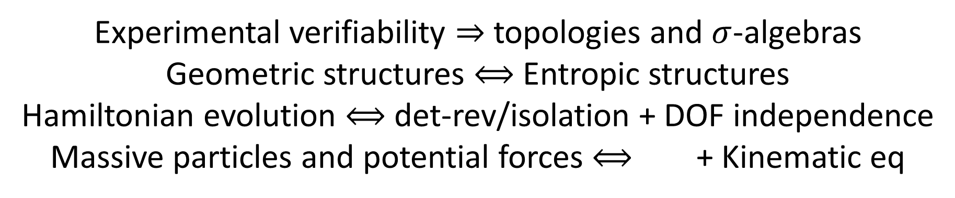
We found:
Experimental verifiability $⇒$ topologies and $σ$-algebras
Geometric structures $⟺$ Entropic structures
Hamiltonian evolution $⟺$ det-rev/isolation + DOF independence
Massive particles and potential forces $⟺$ + Kinematic eq
Physical requirements and assumptions drive most of the theoretical apparatus
Goal of physics is to find the true laws of the universe!
Goal of physics is to find models that can be empirically tested
Less productive point of view
More productive point of view

Slide 5
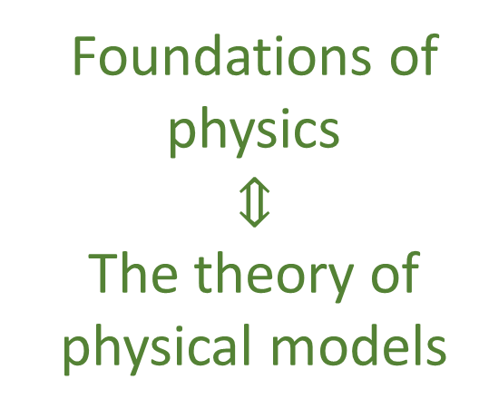
Our view of the foundations of physics
Foundations of physics $$⇕$$ The theory of physical models
General physical principles and requirements
General mathematical framework
Specific assumptions
Classical mechanics
Quantum mechanics
derivation
Thermodynamics
…
specialization

Slide 6
Find the right overall concepts
Reverse Physics: Start with the equations, reverse engineer physical assumptions/principles
Reverse Physics
Physics
Smallest set of assumptions required to rederive the theory
Physical theory
Physical result/ effect/prediction
Reverse Mathematics
Mathematics
Smallest set of axioms required to prove the theorem
Theorem
Mathematical result/ corollary/calculation
Found. Phys. 52, 40 (2022)
Goal: find the right overall physical concepts, “elevate” the discussion from mathematical constructs to physical principles
Physical Mathematics: Start from scratch and rederive all mathematical structures from physical requirements
Physics
Physical requirements
Semantics
Physical mathematics
Goal: get the details right, perfect one-to-one map between mathematical and physical objects

Slide 7
“When the math is derived from the right physical assumptions, the physical assumptions can be derived from the math.”
Reverse Physics aims to adopt approaches that are more in line with the foundations of mathematics, to break physics into a set of physical and mathematical conditions with well-understood logical relationships.
A new methodology for the foundations of physics
Assumptions of Physics, Michigan Publishing (v3 2025)
https://doi.org/10.3998/mpub.12204707
Found. Phys. 52 40 (2022)
https://link.springer.com/article/10.1007/s10701-022-00555-z
J. Phys. Commun. 2 045026 (2018)
http://iopscience.iop.org/article/10.1088/2399-6528/aaba25

Slide 8
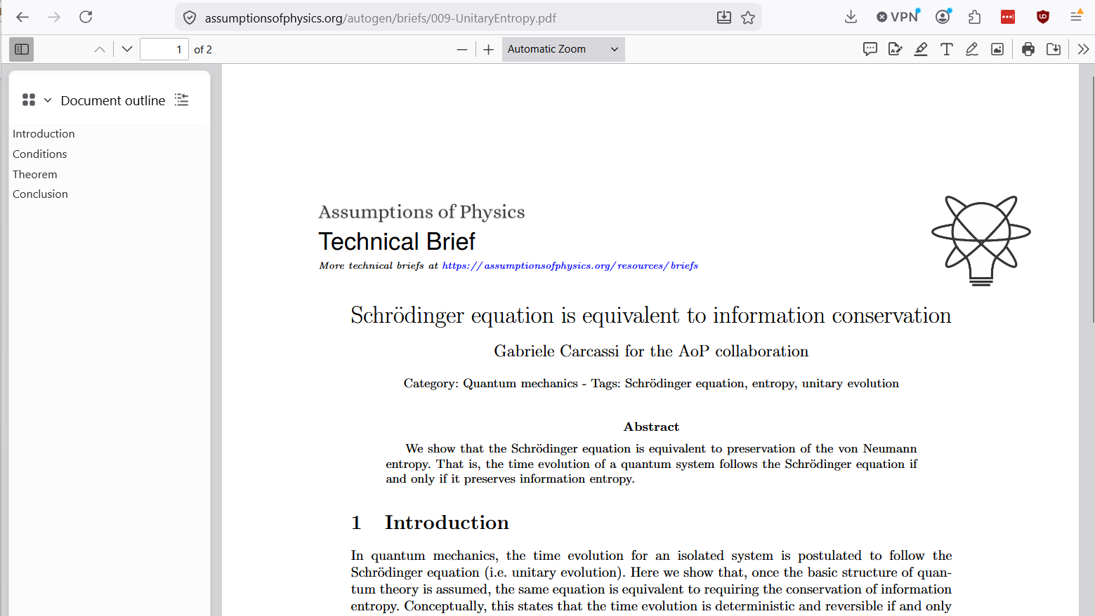
Goals of Reverse Physics
Framework/interpretation/formulation/theory neutral
Allow for each result to be independently formulated from the others
Uncover “paradoxes” and develop standards of rigor appropriate for physics
Clarify the logical dependencies of physical/mathematical conditions
Identify core constitutive requirements of physical theories
The “big four” of Reverse Physics
Where relevant throughout lecture, link to papers or technical briefs

Slide 9
Examining the actual content of mathematical structures

Slide 10



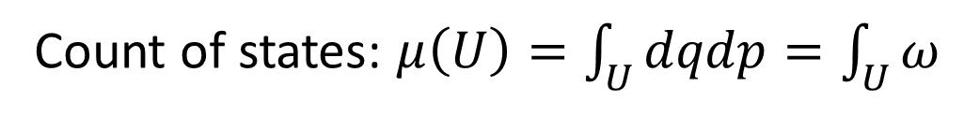




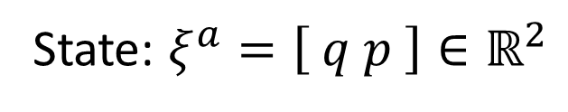






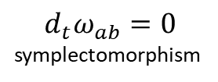

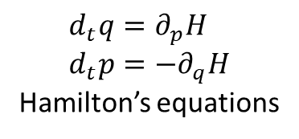
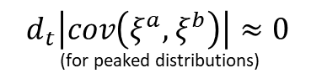


Hamiltonian mechanics 1 DOF $⟺$ Det/Rev
$$d_{t}μ\left(U\right)=0$$
$$⟺$$
$$d_{t}\log{μ\left(U\right)}=0$$
$$⟺$$
$$⟺$$
$d_{t}\int{−ρ\log{ρ}dμ}=0$
$$⟺$$
Conservation of state count
Conservation of thermodynamic entropy
$$⟺$$
$$⟺$$
Conservation of information entropy
$$⟺$$
$$⟺$$
$$⟺$$
$$⟺$$
$$d_{t}\left|cov\left(ξ^{a},ξ^{b}\right)\right|≈0$$ (for peaked distributions)
$$d_{t}ω_{ab}=0$$ symplectomorphism
Determinism and reversibility
$$⟺$$
$$⟺$$
$$⟺$$
Conservation of uncertainty
$$d_{t}q=∂_{p}H \\ d_{t}p=−∂_{q}H$$ Hamilton’s equations
All equivalent conditions!!!
Base theory:
State: $ξ^{a}=\left[ q p \right]∈ℝ^{2}$
Count of states: $μ\left(U\right)=\int_{U}{dqdp}=\int_{U}{ω}$
https://assumptionsofphysics.org/book/AssumptionsOfPhysicsV3.0.pdf#section.1.1.4

Slide 11



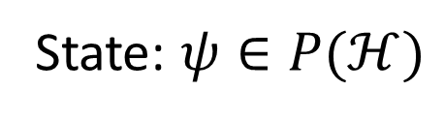






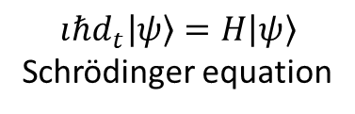



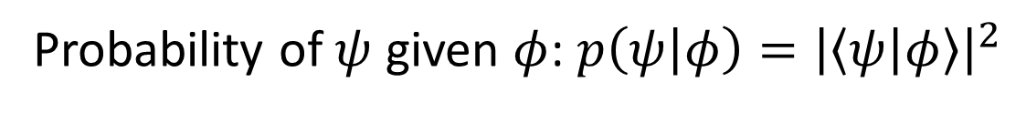
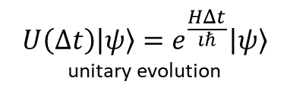

Schrödinger equation $⟺$ Det/Rev
$ψ(0)=φ$ iff $ψ(t)=e^{\frac{HΔt}{ıℏ}}φ$
$$⟺$$
$$d_{t}\text{tr}\left(−ρ\log{ρ}\right)=0$$
$$⟺$$
$$…$$
$$⟺$$
$$⟺$$
Bijective map of state and probability
Conservation of information entropy
$$⟺$$
$$⟺$$
…
$$⟺$$
$$⟺$$
$$⟺$$
$$U\left(Δt\right)\left|ψ\right\rangle =e^{\frac{HΔt}{ıℏ}}\left|ψ\right\rangle$$ unitary evolution
Determinism and reversibility
$$⟺$$
$$ıℏd_{t}\left|ψ\right\rangle =H\left|ψ\right\rangle$$ Schrödinger equation
All equivalent conditions!!!
Base theory:
State: $ψ∈P(ℋ)$
Probability of $ψ$ given $φ$: $p\left(ψ | φ\right)={\left|\left\langle ψ | φ\right\rangle \right|}^{2}$
https://assumptionsofphysics.org/autogen/briefs/009-UnitaryEntropy.pdf

Slide 12


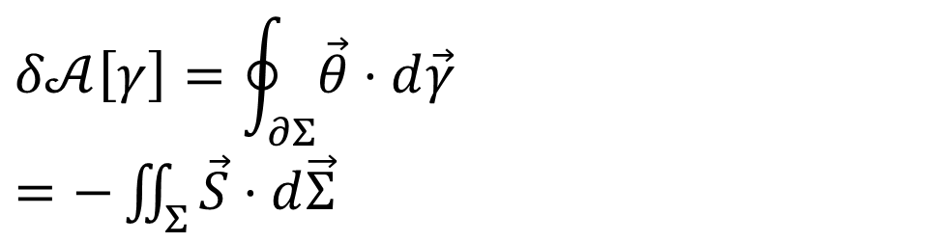


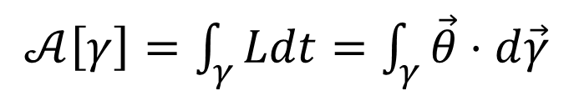







Reversing the principle of stationary action
DR
$p\frac{dq}{dt}+0\frac{dp}{dt}−H\frac{dt}{dt}$
$$\left[p,0,−H\left(q,p\right)\right]$$
KE
$$∇⋅\vec{S}=0$$
$$\vec{S}=−∇×\vec{θ}$$
$𝒜\left[γ\right]=\int_{γ}{Ldt}=\int_{γ}{\vec{θ}⋅d\vec{γ}}$
No state is “lost” or “created” as time evolves
(Minus sign to recover Ham eq)
Sci Rep 13, 12138 (2023)
unphysical
The action is the line integral of the vector potential of the flow of states
$$p$$
$$q$$
Variation of the action
$$Σ$$
Gauge independent, physical!
$$δ𝒜\left[γ\right]=\oint_{∂Σ}{\vec{θ}⋅d\vec{γ}}$$ $=−\iint_{Σ}{\vec{S}⋅d\vec{Σ}}$
$$γ$$
$$γ′$$
$$t$$
Scientific Reports 13, 12138 (2023)
Variation of the action measures the flow of states (physical). Variation = 0 $⇒$ flow of states tangent to the path.
https://arxiv.org/pdf/2208.06428
https://www.nature.com/articles/s41598-023-39145-y

Slide 13
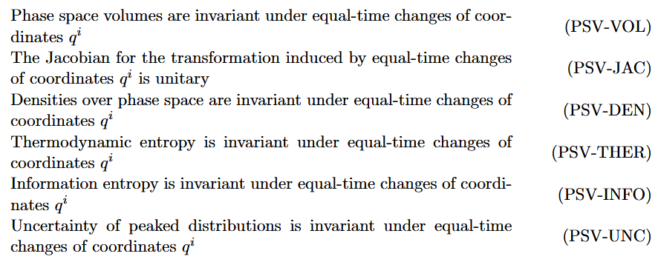
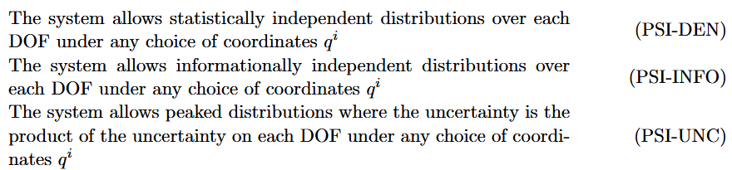







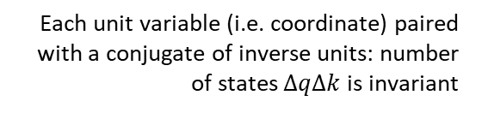




Reversing phase space
Erkenntnis 90, 443 (2025)
Stud Hist Phil Sci B 71, 082020, 60-71 (2020)
Each unit variable (i.e. coordinate) paired with a conjugate of inverse units: number of states $ΔqΔk$is invariant
$\hat{q}=100 cm/m q$
$$x↦x^{3}$$
$$1$$
$Δk=1 m^{−1}$
$$1$$
$Δ\hat{k}=0.01 cm^{−1}$
$$x$$
$$x^{3}$$
$Δ\hat{q}=100 cm$
$Δq=1 m$
Density, entropy, uniform distributions NOT in general coordinate invariant
Phase-space (symplectic) structure is the only one that supports coordinate-invariant density, entropy, state count
Invariance of entropy/state count + DOF independence
$⟺$ structure of phase space (i.e. conjugate pairs)
https://philsci-archive.pitt.edu/22202/1/Hamiltonian_Privilege_preprint.pdf
https://link.springer.com/article/10.1007/s10670-023-00708-0

Slide 14

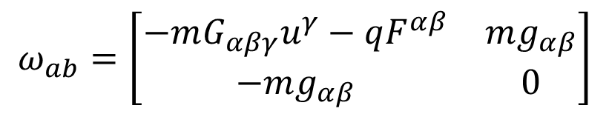
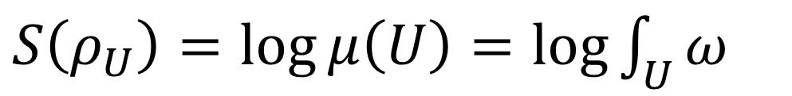

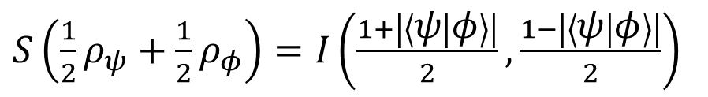
Geometry is entropy
Classical mechanics
Quantum mechanics
$S\left(ρ_{U}\right)=\log{μ\left(U\right)}=\log{\int_{U}{ω}}$
$S\left(\frac{1}{2}ρ_{ψ}+\frac{1}{2}ρ_{φ}\right)=I\left(\frac{1+\left|\left\langle ψ | φ\right\rangle \right|}{2},\frac{1−\left|\left\langle ψ | φ\right\rangle \right|}{2}\right)$
$$=−\frac{1+\left|\left\langle ψ | φ\right\rangle \right|}{2}\log{\frac{1+\left|\left\langle ψ | φ\right\rangle \right|}{2}}−\frac{1−\left|\left\langle ψ | φ\right\rangle \right|}{2}\log{\frac{1−\left|\left\langle ψ | φ\right\rangle \right|}{2}}$$
Symplectic form determines and is determined by the entropy of all uniform joint and marginal (DOF) distributions
Born rule determines and is determined by the entropy of all equal mixtures of pairs of pure states
$$∂_{α}g_{βγ}−∂_{β}g_{αγ}$$
$$ω_{ab}=\left[\begin{matrix}−mG_{αβγ}u^{γ}−qF^{αβ} & mg_{αβ} \\ −mg_{αβ} & 0\end{matrix}\right]$$
Metric tensor appears as the position-velocity part of the symplectic form

Slide 15
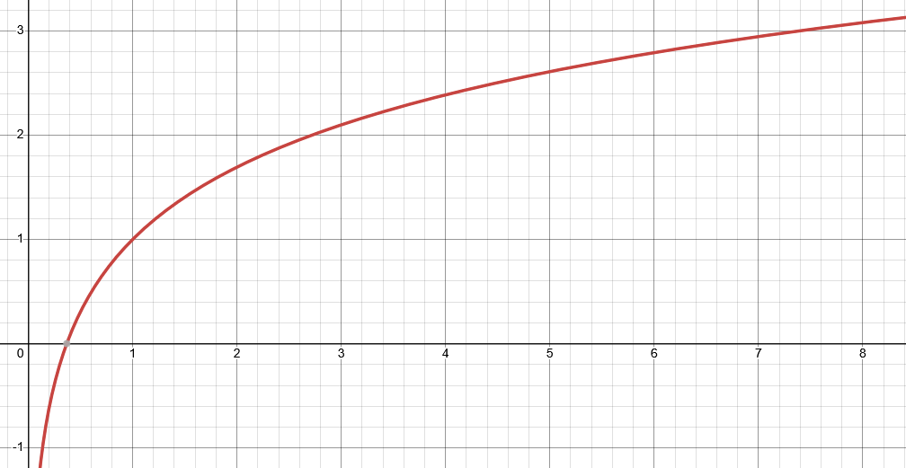
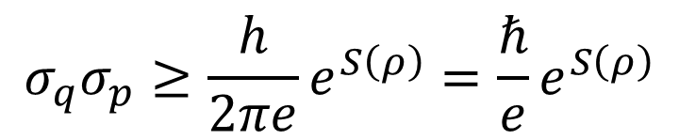

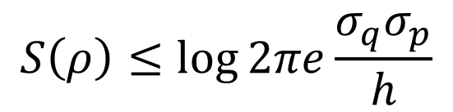
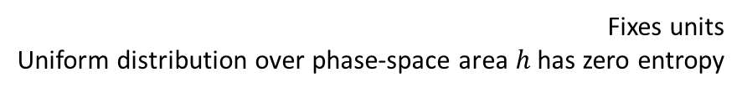


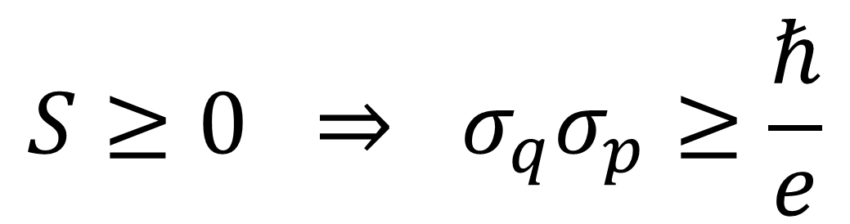
Classical uncertainty principle
Found. Phys. 52, 40 (2022)
$S\left(ρ\right)=−∫ρ\log{hρ}dqdp$
$$S$$
Fixes units Uniform distribution over phase-space area $h$ has zero entropy
excluded by gaussian bound
$$S\left(ρ\right)≤\log{2πe\frac{σ_{q}σ_{p}}{h}}$$
Gaussian maximizes entropy for a given uncertainty
$$\frac{σ_{x}σ_{p}}{ℏ}$$
excluded by 3rd law of thermodynamics
$$σ_{q}σ_{p}≥\frac{h}{2πe}e^{S\left(ρ\right)}=\frac{ℏ}{e}e^{S\left(ρ\right)}$$
Entropy puts a lower bound on the uncertainty
$$S≥0 ⇒ σ_{q}σ_{p}≥\frac{ℏ}{e}$$
https://assumptionsofphysics.org/autogen/briefs/004-ClassicalUncertaintyPrinciple.pdf
https://link.springer.com/article/10.1007/s10701-022-00555-z

Slide 16
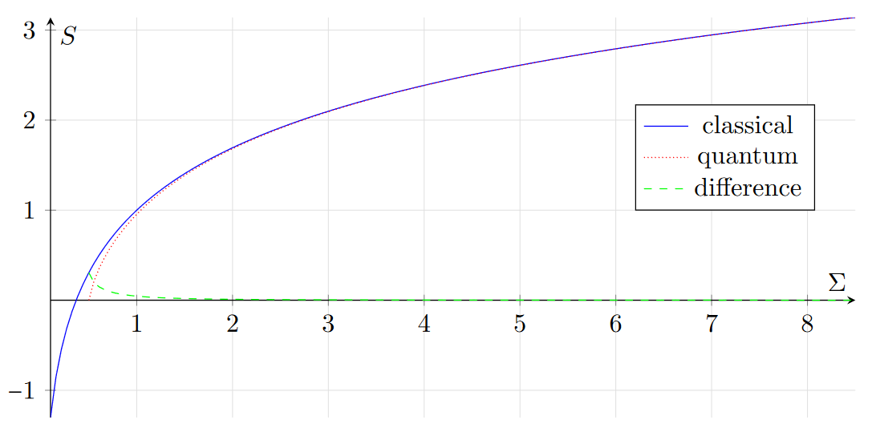
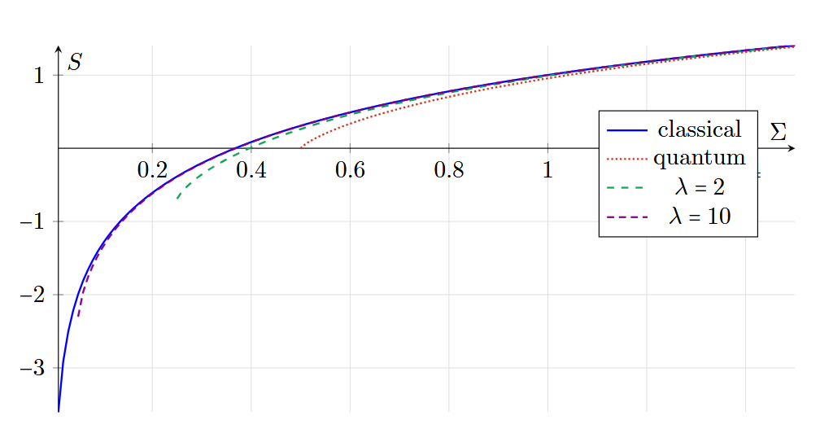



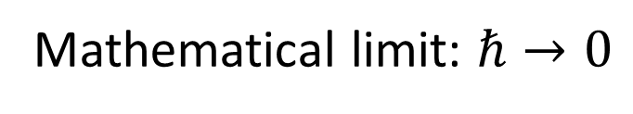


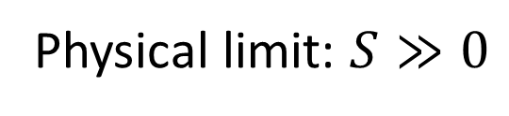
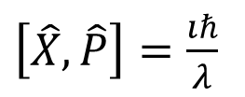


Classical mechanics as high-entropy limit of quantum mechanics
like $c→∞$
Physical limit: $S≫0$
like $\frac{v}{c}≪1$
Mathematical limit: $ℏ→0$
$$T(ρ)$$
$$\frac{σ_{q}σ_{p}}{ℏ}$$
Phys. Scr. 101 065105 (2026)
$$\left[X,P\right]=ıℏ$$
$$\left[T\left(X\right),T\left(P\right)\right]=λıℏ$$
$$\left[T\left(\hat{X}\right),T\left(\hat{P}\right)\right]=ıℏ$$
$\left[\hat{X},\hat{P}\right]=\frac{ıℏ}{λ}$
Physical limit: increase the entropy of mixed states
Mathematical limit: decrease the entropy of pure states
https://arxiv.org/pdf/2411.00972
https://iopscience.iop.org/article/10.1088/1402-4896/ae3a20

Slide 17

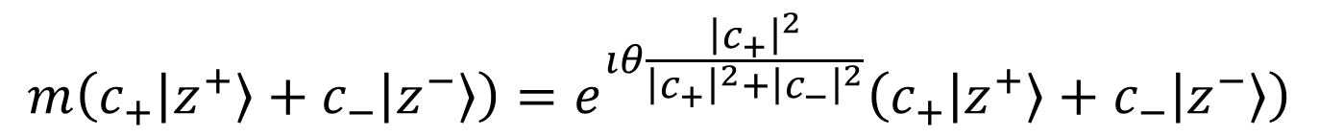
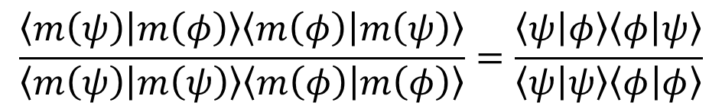
Non-linear representation in quantum mechanics
This map introduces a total phase based on all coefficients
const. $θ∈(0,2π)$
$$m\left(c_{+}\left|z^{+}\right\rangle +c_{−}\left|z^{−}\right\rangle \right)=e^{ıθ\frac{{\left|c_{+}\right|}^{2}}{{\left|c_{+}\right|}^{2}+{\left|c_{−}\right|}^{2}}}\left(c_{+}\left|z^{+}\right\rangle +c_{−}\left|z^{−}\right\rangle \right)$$
Non-linear map…
$$\frac{\left\langle m\left(ψ\right) | m\left(φ\right)\right\rangle \left\langle m\left(φ\right) | m\left(ψ\right)\right\rangle }{\left\langle m\left(ψ\right) | m\left(ψ\right)\right\rangle \left\langle m\left(φ\right) | m\left(φ\right)\right\rangle }=\frac{\left\langle ψ | φ\right\rangle \left\langle φ | ψ\right\rangle }{\left\langle ψ | ψ\right\rangle \left\langle φ | φ\right\rangle }$$
… that preserves the physics (i.e. Born rule)
Linearity is a mathematical convenience, not a physical necessity
https://assumptionsofphysics.org/autogen/briefs/008-NonLinearQuantum.pdf

Slide 18
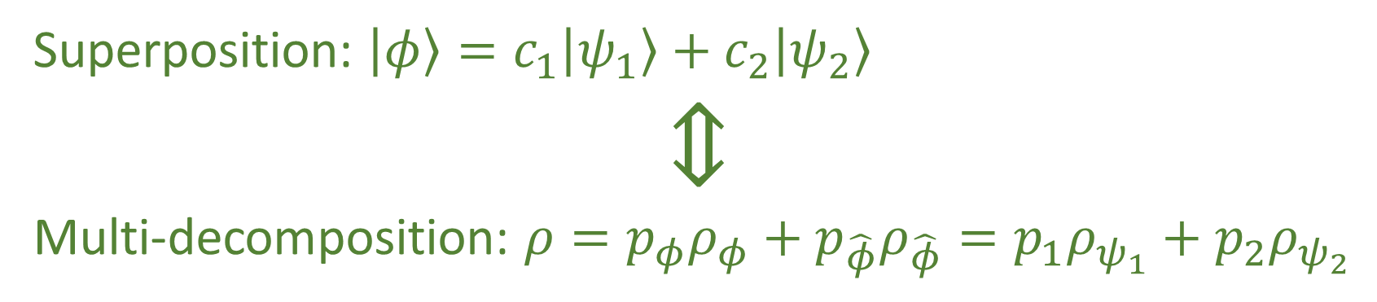
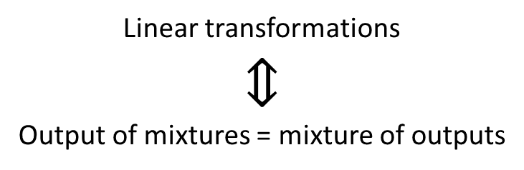
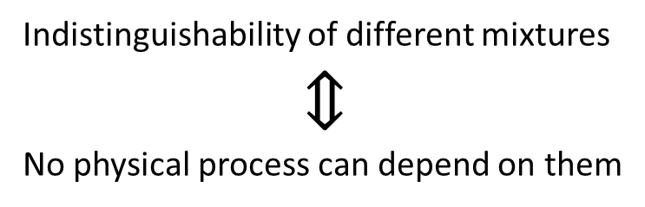
Superposition is multi-decomposition
Property of the vector space representation of states in quantum mechanics
Superposition: $\left|φ\right\rangle =c_{1}\left|ψ_{1}\right\rangle +c_{2}\left|ψ_{2}\right\rangle$
$$⇕$$ Multi-decomposition: $ρ=p_{φ}ρ_{φ}+p_{\hat{φ}}ρ_{\hat{φ}}=p_{1}ρ_{ψ_{1}}+p_{2}ρ_{ψ_{2}}$
Impossible in classical probability (i.e. Choquet simplex)
Property of distinguishability of preparations
Linear transformations
$$⇕$$
Output of mixtures = mixture of outputs
Indistinguishability of different mixtures
$$⇕$$
No physical process can depend on them
https://assumptionsofphysics.org/autogen/briefs/002-SuperpositionAndMultipleMixtures.pdf

Slide 19
Illuminating paradoxes and developing standards of rigor

Slide 20

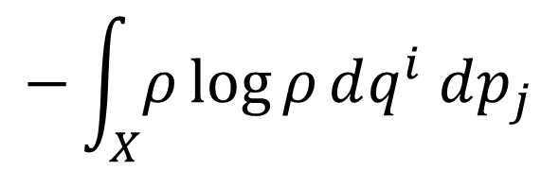

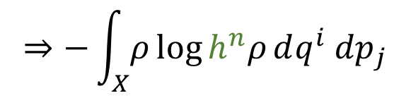
Poor dimensional checking in statistical mechanics
Definition of Gibbs entropy
$$−\int_{X}{ρ\log{ρ}dq^{i} dp_{j}}$$
$$⇒−\int_{X}{ρ\log{h^{n}ρ}dq^{i} dp_{j}}$$
When deriving Sackur–Tetrode equation for the entropy of a monatomic ideal gas
Density is not a pure number
You can’t “approximate physical dimensions”!!!
$$length^{N}≄length^{N−1}$$

Slide 21
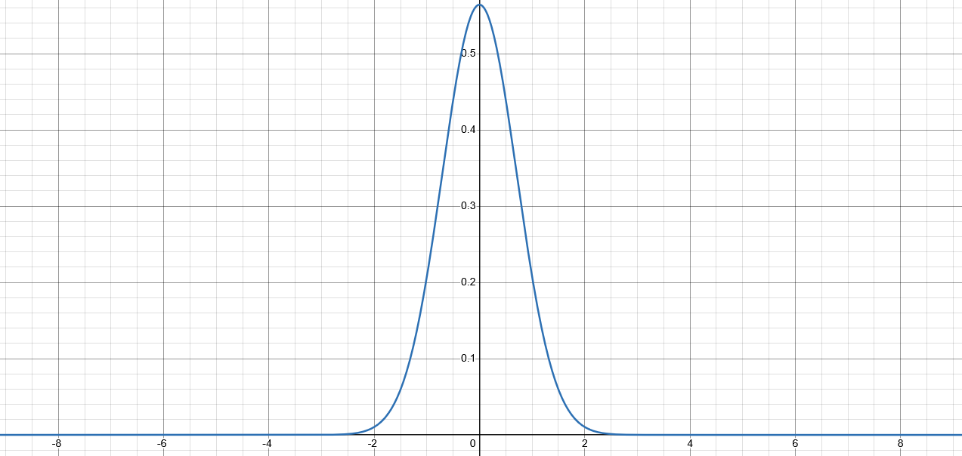
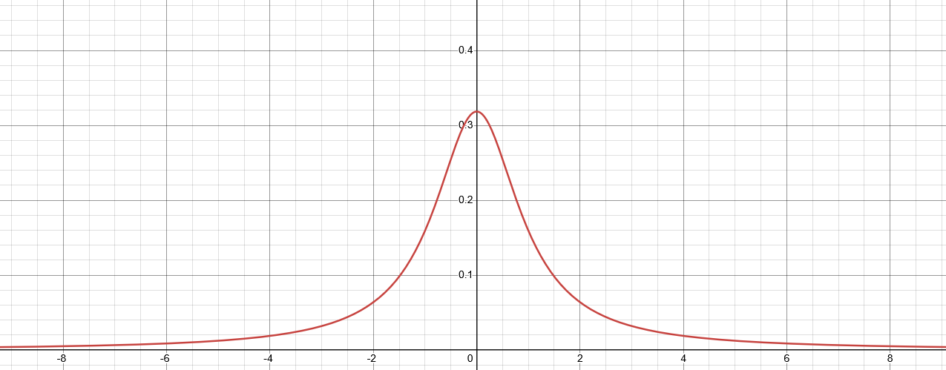

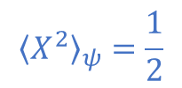




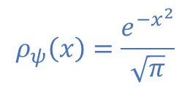

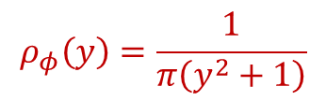
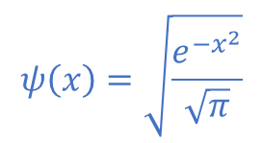
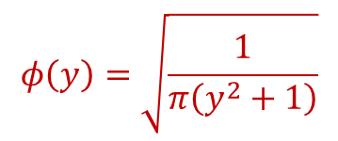
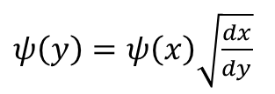
Inconsistent expectations in Hilbert spaces
Quantum Stud.: Math. Found. 12, 13 (2025)
Different observers see finite/infinite expectation
$$ψ\left(x\right)=\sqrt{\frac{e^{−x^{2}}}{\sqrt{π}}}$$
$$∫{\left|ψ\right|}^{2}dx=1$$
$$y=\tan\left(\frac{π}{2}\operatorname{erf}\left(x\right)\right)$$
$$ρ_{ψ}\left(x\right)=\frac{e^{−x^{2}}}{\sqrt{π}}$$
$${\left\langle X^{2}\right\rangle }_{ψ}=\frac{1}{2}$$
$ψ\left(y\right)=ψ\left(x\right)\sqrt{\frac{dx}{dy}}$
Expectation can have finite/infinite oscillations
$$φ\left(y\right)=\sqrt{\frac{1}{π\left(y^{2}+1\right)}}$$
$$∫{\left|φ\right|}^{2}dy=1$$
$x\left(x_{0},t\right)=x_{0}\cos^{2}{\frac{πt}{2}}+\tan\left(\frac{π}{2}\operatorname{erf}\left(x_{0}\right)\right)\sin^{2}{\frac{πt}{2}}$
$$ρ_{φ}\left(y\right)=\frac{1}{π\left(y^{2}+1\right)}$$
$${\left\langle Y^{2}\right\rangle }_{φ}→∞$$
Every continuous linear operator defined on the whole Hilbert space is bounded $⇒$ position/momentum/energy/number of particles are not defined on the whole Hilbert space!!!
https://arxiv.org/pdf/2308.06669
https://link.springer.com/article/10.1007/s40509-024-00357-0

Slide 22
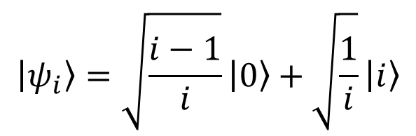
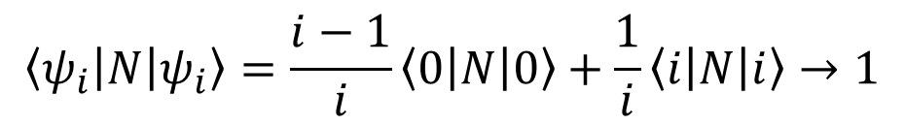

Inconsistent convergence in Hilbert spaces
Consider the sequence of states given by
$$\left\langle ψ_{i}\left|N\right|ψ_{i}\right\rangle =\frac{i−1}{i}\left\langle 0\left|N\right|0\right\rangle +\frac{1}{i}\left\langle i\left|N\right|i\right\rangle →1$$
$$\left|ψ_{i}\right\rangle =\sqrt{\frac{i−1}{i}}\left|0\right\rangle +\sqrt{\frac{1}{i}}\left|i\right\rangle$$
$$\left|ψ_{i}\right\rangle →\left|0\right\rangle$$
The state converges to the ground state while the energy level converges to the first level
https://assumptionsofphysics.org/autogen/briefs/006-InconsistentConvergence.pdf

Slide 23


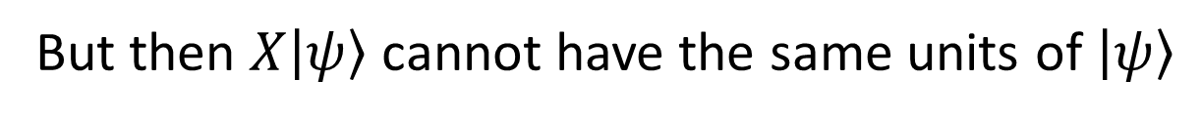
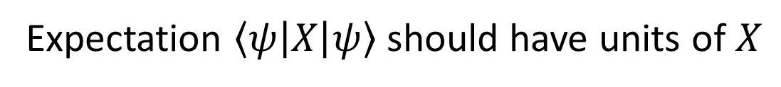
Inconsistent units for quantum observables
Suppose $X$ is an observable
Expectation $\left\langle ψ\left|X\right|ψ\right\rangle$ should have units of $X$
But then $X\left|ψ\right\rangle$ cannot have the same units of $\left|ψ\right\rangle$
But then $X\left|ψ\right\rangle +\left|ψ\right\rangle$ makes no physical sense
Therefore, $X$ cannot be a map within the same space

Slide 24
Identifying logical dependencies and developing/clarifying base theories

Slide 25

Classical conditions and their relationships
MPPF
Core assumptions
Physical theories
CST: Classical STates
NM: Newtonian Mechanics
HM: Hamiltonian Mechanics LM: Lagrangian Mechanics MPPF: Massive Particles under Potential Forces
LM
IR: Infinitesimal Reducibility IND: INDependent DOF W/FKE: Weak/Full Kinematic Equivalence
DR: Determinism+Reversibility
FKE
NM
HM
WKE
CST
DR
Each assumption is an equivalence class of multiple conditions
IR
IND
https://assumptionsofphysics.org/book/AssumptionsOfPhysicsV3.0.pdf#chapter.1.1

Slide 26

Goal: Create a base theory for all of physics
Collection of conditions that MUST be true in all physical theories.
Additional, different conditions or assumptions will then lead to different physical theories, e.g. classical Hamiltonian particle mechanics, nonrelativistic quantum mechanics, …
Any new, yet-undiscovered physical theory MUST still be built on the base theory
Base theory $≠$ Theory of everything

Slide 27
Foundational pillars
The “big four” of Reverse Physics—core constitutive requirements of physical theories:
Experimental verifiability
Reproducibility and ensembles
Ensemble variability
Equilibria

Slide 28






Experimental verifiability
Science is evidence based $⇒$ Statements are associated to experimental tests
Verifiable statement | Test Result
T | SUCCESS (in finite time)
F | UNDEFINED
 | FAILURE (in finite time)
Theoretical statements
$int(A)$ corresponds to the verifiable part of a statement
$$s$$ | Test
T | S
 | U
F | U
 | F
Verifiable statements
Possibilities
$∂A$ corresponds to the undecidable part of a statement
$ext(A)$ corresponds to the falsifiable part of a statement
Open sets
Points
Inference relationship $𝓇:𝒟_{Y}→𝒟_{X}$ such that $𝓇\left(s\right)≡s$
Borel sets
Experimental verifiability $⇒$ topology and $σ$-algebra
Experimental relationships must be topologically continuous
Causal relationship $f:X→Y$ such that $x≼f\left(x\right)$
https://assumptionsofphysics.org/book/AssumptionsOfPhysicsV3.0.pdf#section.2.1.1

Slide 29









Reproducibility and ensembles
Scientific laws describe reproducible relationships $⇒$ Ensembles
$$P$$
Ensembles are outputs of repeatable processes
$P_{1}$
$$e_{1}$$
$$S_{p}$$
$$pe_{1}+\left(1−p\right)e_{2}$$
Statistical mixing $⇒$ Linear structures in physics
$P_{2}$
$$e_{2}$$
Note: mixing coefficients are parameters of the preparation, NOT probabilities in the ordinary sense

Slide 30






Ensemble variability
Variability of the elements within an ensemble $⇒$ Entropy
$$e_{1}$$
$$…$$
Mutually exclusive $⟺$ orthogonality
$⇕$
Maximal variability increase during mixing
$$e_{2}$$
more variability
$$…$$
Variability $⇒$ Probabilities, inner product and geometry
Probability $⟺$ Mixtures of mutually exclusive ensembles
Classical mechanics/probability $⟺$ All pure states are mutually exclusive
Pure states $⟺$ Best preparations $⇎$ No variability

Slide 31






Equilibria
States must exist for at least a short time $⇒$ Equilibria
$$X(t)$$
$$\left\{x\left(t\right),y\left(t\right)\right\}$$
Of system/environment interactions that don’t matter/we are not sensitive to
Of internal processes at faster scales that don’t matter/we are not sensitive to
$$x$$
$$x(t)$$
$$y(t)$$
$$dt$$
Least developed part
This requirement allows us to properly talk about different physical objects
Equilibria $⇒$ Symmetries, differentiability, Lie algebras

Slide 32
Wrapping it up
Assumptions of Physics: different approach to the foundations of physics
No interpretations, no theories of everything: physically meaningful starting points from which we can rederive the laws and the mathematical frameworks they need
Physical theories are models
Need to clarify exactly what the realm of applicability of each model is
Reverse Physics: reverse engineer principles from the known laws
Current laws are given through mathematical structures, which make it hard to understand the physics
We have to find physical principles and assumptions from which to rederive the laws
These starting points must have a clear intuitive meaning for the majority of physicists and engineers
Investigate physics as a whole (no theory is “more fundamental”)

Slide 33
Reverse Physics gives us a powerful new methodology for the foundations of physics, more in line with foundational approaches of other disciplines, offering a lot more—and more precise—insights and opening new avenues of research
Notes:
To sum up, the claim is that the foundation of physics has a big methodology problem. And that Reverse Physics gives us a powerful methodology that is more in line to what people do in the foundations of mathematics, gives us a lot more and more precise insights, and open news avenues of research. The point of this talk was not to show you all the results in detail… it would take weeks. The point was to put you in front of a binary choice. Either I am insane, I have no idea what I am talking about and it’s all rubbish… and you should disregard the claim. Or I am not insane, I have enough understanding of physics, math and philosophy to substantiate the claim… and it would be insane to disregard it.

Slide 34
Assumptions of Physics is an open research program
Our main output is an open access book: https://assumptionsofphysics.org/book/
All our material is developed on GitHub: https://github.com/assumptionsofphysics
Livestream discussions
One YouTube channel dedicated to publicize results: https://www.youtube.com/user/gcarcassi
Another YouTube channel dedicated to research: https://www.youtube.com/@AssumptionsofPhysicsResearch
Activities coordinated through a Discord server (contact info@assumptionsofphysics.org for an invite)
Always looking for experts to gain insights and/or help
Always looking for collaborations
Always looking for editors/journals/conferences that are sympathetic to the mission

