Slide 1

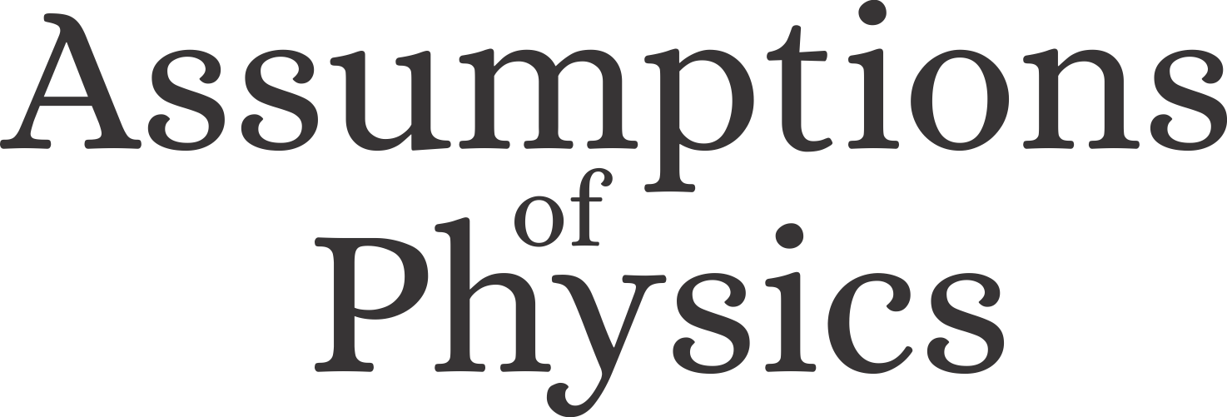


Assumptions of Physics Summer School 2026 Results from Reverse Physics
https://assumptionsofphysics.org
Gabriele Carcassi, Christine A. Aidala, and Tobias Thrien
Physics Department University of Michigan

Slide 2
Overview of Reverse Physics results for classical mechanics
“When the math is derived from the right physical assumptions, the physical assumptions can be derived from the math.”

Slide 3
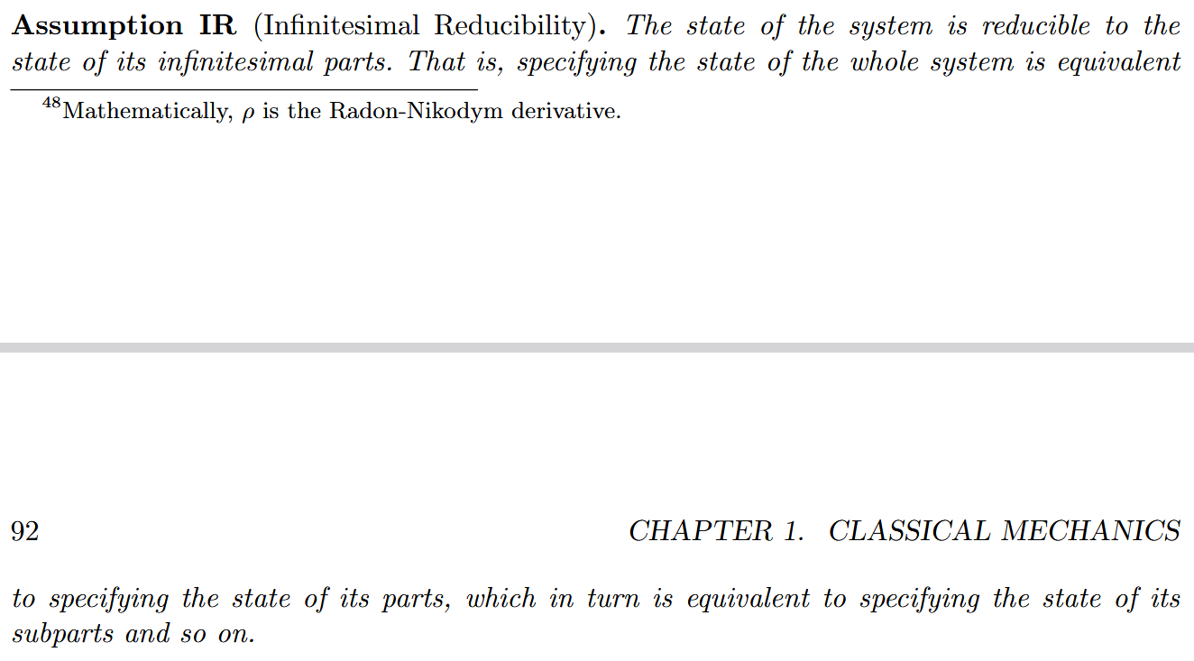
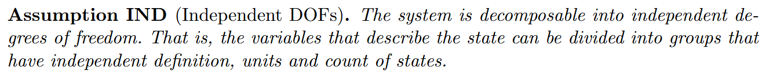
Classical state is a distribution over the states of infinitesimal parts
Recovers pairs of conjugate variables for each DOF, frame-invariant entropy and count of states
Conservation of entropy/count of states and DOF independence recovers Hamiltonian evolution
Links trajectories in space with dynamics, recovering inertia, masses and scalar/vector potential forces
Classical Mechanics (CM): IR + IND
Assumptions for classical mechanics
Newtonian Mechanics: CM + KE
Lagrangian Mechanics: CM + KE + DR
Hamiltonian Mechanics : CM + DR

Slide 4
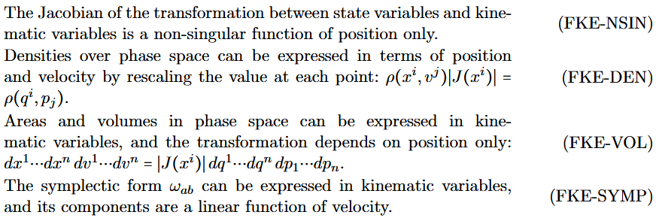
Classical conditions and their relationships
MPPF
Core assumptions
Physical theories
CST: Classical STates
NM: Newtonian Mechanics
HM: Hamiltonian Mechanics LM: Lagrangian Mechanics MPPF: Massive Particles under Potential Forces
LM
IR: Infinitesimal Reducibility IND: INDependent DOF W/FKE: Weak/Full Kinematic Equivalence
DR: Determinism+Reversibility
FKE
NM
HM
WKE
CST
DR
Each assumption is an equivalence class of multiple conditions
IR
IND
https://assumptionsofphysics.org/book/AssumptionsOfPhysicsV3.0.pdf#section.1.1.4

Slide 5

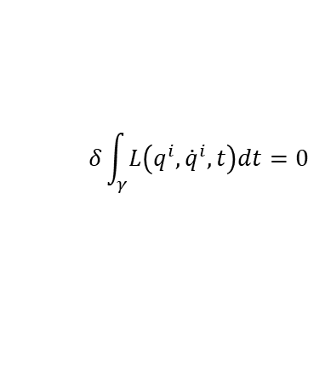











Assumptions of classical mechanics
$$\frac{dq^{i}}{dt}=\frac{∂H}{∂p_{i}}$$
$$\frac{dp_{i}}{dt}=−\frac{∂H}{∂q^{i}}$$
$$δ\int_{γ}{L\left(q^{i},{\dot{q}}^{i},t\right)dt}=0$$
$$[q^{i},p_{i}]$$
(IR) Infinitesimal reducibility
Classical Phase Space
Hamiltonian Mechanics
Lagrangian Mechanics
+
+
+
Massive particles under potential forces
(DR) Determinism /Reversibility
weak
+
(IND) Degree of freedom independence
(KE) Kinematic Equivalence
full
$$H=\frac{1}{2m}\left(p_{i}−𝔮A_{i}\right)g^{ij}\left(p_{j}−𝔮A_{j}\right)+𝔮V$$
$$ρ_{1}ρ_{2}⇒ρ$$
$$p$$
$$p$$
$$z$$
$$y$$
$$q$$
$$q$$
$$x$$

Slide 6
Principle of least action - one DOF

Slide 7
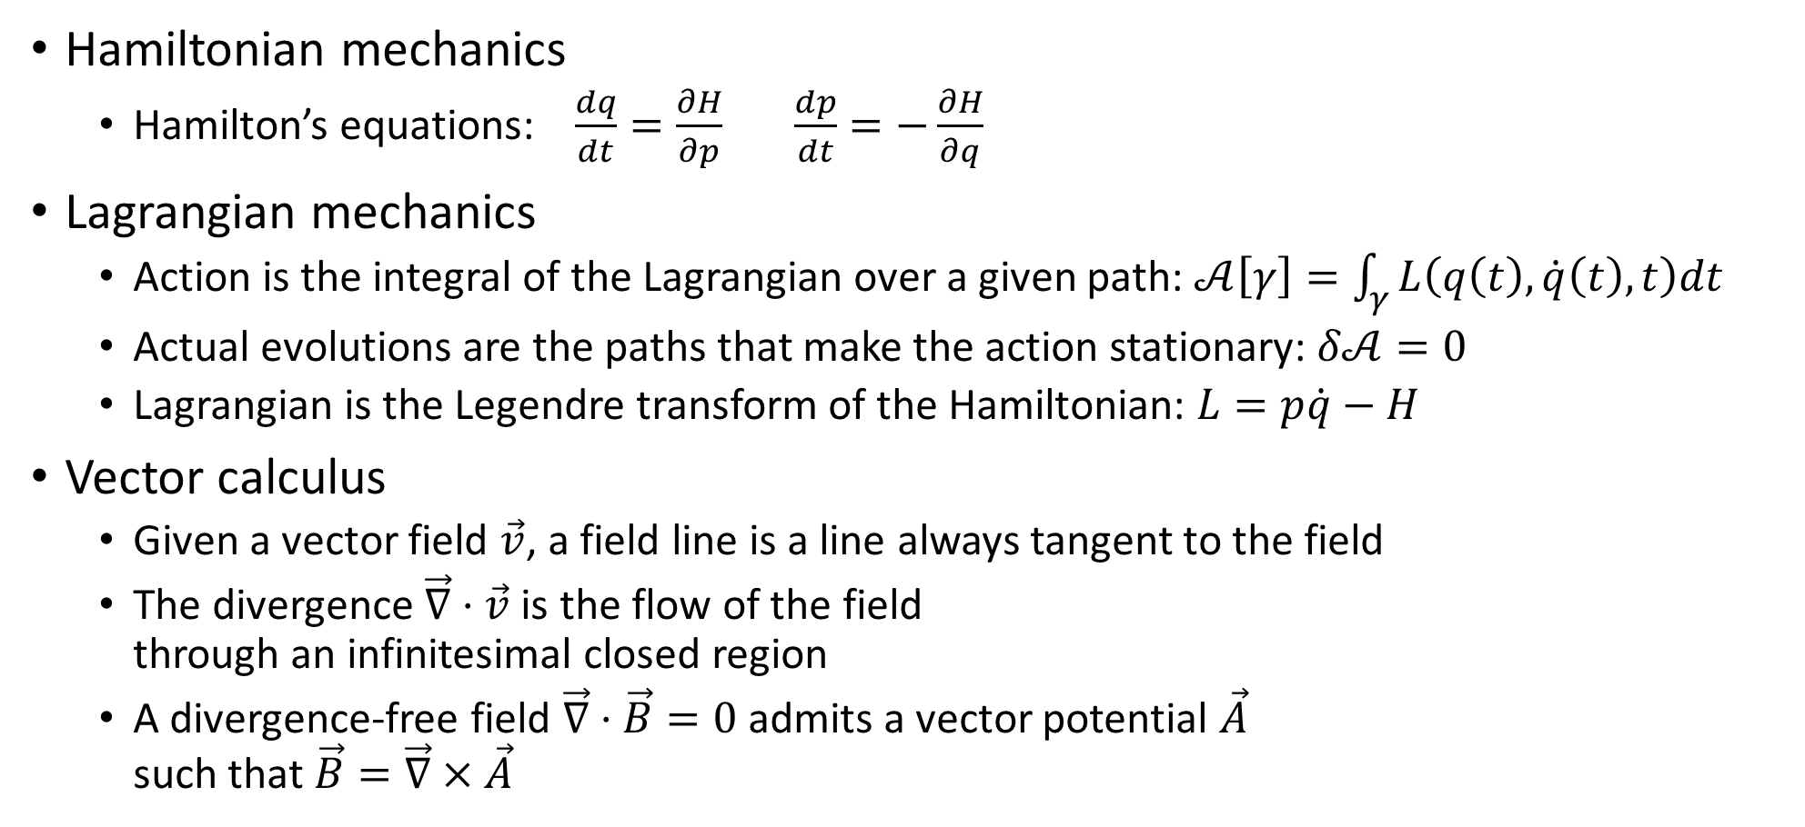
Required background
Hamiltonian mechanics
Hamilton’s equations: $\frac{dq}{dt}=\frac{∂H}{∂p}$ $\frac{dp}{dt}=−\frac{∂H}{∂q}$
Lagrangian mechanics
Action is the integral of the Lagrangian over a given path: $𝒜\left[γ\right]=\int_{γ}{L\left(q\left(t\right),\dot{q}\left(t\right), t\right)dt}$
Actual evolutions are the paths that make the action stationary: $δ𝒜=0$
Lagrangian is the Legendre transform of the Hamiltonian: $L=p\dot{q}−H$
Vector calculus
Given a vector field $\vec{v}$, a field line is a line always tangent to the field
The divergence $\vec{∇}⋅\vec{v}$ is the flow of the field through an infinitesimal closed region
A divergence-free field $\vec{∇}⋅\vec{B}=0$ admits a vector potential $\vec{A}$ such that $\vec{B}=\vec{∇}×\vec{A}$

Slide 8
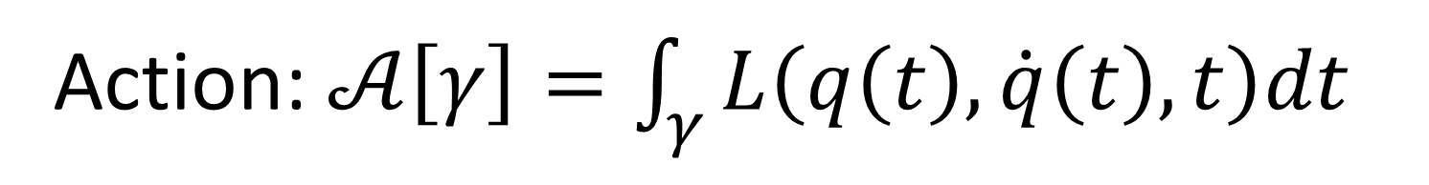
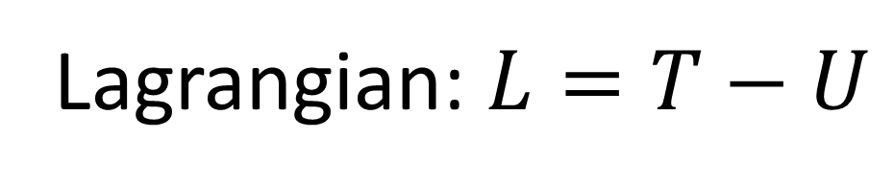
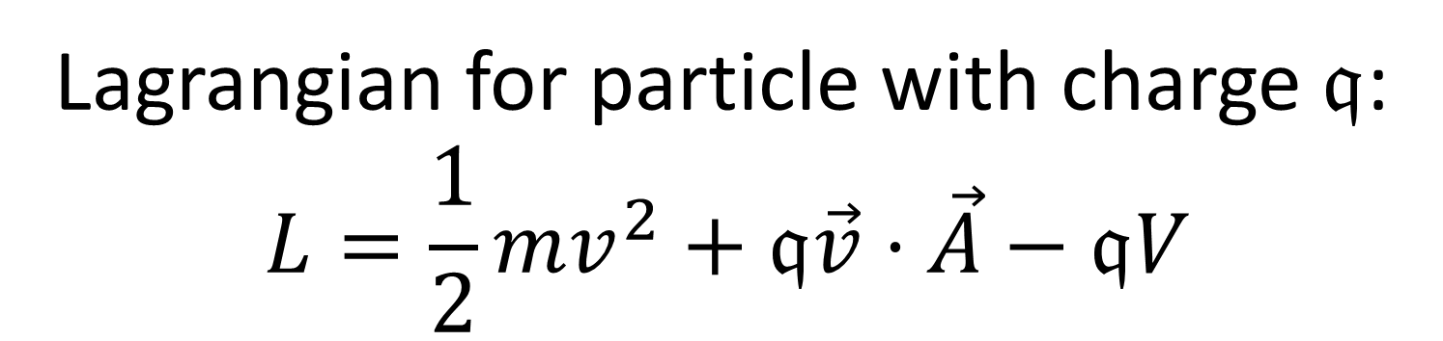
Action: $𝒜\left[γ\right]=\int_{γ}{L\left(q\left(t\right),\dot{q}\left(t\right), t\right)dt}$
Does not always work!
Lagrangian: $L=T−U$
Lagrangian for particle with charge $𝔮$: $$L=\frac{1}{2}mv^{2}+𝔮\vec{v}⋅\vec{A}−𝔮V$$
Kinetic
???
Potential

Slide 9


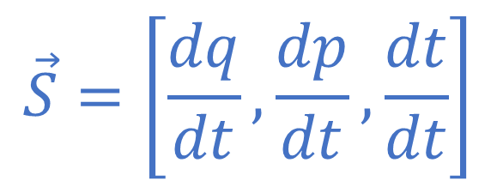


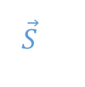

Displacement field
Tells us how states “move”
Scientific Reports 13, 12138 (2023)
$$p$$
$$\vec{S}=\left[\frac{dq}{dt},\frac{dp}{dt},\frac{dt}{dt}\right]$$
$$q$$
$$γ$$
$$\vec{S}$$
Evolution
$$γ=[q\left(t\right), p\left(t\right), t]$$
$$t$$
Time is both a parameter and a variable
Evolutions are field lines of the displacement field
Always tangent to the field
https://arxiv.org/pdf/2208.06428
https://www.nature.com/articles/s41598-023-39145-y

Slide 10
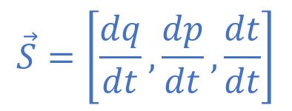


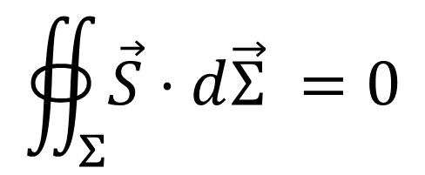

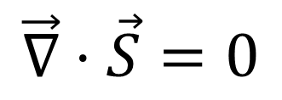
(DR) Determinism and Reversibility
$$\vec{S}=\left[\frac{dq}{dt},\frac{dp}{dt},\frac{dt}{dt}\right]$$
$$p$$
$$q$$
$$γ$$
$$Σ$$
$$\vec{S}$$
No states are lost or created
(count of states is preserved in time)
$$∯_{Σ}{\vec{S}⋅d\vec{Σ}} =0$$
$$t$$
$⇒$ Divergence-free displacement
$$\vec{∇}⋅\vec{S}=0$$
Vector potential
$$\vec{S}=−\vec{∇}×\vec{θ}$$
Displacement admits a vector potential
Minus sign added to match conventions

Slide 11
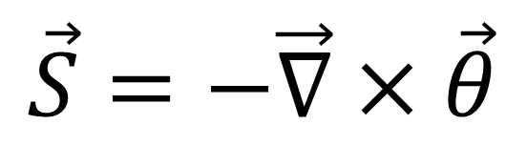




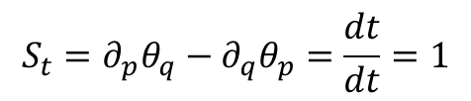

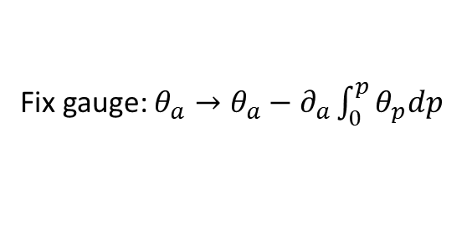
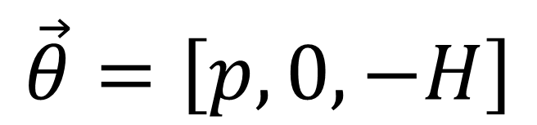
$$\vec{θ}=\left[θ_{q},θ_{p},θ_{t}\right]$$
$$\vec{S}=\left[\frac{dq}{dt},\frac{dp}{dt},\frac{dt}{dt}\right]$$
Without loss of generality
Fix gauge: $θ_{a}→θ_{a}−∂_{a}\int_{0}^{p}{θ_{p}dp}$
$$\vec{θ}=\left[θ_{q},0,θ_{t}\right]$$
$$\vec{S}=−\vec{∇}×\vec{θ}$$
$$\vec{θ}=\left[p,0,−H\right]$$
$$S_{t}=∂_{p}θ_{q}−∂_{q}θ_{p}=\frac{dt}{dt}=1$$
$$\vec{θ}=\left[p,0,θ_{t}\right]$$
similar to four-momentum
Rename $θ_{t}$
$$\vec{θ}=\left[p,0,−H\right]$$

Slide 12
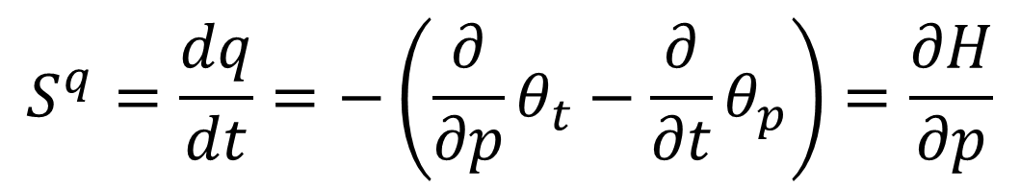
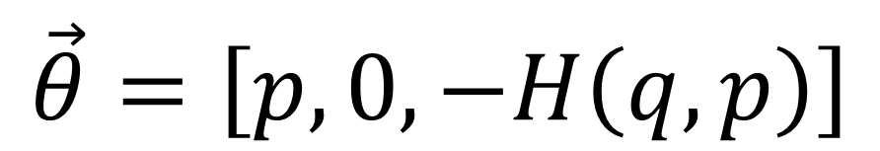
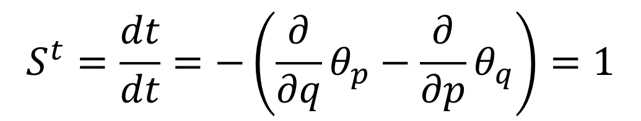
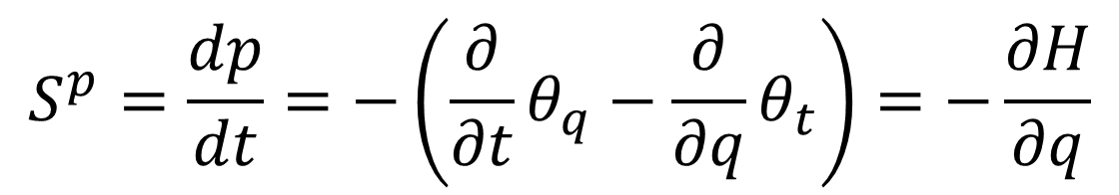
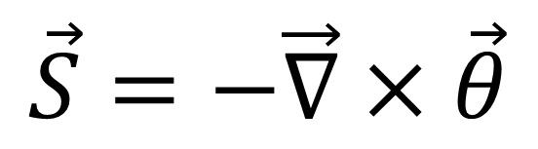
$$\vec{S}=\left[\frac{dq}{dt},\frac{dp}{dt},\frac{dt}{dt}\right]$$
$$\vec{S}=−\vec{∇}×\vec{θ}$$
$$\vec{θ}=\left[p,0,−H\left(q,p\right)\right]$$
$$S^{q}=\frac{dq}{dt}=−\left(\frac{∂}{∂p}θ_{t}−\frac{∂}{∂t}θ_{p}\right)=\frac{∂H}{∂p}$$
Hamilton’s equations
$$S^{p}=\frac{dp}{dt}=−\left(\frac{∂}{∂t}θ_{q}−\frac{∂}{∂q}θ_{t}\right)=−\frac{∂H}{∂q}$$
$$S^{t}=\frac{dt}{dt}=−\left(\frac{∂}{∂q}θ_{p}−\frac{∂}{∂p}θ_{q}\right)=1$$

Slide 13

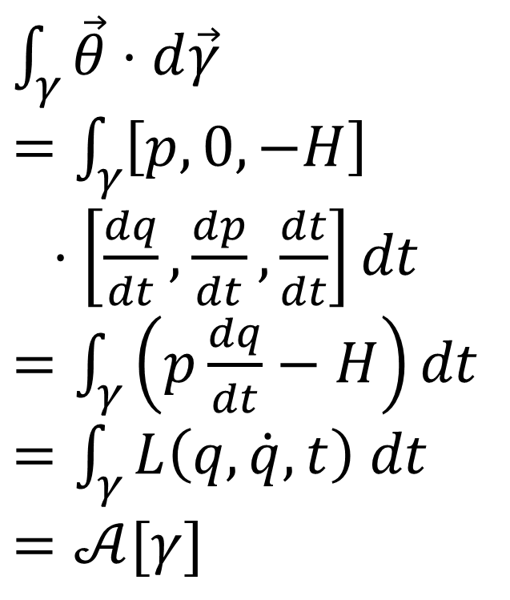
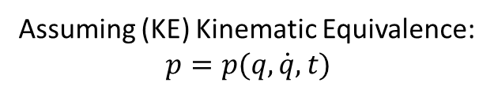
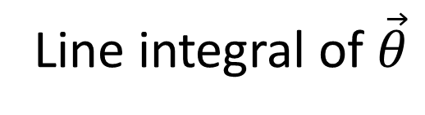
Line integral of $\vec{θ}$
$$p$$
$\int_{γ}{\vec{θ}⋅d\vec{γ}}$
$=\int_{γ}{\left[p,0,−H\right]}$
$⋅\left[\frac{dq}{dt},\frac{dp}{dt},\frac{dt}{dt}\right]dt$ $=\int_{γ}{\left(p\frac{dq}{dt}−H\right)dt}$
$=\int_{γ}{L\left(q,\dot{q},t\right) dt}$
$=𝒜[γ]$
$$q$$
Express in components
$$γ$$
$$\vec{S}$$
$$t$$
Assuming (KE) Kinematic Equivalence: $$p=p(q,\dot{q},t)$$
The action is the line integral of the vector potential of the flow of states

Slide 14

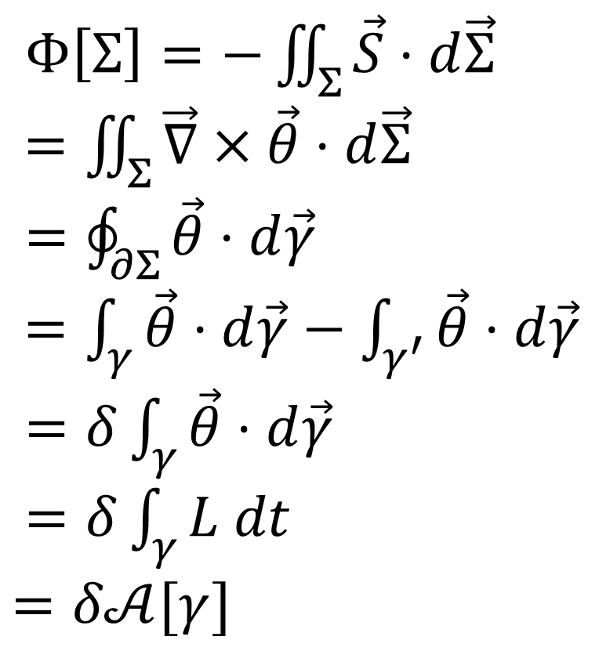


Flow between a path $γ$ and its variation $γ′$
$$p$$
$$q$$
$$γ$$
$$Σ$$
$Φ\left[Σ\right]=−\iint_{Σ}{\vec{S}⋅d\vec{Σ}}$
$=\iint_{Σ}{\vec{∇}×\vec{θ}⋅d\vec{Σ}}$
$=\oint_{∂Σ}{\vec{θ}⋅d\vec{γ}}$ $=\int_{γ}{\vec{θ}⋅d\vec{γ}}−\int_{γ^{′}}{\vec{θ}⋅d\vec{γ}}$ $=δ\int_{γ}{\vec{θ}⋅d\vec{γ}}$
$=δ\int_{γ}{L dt}$ $=δ𝒜[γ]$
$$\vec{S}$$
Hamilton equations
Stokes’ theorem
$$γ′$$
$$t$$
The variation of the action is the flow between the
path and its variation

Slide 15



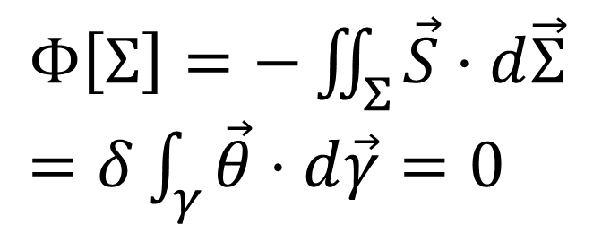

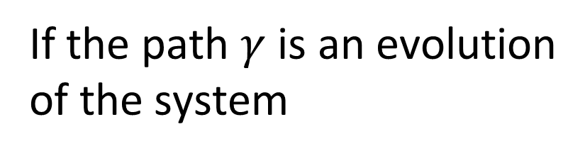

If the path $γ$ is an evolution of the system
$$p$$
$$q$$
$$γ$$
$$Σ$$
$$\vec{S}$$
$Φ\left[Σ\right]=−\iint_{Σ}{\vec{S}⋅d\vec{Σ}}$ $=δ\int_{γ}{\vec{θ}⋅d\vec{γ}}=0$
$$γ′$$
flow is tangent
$$t$$
If the path $γ$ is not an evolution of the system, we can always find a variation $γ′$ such that
Action is stationary over and only over evolutions
$−\iint_{Σ}{\vec{S}⋅d\vec{Σ}}=δ\int_{γ}{\vec{θ}⋅d\vec{γ}}≠0$

Slide 16
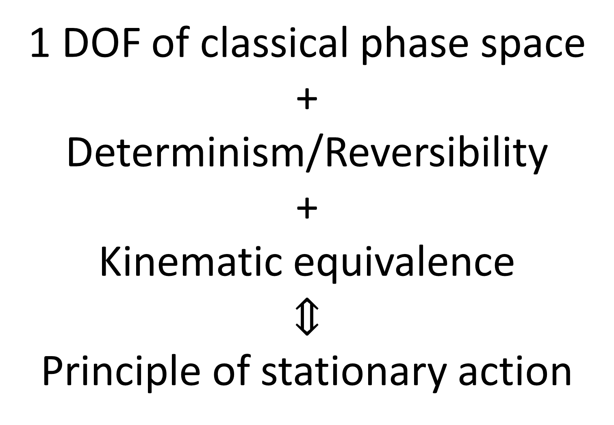
1 DOF of classical phase space +
Determinism/Reversibility
+
Kinematic equivalence
$$⇕$$
Principle of stationary action

Slide 17
Relativistic mechanics
https://assumptionsofphysics.org/book/AssumptionsOfPhysicsV3.0.pdf#section.1.1.9
J. Phys. Commun. 2 045026 (2018)
https://arxiv.org/abs/1702.07052
http://iopscience.iop.org/article/10.1088/2399-6528/aaba25

Slide 18
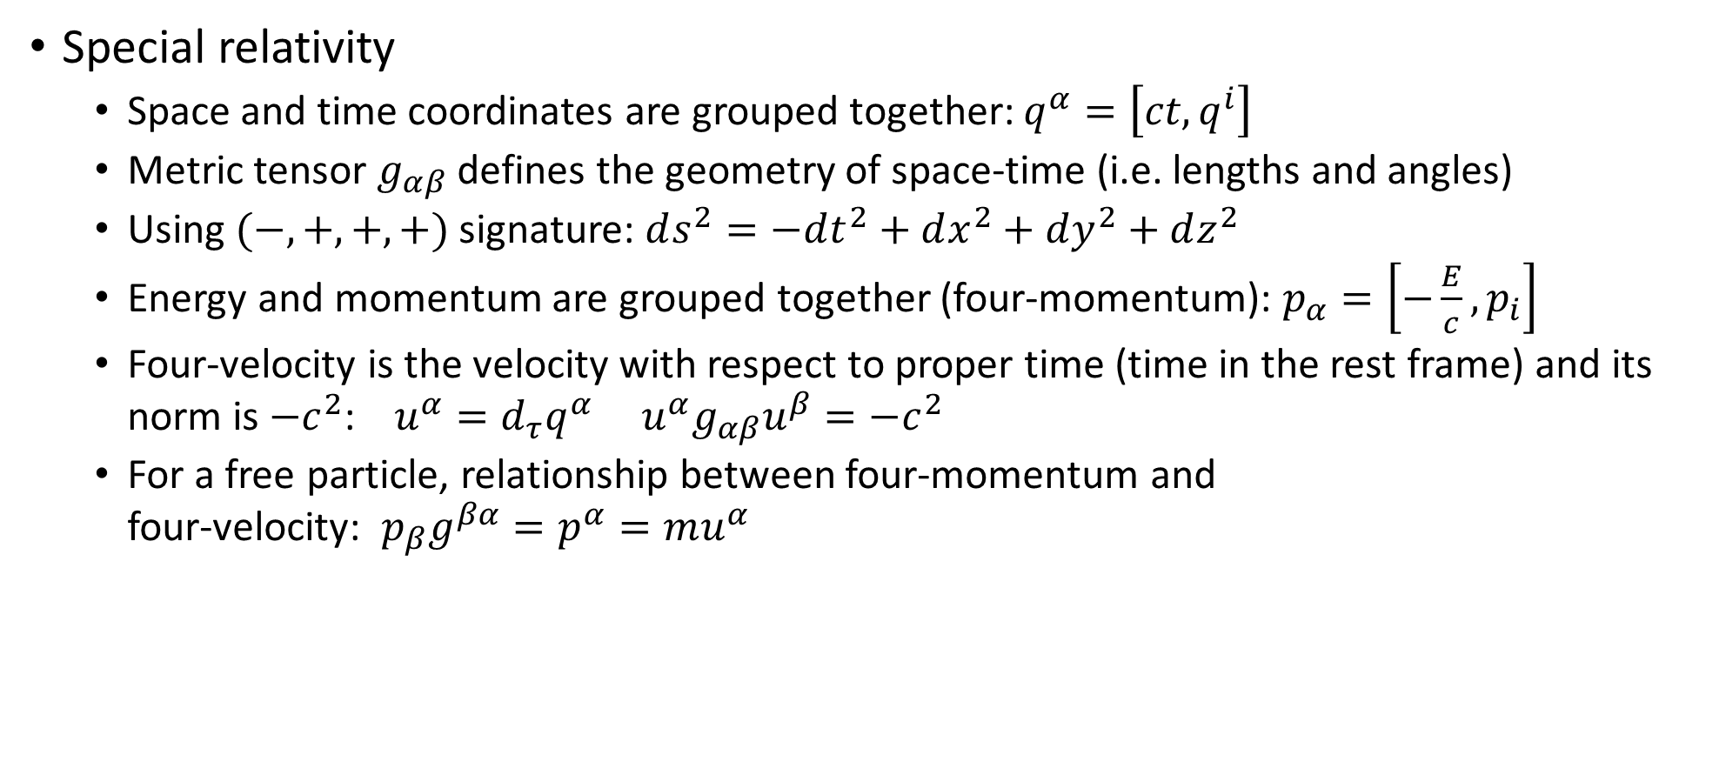
Required background
Special relativity
Space and time coordinates are grouped together: $q^{α}=\left[ct,q^{i}\right]$
Metric tensor $g_{αβ}$ defines the geometry of space-time (i.e. lengths and angles)
Using $(−,+,+,+)$ signature: $ds^{2}=−dt^{2}+dx^{2}+dy^{2}+dz^{2}$
Energy and momentum are grouped together (four-momentum): $p_{α}=\left[−\frac{E}{c},p_{i}\right]$
Four-velocity is the velocity with respect to proper time (time in the rest frame) and its norm is $−c^{2}$: $u^{α}=d_{τ}q^{α}$ $u^{α}g_{αβ}u^{β}=−c^{2}$
For a free particle, relationship between four-momentum and four-velocity: $p_{β}g^{βα}=p^{α}=mu^{α}$

Slide 19

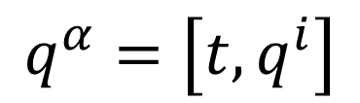
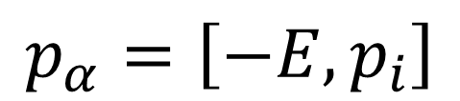
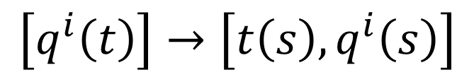

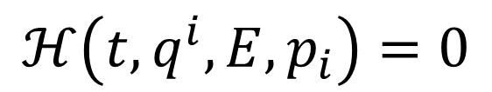

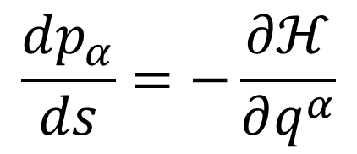
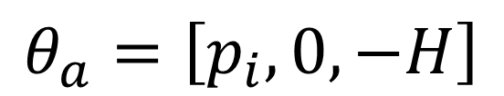
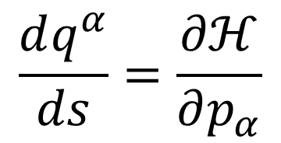
Want to extend Hamiltonian mechanics to handle change of coordinates that mix space and time variables
$$q^{α}=\left[t,q^{i}\right]$$
$$\left[q^{i}\left(t\right)\right]→\left[t\left(s\right), q^{i}\left(s\right)\right]$$
Hamiltonian mechanics on the extended phase space
Separate time-the-variable from time-the-parameter
Recall
$$θ_{q^{i}}$$
$$θ_{t}$$
$$θ_{a}=\left[p_{i},0,−H\right]$$
$$p_{α}=\left[−E,p_{i}\right]$$
$⇒$ only possible choice for conjugates
Form a covector
$$\frac{dq^{α}}{ds}=\frac{∂ℋ}{∂p_{α}}$$
$$\frac{dp_{α}}{ds}=−\frac{∂ℋ}{∂q^{α}}$$
Hamiltonian constraint
$$ℋ\left(t,q^{i},E,p_{i}\right)=0$$
Not just a conserved quantity

Slide 20









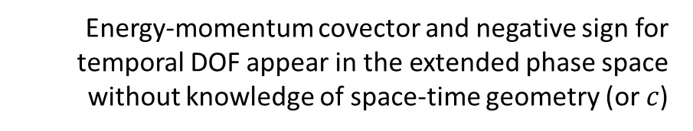
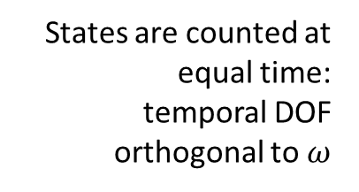
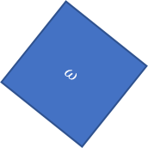

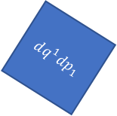
$$q^{α}=\left[t,q^{i}\right]$$
Energy-momentum covector and negative sign for temporal DOF appear in the extended phase space without knowledge of space-time geometry (or $c$)
$$ω=dq^{i}dp_{i}−dtdE$$
$$p_{α}=\left[−E,p_{i}\right]$$
Lorentzian relativity is the only “correct” one
It extends the count of configurations per DOF to the temporal DOF in the correct way
$$ω=dq^{1}dp_{1}+dq^{2}dp_{2}$$
$$ω=dq^{1}dp_{1}−dtdE$$
$$ω$$
$$dq^{1}dp_{1}=ω+dtdE$$
$$dq^{2}dp_{2}$$
States are counted at equal time: temporal DOF orthogonal to $ω$
2D representation of 4D relationship
$$dq^{1}dp_{1}$$
$$dq^{1}dp_{1}$$
$$dtdE$$
$$ω$$
Independent DOFs are orthogonal
Pythagoras's formula still present

Slide 21
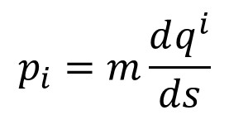
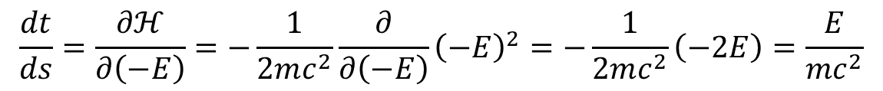
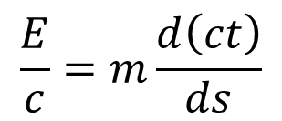
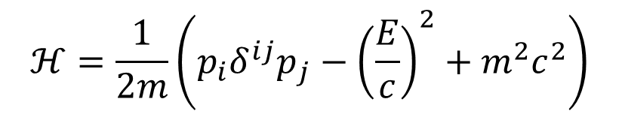
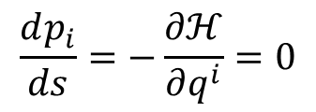
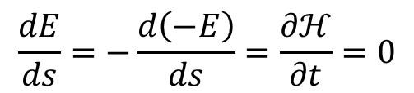
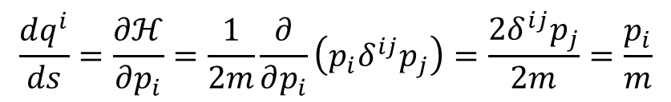
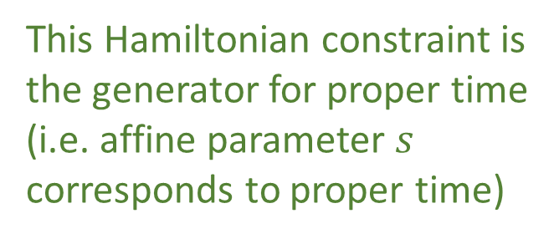
Example: free particle in an inertial frame
$$ℋ=\frac{1}{2m}\left(p_{i}δ^{ij}p_{j}−{\left(\frac{E}{c}\right)}^{2}+m^{2}c^{2}\right)$$
$$\frac{dt}{ds}=\frac{∂ℋ}{∂\left(−E\right)}=−\frac{1}{2mc^{2}}\frac{∂}{∂\left(−E\right)}{\left(−E\right)}^{2}=−\frac{1}{2mc^{2}}\left(−2E\right)=\frac{E}{mc^{2}}$$
This Hamiltonian constraint is the generator for proper time (i.e. affine parameter $s$ corresponds to proper time)
$$\frac{dq^{i}}{ds}=\frac{∂ℋ}{∂p_{i}}=\frac{1}{2m}\frac{∂}{∂p_{i}}\left(p_{i}δ^{ij}p_{j}\right)=\frac{2δ^{ij}p_{j}}{2m}=\frac{p_{i}}{m}$$
$$\frac{dE}{ds}=−\frac{d\left(−E\right)}{ds}=\frac{∂ℋ}{∂t}=0$$
$$\frac{E}{c}=m\frac{d\left(ct\right)}{ds}$$
four momentum
four velocity
$$\frac{dp_{i}}{ds}=−\frac{∂ℋ}{∂q^{i}}=0$$
$$p_{i}=m\frac{dq^{i}}{ds}$$
proper time!

Slide 22








Compare to “standard” way
Generator for proper time
Nice and quadratic
$$ℋ=\frac{1}{2m}\left(p_{i}δ^{ij}p_{j}−{\left(\frac{E}{c}\right)}^{2}+m^{2}c^{2}\right)$$
$$H=c\sqrt{m^{2}c^{2}+p_{i}δ^{ij}p_{j}}$$
Hamiltonian is time generator
$$\frac{dq^{i}}{dt}=\frac{ds}{dt}\frac{dq^{i}}{ds}=\frac{mc^{2}}{E}\frac{p_{i}}{m}$$
$$\frac{dq^{i}}{dt}=\frac{∂H}{∂p_{i}}=c\frac{∂}{∂p_{i}}\sqrt{m^{2}c^{2}+p_{i}δ^{ij}p_{j}}$$
$$=\frac{c}{2}\frac{1}{\sqrt{m^{2}c^{2}+p_{i}δ^{ij}p_{j}}}\frac{∂}{∂p_{i}}\left(m^{2}c^{2}+p_{i}δ^{ij}p_{j}\right)$$
Hamiltonian mechanics on the extended phase-space comes out more naturally and is a nicer formulation
$$=\frac{1}{2}\frac{2δ^{ij}p_{j}}{\sqrt{m^{2}+\frac{p_{i}δ^{ij}p_{j}}{c^{2}}}}=\frac{p_{i}}{\sqrt{m^{2}+\frac{{\left|p_{i}\right|}^{2}}{c^{2}}}}$$
Wait… quadratic? Can $E$ be negative?
$$\frac{dp_{i}}{dt}=−\frac{∂H}{∂q^{i}}=0$$

Slide 23






Classical anti-particles
This can be negative
$$p$$
$$d_{s}t=∂_{−E}ℋ$$
$$d_{s}q^{i}=∂_{p_{i}}ℋ$$
$$d_{s}(−E)=∂_{t}ℋ$$
$$d_{s}p_{i}=∂_{q^{i}}ℋ$$
$$q$$
$$\frac{dξ^{a}}{ds}$$
$$t$$
Particle: affine parameter aligned with time
Anti-particle: affine parameter anti-aligned with time
Parametrization flows backwards with respect to time
Free particle
Anti-particle = negative energy
An evolution cannot change time alignment

Slide 24





Recover standard Hamiltonian
Over valid states $ℋ=0$ and $E=H\left(q^{i},p_{i},t\right)$
Assume no $E$ dependence
$$=0$$

Slide 25





Hamiltonian constraint can “hide” multiple $H$s
Free particle Hamiltonian constraint
Negative energy
Positive energy
$$H_{1}=−H_{2}$$

Slide 26





Classical-quantum parallel
Free particle Hamiltonian constraint
Hamiltonian constraint becomes Klein-Gordon equation in QM
minus sign from $ı^{2}$
$$ℋρ=0$$
Density can be non-zero only where $ℋ=0$
Also note:

Slide 27


Hamiltonian constraint for charged particles
pure four-velocity kinetic term
$$ℋ=\frac{1}{2m}\left(p_{α}−𝔮A_{α}\right)g^{αβ}\left(p_{β}−𝔮A_{β}\right)+\frac{1}{2}mc^{2}=\frac{1}{2}mu^{α}g_{αβ}u^{β}+\frac{1}{2}mc^{2}$$
$$mu_{α}=mu^{β}g_{βα}=p_{α}−𝔮A_{α}$$
Kinetic momentum
Momentum gauge and EM gauge must cancel out
Compare to EM Klein-Gordon equation
$$\left[c^{2}\left(∂_{α}−ı𝔮A_{α}\right)η^{αβ}\left(∂_{α}−ı𝔮A_{α}\right)+m^{2}c^{4}\right]ψ=\left[c^{2}D_{α}η^{αβ}D_{β}+m^{2}c^{4}\right]ψ=0$$
$$D_{α}=∂_{α}−ı𝔮A_{α}$$
Gauge-covariant derivative is kinetic momentum

Slide 28
Takeaways
Relativistic mechanics is recovered without additional assumptions
Relativity is needed to make densities/entropy invariant over time transformations
Hamiltonian mechanics on the extended phase space is a more relativistic formulation
Hamiltonian constraint is the generator of the affine parameter, and can be taken to generate proper time for particles and minus proper time for anti-particles
Multiple connections to quantum mechanics
Anti-particles already present in classical Hamiltonian particle mechanics
Hamiltonian constraint related to Klein-Gordon (and Dirac) operators
Gauge considerations are already present in classical particle mechanics

Slide 29
Classical mechanics – Summary
All the core elements of classical mechanics can be rederived and understood using four physically meaningful assumptions
Infinitesimal Reducibility (IR), DOF independence (IND), Determinism and Reversibility (DR) and Kinematic Equivalence (KE)
Many physical ideas are a consequence of those assumptions
Principle of stationary action, massive particles under scalar/vector potential forces, relativistic mechanics, phase space (conjugate quantities), …
A great number of better insights from a theory that is generally considered as “understood”
Probably even better insights to be found

Slide 30
Why does classical mechanics fail?
What is quantum mechanics fixing?
“When the math is derived from the right physical assumptions, the physical assumptions can be derived from the math.”

Slide 31






Wikipedia
Third law of thermodynamics
Temperature/entropy curve for ideal gases
to minus infinity!
Every substance has a finite positive entropy, but at the absolute zero of temperature the entropy may become zero, and does so become in the case of perfect crystalline substances.
$$p$$
G. N. Lewis and M. Randall, Thermodynamics and the
free energy of chemical substances (McGraw-Hill, 1923)
$$S≥0$$
$$S=\log{ΔxΔp}$$
$$x$$
For a single microstate
$$S=\log{0}=−∞$$
Classical physics allows arbitrarily small entropy…
… but thermodynamics doesn’t!!!

Slide 32








Classical uncertainty principle
Found. Phys. 52, 40 (2022)
$S\left(ρ\right)=−∫ρ\log{hρ}dqdp$
$$S$$
Fixes units Uniform distribution over phase-space area $h$ has zero entropy
excluded by gaussian bound
$$S\left(ρ\right)≤\log{2πe\frac{σ_{q}σ_{p}}{h}}$$
Gaussian maximizes entropy for a given uncertainty
$$\frac{σ_{x}σ_{p}}{ℏ}$$
excluded by 3rd law of thermodynamics
$$σ_{q}σ_{p}≥\frac{h}{2πe}e^{S\left(ρ\right)}=\frac{ℏ}{e}e^{S\left(ρ\right)}$$
Entropy puts a lower bound on the uncertainty
$$S≥0 ⇒ σ_{q}σ_{p}≥\frac{ℏ}{e}$$
https://assumptionsofphysics.org/autogen/briefs/004-ClassicalUncertaintyPrinciple.pdf
https://link.springer.com/article/10.1007/s10701-022-00555-z

Slide 33






Comparing theories
excluded by gaussian bound
$$σ_{q}σ_{p}≥\frac{ℏ}{e}$$
$$σ_{q}σ_{p}≥\frac{ℏ}{2}$$
classical
quantum
$$\frac{σ_{q}σ_{p}}{ℏ}$$
2.71828…
excluded by 3rd law of thermodynamics
Entropy of quantum states is already non-negative
$$S_{C}=\ln{eσ}$$
The gaussian bound quickly becomes very similar across theories
$S_{Q}=\left(σ+\frac{1}{2}\right)\ln\left(σ+\frac{1}{2}\right)−\left(σ−\frac{1}{2}\right)\ln\left(σ−\frac{1}{2}\right)$
Quantum mechanics incorporates the third law. Classical mechanics does not.
Is this the only difference?

Slide 34
Suppose the lower bound on the entropy is the only difference, then in the limit of high entropy of quantum mechanics we should recover classical mechanics
Can we?

Slide 35



06/01/2024

Slide 36








Looking for a map $R(ρ)$ that increases entropy of all mixed states, such that every level set of entropy maps to another level set
In the limit!
$$S$$
$⇒$ Unitary trans. must be mapped to unitary trans.
excluded by gaussian bound
$R\left(ρ\right)$ Entropy increasing map
Unitary map
$$\frac{σ_{x}σ_{p}}{ℏ}$$
excluded by 3rd law of thermodynamics
classical
quantum
$$\left[X,P\right]=ıℏ⇒$$
$$\left[T\left(X\right),T\left(P\right)\right]=λıℏ$$
Physica Scripta 101, 065105 (2026)
https://arxiv.org/pdf/2411.00972
https://iopscience.iop.org/article/10.1088/1402-4896/ae3a20

Slide 37







Another perspective: move the pure states to minus infinite entropy
Instead of
$$\left[X,P\right]=ıℏ$$
$$\left[T\left(X\right),T\left(P\right)\right]=λıℏ$$
Redefine original space such that
$$\left[\hat{X},\hat{P}\right]=\frac{ıℏ}{λ}$$
$$\left[T\left(\hat{X}\right),T\left(\hat{P}\right)\right]=ıℏ$$
$λ→∞ ⇒ \frac{ℏ}{λ}→0$
Mathematically equivalent to lowering the entropy of a pure state to $−∞$, or $ℏ→0$ (group contraction)
Physica Scripta 101, 065105 (2026)

Slide 38


“$c→∞$”
Speed
Classical Mechanics | Relativistic Mechanics
Quantum Mechanics | Quantum Field Theory
“$ℏ→0$”
Entropy
No-mechanism limit (same as non-relativistic limit)
Physica Scripta 101, 065105 (2026)

Slide 39

$$\left\{A,B\right\}⟶\frac{\left[A,B\right]}{ıℏ}$$
Dirac’s correspondence principle: give me a theory with an entropic lower bound that recovers the classical one at high entropy
Only one way to do it
Moyal bracket is the unique one-parameter Lie-algebraic deformation of the Poisson bracket
Quantizing a classical theory means putting a lower bound on the entropy
Physica Scripta 101, 065105 (2026)

Slide 40








Geometry is entropy!
The geometric structures of both classical and quantum mechanics are equivalent to the entropic structure
Standard probability
$$ρ\left(x\right)=\frac{1}{μ\left(U\right)}$$
Thermodynamics/Statistical mechanics are not built on top of mechanics
$μ\left(U\right)=\int_{U}{ω^{n}}$
Symplectic manifold
Mechanics is the ideal case of thermodynamics/statistical mechanics
$ρ$ uniform over $U$
Information theory
$$S\left(ρ\right)=\log{μ\left(U\right)}$$
$$\left\langle ψ | φ\right\rangle$$
Quantum probability
$$p\left(ψ | φ\right)={\left|\left\langle ψ | φ\right\rangle \right|}^{2}$$
Projective Hilbert space
$$ρ=\frac{1}{2}ρ_{ψ}+\frac{1}{2}ρ_{φ}$$
Quantum information theory
$$S\left(ρ\right)=S\left(\frac{1+\sqrt{p}}{2},\frac{1−\sqrt{p}}{2}\right)$$

Slide 41
Reverse Physics tells us there are not many “independent concepts” in a physical theory
Extracting principles/assumptions behind the laws gives us solid intuition that cuts across fields and leads to new insights/results
But: the only way to be sure we got all the concepts is to derive all the math from scratch
→ Physical Mathematics

Slide 42
Assumptions of Physics is an open research program
Our main output is an open access book: https://assumptionsofphysics.org/book/
All our material is developed on GitHub: https://github.com/assumptionsofphysics
Livestream discussions
One YouTube channel dedicated to publicize results: https://www.youtube.com/user/gcarcassi
Another YouTube channel dedicated to research: https://www.youtube.com/@AssumptionsofPhysicsResearch
Activities coordinated through a Discord server (contact info@assumptionsofphysics.org for an invite)
Always looking for experts to gain insights and/or help
Always looking for collaborations
Always looking for editors/journals/conferences that are sympathetic to the mission

Slide 43
Extra

Slide 44
Action principle multiple DOF

Slide 45

Required background
Elements of differential geometry
A differential n-form takes n vectors and returns a number that depends on the volume of the parallelepiped (must be anti-symmetric): $W\left[γ\right]=\int_{γ}{dW}=\int_{γ}{F_{a}{dx}^{a}}$ $Φ\left[Σ\right]=\int_{Σ}{dΦ}=\int_{Σ}{B_{ab}v^{a}w^{b}}$ $m\left[V\right]=\int_{V}{dm}=\int_{V}{ρ_{abc}v^{a}w^{b}u^{c}}$
Pseudo-vectors are really two-forms in 3D: $\vec{B}→B_{ij}$
The exterior derivative generalizes gradient, curl, divergence: $∇f→∂_{a}∧f$ $∇×\vec{θ}→∂_{a}∧θ_{b}$ $∇⋅\vec{B}→∂_{a}∧B_{bc}$
Generalized properties
Generalized Stokes theorem: $\int_{Σ}{∂_{a}∧θ_{b}}dΣ^{ab}=\int_{∂Σ}{θ_{b}dγ^{a}}$
Define closed form as having zero exterior derivative: $∂_{a}∧ω_{ab}=0$
A closed form (locally) admits a vector potential: $ω_{ab}=∂_{a}∧θ_{b}=∂_{a}θ_{b}−∂_{b}θ_{a}$

Slide 46



















Characterize configuration flow
$$p_{1}$$
$$p_{2}$$
$$q^{1}$$
Flow of configurations through an infinitesimal surface
$$q^{2}$$
$$\vec{v}$$
$$\vec{S}$$
$$dΦ=v^{a}ω_{ab}w^{b}$$
$$\vec{w}$$
Function of surface: $ω_{ab}=−ω_{ba}$
$$\vec{v}$$
$$\vec{v}$$
$$t$$
$$\vec{w}$$
$$\vec{w}$$
change of order = change of orientation
(DR) Determinism and reversibility: $∂_{t}∧ω_{ab}=0$
Configurations are conserved through time
$$t$$
$∂_{q^{i}}∧ω_{ab}=0$
$∂_{p_{i}}∧ω_{ab}=0$
Configurations are conserved across DOF
(IND) DOF independence:
$$q^{i}$$
IND + DR: $ω_{ab}$ closed two-form ($∂_{a}∧ω_{bc}=0$)

Slide 47





$$∂_{a}∧ω_{bc}=0$$
$$ω_{ab}=−∂_{a}∧θ_{b}=−\left(∂_{a}θ_{b}−∂_{b}θ_{a}\right)$$
Closed form (DR) + (IND)
Vector potential
$θ$ is the potential of $ω$
without loss of generality

Slide 48





Displacement kills the flow
$$p_{1}$$
$$p_{2}$$
$$q^{1}$$
Displacement only direction that “kills” the flow
$$q^{2}$$
$$\vec{w}$$
$$\vec{S}$$
$$S^{a}ω_{ab}w^{b}=0$$
For all $\vec{w}$
$$\vec{S}$$
Flow is tangent (and only tangent) to the displacement
$$S^{a}ω_{ab}=0$$
$$t$$
Let’s calculate!

Slide 49




Displacement kills the flow
$$p_{1}$$
$$p_{2}$$
$$q^{1}$$
$$S^{a}ω_{ab}=0$$
$$q^{2}$$
$$\vec{v}$$
$$\vec{S}$$
$$\vec{w}$$
$$t$$
$$S^{p_{i}}=\frac{dp_{i}}{dt}=−\frac{∂H}{∂q^{i}}$$
$$S^{q^{i}}=\frac{dq^{i}}{dt}=\frac{∂H}{∂p_{i}}$$
Recovers Hamilton’s equations

Slide 50









$$ξ^{a}=\left[q^{i},p_{i},t\right]$$
$$θ_{a}=\left[p_{i},0,−H\right]$$
$$\int_{γ}{θ_{a}dγ^{a}}=\int_{γ}{θ_{a}d_{t}ξ^{a}dt}=\int_{γ}{\left(p_{i}d_{t}q^{i}−H\right)dt}=\int_{γ}{Ldt}=𝒜\left[γ\right]$$
Action is the line integral of the vector potential
$$p$$
$$q$$
$$γ$$
$$Σ$$
$$\vec{S}$$
$$γ′$$
$$t$$

Slide 51


$$δ𝒜\left[γ\right]=δ\int_{γ}{Ldt}=δ\int_{γ}{θ_{a}d_{t}ξ^{a}dt}=\oint_{∂Σ}{θ_{a}dξ^{a}}=\int_{Σ}{∂_{a}∧θ_{b}dξ^{a}dη^{b}}=−\int_{Σ}{dξ^{a}ω_{ab}dη^{b}}=−Φ\left[Σ\right]$$
The variation of the action is the flow between path and its variation
$$δ𝒜\left[γ\right]=0 ⟺ dξ^{a}ω_{ab}dη^{b}=dtd_{t}ξ^{a}ω_{ab}dη^{b}=0 ∀dη^b$$
Action is stationary when the path kills the flow
$$⟺ d_{t}ξ^{a}ω_{ab}=0$$
$$d_{t}ξ^{a}=S^{a}$$
$$p$$
$$q$$
$$γ$$
$$Σ$$
$$\vec{S}$$
$$γ′$$
$$t$$

Slide 52

DOF independence +
Determinism/Reversibility
+
Kinematic equivalence
$$⇕$$
Principle of stationary action

