Slide 1
From physical assumptions to classical Hamiltonian and Lagrangian particle mechanics
Gabriele Carcassi, Christine A. Aidala, David John Baker and Lydia Bieri
University of Michigan
Foundations of Physics 2016

Slide 2
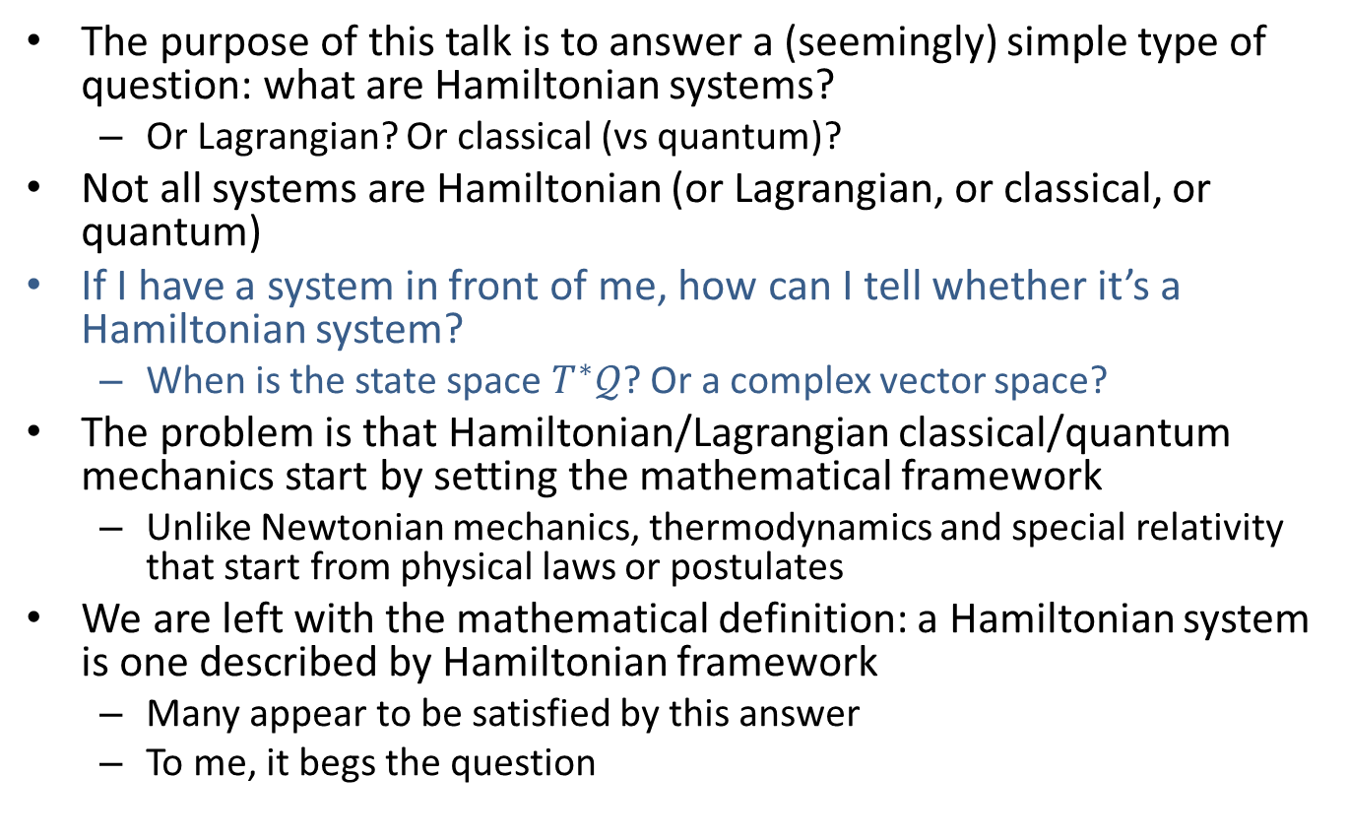
Introduction
The purpose of this talk is to answer a (seemingly) simple type of question: what are Hamiltonian systems?
Or Lagrangian? Or classical (vs quantum)?
Not all systems are Hamiltonian (or Lagrangian, or classical, or quantum)
If I have a system in front of me, how can I tell whether it’s a Hamiltonian system?
When is the state space $T^{∗}𝒬$? Or a complex vector space?
The problem is that Hamiltonian/Lagrangian classical/quantum mechanics start by setting the mathematical framework
Unlike Newtonian mechanics, thermodynamics and special relativity that start from physical laws or postulates
We are left with the mathematical definition: a Hamiltonian system is one described by Hamiltonian framework
Many appear to be satisfied by this answer
To me, it begs the question

Slide 3
Introduction
To answer the question, we need a way to physically motivate Hamiltonian (and Lagrangian) mechanics
Start from physical assumptions that characterize the system under study
Hopefully ideas that are already familiar
Show that those assumptions lead necessarily to the known mathematical frameworks
in the most direct way possible
not to some new theory
Gain new insights
provide a math-physics dictionary
The objective of this talk is to show that such a program is indeed possible and worthwhile

Slide 4
Introduction
We limit ourselves here to classical Hamiltonian/Lagrangian particle mechanics
no relativity, quantum or field theory
Go through highlights of the derivation and give physical intuition for them
Elements from different fields are used: vector spaces, topology, measure theory, differential/ symplectic/Riemannian geometry
Let’s start with an overview of the assumptions and what they lead to
The rest of the talk is more details and insight to see how it all works

Slide 5
Overview
Only 3 assumptions:
Determinism and reversibility (given the initial state we can identify the final state and vice versa)
Dynamical system
State space is a topological space, evolution map is a self-homeomorphism
Infinitesimal reducibility (describing the state of the whole is equivalent to describing the state of its infinitesimal parts)
Hamiltonian mechanics for infinitesimal parts
State of the whole is a distribution over the state space for the infinitesimal parts (i.e. phase space)
Kinematic equivalence (studying the motion of the infinitesimal parts is equivalent to studying the state evolution)
Lagrangian mechanics for infinitesimal parts
Dynamics is the one for massive particles under scalar/vector potential forces

Slide 6
Assumption I: Determinism and reversibility
The system undergoes deterministic and reversible time evolution: given the initial state, we can identify the final state; given the final state, we can reconstruct the initial state

Slide 7
Physical distinguishability and topological spaces
States are physical configurations of the system at a given time
=> states must be physically distinguishable
There must exist an external process (i.e. that involves the environment) that is potentially able to tell two states apart
How do we mathematically capture physical distinguishability?

Slide 8
Physical distinguishability and topological spaces
External process
System under study (identically prepared n times)
Set of states
Set of outcomes
Set of states compatible with the given outcome
The collection of all sets of states compatible with all potential outcomes of all potential processes form a Hausdorff and second countable topology

Slide 9
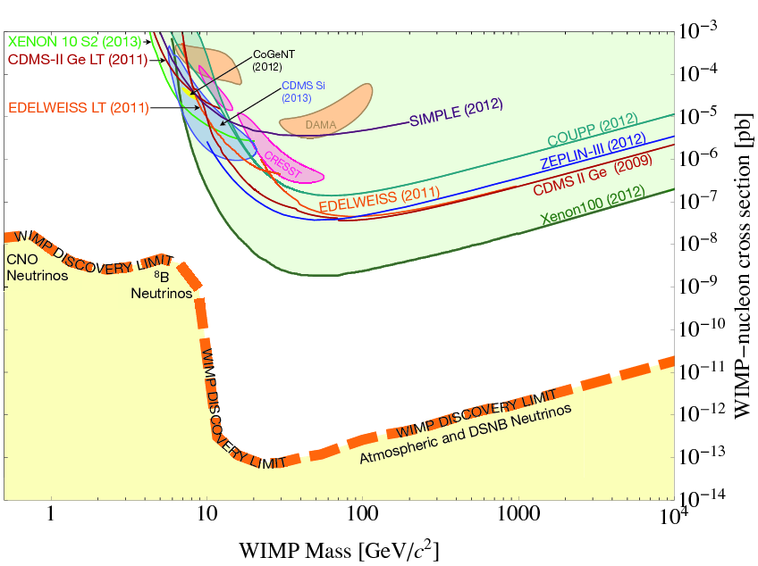
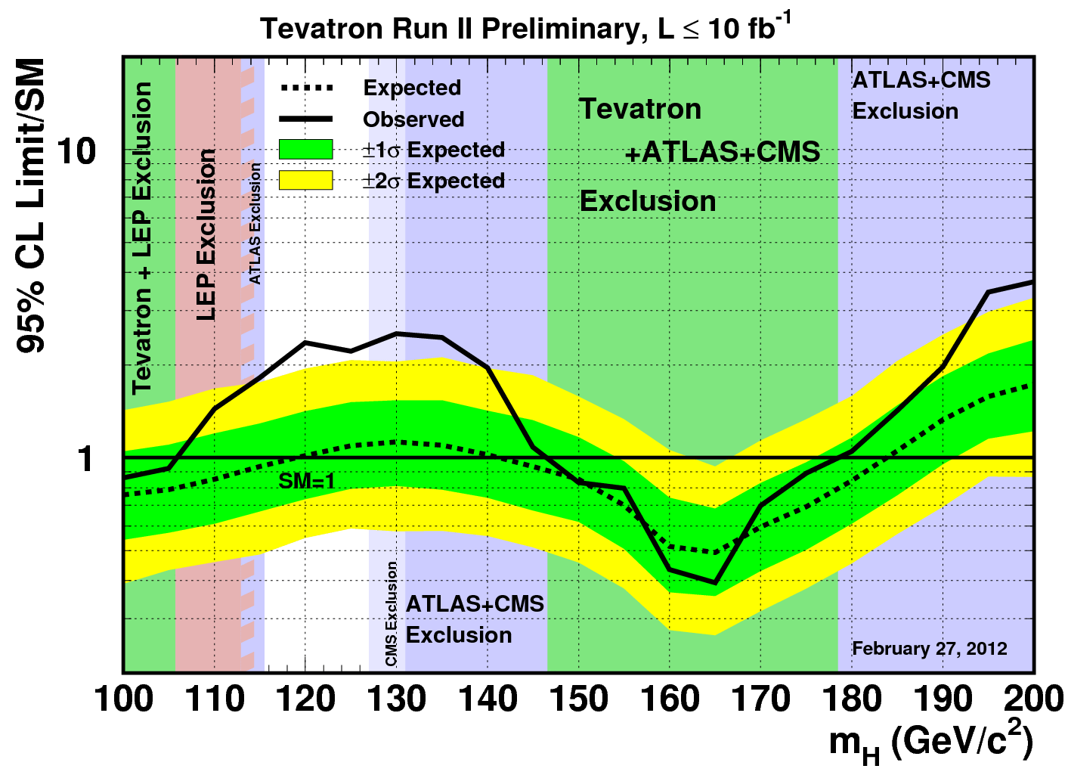
Physical distinguishability and topological spaces
Use of sets and set operations is apparent in exclusion plots
Range of WIMP (dark matter) mass/cross section excluded by different experiments
Range of Higgs masses excluded by different experiments

Slide 10
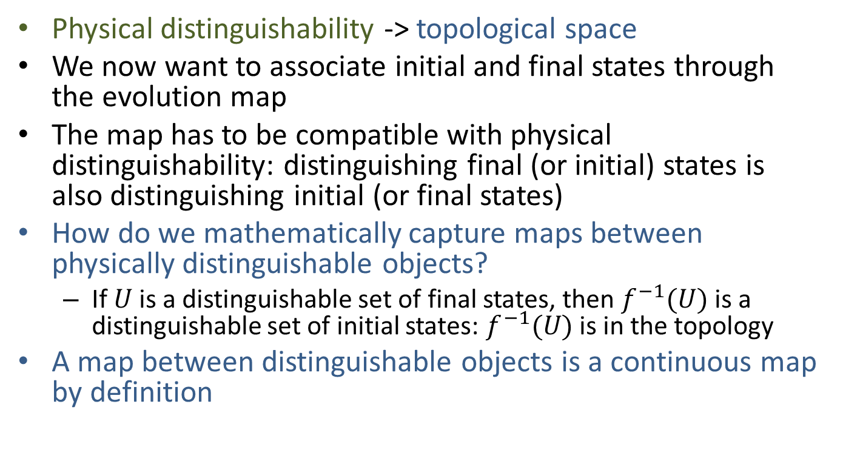
Mapping physical objects and continuous functions
Physical distinguishability -> topological space
We now want to associate initial and final states through the evolution map
The map has to be compatible with physical distinguishability: distinguishing final (or initial) states is also distinguishing initial (or final states)
How do we mathematically capture maps between physically distinguishable objects?
If $U$ is a distinguishable set of final states, then $f^{−1}(U)$ is a distinguishable set of initial states: $f^{−1}(U)$ is in the topology
A map between distinguishable objects is a continuous map by definition
topological sense

Slide 11
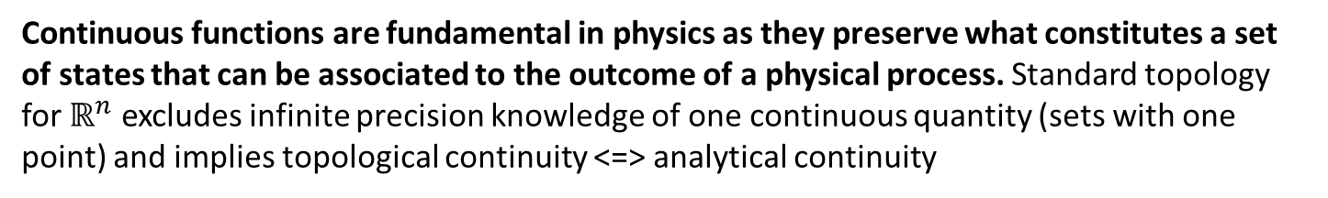
Mapping physical objects and continuous functions
Continuous functions are fundamental in physics as they preserve what constitutes a set of states that can be associated to the outcome of a physical process. Standard topology for $ℝ^{n}$ excludes infinite precision knowledge of one continuous quantity (sets with one point) and implies topological continuity <=> analytical continuity
discontinuity
Finite precision knowledge of one continuous quantity corresponds to finite precision knowledge of the other
Finite precision knowledge of one continuous quantity does not always correspond to finite precision knowledge of the other

Slide 12
Deterministic and reversible maps and homeomorphisms
Physical distinguishability -> topological space
Map between physically distinguishable objects -> continuous map
Deterministic and reversible evolution is a bijective map
A bijective continuous map is a homeomorphism: deterministic and reversible evolution is a self-homeomorphism
A map onto the same space that preserves what is physically distinguishable (i.e. the topology)

Slide 13
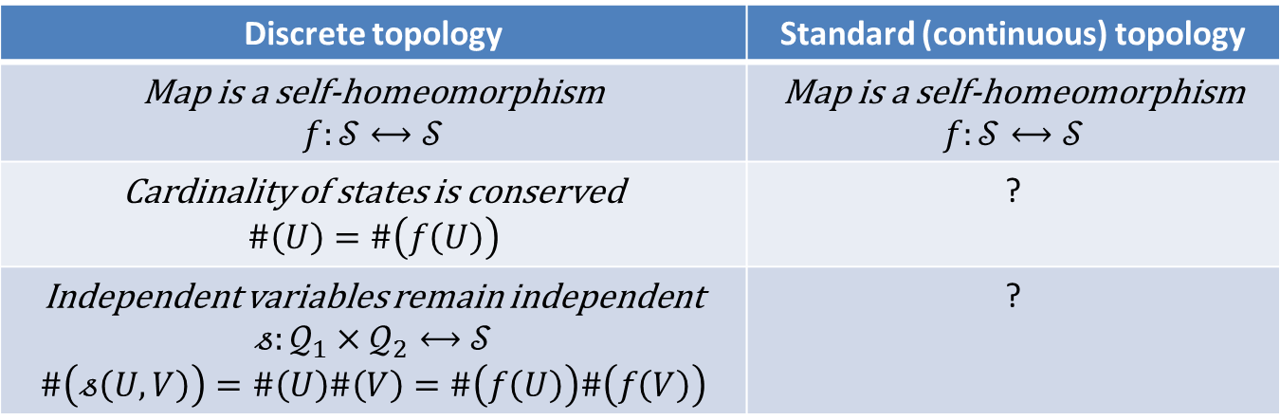
Not all self-homeomorphisms are deterministic and reversible maps
Discrete topology | Standard (continuous) topology
Map is a self-homeomorphism $$f:𝒮⟷𝒮$$ | Map is a self-homeomorphism $$f:𝒮⟷𝒮$$
Cardinality of states is conserved $$\#\left(U\right)=\#\left(f\left(U\right)\right)$$ | ?
Independent variables remain independent $$𝓈:𝒬_{1}×𝒬_{2}⟷𝒮$$ $$\#\left(𝓈\left(U,V\right)\right)=\#\left(U\right)\#\left(V\right)=\#\left(f\left(U\right)\right)\#\left(f\left(V\right)\right)$$ | ?
A self-homeomorphism that maps a set to a proper superset or subset is clearly not a deterministic or reversible process!
Need to keep track of the cardinality of states and possibilities. We need a measure.
measure theory sense

Slide 14
From assumption I
Physical distinguishability -> topological space
Map between physically distinguishable objects -> continuous map
Deterministic and reversible evolution -> self-homeomorphism
Not all self-homeomorphisms -> need a measure to count states

Slide 15
Assumption II: infinitesimal reducibility (classical material)
The system is composed of a homogeneous infinitesimally reducible material. Each part undergoes deterministic and reversible evolution.

Slide 16
Classical homogeneous material and real vector spaces
A “classical material” is:
Decomposable: can be divided into smaller amounts
Infinitesimally so: can keep dividing arbitrarily (“particles” are the limits of such division)
Reducible: giving state of whole equivalent to giving state of parts
Homogeneous: state space of each part is the same
A classical fluid is an example
How do we mathematically capture the structure of such material?

Slide 17

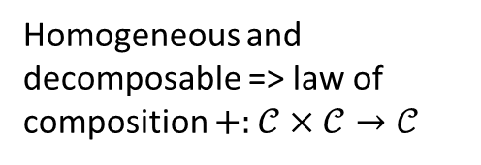
Classical homogeneous material and real vector spaces
+
=
Homogeneous and decomposable => law of composition $+:𝒞×𝒞→𝒞$
2$∗$
=
Infinitesimally decomposable => increase/decrease the amount of material by a real number
These two operations give the structure of a vector space

Slide 18
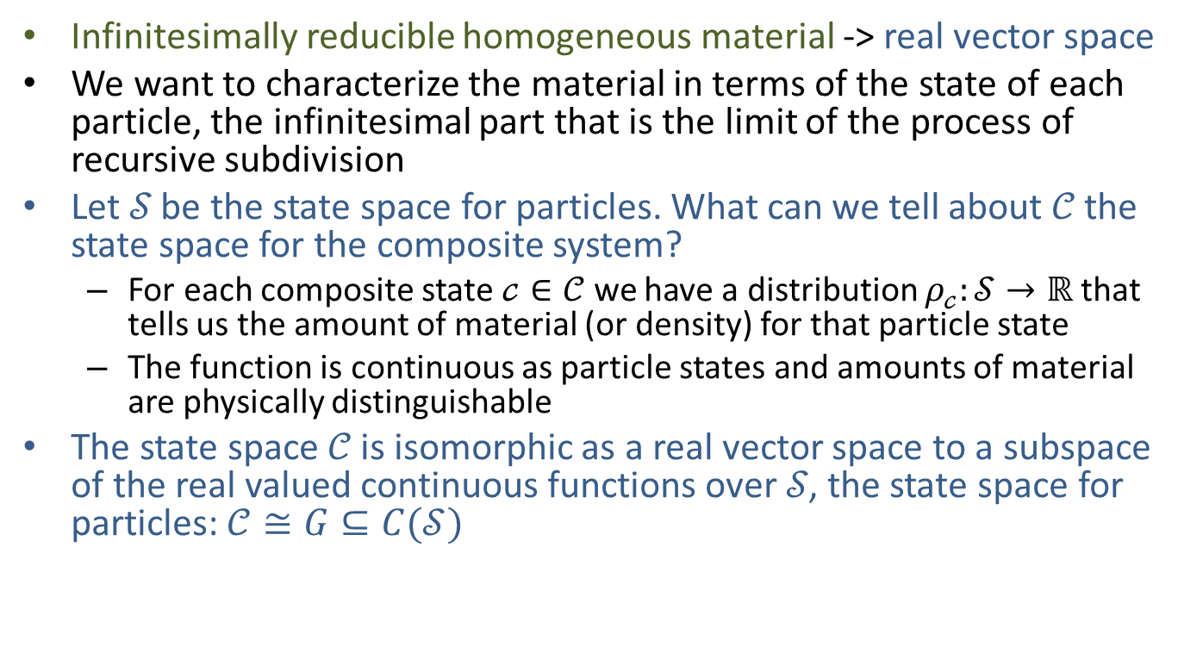
Classical homogeneous material and function spaces
Infinitesimally reducible homogeneous material -> real vector space
We want to characterize the material in terms of the state of each particle, the infinitesimal part that is the limit of the process of recursive subdivision
Let 𝒮 be the state space for particles. What can we tell about 𝒞 the state space for the composite system?
For each composite state $𝒸∈𝒞$ we have a distribution $ρ_{𝒸}:𝒮→ℝ$ that tells us the amount of material (or density) for that particle state
The function is continuous as particle states and amounts of material are physically distinguishable
The state space 𝒞 is isomorphic as a real vector space to a subspace of the real valued continuous functions over 𝒮, the state space for particles: $𝒞≅G⊆C(𝒮)$

Slide 19
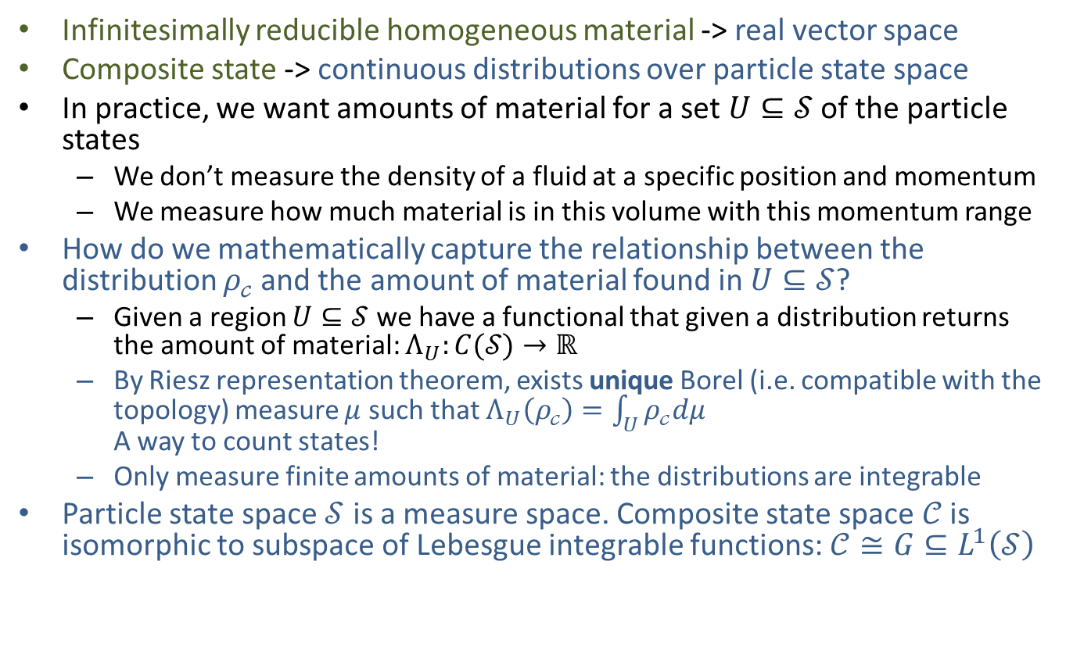
Integration and measure
Infinitesimally reducible homogeneous material -> real vector space
Composite state -> continuous distributions over particle state space
In practice, we want amounts of material for a set $U⊆𝒮$ of the particle states
We don’t measure the density of a fluid at a specific position and momentum
We measure how much material is in this volume with this momentum range
How do we mathematically capture the relationship between the distribution $ρ_{𝒸}$and the amount of material found in $U⊆𝒮$?
Given a region $U⊆𝒮$ we have a functional that given a distribution returns the amount of material: $Λ_{U}:C(𝒮)→ℝ$
By Riesz representation theorem, exists unique Borel (i.e. compatible with the topology) measure $μ$ such that $Λ_{U}\left(ρ_{𝒸}\right)=\int_{U}{ρ_{𝒸}dμ}$ A way to count states!
Only measure finite amounts of material: the distributions are integrable
Particle state space $𝒮$ is a measure space. Composite state space $𝒞$ is isomorphic to subspace of Lebesgue integrable functions: $𝒞≅G⊆L^{1}\left(𝒮\right)$

Slide 20



Integration and measure
Because we have densities and integration we can assign a measure (a “size”) to each set of states
Infinite amount: infinite set
Take a set of particle states. Fill it with a uniform density. Look at the total amount of material.
$$U$$
Zero amount: zero measure set
Finite amount: finite set
V double amount of U:
V is double the size
$$V$$
Analogous to using water to measure the capacity of a container

Slide 21
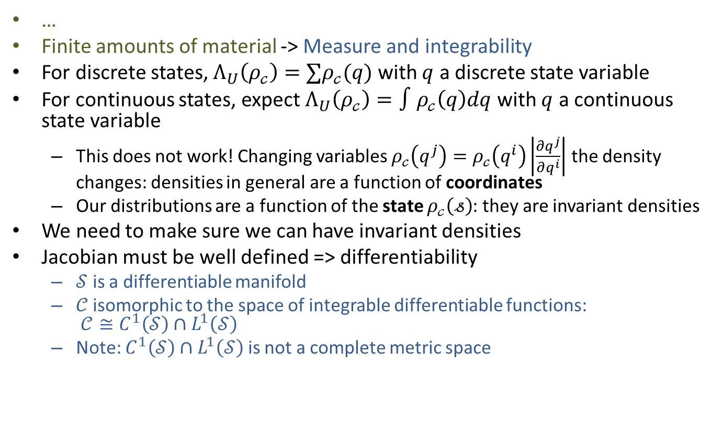
Invariant densities and differentiability
…
Finite amounts of material -> Measure and integrability
For discrete states, $Λ_{U}\left(ρ_{𝒸}\right)=∑ρ_{𝒸}(q)$ with $q$ a discrete state variable
For continuous states, expect $Λ_{U}\left(ρ_{𝒸}\right)=∫ρ_{𝒸}\left(q\right)dq$ with $q$ a continuous state variable
This does not work! Changing variables $ρ_{𝒸}\left(q^{j}\right)=ρ_{𝒸}\left(q^{i}\right)\left|\frac{∂q^{j}}{∂q^{i}}\right|$ the density changes: densities in general are a function of coordinates
Our distributions are a function of the state $ρ_{𝒸}\left(𝓈\right)$: they are invariant densities
We need to make sure we can have invariant densities
Jacobian must be well defined => differentiability
$𝒮$ is a differentiable manifold
𝒞 isomorphic to the space of integrable differentiable functions: $𝒞≅C^{1}\left(𝒮\right)∩L^{1}\left(𝒮\right)$
Note: $C^{1}\left(𝒮\right)∩L^{1}\left(𝒮\right)$ is not a complete metric space

Slide 22
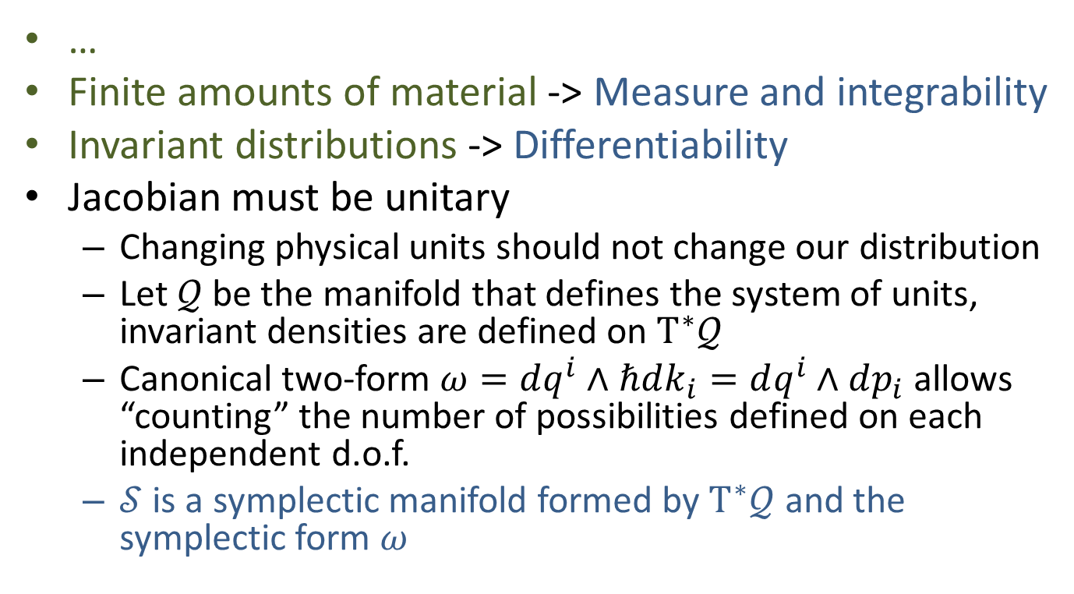
Invariant densities and symplectic manifolds
…
Finite amounts of material -> Measure and integrability
Invariant distributions -> Differentiability
Jacobian must be unitary
Changing physical units should not change our distribution
Let $𝒬$ be the manifold that defines the system of units, invariant densities are defined on $T^{∗}𝒬$
Canonical two-form $ω=dq^{i}∧ℏdk_{i}=dq^{i}∧dp_{i}$ allows “counting” the number of possibilities defined on each independent d.o.f.
$𝒮$ is a symplectic manifold formed by $T^{∗}𝒬$ and the symplectic form $ω$

Slide 23



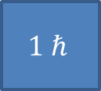

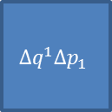

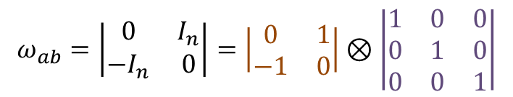
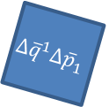



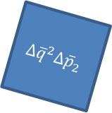
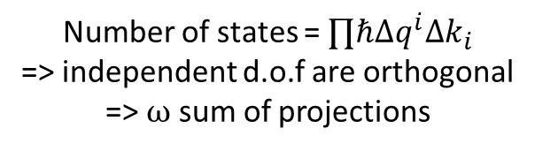

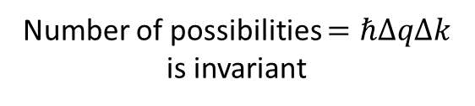

Invariant densities and symplectic manifolds
$$ω_{ab}=\left|\begin{matrix}0 & I_{n} \\ −I_{n} & 0\end{matrix}\right|=\left|\begin{matrix}0 & 1 \\ −1 & 0\end{matrix}\right|⊗\left|\begin{matrix}1 & 0 & 0 \\ 0 & 1 & 0 \\ 0 & 0 & 1\end{matrix}\right|$$
$$ω=dq^{i}∧ℏdk_{i}=dq^{i}∧dp_{i}$$
Wedge product (area) within a d.o.f.
Scalar product across independent d.o.f.
$$1 ℏ$$
Number of states = $∏ℏΔq^{i}Δk_{i}$ => independent d.o.f are orthogonal => $ω$ sum of projections
$Δk=1 m^{−1}$
$Δq=1 m$
$$ω$$
$$ω$$
$\overline{q}=100 cm/m q$
$$Δq^{2}Δp_{2}$$
$$Δ{\overline{q}}^{1}Δ{\overline{p}}_{1}$$
$Δ\overline{k}=0.01 cm^{−1}$
$$1 ℏ$$
$Δ\overline{q}=100 cm$
$$Δq^{1}Δp_{1}$$
$$Δ{\overline{q}}^{2}Δ{\overline{p}}_{2}$$
Number of possibilities $=ℏΔqΔk$ is invariant
2D rendition of 4D space

Slide 24
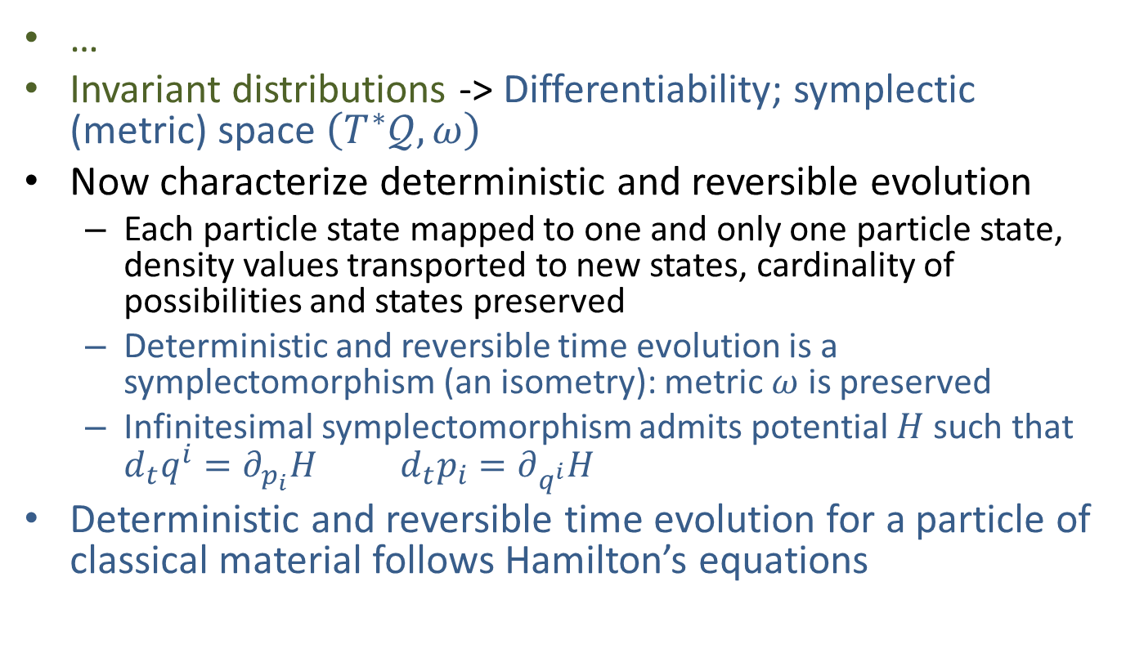
Deterministic and reversible maps and symplectomorphisms
…
Invariant distributions -> Differentiability; symplectic (metric) space $\left(T^{∗}𝒬, ω\right)$
Now characterize deterministic and reversible evolution
Each particle state mapped to one and only one particle state, density values transported to new states, cardinality of possibilities and states preserved
Deterministic and reversible time evolution is a symplectomorphism (an isometry): metric $ω$ is preserved
Infinitesimal symplectomorphism admits potential $H$ such that $d_{t}q^{i}=∂_{p_{i}}H d_{t}p_{i}=∂_{q^{i}}H$
Deterministic and reversible time evolution for a particle of classical material follows Hamilton’s equations

Slide 25








Deterministic and reversible maps and symplectomorphisms
Possibilities (area) within a d.o.f. conserved
$$p_{i}$$
$${\hat{p}}_{i}$$
$$q^{i}$$
$${\hat{q}}^{i}$$
$$(q^{y},p_{y})$$
$$({\hat{q}}^{y},{\hat{p}}_{y})$$
$$(q^{x},p_{x})$$
$$({\hat{q}}^{x},{\hat{p}}_{x})$$
Independent d.o.f. remain
independent (orthogonal)
Total number of states (volume) is conserved
All that Hamiltonian mechanics does is to conserve the number of states and possibilities
It’s the continuous equivalent of “3 possibilities for x times 2 possibilities for y gives 6 total states”

Slide 26
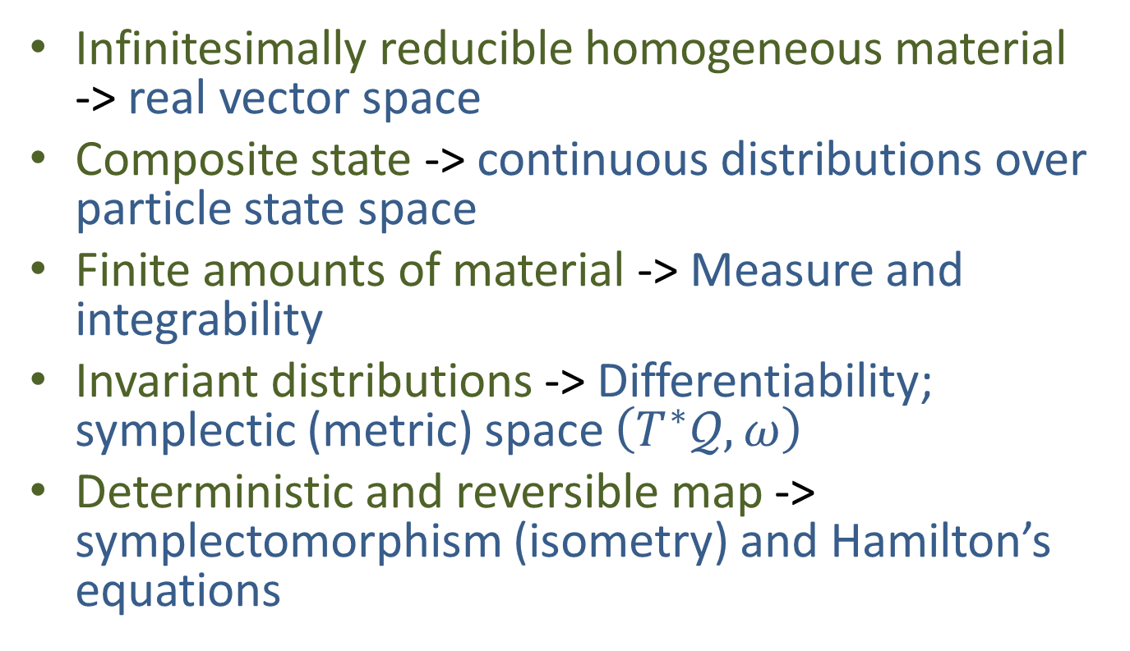
From assumption II
Infinitesimally reducible homogeneous material -> real vector space
Composite state -> continuous distributions over particle state space
Finite amounts of material -> Measure and integrability
Invariant distributions -> Differentiability; symplectic (metric) space $\left(T^{∗}𝒬, ω\right)$
Deterministic and reversible map -> symplectomorphism (isometry) and Hamilton’s equations

Slide 27
Assumption III: kinematic equivalence
Studying the motion (kinematics) of the system is equivalent to studying its state evolution (dynamics)

Slide 28
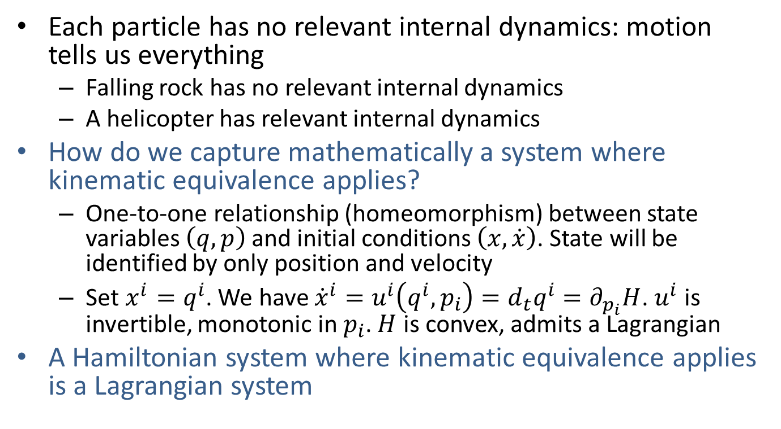
Kinematic equivalence and Lagrangian systems
Each particle has no relevant internal dynamics: motion tells us everything
Falling rock has no relevant internal dynamics
A helicopter has relevant internal dynamics
How do we capture mathematically a system where kinematic equivalence applies?
One-to-one relationship (homeomorphism) between state variables $\left(q, p\right)$ and initial conditions $\left(x, \dot{x}\right)$. State will be identified by only position and velocity
Set ${x^{i}=q}^{i}$. We have ${\dot{x}}^{i}=u^{i}\left(q^{i},p_{i}\right)=d_{t}q^{i}=∂_{p_{i}}H$. $u^{i}$ is invertible, monotonic in $p_{i}$. $H$ is convex, admits a Lagrangian
A Hamiltonian system where kinematic equivalence applies is a Lagrangian system

Slide 29
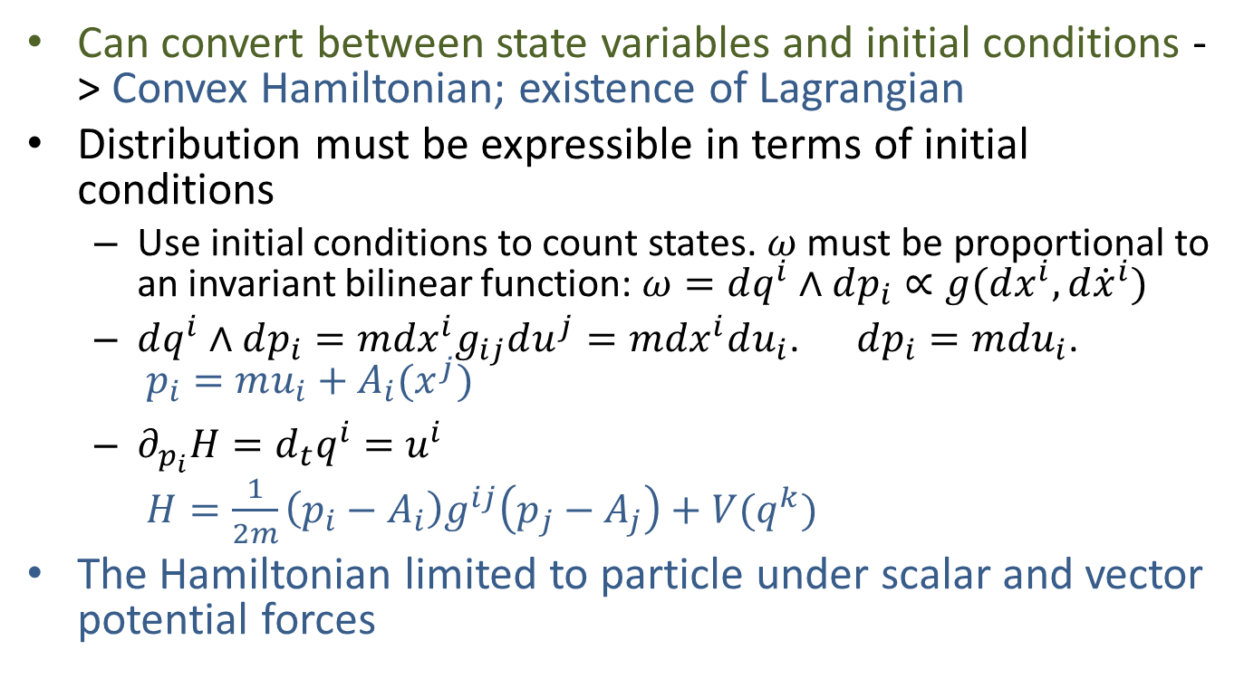
Kinematic equivalence, inertial mass and conservative forces
Can convert between state variables and initial conditions -> Convex Hamiltonian; existence of Lagrangian
Distribution must be expressible in terms of initial conditions
Use initial conditions to count states. $ω$ must be proportional to an invariant bilinear function: $ω=dq^{i}∧dp_{i}∝g(dx^{i},d{\dot{x}}^{i})$
$dq^{i}∧dp_{i}=mdx^{i}g_{ij}du^{j}=mdx^{i}du_{i}$. $dp_{i}=mdu_{i}$. $p_{i}=mu_{i}+A_{i}(x^{j})$
$∂_{p_{i}}H=d_{t}q^{i}=u^{i}$ $H=\frac{1}{2m}\left(p_{i}−A_{i}\right)g^{ij}\left(p_{j}−A_{j}\right)+V(q^{k})$
The Hamiltonian limited to particle under scalar and vector potential forces

Slide 30


Kinematic equivalence, inertial mass and conservative forces
What is inertial mass? It’s the constant that tells us how many possibilities (i.e. possible states) there are for a unit range of velocity.
More massive object = more states
$$u_{0}$$
$$u_{1}$$
Why is a more massive body more difficult to accelerate? Because for the same change in velocity it has to go through more states.
What are conservative forces? The ones that conserve the number of states (deterministic and reversible forces).

Slide 31
From assumption III
Can convert between state variables and initial conditions -> Convex Hamiltonian; existence of Lagrangian
Invariant densities on initial conditions -> linear relationship between conjugate momentum and velocity; inertial mass; scalar/vector potential forces

Slide 32
Conclusion
Physically motivating Hamiltonian and Lagrangian mechanics is possible and offers insights
Classical Hamiltonian and Lagrangian mechanics founded upon three physical assumptions, which give the definition of states and their laws of evolution
Only distributions give meaningful account for use of cotangent bundle/Hamilton’s equations
Kinematic equivalence gives potential forces, tells why second order equations of motion, what is inertial mass
Extending this approach to other fundamental theories may give insights useful to address open problems

